Slide 1

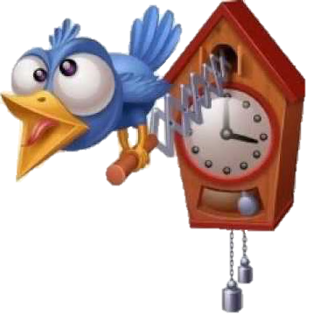
Hashing II
CS2110
Spring 2018

Slide 2

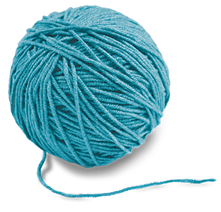
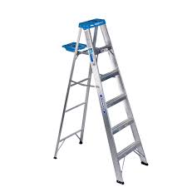

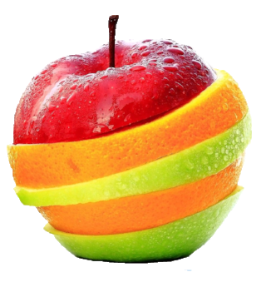
Hash Functions
0
Requirements:
  deterministic
  return a number in [0..n]
1
1
4
3
Properties of a good hash:
  fast
  collision-resistant
  evenly distributed
  hard to invert
Notes:
if the values are equal then…
If hashes are equal then…
For non-integer, encode as int (e.g., ascii)
sum_{i=0}^{n-1} s[i]* 31^{n-1-i}
Finding good hash functions is hard. SHA-3 2006-2015.

Slide 3
Hash Table
add(“CA”)
CA
Hash hunction
mod 6
5
0
1
2
3
4
5
b
MA
NY
CA
Two ways of handling collisions:
Chaining 2. Open Addressing

Slide 4
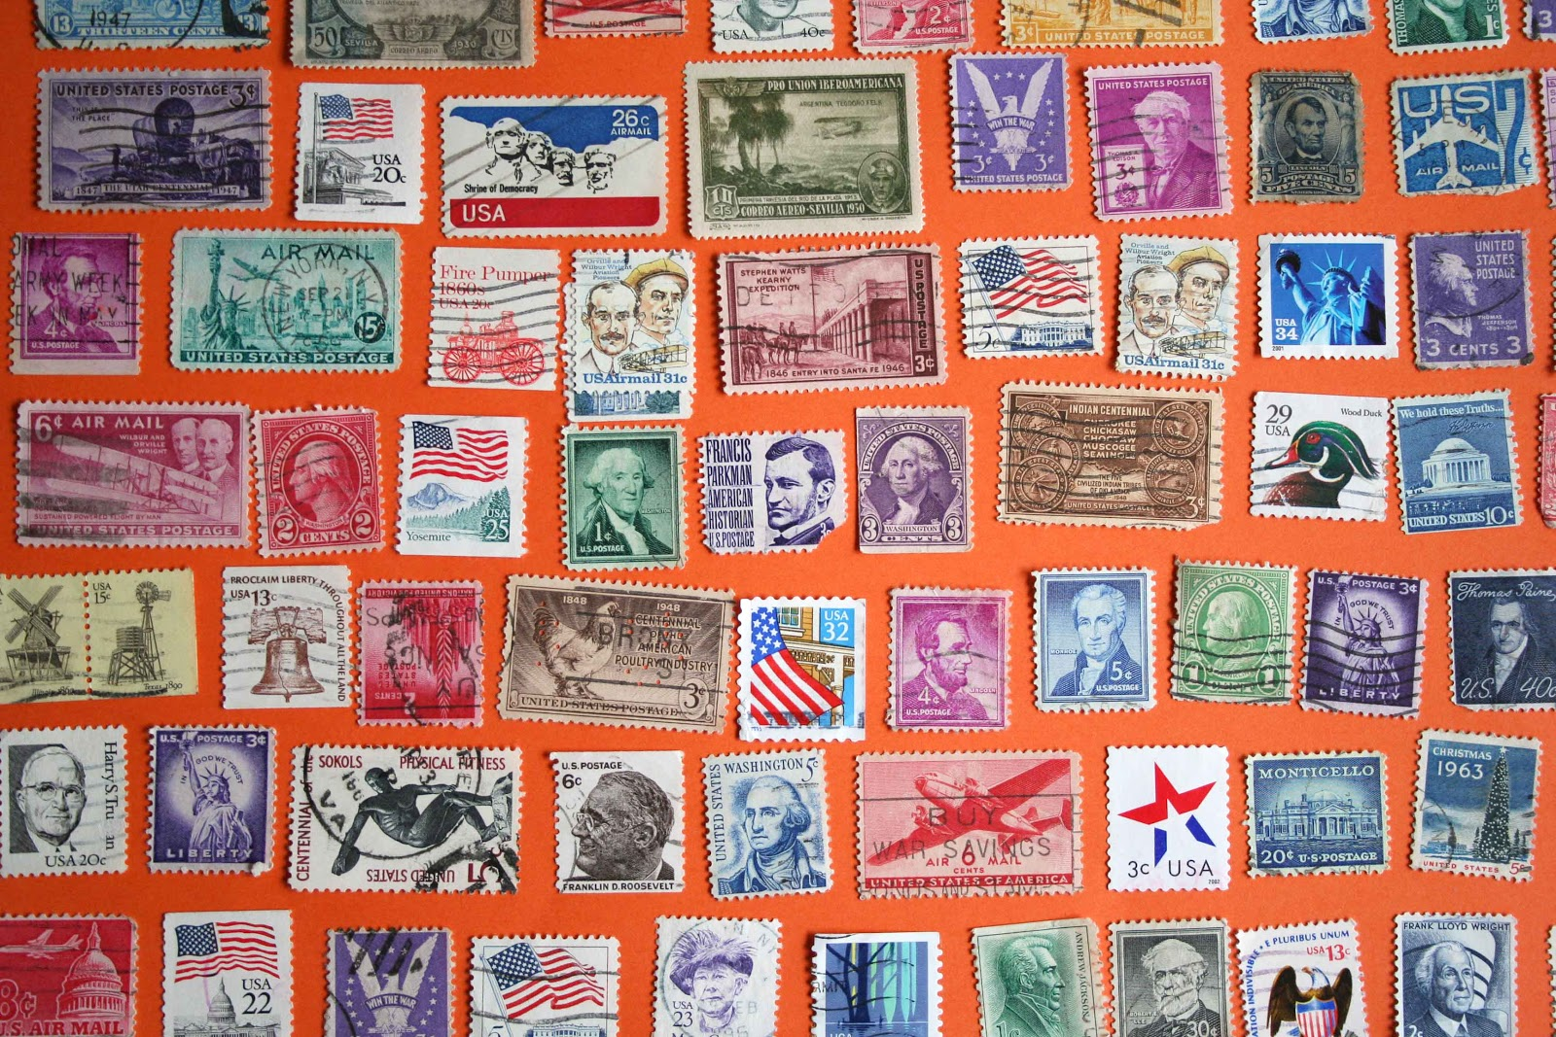
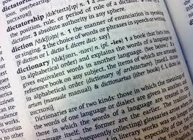
HashSet and HashMap
Set<V>{
boolean add(V value);
boolean contains(V value);
boolean remove(V value);
}
Map<K,V>{
V put(K key, V value);
V get(K key);
V remove(K key);
}
Notes:
Note: also called Map, associative array
used to implement database indexes, caches,
Possible implementations:
Array: put O(1) if space, update O(n) get O(n) remove O(n)
LinkedList: put O(1) update O(n) get O(n) remove O(n)
Tree: put O(1)/O(log n)/O(n) update O(log n)/O(n) get O(log n)/O(n) remove O(log n)/O(n)

Slide 5
Remove
put('a')
put('b')
put('c')
put('d')
get('d')
remove('c')
get('d')
put('e')
Chaining
Open Addressing
0
1
2
3
0
1
2
3
a
e
c
d
b
a
e
b
c
d
Notes:
add/update/lookup/delete
analyse running time (naïve version)

Slide 6
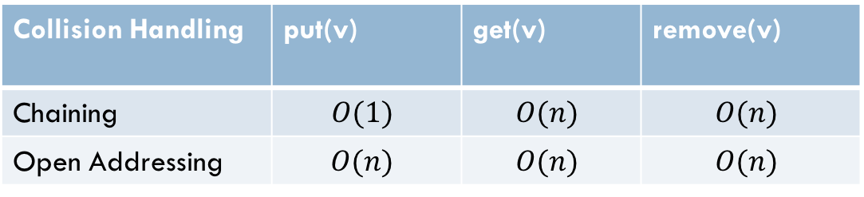
Time Complexity (no resizing)
Collision Handling | put(v) | get(v) | remove(v)
Chaining | $$O(1)$$ | $$O(n)$$ | $$O(n)$$
Open Addressing | $$O(n)$$ | $$O(n)$$ | $$O(n)$$

Slide 7
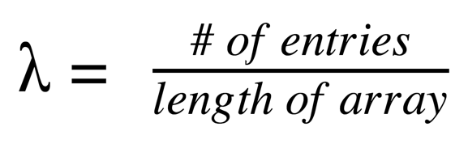
Load Factor
Load factor
Notes:
When array becomes too full:
with open addressing it becomes impossible to insert
with chaining, still possible but the operations slow down
Solution: same concept as ArrayLists:
when it gets too full, copy to a larger array
sometimes decrease size if too small, but remove is a much less common operation and it is likely that it will have to grow again soon anyway
typically double the size of the array

Slide 8
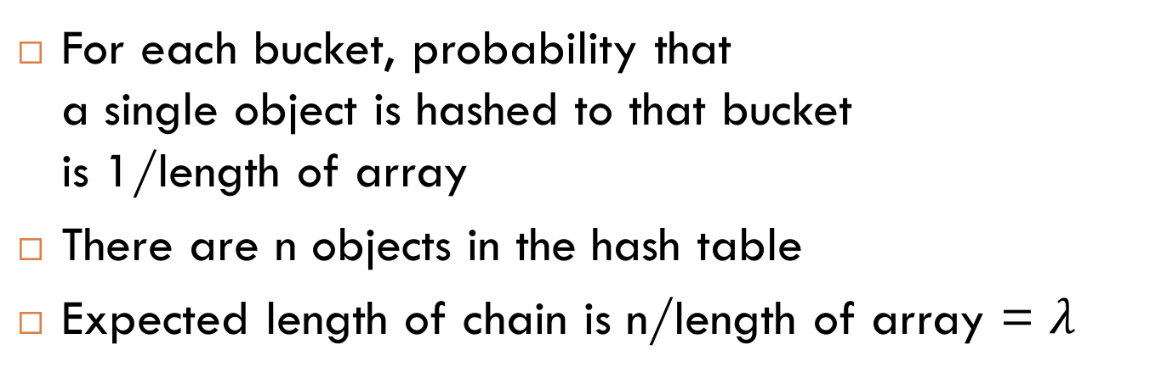
Expected Chain Length
0
1
2
3
4
5
a
e
b
c
For each bucket, probability that a single object is hashed to that bucket is 1/length of array
There are n objects in the hash table
Expected length of chain is n/length of array = $λ$
d

Slide 9
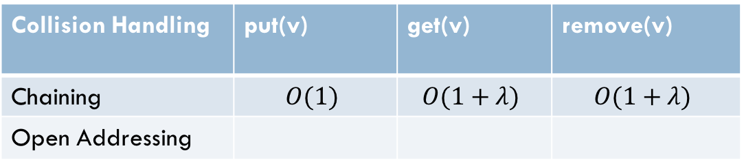
Expected Time Complexity
(no resizing)
Collision Handling | put(v) | get(v) | remove(v)
Chaining | $$O(1)$$ | $$O(1+λ)$$ | $$O(1+λ)$$
Open Addressing

Slide 10
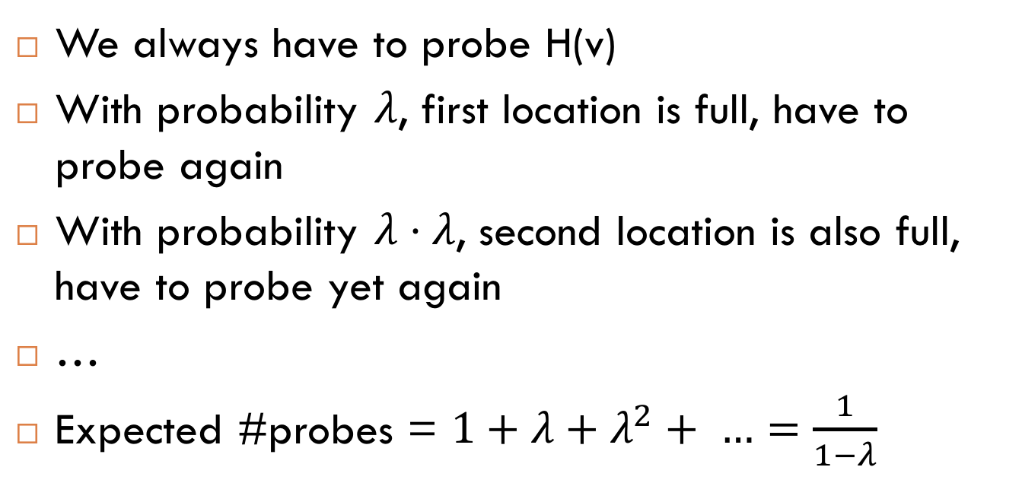
Expected Number of Probes
0
1
2
3
4
5
We always have to probe H(v)
With probability $λ$, first location is full, have to probe again
With probability $λ⋅λ$, second location is also full, have to probe yet again
…
Expected #probes = $1+λ+λ^{2}+ …=\frac{1}{1−λ}$

Slide 11
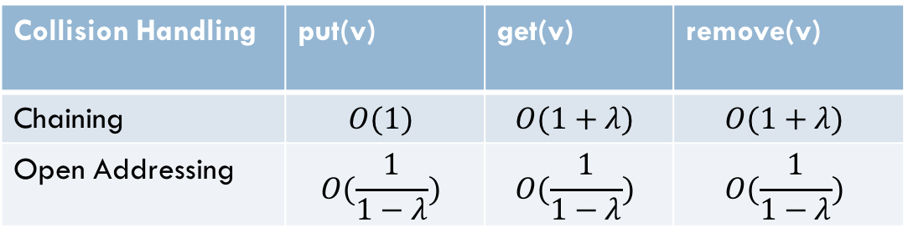
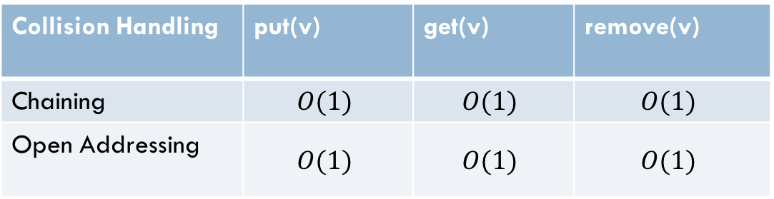
Expected Time Complexity
(no resizing)
Collision Handling | put(v) | get(v) | remove(v)
Chaining | $$O(1)$$ | $$O(1+λ)$$ | $$O(1+λ)$$
Open Addressing | $$O(\frac{1}{1−λ})$$ | $$O(\frac{1}{1−λ})$$ | $$O(\frac{1}{1−λ})$$
Collision Handling | put(v) | get(v) | remove(v)
Chaining | $$O(1)$$ | $$O(1)$$ | $$O(1)$$
Open Addressing | $$O(1)$$ | $$O(1)$$ | $$O(1)$$
Assuming constant load factor
We need to dynamically resize!

Slide 12

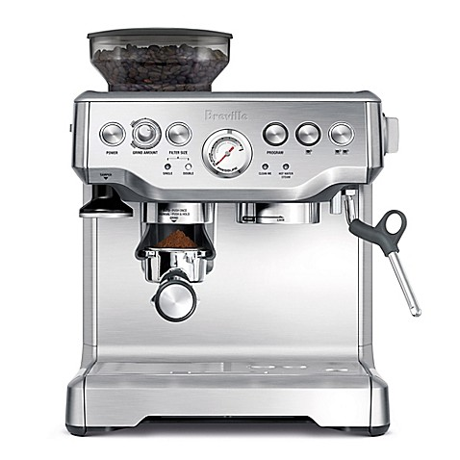
Amortized Analysis
In an amortized analysis, the time required to perform a sequence of operations is averaged over all the operations
Can be used to calculate average cost of operation
vs.

Slide 13
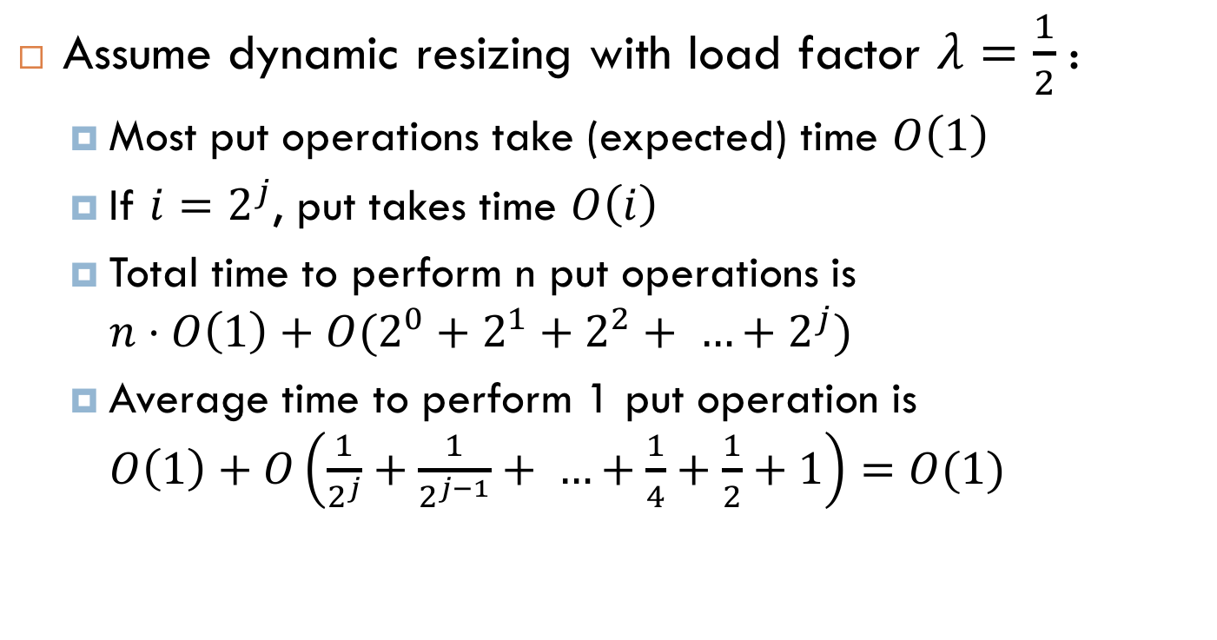
Amortized Analysis of put
Assume dynamic resizing with load factor $λ=\frac{1}{2}$ :
  Most put operations take (expected) time $O\left(1\right)$
  If $i=2^{j}$, put takes time $O\left(i\right)$
  Total time to perform n put operations is $n⋅O\left(1\right)+O(2^{0}+2^{1}+2^{2}+ …+2^{j})$
  Average time to perform 1 put operation is $O\left(1\right)+O\left(\frac{1}{2^{j}}+\frac{1}{2^{j−1}}+ …+\frac{1}{4}+\frac{1}{2}+1\right)=O(1)$

Slide 14
Expected Time Complexity
(with dynamic resizing)
Collision Handling | put(v) | get(v) | remove(v)
Chaining | $$O(1)$$ | $$O(1)$$ | $$O(1)$$
Open Addressing | $$O(1)$$ | $$O(1)$$ | $$O(1)$$

Slide 15
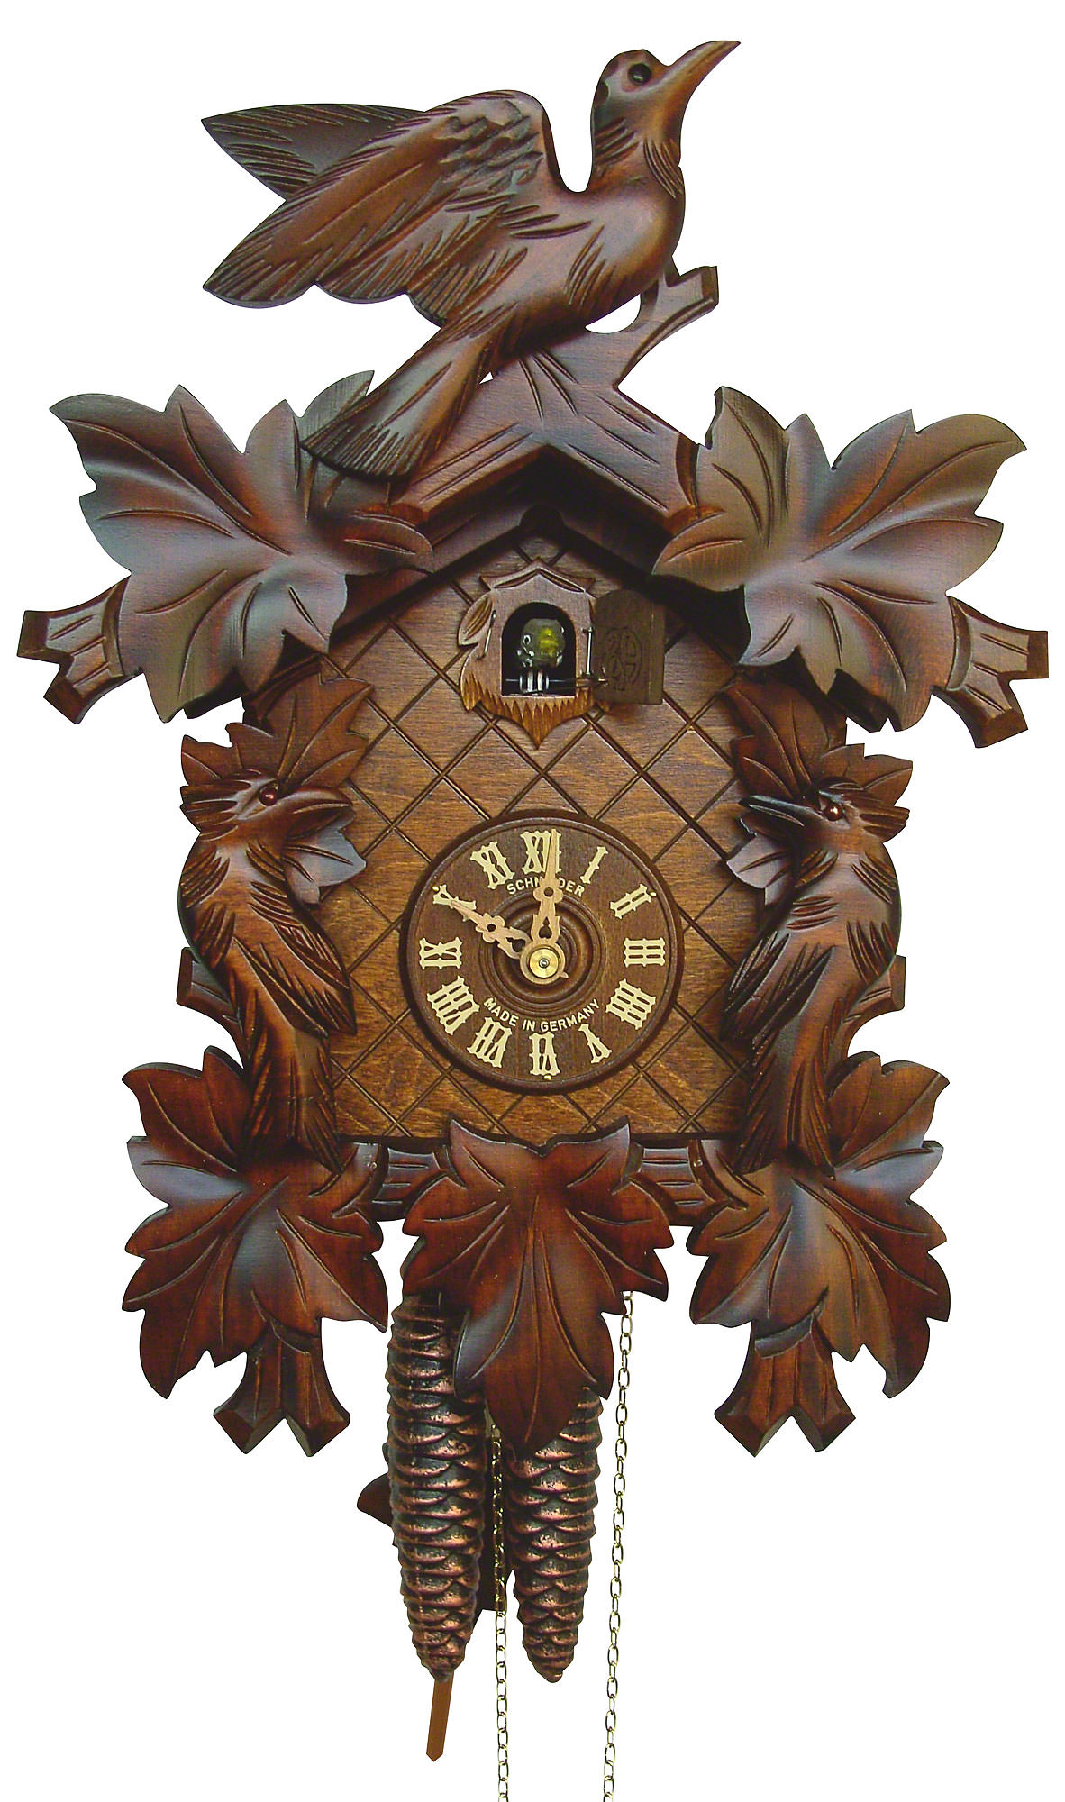
Cuckoo Hashing

Slide 16
Cuckoo Hashing
Alternative solution to collisions
Assume you have two hash functions H1 and H2
element | a | b | c | d | e
H1 | 0 | 9 | 17 | 11 | 5
H2 | 5 | 2 | 10 | 3 | 13
0
1
2
3
4
5
d
c
a
b
d
c
e
b
What if there are loops?

Slide 17
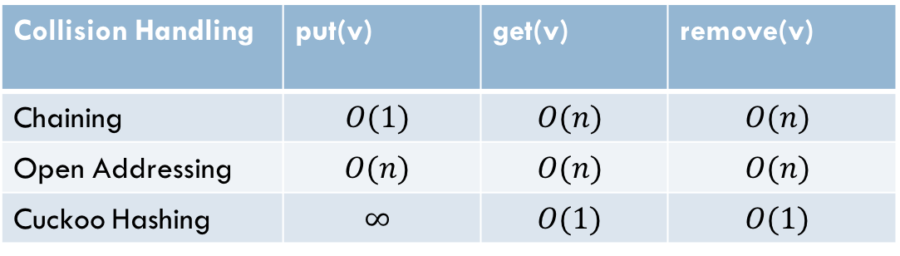
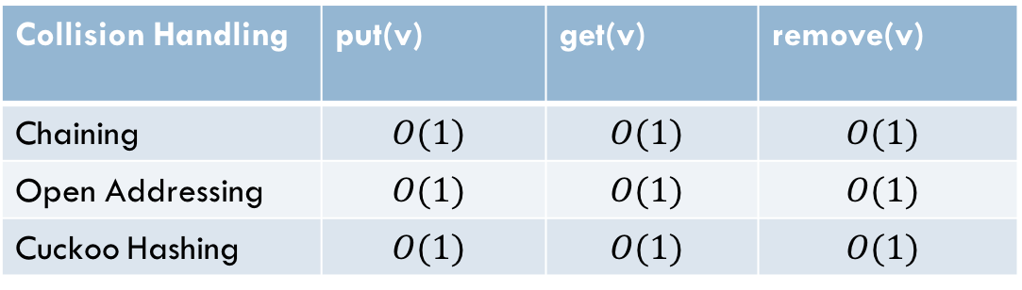
Complexity of Cuckoo Hashing
Worst Case:
Expected Case:
Collision Handling | put(v) | get(v) | remove(v)
Chaining | $$O(1)$$ | $$O(n)$$ | $$O(n)$$
Open Addressing | $$O(n)$$ | $$O(n)$$ | $$O(n)$$
Cuckoo Hashing | $$∞$$ | $$O(1)$$ | $$O(1)$$
Collision Handling | put(v) | get(v) | remove(v)
Chaining | $$O(1)$$ | $$O(1)$$ | $$O(1)$$
Open Addressing | $$O(1)$$ | $$O(1)$$ | $$O(1)$$
Cuckoo Hashing | $$O(1)$$ | $$O(1)$$ | $$O(1)$$
Notes:
Discussion: what about more than two hash functions?

Slide 18
Bloom Filters
Assume we only want to implement a set
What if you had stored the value at "all" hash locations (instead of one)?
element | a | b | c | d | e
H1 | 0 | 9 | 17 | 11 | 5
H2 | 5 | 2 | 10 | 3 | 13
0
1
2
3
4
5
🔵
🔵
🔵
🔵

Slide 19

Features of Bloom Filters
Worst-case $O(1)$ put, get, and remove
Works well with higher load factors
But: false positives

