Slide 1
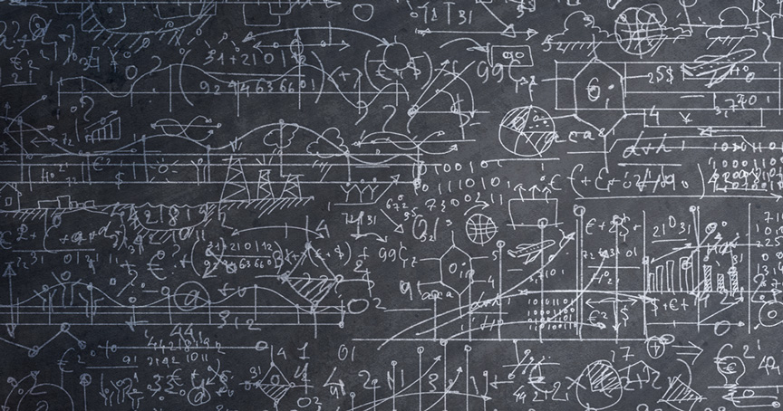
Asymptotic complexity
“Simplicity is a great virtue but it requires hard work to achieve it and education to appreciate it. And to make matters worse: complexity sells better.”
- Edsger Dijkstra
Lecture 10
CS2110 – Spring 2018

Slide 2
What Makes a Good Algorithm?
Suppose you have two possible algorithms that do the same thing; which is better?
What do we mean by better?
Faster?
Less space?
Easier to code?
Easier to maintain?
Required for homework?
FIRST, Aim for simplicity, ease of understanding, correctness.
SECOND, Worry about efficiency only when it is needed.
How do we measure speed of an algorithm?

Slide 3
Basic Step: one “constant time” operation
Constant time operation: its time doesn’t depend on the size
or length of anything. Always roughly the same. Time is bounded above by some number
Basic step:
Input/output of a number
Access value of primitive-type variable, array element, or object field
assign to variable, array element, or object field
do one arithmetic or logical operation
method call (not counting arg evaluation and execution of method body)

Slide 4
Counting Steps
// Store sum of 1..n in sum
sum= 0;
// inv: sum = sum of 1..(k-1)
for (int k= 1; k <= n; k= k+1){
sum= sum + k;
}
Statement: # times done sum= 0; 1
k= 1; 1
k <= n n+1
k= k+1; n
sum= sum + k; n
Total steps: 3n + 3
Linear algorithm in n
All basic steps take time 1.
There are n loop iterations. Therefore, takes time proportional to n.

Slide 5
Not all operations are basic steps
Statement: # times done s= ""; 1
k= 1; 1
k <= n n+1
k= k+1; n
s= s + 'c'; n
Total steps: 3n + 3
// Store n copies of ‘c’ in s
s= "";
// inv: s contains k-1 copies of ‘c’
for (int k= 1; k <= n; k= k+1){
s= s + 'c';
}
❌
Concatenation is not a basic step. For each k, catenation creates and fills k array elements.

Slide 6
String Concatenation
s= s + “c”; is NOT constant time. It takes time proportional to 1 + length of s
String@00
s
String@90
String
String
b
b
char[]
char[]
char[]@02
char[]@018
char[]
char[]
0
‘d’
0
‘d’
1
‘x’
1
‘x’
2
‘c’

Slide 7
Not all operations are basic steps
Statement: # times done s= ""; 1
k= 1; 1
k <= n n+1
k= k+1; n
s= s + 'c'; n
Total steps: 3n + 3
// Store n copies of ‘c’ in s
s= "";
// inv: s contains k-1 copies of ‘c’
for (int k= 1; k <= n; k= k+1){
s= s + 'c';
}
Statement: # times # steps
s= ""; 1 1
k= 1; 1 1
k <= n n+1 1
k= k+1; n 1
s= s + 'c'; n k
Total steps: n*(n-1)/2 + 2n + 3
Concatenation is not a basic step. For each k, catenation creates and fills k array elements.
Quadratic algorithm in n

Slide 8
Linear versus quadractic
// Store sum of 1..n in sum
sum= 0;
// inv: sum = sum of 1..(k-1)
for (int k= 1; k <= n; k= k+1)
sum= sum + n
// Store n copies of ‘c’ in s
s= “”;
// inv: s contains k-1 copies of ‘c’
for (int k= 1; k = n; k= k+1)
s= s + ‘c’;
Linear algorithm
Quadratic algorithm
In comparing the runtimes of these algorithms, the exact number of basic steps is not important. What’s important is that
One is linear in n—takes time proportional to n
One is quadratic in n—takes time proportional to n²

Slide 9
Looking at execution speed
Number of operations executed
2n+2, n+2, n are all linear in n, proportional to n
2n + 2 ops
n*n ops
n + 2 ops
n ops
Constant time
0 1 2 3 …
size n of the array

Slide 10
What do we want from a definition of “runtime complexity”?
1. Distinguish among cases for large n, not small n
Number of operations executed
2. Distinguish among important cases, like
n*n basic operations
n basic operations
log n basic operations
5 basic operations
n*n ops
2+n ops
5 ops
3. Don’t distinguish among trivially different cases.
5 or 50 operations
n, n+2, or 4n operations
0 1 2 3 …
size n of problem

Slide 11
"Big O" Notation
Formal definition: f(n) is O(g(n)) if there exist constants c > 0 and N ≥ 0 such that for all n ≥ N, f(n) ≤ c·g(n)
Get out far enough (for n ≥ N)
f(n) is at most c·g(n)
c·g(n)
f(n)
Intuitively, f(n) is O(g(n))
means that f(n) grows
like g(n) or slower
N

Slide 12
Prove that (2n² + n) is O(n²)
Formal definition: f(n) is O(g(n)) if there exist constants c > 0 and N ≥ 0 such that for all n ≥ N, f(n) ≤ c·g(n)
Example: Prove that (2n² + n) is O(n²)
Methodology:
Start with f(n) and slowly transform into c · g(n):
Use = and <= and < steps
At appropriate point, can choose N to help calculation
At appropriate point, can choose c to help calculation

Slide 13
Prove that (2n² + n) is O(n²)
Formal definition: f(n) is O(g(n)) if there exist constants c > 0 and N ≥ 0 such that for all n ≥ N, f(n) ≤ c·g(n)
Example: Prove that (2n² + n) is O(n²)
f(n)
= <definition of f(n)>
2n² + n
<= <for n ≥ 1, n ≤ n²>
2n² + n²
= <arith>
3*n²
= <definition of g(n) = n²>
3*g(n)
Transform f(n) into c·g(n):
Use =, <= , < steps
Choose N to help calc.
Choose c to help calc
Choose
N = 1 and c = 3

Slide 14
Prove that 100 n + log n is O(n)
Formal definition: f(n) is O(g(n)) if there exist constants c > 0 and N ≥ 0 such that for all n ≥ N, f(n) ≤ c·g(n)
f(n)
= <put in what f(n) is>
100 n + log n
<= <We know log n ≤ n for n ≥ 1>
100 n + n
= <arith>
101 n
= <g(n) = n>
101 g(n)
Choose
N = 1 and c = 101

Slide 15
O(…) Examples
Let f(n) = 3n² + 6n – 7
f(n) is O(n²)
f(n) is O(n³)
f(n) is O(n⁴)
…
p(n) = 4 n log n + 34 n – 89
p(n) is O(n log n)
p(n) is O(n²)
h(n) = 20·2^{n} + 40n
h(n) is O(2^{n})
a(n) = 34
a(n) is O(1)
Only the leading term (the term that grows most rapidly) matters
If it’s O(n²), it’s also O(n³)
etc! However, we always use the smallest one

Slide 16
Do NOT say or write f(n) = O(g(n))
Formal definition: f(n) is O(g(n)) if there exist constants c > 0 and N ≥ 0 such that for all n ≥ N, f(n) ≤ c·g(n)
f(n) = O(g(n)) is simply WRONG. Mathematically, it is a disaster.
You see it sometimes, even in textbooks. Don’t read such things.
Here’s an example to show what happens when we use = this way.
We know that n+2 is O(n) and n+3 is O(n). Suppose we use =
n+2 = O(n)
n+3 = O(n)
But then, by transitivity of equality, we have n+2 = n+3.
We have proved something that is false. Not good.

Slide 17
Problem-size examples
Suppose a computer can execute 1000 operations per second; how large a problem can we solve?
operations | 1 second | 1 minute | 1 hour
n | 1000 | 60,000 | 3,600,000
n log n | 140 | 4893 | 200,000
n² | 31 | 244 | 1897
3n² | 18 | 144 | 1096
n³ | 10 | 39 | 153
2^{n} | 9 | 15 | 21

Slide 18
Commonly Seen Time Bounds
O(1) | constant | excellent
O(log n) | logarithmic | excellent
O(n) | linear | good
O(n log n) | n log n | pretty good
O(n²) | quadratic | maybe OK
O(n³) | cubic | maybe OK
O(2^{n}) | exponential | too slow

Slide 19
Big O Poll
Consider two different data structures that could store your data: an array or a doubly-linked list. In both cases, let n be the size of your data structure (i.e., the number of elements it is currently storing). What is the running time of each of the following operations:
get(i) using an array
get(i) using a DLL
insert(v) using an array
insert(v) using a DLL
a

Slide 20
Java Lists
java.util defines an interface List<E>
implemented by multiple classes:
ArrayList
LinkedList

Slide 21
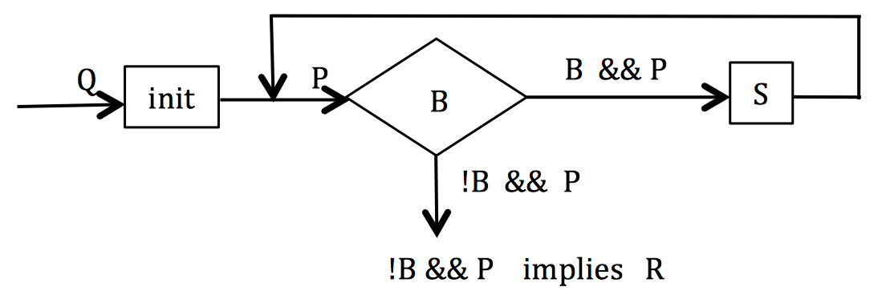
Search for v in b[0..]
/** returns the index of the first occurrence of v in array b
* Precondition: b is sorted **/
Methodology:
Define pre and post conditions.
Draw the invariant as a combination of pre and post.
Develop loop using 4 loopy questions.
Practice doing this!

Slide 22
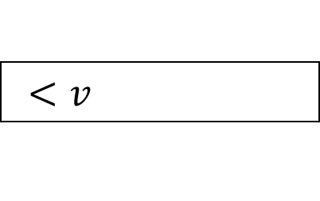
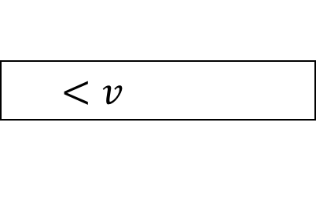
Search for v in b[0..]
/** returns the index of the first occurrence of v in array b
* Precondition: b is sorted **/
0 b.length
b
Methodology:
Define pre and post conditions.
Draw the invariant as a combination of pre and post.
Develop loop using 4 loopy questions.
Practice doing this!
pre:
sorted
0 i b.length
b
$$<v$$
post:
$$≥v$$
0 i b.length
sorted
b
inv:
$$<v$$

Slide 23
The Four Loopy Questions
Does it start right?
Is {Q} init {P} true?
Does it continue right?
Is {P && B} S {P} true?
Does it end right?
Is P && !B => R true?
Will it get to the end?
Does it make progress toward termination?

Slide 24
Search for v in b[0..]
/** returns the index of the first occurrence of v in array b
* Precondition: b is sorted, v is in b **/
0 b.length
i= 0;
b
pre:
while ( ) {
}
return i;
sorted
b[i] < v
0 i b.length
i= i+1;
b
$$<v$$
post:
$$≥v$$
0 i b.length
Each iteration takes constant time.
sorted
b
inv:
$$<v$$
Worst case: b.length iterations
Linear algorithm: O(b.length)

Slide 25
Another way to search for v in b[0..]
/** returns the index of the first occurrence of v in array b
* Precondition: b is sorted, v is in b **/
0 b.length
b
Methodology:
Define pre and post conditions.
Draw the invariant as a combination of pre and post.
Develop loop using 4 loopy questions.
Practice doing this!
pre:
sorted
0 i b.length
b
$$<v$$
post:
$$≥v$$
0 k i b.length
b
inv:
$$<v$$
sorted
$$≥v$$

Slide 26
Another way to search for v in b[0..]
/** returns the index of the first occurrence of v in array b
* Precondition: b is sorted, v is in b **/
0 b.length
k= -1;
i= b.length;
b
pre:
sorted
while ( ) {
}
return i;
k< i-1
0 i b.length
int j=(k+i)/2;
if (b[j]<v) k= j;
else i= j;
b
$$<v$$
post:
$$≥v$$
0 k i b.length
b
inv:
$$<v$$
sorted
$$≥v$$
Each iteration takes constant time.
Logarithmic: O(log(b.length))
Worst case: log(b.length) iterations

Slide 27
Another way to search for v in b[0..]
/** returns the index of the first occurrence of v in array b
* Precondition: b is sorted **/
0 b.length
This algorithm is better than binary searches that stop when v is found.
Gives good info when v not in b.
Works when b is empty.
Finds first occurrence of v, not arbitrary one.
Correctness, including making progress, easily seen using invariant
b
i= -1;
k= b.length;
pre:
$$?$$
0 i b.length
i < k
while ( -1) {
}
b
$$<v$$
int j=(k+i)/2;
b[j]<v ? i=j : k=j
post:
$$≥v$$
0 i j k b.length
b
inv:
$$<v$$
$$≥v$$
Each iteration takes constant time.
Logarithmic: O(log(b.length))
Worst case: log(b.length) iterations

Slide 28
Dutch National Flag Algorithm

Slide 29
Dutch National Flag Algorithm
Dutch national flag. Swap b[0..n-1] to put the reds first, then the whites, then the blues. That is, given precondition Q, swap values of b[0.n] to truthify postcondition R:
0 n
?
Q: b
0 n
R: b
reds whites blues
0 n
P1: b
reds whites blues ?
0 n
P2: b
reds whites ? blues

Slide 30
Dutch National Flag Algorithm: invariant P1
0 n
Q: b
h= 0; k= h; p= k;
?
while ( ) {
}
0 n
p != n
if (b[p] blue)
else if (b[p] white) {
}
else { // b[p] red
}
R: b
reds whites blues
p= p+1;
0 n
h k p
swap b[p], b[k];
p= p+1; k= k+1;
P1: b
reds whites blues ?
swap b[p], b[h];
swap b[p], b[k];
p= p+1; h=h+1; k= k+1;

Slide 31
Dutch National Flag Algorithm: invariant P2
0 n
Q: b
h= 0; k= h; p= n;
?
while ( ) {
}
0 n
k != p
R: b
reds whites blues
if (b[k] white)
else if (b[k] blue) {
}
else { // b[k] is red
}
k= k+1;
0 n
h k p
P2: b
reds whites ? blues
p= p-1;
swap b[k], b[p];
swap b[k], b[h];
h= h+1; k= k+1;

Slide 32
Asymptotically, which algorithm is faster?
Invariant 1
Invariant 2
0 h k p n
0 h k p n
reds whites blues ?
reds whites ? blues
h= 0; k= h; p= k;
h= 0; k= h; p= n;
while ( ) {
}
p != n
while ( ) {
}
k != p
if (b[p] blue)
else if (b[p] white) {
}
else { // b[p] red
}
p= p+1;
if (b[k] white)
else if (b[k] blue) {
}
else { // b[k] is red
}
k= k+1;
swap b[p], b[k];
p= p+1; k= k+1;
p= p-1;
swap b[k], b[p];
swap b[p], b[h];
swap b[p], b[k];
p= p+1; h=h+1; k= k+1;
swap b[k], b[h];
h= h+1; k= k+1;

Slide 33
Asymptotically, which algorithm is faster?
Invariant 1
Invariant 2
0 h k p n
0 h k p n
reds whites blues ?
reds whites ? blues
h= 0; k= h; p= k;
h= 0; k= h; p= n;
might use 2 swaps per iteration
uses at most 1 swap per iteration
while ( ) {
}
p != n
while ( ) {
}
k != p
if (b[p] blue)
else if (b[p] white) {
}
else { // b[p] red
}
p= p+1;
if (b[k] white)
else if (b[k] blue) {
}
else { // b[k] is red
}
k= k+1;
swap b[p], b[k];
p= p+1; k= k+1;
p= p-1;
swap b[k], b[p];
These two algorithms have the same asymptotic running time
(both are O(n))
swap b[p], b[h];
swap b[p], b[k];
p= p+1; h=h+1; k= k+1;
swap b[k], b[h];
h= h+1; k= k+1;

