Slide 1
CS/ENGRD 2110 Spring 2018
The fattest knight at King Arthur's round table was Sir Cumference. He acquired his size from too much pi.
Lecture 6: Consequence of type, casting; function equals
http://courses.cs.cornell.edu/cs2110

Slide 2
Overview references in JavaHyperText
Quick look at arrays array
Casting among classes cast, object-casting rule
Operator instanceof
Function getClass
Function equals
compile-time reference rule
Homework. JavaHyperText while-loop for-loop
while ( <bool expr> ) { … } // syntax
for (int k= 0; k < 200; k= k+1) { … } // example

Slide 3
A2 is due Thursday
Everyone should get 100/100 since we gave you all the test cases you need.
Please look at the pinned Piazza note “Assignment A2” for information that is not in the handout and answers to questions.

Slide 4
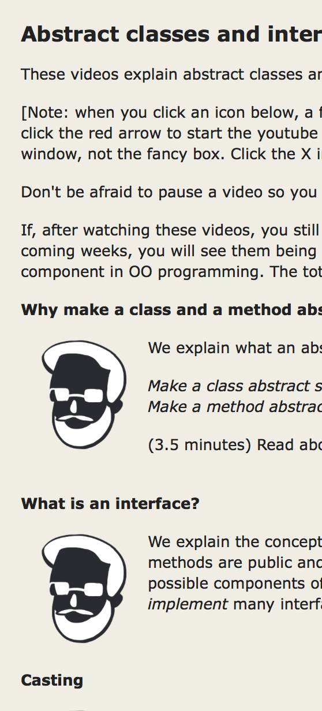
Before Next Lecture…
Follow the tutorial on abstract classes and interfaces, and watch less than 13 minutes of videos.
Visit JavaHyperText and click on
Abstract classes and interfaces
This will make Thursday’s lecture far more
understandable.
Click these

Slide 5
Classes we work with today
Work with a class Animal and subclasses like Cat and Dog
Put components common to animals in Animal
a0
a1
5
Animal
Animal
age
isOlder(Animal)
age
isOlder(Animal)
class hierarchy:
6
Object
Cat
getNoise() toString() getPurrs()
Dog
Animal
getNoise() toString()
Dog
Cat
Object partition is there but not shown

Slide 6
Animal[] v= new Animal[3];
declaration of array v
Create array of 3 elements
v
null
a6
Assign value of new-exp to v
a6
Animal[]
Assign and refer to elements as usual:
v[0]= new Animal(…);
…
a= v[0].getAge();
0
1
2
null
null
null
Sometimes use horizontal picture of an array:
0 1 2
v
null null null

Slide 7
Consequences of a class type
Animal[] v; declaration of v. Also means that each
variable v[k] is of type Animal
The type of v is Animal[]
The type of each v[k] is Animal
The type is part of the syntax/grammar of the language. Known at compile time.
0 1 2
v
a0 null a1
Animal objects
A variable’s type:
• Restricts what values it can contain.
• Determines which methods are legal to call on it.
Notes:
• For example, a variable of type Animal can hold any object with an Animal segment. So a plain Animal, a Dog, or a Cat.
• (On next slide.)

Slide 8
Dog and Cat objects stored in Animal variable
0 1 2
Which function is called by
v[0].toString() ?
(Remember, the hidden Object partition contains toString().)
v
a0 null a1
Can store (pointers to) subclass objects in superclass variable
a0
a1
5
Animal
Animal
age
isOlder(Animal)
age
isOlder(Animal)
6
Bottom-up or overriding rule says function toString in Cat partition
Cat
toString() getNoise() getPurrs()
Dog
toString() getNoise()

Slide 9
From an Animal variable, can use only methods available in class Animal
Compile-time reference rule: From a variable of type C, can reference only methods/fields that are available in class C.
a.getPurrs() is obviously illegal.
The compiler will give you an error.
a
a0
Animal
a0
5
Animal
age
isOlder(Animal)
When checking legality of a call like
a.getPurrs(…)
since the type of a is Animal, method getPurrs must be declared in Animal or one of its superclasses.
Dog
getNoise() toString()
see JavaHyperText: compile-time reference rule
Notes:
The Java compiler wants to keep you *safe*. So this rule requires there to be *some* method with the right name. But it doesn't have to know *which* method will be called!

Slide 10
Compile-time reference rule: From a variable of type C, can reference only methods/fields that are available in class C.
Suppose a0 contains an object of a subclass Cat of Animal. By the copmle-time reference rule below, a.getPurrs(…) is still illegal. Remember, the test for legality is done at compile time, not while the program is running.
a
a0
Animal
a0
5
Animal
age
isOlder(Animal)
When checking legality of a call like
a.getPurrs(…)
since the type of a is Animal, method getPurrs must be declared in Animal or one of its superclasses.
Cat
getNoise() toString() getPurrs()
see JavaHyperText: compile-time reference rule
Notes:
Types exist at compile time. Objects exist at run time. The compiler has NO IDEA what object you will put in what variable, except that it obeys the type rule: Animal variables hold objects with *some* Animal segment.

Slide 11
Compile-time reference rule: From a variable of type C, can reference only methods/fields that are available in class C.
The same object a0, from the viewpoint of a Cat variable and an Animal variable
c
a0
a
a0
Cat
Animal
c.getPurrs() is legal
a.getPurrs() is illegal
because getPurrs
is not available in class Animal
a0
a0
5
Animal
age
isOlder(Animal)
5
Animal
age
isOlder(Animal)
Cat
getNoise() toString() getPurrs()
Cat
getNoise() toString() getPurrs()

Slide 12
Compile-time reference rule: From a variable of type C, can reference only methods/fields that are available in class C.
Rule: c.m(…) is legal and the program will compile ONLY if method m is declared in C or one of its superclasses.
(JavaHyperText entry: compile-time reference rule.)
a0
Object
c
a0
C
…
m(…) must be declared in one of these classes
…
…
C

Slide 13
Another example
Type of v[0]: Animal
Should this call be allowed? Should program compile?
v[0].getPurrs()
Should this call be allowed? Should program compile?
v[k].getPurrs()
a0
a1
5
Animal
Animal
age
isOlder(Animal)
age
isOlder(Animal)
6
Cat
getNoise() toString() getPurrs()
Dog
getNoise() toString()
0 1 2
v
a0 null a1
Notes:
Again, the value of k only exists at run time! Not when you're compiling your code. So the compiler cannot *possibly* know which object you're referring to. And it just wants to keep you safe!

Slide 14
View of object based on the type
Each element v[k] is of
type Animal.
From v[k], see only what is in partition Animal and partitions above it.
getPurrs() not in class Animal or Object. Calls are illegal, program does not compile:
v[0].getPurrs() v[k].getPurrs()
a0
a1
Components are in lower partitions, but can’t see them
5
Animal
Animal
age
isOlder(Animal)
age
isOlder(Animal)
6
0 1 2
Cat
getNoise() toString() getPurrs()
Dog
getNoise() toString()
v
a0 null a1
Animal

Slide 15
Casting objects
a0
5
Animal
age
isOlder(Animal)
Object
You know about casts like:
(int) (5.0 / 7.5)
(double) 6
double d= 5; // automatic cast
Animal
Cat
getNoise() toString() getPurrs()
Dog
Cat
You can also use casts with class types:
Animal h= new Cat("N", 5);
Cat c= (Cat) h;
a1
Animal
age
isOlder(Animal)
6
Dog
A class cast doesn’t change the object. It just changes the perspective: how it is viewed!
getNoise() toString()

Slide 16
Explicit casts: unary prefix operators
Object-casting rule: At runtime, an object can be cast to the name of any partition that occurs within it —and to nothing else.
a0 can be cast to Object, Animal, Cat.
An attempt to cast it to anything else causes an exception
a0
Object
equals() …
5
Animal
age
isOlder(Animal)
(Cat) c
(Object) c
(Animal) (Animal) (Cat) (Object) c
Cat
getNoise() toString() getPurrs()
These casts don’t take any time. The object does not change. It’s a change of perception.
c
a0
Cat
Notes:
And they cannot fail at run time!

Slide 17
Implicit upward cast
a0
5
Animal
age
isOlder(Animal)
public class Animal {
/** = "this Animal is older than h" */
public boolean isOlder(Animal h) {
return age > h.age; }
Cat
getNoise() toString() getPurrs()
Call c.isOlder(d)
Variable h is created. a1 is cast up to class Animal and stored in h
a1
Animal
age
isOlder(Animal)
6
Upward casts done automatically when needed
Dog
getNoise() toString()
h
a1
c
a0
d
a1
Animal
Cat
Dog

Slide 18
Example
a1
Animal
age
isOlder(Animal)
6
public class Animal {
/** = "this is older than h" */
public boolean isOlder(Animal h) {
return age > h.age; }
Dog
getNoise() toString()
Type of h is Animal. Syntactic property.
Determines at compile-time what components can be used: those available in Animal
If a method call is legal, the overriding rule determines which implementation is called
h
a1
Animal

Slide 19
Components used from h
a1
Animal
age
isOlder(Animal)
6
public class Animal {
/** = "this is older than h" */
public boolean isOlder(Animal h) {
return age > h.age; }
Dog
getNoise() toString()
h.toString() OK —it’s in class Object partition
h.isOlder(…) OK —it’s in Animal partition
h.getPurrs() ILLEGAL —not in Animal
partition or Object partition
By overriding rule, calls toString() in Dog partition
h
a1
Animal

Slide 20
Function h.equals(ob)
Function h.equals(ob) returns true if objects h and ob are equal, where equality depends on the class.
Here, we mean all corresponding fields are equal.
h
a0
k
a1
h.equals(h): true
h.equals(k): true
h.equals(j): false
a0.equals(a0): true
a0.equals(a1): true
a0.equals(a2) false
j
a2
Not Java
a2
a1
a0
3
An
An
An
age
equals(Object)
5
5
age
equals(Object)
age
equals(Object)

Slide 21
Function h.equals(ob)
Function h.equals(ob) returns true if objects h and ob are equal, where equality depends on the class. Here, we mean all corresponding fields are equal.
a0.equals(a0): true
a0.equals(a1): false
a0.equals(a2): false
a2
a1
a0
An
An
An
age _5_
equals(Object)
age _2_
equals(Object)
age _5_
equals(Object)
Cat
Cat
Cat
noise _”q”_
equals(Object)
noise _”p”_
equals(Object)
noise _”p”_
equals(Object)

Slide 22
Function h.equals(ob)
Function h.equals(ob) returns true if objects h and ob are equal, where equality depends on the class.
Here, we mean all corresponding fields are equal.
a0
This function checks equality of age
An
age _5_
equals(Object)
Cat
This function
Calls superclass equality
checks equality of noise
noise _”p”_
equals(Object)

Slide 23
Function h.equals(ob)
Function h.equals(ob) returns true if objects h and ob are equal, where equality depends on the class. Here, we mean all corresponding fields are equal.
a1
5
An
age
equals(Object)
What is value of a1.equals(a0)?
a0.equals(a1)?
a0
Obviously, h.equals(0b) has to check
that the classes of h and ob are the same
An
age _5_
equals(Object)
This function checks equality of age
This function
Calls super-class equality
checks equality of noise
Cat
noise _”p”_
equals(Object)

Slide 24
Function h.equals(ob)
a0
(1) Check classes of this and parameter
(2) Check age of this and parameter
An
age _5_
equals(Object)
Call super-class equality
(3) Check equality of noise
Cat
noise _”p”_
equals(Object)
Siamese
Call super-class equality
(3) Check equality of f
f _8_
equals(Object)

Slide 25
Use function getClass
h.getClass()
Let Cat be the lowest partition of object h
Then h.getClass() == Cat.class
h.getClass() != Animal.class
a0
5
Animal
age
isOlder(Animal)
Cat
purrs _____ getNoise() toString() getPurrs()
h
a0
Animal

Slide 26
Equals in Animal
a0
5
Animal
age
equals(Object)
public class Animal { private int age;
/** return true iff this and ob are of the same class
* and their age fields have same values */
public boolean equals(Object ob) {
}
if (ob == null || getClass() != ob.getClass()) return false;
Animal an= (Animal) ob; // cast ob to Animal!!!!
return age == an.age; // downcast was needed to reference age

Slide 27
Equals in Cat
a0
5
Animal
age
equals(Object)
public class Animal { private int age;
/** return true iff this and ob are of same class
* and their age fields have same values */
public boolean equals(Object ob) {}
noise _”p”_
equals(Object)
Cat
public class Cat extends Animal { private int age;
/** return true iff this and ob are of same class
* and their age and noise fields have same values */
public boolean equals(Object ob) {}
}
if (!super.equals(ob) return false;
Cat ca= (Cat) ob; // downcast is necessary!
return noise == ca.noise; // needed to reference noise

Slide 28
Use operator instanceof
ob instanceof C
true iff ob has a partition named C
a0
5
Animal
age
isOlder(Animal)
h instanceof Object true
h instanceof Animal true
h instanceof Cat true
h instanceof JFrame false
Cat
purrs _____ getNoise() toString() getPurrs()
h
a0
Animal

Slide 29
Opinions about casting
Use of instanceof and downcasts can indicate bad design
DON’T:
if (x instanceof C1)
do thing with (C1) x
else if (x instanceof C2)
do thing with (C2) x
else if (x instanceof C3)
do thing with (C3) x
DO:
x.do()
… where do is overridden in the classes C1, C2, C3
But how do I implement equals() ?
That requires casting!

