Slide 1
DEBUGGING
CS2110

Slide 2
Announcements
Lunch with Professors – sign up, including today!
Prelim 2 Regrade Requests due tonight at 11:59PM

Slide 3
Context
2110 teaches you how to write code with care. Use:
  meaningful comments
  meaningful variable names
  loop invariants
  preconditions
  asserts
  testing (lots and lots of testing!)
  clean style
  a structure that is easy to reason about
What not to do: https://www.ioccc.org

Slide 4
Correctness first, then Performance
"Programmers waste enormous amounts of time thinking about, or worrying about, the speed of noncritical parts of their programs, and these attempts at efficiency actually have a strong negative impact when debugging and maintenance are considered. We should forget about small efficiencies, say about 97% of the time: premature optimization is the root of all evil. Yet we should not pass up our opportunities in that critical 3%.”
—Donald Knuth
Correctness first, then speed.
If speed really matters, use a profiler.

Slide 5
Sometimes…
…despite your best efforts, your code will not work
Now what?

Slide 6
The 1st Bug
On September 9, 1947, U.S. Navy officers found a moth between the relays on the Harvard Mark II computer they were working on. In those days
computers filled rooms and the warmth of the internal components attracted moths, flies and other flying creatures. Those creatures then shortened circuits and caused the computer to malfunction.
https://thenextweb.com/shareables/2013/09/18/the-very-first-computer-bug/
Notes:
https://thenextweb.com/shareables/2013/09/18/the-very-first-computer-bug/

Slide 7
Debugging is twice as hard as writing the code in the first place. Therefore, if you write the code as cleverly as possible, you are, by definition, not smart enough to debug it. —BRIAN KERNIGHAN
If debugging is the process of removing software bugs, then programming must be the process of putting them in. —E. W. DIJKSTRA
Deleted code is debugged code.
—JEFF SICKEL

Slide 8
Debugging 101
Step 1: know what the correct behavior is
Step 2: find a single, reproducible* case where your code is incorrect
Step 3: figure out what your code is doing
  NOT: why your code isn’t doing what it should
  (your code is doing exactly what you told it to)
*if your code (or code you call) generates a random # anywhere you need to stop (or seed) that

Slide 9
Inspecting your code…
Several approaches. Look at:
+ the last thing you touched
+ the part you feel the least sure of
+ the code most associated with the error you’re
observing
– every single line of code

Slide 10
Step through your code
Print statements
Use a debugger!

Slide 11
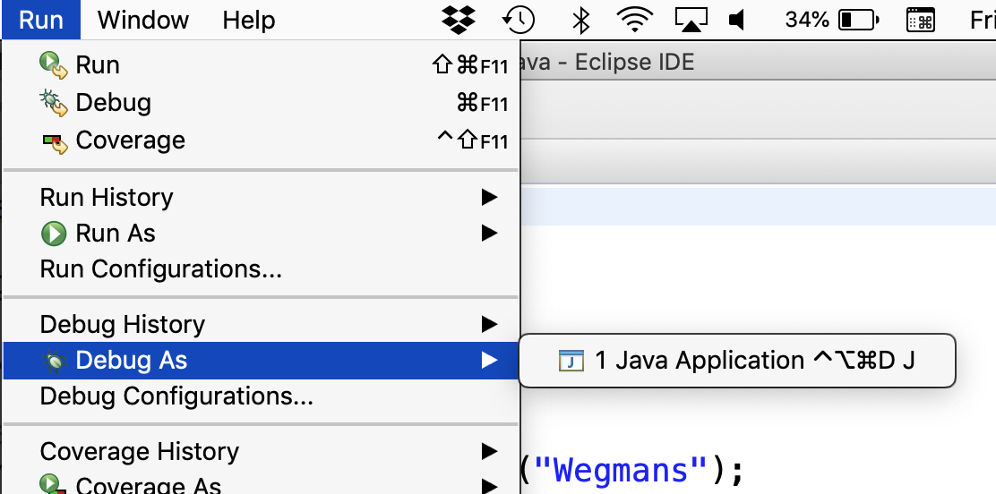

How to start the Eclipse debugger
OR

Slide 12
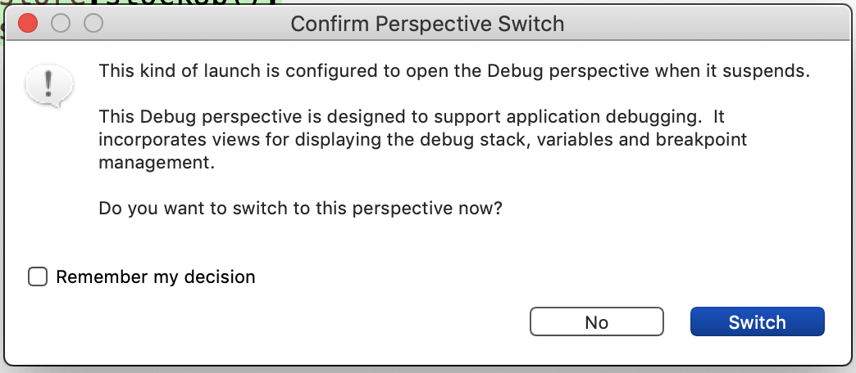

Slide 13
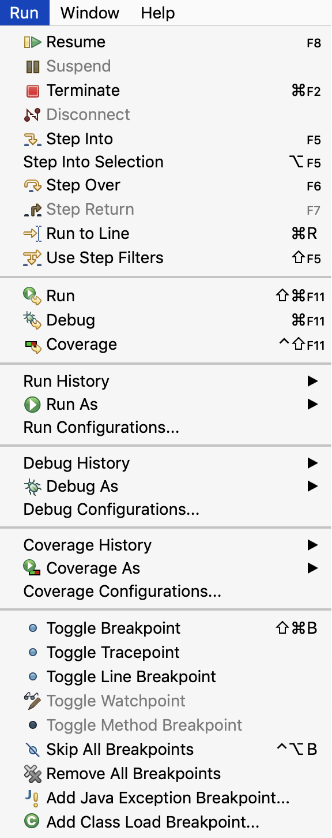
Under the Run Menu
The controls of your debugger
How you navigate through the execution of your code in debug mode.
Lines or variables of interest

Slide 14
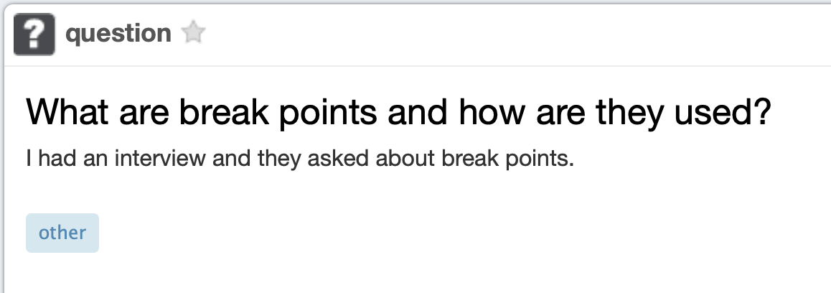
2 days ago on piazza

Slide 15
Breakpoints, Watchpoints, etc.
Some basic functionality common to all debuggers
Breakpoint
  a line you want to see get executed
Conditional Breakpoint
  a line you sometimes want to see get executed
  Warning: can make your code super slow
Watchpoint
  a global variable you want to track
    When read
    When written to

Slide 16
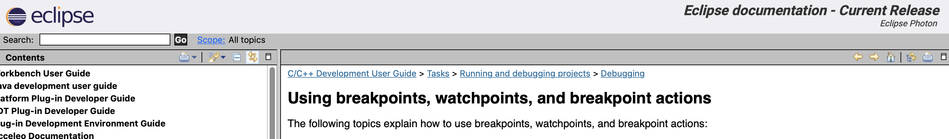
Breakpoints & Watchpoints:
https://help.eclipse.org/photon/index.jsp?topic=%2Forg.eclipse.cdt.doc.user%2Ftasks%2Fcdt_o_brkpnts_watch.htm

