Slide 1
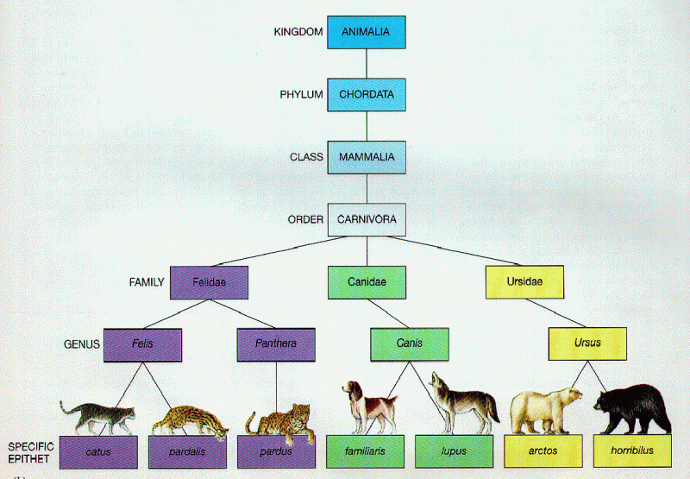
CS/ENGRD 2110 Fall 2018
Lecture 4: The class hierarchy; static components
http://cs.cornell.edu/courses/cs2110

Slide 2
Announcements
A1 Due Friday
A2 Out Today

Slide 3
Where am I? Big ideas so far.
Java variables have types (L1)
A type is a set of values and operations on them (int: +, -, *, /, %, etc.)
Classes define new types (L2) and define the contents of each object of the class.
Methods are the operations on objects of that class.
Fields allow objects to contain data (L3)

Slide 4
Class House
public class House {
private int nBed; // number of bedrooms, >= 0.
private int nBath; // number of bathrooms, in 1..5
/** Constructor: bed is number of bedrooms,
* bath is number of bathrooms * Prec: bed >= 0, 0 < bath <= 5 */
public House(int bed, int bath) {
nBed= bed; nBath= bath;
}
/** Return no. of bedrooms */
public int getNumBed() {
return nBed;
}
…
}
House@af8
House
nBed
3
nBath
1
House(…) getNumBed()
getNumBath() setNumBed(…)
setNumBath(…)
toString()
equals(Object) hashCode()
Contains other methods!

Slide 5
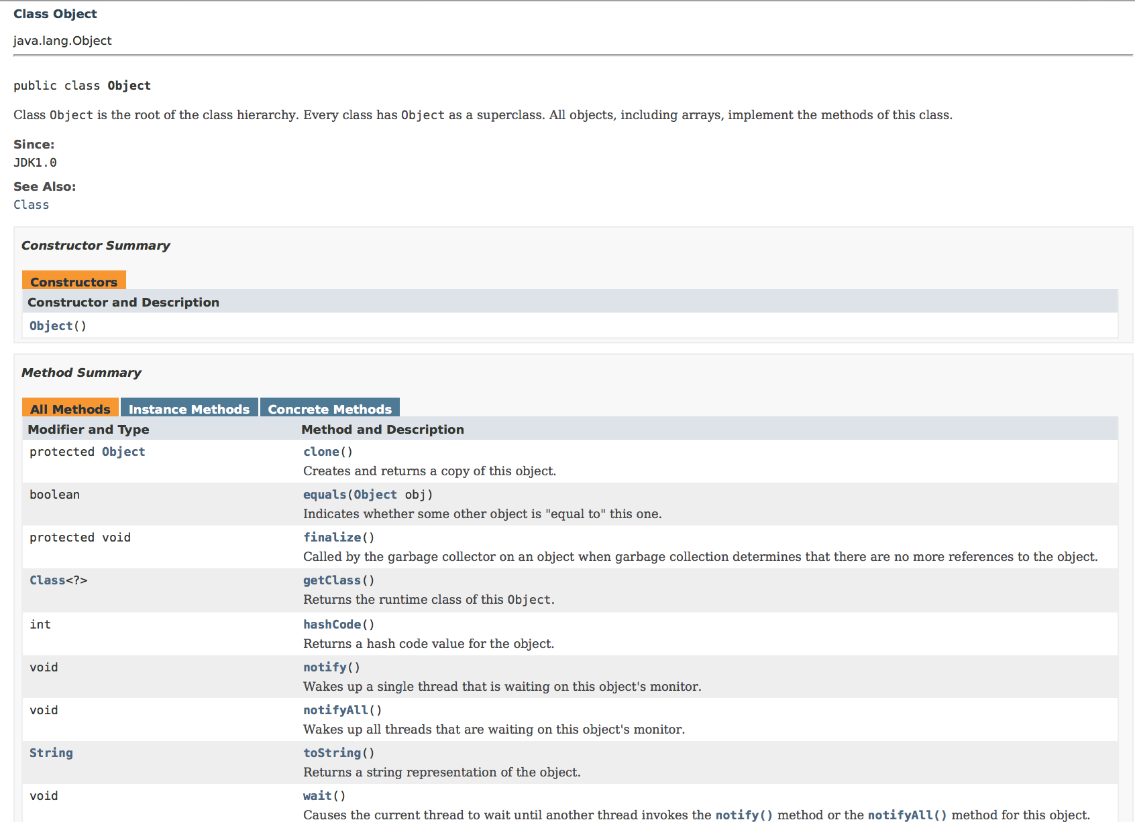
Class Object

Slide 6
Class Object: the superest class of all
public class House {
private int nBed; // number of bedrooms, >= 0.
private int nBath; // number of bathrooms, in 1..5
/** Constructor: bed is number of bedrooms,
* bath is number of bathrooms * Prec: bed >= 0, 0 < bath <= 5 */
public House(int bed, int bath) {
nBed= bed; nBath= bath;
}
/** Return no. of bedrooms */
public int getNumBed() {
return nBed;
}
…
}
extends Object {
Java: Every class that does not extend another class extends class Object.
House@af8
Object
House
toString()
equals(Object) hashCode()
nBed
3
nBath
1
House(…) getNumBed()
getNumBath() setNumBed(…)
Notes:
Before this, demo Object using Meta and Empty.

Slide 7
Class Object: the superest class of all
public class House {
private int nBed; // number of bedrooms, >= 0.
private int nBath; // number of bathrooms, in 1..5
/** Constructor: bed is number of bedrooms,
* bath is number of bathrooms * Prec: bed >= 0, 0 < bath <= 5 */
public House(int bed, int bath) {
nBed= bed; nBath= bath;
}
/** Return no. of bedrooms */
public int getNumBed() {
return nBed;
}
…
}
extends Object {
Java: Every class that does not extend another class extends class Object.
House@af8
Object
House
toString()
equals(Object) hashCode()
nBed
3
nBath
1
House(…) getNumBed()
getNumBath() setNumBed(…)
We often omit the Object partition to reduce clutter; we know that it is always there.
Notes:
Before this, demo Object using Meta and Empty.

Slide 8
Class Object: the superest class of all
public class House {
private int nBed; // number of bedrooms, >= 0.
private int nBath; // number of bathrooms, in 1..5
/** Constructor: bed is number of bedrooms,
* bath is number of bathrooms * Prec: bed >= 0, 0 < bath <= 5 */
public House(int bed, int bath) {
nBed= bed; nBath= bath;
}
/** Return no. of bedrooms */
public int getNumBed() {
return nBed;
}
…
}
extends Object {
Java: Every class that does not extend another class extends class Object.
House@af8
Object
toString()
equals(Object) hashCode()
We often omit the Object partition to reduce clutter; we know that it is always there.
House
nBed
3
nBath
1
House(…) getNumBed()
getNumBath() setNumBed(…)
Notes:
Before this, demo Object using Meta and Empty.

Slide 9
Classes can extend other classes
We saw this in L2!
/** An instance is a subclass of JFrame */
public class C extends javax.swing.JFrame {
}
C@6667f34e
C: subclass of JFrame
JFrame: superclass of C
C inherits all methods that are in a JFrame
Object
equals() toString() …
JFrame
hide() show()
setTitle(String) getTitle()
object has 3 partitions:
for Object components,
for JFrame components,
for C components
getWidth() getHeight() …
getX() getY() setLocation(int, int)
C

Slide 10
Classes can extend other classes
You also saw this in the tutorial for this week's recitation
There are subclasses of Exception for different types of exceptions
NFE@2
Object
Throwable
Exception
NumberFormatException

Slide 11
Accessing superclass things
Subclasses are different classes
Public fields and methods can be accessed
Private fields and methods cannot be accessed
Protected fields can be access by subclasses

Slide 12
Keywords: this
public class House {
private int nBed; // number of bedrooms, >= 0.
private int nBath; // number of bathrooms, in 1..5
/** Constructor: */
public House(int nBed, int nBath) {
nBed= nBed;
nBath= nBath;
}
}
// has no effect!
this.nBed= nBed;
this.nBath= nBath;
Inside-out rule shows that field nBed is inaccessible! ☹
this avoids overshadowed field names
this evaluates to the name of the object in which it occurs
Makes it possible for an object to access its own name (or pointer)
Example: Referencing a shadowed class field

Slide 13
A Subclass Example
public class House {
private int nBed; // num bedrooms, >= 0
private int nBath; // num bathrooms, in 1..5
/** Constructor: bed is number of bedrooms
* bath is number of bathrooms * Prec: bed >= 0, 0 < bath <= 5 */
public House(int bed, int bath) {
nBed= bed; nBath= bath;
}
public int getNumBed() {
return nBed;
}
…
}
public class Apt extends House {
private int floor;
private Apt downstairsApt;
public Apt(int floor, Apt downstairs) {
this. floor= floor;
downstairsApt= downstairs;
}
}

Slide 14
Overriding methods
Apt@af8
Object defines a method toString() that returns the name of the object
Apt@af8
Object
toString()
equals(Object) hashCode()
House
nBed
3
nBath
1
Java Convention: Define toString() in any class to return a representation of an object, giving info about the values in its fields.
New definitions of toString() override the definition in Object.toString()
House(…) getNumBed()
getNumBath() setNumBed(…)
floor
2
Apt
downstairsApt
Apartment@f34
Apt(…) isBelow(…)
toString()

Slide 15
Overriding methods
Apt@af8
public class Apt{
…
/** Return a representation of an Apartment*/
@Override
public String toString() {
return "" + (getNumBed() + getNumBath()) +
" room apartment on " + floor + "th floor";
}
}
Object
toString()
equals(Object) hashCode()
House
nBed
3
nBath
1
House(…) getNumBed()
getNumBath() setNumBed(…)
floor
2
Apt
upstairsApt
Apartment@f34
Apt(…) isBelow(…)
toString()
a.toString() calls this method
toString()

Slide 16
When should you make a subclass?
The inheritance hierarchy should reflect modeling semantics, not implementation shortcuts
A should extend B if and only if A “is a” B
An elephant is an animal, so Elephant extends Animal
A car is a vehicle, so Car extends Vehicle
An instance of any class is an object, so AnyClass extends java.lang.Object
Don’t use extends just to get access to protected fields!

Slide 17
When should you make a subclass?
Which of the following seem like reasonable designs?
Triangle extends Shape { … }
PHDTester extends PHD { … }
BankAccount extends CheckingAccount { … }

Slide 18
When should you make a subclass?
Which of the following seem like reasonable designs?
Triangle extends Shape { … }
Yes! A triangle is a kind of shape.
PHDTester extends PHD { … }
No! A PHDTester “tests a” PHD, but itself is not a PHD.
BankAccount extends CheckingAccount { … }
No! A checking account is a kind of bank account; we likely would prefer:
CheckingAccount extends BankAccount { ... }

Slide 19
Static Methods
Most methods are instance methods: every instance of the class has a copy of the method
There is only one copy of a static method. There is not a copy in each object.
Make a method static if the body does not refer to any field or method in the object.

Slide 20
An Example
/** returns true if this object is below Apt a”.
Pre: a is not null. */
public Boolean isBelow(Apt a){
return this == a.downstairsApt;
}
/** returns true if Apt b is below Apt a
Pre: b and c are not null. */
public static boolean isBelow(Apt b, Apt a){
return b == a.downstairsApt;
}

Slide 21
Referencing a static method
static: there is only one copy of the method. It is not in each object
Apt@af
Apt@b4
nBed
House
House
2
nBed
2
nBath
1
nBath
1
floor
4
Apt
floor
4
Apt
dstrs
Apt@af
dstrs
Apt@af
isBelow(Apt)
isBelow(Apt)
isBelow(Apt, Apt)
Container for Apartment
contains: objects
, static components
{ a= new Apt(...);
b= new Apt(...);
if (a.isBelow(b)) ...
if (Apt.isBelow(a, b)) ...
}

Slide 22
Good example of static methods
java.lang.Math
http://docs.oracle.com/javase/8/docs/api/java/lang/Math.html
Or find it by googling
Java 8 Math

Slide 23
Static Fields
There is only one copy of a static method. There is not a copy in each object.
There is only one copy of a static field. There is not a copy in each object.
What are static fields good for?

Slide 24
Use of static variables: Maintain info about created objects
public class Apt extends House {
public static int numApt; // number of Apartments created
}
/** Constructor: */
public Apt(…) {
…
numApt= numApt + 1;
}
Apt@af
Apt@b4
nBed
H
H
2
nBed
2
nBath
1
nBath
1
floor
4
Apt
floor
4
Apt
dstrs
Apt@af
dstrs
Apt@af
To have numApt contain the number of objects of class Apartment that have been created, simply increment it in constructors.
0
numApt
2
numAps stored in the Container for Apartment
To access: Apartment.numApt

Slide 25
Class java.awt.Color uses static variables
An instance of class Color describes a color in the RGB (Red-Green-Blue) color space. The class contains about 20 static variables, each of which is (i.e. contains a pointer to) a non-changeable Color object for a given color:
public static final Color black= …;
public static final Color blue= …;
public static final Color cyan= new Color(0, 255, 255);
public static final Color darkGray= …;
public static final Color gray= …;
public static final Color green= …;
…

Slide 26
Uses of static variables: Implement the singleton pattern
Only one WhiteHouse can ever exist.
public class WhiteHouse extends House{
private static final WhiteHouse instance= new WhiteHouse();
private WhiteHouse() { } // ... constructor
public static WhiteHouse getInstance() {
return instance;
}
// ... methods
}
WhiteHouse@x3k3
WH
…
instance
WhiteHouse@x3k3
Container for WhiteHouse

