Slide 1

Computer Security
CS 2110 28 November, 2017

Slide 2
Announcements
Course evals are available. Fill them in by 3pm tomorrow to receive an extra 1% towards your final grade.
Recitations this week will be on a variety of topics, you can attend whichever one you want:
Tu 12:20 | Bard 140 | Regular Expressions | We 12:20 | Bard 140 | Debugging
Tu 12:20 | Hollister 368 | Kooky Data Structures | We 12:20 | Olin 218 | Dynamic Program.
Tu 12:20 | Olin 216 | Sound | We 1:25 | Bard 140 | Version Control
Tu 12:20 | Upson 216 | Coding Interviews | We 1:25 | Upson 216 | Optionals
Tu 1:25 | Hollister 206 | Java 9 | We 2:30 | Bard 140 | TBA
Tu 1:25 | Hollister 312 | Dynamic Programming | We 2:30 | Phillips 407 | Coding Interviews
Tu 2:30 | Hollister 110 | TBA | We 7:30 | Upson 142 | Coding Interviews
Tu 2:30 | Olin 165 | Collections
Tu 3:35 | Bard 140 | Distributed Computing

Slide 3
Computer Science

Slide 4
Computer Security

Slide 5
Computer Security
Security is about making sure that computers behave correctly
A secure system should:
  Do what it is supposed to do
  Not do anything else

Slide 6
What might go wrong
public class ObjectStore {
private Object[] objects;
public ObjectStore(int len){
objects = new Object[len];
}
public Object read(int i){
return objects[i];
}
public void store(int i, Object o){
objects[i]= o;
}
}

Slide 7
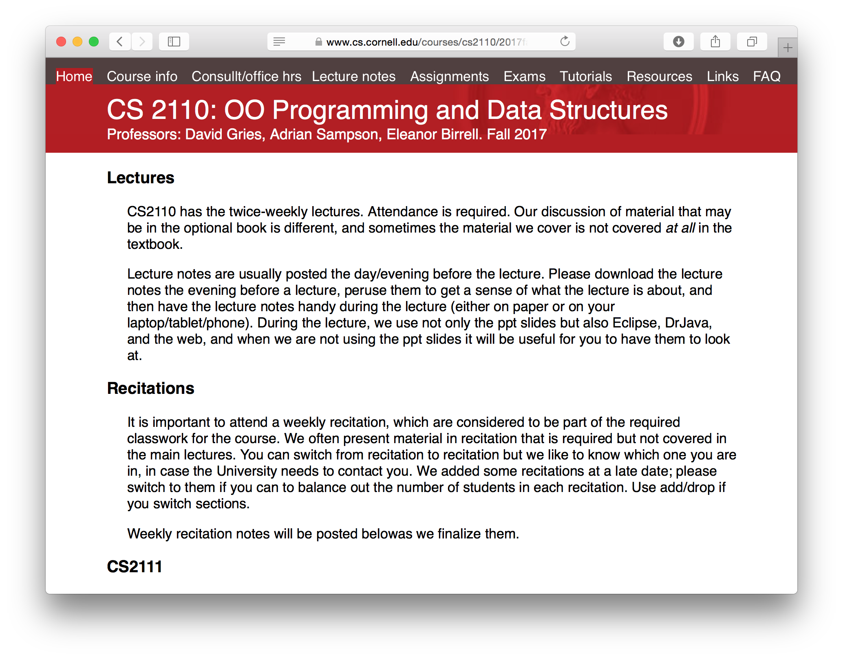
OpenSSL
struct {
HeartbeatMessageType type;
uint16 payload_length;
opaque payload[HeartbeatMessage.payload_length];
opaque padding[padding_length];
} HeartbeatMessage;

Slide 8

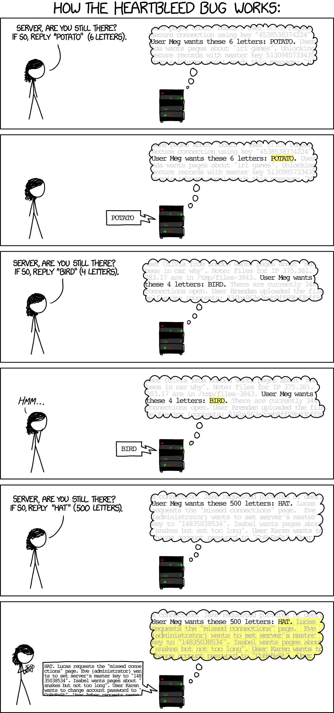
Heartbleed

Slide 9
What might go wrong
public class ObjectStore {
private Object[] objects;
public ObjectStore(int len){
objects = new Object[len];
}
public Object read(int i){
return objects[i];
}
public void store(int i, Object o){
objects[i]= o;
}
}

Slide 10
Memory
Stack
objects
ObjectStore OS = new ObjectStore(10);
...
store(12, o);
...
12
o
Ret ptr
o
Stack ptr
objects[i]= o;
exploit code
Heap
Statics
Code
0x00000000

Slide 11

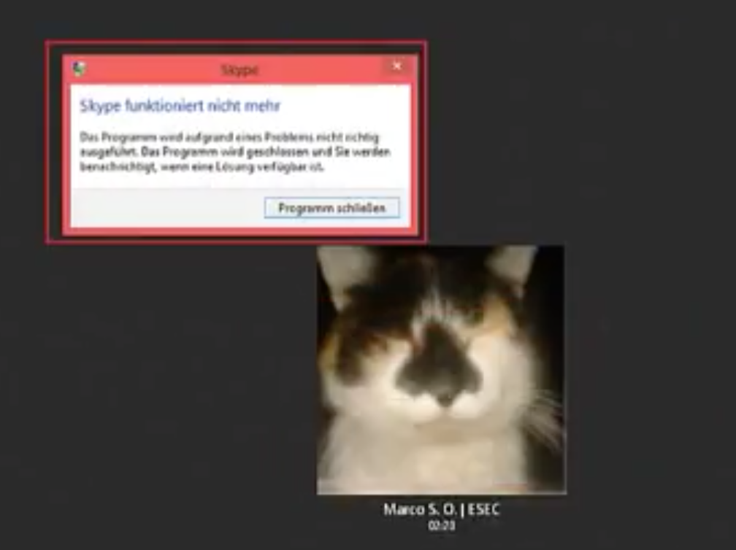
Skype Vulnerability
Notes:
May 2017
Microsoft Skype v7.2, v7.3.5 & v7.3.6 on Windows XP, 7, 8, or 10
exploits vulnerability in copy function; carefully constructed cat photo will trigger overflow, overwrite return pointer, and allow arbitrary code execution

Slide 12
What might go wrong
Thread 1
Thread 2
Initially, i = 0
tmp = load i;
Load 0 from memory
Load 0 from memory
tmp = load i;
tmp = tmp + 1;
store tmp to i;
Store 1 to memory
tmp = tmp + 1;
store tmp to i;
Store 1 to memory
time

Slide 13
Copy-on-write (COW)
Common resource optimization
When someone copies a file, it doesn't really get copies
If/when someone modifies the "copy" the original file gets copied and modified

Slide 14

Privilege Escalation
Notes:
October 2016
privilege escalation vulnerability discovered in Linux
A bug in the copy-on-write (COW) mechanism allowed any installed application to gain root level access. At a high level, the exploit works by opening a root-owned executable as read-only and memory mapping it into the user-level process’s address space. The user-level process then runs two threads: one of which repeatedly uses madvise() to tell the kernel it doesn’t intend to use that memory and one of which repeatedly overwrites some of its own memory that’s mapped to the root-owned executable. A race condition bug results in writes updating the mapping copy instead of writing to a private copy; these changes are subsequently committed by the kernel to storage. This technique can be exploited to alter a root-owned setuid binary so that it, for example, spawns a root-owned shell, allowing the user-level process to operate with root privileges.

Slide 15
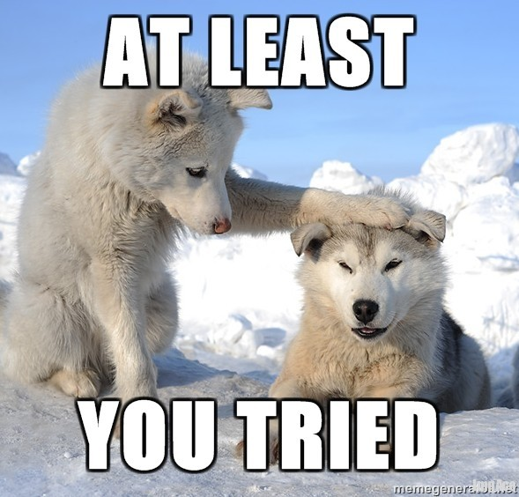


So how do we fix this?
Testing
Bug finding tools
White-hat hacking

Slide 16
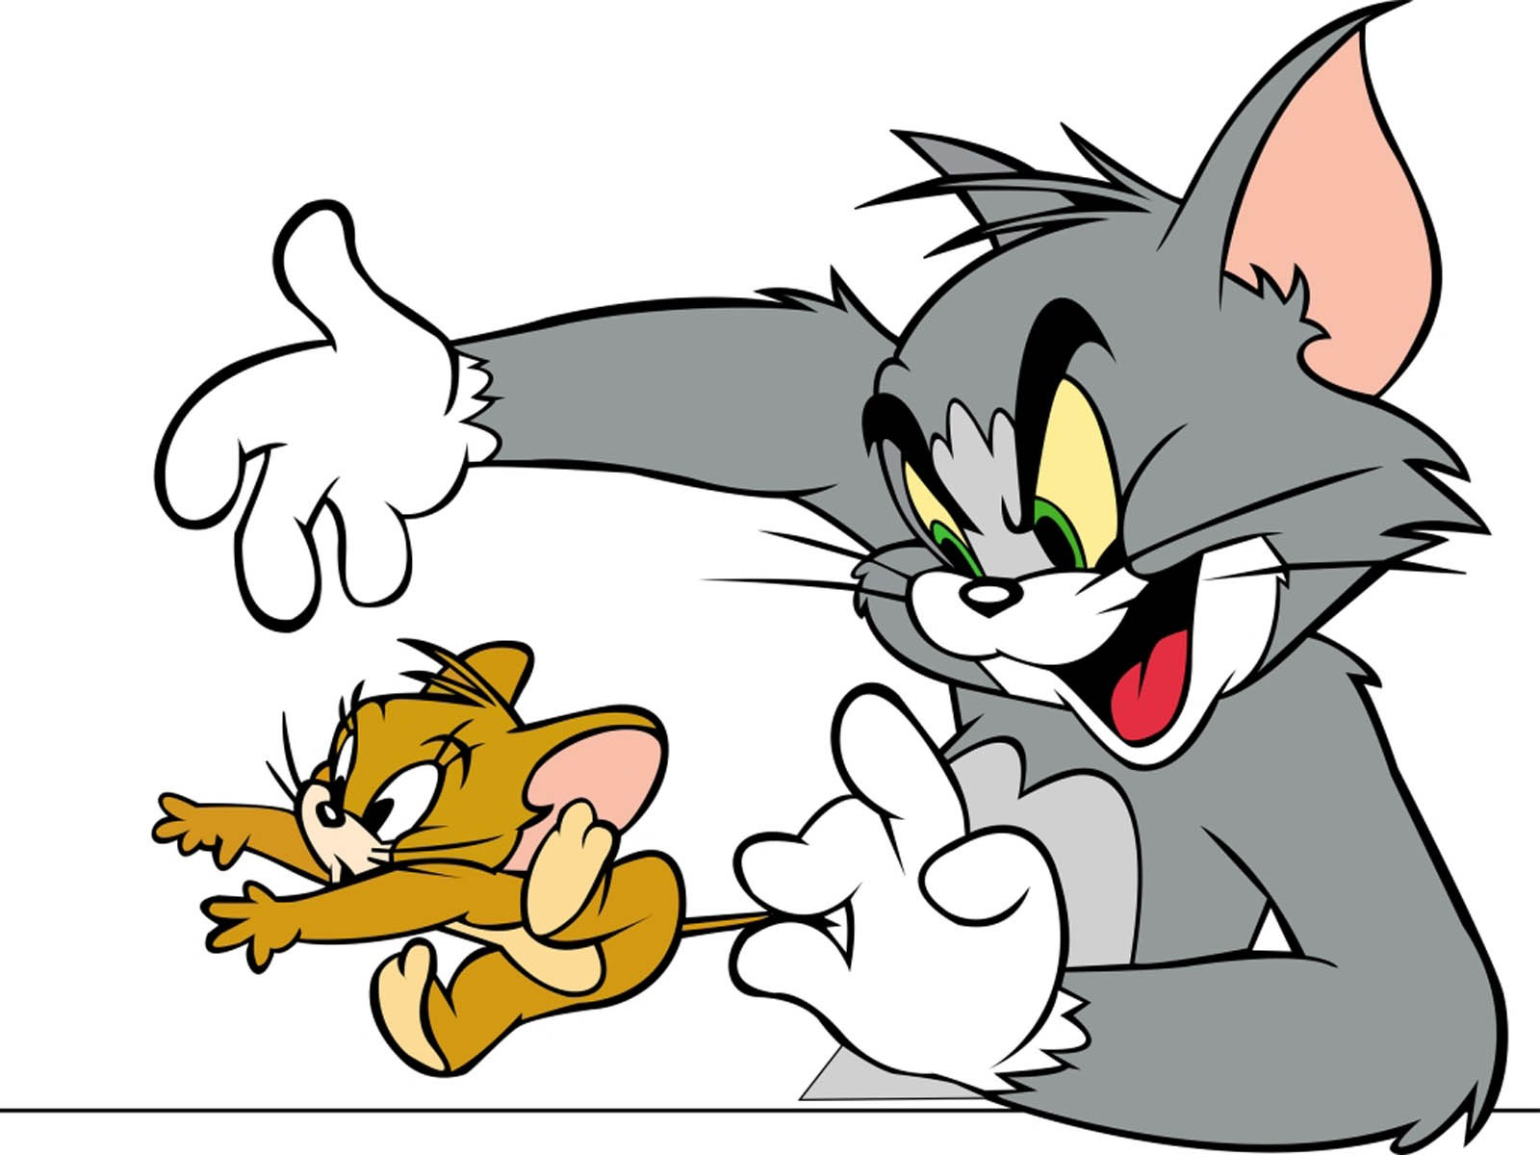

Slide 17

So how do we fix this?

Slide 18
Security by Design
Build secure, trustworthy computer systems/applications/etc.
Define what the system is supposed to do
Make sure it does that (and only that)

Slide 19
How do we specify what systems are and are not supposed to do?

Slide 20
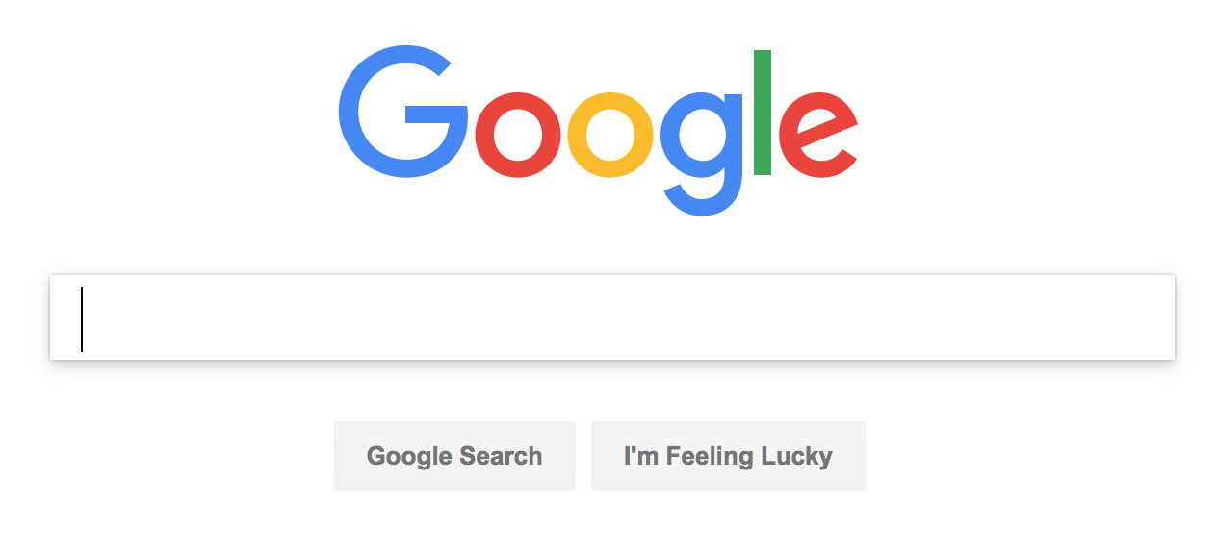
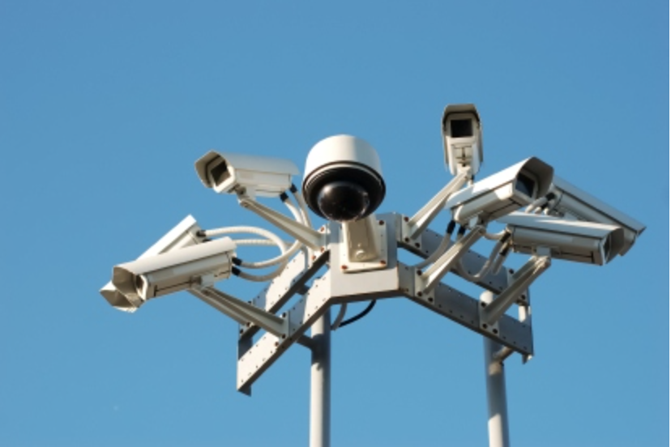
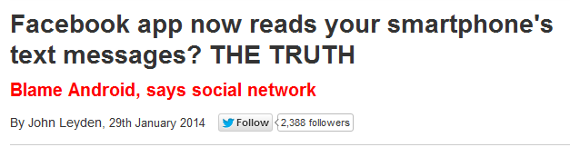
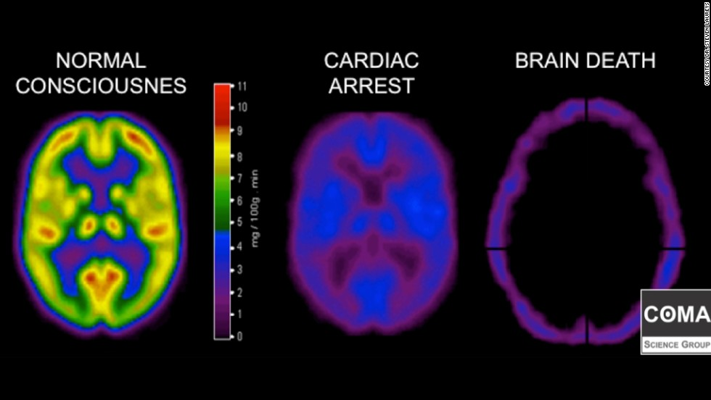
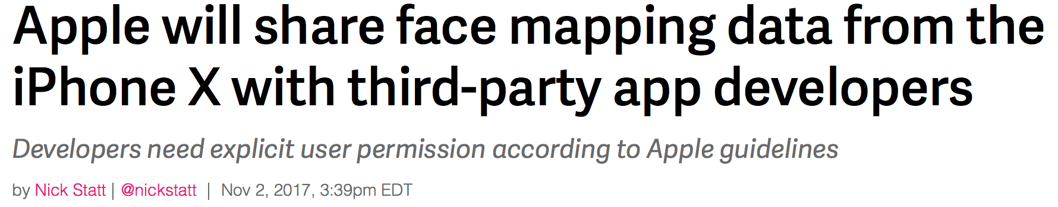

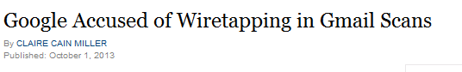
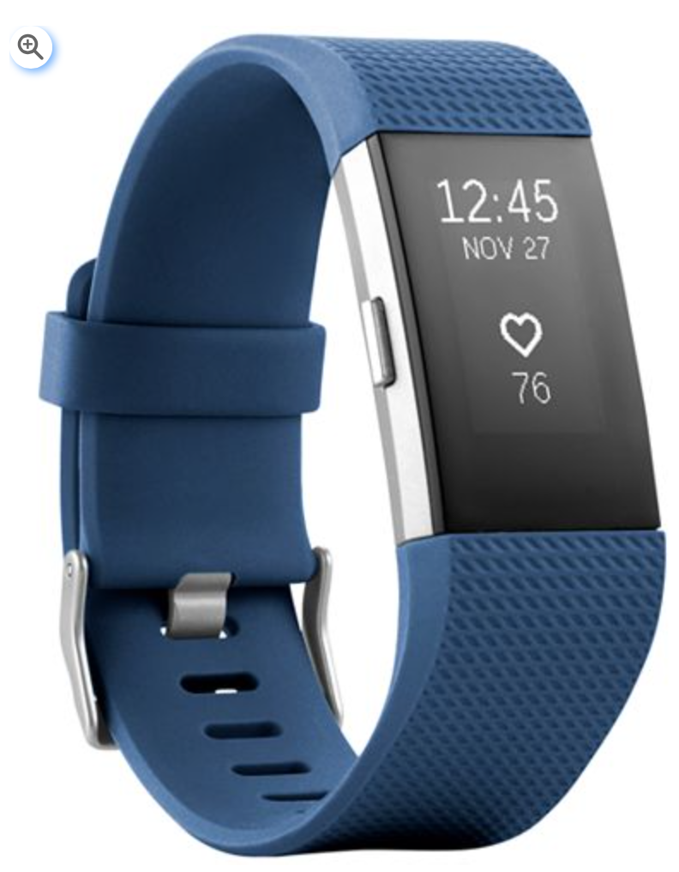
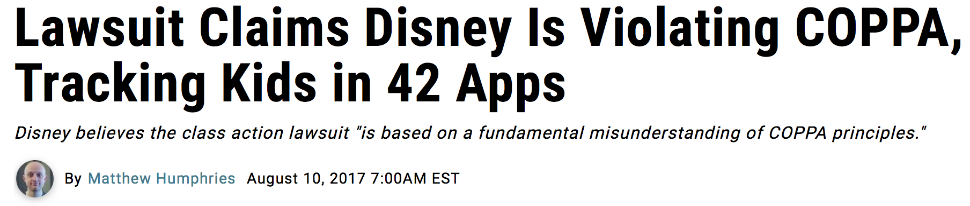
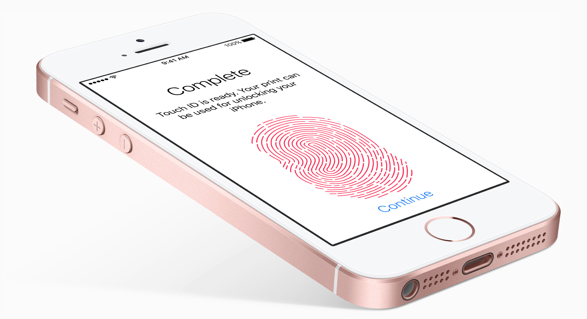
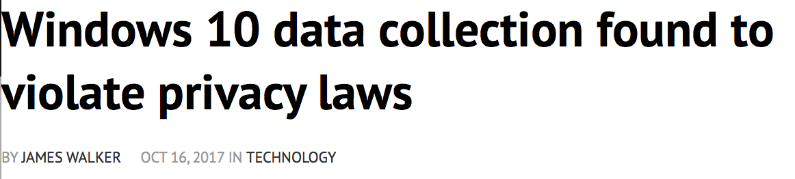


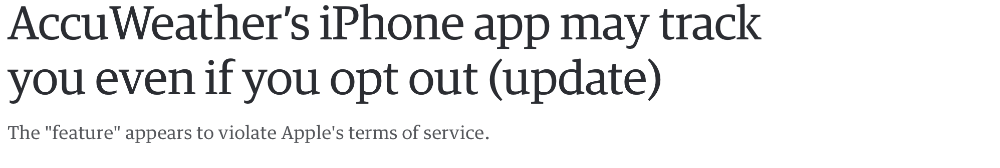
Example: Data Privacy
Notes:
Lots of data: by one estimate, 2.5 exabytes of data are produced every day
This data has lots of potential uses
the problem: what happens with the data isn’t always what you want => user’s don’t consent, legal restrictions

Slide 21

What is Privacy?
Notes:
discuss
Warren/Brandeis (right to be left alone)
Privacy as confidentiality
Nissenbaum (contextual integrity)

Slide 22
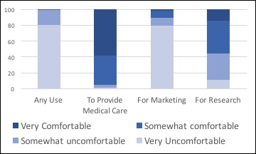
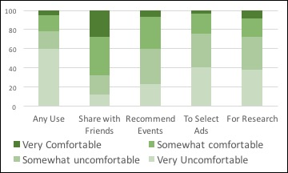
Use-Based Privacy
Privacy viewed as restrictions on uses [Cate02]
Captures modern privacy goals
  express restrictions in presence of necessary sharing
Medical Data
Social Network Data
Notes:
Then need a language for privacy policies, then need to express security goals in language

Slide 23
Policy Language
[{"curr":"1", "states":{"1":{"name":"s1-1", "permissions":{"aggregate":true}, "transitions":{"aggregate":"s2-1"}, "defaultPermission":false}, "2":{"name":"s2-1", "permissions":{"fulfill":true}, "transitions":{}, "defaultPermission":true}}}, {"curr":"2", "states":{"1":{"name":"s1-2", "permissions":{"aggregate":true}, "transitions":{"aggregate":"s2-2"}, "defaultPermission":false}, "2":{"name":"s2-2", "permissions":{"fulfill":true}, "transitions":{}, "defaultPermission":true}}}]
aggregate
fulfill
aggregate

Slide 24
How do we make systems secure?

Slide 25
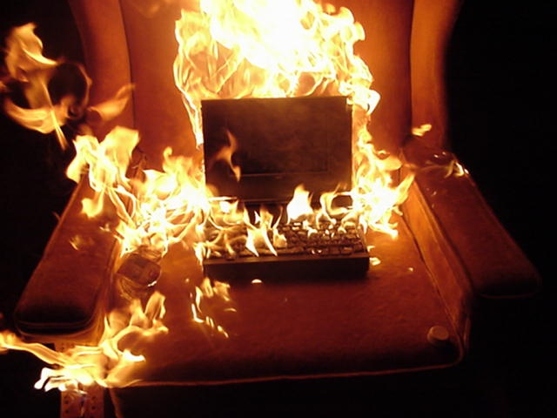
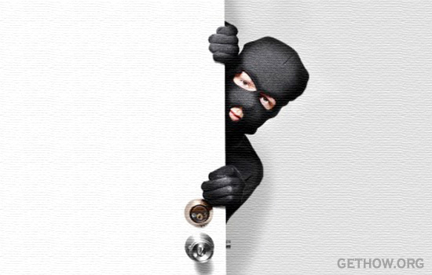

Threat Models

Slide 26
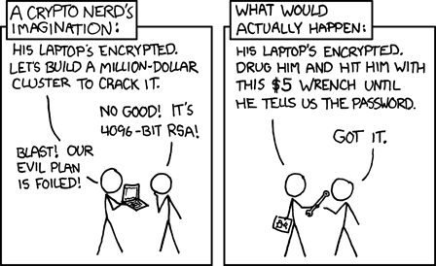
Threat Models

Slide 27
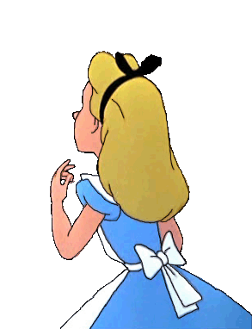



Example: Threat Model for Data Privacy
DS
Notes:
In our context, adversaries are service providers.
adversarial
accountable

Slide 28
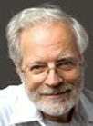
Approaches to security
  Axiomatic security
    You trust someone else to get it right

Slide 29

Approaches to security
  Axiomatic security
    You trust someone else to get it right
  Constructive security
    E.g., compiler checks, automated proofs

Slide 30
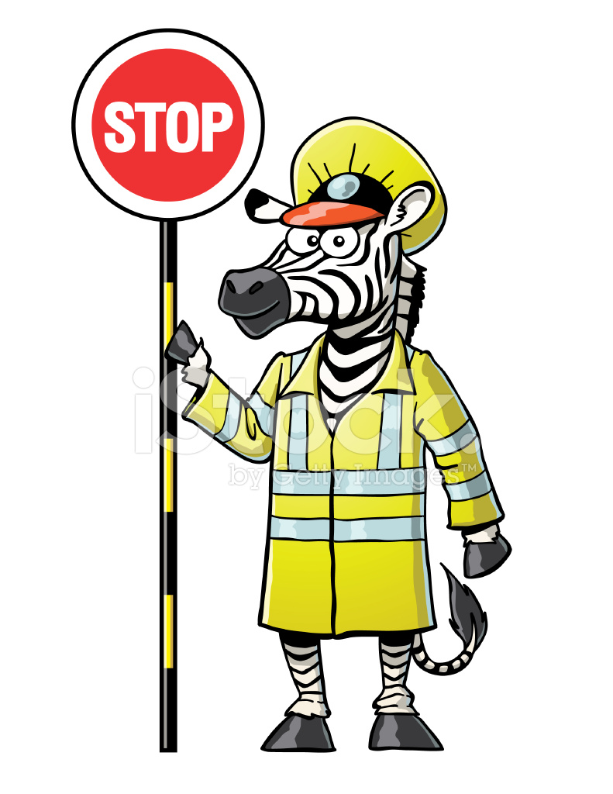
Approaches to security
  Axiomatic security
    You trust someone else to get it right
  Constructive security
    E.g., compiler checks, automated proofs
  Synthetic security
    Modify the code to add checks (e.g., monitoring)
Code
Monitor
Code

Slide 31
Approaches to security
  Axiomatic security
    You trust someone else to get it right
  Constructive security
    E.g., compiler checks, automated proofs
  Synthetic security
    Modify the code to add checks (e.g., monitoring)
  Deterrence through accountability
    Make sure you'll notice if something goes wrong

Slide 32
Example: Data Privacy from SGX
Data Source
Policy enforcement implemented by external monitor that runs on DHs
  monitor can send/receive values from DS
  monitor shares values with authorized programs co-located at DH
    auth decisions based on credentials
  unauthorized values are cryptographically sealed with associated policy to prevent authorized use
  monitor maintains taint for each program, automatically derives policies for derived values
Data Store
Agent Authenticator
Policy Store
data->pol
Data Handler
Agent
Program
Taints
pid -> pol
CredentialAuthent.
Program
Decision Engine
Program

Slide 33
Security
[{"curr":"1", "states":{"1":{"name":"s1-1", "permissions":{"aggregate":true}, "transitions":{"aggregate":"s2-1"}, "defaultPermission":false}, "2":{"name":"s2-1", "permissions":{"fulfill":true}, "transitions":{}, "defaultPermission":true}}}]

