Slide 1
CS/ENGRD 2110 Fall 2017
Lecture 6: Consequence of type, casting; function equals
http://courses.cs.cornell.edu/cs2110

Slide 2
Overview ref in JavaHyperText
Quick look at arrays array
Casting among classes cast
Operator instanceof
Function getClass
Function equals
compile-time reference rule
Homework. JavaHyperText while-loop for-loop
while ( <bool expr> ) { … } // syntax
for (int k= 0; k < 200; k= k+1) { … } // example

Slide 3
Announcements
Search Piazza for your question (before posting)!
Partner-finding event:
Tuesday, September 12 at 5:30pm
Phillips 203
There will be snacks!

Slide 4
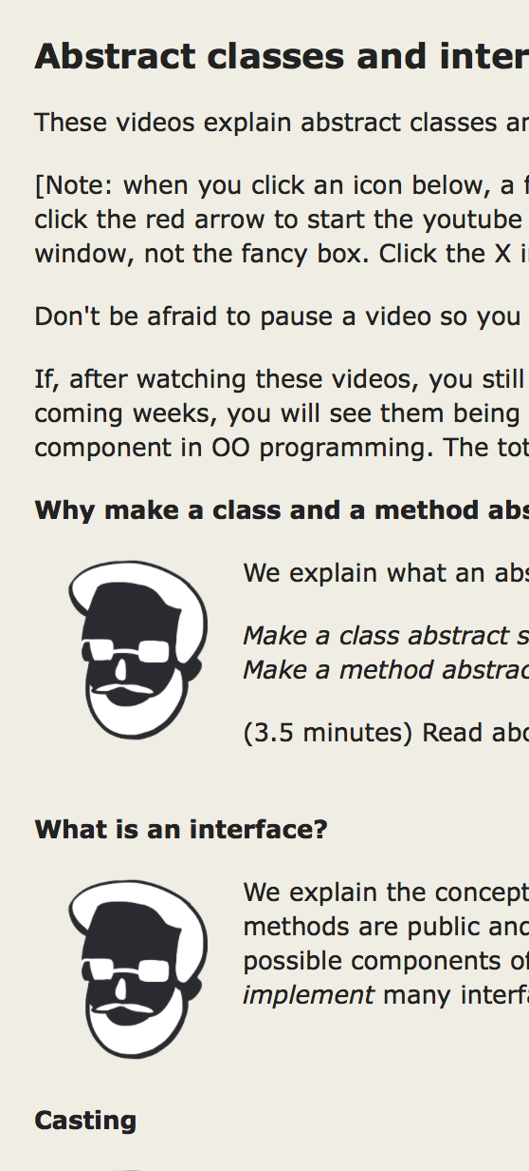
Before Next Lecture…
Follow the tutorial on abstract classes and interfaces, and watch the videos.
Click these

Slide 5
Classes we work with today
Work with a class Animal and subclasses like Cat and Dog
Put components common to animals in Animal
a0
a1
5
Animal
Animal
age
isOlder(Animal)
age
isOlder(Animal)
class hierarchy:
6
Object
Cat
getNoise() toString() getPurrs()
Dog
Animal
getNoise() toString()
Dog
Cat
Object partition is there but not shown

Slide 6
Animal[] v= new Animal[3];
declaration of array v
Create array of 3 elements
v
null
a6
Assign value of new-exp to v
a6
Animal[]
Assign and refer to elements as usual:
v[0]= new Animal(…);
…
a= v[0].getAge();
0
1
2
null
null
null
Sometimes use horizontal picture of an array:
0 1 2
v
null null null

Slide 7
Which function is called?
0 1 2
Which function is called by
v[0].toString() ?
(Remember, the hidden Object partition contains toString().)
v
a0 null a1
a0
a1
5
Animal
Animal
age
isOlder(Animal)
age
isOlder(Animal)
6
Bottom-up or overriding rule says function toString in Cat partition
Cat
toString() getNoise() getPurrs()
Dog
toString() getNoise()

Slide 8
Consequences of a class type
Animal[] v; declaration of v. Also means that each
variable v[k] is of type Animal
The type of v is Animal[]
The type of each v[k] is Animal
The type is part of the syntax/grammar of the language. Known at compile time.
0 1 2
v
a0 null a1
Animal objects
A variable’s type:
• Restricts what values it can contain.
• Determines which methods are legal to call on it.
Notes:
• For example, a variable of type Animal can hold any object with an Animal segment. So a plain Animal, a Dog, or a Cat.
• (On next slide.)

Slide 9
From an Animal variable, can use only methods available in class Animal
a.getPurrs() is obviously illegal.
The compiler will give you an error.
a
a0
Animal
a0
5
Animal
age
isOlder(Animal)
When checking legality of a call like
a.getPurrs(…)
since the type of a is Animal, method getPurrs must be declared in Animal or one of its superclasses.
Dog
getNoise() toString()
see JavaHyperText: compile-time reference rule
Notes:
The Java compiler wants to keep you *safe*. So this rule requires there to be *some* method with the right name. But it doesn't have to know *which* method will be called!

Slide 10
From an Animal variable, can use only methods available in class Animal
Suppose a0 contains an object of a subclass Cat of Animal. By the rule below, a.getPurrs(…) is still illegal.
Remember, the test for legality is done at compile time, not while the program is running.
a
a0
Animal
a0
5
Animal
age
isOlder(Animal)
When checking legality of a call like
a.getPurrs(…)
since the type of a is Animal, method getPurrs must be declared in Animal or one of its superclasses.
Cat
getNoise() toString() getPurrs()
see JavaHyperText: compile-time reference rule
Notes:
Types exist at compile time. Objects exist at run time. The compiler has NO IDEA what object you will put in what variable, except that it obeys the type rule: Animal variables hold objects with *some* Animal segment.

Slide 11
From an Animal variable, can use only methods available in class Animal
The same object a0, from the viewpoint of a Cat variable and an Animal variable
c
a0
a
a0
Cat
Animal
c.getPurrs() is legal
a.getPurrs() is illegal
because getPurrs
is not available in class Animal
a0
a0
5
Animal
age
isOlder(Animal)
5
Animal
age
isOlder(Animal)
Cat
getNoise() toString() getPurrs()
Cat
getNoise() toString() getPurrs()

Slide 12
Rule for determining legality of method call
Rule: c.m(…) is legal and the program will compile ONLY if method m is declared in C or one of its superclasses.
(JavaHyperText entry: compile-time reference rule.)
a0
Object
c
a0
C
…
m(…) must be declared in one of these classes
…
…
C

Slide 13
Another example
Type of v[0]: Animal
Should this call be allowed? Should program compile?
v[0].getPurrs()
Should this call be allowed? Should program compile?
v[k].getPurrs()
a0
a1
5
Animal
Animal
age
isOlder(Animal)
age
isOlder(Animal)
6
Cat
getNoise() toString() getPurrs()
Dog
getNoise() toString()
0 1 2
v
a0 null a1
Notes:
Again, the value of k only exists at run time! Not when you're compiling your code. So the compiler cannot *possibly* know which object you're referring to. And it just wants to keep you safe!

Slide 14
View of object based on the type
Each element v[k] is of
type Animal.
From v[k], see only what is in partition Animal and partitions above it.
getPurrs() not in class Animal or Object. Calls are illegal, program does not compile:
v[0].getPurrs() v[k].getPurrs()
a0
a1
Components are in lower partitions, but can’t see them
5
Animal
Animal
age
isOlder(Animal)
age
isOlder(Animal)
6
0 1 2
Cat
getNoise() toString() getPurrs()
Dog
getNoise() toString()
v
a0 null a1
Animal

Slide 15
Casting objects
a0
5
Animal
age
isOlder(Animal)
Object
You know about casts like:
(int) (5.0 / 7.5)
(double) 6
double d= 5; // automatic cast
Animal
Cat
getNoise() toString() getPurrs()
Dog
Cat
You can also use casts with class types:
Animal h= new Cat("N", 5);
Cat c= (Cat) h;
a1
Animal
age
isOlder(Animal)
6
Dog
A class cast doesn’t change the object. It just changes the perspective: how it is viewed!
getNoise() toString()

Slide 16
Explicit casts: unary prefix operators
Rule: At run time, an object can be cast to the name of any partition that occurs within it —and to nothing else.
a0 can be cast to Object, Animal, Cat.
An attempt to cast it to anything else causes an exception
a0
Object
equals() …
5
Animal
age
isOlder(Animal)
(Cat) c
(Object) c
(Animal) (Animal) (Cat) (Object) c
Cat
getNoise() toString() getPurrs()
These casts don’t take any time. The object does not change. It’s a change of perception.
c
a0
Cat
Notes:
And they cannot fail at run time!

Slide 17
Implicit upward cast
a0
5
Animal
age
isOlder(Animal)
public class Animal {
/** = "this Animal is older than h" */
public boolean isOlder(Animal h) {
return age > h.age; }
Cat
getNoise() toString() getPurrs()
Call c.isOlder(d)
Variable h is created. a1 is cast up to class Animal and stored in h
a1
Animal
age
isOlder(Animal)
6
Upward casts done automatically when needed
Dog
getNoise() toString()
h
a1
c
a0
d
a1
Animal
Cat
Dog

Slide 18
Example
a1
Animal
age
isOlder(Animal)
6
public class Animal {
/** = "this is older than h" */
public boolean isOlder(Animal h) {
return age > h.age; }
Dog
getNoise() toString()
Type of h is Animal. Syntactic property.
Determines at compile-time what components can be used: those available in Animal
If a method call is legal, the overriding rule determines which implementation is called
h
a1
Animal

Slide 19
Components used from h
a1
Animal
age
isOlder(Animal)
6
public class Animal {
/** = "this is older than h" */
public boolean isOlder(Animal h) {
return age > h.age; }
Dog
getNoise() toString()
h.toString() OK —it’s in class Object partition
h.isOlder(…) OK —it’s in Animal partition
h.getPurrs() ILLEGAL —not in Animal
partition or Object partition
By overriding rule, calls toString() in Dog partition
h
a1
Animal

Slide 20
Explicit downward cast
a0
5
Animal
age
isOlder(Animal)
public class Cat extends Animal { private int purrs;
/** return true iff ob is a Cat and its
* fields have same values as this */
public boolean equals(Object ob) { ? // { h is a Cat }
if ( ! super.equals(ob) ) return false;
Cat c= (Cat) ob ; // downward cast
return purrs == c.getPurrs();
}
Cat
purrs ____ getNoise() toString() getPurrs()
h
a0
Animal
(Dog) ob leads to runtime error.
Don’t try to cast an object to something that it is not!

Slide 21
Method getClass, explicit down cast
a0
5
Animal
public class Cat extends Animal { private int purrs;
/** return true iff ob is a Cat and its
* fields have same values as this */
public boolean equals(Object ob) {
if ( ob.getClass() != getClass() ) return false;
// { h is a Cat }
if ( ! super.equals(ob) ) return false;
Cat c= (Cat) ob ; // downward cast
return purrs == c.getPurrs();
}
age
isOlder(Animal)
Cat
purrs _____ getNoise() toString() getPurrs()
h
a0
Animal
<object>.getClass() == <class-name>.class
true iff <object>’s bottom partition is <class-name>

Slide 22
A complete implementation of equals
a0
5
Animal
public class Cat extends Animal { private int purrs;
/** return true iff ob is a Cat and its
* fields have same values as this */
public boolean equals(Object ob) {
if ( ob == null || ob.getClass() != getClass() ) return false;
// { h is a Cat }
if ( ! super.equals(ob) ) return false;
Cat c= (Cat) ob ; // downward cast
return purrs == c.getPurrs();
}
age
isOlder(Animal)
Cat
purrs _____ getNoise() toString() getPurrs()
h
a0
Animal
Check whether ob is null before calling getClass.

Slide 23
Operator instanceof
a0
5
Animal
// Both are true.
if ( a0 instanceof Cat ) …
if ( a0 instanceof Animal ) …
// Only the first is true.
if ( a0.getClass() == Cat.class ) …
if ( a0.getClass() == Animal.class ) …
age
isOlder(Animal)
Cat
purrs _____ getNoise() toString() getPurrs()
h
a0
Animal
<object> instanceof <class-name>
true iff <object> has a partition for <class-name>

Slide 24
Opinions about casting
Use of instanceof and downcasts can indicate bad design
DON’T:
if (x instanceof C1)
do thing with (C1) x
else if (x instanceof C2)
do thing with (C2) x
else if (x instanceof C3)
do thing with (C3) x
DO:
x.do()
… where do is overridden in the classes C1, C2, C3
But how do I implement equals() ?
That requires casting!

