Slide 1
User-Oriented Language Design
CS 2110 – Spring 2016

Slide 2
Decidability

Slide 3
Wildcards
public Variable {
boolean value;
/** Add this to the list corresponding to value */
public void addTo(
List<? super Variable> trues,
List<? super Variable> falses) {
(value ? trues : falses).add(this);
}
}

Slide 4
Subtyping
Contrived
class C〈P〉 extends D〈D〈? super C〈L〈P〉〉〉〉 {}
C〈X〉 <: D〈? super C〈X〉〉
D〈D〈? super C〈L〈X〉〉〉〉 <: D〈? super C〈X〉〉
C〈X〉 <: D〈? super C〈L〈X〉〉〉
D〈D〈? super C〈L〈X〉〉〉〉 <: D〈? super C〈L〈X〉〉〉
C〈L〈X〉〉 <: D〈? super C〈L〈X〉〉〉
Inheritance
Infinite Proof
of Subtyping
Instantiation
Inheritance
Instantiation

Slide 5
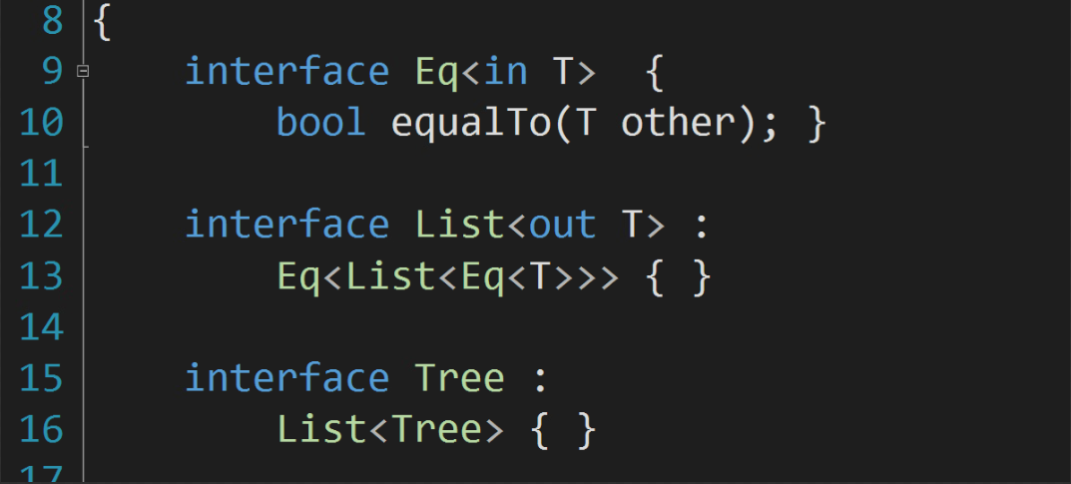
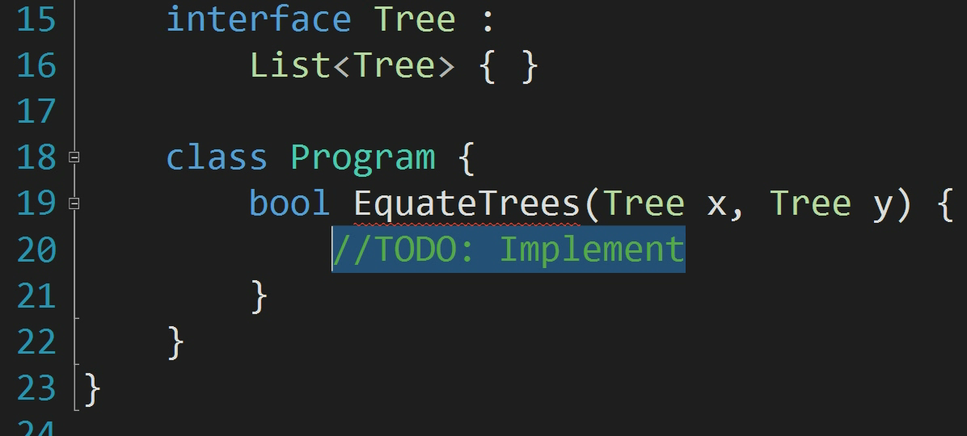
Efficiency
Notes:
(1) 5:30

Slide 6
Restrictions
Termination Guaranteed
Contrived
Inheritance Restriction
  No use of ? super in the inheritance hierarchy
Parameter Restriction
  When constraining type parameters,
  ? super may only be used at covariant locations
class C〈P〉 extends D〈D〈? super C〈L〈P〉〉〉〉 {}
Contrived
〈P extends List〈List〈? super C〈L〈P〉〉〉〉〉

Slide 7
Survey
No Violations of
Our Restrictions
9.2 Million Lines of Code Analyzed
Wildcards in Inheritance
Wildcards in Constraints
1000
10000
100000
0
Only Unconstrained
Wildcards

# of Superclass
Declarations

All at covariant locations

Slide 8






Industry Collaborations
at
on
Gavin King
at
on
Andrey Breslav

Slide 9
Materials and Shapes
Material
  List, Integer, Property, Comparator
Shape
  Comparable, Summable, Cloneable
No class/interface is both
a material and a shape
13.5 Million Lines of Code Analyzed

Slide 10
Programmers are Humans

Slide 11
Library Designer
Want to provide a “separate” function
  Inputs: middle, elems, smaller, bigger
  Requirements:
    Place all values in elems less than middle into smaller
    Place all other values in elems into bigger
Goals
  Implement separate
  Provide maximally flexible type signature

Slide 12
Library User
Goal
  Place nonnegative values in “ints” into “positives”
Context
  “ignore” throws away all elements added to it
Implementation
  separate(0, ints, ignore, positives);

Slide 13
User Types
ints : Iterable<Integer>
  You can get things from iterables
positives : Collection<Integer>
  You can add things to collections
ignore : Collection<Object>
  You can add anything to it
Integer implements Comparable<Number>
  integers can be compared with any number

Slide 14
Library Implementation
void separate(middle,
elems,
smaller,
bigger) {
foreach (elem in elems)
(elem < middle ? smaller : bigger)
.add(elem);
}

Slide 15
Library Type
<T extends Comparable<T>>
void separate(T middle,
Iterable<T> elems,
Collection<T> smaller,
Collection<T> bigger) {
foreach (elem in elems)
(elem < middle ? smaller : bigger)
.add(elem);
}

Slide 16
Insufficient Flexibility
Formals
<T extends Comparable<T>>
void separate(T middle,
Iterable<T> elems,
Collection<T> smaller,
Collection<T> bigger)
Actuals
Integer
0
ints
ignore
positives




Slide 17
Wildcards
<T extends Comparable<? super T>>
void separate(T middle,
Iterable<? extends T> elems,
Collection<? super T> smaller,
Collection<? super T> bigger) {
foreach (elem in elems)
(elem < middle ? smaller : bigger)
.add(elem);
}

Slide 18
Excessive Annotations
<T>
void flatten(
Iterable<? extends Iterable<? extends T>> colls,
Collection<? super T> into) {
for (Iterable<? extends T> coll : colls)
for (T elem : coll)
into.add(elem);
}

Slide 19
Declaration-Site Variance
<T extends Comparable<T>>
void separate(T middle,
Iterable<T> elems,
Collection<T> smaller,
Collection<T> bigger) {
foreach (elem in elems)
(elem < middle ? smaller : bigger)
.add(elem);
}

Slide 20
Insufficient Flexibility
Formals
<T extends Comparable<T>>
void separate(T middle,
Iterable<T> elems,
Collection<T> smaller,
Collection<T> bigger)
Actuals
Integer
0
ints
ignore
positives





Slide 21
Declaration-Site Variance Retry
<T extends Comparable<T>,
U super T, V super T>
void separate(T middle,
Iterable<T> elems,
Collection<U> smaller,
Collection<V> bigger) {
foreach (elem in elems)
(elem < middle ? smaller : bigger)
.add(elem);
}

Slide 22
Mixed-Site Variance
<T extends Comparable<T>>
void separate(T middle,
Iterable<T> elems,
Collection<in T> smaller,
Collection<in T> bigger) {
foreach (elem in elems)
(elem < middle ? smaller : bigger)
.add(elem);
}

Slide 23
Use+Declaration-Site
The two address orthogonal roles
  declaration-site for class/interface designers
  use-site for class/interface users
How do the two interact?
  given interface Iterator<out T> {…}
  what does Iterator<in Number> mean?

Slide 24
Expectations vs. Designs
 | Java | Scala | Default | Layer | Join | Mixed
Has declaration-site variance
C<𝛕> <: C<out 𝛕>
C<out 𝛕> <: C<out 𝛕’> implies 𝛕 <: 𝛕’
instance of C<out τ> is instance of C<τ’> for some τ’ <: τ
instance of C<out τ> allocated as C<τ’> for some τ’ <: τ
C<in τ out τ’> is expressible
C<in τ out τ> is valid implies C<τ> is valid
Out<in τ> is valid
implicit constraints used in subtyping

Slide 25
Principal Types

Slide 26
Principal Type
The principal type of an expression
  a type for that expression that is better than all other types for that expression
“Hello” has principal type String
  “Hello” also has type Object, CharSequence, …
  String is a subtype of all those types
A language has principal types
  if every possible expression has a principal type

Slide 27
Java
assertEquals(5, Integer.valueOf(5))
  ambiguous!
  Is it two ints or two Integers?
But the expression 5 is also an Integer
And Integer.valueOf(5) is also an int
Neither expression has a principal type

Slide 28
Ambiguous Semantics
〈P〉 List〈P〉 singleton(P elem) {return null;}
〈Q extends Comparable〈?〉〉 Q foo(List〈? super Q〉 list)
{return null;}
String typeName(Comparable〈?〉 c) {return “Comparable”;}
String typeName(String s) {return “String”;}
String typeName(Integer i) {return “Integer”;}
String typeName(Calendar c) {return “Calendar”;}
String ambiguous(boolean b) {
return typeName(foo(singleton(b ? “Blah” : 1)));
}
“Comparable”

javac
“String”

Smith & Cartwright
“Integer”

Socrates
P ↦ Object
“Calendar”

Q ↦ Calendar

Slide 29
Use-Site Inferability Check
〈T〉 List〈T〉 singletonList(T) {...}
var objs = singletonList(“Hello”);
objs.add(5);
  fails to type check
  objs is inferred to be an List〈String〉
  needs to be an List〈Object〉

Slide 30
Declaration-Site Inferability
〈T〉 List〈T〉 singletonList(T)
  T is not inferable because Array is invariant
  singletonList(“Hello”)
    could have type List〈String〉 or List〈Object〉
    no principal type
〈T〉 Iterable〈? extends T〉 singletonIterable(T)
  T is inferable because ? extends is covariant
  singletonIterable(“Hello”)
    has type Iterable〈? extends String〉
    which is subtype of Iterable〈? extends Object〉

Slide 31
Gradual Types

Slide 32
Goal
Mix static and dynamic type systems
  e.g. Java with JavaScript
Requirements
  no implicit insertions of wrappers
  dynamic code is just static code minus types
  stripping types preserves or improves semantics
  static code can assume type annotations are true

Slide 33
C#’s dynamic Type
bool Equal(object left, object right) {
return left == right;
}
Equal(0, 0) returns false

Slide 34
C#’s dynamic Type
interface Getter〈T〉 { T get(); }
class Five : Getter〈int〉, Getter〈string〉 {
int Getter〈int〉.get()
{ return 5; }
double Getter〈string〉.get()
{ return 5.0; }
}
void Print(Getter〈int〉 getter) { Console.WriteLine(getter.get());
}
Crashes if changed to dynamic!

Slide 35
C#’s dynamic Type
List〈T〉 Snoc〈T〉(IEnumerable〈T〉 start,
T end) {
var elems = ToList(start);
elems.add(end);
return elems;
}
Snoc(Singleton(“Hello”), 5) works
Crashes if made dynamic!

Slide 36
Prerequisite Language Properties
Static Behavioral Subtyping
  Using a more precise type for a subexpression
  improves the typability of the whole expression
Decidability
  Typing must be reliably doable at run time
Principality
  Every execution has a most precise typing

