Slide 1
Shortest Paths Readings? Chapter 28
Lecture 20
CS2110 – Spring 2016

Slide 2
About A6
We give you class ArrayHeaps for a reason:
It shows the simplest way to write methods like bubble-up and bubble-down. It gives you a method to get the smaller child.
You can write A6 most easily by adapting the ArrayHeap methods to work in the new environment! Doing the assignment without looking at ArrayHeap makes it MUCH harder!
Look at all the notes in the pinned Piazza note A6 FAQ before beginning —and then every other day to see whether new info has been added.

Slide 3
Shortest Paths in Graphs
Problem of finding shortest (min-cost) path in a graph occurs often
Find shortest route between Ithaca and West Lafayette, IN
Result depends on notion of cost
Least mileage… or least time… or cheapest
Perhaps, expends the least power in the butterfly while flying fastest
Many “costs” can be represented as edge weights
Every time you use googlemaps or the GPS system on your smartphone to find directions you are using a shortest-path algorithm

Slide 4
Dijkstra’s shortest-path algorithm
4
Edsger Dijkstra, in an interview in 2010 (CACM):
… the algorithm for the shortest path, which I designed in about 20 minutes. One morning I was shopping in Amsterdam with my young fiance, and tired, we sat down on the cafe terrace to drink a cup of coffee, and I was just thinking about whether I could do this, and I then designed the algorithm for the shortest path. As I said, it was a 20-minute invention. [Took place in 1956]
Dijkstra, E.W. A note on two problems in Connexion with graphs. Numerische Mathematik 1, 269–271 (1959).
Visit http://www.dijkstrascry.com for all sorts of information on Dijkstra and his contributions. As a historical record, this is a gold mine.
Notes:
Here’s a bit of history about Dijkstra’s shortest path algorithm.
Dijkstra was 26 at the time. Dijkstra died of cancer at the age of 72.
His wife, Ria, the young fiance he mentions, died three years ago, in October 2012.

Slide 5
Dijkstra’s shortest-path algorithm
5
Dijsktra describes the algorithm in English:
When he designed it in 1956 (he was 26 years old), most people were programming in assembly language!
Only one high-level language: Fortran, developed by John Backus at IBM and not quite finished.
No theory of order-of-execution time —topic yet to be developed. In paper, Dijkstra says, “my solution is preferred to another one … “the amount of work to be done seems considerably less.”
Dijkstra, E.W. A note on two problems in Connexion with graphs. Numerische Mathematik 1, 269–271 (1959).
Notes:
Gries had only one course on programming or computer science: a course in 1959 on an assembly language for a fake computer. We, too, could not test our program! There were about 20 students in the course, so the professor didn’t have TOO much grading to do –no TAs. After graduating in June 1960, he worked for two years for the US Naval Weapons Lab (as a civilian), as a mathemataician-programmer. He was taught Fortran in 1 week, and then started programming in both Fortran and the IBM 7090 assembly language.

Slide 6
1968 NATO Conference on Software Engineering, Garmisch, Germany
6
Dijkstra
Gries
Term “software engineering” coined for this conference
Notes:
Gries had only one course on programming or computer science: a course in 1959 on an assembly language for a fake computer. We, too, could not test our program! There were about 20 students in the course, so the professor didn’t have TOO much grading to do –no TAs. After graduating in June 1960, he worked for two years for the US Naval Weapons Lab (as a civilian), as a mathemataician-programmer. He was taught Fortran in 1 week, and then started programming in both Fortran and the IBM 7090 assembly language.

Slide 7
1968 NATO Conference on Software Engineering
In Garmisch, Germany
Academicians and industry people attended
For first time, people admitted they did not know what they were doing when developing/testing software. Concepts, methodologies, tools were inadequate, missing
The term software engineering was born at this conference.
The NATO Software Engineering Conferences:
http://homepages.cs.ncl.ac.uk/brian.randell/NATO/index.html
Get a good sense of the times by reading these reports!

Slide 8
1968 NATO Conference on Software Engineering, Garmisch, Germany
8
Notes:
Gries had only one course on programming or computer science: a course in 1959 on an assembly language for a fake computer. We, too, could not test our program! There were about 20 students in the course, so the professor didn’t have TOO much grading to do –no TAs. After graduating in June 1960, he worked for two years for the US Naval Weapons Lab (as a civilian), as a mathemataician-programmer. He was taught Fortran in 1 week, and then started programming in both Fortran and the IBM 7090 assembly language.

Slide 9
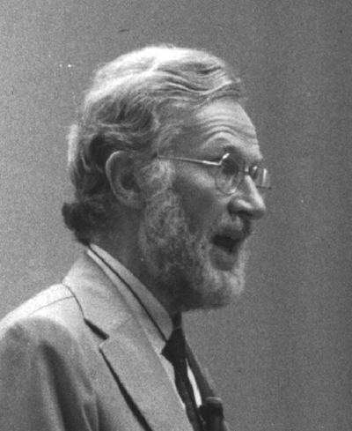
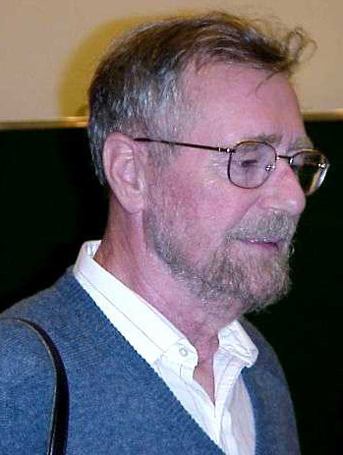
1968/69 NATO Conferences on Software Engineering
Beards
The reason why some people grow
aggressive tufts of facial hair
Is that they do not like to show
the chin that isn't there.
a grook by Piet Hein
Editors of the proceedings
Edsger Dijkstra Niklaus Wirth Tony Hoare David Gries
9

Slide 10
From Gries to Tate
Googlemaps: find a route from Gries’s to Tate’s house.
Gives two routes
12 minutes, 7.3 miles
15 minutes, 6.6 miles

Slide 11
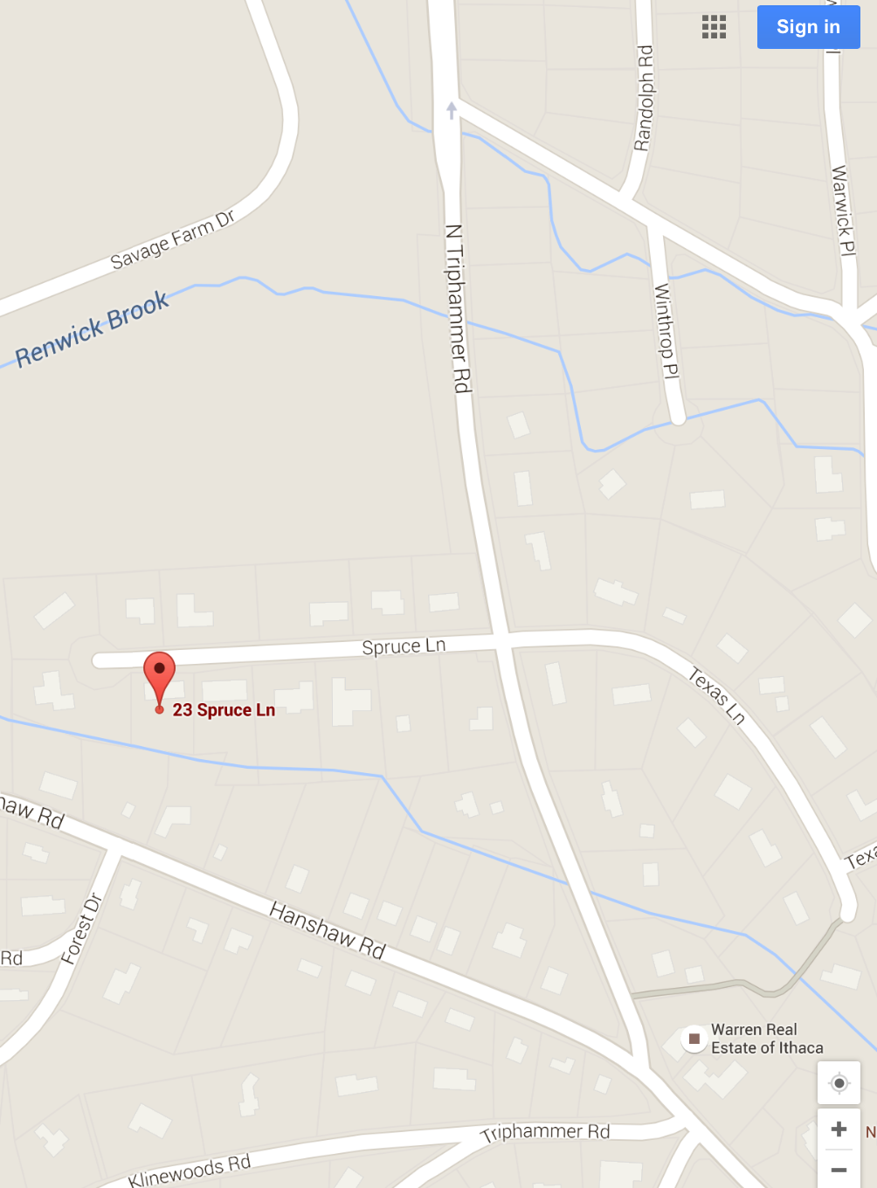
Shortest path?
Each intersection is a node of the graph, and each road between two intersections has a weight
distance?
time to traverse?
…

Slide 12
Shortest path?
Fan out from the start node (kind of breadth-first search)
Settled set: Nodes whose shortest distance is known.
Frontier set: Nodes seen at least once but shortest distance not yet known

Slide 13
Shortest path?
Settled set: we know their shortest paths
Frontier set: We know some but not all information
Each iteration:
1. Move to the Settled set: a Frontier node with shortest distance from start node.
2. Add neighbors of the new Settled node to the Frontier set.

Slide 14
Shortest path?
Fan out from the start node (kind of breadth-first search). Start:
Settled set:
Frontier set:
1. Move to Settled set the Frontier node with shortest distance from start

Slide 15
Shortest path?
Fan out from start node. Recording shortest distance from start seen so far
Settled set:
Frontier set:
1
2
1
2
2. Add neighbors of new Settled node to Frontier

Slide 16
Shortest path?
Fan out from start node. Recording shortest distance from start seen so far
Settled set:
Frontier set:
1
1
2
1
1
2
1. Move to Settled set a Frontier node with shortest distance from start

Slide 17
Shortest path?
Fan out from start node. Recording shortest distance from start seen so far
Settled set:
Frontier set:
1
2
1
2
2. Add neighbors of new Settled node to Frontier (there are none)

Slide 18
Shortest path?
Fan out from start, recording shortest distance seen so far
Settled set:
Frontier set:
1
2
2
1
2
2
1. Move to Settled set a Frontier node with shortest distance from start

Slide 19
Shortest path?
Fan out from start, recording shortest distance seen so far
Settled set:
Frontier set:
1
2
2
1
2
2. Add neighbors of new Settled node to Frontier

Slide 20
Shortest path?
3
Fan out from start, recording shortest distance seen so far
Settled set:
Frontier set:
1
2
5
1
2
3
4
5
1. Move to Settled set a Frontier node with shortest distance tfrom start
4
5
5

Slide 21
Shortest path?
3
Fan out from start, recording shortest distance seen so far
Settled set:
Frontier set:
1
2
5
1
2
7
3
4
6
7
1. Add neighbors of new Settled node to Frontier
4
5
5
6

Slide 22
Dijkstra’s shortest path algorithm
The n (> 0) nodes of a graph numbered 0..n-1.
Each edge has a positive weight.
wgt(v1, v2) is the weight of the edge from node v1 to v2.
Some node v be selected as the start node.
Calculate length of shortest path from v to each node.
Use an array L[0..n-1]: for each node w, store in L[w] the length of the shortest path from v to w.
L[0] = 2
L[1] = 5
L[2] = 6
L[3] = 7
L[4] = 0
0
2
4
2
v
3
3
4
1
4
3
1
Notes:
This will be a high-level description, not mentioning what the graph representation is.

Slide 23
Dijkstra’s shortest path algorithm
Develop algorithm, not just present it.
Need to show you the state of affairs —the relation among all variables— just before each node i is given its final value L[i].
This relation among the variables is an invariant, because it is always true.
Each node i (except the first) is given its final value L[i] during an iteration of a loop, so the invariant is called a loop invariant.
L[0] = 2
L[1] = 5
L[2] = 6
L[3] = 7
L[4] = 0
Notes:
Showing an algorithm and then presenting its correctness proof is not as compelling
as showing the development of program and proof hand-in-hand, with the proof ideas
leading the way. If possible, one should show how to develop the invariant from the pre-
and post-conditions, but that is not always possible. Here, we describe the loop
invariant first, not saying how it came about.

Slide 24
The loop invariant
Settled
S
Frontier
F
Far off
(edges leaving the Far off set and edges from the Frontier to the Settled set are not shown)
f
1. For a Settled node s, L[s] is length of shortest v → s path.
2. All edges leaving S go to F.
3. For a Frontier node f, L[f] is length of shortest v → f path
using only red nodes (except for f)
f
0
2
4
2
v
3
3
4
1
4
3
1
Notes:
Settled node information is always in red, Frontier information in blue, and Far off info in black.

Slide 25
Settled
S
Frontier
F
Far off
Theorem about the invariant
g
v
f
L[g] ≥ L[f]
f
g
1. For a Settled node s, L[s] is length of shortest v → r path.
2. All edges leaving S go to F.
3. For a Frontier node f, L[f] is length of shortest v → f path
using only Settled nodes (except for f).
Theorem. For a node f in F with minimum L value (over nodes in F), L[f] is the length of a shortest path from v to f.
Case 1: v is in S.
Case 2: v is in F. Note that L[v] is 0; it has minimum L value
Notes:
Note that the theorem is proved not in terms of executing things but in terms of a state of affairs.
This makes it easier to state and to prove.
The case v is in F is here only to make the algorithm a bit shorter. We could start with v in S, but that
would require more work in order to truthify the invariant later on.

Slide 26
The algorithm
S= { }; F= { v }; L[v]= 0;
S F Far off
v
1. For s, L[s] is length of
shortest v→ s path.
2. Edges leaving S go to F.
3. For f, L[f] is length of
shortest v → f path using
red nodes (except for f).
Theorem: For a node f in F
with min L value, L[f] is
shortest path length
Loopy question 1:
How does the loop start? What is done to truthify the invariant?
Notes:
To truthify invariant initially, set all L values to infinity and L[v] to 0.
Then make F contain v and s empty. It is easy to see that each part of the invariant is true.

Slide 27
The algorithm
S= { }; F= { v }; L[v]= 0;
S F Far off
while {
}
F ≠ {}
1. For s, L[s] is length of
shortest v → s path.
2. Edges leaving S go to F.
3. For f, L[f] is length of
shortest v → f path using
red nodes (except for f).
Theorem: For a node f in F
with min L value, L[f] is
shortest path length
Loopy question 2:
When does loop stop? When is array L completely calculated?
Notes:
The loop can stop when l is empty. Then, v has to be in S, there are no edges leaving S, so all nodes are in S.

Slide 28
The algorithm
S= { }; F= { v }; L[v]= 0;
S F Far off
while {
}
F ≠ {}
f= node in F with min L value; Remove f from F, add it to S;
f
f
1. For s, L[s] is length of
shortest v → s path.
2. Edges leaving S go to F.
3. For f, L[f] is length of
shortest v → f path using
red nodes (except for f).
Theorem: For a node f in F
with min L value, L[f] is
shortest path length
Loopy question 3: Progress toward termination?
Notes:
To make progress add a node to the settled set. The theorem tells us which one to add.
Note that moving f to S may gives new branches to both F and Far Off. Something must
Be done to truthify the invariant.

Slide 29
The algorithm
S= { }; F= { v }; L[v]= 0;
S F Far off
while {
}
F ≠ {}
w
f= node in F with min L value; Remove f from F, add it to S;
f
w
1. For s, L[s] is length of
shortest v → s path.
for each edge (f, w) {
}
if (w not in S or F) {
} else {
}
2. Edges leaving S go to F.
3. For f, L[f] is length of
shortest v → f path using
red nodes (except for f).
Theorem: For a node f in F
with min L value, L[f] is
shortest path length
Loopy question 4: Maintain invariant?
Notes:
To make progress add a node to the settled set. The theorem tells us which one to add.
Note that moving f to S may gives new branches to both F and Far Off. Something must
Be done to truthify the invariant.

Slide 30
The algorithm
S= { }; F= { v }; L[v]= 0;
S F Far off
while {
}
F ≠ {}
w
f= node in F with min L value; Remove f from F, add it to S;
f
w
w
1. For s, L[s] is length of
shortest v → s path.
for each edge (f, w) {
}
if (w not in S or F) {
L[w]= L[f] + wgt(f, w);
add w to F;
} else {
}
2. Edges leaving S go to F.
3. For f, L[f] is length of
shortest v → f path using
red nodes (except for f).
Theorem: For a node f in F
with min L value, L[f] is
shortest path length
Loopy question 4: Maintain invariant?
Notes:
To make progress add a node to the settled set. The theorem tells us which one to add.
Note that moving f to S may gives new branches to both F and Far Off. Something must
Be done to truthify the invariant.

Slide 31
The algorithm
S= { }; F= { v }; L[v]= 0;
S F Far off
while {
}
F ≠ {}
w
f= node in F with min L value; Remove f from F, add it to S;
f
w
1. For s, L[s] is length of
shortest v → s path.
for each edge (f, w) {
}
if (w not in S or F) {
L[w]= L[f] + wgt(f, w);
add w to F;
} else {
}
2. Edges leaving S go to F.
3. For f, L[f] is length of
shortest v → f path using
red nodes (except for f).
if (L[f] + wgt (f,w) < L[w])
L[w]= L[f] + wgt(f, w);
Theorem: For a node f in F
with min L value, L[f] is
shortest path length
Loopy question 4: Maintain invariant?
Notes:
To make progress add a node to the settled set. The theorem tells us which one to add.
Note that moving f to S may gives new branches to both F and Far Off. Something must
Be done to truthify the invariant.

Slide 32
The algorithm
S= { }; F= { v }; L[v]= 0;
S F Far off
while {
}
F ≠ {}
f= node in F with min L value; Remove f from F, add it to S;
1. For s, L[s] is length of
shortest v → s path.
for each edge (f, w) {
}
if (w not in S or F) {
L[w]= L[f] + wgt(f, w);
add w to F;
} else {
}
2. Edges leaving S go to F.
3. For f, L[f] is length of
shortest v → f path using
red nodes (except for f).
if (L[f] + wgt (f,w) < L[w])
L[w]= L[f] + wgt(f, w);
Theorem: For a node f in F
with min L value, L[f] is
shortest path length
Algorithm is finished!
Notes:
To make progress add a node to the settled set. The theorem tells us which one to add.
Note that moving f to S may gives new branches to both F and Far Off. Something must
Be done to truthify the invariant.

Slide 33
S F Far off
Implement F using a min-heap, priorities are L-values
S= { }; F= { v }; L[v]= 0;
while F ≠ {} {
f= node in F with min L value;
Remove f from F, add it to S;
for each edge (f, w) {
if (w not in S or F) {
L[w]= L[f] + wgt(f, w);
add w to F;
} else {
if (L[f] + wgt (f,w) < L[w])
L[w]= L[f] + wgt(f, w);
}
}}
Need L-values of nodes in S
Need to tell quickly whether a node is in S or F
class SFInfo { // this node’s L-value int distance; } more fields later
// entries for nodes in S or F HashMap<Node, SFInfo> map;
Notes:
Here’s the algorithm. We want figure out how to implement S and F
And then figure out the order of execution.

Slide 34
S F
add v to map
S= {}; F= { v }; L[v]= 0;
while F ≠ {} {
f= node in F with min L value;
Remove f from F, add it to S;
for each edge (f, w) {
if (w not in F or S ) {
L[w]= L[f] + wgt(f, w);
add w to F;
} else {
if (L[f] + wgt (f,w) < L[w])
L[w]= L[f] + wgt(f, w);
}
}}
class SFInfo { // this node’s L-value int distance; } more fields later
map
add w to map
// entries for nodes in S or F HashMap<Node, SFInfo> map;
Notes:
Here’s the algorithm. We want figure out how to implement S and F
And then figure out the order of execution.

Slide 35
S F
Final algorithm
F= { v }; L[v]= 0; add v to map
while F ≠ {} {
f= node in F with min L value;
Remove f from F;
for each edge (f, w) {
if (w not in map) {
L[w]= L[f] + wgt(f, w);
add w to F; add w to map;
} else {
if (L[f] + wgt (f,w) < L[w])
L[w]= L[f] + wgt(f, w);
}
}}
class SFInfo { // this node’s L-value int distance; } more fields later
// entries for nodes in S or F HashMap<Node, SFInfo> map;
Notes:
Here’s the algorithm. We want figure out how to implement S and F
And then figure out the order of execution.

Slide 36
S F
n nodes, reachable from v. e ≥ n-1 edges. n–1 ≤ e ≤ n*n
F= { v }; L[v]= 0; add v to map
while F ≠ {} {
f= node in F with min L value;
Remove f from F;
for each edge (f, w) {
if (w not in map) {
L[w]= L[f] + wgt(f, w);
add w to F; add w to map;
} else {
if (L[f] + wgt (f, w) < L[w])
L[w]= L[f] + wgt(f, w);
}
}}
For each statement, calculate the average TOTAL time it takes to execute it.
Examples:
F ≠ {} is evaluated n+1 times. O(n)
w not in map is evaluated e times (once for each edge).
It’s true n-1 times
It’s false e – (n-1) times
Notes:
Here’s the algorithm. And then figure out the order of execution.

Slide 37
S F
n nodes, reachable from v. e ≥ n-1 edges. n–1 ≤ e ≤ n*n
F= { v }; L[v]= 0; add v to map
while F ≠ {} {
f= node in F with min L value;
Remove f from F;
for each edge (f, w) {
if (w not in map) {
L[w]= L[f] + wgt(f, w);
add w to F; add w to map;
} else {
if (L[f] + wgt (f, w) < L[w])
L[w]= L[f] + wgt(f, w);
}
}}
outer loop:
n iterations.
Condition evaluated
n+1 times.
inner loop:
e iterations.
Condition evaluated
n + e times.
O(1)
O(n)
O(n)
O(n log n)
O(n + e)
true n-1 times
false
e-(n-1)
O(e)
O(n)
O(n log n)
O((e-n) log n)
Complete graph: O(n² log n). Sparse graph: O(n log n)
Notes:
Here’s the algorithm. And then figure out the order of execution.

