Slide 1
Recitation 3
2D Arrays, Exceptions

Slide 2
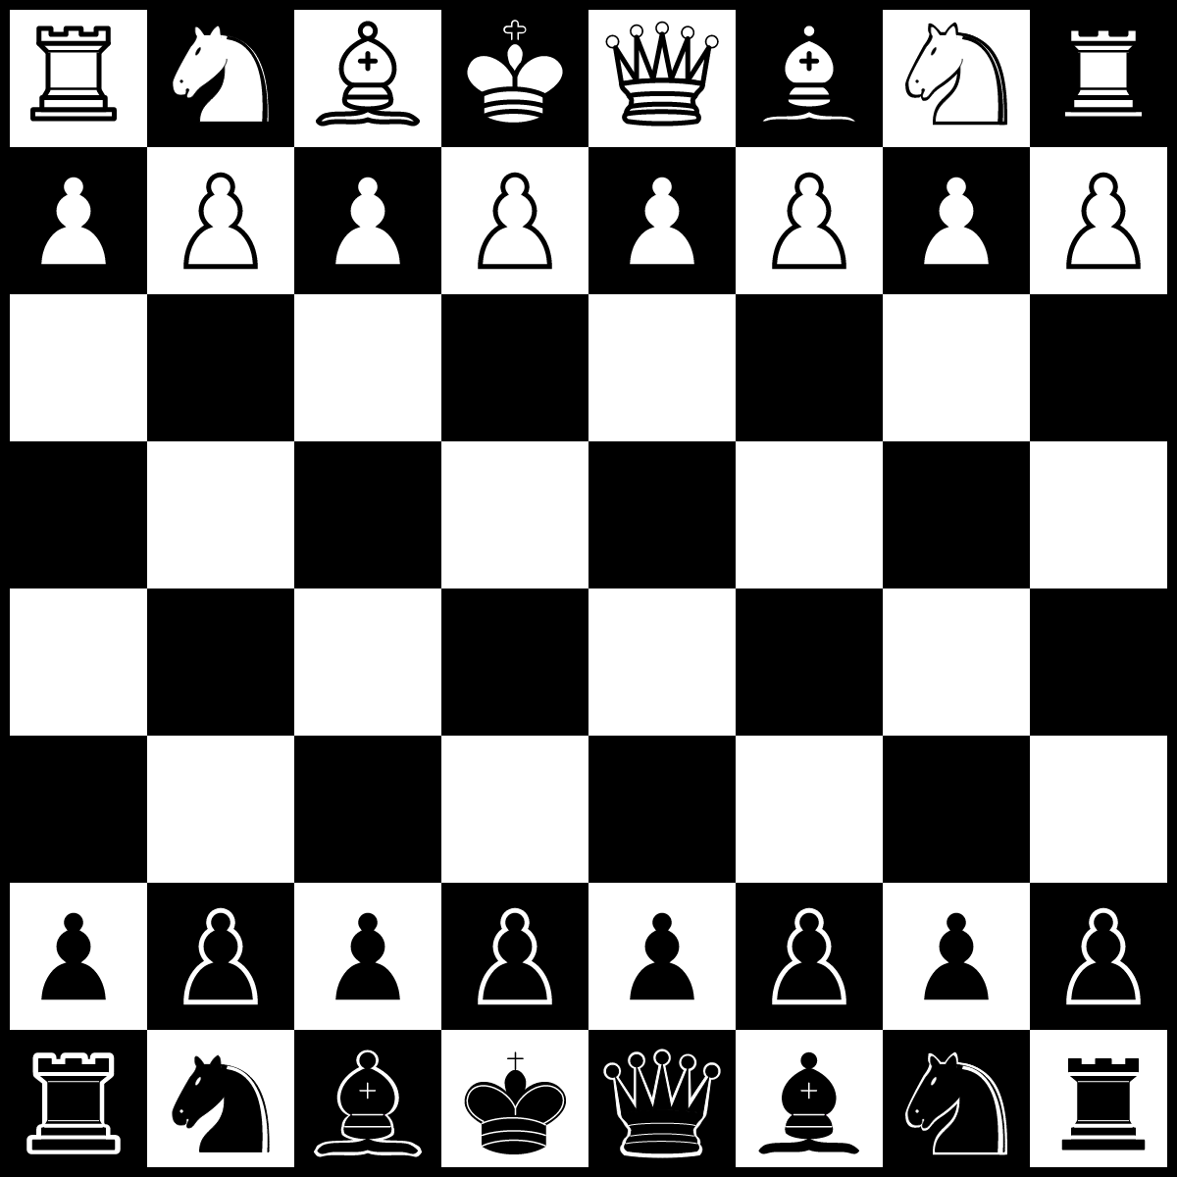
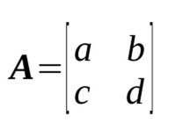
2D arrays
2D Arrays
Many applications have multidimensional structures:
Matrix operations
Collection of lists
Board games (Chess, Checkers)
Images (rows and columns of pixels)
...

Slide 3
1D Array Review
2D Arrays
Animal[] pets= new Animal[3];
pets
null
Array@0x10
pets.length is 3
pets[0]= new Animal();
pets[0].walk();
Array@0x10
0
null
Why is the following illegal?
pets[1] = new Object();
1
null
2
null
Notes:
Explain how variable pets and the referenced value are separate.
Explain that any object can be stored in the array as long as it has the appropriate type.
We need to be assured that we can call any methods that belong to Animal with the elements in the array.
All elements in the array are of the same type.
new Object() won’t fit because it cannot be cast down to Animal.

Slide 4
Java arrays vs Python lists
2D Arrays
Java arrays do not change size!
b
A@0x12
A@0xab
A@0x12
A@0xab
0
“Cornell”
0
“Cornell”
bBig
A@0x12
1
“Ithaca”
1
“Ithaca”
2
3
String[] b= {“Cornell”, “Ithaca”};
String[] bBig= Arrays.copyOf(b, 4);
b= bBig;
Notes:
Explain that Java arrays do not expand. If you would like to add more elements to an array, you need to copy the previous array to the new one. Note that the students do not need to know System.arraycopy or Arrays.copyOf.

Slide 5
Java array initialization
2D Arrays
Instead of
int[] c= new int[5];
c[0]= 5; c[1]= 4; c[2]= 7; c[3]= 6; c[4]= 5;
Use an array initializer:
int[] c= new int[] {5, 4, 7, 6, 5};
Note: The length of c is the number of values in the list.

Slide 6
Exercise 1: Looping over an array
2D Arrays
/** Return index of occurrence number n of
* t in b.
* Precondition: n >= 1.
* Return -1 if not found. */
public static int get(int[] b, int n, int t) {
...
}
get(new int[]{2110, 0, 1, 2110, 2110}, 2, 2110);
would return 3
Notes:
public static int get(int[] b, int n, int t) {
for (int i = 0; i < b.length; i++) {
if (arr[i] == t) {
if (n == 1) return i;
n--;
}
}
return -1;
}

Slide 7
2D arrays: An array of 1D arrays.
2D Arrays
Java only has 1D arrays, whose elements can also be arrays.
int[][] b= new int[2][3];
This array has 2 int[] arrays of length 3 each.
0
0
1
0
b
2
0
0
0
0
1
1
0
2
0

Slide 8
2D arrays: An array of 1D arrays.
2D Arrays
How many rows in b? b.length
How many columns in row 0? b[0].length
How many columns in row 1? b[1].length
0
0
1
0
b
2
0
0
0
0
1
1
0
2
0

Slide 9
2D arrays: An array of 1D arrays.
2D Arrays
int[][] b= new int[2][];
The elements of b are of type int[].
b
0
null
1
null

Slide 10
2D arrays: An array of 1D arrays.
2D Arrays
int[][] b= new int[2][];
b[0]= new int[] {0,4,1,3,9,3};
b[1]= new int[] {1110,2110,3110};
b is called a ragged array
0
0
1
4
b
2
1
3
3
0
0
4
9
1110
1
1
5
3
2110
2
3110

Slide 11
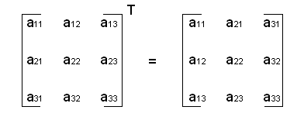
Exercise 2: Transpose Matrix
2D Arrays
A
A^{T}
A^{T} [i][j] is A [j][i]
Notes:
/** Return the transpose of rectangular array b. */
public static int[][] transpose(int[][] b) {
int[][] t= new int[b[0].length][b.length];
for (int i= 0; i < b.length; i++) {
for (int j= 0; j < b[i].length; j++) {
t[j][i] = b[i][j];
}
}
return t;
}

Slide 12
Exceptions
Notes:
Before moving on, you could ask if there are any remaining questions about 2D arrays.
Also, ask them whether or not int[][] is a primitive type or reference type. (It’s a reference type.)

Slide 13
Exceptions make your code crash
Exceptions
public static void main(String[] args) {
System.out.println(args[0]);
}
public static void main(String[] args) {
System.out.println(8 / 0);
}
public static void main(String[] args) {
System.out.println(null.toString());
}
Notes:
We’ve all seen our code crash! Why is it important to crash?
Go through each error describing why it crashed.

Slide 14
What could happen without exceptions?
Exceptions
public static double getAverage(double[] b) {
double sum = 0;
for (int i = 0; i < b.length; i++) {
sum += b[i];
}
return sum / b.length;
}
If b.length is 0, what should be returned?
Infinity
“special” int - Integer.MAX_VALUE? 2110? 0?
Notes:
Without exceptions, we could just signify a failure by returning zero --except that 0 is often a valid returned value.
Why can’t we simply use error codes?
A big motivation behind exceptions is to avoid using custom error codes.
In this case, when possible correct values encompass the entire domain set of the return type, then we cannot use error codes. For example, in this case, all three of those proposed error code values could actually be the average of the list.

Slide 15
Superclass of exceptions: Throwable
Exceptions
When some sort of exception occurs, an object of class java.lang.Throwable (or one of its subclasses) is created and “thrown” --we explain later what “throw” means.
Throwable@x2
Throwable
“/ by zero”
detailMessage
Throwable() Throwable(String) getMessage()
The object has
1. Field to contain an error message
2. Two constructors
3. Function to get the message in the field
Notes:
Like so many things in Java, exceptions are handled using a class.

Slide 16
Superclass of exceptions: Throwable
Exceptions
Two subclasses of Throwable exist:
Error: For errors from which one can’t recover –don’t “catch” them
Exception: For errors from which a program could potentially recover –it’s ok to “catch” them
Exception@x2
Error@x2
Throwable
“/ by zero”
Throwable
“/ by zero”
detailMessage
Throwable() Throwable(String) getMessage()
Error() Error(String)
detailMessage
Throwable() Throwable(String) getMessage()
Exception() Exception(String)
Exception
Error
Notes:
When discussing classes Error and Exception, be sure to tell the student that they can write their own subclasses of Exception. They should include two constructors, like the ones shown. This will be shown later in the lecture.

Slide 17
A Throwable instance: ArithmeticException
Exceptions
There are so many different kinds of exceptions we need to organize them.
ArithmeticException@x2
Throwable
detailMessage
“/ by zero”
Exception
Throwable
Exception
Error
RuntimeException
RuntimeException
ArithmeticException
ArithmeticException
Notes:
Here is an example of a throwable instance.
We have so many different exceptions for different problems that we run into.
Field detailMessage is part of the Throwable partition of the ArithmeticException.
You can restate that there are two constructors. One that has a String parameter and one that doesn’t,
As well as function getMessage.
And, every subclass should have the two constructors.

Slide 18
Throwing an exception
Exceptions
When an exception is thrown, it is thrown to the place of call, which throws it out further to where that method was called. The code that called main will “catch” the exception and print the error message
1
2
3
4
5
6
7
8
9
10
11
12
13
class Ex {
static void main(…) {
second();
}
static void second() {
third();
}
Static void third() {
int c= 5/0;
}
}
AE
Method call: main(new String[] {});
Console:
java.lang.AE: / by zero
at Ex.third(Ex.java:11)
at Ex.second(Ex.java:7)
at Ex.main(Ex.java:3)
AE
AE
AE = ArithmeticException
Notes:
It is important that you go through this slowly and carefully.
1. the division by 0 causes the object to be created.
2. The object is thrown out to the place of call –third()
3. The object is thrown out to the place of call –second()
4. The object is thrown out to the system, the code that called main()
5. That code in the system “catches” the thrown object and prints the error message.

Slide 19
Decoding the output from an exception
Exceptions
1
2
3
public static void main(String[] args) {
int div= 5/0;
}
Exception that is thrown
message
Exception in thread "main" java.lang.ArithmeticException: / by zero
at Animal.main(Animal.java:2)
called method
line number

Slide 20
Try statement: catching a thrown exception
To execute the try statement:
Execute the try-block. If it finishes without throwing an exception, fine.
If the try-block throws a MyException object, catch it (execute the catch block); else throw it out further.
If the exception was caught, execution proceeds to the code S following the try-statement.
try {
code (this is the try-block)
}
catch (MyException ae) {
code (this is the catch-block)
}
S; (code following the try statement)
ae is like a parameter. When the catch-block catches a thrown object, ae contains the object
Notes:
You have to emphasize that when an object is thrown, i.e. when some sort of exception occurs, the normal execution pattern is stopped,
And the thrown object is thrown to the place of call, etc. until some catch block catches it.
Tell them that it will take a while for all this to sink in.

Slide 21
throw keyword: Forcing a crash
Exceptions
Why might I want to crash the application?
class Integer {
/** Parse s as a signed decimal integer.
* Throw a
* NumberFormatException if not possible
*/
public static int parseInt(String s){
...
}
}
parseInt(“42”) -> 42
parseInt(“Sid”) -> ???
if (can’t convert to int){
throw new NumberFormatException();
}

Slide 22
Demo 1: Read an Integer
Ask the user to input an int
Try to convert user input to an int
If an exception is thrown, catch it and ask for more input

Slide 23
Exercise 3: Illegal Arguments
Exceptions
Create class Person with two fields, name and age. Throw an IllegalArgumentException instead of having preconditions when given a null name or a non-positive age.
Notes:
class Person { // given without javadoc specs to conserve space
private String name;
private int age;
public Person(String name, int age) {
setName(name);
setAge(age);
}
public void setName(String name) {
if (name == null)
throw new IllegalArgumentException();
this.name = name;
}
public void setAge(int age) {
if (age <= 0)
throw new IllegalArgumentException();
this.age = age;
}
}

Slide 24
How to write an exception class
Exceptions
/** An instance is an exception */
public class OurException extends Exception {
/** Constructor: an instance with message m*/
public OurException(String m) {
super(m);
}
/** Constructor: an instance with no message */
public OurException() {
super();
}
}
Notes:
You can write a subclass of Exception, or RuntimeException, or any other subclass of Throwable.
Always put in both constructors, as shown.

Slide 25
throws clause
Exceptions
Exceptions
public static void second() {
…
String line= kyboard.readLine();
…
}
Unhandled exception type IOException
You may get an error message like the yellow one above. In that case, insert a throws clause as shown below.
public static void second() throws IOException {
…
String line= kyboard.readLine();
}
Notes:
This slide tells what to do when an unhandled exception is thrown.
When Gries talks about this, he tells the students that this is a rather controversial thing, and
That at this stage of the student’s learning, they don’t have to understand the controversy.
Instead, just do what the slide says to do. That’s all.
This is just a syntax thing, nothing very deep. If it needs a throws clause, well, just put it in!
Gries would end the lecture here.
But if you want to explain checked/unchecked exceptions and the controversy, then put up the next slide.

Slide 26
throws clause for checked exceptions
Exceptions
Exceptions
/** Class to illustrate exception handling */
public class Ex {
public static void main() {
try { second(); } catch (OurException e) {}
}
public static void second() throws OurException {
third();
}
public static void third() throws OurException {
throw new OurException("mine");
}
}
If you’re interested in the “controversy”, http://docs.oracle.com/javase/tutorial/essential/exceptions/runtime.html
Notes:
In Java, there are checked and unchecked exceptions.
If a checked exception can be thrown outside the method to the place of call, then a throws clause is needed.
In the first method above, the OurException is caught, so it can’t be thrown outside the method.
Tell the students that there is a controversy is regarding java’s design decision to have checked and unchecked exceptions.
It is bad style to throw only unchecked exceptions (the lazy programmer doesn’t want to declare exceptions).
This actually is a small point in the whole Java OO concept. Don’t worry about it. If Java asks you to put in a throws clause, put it in.
That’s all there need be to the issue.
Here’s the general guideline: If a client can reasonably be expected to recover from an exception, make it a checked exception. If a client cannot do anything to recover from the exception, make it an unchecked exception (e.g. IllegalArgumentException is unchecked).

Slide 27
Demo 2: Pythagorean Solver
Exceptions
Given a and b: solve for c in a² + b² = c²
Reads in input from keyboard
Handles any exceptions

Slide 28
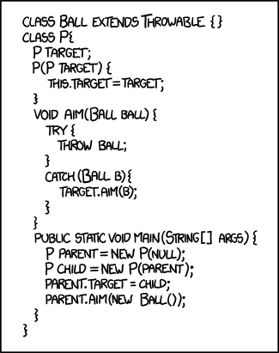
Key takeaways
Java arrays do not extend!
A 2D array is just a 1D array of 1D arrays.
Thrown exceptions bubble up the call stack until they are handled by a try-catch block. In the system, the call of method main is in a try-catch statement, and its catch block prints out information about the thrown exception.
http://xkcd.com/1188/
Alt-Text: I'm trying to build character but Eclipse is really confusing.

