Slide 1
Recitation 2
Main Method, API & Packages, Java Basics

Slide 2
Demo 1: Making an application
Method main
Create a new eclipse project
Eclipse: File -> New -> Java Project
File -> New -> Class
Check the main method stub. Hit “Finish”
Write inside main method stub:
  System.out.println(“Hello World”);
Hit the green play button

Slide 3
Main method
Method main
When you run your application, it starts by calling method main:
public static void main(String[] args) { … }
Accepts one parameter of type String[] (array of Strings)

Slide 4
Demo 2: Using program arguments
Method main
Now let’s change the program to print out a user supplied argument!
Notes:
Run through demo 2, getting student input if possible. It’s fairly straightforward, just make sure they know that args is an array and that you can check the length with the length property and get elements using []. Also briefly mention that you can concatenate Strings with the + operator, but don’t elaborate on this (it comes up later in the slides).

Slide 5
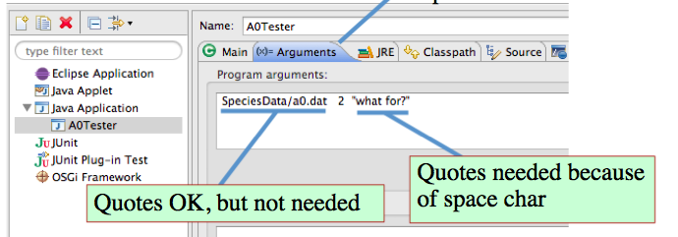
Demo 2: Inputting program arguments
Method main
Now we’ll tell Eclipse what arguments to use
Run -> Run Configurations
Click “Arguments” tab
Enter arguments, and hit “Apply”
Notes:
Run the program you just wrote and make sure to show them the console output. You can mention that using System.out.println and console output is helpful for debugging.

Slide 6
Exercise 1: Using program arguments
Method main
Write a program that prints whether a point is inside a circle. The program should receive 5 arguments in this order:
x coordinate of the point
y coordinate of the point
x coordinate of the circle’s origin
y coordinate of the circle’s origin
radius of the circle
Hints:
Java arrays are 0-indexed
Double.parseDouble(str) returns str as a double
Math.sqrt(d)s returns the square root of d
Notes:
Give them a few minutes to work on this.
The best way to handle bad input (not doubles) is with exceptions and they haven’t learned those yet so just tell them to just assume that all arguments are valid doubles.
Then walk students through the solution, asking for input along the way.
Solution:
public static void exercise1PointInsideCircle(String[] args) {
double xDiff = Double.parseDouble(args[0]) - Double.parseDouble(args[2]);
double yDiff = Double.parseDouble(args[1]) - Double.parseDouble(args[3]);
double radius = Double.parseDouble(args[4]);
boolean insideCircle = Math.sqrt(xDiff * xDiff + yDiff * yDiff) < radius;
System.out.println("Point is " + (insideCircle ? "" : "not ") + "inside the circle.");
}

Slide 7
Java API & Packages

Slide 8
Java API (Application Programming Interface)
Java API & Packages
Java provides a number of useful classes and interfaces
The Java API documents how to use these classes. Each API page contains:
  class/interface hierarchy
  Overview
  fields
  constructors
  Methods
http://docs.oracle.com/javase/8/docs/api/index.html
  Also available on course website. Click the “Links” tab
For fields, constructors, methods there is a
Summary and a Detail
most useful
Notes:
When you demo this API stuff in your browser, show the students how you can click on a method name in
The Summary to get to the complete, detailed, description.

Slide 9
Demo 3: How to use Java API
Java API & Packages
Let’s make a program that takes a user supplied time (String) in the form of hours:minutes and prints out the hours and then the minutes.
What class can help you with this?
  Google search “Java 8 API <name of class>”
  Click the docs.oracle.com link
  Look for methods related to your task
Notes:
First, ask students which class will help them with the task. The answer is String (if they suggest class Time or Date, say that is a good suggestion but because this is such a simple example we can do it more easily with another class)
Then show how to find class String (Google search works best):
Google search “Java 7 API String”
Click the docs.oracle.com link (usually first)
Find the methods you need (substring, indexOf) and then code (or show) the solution in Eclipse
After you finish with the task, go back to the Java API and show how to browse through related classes and interfaces at the top of the page
Finally, if you have time mention that if they aren’t sure what class to use or how to use one, they can look up concepts in the java tutorials (again, Google search is the best way to find things): http://docs.oracle.com/javase/tutorial/index.html

Slide 10
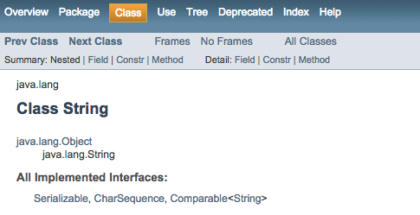
Where did class String come from?
Java API & Packages
Package java.lang
Package: group of related classes
  Can contain sub-packages
Why?
  organization
  namespace
  encapsulation
Notes:
Why? (don’t get bogged down in this, it’s not really that important, but it’s nice to mention. Skip it if you’re low on time or if you don’t think you’ll be able to give a very concise explanation)
organization: there are thousands of classes in the Java API. Packages allow you to find related classes more easily and allow programmers to organize code
namespace: if it weren’t for packages, every class in the Java API and your code would need a unique name (thousands of classes!)
encapsulation: package level access modifier! They have all seen public and private, but tell them that if you declare something (class, field, method) with NO access modifier, it is visible only within its own package. Very useful for larger projects.

Slide 11
Demo 4: java.lang is special
Java API & Packages
What happens when we try to use a class from a package other than java.lang?
Make a method whose body is:
  JFrame frame = new JFrame();
Hover over the error and have Eclipse import the class
Scroll to the top and see what the import statement looks like
Notes:
After you type JFrame frame= new JFrame(); show how Eclipse highlights the error.
Show how to fix it by typing javax.swing.JFrame frame= new javax.swing.JFrame();
Then ask if anyone has suggestions for a better way to do this.
If they suggest importing, great
If not, try to hint more abstractly at the idea of making it so that we don’t have to write the whole package name every time.
Then delete javax.swing. and go back to JFrame frame= new JFrame();
Show how to hover over the Eclipse error and a suggestion box pops up. The top one automatically imports it.
Scroll up to the top and show what the import statement looks like.
Explain that it can be typed by hand but it is usually easier to let Eclipse figure it out for you. Just make sure to get the correct class (sometimes there are multiple classes with the same name from different packages)

Slide 12
Importing from other packages
Java API & Packages
import javax.swing.JFrame;
  imports class JFrame from package javax.swing
import javax.swing.*;
  imports every class and interface from package javax.swing
Notes:
You can mention that usually if you only have a few imports from the same package, do them individually. If you have a high number of imports from the same package, import the whole thing.

Slide 13
Exercise 2: Random numbers
Java API & Packages
Write a function that accepts two parameters of type double, and prints out a random double between those two numbers
Hints:
  You will need to import a class from the Java API
  Use your intuition about what class to use, and search Google for it
  Look over the class’s methods to find one that can help you
Notes:
Students should find the Java API for class Random on their own and look at the methods on their own.
If you think they need it, you can give them a hint that there is no method that does exactly what they’re trying to do, but they can use one of the methods to help them out. Point them toward the methods starting with “next”
Solution:
public static void exercise2Random(double lower, double upper) {
Random r= new Random();
double randDouble= r.nextDouble();
System.out.println(lower + randDouble * (upper - lower));
}

Slide 14
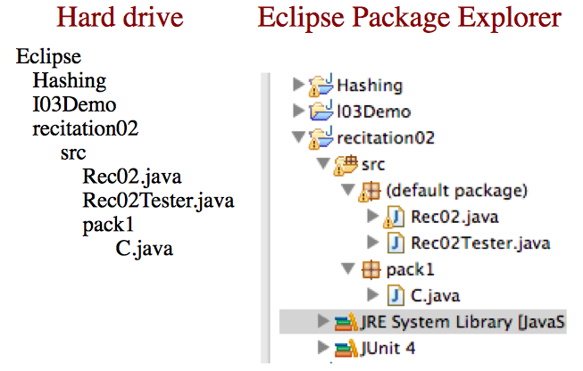
Custom packages
Java API & Packages
Except for the default package, file structure matches package structure

Slide 15
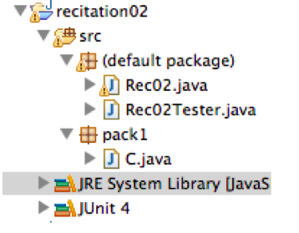
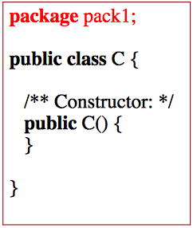
Custom packages (continued)
Java API & Packages
Importing works the same as the Java API
Except for the default package, classes must declare their package above the class header

Slide 16
Java Basics

Slide 17
Primitive types vs classes
Java Basics
Variable declarations:
  int i= 5;
  Animal a= new Animal(“Bob”);
Animal and int are both types, but Animal is a class and int is a primitive type
a
Animal@0x36
Animal@0x36
i
5
“Bob”
name

Slide 18
Demo 5: Primitive types vs classes
Java Basics
instantiating primitive types
how == behaves on primitives and objects
Notes:
Show them the demo code, then run it and show what gets printed to the console. Don’t go too much into the way == works on primitives and objects because the following slides show the difference in a diagram. So just tell them to notice how in the demo == works differently and then move on to the slides that explain this.

Slide 19
Demo explained
Java Basics
Variables with a primitive type contain their value directly:
int i1= 5;
int i2= 5;
So i1 == i2 translates to 5 == 5
Variables with a class type contain a pointer to an object . . .
i1
5
i2
5

Slide 20
Demo explained
Java Basics
Animal bob1= new Animal(“Bob”);
Animal bob2= new Animal(“Bob”);
Animal anotherPointerToBob1= bob1;
bob1
Animal@0x36
Animal@0x36
bob2
Animal@0x84
Animal@0x84
name
“Bob”
name
“Bob”
anotherPointerToBob1
Animal@0x36

Slide 21
Demo explained
Java Basics
bob1
Animal@0x36
bob2
Animal@0x84
anotherPointerToBob1
Animal@0x36
So bob1 == bob2 translates to
Animal@0x36 == Animal@0x84
While bob1 == anotherPointerToBob1 translates to
Animal@0x36 == Animal@0x36
Notes:
Explain that the values contained are “references” or memory addresses, so Animal@0x36 == Animal@0x84 is false because the address is different but the other is true because they are the same memory address

Slide 22
Class Character
Java Basics
class Character contains useful methods
Examples of useful Character methods:
  Character.isDigit(c)
  Character.isLetter(c)
  Character.isWhitespace(c)
  Character.isLowerCase(c)
  Character.toLowerCase(c)
  see Java API for more!
These methods are static and are applied to char c
Notes:
We don’t want to get too much into wrapper classes at this point because it’s a pretty strange concept for people just picking up Java and it’s not very important early on. This is mainly to let them know that
primitive types cannot have methods, and
each primitive type has a related wrapper class with useful methods
Don’t talk about casting between primitives and their wrappers or about equality of wrapped primitives, just treat these classes as if they were a collection of static methods related to the primitives.
It can be nice to mention that the method they saw earlier Double.parseDouble(str) comes from the Double wrapper class, and that Integer.parseInt is a similar useful one. Integer.MAX_VALUE and Integer.MIN_VALUE can also be useful.

Slide 23
Demo 6: chars
Java Basics
Notice the characters beginning with a \. These are called escaped characters and have a special meaning
  Examples: ‘\n’ ‘\t’ ‘\”’ ‘\’’
  Google search “java tutorial escaped characters” to see all the escaped characters
Character int values for letters and numbers are sequential
chars can be compared by their int value.
Notes:
Run demo 6, making sure students can see the code AND the console output. Other notes that you should mention if possible:
Any character can be declared as a character with single quotes or used in a string
escaping ‘ only necessary in a String, and escaping “ only necessary in a char
int codes of chars are sequential over letters and numbers
int characters do NOT have the same int code (for example, the int value of char '3' is 51, not 3)
using <, >, <=, >=, ==, and != works on chars by casting them to ints
They should try to find methods in class Character rather than use comparison operators on chars because those methods are usually more robust

Slide 24
Strings: Special objects
Java Basics
Strings are objects
However:
  They can be created with literals
  They are immutable (unchangeable)
Notes:
The next slides go into more detail on this, so this slide should be quick.

Slide 25
String literals
Java Basics
String instantiation:
Constructor: String s= new String(“dog”);
Literal: String s2= “dog”;
Roughly equivalent, but literal is preferred
s
String@0x62
String@0x62
s2
String@0x28
String@0x28
“dog”
“dog”

Slide 26
Strings are immutable
Java Basics
Once a String is created, it cannot be changed
Methods such as toLowerCase and substring return new Strings, leaving the original one untouched
In order to “modify” Strings, you instead construct a new String and then reassign it to the original variable:
  String name = “Gries”;
  name= name + “, “;
  name= name + “David”;

Slide 27
Strings are immutable
Java Basics
What happens when you execute this?
  String name= “Gries”;
  name= name + “, “;
  name= name + “David”;
name
String@0x16
String@0x16
“Gries”

Slide 28
Strings are immutable
Java Basics
What happens when you execute this?
  String name= “Gries”;
  name= name + “, “;
  name= name + “David”;
name
String@0x30
String@0x16
String@0x30
“Gries”
“Gries, ”

Slide 29
Strings are immutable
Java Basics
What happens when you execute this?
  String name= “Gries”;
  name= name + “, “;
  name= name + “David”;
name
String@0x44
String@0x16
String@0x30
String@0x44
“Gries”
“Gries, ”
“Gries, David”

Slide 30
String concatenation
Java Basics
Operator + operator is called catenation, or concatenation
If one operand is a String and the other isn’t, the other is converted to a String
Important case: Use “” + exp to convert exp to a String.
Evaluates left to right. Common mistake:
  System.out.println(“sum: “ + 5 + 6);
    Prints “sum: 56”
  System.out.println(“sum: “ + (5 + 6));
    Prints “sum: 11”

Slide 31
Other String info
Java Basics
Always use equals to compare Strings:
  str1.equals(str2)
Useful methods:
  length, substring, indexOf, charAt, lastIndexOf, split, trim, contains, compareTo, startsWith, endsWith
Look these up yourself in the Java API!

Slide 32
Key takeaways
The Java API is your best friend. Google search is a good way to find documentation on classes and methods.
  Other way to get to Java API: Course webpage, click “Link” in navigation bar, and click the Java API link.
Variables with a primitive type contain primitive values, those with a class type contain names (pointers to) to objects, like String@45afbc
Strings are immutable objects

