Slide 1
CS/ENGRD 2110 Fall2015
Lecture 1: Overview and intro to types
http://courses.cs.cornell.edu/cs2110/2015fa

Slide 2
Welcome to CS2110!
054 Freshmen
220 Sophomores
045 Juniors
053 Seniors
076 Meng
034 Graduate
Above numbers were from several days ago.
Last look at enrollment: 478.
Instructors:
Nate Foster, David Gries,
Recitation leaders: 18
Consultants: 25

Slide 3
Welcome to CS2110!
Learning about:
OO, abstract data types, generics, Java Collections, …
Reasoning about complex problems, analyzing algorithms we create to solve them, and implementing algorithms with elegant, easy-to-understand, correct code
Testing; Reasoning about correctness
Data structures: linked lists, trees, graphs, etc.
Recursion
Algorithmic complexity
Parallelism —threads of execution

Slide 4
What’s CS 2110 about?
Computational tools are “universal” but the key is to master computational thinking.
Looking at problems in ways that lead naturally to highly effective, correct, computational solutions
There are many ways to do anything, but some are better than others
Mastery of computational thinking will help you become a master of the universe!
Great job prospects with high salaries…

Slide 5
Is CS2110 right for you?
Knowledge of Java not required
Only ~30% of you know Java –others know Matlab, Python …
Requirement: comfort with some programming language, on the level of CS1110 (Python based) and CS1112 (Matlab based).
Prior knowledge of OO not required.
We assume you do not know Java!

Slide 6
Homework!
Homework 1. Read article Why Software is So Bad. Link: Course website -> Lectures notes (Lecture 1)
Homework 2. Get Java and Eclipse on your computer
Homework 3. Spend some time perusing the course website.
Look at course information, resources, links, etc.
Homework 4. BEFORE EACH LECTURE: download the pdf form of the slides, bring them to class, and look through them during the lecture. We will be projecting not only PPT but also Eclipse and other things; having the PPT slides in paper form or on your laptop/tablet can help you during the lecture

Slide 7
Lectures
TR 10:10-11am, Statler auditorium
Attendance mandatory
ENGRD 2110 or CS 2110?
Same course! We call it CS 2110 in online materials
Non-engineers sign up for CS 2110
Engineers sign up for ENGRD 2110

Slide 8
Sections (Recitations)
Some time EARLY, visit StudentCenter and change your section to even out the numbers
T 12:20 4 sections: 44, 44, 21, 0
T 1:25 2 sections: 46, 25
T 2:30 2 sections: 40, 4
T 3:35 1 section: 27
W 12:20 2 sections: 36, 22
W 01:25 2 sections: 33, 18
W 02:30 1 section: 27, 6
W 07:30 1 section: 10
Attendance is mandatory
Sometimes review, help on homework, new material
No permission needed to switch sections, but do register for whichever one you attend

Slide 9
CS2111
An “enrichment” course
We want to help students who might otherwise feel overwhelmed by CS2110
Gives more explanation of core ideas behind Java, programming, data structures, assignments, etc.
Taught by Foster and Gries, 1 credit S/U
Only for students who also take CS2110
Only requirement: Attend weekly lecture

Slide 10
Academic Excellence Workshops
Two-hour labs: students work together in cooperative setting
One credit S/U course based on attendance
Time and location TBA
See website for more info:
www.engineering.cornell.edu/academics/undergraduate/curriculum/courses/workshops/index.cfm

Slide 11
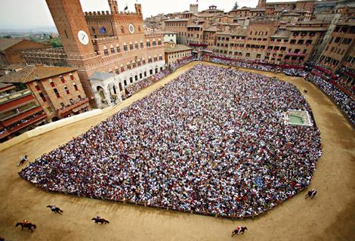
Piazza
Click link on our web page to register
Incredible resource for 24 x 7 help with anything
We keep an eye on it and answer questions. YOU can (and will) too. Visit the Piazza often.

Slide 12
Resources
Book: Frank M. Carrano, Data Structures and Abstractions with Java, 3nd ed., Prentice Hall
2nd edition is okay. E-book not required
Share textbook. Need access to it from time to time
Copies on reserve in Engr Library
PPT slides (on course website and Piazza) outline all of OO in Java. Has index at beginning
Great Java resource: online materials at Oracle JDK web site. Google has it indexed.
VideoNote: videos of lectures from Spring 2014. http://www.videonote.com/cornell. Log in with netid

Slide 13
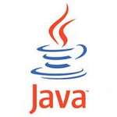
Obtaining Java
Follow instructions on our Resources web page
Make sure you have Java JDK 1.8, if not download and install. We explain how on the web page.
Then download and install the Eclipse IDE
Test it out: launch Eclipse and click “new>Java Project”
This is one of a few ways Java can be used
When program runs, output is visible in a little console window

Slide 14
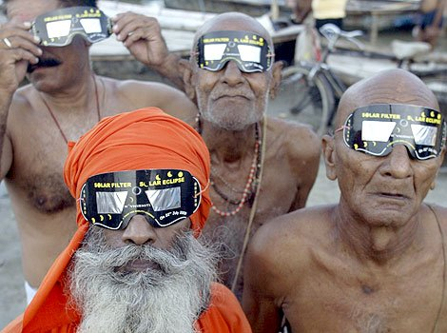
Eclipse IDE
IDE: Integrated Development Environment
Helps you write your code
Protects against many common mistakes
At runtime, helps with debugging
Follow Resources link to download and install

Slide 15
DrJava IDE
IDE: Integrated Development Environment
DrJava is a much simpler IDE, few features
We use it only to demo Java features and programming concepts. Has an “interactions pane”, which allows trying things without requiring a complete Java program.
DON’T use it for course assignments –use Eclipse
Free at www.drjava.org

Slide 16
Coursework
7–8 assignments involving both programming and written answers (35%)
Two prelims (15% each)
Final exam (30%)
Course evaluation (1%)
Possible surprise in-class quizzes (4%)
Formula will change as the course progresses and we make changes in assignments, give quizzes, etc.
Exams are most important aspect in determining final grade

Slide 17
Assignments
Teams of one or two
A0 and then A1 will be posted soon on the CMS
Finding a partner: choose your own or contact your TA. Piazza can be helpful.
Two kinds of assignment:
Vanilla: specific experience to learn and practice what’s being taught. We give exact instructions for doing it
Chocolate: Open-ended project done in 3 chunks Parts of the design are left to you. CS 2111 will give more help on it.

Slide 18
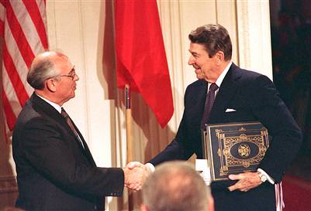
Academic Integrity… Trust but verify!
98% of you are honest and don’t try to cheat
We use artificial intelligence tools to check each homework assignment, so catch the other 2%
The software is very accurate!
It tests your code and also notices similarities between code written by different people
Sure, you can fool this software
… but it’s easier to just do the assignments
… and if you try to fool it and screw up, you might fail the assignment or even the whole course.

Slide 19
Types in Java
References in text and in JavaSummary
type: A.14 slide 4
variable: A.13 slide 7
variable declaration: A.15 slide 7
Primitive types, A.16, back inside cover slide 5
Constants, A.17 slide 20
Assignment, A.18-A.20 slide 8
Casting, A.21 slide 6
Expressions: A.22-A.23
Precedences: A.24, back inside cover
Unicode character codes, back inside cover

Slide 20
Type: Set of values together with operations on them.
Type integer:
values: …, –3, –2, –1, 0, 1, 2, 3, …
operations: +, –, *, /, unary –
God’s integers!
Can represent them in many ways — decimal, binary, octal, maybe as strokes ||||
(that’s 4)
Do you know how your computer represents them?

Slide 21
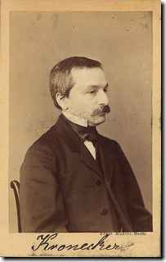
The integers as the basis
Leopold Kronecker (1823-1891), Prussian mathematician,
Argued that arithmetic and analysis should be founded on the whole numbers (integers):
Die ganzen Zahlen hat der liebe Gott gemacht, alles andere ist Menschenwerk.
The beloved God made the whole numbers, everything else is the work of man.
He insisted on the constructibility of math objects. Real numbers –do they really exist?
You can’t compute most of them because they have an infinite number of digits.
God’s integers!

Slide 22
Type: Set of values together with operations on them.
Valid Python sequence:
x= 100;
x= ‘Hello World’;
x= (1, 2, 3, 4, 5 );
Matlab and Python are weakly typed:
One variable can contain at different times a number, a string, an array, etc.
One isn’t so concerned with types.
Corresponding Java
int x;
x= 100;
x= “Hello”;
Java strongly typed:
A variable must be declared before it is used and can contain only values of the type with which it is declared
Declaration of x: x can contain only values of type int
Illegal assignment: “Hello” is not an int

Slide 23
Weakly typed versus strongly typed
Weakly typed:
Shorter programs, generally.
Programmer has more freedom, language is more liberal in applying operations to values.
Strongly typed:
Programmer has to be more disciplined. Declarations provide a place for comments about variables.
More errors caught at compile-time (e.g. it’s a syntax error to assign a string to an int variable).
Note: weak and strong typing not well defined; literature has several definitions

Slide 24
Type: Set of values together with operations on them.
Java Type int:
values: –2³¹ .. 2³¹–1
operations: +, –, *, /, %, unary –
b % c : remainder when b is divided by c. 67 % 60 = 7
Java designers decided on this Principle: primitive operations on type int should yield an int.

Slide 25
Most-used ‘primitive’ types
Inside back cover, A-6..7
b % c : remainder when b is divided by c. 67 % 60 = 7
int: values: –2³¹ .. 2³¹–1
operations: +, –, *, /, %, unary –
double: values like : –22.51E6, 24.9
operations: +, –, *, /, %, unary –
Write values in “scientific notation”
char: values like : 'V' '$' '\n'
operations: none
Use single quotes for type char.
'\n' is new-line char
boolean: values: true false
operations: ! (not), && (and), || (or)
Can’t use integers as booleans!

Slide 26
About ‘primitive’ type int
Inside back cover, A-6..7
Java Principle: A basic operation of type int must produce an int
int: values: –2³¹ .. 2³¹–1, i.e.
operations: +, –, *, /, %, unary –
Integer.MAX_VALUE: name for max int value: 2³¹–1: 2147483647
Integer.MAX_VALUE + 1 is
–2³¹: -2147483648 WRAP-AROUND

Slide 27
Primitive number types
Inside back cover, A-6..7
Integer types: byte short int long
1 byte 2 bytes 4 bytes 8 bytes
Real types: float double –22.51E6
4 bytes 8 bytes 24.9
usual
operators
usual
operators
Use these to save space.
Have an array of 1,000,000 integers in range 0..7?
Use a byte array rather than an int array
Don’t worry about this in next 7-8 weeks. Use int and double.

Slide 28
Casting among types
Page A-9, inside back cover
28
(int) 3.2 casts double value 3.2 to an int
any number type
any number expression
may be automatic cast
narrow
wider
byte short int long float double
must be explicit cast, may truncate
(int) is a unary prefix operator, just like –
– – 3 evaluates to 3
– (int) 3.2 evaluates to –3

Slide 29
Char is a number type!
Page A-9, inside back cover
29
char is a number type: (int) 'V' (char) 86
Unicode repr. in decimal: 86
'V'
Unicode: 16-bit char repr. Encodes chars in just about all languages. In java, use hexadecimal (base 16) char literals:
'\u0041' is 'A'
'\u0042' is 'B'
'\u0056' is 'V'
'\u0024' is ‘$'
'\u0950' is 'ॐ’ —Om, the sound of the universe
'\u5927' is '大' —大衛 is (I think) a transliteration
'\u885b' is '衛' of David into Chinese (Da Wei)
See www.unicode.org

Slide 30
Basic Variable Declaration
Page A-6
30
Declaration: gives name of variable, type of value it can contain
int x;
Declaration of x, can contain an int value
double area;
Declaration of area, can contain a double value
int[] a;
Declaration of a, can contain a pointer to an int array. We explain arrays much later
x
5
area
20.1
a
int
double
int[]

Slide 31
Assignment statement
31
Much like in other languages —need ‘;’ at end:
<variable>= <expression> ;
int x;
x= 10;
… other code
x= x+1;
Have to declare x before assigning to it.
int x= 10;
… other code
x= x+1;
Can combine declaration with an initializing assignment. Shorthand for a declaration followed by an assignment.

Slide 32
Assignment statement type restriction
32
Every expression has a type, which depends on its operators and the types of its operands in a natural way.
Rule: In x= e; type of e has to be same as or narrower than type of x. Reason: To avoid possibly losing info without the programmer realizing it.
double y= 5 + 1;
The value of 5+1 is automatically cast from type int to type double.
int x= 75.5 + 1;
Illegal: The exp value is of type double.
int x= (int) (75.5 + 1);
You can cast to int explicitly. 76 will be stored in x.

Slide 33
A function in Matlab, Python, and Java
33
function s = sum(a, b)
% Return sum of a and b
s= a + b;
Matlab
def sum(a, b):
""" return sum of a and b"""
return a + b
Python
Specification:
in comment
before function
/** return sum of a and b */
public static double sum(double a, double b) {
return a + b;
}
Declarations of parameters a and b
return type

