Slide 1
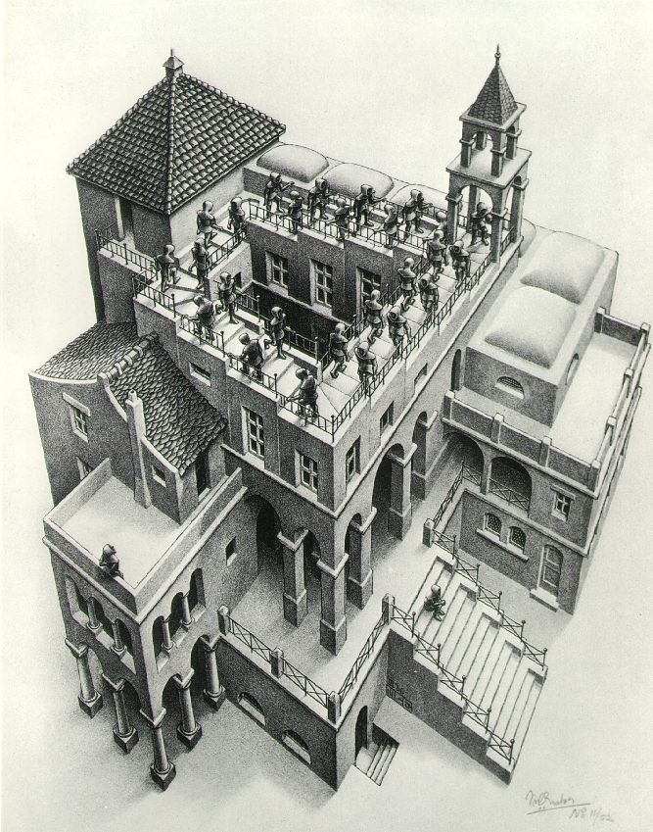
Priority Queues and Heaps
Lecture 16
CS2110 Fall 2014

Slide 2
Reminder: A4 Collision Detection
Due tonight by midnight

Slide 3

Readings and Homework
Read Chapter 26 “A Heap Implementation” to learn about heaps
Exercise: Salespeople often make matrices that show all the great features of their product that the competitor’s product lacks. Try this for a heap versus a BST. First, try and
sell someone on a BST: List some
desirable properties of a BST
that a heap lacks. Now be the heap
salesperson: List some good things
about heaps that a BST lacks. Can
you think of situations where you
would favor one over the other?
With ZipUltra heaps, you’ve got it made in the shade my friend!

Slide 4
The Bag Interface
A Bag:
interface Bag<E> {
void insert(E obj);
E extract(); //extract some element
boolean isEmpty();
}
Like a Set except that a value can be in it more than once. Example: a bag of coins
Refinements of Bag: Stack, Queue, PriorityQueue

Slide 5
Stacks and Queues as Lists
Stack (LIFO) implemented as list
insert(), extract() from front of list
Queue (FIFO) implemented as list
insert() on back of list, extract() from front of list
These operations are O(1)
first
55
120
19
16
last

Slide 6
Priority Queue
A Bag in which data items are Comparable
lesser elements (as determined by compareTo()) have higher priority
extract() returns the element with the highest priority = least in the compareTo() ordering
break ties arbitrarily

Slide 7
Examples of Priority Queues
Scheduling jobs to run on a computer
default priority = arrival time
priority can be changed by operator
Scheduling events to be processed by an event handler
priority = time of occurrence
Airline check-in
first class, business class, coach
FIFO within each class

Slide 8
java.util.PriorityQueue<E>
boolean add(E e) {...} //insert an element (insert)
void clear() {...} //remove all elements
E peek() {...} //return min element without removing
//(null if empty)
E poll() {...} //remove min element (extract)
//(null if empty)
int size() {...}

Slide 9
Priority Queues as Lists
Maintain as unordered list
insert() put new element at front – O(1)
extract() must search the list – O(n)
Maintain as ordered list
insert() must search the list – O(n)
extract() get element at front – O(1)
In either case, O(n²) to process n elements
Can we do better?

Slide 10
Important Special Case
Fixed number of priority levels 0,...,p – 1
FIFO within each level
Example: airline check-in
insert()– insert in appropriate queue – O(1)
extract()– must find a nonempty queue – O(p)

Slide 11
Heaps
A heap is a concrete data structure that can be used to implement priority queues
Gives better complexity than either ordered or unordered list implementation:
  insert(): O(log n)
  extract(): O(log n)
O(n log n) to process n elements
Do not confuse with heap memory, where the Java virtual machine allocates space for objects – different usage of the word heap

Slide 12
Heaps
Binary tree with data at each node
Satisfies the Heap Order Invariant:
Size of the heap is “fixed” at n. (But can usually double n if heap fills up)
The least (highest priority) element of any subtree is found at the root of that subtree.

Slide 13
Heaps
Smallest element in any subtree
is always found at the root
of that subtree
4
6
14
21
8
19
35
22
38
55
10
20
Note: 19, 20 < 35: Smaller elements
can be deeper in the tree!

Slide 14
Examples of Heaps
Ages of people in family tree
parent is always older than children, but you can have an uncle who is younger than you
Salaries of employees of a company
bosses generally make more than subordinates, but a VP in one subdivision may make less than a Project Supervisor in a different subdivision

Slide 15
Balanced Heaps
These add two restrictions:
Any node of depth < d – 1 has exactly 2 children, where d is the height of the tree
implies that any two maximal paths (path from a root to a leaf) are of length d or d – 1, and the tree has at least 2^{d} nodes
All maximal paths of length d are to the left of those of length d – 1

Slide 16
Example of a Balanced Heap
4
6
14
21
8
19
35
22
38
55
10
20
d = 3

Slide 17
Store in an ArrayList or Vector
Elements of the heap are stored in the array in order, going across each level from left to right, top to bottom
The children of the node at array index n are at indices 2n + 1 and 2n + 2
The parent of node n is node (n – 1)/2

Slide 18
Store in an ArrayList or Vector
4
0
6
1
14
2
3
4
5
6
21
8
19
35
22
7
38
8
55
9
10
10
20
11
children of node n are found at 2n + 1 and 2n + 2

Slide 19
Store in an ArrayList or Vector
4
0
6
1
14
2
21
3
8
4
19
5
35
6
22
7
38
8
55
9
10
10
20
11
0 | 1 | 2 | 3 | 4 | 5 | 6 | 7 | 8 | 9 | 10 | 11
4 | 6 | 14 | 21 | 8 | 19 | 35 | 22 | 38 | 55 | 10 | 20
children of node n are found at 2n + 1 and 2n + 2

Slide 20
insert()
Put the new element at the end of the array
If this violates heap order because it is smaller than its parent, swap it with its parent
Continue swapping it up until it finds its rightful place
The heap invariant is maintained!

Slide 21
insert()
4
6
14
21
8
19
35
22
38
55
10
20

Slide 22
insert()
4
6
14
21
8
19
35
22
38
55
10
20
5

Slide 23
insert()
4
6
14
21
8
5
35
22
38
55
10
20
19

Slide 24
insert()
4
6
5
21
8
14
35
22
38
55
10
20
19

Slide 25
insert()
4
6
5
21
8
14
35
22
38
55
10
20
19

Slide 26
insert()
4
6
5
21
8
14
35
22
38
55
10
20
19
2

Slide 27
insert()
4
6
5
21
8
14
2
22
38
55
10
20
19
35

Slide 28
insert()
4
6
2
21
8
14
5
22
38
55
10
20
19
35

Slide 29
insert()
2
6
4
21
8
14
5
22
38
55
10
20
19
35

Slide 30
insert()
2
6
4
21
8
14
5
22
38
55
10
20
19
35

Slide 31
insert()
Time is O(log n), since the tree is balanced
  size of tree is exponential as a function of depth
  depth of tree is logarithmic as a function of size

Slide 32
insert()
/** An instance of a priority queue */
class PriorityQueue<E> extends java.util.Vector<E> {
/** Insert e into the priority queue */
public void insert(E e) {
super.add(e); //add to end of array
bubbleUp(size() - 1); // given on next slide
}
}

Slide 33
insert()
class PriorityQueue<E> extends java.util.Vector<E> {
/** Bubble element k up the tree */
private void bubbleUp(int k) {
int p= (k-1)/2; // p is the parent of k
// inv: Every element satisfies the heap property
// except element k might be smaller than its parent
while (k>0 && get(k).compareTo(get(p)) < 0) {
“swap elements k and p”;
k= p;
p= (k-1)/2;
}
}

Slide 34
extract()
Remove the least element – it is at the root
This leaves a hole at the root – fill it in with the last element of the array
If this violates heap order because the root element is too big, swap it down with the smaller of its children
Continue swapping it down until it finds its rightful place
The heap invariant is maintained!

Slide 35
extract()
4
6
5
21
8
14
35
22
38
55
10
20
19

Slide 36
extract()
4
6
5
21
8
14
35
22
38
55
10
20
19

Slide 37
extract()
4
6
5
21
8
14
35
22
38
55
10
20
19

Slide 38
extract()
4
19
6
5
21
8
14
35
22
38
55
10
20

Slide 39
extract()
4
5
6
19
21
8
14
35
22
38
55
10
20

Slide 40
extract()
4
5
6
14
21
8
19
35
22
38
55
10
20

Slide 41
extract()
4
5
6
14
21
8
19
35
22
38
55
10
20

Slide 42
extract()
4 5
6
14
21
8
19
35
22
38
55
10
20

Slide 43
extract()
4 5
6
14
21
8
19
35
22
38
55
10
20

Slide 44
extract()
4 5
20
6
14
21
8
19
35
22
38
55
10

Slide 45
extract()
4 5
6
20
14
21
8
19
35
22
38
55
10

Slide 46
extract()
4 5
6
8
14
21
20
19
35
22
38
55
10

Slide 47
extract()
4 5
6
8
14
21
10
19
35
22
38
55
20

Slide 48
extract()
4 5
6
8
14
21
10
19
35
22
38
55
20

Slide 49
extract()
Time is O(log n), since the tree is balanced

Slide 50
extract()
/** Remove and return the smallest element
(return null if list is empty) */
public E extract() {
if (size() == 0) return null;
E temp= get(0); // smallest value is at root
set(0, get(size() – 1)); // move last element to root
setSize(size() - 1); // reduce size by 1
bubbleDown(0);
return temp;
}

Slide 51
/** Bubble the root down to its heap position.
Pre: tree is a heap except: root may be >than a child */
private void bubbleDown() {
int k= 0;
// Set c to smaller of k’s children
int c= 2*k + 2; // k’s right child
if (c > size()-1 || get(c-1).compareTo(get(c)) < 0) c--;
// inv tree is a heap except: element k may be > than a child.
// Also k’s smallest child is element c
while (c < size() && get(k).compareTo(get(c) > 0) {
Swap elements at k and c;
k= c;
c= 2*k + 2; // k’s right child
if (c > size()-1 || get(c-1).compareTo(get(c)) < 0) c--;
}
}

Slide 52
HeapSort
Given a Comparable[] array of length n,
  Put all n elements into a heap – O(n log n)
  Repeatedly get the min – O(n log n)
public static void heapSort(Comparable[] b)
{
PriorityQueue<Comparable> pq=
new PriorityQueue<Comparable>(b);
for (int i = 0; i < b.length; i++) {
b[i] = pq.extract();
}
}
One can do the two stages in the array itself, in place, so algorithm takes O(1) space.

Slide 53
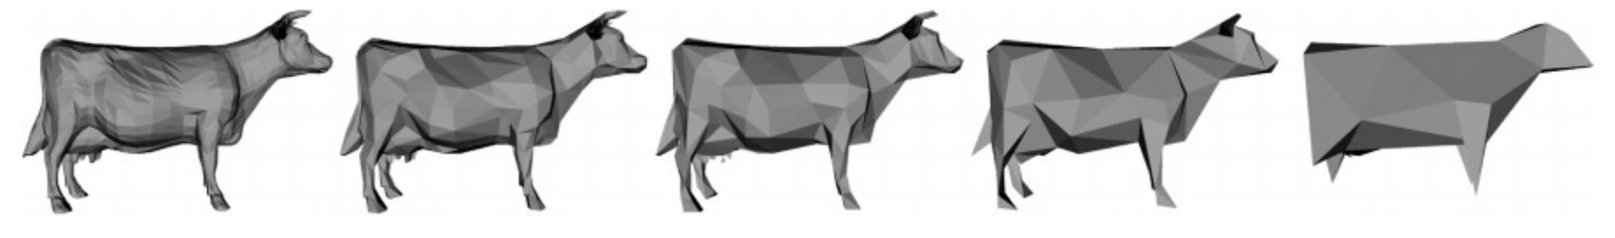
Many uses of priority queues & heaps
Surface simplification [Garland and Heckbert 1997]
Mesh compression: quadric error mesh simplification
Event-driven simulation: customers in a line
Collision detection: "next time of contact" for colliding bodies
Data compression: Huffman coding
Graph searching: Dijkstra's algorithm, Prim's algorithm
AI Path Planning: A* search
Statistics: maintain largest M values in a sequence
Operating systems: load balancing, interrupt handling
Discrete optimization: bin packing, scheduling
Spam filtering: Bayesian spam filter

Slide 55
PQ Application: Simulation
Example: Probabilistic model of bank-customer arrival times and transaction times, how many tellers are needed?
  Assume we have a way to generate random inter-arrival times
  Assume we have a way to generate transaction times
  Can simulate the bank to get some idea of how long customers must wait
Time-Driven Simulation
Check at each tick to see if any event occurs
Event-Driven Simulation
Advance clock to next event, skipping intervening ticks
This uses a PQ!

