Slide 1
Abstract Data Types; lists & trees
Lecture 10
CS2110 – Fall 2014

Slide 2
References and Homework
Text:
Chapters 10, 11 and 12
Homework: Learn these List methods, from http://docs.oracle.com/javase/7/docs/api/java/util/List.html
add, addAll, contains, containsAll, get, indexOf, isEmpty, lastIndexOf, remove, size, toArray
myList = new List(someOtherList)
myList = new List(Collection<T>)
Also useful: Arrays.asList()
Notes:
This is part of the Java Collections classes. List is an INTERFACE. It describes the operations available on a List.
We’ll talk in a minute about the use of interfaces.

Slide 3
Summary of These Four Lectures
Discuss Abstract Data Type (ADT): set of values together with operations on them: Examples are:
set, bag or multiset tree, binary tree, BST
list or sequence, stack, queue graph
map, dictionary
Look at various implementations of these ADTs from the stand-point of speed and space requirements. Requires us to talk about
Asymptotic Complexity: Determining how much time/space an algorithm takes.
Loop invariants: Used to help develop and present loops that operate on these data structures —or any loops, actually.
Notes:
Both asymptotic complexity and loop invariant are general concepts that we use to define, develop, present, and and analyze various data structures.
The phrase “data structure” means simply some well defined way of structuring data. An array is a data structure. A singly linked list is a data structure. Etc.

Slide 4
Abstract Data Type (ADT)
An Abstract Data Type, or ADT:
A type (set of values together with operations on them), where:
We state in some fashion what the operations do
We may give constraints on the operations, such as how much they cost (how much time or space they must take)
We use ADTs to help describe and implement many important data structures used in computer science, e.g.:
set, bag tree, binary tree, BST
list or sequence, stack, queue graph
map, dictionary
Notes:
There really is no need for the term ADT, since it is basically a type: a set of values together with operations on them.
The word “abstract” is used because, in defining an ADT, we don’t give an implementation, we just define the “behaviour”
that is required by defining the operation operations on the values –giving a specification of those values.
Set is a mathematical concept; it just means a bunch of DIFFERENT values. A bag or multiset is a bunch of values in which the same value map appear many times.
E.g. We can have a bag of coins. There may be many quarters in it, many nickels. But a set of coins has at most one quarter, at most one nickel.

Slide 5
ADT Example: Linked List
Head = first element of the list
Tail = rest of the list
33
10
-7
1
84
φ
head
tail

Slide 6
ADT example: Set (bunch of different values)
Set of values: Values of some type E (e.g. int)
Typical operations:
1. Create an empty set (using a new-expression)
2. size() – size of the set
3. add(v) – add value v to the set (if it is not in)
4. delete(v) – delete v from the set (if it is in)
5. isIn(v) – = “v is in the set”
Constraints: size takes constant time.
add, delete, isIn take expected (average) constant time but may take time proportional to the size of the set.
We learn about hashing later on, it gives us such an implementation
Notes:
Have to make sure they know that set is the mathematical thing they should already know about it. No duplicates.
If it may continue duplicates, we call it a BAG.
“Constant time” means that the time it takes, or the number of operations it takes to do it, is bounded above by some
Constant. It means that the time cannot depend on the size of the set.
Expected or average time: If you took a look at all possible sets and tried to add an element, this is the average time.
You might think that it depends on the size of the set –how can you expect to tell whether a value is in the set in constant
Time? You might have to look at all values in the set.
There is a technique called hashing that allows us to implement these operations in expected constant time. We will
introduce it to you later on in a recitation.
Later, we formally define what “constant time” means.

Slide 7
Java Collections Framework
Java comes with a bunch of interfaces and classes for implementing some ADTs like sets, lists, trees. Makes it EASY to use these things. Defined in package java.util.
Homework: Peruse these two classes in the API package:
ArrayList<E>: Implement a list or sequence –some methods:
add(e) add(i, e) remove(i) remove(e)
indexOf(e) lastIndexOf(e) contains(e)
get(i) set(i, e) size() isEmpty()
Vector<E>: Like ArrayList, but an older class
i: a position. First is 0
e: an object of class E
They use an array to implement the list!
Notes:
Any class that implements set<E> must implement all its methods. This is called ”generics”.
Class Vector came with the first Java implementation back in the mid-1990s. Later, the Java people developed
A comprehensive set of of classes to define and implement sets, lists, etc. They did
Update Vector a bit, but for backwards compatibility they could not change it completely the way they wanted.
So they also created ArrayList.

Slide 8
Maintaining a list in an array
Must specify array size at creation
Need a variable to contain the number of elements
Insert, delete require moving elements
Must copy array to a larger array when it gets full
Class invariant: elements are,
in order, in b[0..size-1]
size
4
b
24 -7 87 78
When list gets full, create a new array of twice the size, copy values into it, and use the new array
unused
Notes:
Here’s one way to implement a list in an array. You need TWO variables: the array and the size.
1. Note that the class invariant says where the list values are in the array.
2. Note that there is a way to increase the array size when the array gets full. It is expensive, but it can be done.
We can look at such an implementation later.

Slide 9
Java Collections Framework
Homework: Peruse following in the API package:
LinkedList<E>: Implement a list or sequence –some methods:
add(e) add(i, e) remove(i) remove(e)
indexOf(e) lastIndexOf(e) contains(e)
get(i) set(i, e) size() isEmpty()
getFirst() getLast()
Uses a doubly linked list to implement the list or sequence of values
i: a position. First is 0
e: an object of class E
Notes:
Any class that implements set<E> must implement all its methods.
You know all about linked lists now, since you implemented one for assignment A2.
Now you see that there exists a class in Java that you can use to use a doubly linked list.

Slide 10
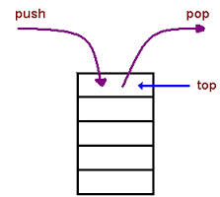
Stack<E> in java.util Queue not in java.util
Stack<E>: Implements a stack:
size() isEmpty()
push(e) pop() peek()
Queue Implement a queue: size() isEmpty()
push(e) pop() peek()
Stack is actually a subclass of Vector,
So you can use all of Vector’s methods
peek: get top or first value but don’t remove it
Stack LIFO last in first out
Queue: FIFO first in first out
Notes:
Two special kinds of lists are the stack and the queue.
Stack: LIFO. Example, the stack of trays in the cafeteria –you always take the top one.
Example: The stack of frames for method calls that are being executed but have not finished.
Pop removes and returns the top stack value; peek gives you the value without removing it.
2. Interesting: class Stack is implemented using a Vector, which is a more general implementation of a list!
3. Queue: We in America stand on a line to buy tickets for something. The British stand in a queue.
It’s a first-in-first-out structure –the person at the head of the queue.

Slide 11
Linked List
Head = first element of the list
Tail = rest of the list
33
10
-7
1
84
φ
head
tail

Slide 12
Access Example: Linear Search
public static boolean search(T x, ListCell c) {
while(c != null) {
if (c.getDatum().equals(x)) return true;
c = c.getNext();
}
return false;
}

Slide 13
Why would we need to write code for search? It already exists in Java utils!
Good question! In practice you should always use indexOf(), contains(), etc
But by understanding how to code search, you gain skills you’ll need when working with data structures that are more complex and that don’t match predefined things in Java utils
General rule: If it already exists, use it. But for anything you use, know how you would code it!

Slide 14
Recursion on Lists
Recursion can be done on lists
Similar to recursion on integers
Almost always
Base case: empty list
Recursive case: Assume you can solve problem on the tail, use that in the solution for the whole list
Many list operations can be implemented very simply by using this idea
Although some are easier to implement using iteration

Slide 15
Recursive Search
Base case: empty list
return false
Recursive case: non-empty list
if data in first cell equals object x, return true
else return the result of doing linear search on the tail
Notes:
Method is declared static, so it belongs to class and can be invoked by class.methodName(), but does not belong to the objects.
Math routines are defined this way: public static int pow(int a, int b) can be called anywhere as Math.pow(2,4)

Slide 16
Recursive Search: Static method
public static boolean search(T x, ListCell c) {
if (c == null) return false;
if (c.getDatum().equals(x)) return true;
return search(x, c.getNext());
}

Slide 17
Trees
Lecture 10
CS2110 – Fall 2013

Slide 18
Readings & Homework on Trees
Textbook:
Chapter 23 “Trees”
Chapter 24 “Tree Implementations”
Assignment #4
“Collision Detection”
Based on “bounding box” trees

Slide 19
Readings and Homework
Textbook:
Chapter 23 “Trees”
Chapter 24“Tree Implementations”
Homework: A thought problem (draw pictures!)
Suppose you use trees to represent student schedules. For each student there would be a general tree with a root node containing student name and ID. The inner nodes in the tree represent courses, and the leaves represent the times/places where each course meets. Given two such trees, how could you determine whether and where the two students might run into one-another?

Slide 20
Tree Overview
5
5
Tree: recursive data structure (similar to list)
Each node may have zero or more successors (children)
Each node has exactly one predecessor (parent) except the root, which has none
All nodes are reachable from root
Binary tree: tree in which each node can have at most two children: a left child and a right child
4
2
4
2
7
8
9
7
8
General tree
Binary tree
5
5
4
6
7
8
8
Not a tree
List-like tree

Slide 21
Binary Trees were in A1!
You have seen a binary tree in A1.
An elephant has a mom and pop. There is an ancestral tree!
elephant
mom pop
mom pop mom

Slide 22
Tree Terminology
M: root of this tree
G: root of the left subtree of M
B, H, J, N, S: leaves
N: left child of P; S: right child
P: parent of N
M and G: ancestors of D
P, N, S: descendents of W
J is at depth 2 (i.e. length of path from root = no. of edges)
W is at height 2 (i.e. length of longest path to a leaf)
A collection of several trees is called a ...?
M
G
W
D
J
P
B
H
N
S

Slide 23
Class for Binary Tree Node
Points to left subtree
class TreeNode<T> {
private T datum;
private TreeNode<T> left, right;
/** Constructor: one node tree with datum x */
public TreeNode (T x) { datum= x; }
/** Constr: Tree with root value x, left tree lft, right tree rgt */ public TreeNode (T x, TreeNode<T> lft, TreeNode<T> rgt) {
datum= x; left= lft; right= rgt;
}
}
Points to right subtree
more methods: getDatum, setDatum, getLeft, setLeft, etc.

Slide 24
Binary versus general tree
In a binary tree each node has exactly two pointers: to the left subtree and to the right subtree
Of course one or both could be null
In a general tree, a node can have any number of child nodes
Very useful in some situations …

Slide 25
Class for General Tree nodes
5
class GTreeNode {
private Object datum;
private GTreeCell left;
private GTreeCell sibling;
appropriate getters/setters
}
4
2
General tree
7
8
9
7
8
3
1
5
Parent node points directly only to its leftmost child
Leftmost child has pointer to next sibling, which points to next sibling, etc.
4
2
Tree represented using GTreeCell
7
8
9
7
8
3
1

Slide 26
Applications of Trees
Most languages (natural and computer) have a recursive, hierarchical structure
This structure is implicit in ordinary textual representation
Recursive structure can be made explicit by representing sentences in the language as trees: Abstract Syntax Trees (ASTs)
ASTs are easier to optimize, generate code from, etc. than textual representation
A parser converts textual representations to AST

Slide 27
Example
Expression grammar:
E → integer
E → (E + E)
In textual representation
Parentheses show hierarchical structure
In tree representation
Hierarchy is explicit in the structure of the tree
Text
AST Representation
-34
-34
(2 + 3)
+
2
3
((2+3) + (5+7))
+
+
+
2
3
5
7

Slide 28
Recursion on Trees
Recursive methods can be written to operate on trees in an obvious way
Base case
empty tree
leaf node
Recursive case
solve problem on left and right subtrees
put solutions together to get solution for full tree

Slide 29
Searching in a Binary Tree
/** Return true iff x is the datum in a node of tree t*/ public static boolean treeSearch(Object x, TreeNode t) {
if (t == null) return false;
if (t.datum.equals(x)) return true;
return treeSearch(x, t.left) || treeSearch(x, t.right);
}
Analog of linear search in lists: given tree and an object, find out if object is stored in tree
Easy to write recursively, harder to write iteratively
2
9
0
8
3
5
7

Slide 30
Searching in a Binary Tree
/** Return true iff x is the datum in a node of tree t*/ public static boolean treeSearch(Object x, TreeNode t) {
if (t == null) return false;
if (t.datum.equals(x)) return true;
return treeSearch(x, t.left) || treeSearch(x, t.right);
}
Important point about t. We can think of it either as
One node of the tree OR
The subtree that is rooted at t
2
9
0
8
3
5
7

Slide 31
Binary Search Tree (BST)
5
If the tree data are ordered: in every subtree,
All left descendents of node come before node
All right descendents of node come after node
Search is MUCH faster
2
8
0
3
7
9
/** Return true iff x if the datum in a node of tree t.
Precondition: node is a BST */ public static boolean treeSearch (Object x, TreeNode t) {
if (t== null) return false;
if (t.datum.equals(x)) return true;
if (t.datum.compareTo(x) > 0)
return treeSearch(x, t.left);
else return treeSearch(x, t.right);
}

Slide 32
Building a BST
To insert a new item
Pretend to look for the item
Put the new node in the place where you fall off the tree
This can be done using either recursion or iteration
Example
Tree uses alphabetical order
Months appear for insertion in calendar order
jan
feb
mar
apr
jun
may
jul

Slide 33
What Can Go Wrong?
apr
A BST makes searches very fast, unless…
Nodes are inserted in alphabetical order
In this case, we’re basically building a linked list (with some extra wasted space for the left fields that aren’t being used)
BST works great if data arrives in random order
feb
jan
jul
jun
mar
may

Slide 34
Printing Contents of BST
Because of ordering rules for a BST, it’s easy to print the items in alphabetical order
Recursively print left subtree
Print the node
Recursively print right subtree
/** Print the BST in alpha. order. */
public void show () {
show(root);
System.out.println();
}
/** Print BST t in alpha order */
private static void show(TreeNode t) {
if (t== null) return;
show(t.lchild);
System.out.print(t.datum);
show(t.rchild);
}

Slide 35
Tree Traversals
“Walking” over whole tree is a tree traversal
Done often enough that there are standard names
Previous example: inorder traversal
Process left subtree
Process node
Process right subtree
Note: Can do other processing besides printing
Other standard kinds of traversals
Preorder traversal
Process node
Process left subtree
Process right subtree
Postorder traversal
Process left subtree
Process right subtree
Process node
Level-order traversal
Not recursive uses a queue

Slide 36
Some Useful Methods
/** Return true iff node t is a leaf */
public static boolean isLeaf(TreeNode t) {
return t!= null && t.left == null && t.right == null;
}
/** Return height of node t using postorder traversal
public static int height(TreeNode t) {
if (t== null) return -1; //empty tree
if (isLeaf(t)) return 0;
return 1 + Math.max(height(t.left), height(t.right));
}
/** Return number of nodes in t using postorder traversal */
public static int nNodes(TreeNode t) {
if (t== null) return 0;
return 1 + nNodes(t.left) + nNodes(t.right);
}

Slide 37
Useful Facts about Binary Trees
Max number of nodes at depth d: 2^{d}
If height of tree is h
min number of nodes in tree: h + 1
Max number of nodes in tree:
2⁰ + … + 2^{h} = 2^{h+1} – 1
Complete binary tree
All levels of tree down to a certain depth are completely filled
depth
0
5
1
4
2
2
7
8
0
4
Height 2,
maximum number of nodes
5
2
4
Height 2,
minimum number of nodes

Slide 38
Tree with Parent Pointers
In some applications, it is useful to have trees in which nodes can reference their parents
Analog of doubly-linked lists
5
4
2
7
8

Slide 39
Things to Think About
What if we want to delete data from a BST?
A BST works great as long as it’s balanced
How can we keep it balanced? This turns out to be hard enough to motivate us to create other kinds of trees
jan
feb
mar
apr
jun
may
jul

Slide 40
Suffix Trees
Given a string s, a suffix tree for s is a tree such that
each edge has a unique label, which is a nonnull substring of s
any two edges out of the same node have labels beginning with different characters
the labels along any path from the root to a leaf concatenate together to give a suffix of s
all suffixes are represented by some path
the leaf of the path is labeled with the index of the first character of the suffix in s
Suffix trees can be constructed in linear time

Slide 41
Suffix Trees
a
cadabra$
bra
ra
dabra$
$
dabra$
cadabra$
$
cadabra$
$
cadabra$
$
bra
$
cadabra$
abracadabra$

Slide 42
Suffix Trees
Useful in string matching algorithms (e.g., longest common substring of 2 strings)
Most algorithms linear time
Used in genomics (human genome is ~4GB)

Slide 43
Huffman Trees
0
1
0
1
0
1
0
1
0
1
e
e
t
a
s
t
0
1
197
63
40
26
a
s
Fixed length encoding
197*2 + 63*2 + 40*2 + 26*2 = 652
Huffman encoding
197*1 + 63*2 + 40*3 + 26*3 = 521

Slide 44
Huffman Compression of “Ulysses”
' ' 242125 00100000 3 110
'e' 139496 01100101 3 000
't' 95660 01110100 4 1010
'a' 89651 01100001 4 1000
'o' 88884 01101111 4 0111
'n' 78465 01101110 4 0101
'i' 76505 01101001 4 0100
's' 73186 01110011 4 0011
'h' 68625 01101000 5 11111
'r' 68320 01110010 5 11110
'l' 52657 01101100 5 10111
'u' 32942 01110101 6 111011
'g' 26201 01100111 6 101101
'f' 25248 01100110 6 101100
'.' 21361 00101110 6 011010
'p' 20661 01110000 6 011001
44

Slide 45
Huffman Compression of “Ulysses”
...
'7' 68 00110111 15 111010101001111
'/' 58 00101111 15 111010101001110
'X' 19 01011000 16 0110000000100011
'&' 3 00100110 18 011000000010001010
'%' 3 00100101 19 0110000000100010111
'+' 2 00101011 19 0110000000100010110
original size 11904320
compressed size 6822151
42.7% compression
45

Slide 46
BSP Trees
BSP = Binary Space Partition (not related to BST!)
Used to render 3D images composed of polygons
Each node n has one polygon p as data
Left subtree of n contains all polygons on one side of p
Right subtree of n contains all polygons on the other side of p
Order of traversal determines occlusion (hiding)!
Notes:
Visually impoverished slide ☹

Slide 47
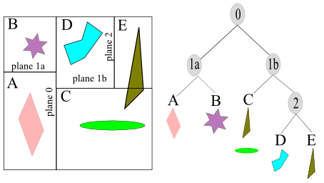
BSP Trees (c.f. k-d trees)
BSP = Binary Space Partition (not related to BST!)
Used to render 3D images of polygons, e.g., Doom engine
Example: Axis-aligned BSP Tree
Each non-leaf node n represents a region & splitting plane p
Left subtree of n contains all sub-regions on one side of p
Right subtree of n contains all sub-regions on the other side of p
Leaf nodes represent regions with associated data (e.g., geometry)
http://www.bogotobogo.com/Games/spatialdatastructure.php

Slide 48
Tree Summary
A tree is a recursive data structure
Each cell has 0 or more successors (children)
Each cell except the root has at exactly one predecessor (parent)
All cells are reachable from the root
A cell with no children is called a leaf
Special case: binary tree
Binary tree cells have a left and a right child
Either or both children can be null
Trees are useful for exposing the recursive structure of natural language and computer programs

Slide 49
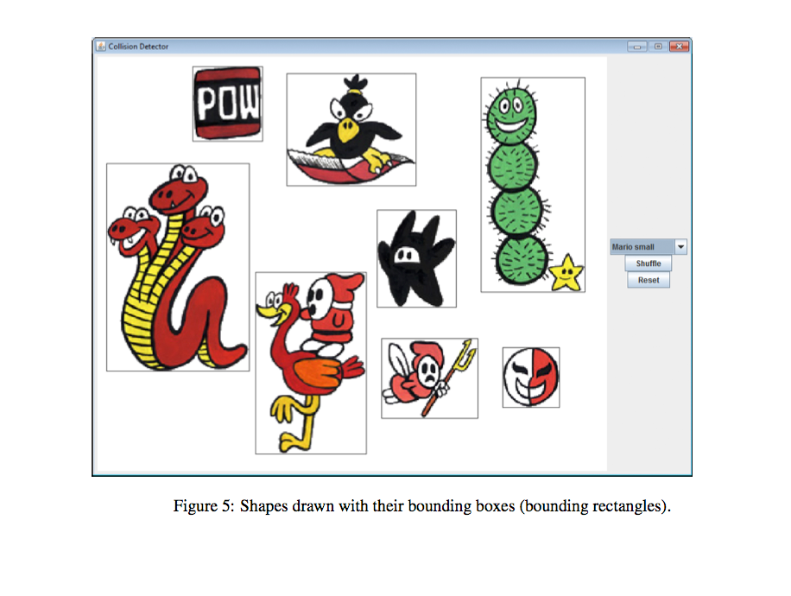
A4: Collision Detection
Axis-aligned Bounding Box Trees (AABB-Trees)
Object partitioning
Build one on each shape
Do tree-tree queries to detect overlapping shapes
Some GUI material
Available on CMS
Due October 22, 11:59 pm
Demo!

