Slide 1
CS/ENGRD 2110
Spring 2013
Lecture 1: Overview
http://courses.cs.cornell.edu/cs2110

Slide 2
Welcome to CS2110!
We’ll be learning about…
  OO, abstract data types, generics, queries on Java collections, other cool Java features
  Reasoning about complex problems, analysis of the algorithms we create to solve them, and implementing those tricky algorithms with elegant, easy to understand, correct code
  Recursion on graphs and other linked structures
  Algorithmic complexity
  (+ lectures on cloud computing & quantum computing)

Slide 3
Is CS2110 right for you?
Knowledge of Java not required
  About 40% of students know Java
  Others know Matlab, Python, …
  Requirement: comfort with some programming language.
  Prior knowledge of OO and “strong typing” not required.
Don’t take cs1110 just because you are worried that your high school programming experience won’t do
We recommend against skipping directly to cs3110. cs3110 requires permission from both Prof Birman and Prof Joachims!

Slide 4
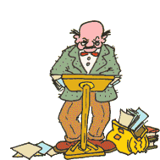

Lectures
TR 10:10-11am, Statler auditorium
  Attendance is mandatory
  Old videonotes from 2010 are available but
  the course has evolved since then …
ENGRD 2110 or CS 2110?
  Same course! We call it CS 2110 in online materials
  Non-engineers sign up for CS 2110
  Engineers sign up for ENGRD 2110

Slide 5
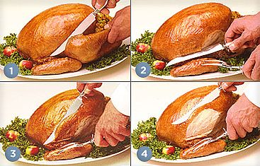
Sections
Like lecture, attendance is mandatory
Usually review, help on homework
Sometimes new material
Section numbers are different for CS and ENGRD
Each section led by member of the teaching staff
No permission needed to switch sections, but do register for whichever one you attend

Slide 6
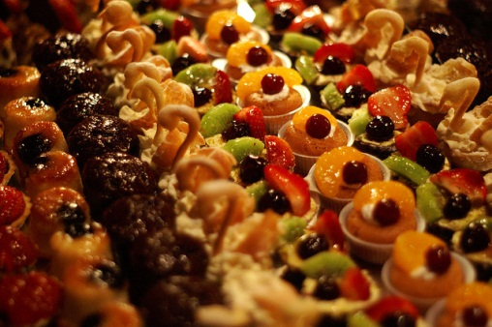

CS2111
New!
  An “enrichment” course
  Aimed at students who want slightly more help understanding core ideas behind Java, objects, and programming
  Taught by Professor Gries, 1 credit S/U, only for students who also take CS2110.
We hope to help students who might otherwise feel overwhelmed by CS2110

Slide 7
Academic Excellence Workshops
Two-hour labs: students work together in cooperative setting
One credit S/U course based on attendance
Time and location TBA
See website for more info:
www.engineering.cornell.edu/student-services/
learning/academic-excellence-workshops/

Slide 8
Resources
Book: Frank M. Carrano, Data Structures and Abstractions with Java, 3nd ed., Prentice Hall
  Note: 2nd edition is okay
  Sharing textbook: fantastic idea. You don’t need a personal copy. You do need access to it from time to time
  Copies on reserve in Engr Library
Additional material on Prentice Hall website
  “e-Book” not required
Great Java resource: online materials at Oracle JDK web site. Google has it indexed.

Slide 9

Obtaining Java
Follow instructions on our « resources » web page
  Make sure you have Java JDK 1.6 or 1.7, if not download and install. We explain how on the page.
  Then download and install the Eclipse Juno « IDE » for Java developers from Eclipse IDE for Java Developers
Test it out: launch Eclipse and click “new>Java Project”
  This is one of a few ways Java can be used
  When program runs, output will be visible
  in a little console window

Slide 10

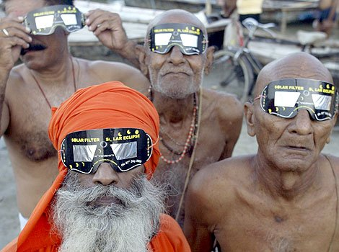
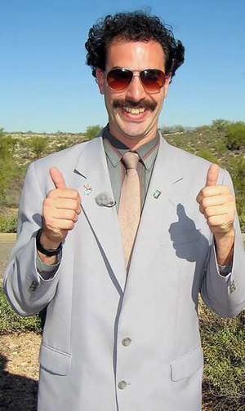
Eclipse IDE
IDE: Integrated Development Environment
  Helps you write your code
  Protects against many common mistakes
  At runtime, helps with debugging
Follow “Resources” link to download
“In my country of Kazakhstan everyone is use Eclipse and Java!
Java 1.7 is best for hack American web site and steal credit card.”

Slide 11
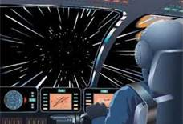
Learning Java
CS 2110 assumes that students are totally new to Java —we’ll teach you the language
We assume you are comfortable programming in some other language, so we’ll teach Java at a pretty fast pace
By end of course, you’ll have seen
some “extreme Java” capabilities…

Slide 12
Coursework
5 assignments involving both programming and written answers (45%)
Two prelims (15% each)
Final exam (20%)
Course evaluation (1%)
Possible surprise in-class quizzes (4%)

Slide 13
Assignments
A1 and A5: do by yourself
A2-A4: teams of one or two (not more than two)
  A1 will be posted soon on CMS
  We encourage you to do them by yourself and have considered making this the rule
  Finding a partner: choose your own or contact your TA. Piazza is incredibly helpful.

Slide 14
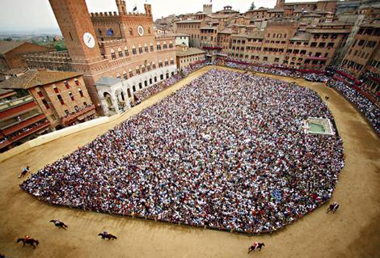
Piazza
Click link on our web page to register
Incredible resource for 24x7 help with anything
We keep an eye on it,
but people help each
other out too.

Slide 15
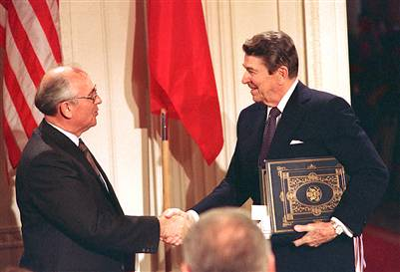
Academic Integrity… Trust but verify!
We use artificial intelligence tools to check each homework assignment
  The software is very accurate!
  It tests your code and also notices similarities between code written by different people
Sure, you can fool this software
  … but it’s easier to just do the assignments
  … and if you try to fool it and screw up, you might fail the assignment or even the whole course.

Slide 16
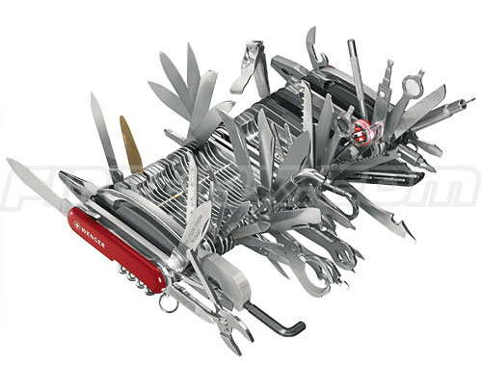
What’s CS 2110 about?
Computational tools are “universal” but
the key is to master computational thinking.
  Looking at problems in ways that lead naturally to highly effective, correct, computational solutions
  There are many ways to do anything, but some are way better than others
Mastery of computational thinking will help you become a master of the universe!
Also: Great job prospects with high salaries…

Slide 17
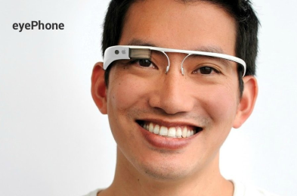
Example (we’ll see it again in April…)
Suppose you wanted to build a massive database of pictures of people and stuff about them
… then create smart eyeglasses
In the past a concept like this was crazy…
  Today, it can be solved with “cloud computing” + Java programs to search huge image databases fast…
  … With CS2110 you’ll be about 1/3 of the way there
    Also: Snavely’s vision course + Ken’s cloud computing course

Slide 18
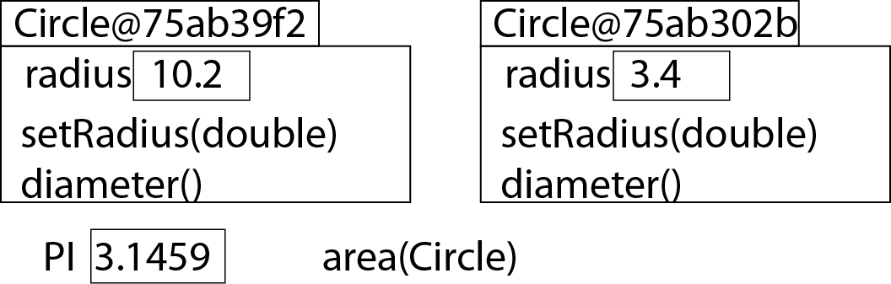
A class declaration defines
Format/content of objects, which can contain variables and functions/procedures
Variables and functions/procedures for which only ONE copy exists
A class defines the form and behavior of some type of objects.
But your program needs to explicitly create them.

Slide 19
World’s simplest Java program
Writing “Hello world” in Java using Eclipse
Running it
Understanding line by line exactly what it says
Let’s launch Eclipse and see these steps in action

Slide 20
Next steps?
Attend a recitation section this week
Repeat what we just did but do it yourself
  Try making mistakes and see what Eclipse “says”
  Try making it a little fancier
Drop in to see what CS2111 is about this afternoon (two times, on Tuesday)

