Slide 1
CS 2110 Review
Johnathon Schultz
10.13.10
(with excerpts from The Brief, Incomplete and Largely Inaccurate History of Programming Languages)

Slide 2
Prelim information
Prelim 1: TOMORROW at 7:30 PM
  Review session – Tonight 7:30 PM, Phillips 101 (or now?)
Things you should do:
  Review every practice prelim #1
  Review practice finals (ignore questions that cover topics you haven’t learned yet)
  Review quizzes
  Review lecture slides

Slide 3
Material Covered
Types
Recursion (including grammars)
Lists and Trees
How Java Works
Software Design Patterns
Easy Big O
Not Covered:
  GUI
  Induction

Slide 4
Java basics
1996 - James Gosling invents Java. Java is a relatively verbose, garbage collected, class based, statically typed, single dispatch, object oriented language with single implementation inheritance and multiple interface inheritance. Sun loudly heralds Java's novelty.
2001 - Anders Hejlsberg invents C#. C# is a relatively verbose, garbage collected, class based, statically typed, single dispatch, object oriented language with single implementation inheritance and multiple interface inheritance. Microsoft loudly heralds C#'s novelty.

Slide 5
Primitive and reference types
Primitive types
  int, double, boolean, char, long, short, float, byte
  compare with ==
Reference types
  Everything else – anything that is an object type
  String, HashMap, Integer
  Arrays are reference types
  compare with .equals()
1980 - Alan Kay creates Smalltalk and invents the term "object oriented." When asked what that means he replies, "Smalltalk programs are just objects." When asked what objects are made of he replies, "objects." When asked again he says "look, it's all objects all the way down. Until you reach turtles."

Slide 6
== vs. .equals()
==
  Compares the contents of two variables
  For primitive types, this is the actual data
  For reference types, this is the reference, not the object
    Two variables are == if they point to the same object
    Two different objects with the same contents are not ==
      different location in memory
equals() is the smarter version
  Looks at the contents of the objects
  Need to override equals() if you create a new class

Slide 7
Pass by value / reference
Primitive types
  Java copies the data itself; original data is unchanged
  Pass by value
Reference types
  Java makes a copy of the reference to the object
  Both references point to the same object
  Changes affecting the object are permanent
  If new reference changes, old reference is unchanged
  Pass by reference

Slide 8
interfaces
Outline of a class
Methods in an interface must be implemented in any class that implements that interface
  For example: Interface Iterable
  If another programmer looks at your class and sees you implemented Iterable, they know for a fact that they can iterate through an object of your class
  One interface can be implemented by many classes; one class can implement many interfaces
Abstract Class
  Similar, but some methods are implemented

Slide 9
Inheritance
Subclasses inherit fields + methods of superclass
Overriding – subclass contains the same method as superclass (same name, parameters, static/not)
Shadowing – subclass contains the same field (instance variable) as superclass (this is BAD)
Casting – upcasting is always type-safe and OK
  Downcasting is bad – sometimes doesn’t work (hard to predict)
  For inheritance, types, see ScopeTester.java
Java is single implementation inheritance and multiple interface inheritance

Slide 10
Typing
Suppose type B implements or extends type A
  B is a subtype of A; A is a supertype of B
Each variable has a static type
  List<Integer> x; – List<Integer> is the static type
  Note: List<SubtypeOfInteger> is not a subtype of List<Integer>
Can safely assign x a dynamic subtype of List<Integer>
  x = new ArrayList<Integer>;
Static type can differ from dynamic type at runtime
  The dynamic type cannot be an interface

Slide 11
Typing examples
B var = new C();
Static type = B
  Static type is used when calling fields; i.e. var.x will call the field x in class B
  NEVER CHANGES
Dynamic type = C
  Used when calling methods; i.e. var.hello() will call the method hello() in C (not the one in B!)
  Changed by: var = new B();
  Now, the dynamic type is B
  Casting: var = (B) var – does not change any type

Slide 12
miscellaneous
a++ vs. ++a
  By themselves, equivalent
  But when used in conjunction with other statements:
    arr[a++]: arr[a]; a += 1;
    arr[++a]: a += 1; arr[a];
Static keyword:
  Associates a given field with the Class instead of a specific instance
Visibility
  Public
  Private
  Protected

Slide 13
recursion
1801 - Joseph Marie Jacquard uses punch cards to instruct a loom to weave "hello, world" into a tapestry. Redditers of the time are not impressed due to the lack of tail call recursion, concurrency, or proper capitalization.
1958 - John McCarthy and Paul Graham invent LISP. Due to high costs caused by a post-war depletion of the strategic parentheses reserve LISP never becomes popular [1]. In spite of its lack of popularity, LISP remains an influential language in “key algorithmic techniques such as recursion and condescension” [2].

Slide 14
recursion
To understand recursion, you must first understand recursion.
A procedure or subroutine whose implementation references itself
Examples
  Fibonacci: Fib(n) = Fib(n-1) + Fib(n-2)
  Factorial: n! = n * (n-1)!
  Grammar Parsing
Must have one or more base cases and a recursive case
  You don’t need to know proofs by induction for Prelim 1
If a problem asks you to write a recursive method, you must call that method within itself
You should know how to run through a recursive method and figure out its output
  See Recursion.java

Slide 15
Grammars and parsing
Refer to the following grammar (ignore spaces). <S> is the start symbol of the grammar. (Note that P → a | b is really two rules, P → a and P → b)
  <S> → <exp>
  <exp> → <int> + <int> | <int> - <med_int> | <int> + <exp>
  <int> → <small_int> | <med_int> <large_int> | <small_int>.<large_int>
  <large_int> → 8 | 9
  <med_int> → 5 | 6 | 7
  <small_int> → 0 | 1 | 2 | 3 | 4
  Is “3 + 2.8 – 7” a valid sentence?

Slide 16
Grammars and parsing
Refer to the following grammar (ignore spaces). <S> is the start symbol of the grammar. (Note that P → a | b is really two rules, P → a and P → b)
  <S> → <exp>
  <exp> → <int> + <int> | <int> - <med_int> | <int> + <exp>
  <int> → <small_int> | <med_int> <large_int> | <small_int>.<large_int>
  <large_int> → 8 | 9
  <med_int> → 5 | 6 | 7
  <small_int> → 0 | 1 | 2 | 3 | 4
  Is “30 + 0 + 0.99” a valid sentence?

Slide 17
Grammars and parsing
Refer to the following grammar (ignore spaces). <S> is the start symbol of the grammar. (Note that P → a | b is really two rules, P → a and P → b)
  <S> → <exp>
  <exp> → <int> + <int> | <int> - <med_int> | <int> + <exp>
  <int> → <small_int> | <med_int> <large_int> | <small_int>.<large_int>
  <large_int> → 8 | 9
  <med_int> → 5 | 6 | 7
  <small_int> → 0 | 1 | 2 | 3 | 4
Which rule makes the grammar infinite?

Slide 18
Recursive descent parsers
Recursively parse the data by descending from the top level into smaller and smaller chunks.
Cannot handle all Grammars
  Ex:
    S → b
    S → Sa
Grammar can be rewritten:
  S → b
  S → bA
  A→ a
  A → aA

Slide 19
Lists
1964 - John Kemeny and Thomas Kurtz create BASIC, an unstructured programming language for non-computer scientists.
1965 - Kemeny and Kurtz go to 1964.

Slide 20
Lists
Definition:
  A data structure that contains a sequence of elements such that each element contains a reference to the next element
public interface List<T> {
public void insert(T element);
public void delete(T element);
public boolean contains(T element);
public int size();
}

Slide 21
More Lists
Each element points to the next element in the list
Doubly linked lists – element points to the previous element in the list
Circular linked lists – last element points to the first element
  See code – List.java, Node.java, ListTester.java
  There are more List implementations on the website
Examples:
  Java.util.ArrayList
  Java.util.LinkedList

Slide 22
Trees
1972 - Dennis Ritchie invents a powerful gun that shoots both forward and backward simultaneously. Not satisfied with the number of deaths and permanent maimings from that invention he invents C and Unix.
1983 - Bjarne Stroustrup bolts everything he's ever heard of onto C to create C++. The resulting language is so complex that programs must be sent to the future to be compiled by the Skynet artificial intelligence. Build times suffer. Skynet's motives for performing the service remain unclear but spokespeople from the future say "there is nothing to be concerned about, baby," in an Austrian accented monotones. There is some speculation that Skynet is nothing more than a pretentious buffer overrun.

Slide 23
trees
Tree: recursive data structure (similar to list)
  Each cell may have zero or more successors (children)
  Each cell has exactly one predecessor (parent) except the root, which has none
  All cells are reachable from root
Binary tree: tree in which each cell can have at most two children: a left child and a right child
5
5
4
2
4
2
7
8
9
7
8
General tree
Binary tree
5
5
4
6
7
8
8
Not a tree
List-like tree

Slide 24
Tree terminology
M is the root of this tree
G is the root of the left subtree of M
B, H, J, N, and S are leaves
N is the left child of P; S is the right child
P is the parent of N
M and G are ancestors of D
P, N, and S are descendants of W
Node J is at depth 2 (i.e., depth = length of path from root)
Node W is at height 2 (i.e., height = length of longest path to a leaf)
A tree is complete if it all the levels are completely filled except for the last
M
G
W
D
J
P
B
H
N
S

Slide 25
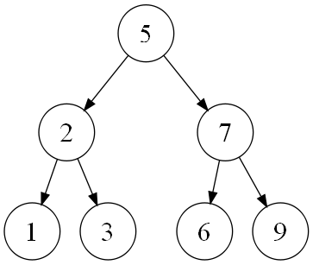
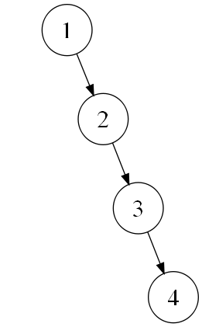
Binary search trees
Also known as BSTs
Children to the left are less than the current node
Children to the right are greater than the current node

Slide 26
Tree traversals
Preorder
  Root node, Left Node, Right Node
Postorder
  Left Node, Right Node, Root Node
Inorder
  Left Node, Root Node, Right Node
Breadth First
  First level, Second Level, Third Level, …
Depth First
  Root, Child, Child, Child, …, Leaf, Up One, Child, Child, Leaf, …

Slide 27
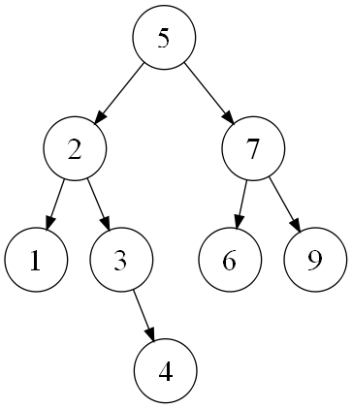
Preorder Traversal
Pre(5)
5, Pre(2), Pre(7)
5, 2, 1, Pre(3), Pre(7)
5, 2, 1, 3, 4, Pre(7)
5, 2, 1, 3, 4, 7, 6, 9

Slide 28
Inorder Traversal
In(5)
In(2), 5, In(7)
1, 2, In(3), 5, In(7)
1, 2, 3, 4, 5, In(7)
1, 2, 3, 4, 5, 6, 7, 9

Slide 29
Postorder Traversal
Post(5)
Post(2), Post(7), 5
1, Post(3), 2, Post(7), 5
1, 4, 3, 2, Post(7), 5
1, 4, 3, 2, 6, 9, 7, 5

Slide 30
Quick Aside
Stack
  LIFO -- Last-In First-Out
  Push(Object o), pop()
Queue
  FIFO -- First-In First-Out
  Enqueue(Object o), Dequeue() [sometimes this is pop() as well)

Slide 31
Breadth first and depth first
  Breadth First:
    5, Depth 1, Depth 2, Depth 3
    5, 2, 7, Depth 2, Depth 3
    5, 2, 7, 1, 3, 6, 9, Depth 3
    5, 2, 7, 1, 3, 6, 9, 4
Depth First:
  5, 5.Left, 5.Right
  5, 2, 2.Left, 2.Right, 5.Right
  5, 2, 1, 2.Right, 5.Right
  5, 2, 1, 3, 3.Right, 5.Right
  5, 2, 1, 3, 4, 5.Right

Slide 32
Breadth first and depth first
Queue q = new Queue();
q.enqueue(root);
While(q.size() != 0){
node = q.dequeue();
if(node == val){
return True;
q.enqueue(node.left);
q.enqueue(node.right);
}
What happens if we change the Queue to a Stack?

Slide 33
Tree summary
Know how to traverse (in-order, pre-order, post-order)
Know how to search (BFS, DFS)
Know how to write methods for a tree (including binary search trees) – insert, delete, contains
  Base cases – empty tree or leaf node
  Recursive cases – Call method on left and right subtrees (or on the correct subtree, for example contains on a BST)
  These methods are all in the lecture slides
1957 - John Backus and IBM create FORTRAN. There's nothing funny about IBM or FORTRAN. It is a syntax error to write FORTRAN while not wearing a blue tie.

Slide 34
efficiency
1987 - Larry Wall falls asleep and hits Larry Wall's forehead on the keyboard. Upon waking Larry Wall decides that the string of characters on Larry Wall's monitor isn't random but an example program in a programming language that God wants His prophet, Larry Wall, to design. Perl is born.
1986 - Brad Cox and Tom Love create Objective-C, announcing "this language has all the memory safety of C combined with all the blazing speed of Smalltalk." Modern historians suspect the two were dyslexic

Slide 35
Big O notation
F is O(n) means F is on the order of n.
Big O provides an upper bound for the number of operations the function is performing, based on the size of its input
5n² + log n + n – 40 is O(n²)
Notation | Name | Example
O(1) | Constant | Determining if a number is odd
O(log n) | Logarithmic | Finding an item in a sorted list or tree
O(n) | Linear | Finding an item in an unsorted list or tree.
O(n log n) | Quasilinear | Quicksort (best and average case), Merge sort
O(n²) | Quadratic | Bubble sort, Quicksort (worst case)
O(n^{c}) | Polynomial | Maximum matching for bipartite graphs
O(c^{n}) | Exponential | Travelling salesman advanced, K-SAT brute-force
O(n^{n}) O(n!) | Factorial | Travelling salesman brute-force

Slide 36
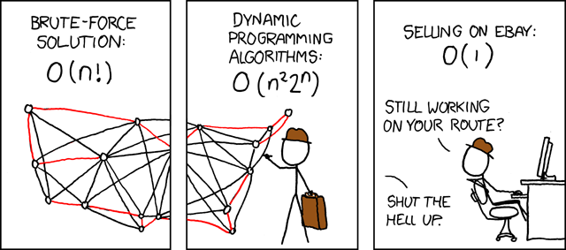

Slide 37
sorting
1995 - Brendan Eich reads up on every mistake ever made in designing a programming language, invents a few more, and creates LiveScript. Later, in an effort to cash in on the popularity of Java the language is renamed JavaScript. Later still, in an effort to cash in on the popularity of skin diseases the language is renamed ECMAScript.
2003 - A drunken Martin Odersky sees a Reese's Peanut Butter Cup ad featuring somebody's peanut butter getting on somebody else's chocolate and has an idea. He creates Scala, a language that unifies constructs from both object oriented and functional languages. This pisses off both groups and each promptly declares jihad.

Slide 38
CLICK TO ADD TITTIE
http://www.sorting-algorithms.com/

Slide 39
Questions?
1970 - Guy Steele and Gerald Sussman create Scheme. Their work leads to a series of "Lambda the Ultimate" papers culminating in "Lambda the Ultimate Kitchen Utensil." This paper becomes the basis for a long running, but ultimately unsuccessful run of late night infomercials. Lambdas are relegated to relative obscurity until Java makes them popular by not having them.
1970 - Niklaus Wirth creates Pascal, a procedural language. Critics immediately denounce Pascal because it uses "x := x + y" syntax instead of the more familiar C-like "x = x + y". This criticism happens in spite of the fact that C has not yet been invented.
1972 - Alain Colmerauer designs the logic language Prolog. His goal is to create a language with the intelligence of a two year old. He proves he has reached his goal by showing a Prolog session that says "No." to every query.

