Slide 1
CS 2110
Based on a slide set by Juan Altmayer Pizzorno
port25.com
Software Design Principles I

Slide 2
Overview
Today: Design Concepts & Principles
    Top-Down, Bottom-Up Design
    Software Process (briefly)
    Modularity
    Information Hiding, Encapsulation
    Principles of Least Astonishment and “DRY”
    Refactoring (if there’s time)
Next week: Test-Driven Development

Slide 3

Our Challenge
For simple applications, writing code is “linear”
  You pin down the problem
    Example: “search files and list lines that contain the string SnortBlat”
  You make minor decisions, such as where the list of files will come from, and whether SnortBlat will be a constant or an input to the program
  And then you write the code
Easy as pie!

Slide 4
But it isn’t always so easy!
Interesting applications are often challenging in ways that simple ones aren’t
  Data sets may be enormous
  The thing being computed may be complex
  The amount of code required to do it in the most obvious way may seem huge (and perhaps also, repetitious)

Slide 5
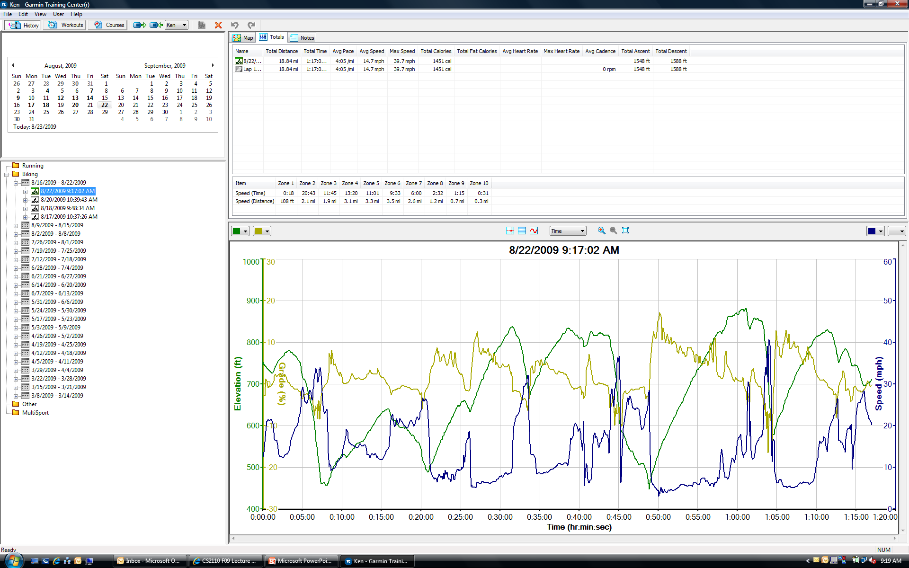
A more complex example
Garmin GPS unit tracks your bike ride

Slide 6
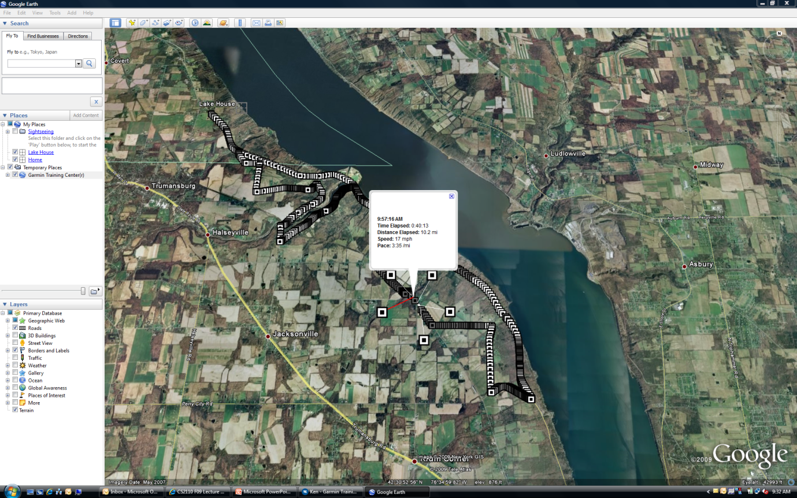
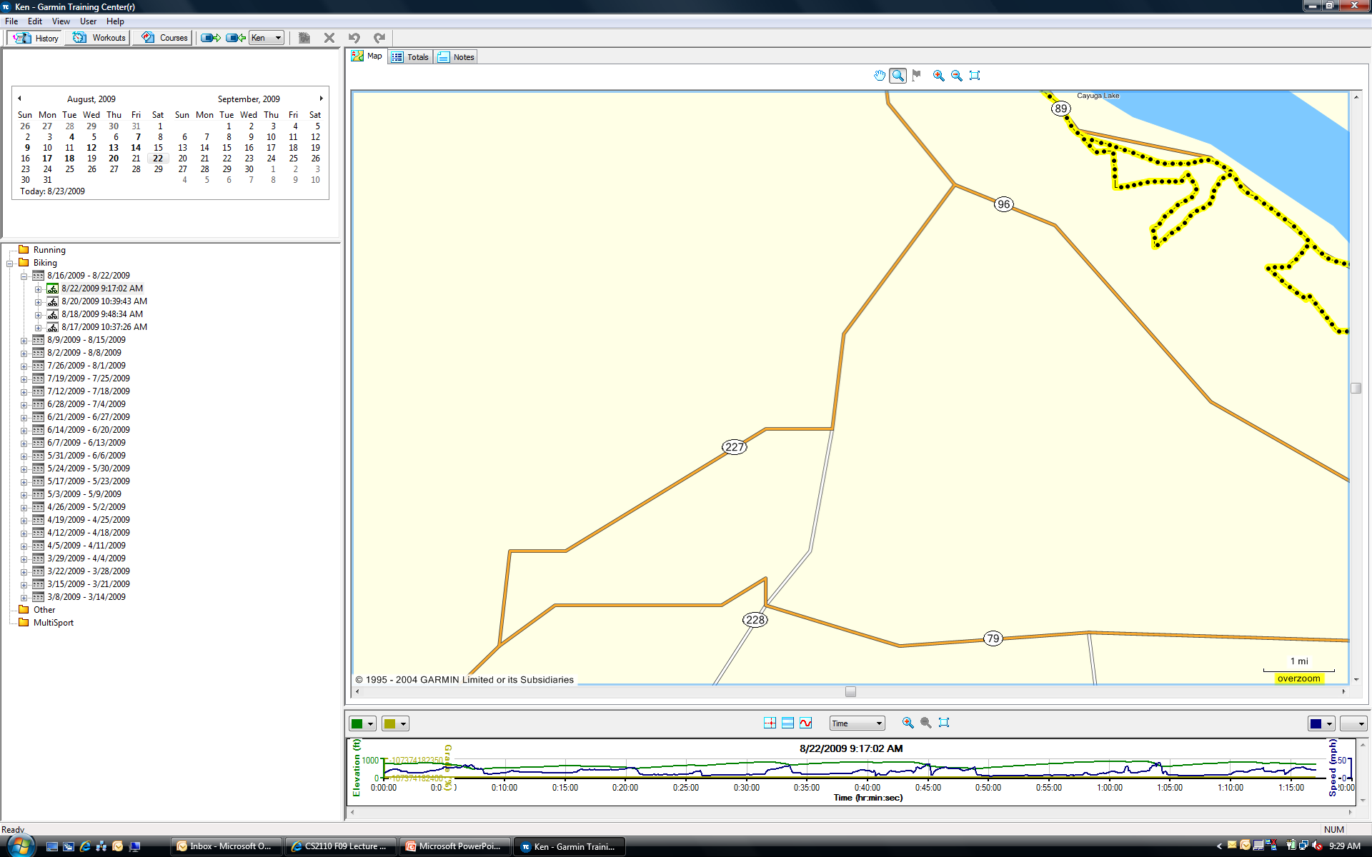
… making display easy

Slide 7
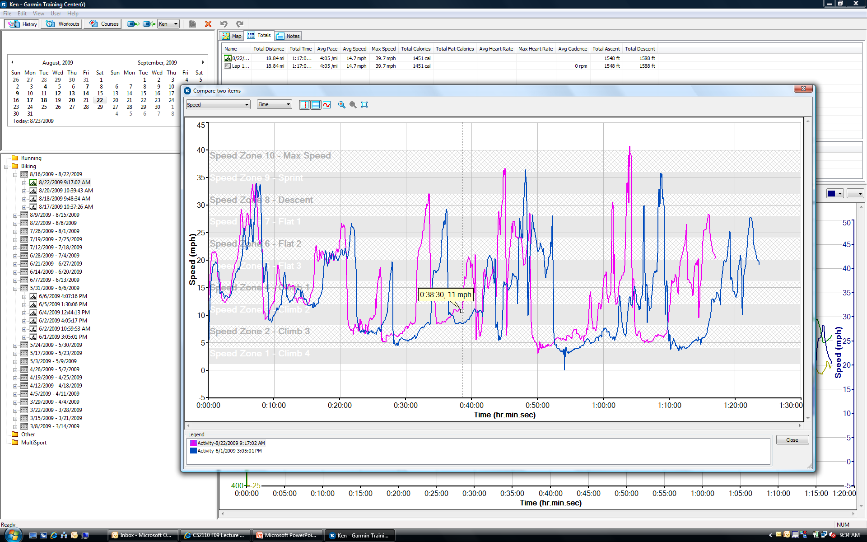
… or comparisons
How did I do today compared to the last time I rode this same route?

Slide 8
… or comparisons
Suppose we wanted to automate “finding previous rides on the same route”
  A rides is a long list of location points and won’t be identical each time
  How could we search a list of “rides” to see which ones were rides on the same route?
Is this problem similar to search files for the word SnortBlat, or different?

Slide 9
Actual data is an XML document containing a list of “track points”
<?xml version="1.0" encoding="UTF-8" standalone="no" ?>
<TrainingCenterDatabase xmlns="http://www.garmin.com/xmlschemas/TrainingCenterDatabase/v2" xmlns:xsi="http://www.w3.org/2001/XMLSchema-instance" xsi:schemaLocation="http://www.garmin.com/xmlschemas/TrainingCenterDatabase/v2 http://www.garmin.com/xmlschemas/TrainingCenterDatabasev2.xsd">
<Activities>
<Activity Sport="Biking">
<Id>2009-08-22T13:17:02Z</Id>
<Lap StartTime="2009-08-22T13:17:02Z">
<TotalTimeSeconds>4625.0800000</TotalTimeSeconds>
<DistanceMeters>30319.2753906</DistanceMeters>
<MaximumSpeed>17.7600002</MaximumSpeed>
<Calories>1451</Calories>
<Intensity>Active</Intensity>
<Cadence>0</Cadence>
<TriggerMethod>Manual</TriggerMethod>
<Track>
<Trackpoint>
<Time>2009-08-22T13:17:03Z</Time>
<Position>
<LatitudeDegrees>42.5619387</LatitudeDegrees>
<LongitudeDegrees>-76.6450787</LongitudeDegrees>
</Position>
<AltitudeMeters>229.4117432</AltitudeMeters>
<DistanceMeters>9.2514458</DistanceMeters>
<SensorState>Absent</SensorState>
</Trackpoint>
<Trackpoint>
<Time>2009-08-22T13:17:06Z</Time>
<Position>
<LatitudeDegrees>42.5618390</LatitudeDegrees>
<LongitudeDegrees>-76.6449268</LongitudeDegrees>
</Position>
<AltitudeMeters>227.4891357</AltitudeMeters>
<DistanceMeters>26.0653191</DistanceMeters>
<SensorState>Absent</SensorState>
</Trackpoint>
…..
</Track>
…
(Time=2009-08-22T13:17:03Z,Latitude=42.5619387, Longitude=- 76.6450787,Altitude=229.4117432)
(Time=2009-08-22T13:17:06Z,Latitude=42.5618390, Longitude=-76.6449268,Altitude=227.4891357)

Slide 10
Each ride is in a separate file
Sort of like a set of documents
I want to find the ones that “describe” the same route – the same list of roads in the same order, turns at the same place, etc
But the GPS unit won’t have collected snapshots at identical spots

Slide 11

An idea!
Think of each ride as a curve that we
represent as a graph (nodes are GPS data, edges link successive points)
If two rides were on the same route, then these curves should overlap closely, provided we ignore the timestamp
  (This is because the rides were different days and perhaps different speeds)

Slide 12
Which rides were similar?

Slide 13
Which rides were similar?
Could match the curves “edge by edge” and compute area between them….
Similar rides should
have small area difference
Different rides won’t match at all….
(Time=2009-08-22T13:17:03Z,Latitude=42.5619387, Longitude=- 76.6450787,Altitude=229.4117432)
(Time=2009-08-22T13:17:03Z,Latitude=42.5619387, Longitude=- 76.6450787,Altitude=229.4117432)
(Time=2009-08-22T13:17:06Z,Latitude=42.5618390, Longitude=-76.6449268,Altitude=227.4891357)
(Time=2009-08-22T13:17:06Z,Latitude=42.5618390, Longitude=-76.6449268,Altitude=227.4891357)
(Time=2009-08-22T13:17:09Z,Latitude=42.5619781, Longitude=- 76.6450671,Altitude=199.4117432)
(Time=2009-08-22T13:17:09Z,Latitude=42.5619781, Longitude=- 76.6450671,Altitude=199.4117432)
(Time=2009-08-22T13:17:13Z,Latitude=42.5619513, Longitude=-76.6440188,Altitude=118.4891357)
(Time=2009-08-22T13:17:13Z,Latitude=42.5619513, Longitude=-76.6440188,Altitude=118.4891357)

Slide 14
The idea of abstraction
Our goal is to learn to think very abstractly
  A “ride” that followed some “route”
  The ride may differ (faster, slower, paused to wait for a car to pass) and yet the “route” is essentially the same
  Yet even the route won’t be identical (depends on how you define identical…)
Finding the “same route” is like “searching files for some term” yet all the details are different!
This gets at the idea of abstraction. In some sense we can use the idea of searching files to think about the search for rides on the same route!

Slide 15

Software Engineering
Actually, more like an “art”!
  Elegantly expresses the necessary logic
  Built with minimum effort… “obviously” correct…
  Self-testing
  Flexible and extensible: can be understood and maintained by someone years after you retire
The go-it-alone style is fine too, but even if a program is for your own use, quality matters

Slide 16
Applied to bike riding
We have an idea for how we might find similar bike rides in a set of bike rides
But to turn this into software we need to decide
  What Java classes to create and what methods to support in each
  We want this to “fit” with our mental image of how the comparison algorithm needs to work
  There are many ways to do this, but some might be awkward to implement or might be confusing to actually work with…

Slide 17
Software Engineering: History
In early days, wasn’t recognized as a real need
Then studies revealed that the best computer scientists were often 10x or even 100x more productive than the average code hacker!
  Moreover, some languages seemed to encourage better code quality
  Java was one of them…
Software Engineering emerged from the effort to reduce this to a kind of science

Slide 18
Top-Down Design
Garmin GPS software
Refine the design at each step
Decomposition / “Divide and Conquer”
User Interface
Show Ridec
Export to Google
Find Similar
Compare
Rides List
One Ride
Route
Track Point List
Track Point Object

Slide 19
Not a perfect, pretty picture
Boxes at lower levels are “more concrete” and contain things like GPS records, actual strings
Boxes at higher levels are more abstract and closer to dealing with the user
In between are “worker bees” that do things like file storage and waking up Google Earth
But don’t take the hierarchy too seriously
  Most things don’t fit perfectly into trees

Slide 20
Bottom-Up Design
Just the opposite: start with parts
Composition
Build-It-Yourself (e.g. IKEA furniture)
User Interface
Show Ridec
Export to Google
Find Similar
Compare
Rides List
One Ride
Route
Track Point List
Track Point Object

Slide 21
Top-Down vs. Bottom-Up
Is one of these ways better? Not really!
    It’s sometimes good to alternate
    By coming to a problem from multiple angles you might notice something you had previously overlooked
    Not the only ways to go about it
With Top-Down it’s harder to test early because parts needed may not have been designed yet
With Bottom-Up, you may end up needing things different from how you built them

Slide 22
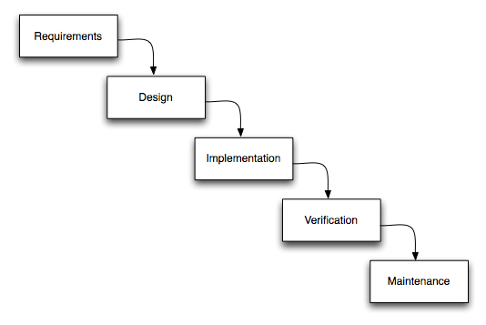
Software Process
For simple programs, a simple process…
But to use this process, you need to be sure that the requirements are fixed and well understood!
  Many software problems are not like that
  Often customer refines the requirements when you try to deliver the initial solution!
“Waterfall”

Slide 23
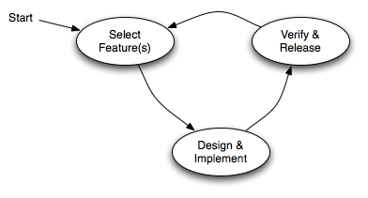
Incremental & Iterative
Deliver versions of the system in several small cycles
Recognizes that for some settings, software development is like gardening
You plant seeds… see what does well… then replace the plants that did poorly

Slide 24
Modularity
Module: component of a system with a
well-defined interface. Examples:
    Tires in a car (standard size, many vendors)
    Cable adaptor for TV (standard input/output)
    External storage for computer
    ...
Modules “hide information” behind their interfaces

Slide 25
A module isn’t just an object
We’re using the term to capture what could be one object, but will often be a larger component constructed using many objects
In fact Java has a module subsystem for this reason (we won’t use it in cs2110)
  A module implements some “abstraction”
  You think of the whole module as a kind of big object

Slide 26
Information Hiding
What “information” do modules hide?
“Internal” design decisions.
A class’s interface is everything in it that is externally accessible
class Set {
  ...
public void add(Object o) ...
  public boolean contains(Object o) ...
  public int size() ...
}

Slide 27
Encapsulation
By hiding code and data behind its interface, a class encapsulates its “inner workings”
Why is that good?
    Lets us change the implementation later without invalidating the code that uses the class
class LineSegment {
private Point2D _p1, _p2;
...
public double length() {
return _p1.distance(_p2);
}
}
class LineSegment {
private Point2D _p;
private double _length;
private double _phi;
...
public double length() {
return _length;
}
}

Slide 28
Encapsulation
Why is that good? (continued)
  Sometimes, we want a few different classes to implement some shared functionality
  For example, recall the “iterator” construct we saw in connection with collections:
To support iteration, a class simply needs to implement the Iterable interface
Iterator it = collection.iterator();
while (it.hasNext()) {
Object next = it.next();
doSomething(next);
}
for (String s: args) {
System.out.println(“Argument “+s);
}

Slide 29
Degenerate Interfaces
Public fields are usually a Bad Thing:
Anybody can change them; the class has no control
class Set {
  public int _count = 0;
public void add(Object o) ...
  public boolean contains(Object o) ...
  public int size() ...
}

Slide 30
Interfaces vs. Implementations
This says “I need this specific implementation”:
This says “I can operate on anything that supports the Iterable interface”
Interfaces represent higher levels of abstraction
(they focus on “what” and leave out the “how”)
public void doSomething(LinkedList items) ...
public void doSomething(Iterable items) ...

Slide 31
Principle of Least Astonishment
Have your designs work how a user would expect
Names and comments matter!
Bad:
public int product(int a, int b) {
return a*b > 0 ? a*b : -a*b;
}
Better:
public int absProduct(int a, int b) {
return a*b > 0 ? a*b : -a*b;
}

Slide 32
Principle of Least Astonishment
Unexpected side effects are a Bad Thing
class Integer {
private int _value;
...
public Integer times(int factor) {
_value *= factor;
return new Integer(_value);
}
}
...
Integer i = new Integer(100);
Integer j = i.times(10);
Developer was trying to be clever. But what does this code do to i?

Slide 33
Duplication
It is very common to find some chunk of working code, make a replica, and then edit the replica
But this makes your software fragile: later, when the code you copied needs to be revised, either
    The person doing that changes all instances, or
    some become inconsistent
Duplication can arise in many ways:
    constants (repeated “magic numbers”)
    code vs. comment
    within an object’s state
    ...

Slide 34
Duplication in Comments
Some people use comments when they should be creating a new method to do the thing the comment “says” you are doing!
  If the thing you are doing captures some idea (here, it involves the formula for the area of a circle), create a method and use that
  The code itself becomes “self documenting”
public double totalArea() {
...
area += circleArea(radius);
...
}
private double circleArea(double radius) {
return PI * pow(radius, 2);
}
public double totalArea() {
...
// now add the circle
area += PI * pow(radius,2);
...
}

Slide 35
Duplication of State
Duplication of state can lead to inconsistency within an object:
Can you see how this code could evolve later and accidentally become inconsistent?
Duplication may be desirable for performance, but don’t optimize too soon
class LineSegment {
private Point2D _p1, _p2;
private double _length;
...
public double length() {
return _length;
}
}
class LineSegment {
private Point2D _p1, _p2;
...
public double length() {
return _p1.distance(_p2);
}
}

Slide 36
“DRY” Principle
Don’t Repeat Yourself
A nice goal is to to have each piece of knowledge live in one place
But don’t go crazy over it
  DRYing up at any cost can increase dependencies between code
  “3 strikes and you refactor” (i.e., clean up)

Slide 37
Refactoring
Refactor: to improve code’s internal structure
without changing its external behavior
Most of the time we’re modifying existing software
“Improving the design after it has been written”
Refactoring steps can be very simple:
Other examples: renaming variables, methods, classes
public double weight(double mass) {
return mass * 9.80665;
}
static final double GRAVITY = 9.80665;
public double weight(double mass) {
return mass * GRAVITY;
}

Slide 38
Why is refactoring good?
If your application later gets used as part of a Nasa mission to Mars, it won’t make mistakes
Every place that the gravitational constant shows up in your program a reader will realize that this is what she is looking at
The compiler may actually produce better code

Slide 39
Extract Method
A comment explaining what is being done usually indicates the need to extract a method
One of the most common refactorings
public double totalArea() {
...
// now add the circle
area += PI * pow(radius,2);
...
}
public double totalArea() {
...
area += circleArea(radius);
...
}
private double circleArea(double radius) {
return PI * pow(radius, 2);
}

Slide 40
Extract Method
Simplifying conditionals with Extract Method
before
if (date.before(SUMMER_START) || date.after(SUMMER_END)) {
charge = quantity * _winterRate + _winterServiceCharge;
}
else {
charge = quantity * _summerRate;
}
after
if (isSummer(date)) {
charge = summerCharge(quantity);
}
else {
charge = winterCharge(quantity);
}

Slide 41
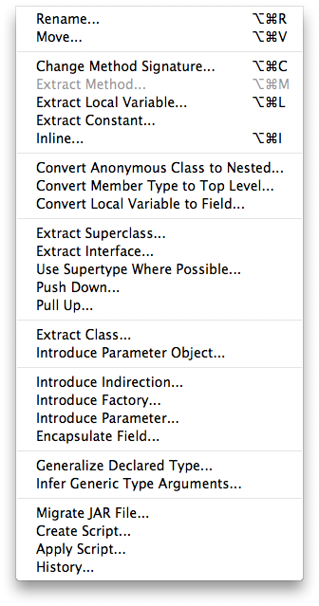
Refactoring & Tests
Eclipse supports various refactorings
You can refactor manually
    Automated tests are essential
    to ensure external behavior
    doesn’t change
    Don’t refactor manually without
    retesting to make sure you didn’t
    break the code you were “improving”!
More about tests and how to drive
development with tests next week

Slide 42
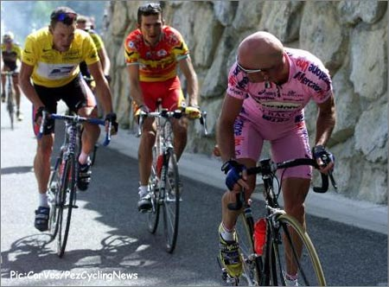
Back to the future…
All of this leads back to
solving problems like our
bike-ride comparisons
In fact we’ll solve a similar problem for homework!
  Animals with DNA containing genes
  Comparing genes is like comparing bike routes
  Comparing animals is like finding people who rode similar sets of bike routes
But solution will need some “tricks of the trade” that we’ll cover in the next few weeks of classes…

