Slide 1

Java Review
Lecture 2
CS2110 Fall 2008

Slide 2
Announcements
Assignment 1 has been posted
  Due Wednesday, September 9, 11:59pm.
    No partners on A1. (Groups of 2 allowed on A2-A5).
Check that you are in CMS
  Materials available in CMS
  Report any problems to Bill Hogan, cs22110 administrative assistant (whh@cs.cornell.edu)

Slide 3
Announcements
It’s really a good idea to start on A1 and check CMS this week (well before the assignment is due)
Sections start this week
  Section material will be useful for A1
Available help
  Consulting will start very soon—watch for announcements
  Instructor & TA office hours are in effect
Check daily for announcements
    http://courses.cs.cornell.edu/cs2110
    Newsgroup also worth watching

Slide 4
Today — A Smorgasbord
A brief (biased) history of programming languages
Review of some Java/OOP concepts
Java tips, trick, and pitfalls
Debugging and experimentation

Slide 5
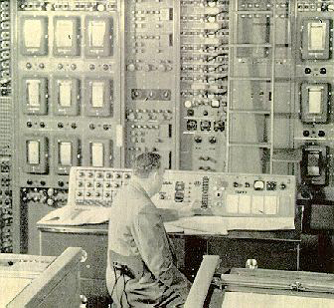
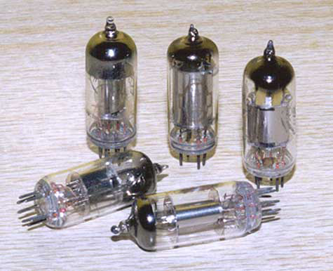
Machine Language
Used with the earliest electronic computers (1940s)
  Machines use vacuum tubes instead of transistors
Programs are entered by setting switches or reading punch cards
All instructions are numbers
Example code
  0110 0001 0000 0110
add reg1 6
An idea for improvement
  Use words instead of numbers
  Result: Assembly Language

Slide 6
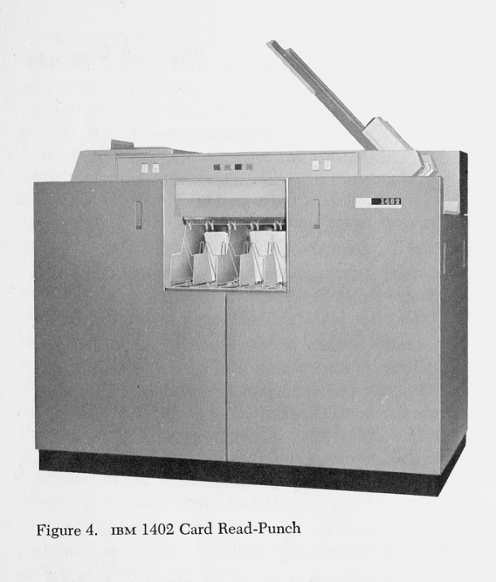
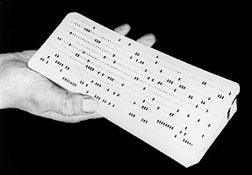
Assembly Language
Idea: Use a program (an assembler) to convert assembly language into machine code
Early assemblers were some of the most complicated code of the time (1950s)
Example code
  ADD R1 6
  MOV R1 COST
  SET R1 0
  JMP TOP
Idea for improvement
  Let’s make it easier for humans by designing a high level computer language
Result: high-level languages

Slide 7
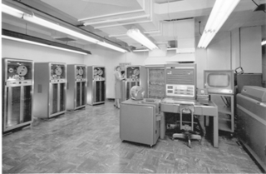
High-Level Language
Idea: Use a program (a compiler or an interpreter) to convert high-level code into machine code
Pro
  Easier for humans to write, read, and maintain code
Con
  The resulting program was usually less efficient than the best possible assembly-code
    Waste of memory
    Waste of time
The whole concept was initially controversial
  FORTRAN (mathematical FORmula TRANslating system) was designed with efficiency very much in mind

Slide 8
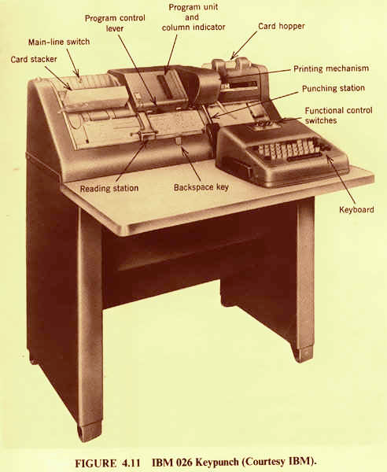
FORTRAN
Initial version developed in 1957 by IBM
Example code
FORTRAN introduced many high-level language constructs still in use today
  Variables & assignment
  Loops
  Conditionals
  Subroutines
  Comments
C SUM OF SQUARES
ISUM = 0
DO 100 I=1,10
ISUM = ISUM + I*I
100 CONTINUE

Slide 9
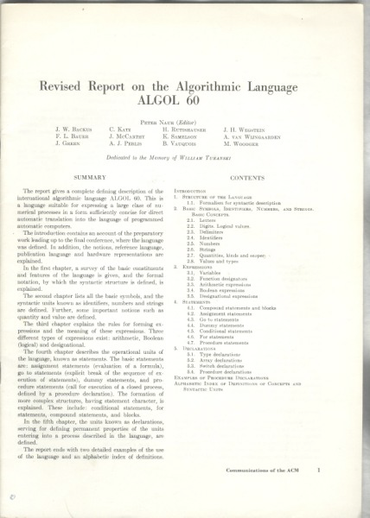
ALGOL
Sample code
ALGOL 60 included recursion
  Pro: easier to design clear, succinct algorithms
  Con: too hard to implement; too inefficient
comment Sum of squares
begin
integer i, sum;
for i:=1 until 10 do
sum := sum + i*i;
end
ALGOL
  = ALGOrithmic Language
Developed by an international committee
First version in 1958 (not widely used)
Second version in 1960 (become a major success)

Slide 10
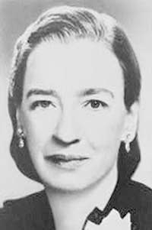
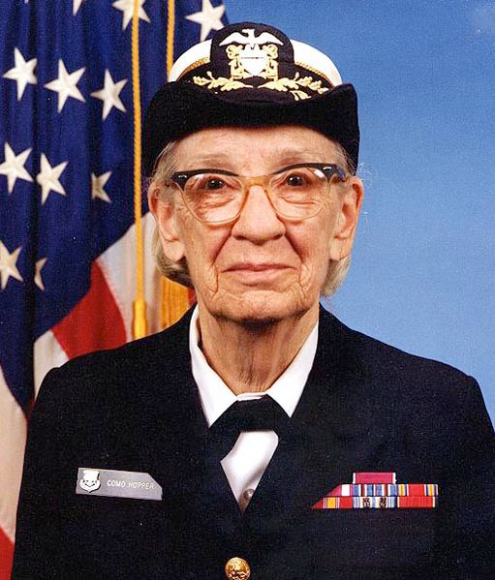
COBOL
COBOL =
COmmon Business Oriented Language
Developed by the US government (about 1960)
  Design was greatly influenced by Grace Hopper
Goal: Programs should look like English
  Idea was that anyone should be able to read and understand a COBOL program
COBOL included the idea of records (a single data structure with multiple fields, each field holding a value)

Slide 11

Simula & Smalltalk
These languages introduced and popularized Object Oriented Programming (OOP)
  Simula was developed in Norway as a language for simulation in the 60s
  Smalltalk was developed at Xerox PARC in the 70s
These languages included
  Classes
  Objects
  Subclassing and inheritance

Slide 12


Java – 1995 (James Gosling)
Java includes
  Assignment statements, loops, conditionals from FORTRAN (but syntax from C)
  Recursion from ALGOL
  Fields from COBOL
  OOP from Simula & Smalltalk
JavaTM and logo © Sun Microsystems, Inc.

Slide 13
In theory, you already know Java…
Classes and objects
Static vs instance fields and methods
Primitive vs reference types
Private vs public vs package
Constructors
Method signatures
Local variables
Arrays
Subtypes and Inheritance, Shadowing

Slide 14
… but even so
Even standard Java features have some subtle aspects relating to object orientation and the way the type system works
Let’s touch on a few of these today
We picked topics that will get you thinking about Java the way that we think about it!

Slide 15
Java is object oriented
In most prior languages, code was executed line by line and accessed variables or record
In Java, we think of the data as being organized into objects that come with their own methods, which are used to access them
  This shift in perspective is critical
  When coding in Java one is always thinking about “which object is running this code?”

Slide 16
Dynamic and Static
Some kinds of information is “static”
  There can only be one instance
  Like a “global variable” in C or C++ (or assembler)
Object-oriented information is more “dynamic”
  Each object has its own private copy
  When we create a new object, we make new copies of the variables it uses to keep its state
In Java this distinction becomes very important

Slide 17
Names
The role of a name is to tell us
  Which class is being referenced, although sometimes this is clear from the context
  Which object is being referenced, unless we’re talking about a static method or a static variable
Example
  System.out.println(a.serialNumber)
    out is a static field in class System
    The value of System.out is an instance of a class that has an instance method println(int)
If an object must refer to itself, use this
  this.i = i;

Slide 18
The main Method
Can be called from anywhere
Associated with the class; don’t need an instance (an object) to invoke it
No return value
Method must be named main
public static void main(String[] args) {
...
}
Parameters passed to program on command line or, in Eclipse, can be defined in the “Run” configuration dialog box (which the same as the “Debug” one…)

Slide 19
Static methods and variables
If a method or a variable is declared “static” there will be just one instance for the class
  Otherwise, we think of each object as having its own “version” of the method or variable
Anyone can call a static method or access a static variable
But to access a dynamic method or variable Java needs to know which object you mean

Slide 20
Static methods and variables
class Foo {
static int xyz;
static void bar(int i) { … }
int zyx;
void abc() { … }
}
Foo a = new Foo();
Foo b = new Foo();
a.bar(b.zyx);
Dynamic method abc()
Dynamic method abc()
Dynamic variable zyx
Dynamic variable zyx
Foo instance
a
Foo instance
b
static method bar()
static variable xyz
Class Foo

Slide 21
Static methods and variables
class Thing {
static int s_val; // One for the whole class
int o_val; // Each object will have its own personal copy
static void s_method() // Anyone can call this
{
s_val++; // Legal: increments the shared variable s_val
o_val = s_val; // Illegal: Which version of o_val do we mean?
o_method(s_val); // Illegal: o_method needs an object reference
}
void o_method()
{
s_val++; // Legal
this.s_val++; // Illegal: s_val belongs to the class, not object
o_val = s_val; // Legal: same as this.o_val = s_val
s_method(); // Legal: calls the class method s_method()
o_method(); // Legal: same as this.o_method();
}
}

Slide 22
Avoiding trouble
Use of static methods is discouraged
Keep in mind that “main” is a static method
  Hence anything main calls needs to have an associated object instance, or itself be static
class Thing {
int counter;
static int sequence;
public static void main(String[] args)
{
int c = ++counter; // Illegal: counter is associated with an
// object of type Thing. But which object?
int s = ++sequence; // Legal: sequence is static too
}
}

Slide 23
Class Hierarchy
superclass of Puzzle and Array and EPuzzle
Object
superclass of EPuzzle
subclass of Object
Puzzle
Array
subclass of Puzzle and Object
EPuzzle
Every class (except Object) has a unique
immediate superclass, called its parent

Slide 24
Constructors
Called to create new instances of a class
Default constructor initializes all fields of the class to default values (0 or null)
class Thing {
int val;
Thing(int val) {
this.val = val;
}
Thing() {
this(3);
}
}
Thing one = new Thing(1);
Thing two = new Thing(2);
Thing three = new Thing();

Slide 25
What about non-class variables?
Those are not automatically initialized, you need to do it yourself!
Can cause confusion
this.val was automatically initialized to zero, but undef has no defined value! Yet the declaration looks very similar! In what way did it differ?
class Thing {
int val;
Thing(int val) {
int undef;
this.val = val+undef;
}
Thing() {
this(3);
}
}

Slide 26
Finalizers
Like constructors but called when the object is deallocated
Might not happen when you expected
  Garbage collector decides when to actually deallocate an object
  So objects can linger even when you no longer have a reference to them!
  For this reason, we tend not to use finalizers – they add an undesired form of unpredictability

Slide 27
Static Initializers
Run once when class is loaded
Used to initialize static objects
class StaticInit {
static Set<String> courses = new HashSet<String>();
static {
courses.add("CS 2110");
courses.add("CS 2111");
}
public static void main(String[] args) {
...
}
}

Slide 28
Static vs Instance Example
16
class Widget {
static int nextSerialNumber = 10000;
int serialNumber;
Widget() {
serialNumber = nextSerialNumber++;
}
public static void main(String[] args) {
Widget a = new Widget();
Widget b = new Widget();
Widget c = new Widget();
System.out.println(a.serialNumber);
System.out.println(b.serialNumber);
System.out.println(c.serialNumber);
}
}

Slide 29
Names
Refer to my static and instance fields & methods by (unqualified) name:
  serialNumber
  nextSerialNumber
Refer to static fields & methods in another class using name of the class
  Widget.nextSerialNumber
Refer to instance fields & methods of another object using name of the object
  a.serialNumber

Slide 30
Overloading of Methods
A class can have several methods of the same name
  But all methods must have different signatures
  The signature of a method is its name plus the types of its parameters
Example: String.valueOf(...) in Java API
There are 9 of them:
  valueOf(boolean);
  valueOf(int);
  valueOf(long);
  ...
Parameter types are part of the method’s signature

Slide 31
Example: Overloading “compareTo”
Many classes extend an object that supports an interface called “comparable”. If you do this you can override these methods:
  equals(): a.equals(b), returns true/false
  compareTo(): a.compareTo(b): returns -/0/+
  hashCode(): a.hashCode: usually you return data.hashCode() for some data object in a that represents a’s “value” (perhaps a string or a number)
Overriding all three methods allows Java utilities that sort arrays to operate on your class
But one warning: if you override these methods you must override all of them

Slide 32
Primitive vs Reference Types
Primitive types
  int, short, long, float, byte,
  char, boolean, double
Efficient
  1 or 2 words
  Not an Object—unboxed
Reference types
  Objects and arrays
  String, int[], HashSet
  Usually require more memory
  Can have special value null
  Can compare null with ==, !=
  Generates NullPointerException
  if you try to dereference null
abc
57
abc
•
nonzero
val
57
next
null

Slide 33
Comparing Reference Types
Comparing objects (or copying them) isn’t easy!
  You need to copy them element by element
  Compare objects using the “equals” method, which implements “deep equality”
Example: suppose we have
    String A = “Fred”, B = “Fred”;
    What will A == B return?
    Need to use A.equals(B)
False! A and B are different
strings even though their value
is the same.

Slide 34
Comparing Reference Types
You can define “equals” for your own classes
Do this by overriding the built in “equals” method:
  boolean equals(Object x);
But if you do this, must also override Object.hashCode() (more on this later)

Slide 35
== versus .equals
A few wrong and then correct examples
What you wrote | How to write it correctly
"xy" == "xy" | “xy".equals("xy")
"xy" == "x" + "y" | "xy".equals("x" + "y")
“xy" == new String("xy“) | "xy".equals(new String("xy"))

Slide 36
== with primitive types
Puzzle: why do Integer comparisons work?
  Integer I = 7;
  (I == 7)?
  (I == new Integer(7))
… the first comparison only works because Java auto-unboxes I to compare it with int 7.
If it had autoboxed the 7, the comparison would have failed! Lucky Java gets this right...
True, but not obvious why!
False

Slide 37
== with primitive types
  Integer I;
  (I == null)? Uninitialized
  (I == 0)? Null ref. ex.
  Integer I = new Integer(0);
  (I == null)? False
  (I == 0)? True
  int i;
  (i == null)? Undefined
  (i == 0)? Uninitialized
  static int i;
  (i == null)? Undefined
  (i == 0)? True

Slide 38
Arrays
String[] a = new String[4];
Arrays are reference types
Array elements can be reference types or primitive types
    E.g., int[] or String[]
a is an array, a.length is its length
  Its elements are
    a[0], a[1], ..., a[a.length-1]
  The length is fixed when the array is
  first allocated using « new »
a[2] = "hello"
a
null
“hello”
a.length = 4

Slide 39
Accessing Array Elements Sequentially
public class CommandLineArgs {
public static void main(String[] args) {
System.out.println(args.length);
// old-style
for (int i = 0; i < args.length; i++) {
System.out.println(args[i]);
}
// new style
for (String s : args) {
System.out.println(s);
}
}
}

Slide 40
Back to the Class Hierarchy
superclass of Puzzle and Array and EPuzzle
Object
superclass of EPuzzle
subclass of Object
Puzzle
Array
subclass of Puzzle and Object
EPuzzle
Every class (except Object) has a unique
immediate superclass, called its parent

Slide 41
Inheritance
A subclass inherits the methods of its superclass
Example: methods of the Object superclass:
  equals(), as in A.equals(B)
  toString(), as in A.toString()
  … others we’ll learn about later in the course
… every object thus supports toString()!

Slide 42
Overriding
A method in a subclass overrides a method in superclass if:
  both methods have the same name,
  both methods have the same signature (number and type of parameters and return type), and
  both are static methods or both are instance methods
Methods are dispatched according to the runtime type of the actual, underlying object

Slide 43
Accessing Overridden Methods
Suppose a class S overrides a method m in its parent
  Methods in S can invoke the overridden method in the parent as
    super.m()
  In particular, can invoke the overridden method in the overriding method! This is very useful
Caveat: cannot compose super more than once as in
    super.super.m()

Slide 44
Unexpected Consequences
An overriding method cannot have more restricted access than the method it overrides
class A {
public int m() {...}
}
class B extends A {
private int m() {...} //illegal!
}
A foo = new B(); // upcasting
foo.m(); // would invoke private method in
// class B at runtime

Slide 45
… a nasty example
class A {
int i = 1;
int f() { return i; }
}
class B extends A {
int i = 2; // Shadows variable i in class A.
int f() { return -i; } // Overrides method f in class A.
}
public class override_test {
public static void main(String args[]) {
B b = new B();
System.out.println(b.i); // Refers to B.i; prints 2.
System.out.println(b.f()); // Refers to B.f(); prints -2.
A a = (A) b; // Cast b to an instance of class A.
System.out.println(a.i); // Now refers to A.i; prints 1;
System.out.println(a.f()); // Still refers to B.f(); prints -2;
}
}
The “runtime” type of “a” is “B”!

Slide 46
Shadowing
Like overriding, but for fields instead of methods
  Superclass: variable v of some type
  Subclass: variable v perhaps of some other type
  Method in subclass can access shadowed variable using super.v
  Variable references are resolved using static binding (i.e., at compile-time), not dynamic binding (i.e., not at runtime)
Variable reference r.v uses the static (declared) type of the variable r, not the runtime type of the object referred to by r
Shadowing variables is bad medicine and should be avoided

Slide 47
… back to our earlier example
class A {
int i = 1;
int f() { return i; }
}
class B extends A {
int i = 2; // Shadows variable i in class A.
int f() { return -i; } // Overrides method f in class A.
}
public class override_test {
public static void main(String args[]) {
B b = new B();
System.out.println(b.i); // Refers to B.i; prints 2.
System.out.println(b.f()); // Refers to B.f(); prints -2.
A a = (A) b; // Cast b to an instance of class A.
System.out.println(a.i); // Now refers to A.i; prints 1;
System.out.println(a.f()); // Still refers to B.f(); prints -2;
}
}
The “declared” or “static” type of “a” is “A”!

Slide 48
Array vs ArrayList vs HashMap
Three extremely useful constructs (see Java API)
Array
  Storage is allocated when array created; cannot change
  Extremely fast lookups
ArrayList (in java.util)
  An “extensible” array
  Can append or insert elements, access i’th element, reset to 0 length
  Lookup is slower than an array
HashMap (in java.util)
  Save data indexed by keys
  Can lookup data by its key
  Can get an iteration of the keys or values
  Storage allocated as needed but works best if you can anticipate need and tell it at creation time.

Slide 49
HashMap Example
Create a HashMap of numbers, using the names of the numbers as keys:
    Map<String, Integer> numbers
    = new HashMap<String, Integer>();
    numbers.put("one", new Integer(1));
    numbers.put("two", new Integer(2));
    numbers.put("three", new Integer(3));
To retrieve a number:
    Integer n = numbers.get("two");
Returns null if the HashMap doesn’t contain key
  Can use numbers.containsKey(key) to check this

Slide 50
Generics and Autoboxing
Old (pre-Java 5)
    Map numbers = new HashMap();
    numbers.put("one", new Integer(1));
    Integer s = (Integer)numbers.get("one");
New (generics)
    Map<String, Integer> numbers =
    new HashMap<String, Integer>();
    numbers.put("one", new Integer(1));
    Integer s = numbers.get("one");
New (generics + autoboxing)
    Map<String, Integer> numbers =
    new HashMap<String, Integer>();
    numbers.put("one", 1);
    int s = numbers.get("one");

Slide 51
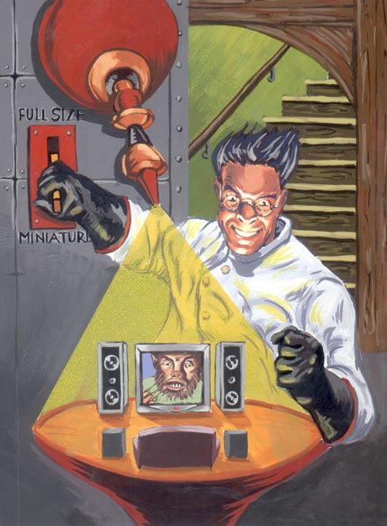
Experimentation
All of this adds up to some pretty confusing stuff you’ll need to learn!
Don’t be afraid to experiment by
writing little code fragments and
seeing if they compile and what
they do.
But don’t write random code hoping
that it might work by some miracle.
Examples in the Sun online JDK manual can be really helpful!
  Cut and paste from Sun JDK manual is not considered to be a violation of academic integrity.
  So go for it!

Slide 52

Debugging
Debugging
  Do not just make random changes, hoping something will work. This never works.
  Think about what could cause the observed behavior
  Isolate the bug. Focus on the first thing that goes wrong.
An IDE helps by providing a Debugging Mode
  Can set breakpoints, step through the program while watching chosen variables
  When program pauses at breakpoint, or dies, can look at values of variables it was using

