Slide 1
CS/ENGRD 2110
(formerly CS 211)
Fall 2009
Lecture 1: Overview
http://courses.cs.cornell.edu/cs2110

Slide 2
Announcements
Please take a look at the course web site
All lectures will be posted online but we tend to revise them at the last minute.
Assignment 1 (of 5) is up, due 9/9. Start early!
Need a Java refresher? Check out the CS 1130 web site (link on the 2110 web site)
CS colloquium: Andy Wilson (Microsoft) – 4:15pm “Surface Computing” Thursday, 8/27 Upson B17.

Slide 3
Announcements
CS colloquium: Surface Computing; Andy Wilson (Microsoft) – 4:15pm Thur. 8/27 Upson B17.
  Aimed at a general computer science community, should be a lot of fun.
  Each week we have a different famous speaker
Added reason to attend?
  You can get 1 credit if you sign up to attend weekly
  Free food from 3:45-4:15 before the talk in the 4th floor Upson Computer Science atrium

Slide 4
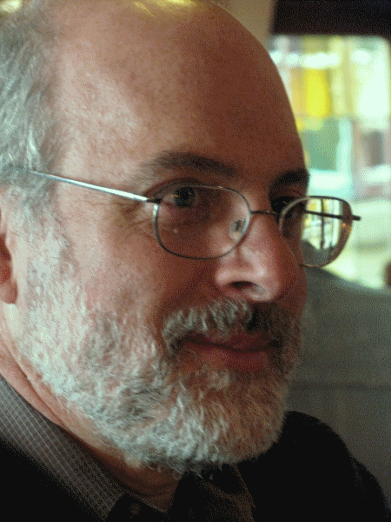

Getting to Details: Course Staff
Instructor
  Ken Birman
  ken@cs.cornell.edu
Administrative Assistant
  Bill Hogan
  whh@cs.cornell.edu
More contact info
  See Staff button on website

Slide 5
Course Staff
Teaching Assistants
  Lead sections (“recitations”, “discussions”) starting next week
  Act as your main contact point
Consultants
  In Upson 360, hours online
  “Front line” for answering questions
  consulting hours start next week
More info?
  See Staff on website

Slide 6
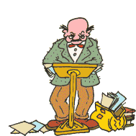

Lectures
TR 10:10-11am, Olin 155
  Attendance is mandatory
ENGRD 2110 or CS 2110?
  Same course! We call it CS 2110
  Non-engineers sign up for CS 2110
  Engineers sign up for ENGRD 2110
We often make last minute changes to the notes
Readings and examples will be posted online together with lecture notes
  Unlike the lecture notes, these won’t change often

Slide 7
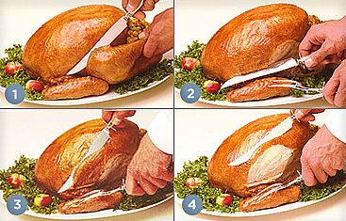
Sections
Like lecture, attendance is mandatory
Usually review, help on homework
Sometimes new material
Section numbers are different for CS and ENGRD
Each section will be led by a member of the teaching staff
No permission needed to switch sections
You may attend more than one section if you wish

Slide 8
Sections
Sections Start Next Week!
Non-Eng | Eng | Day | Time | Room
5741 | DIS 201 | T | 12:20PM - 01:10PM | HLS 110
5743 | DIS 202 | T | 01:25PM - 02:15PM | HLS 306
5745 | DIS 203 | T | 02:30PM - 03:20PM | HLS 306
5747 | DIS 204 | W | 12:20PM - 01:10PM | HLS 306
5749 | DIS 205 | W | 01:25PM - 02:15PM | HLS 306
5751 | DIS 206 | W | 02:30PM - 03:20PM | BRD 140
5753 | DIS 207 | T | 12:20PM - 01:10PM | PHL 219

Slide 9
CS2111 (formerly 212)
Not offered anymore
CS 2111 used to be a special “extra” project for CS majors, but now everyone does the same project

Slide 10
Resources
Course web site
  http://courses.cs.cornell.edu/cs2110
  Watch for announcements
Course newsgroups
  cornell.class.cs2110, cornell.class.cs2110.talk
  Good place to ask questions (carefully)

Slide 11
Resources
Book: Frank M. Carrano, Data Structures and Abstractions with Java, 2nd ed., Prentice Hall
  Note: The 1st edition is pretty obsolete by now
  If you somehow end up with it, consult 2nd edition!
  Copies of 2nd Edition on reserve in Engr Library
Additional material on Prentice Hall website
Great Java resource: the online materials at the Sun JDK web site. Google has it indexed.

Slide 12

Obtaining Java
See Resources on website
Use Java 6 if you can
  Java 5 is ok, but why not upgrade?
Need Java Development Kit (JDK), not just Java Runtime Environment (JRE)
Many production releases… latest is usually best

Slide 13


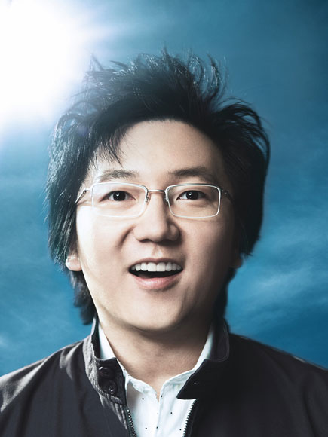
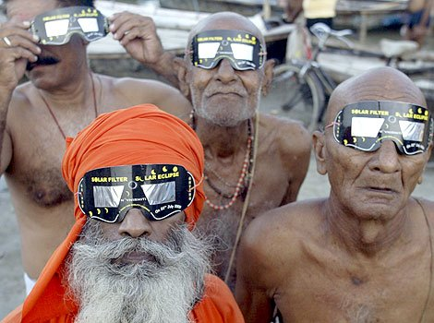
Eclipse IDE
IDE: Interactive Development Environment
  Helps you write your code
  Protects against many common mistakes
  At runtime, helps with debugging

Slide 14
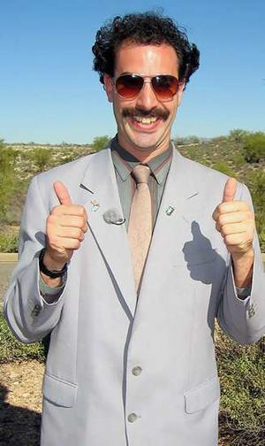
Eclipse IDE
We highly recommend use of an IDE
Eclipse tutorial will be discussed in section
Use version 3.4 (Ganymede) if you can
  V 3.3 (Europa) is ok, but why not upgrade??
See Resources on website
“In my country of Kazakhstan everyone is use Eclipse! Excellent for hack American web site and steal credit card. Also very good for to meet girls.”

Slide 15
Java Help
CS 2110 assumes basic Java knowledge
  classes, objects, fields, methods, constructors, static and instance variables, control structures, arrays, strings, exposure to inheritance
Need a refresher?
  CS 1130, Transition to Object-Oriented Programming
  formerly 101J
  self-guided tutorial, material on website

Slide 16
Academic Excellence Workshops
Two-hour labs in which students work together in cooperative setting
One credit S/U course based on attendance
Time and location TBA
See the website for more info
www.engineering.cornell.edu/student-services/
learning/academic-excellence-workshops/

Slide 17
Coursework
5 assignments involving both programming and written answers (45%)
Two prelims (15% each)
Final exam (20%)
Course evaluation (1%)
Occasional quizzes in class (4%)

Slide 18
Assignments
Except for assignment A1, assignments may be done by teams of two students
  A1 is already posted on CMS
We encourage you to do them by yourself
Finding a partner: choose your own or contact your TA. Newsgroup may be helpful.
Monogamy is usually the wisest policy
Please read partner info and Code of Academic Integrity on website

Slide 19
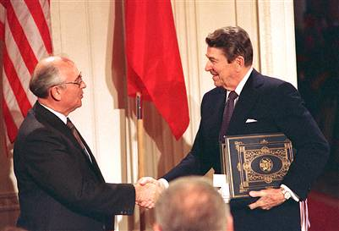
Academic Integrity… Trust but verify!
We use artificial intelligence tools to check each homework assignment
  The software is very accurate!
  It tests your code and also notices similarities between code written by different people
Sure, you can fool this software
  … but it’s easier to just do the assignments
  … and if you try to fool it and screw up, you might fail the assignment or even the whole course.

Slide 20
Using Java, but not a course on Java!
Introduction to computer science, software engineering
Concepts in modern programming languages
  recursive algorithms and data structures
  data abstraction, subtyping, generic programming
  frameworks and event-driven programming
Algorithm analysis and designing for efficiency
  asymptotic complexity, induction
Concrete data structures and algorithms
  arrays, lists, stacks, queues, trees, hashtables, graphs
Organizing large programs

Slide 21
Lecture Topics
Introduction and Review
Software Engineering concepts
Recursion and induction
Object-oriented concepts: data abstraction, subtyping
Data structures: Lists and trees
Grammars and parsing
Inheritance and frameworks
Algorithm analysis, Asymptotic Complexity
Searching and Sorting

Slide 22
More Lecture Topics
Generic Programming
Data Structures
  Sequence Structures: stacks, queues, heaps, priority queues
  Search Structures: binary search trees, hashing
  Graphs and graph algorithms
Graphical user interface (GUI) frameworks
  Event-driven programming
  Concurrency and simple synchronization

Slide 23
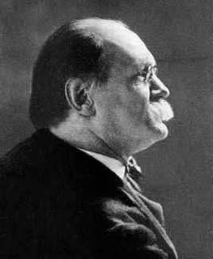
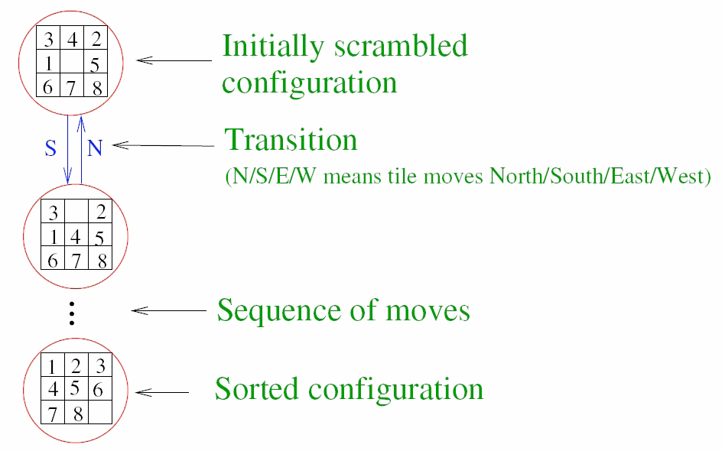
Sam Loyd’s 8 Puzzle
Sam Loyd
Goal: Given an initial configuration of tiles, find a sequence of moves that will lead to the sorted configuration.
A particular configuration is called a state of the puzzle.

Slide 24
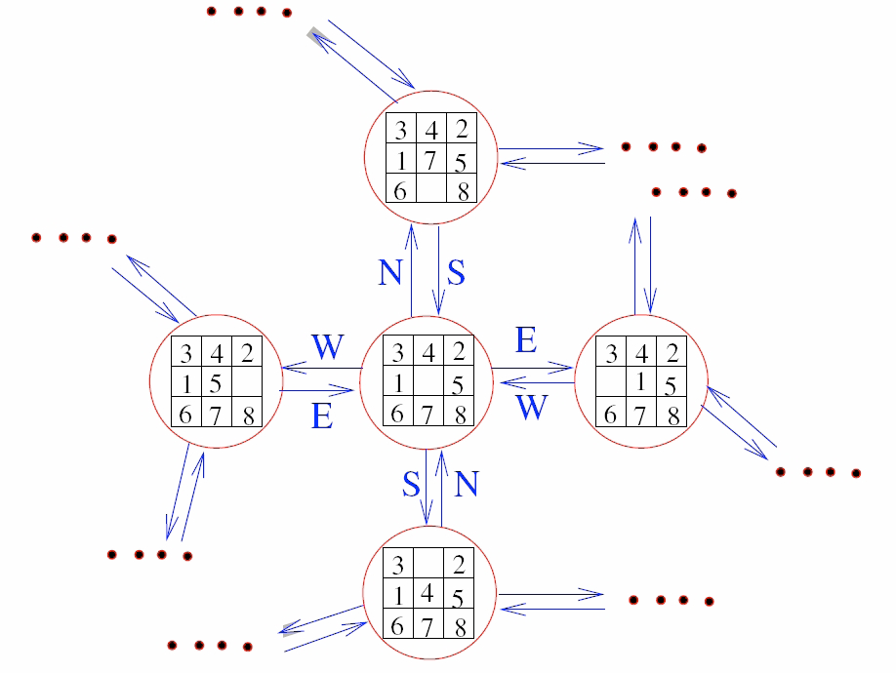
State Transition Diagram of 8-Puzzle
State Transition Diagram: picture of adjacent states.
A state Y is adjacent to state X if Y can be reached from X in one move

Slide 25
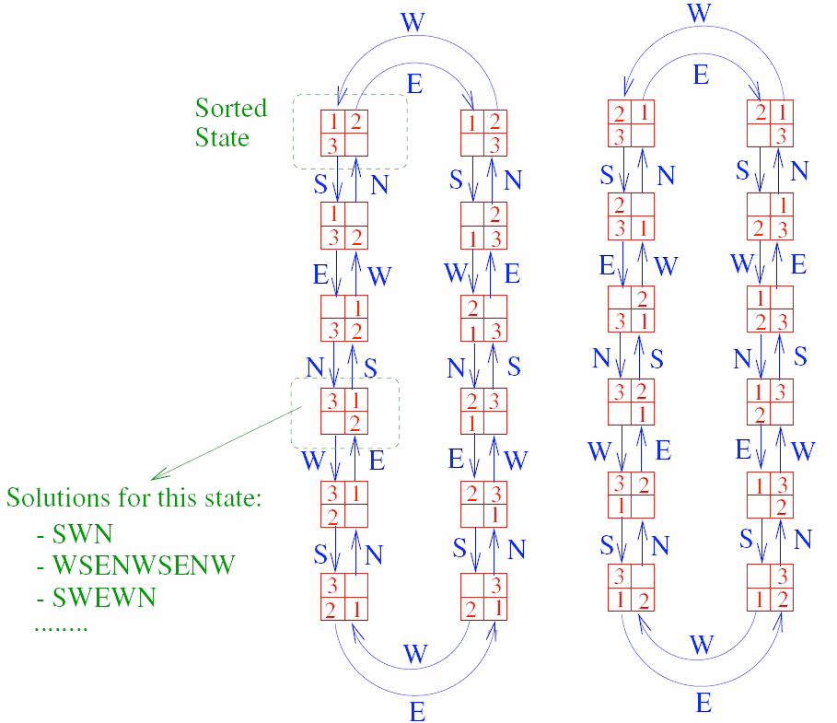
State Transition Diagram for a 2x2 Puzzle

Slide 26
« Simulating » the 8-puzzle
What operations should puzzle objects support?
How do we represent states?
How do we specify an initial state?
What algorithm do we use to solve a given initial configuration?
How should we present information to the user? (GUI design)
How to structure the program so it can be understood, maintained, upgraded?

Slide 27
Graphs
State Transition Diagram in previous slide is an example of a graph: a mathematical abstraction
  vertices (or nodes): (e.g., the puzzle states)
  edges (or arcs): connections between pairs of vertices
  vertices and edges may be labeled with some information (name, direction, weight, cost, …)
Other examples of graphs: roadmaps, airline routes,. . .
  A common vocabulary for problems

Slide 28
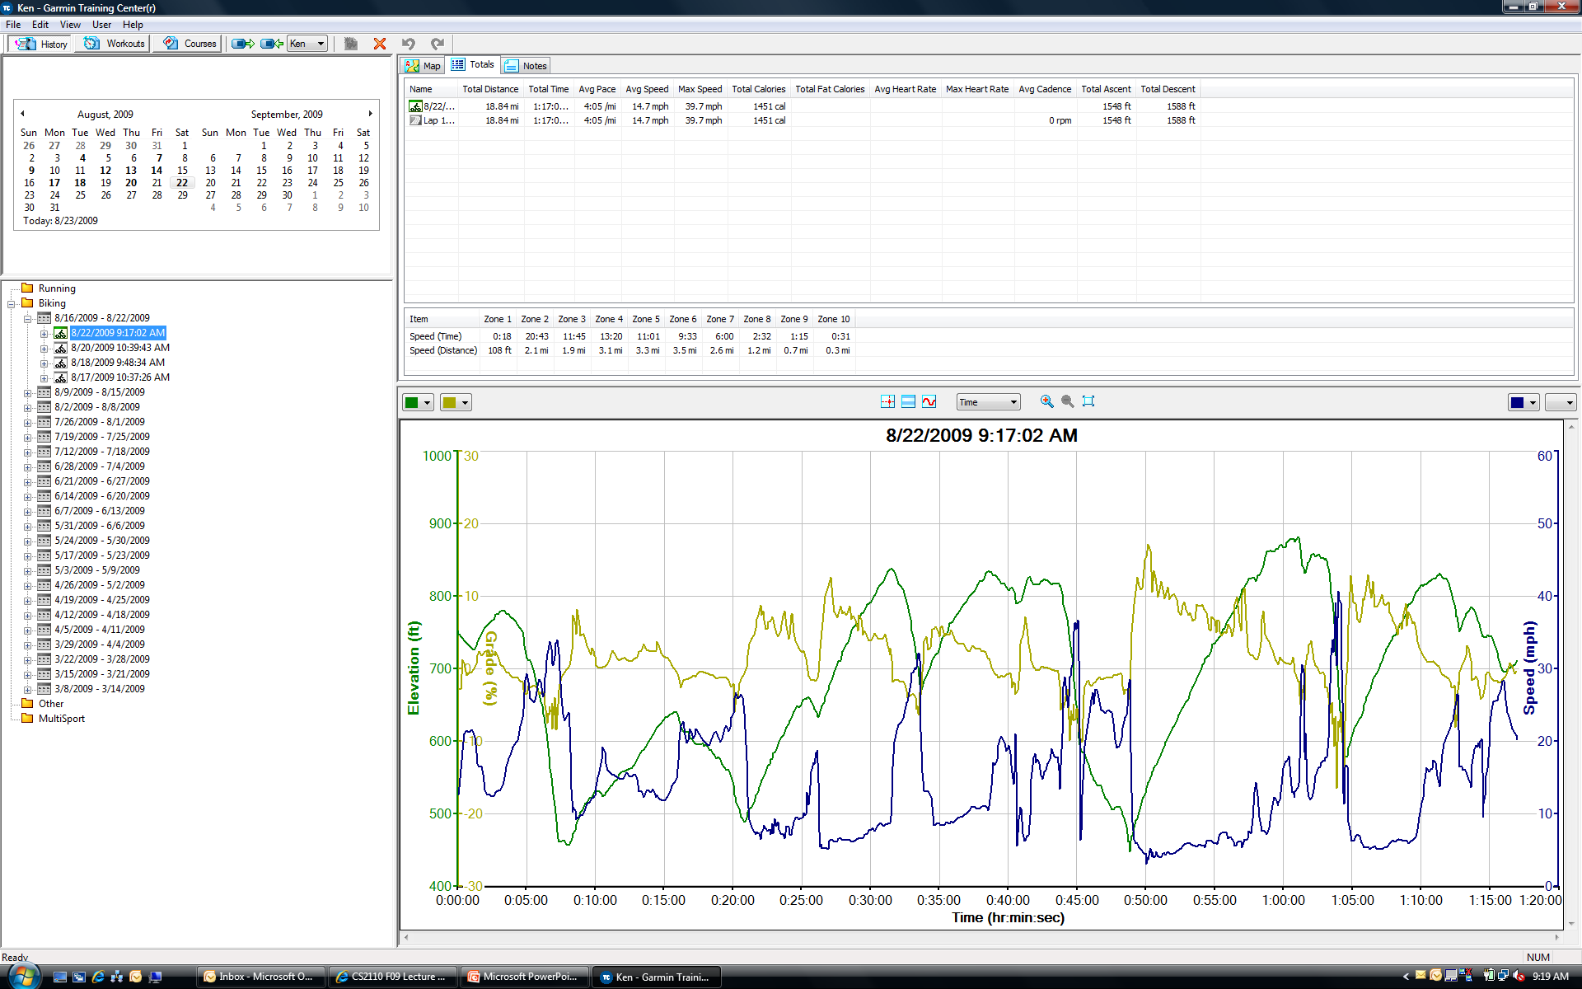
A very different example of a graph
Garmin GPS unit tracks your bike ride

Slide 29
Actual data is a graph!
Garmin GPS records a series of locations
  (time, GPS-coordinates, distance since last record, temperature, etc)
  The graph is defined by the sequence of points
Road maps are also graphs and have a similar representation
Allows Garmin to match my bike ride to a map for display

Slide 30
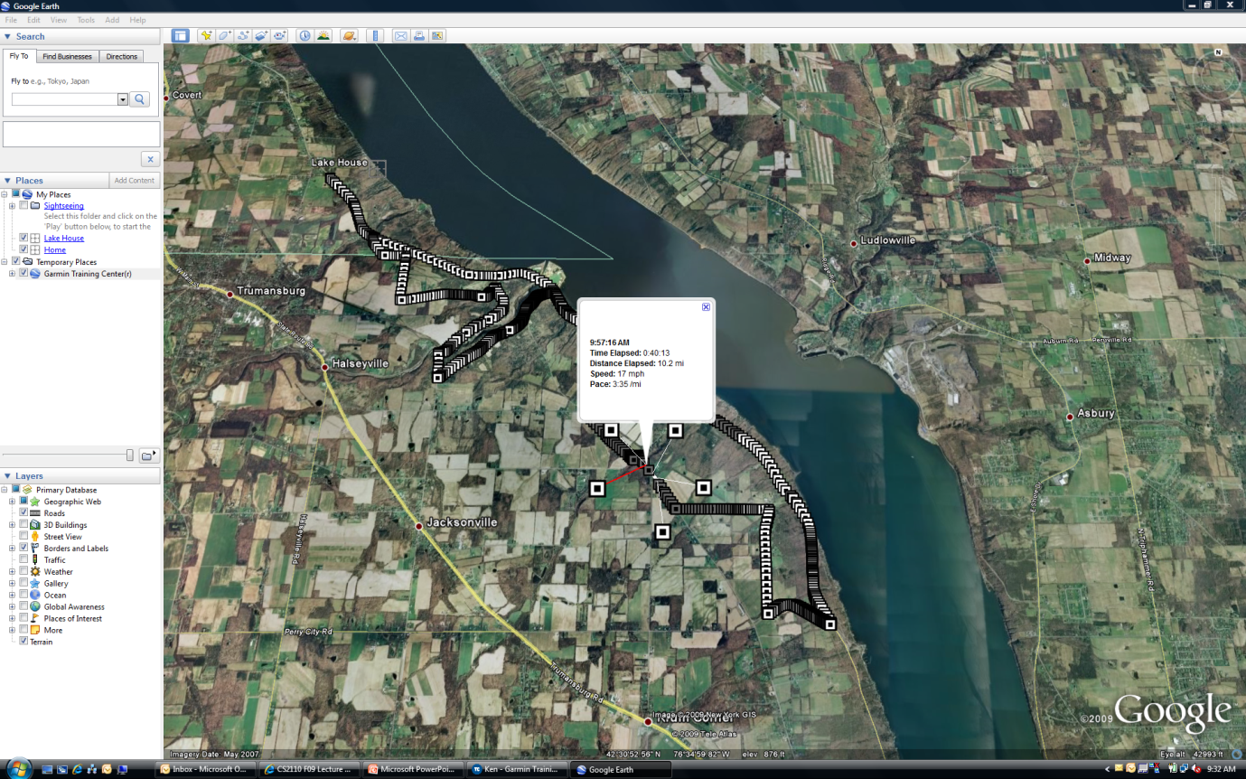
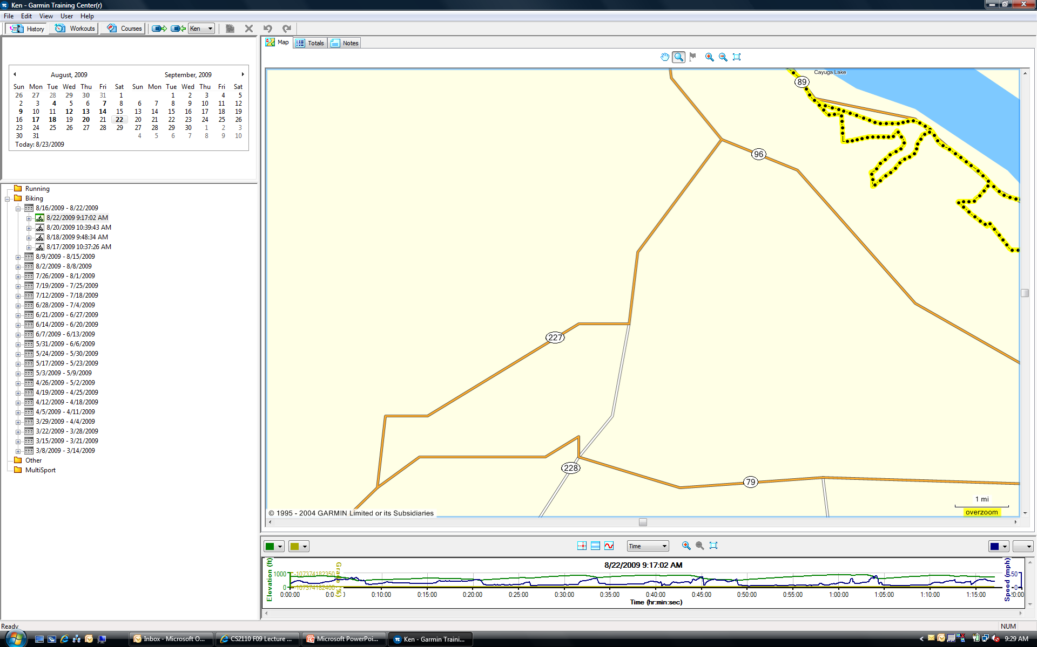
… graphical displays

Slide 31
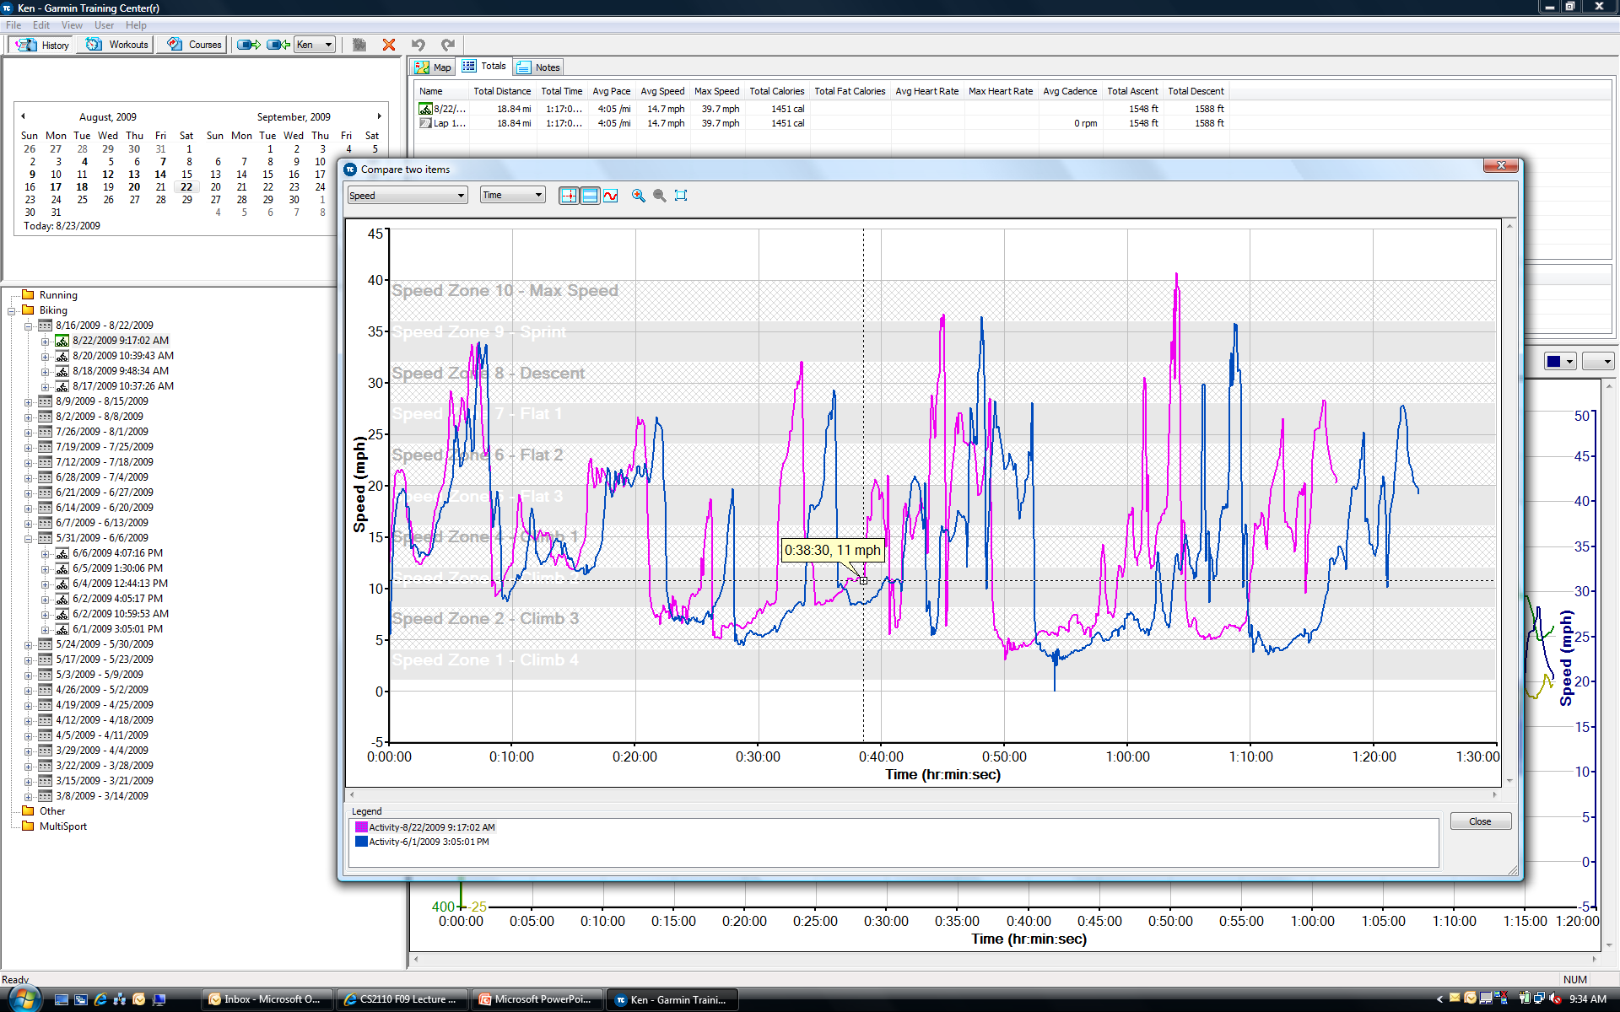
… or comparisons
How did I do today compared to the last time I rode this same route?

Slide 32
Path Problems in Graphs
Is there a path from node A to node B?
  Solve the 8-puzzle
What is the shortest path from A to B?
  Find fastest way to solve the 8-puzzle
  Or the Google Maps / Mapquest problem
Traveling salesman problem
Hamiltonian cycles

Slide 33
Why you need CS 2110
You will be able to design and write moderately large, well-structured programs to simulate such systems.
Computer systems are complex. Need CS to make them work; can’t just hack it
Selected software disasters:
  CTAS air traffic control system 1991-present
  Ariane 5 ex-rocket
  Denver airport automated baggage handling
  German parliament
  and dare I say ... PeopleSoft?

Slide 34
Why you need CS 2110, cont’d
Fun and intellectually interesting: cool math ideas meet engineering (and make a difference)
  Recursion, induction, logic, discrete structures, …
Crucial to any engineering or science career
  Good programmers are 10x more productive
  Leverage knowledge in other fields, create new possibilities
  Where will you be in 10 years?

Slide 35
Why you need CS 2110, cont’d
Real systems are large, complex, buggy, bloated, unmaintainable, incomprehensible.
Commercial software typically has 20 to 30 bugs for every 1,000 lines of code†
*source: Wikipedia
†source: CMU CyLab Sustainable Computing Consortium
Year Operating System Millions of lines of code*
1993 Windows NT 3.1 6
1994 Windows NT 3.5 10
1996 Windows NT 4.0 16
2000 Windows 2000 29
2001 Windows XP 40
2005 Windows Vista 50

Slide 36
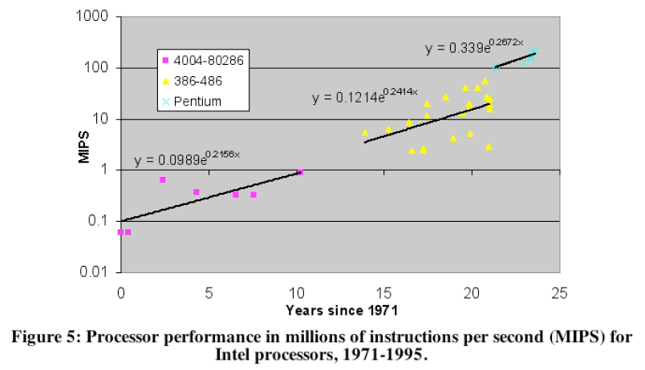
Moore’s Law
From Lives and death of Moore’s Law, Ilkka Tuomi, 2002

Slide 37
Grandmother’s Law
Brain takes about 0.1 second to recognize your grandmother
  About 1 second to add two integers (e.g. 3+4=7)
  About 10 seconds to think/write statement of code
Your brain is not getting any faster!
  So better make those 10 seconds count!
  If you write code ineffectively, or can’t understand why your own code will work… it won’t work!
  Learning to think “algorithmically” really helps!

Slide 38

Anyhow… don’t you want to get rich?
Moore’s Law won’t continue forever...
But it probably will for a while.
Let’s invent some cool ways to use all that computing power!
  Your brain never doubles in speed, so don’t count on producing exponentially more code!
  But we do get smarter, and can work in teams. So we can think of clever uses of computers… go where no man (or woman) has gone before…

Slide 39
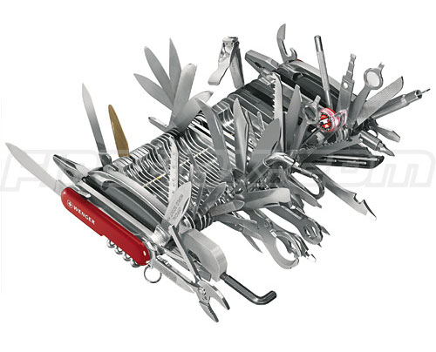
The universal tool!
Computer science is becoming a universal tool
  Algorithms that answer fundamental questions
  Data structures to represent immense amounts of information
  Programming languages that let you express your goals more clearly
  Insights into what is (and is not) possible
Once, mathematics / physics played this role.
Today computational thinking is a
key part of every exciting story

Slide 40


Welcome!
We hope you have fun, and enjoy programming as much as we do

