Slide 1

CS 1114: Data Structures – memory allocation
Prof. Graeme Bailey
http://cs1114.cs.cornell.edu
(notes modified from Noah Snavely, Spring 2009)

Slide 2
Memory allocation
Strategy 1: Computer keep tracks of free space at the end
Strategy 2: Computer keeps a linked list of free storage blocks (“freelist”)
For each block, stores the size and location
When we ask for more space, the computer finds a big enough block in the freelist
What if it doesn’t find one?

Slide 3
Maintaining a freelist
1
2
3
4
5
6
7
8
9
10
11
12
13
7
4
2
7
5
0
0
9
4
X
X
X
X
Start: 10
Free space: 999,990
Free list
Delete the last element
1
2
3
4
5
6
7
8
9
10
11
12
13
7
7
1
X
X
X
0
9
0
X
X
X
X
Start: 4
Free space: 3
Start: 10
Free space: 999,990
Free list

Slide 4
Allocation issues
Surprisingly important question:
Which block do you supply?
The smallest one that the users request fits into?
A larger one, in case the user wants to grow the array?

Slide 5

Memory deallocation
How do we give the computer back a block we’re finished with?
Someone has to figure out that certain values will never be used ever (“garbage”), and should be put back on the free list
If this is too conservative, your program will use more and more memory (“memory leak”)
If it’s too aggressive, your program will crash (“blue screen of death”)

Slide 6
Memory deallocation
Two basic options:
Manual storage reclamation
Programmer has to explicitly free garbage
Languages: C, C++, assembler
2. Automatic storage reclamation
Computer will notice that you’re no longer using cells, and recycle them for you
Languages: Matlab, Java, C#, Scheme

Slide 7
Manual storage reclamation
Programmers always ask for a block of memory of a certain size
In C, explicitly declare when it is free
Desirable but complex invariants:
Everything should be freed when it is no longer going to be used
If we free something, we shouldn’t try to use it again
And, it should be freed exactly once!
Minimize fragmentation

Slide 8
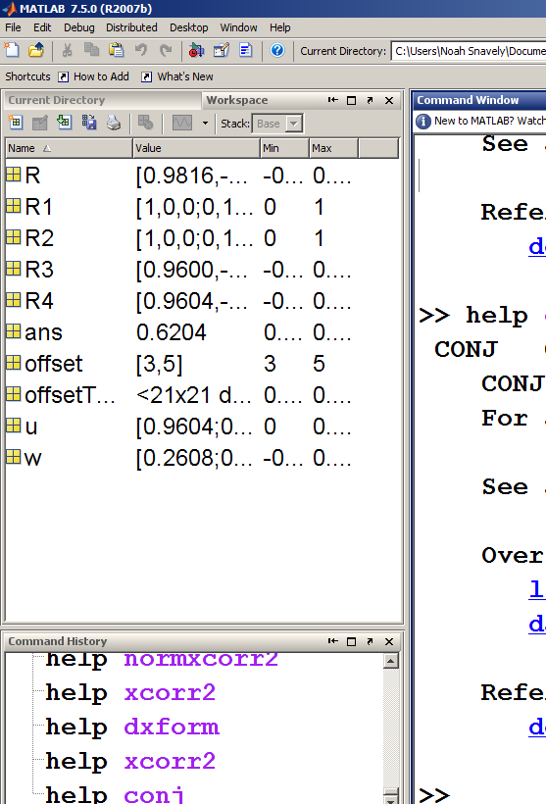
Automatic storage reclamation
“Garbage collection”
1st challenge: find memory locations that are still in use by the programmer (“live”)
Anything that has a name the programmer can get to (the “root set”)
Anything pointed to by a live object
Root set in Matlab

Slide 9
Garbage collection
1
2
3
4
5
6
7
8
9
10
11
12
13
14
15
16
11
2
4
5
1
0
8
3
15
1
6
5
3
7
1
0
X
Y
Two lists, X and Y
Which cells are live?
Which cells are garbage?

Slide 10
Simple algorithm: mark-sweep
Mark: Chase the pointers from the root set, marking everything as you go
Sweep: Scan all of memory – everything not marked is garbage, and can go back on the free list

Slide 11
Mark and sweep
1
2
3
4
5
6
7
8
9
10
11
12
13
14
15
16
11
2
4
5
1
0
8
3
15
1
6
5
3
7
1
0
X
Y
Root set: { X, Y }
Mark phase
Sweep phase

Slide 12
Mark and sweep
The machine needs to be able to tell where the pointers are (we’ll assume that it’s up to the programmer to do that)
For instance, the programmer will say that the second entry in a cell is a pointer (for singly-linked list)
Or, for a doubly-linked list, the first and third entries in a cell are pointers

Slide 13
Mark and sweep
In general, pointers may have a complex structure
How do we mark, in the general case?

Slide 14
When to do garbage collection?
Option 1 (“stop the world”): Once memory is full, stop everything and run garbage collection
Your program will freeze while the garbage is being collected
Not good if you’re coding the safety monitoring system for a nuclear reactor
Option 2 (“incremental GC”): Collect garbage in parallel with the main program
Needs to be careful not to step on the program

Slide 15
Linked lists – running time
What about inserting / deleting from somewhere near the middle of the list?
How can we find items in a list faster than simply starting at one or other end?
How can we fix this?
You’ll have to wait a bit to learn about this……. ☺

Slide 16
Where are we in the story?
London
We started with images
Then sought blobs
Then decided that blobs
are connected, so
Built graphs
Then wanted to find the
connected components, so
Looked at implementing dfs and bfs, so
Looked at implementing stacks and queues
Then found that arrays were inefficient, so
Looked at linked lists
Then looked at implementing linked lists
Arrays were messy, could we use a graph?
Frankfurt
Oslo
Stockholm
Paris
Vienna
Prague
Rome
Berlin

Slide 17
Representing a graph
London
Frankfurt
Oslo
Stockholm
Paris
Build a big 2-D array
Mentally label the rows
and columns by the nodes
Then insert a 0 if there are
no edges between those
nodes, or a 1 if they are connected
What does this array look like if
there are lots of edges?
there are very few edges?
(we call these matrices ‘sparse’)
Vienna
Prague
Rome
Berlin

Slide 18
Representing a graph
London
Can we do better?
Build an array of linked lists!
One linked list per node
The edges live in the list
Details:
For each node A, put the nodes which are
connected to that node into A’s linked list
- no longer ‘sparse’
- and space isn’t being wasted!
- can represent directed graphs easily
Frankfurt
Oslo
Stockholm
Paris
Vienna
Prague
Rome
Berlin

