Slide 1

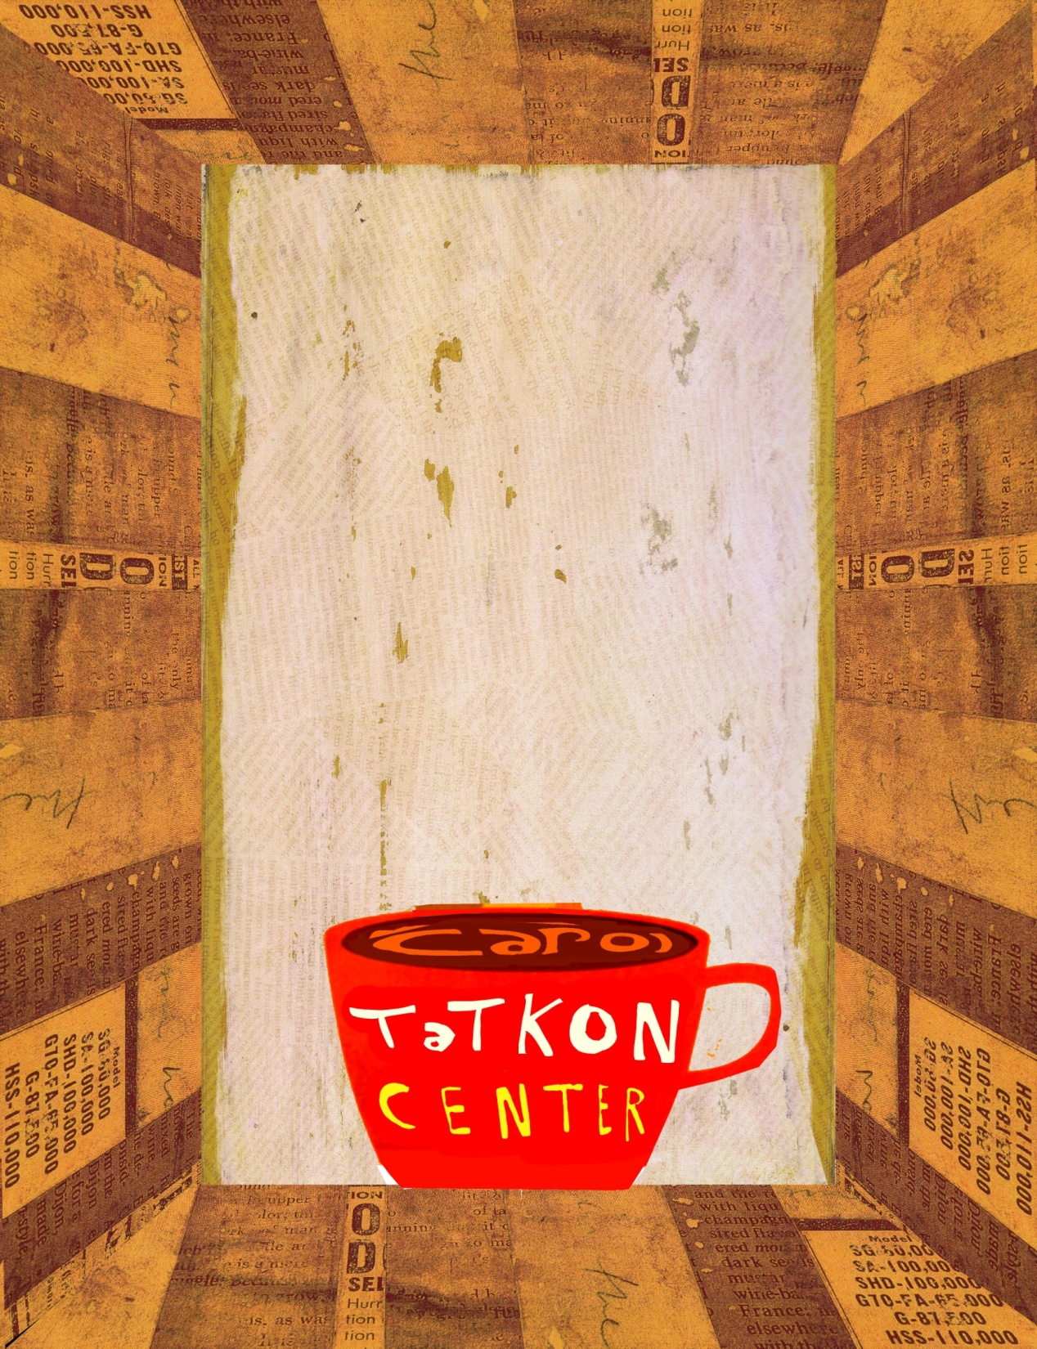

Interested in Computer Science?
Wondering what you can do as a
Computer Science major?
Then come to the
Computer Science
Coffeehouse!
Wednesday, April 15th
4:30-5:30pm
Café Lounge, Carol Tatkon Center
  Drop in anytime during the Coffeehouse to chat with Professor David Gries, Lillian Lee, and Daisy Fan or upper-level students about the Computer Science major, which courses to take, and career options as a Computer Science major!
Free resources, handouts, & refreshments will be available.
Part of the…
For more information email: carol_tatkon_center@cornell.edu.

