Slide 1
Stack buffer overflow

Slide 2
Stack frame layout

Slide 3
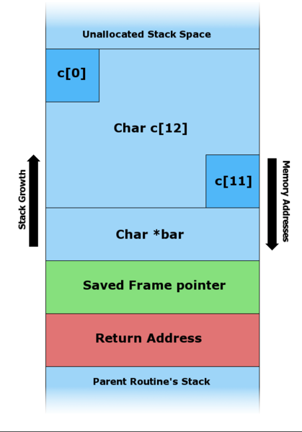
#include <string.h>
void foo (char *bar)
{
char c[12];
strcpy (c, bar); //no bound
}
int main (int argc, char **argv)
{
foo(argv[1]);
}

Slide 4
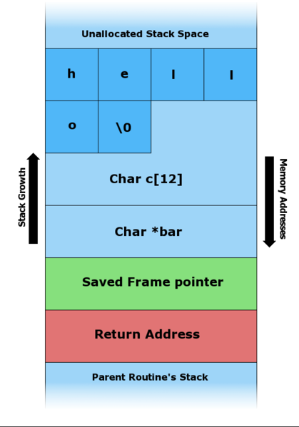
#include <string.h>
void foo (char *bar)
{
char c[12];
strcpy (c, bar); //no bound
}
int main (int argc, char **argv)
{
foo(argv[1]);
}

Slide 5
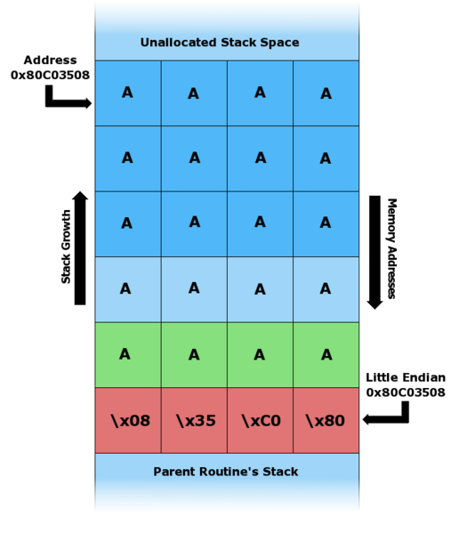
#include <string.h>
void foo (char *bar)
{
char c[12];
strcpy (c, bar); //no bound
}
int main (int argc, char **argv)
{
foo(argv[1]);
}

Slide 6
Demo
Linux

Slide 7
Homework 3
Due next week. Tuesday??
Stack buffer overflow problem, very similar to what we have described today.
Demo.

Slide 8
Linker Exercise
2.31

