Slide 1
Synchronization and
Prelim 2 Review
Hakim Weatherspoon
CS 3410, Spring 2011
Computer Science
Cornell University

Slide 2

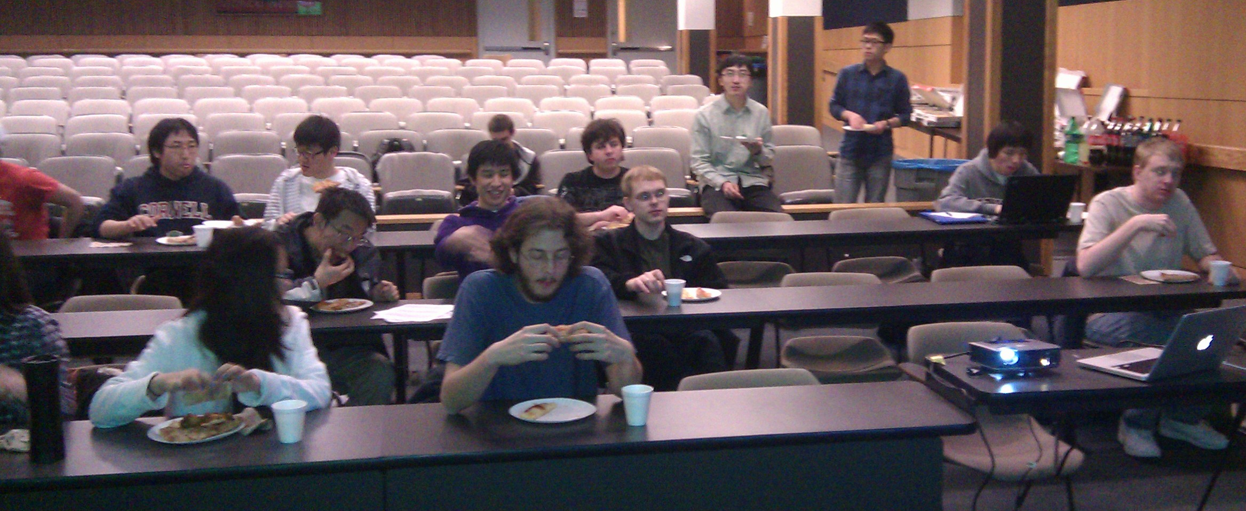
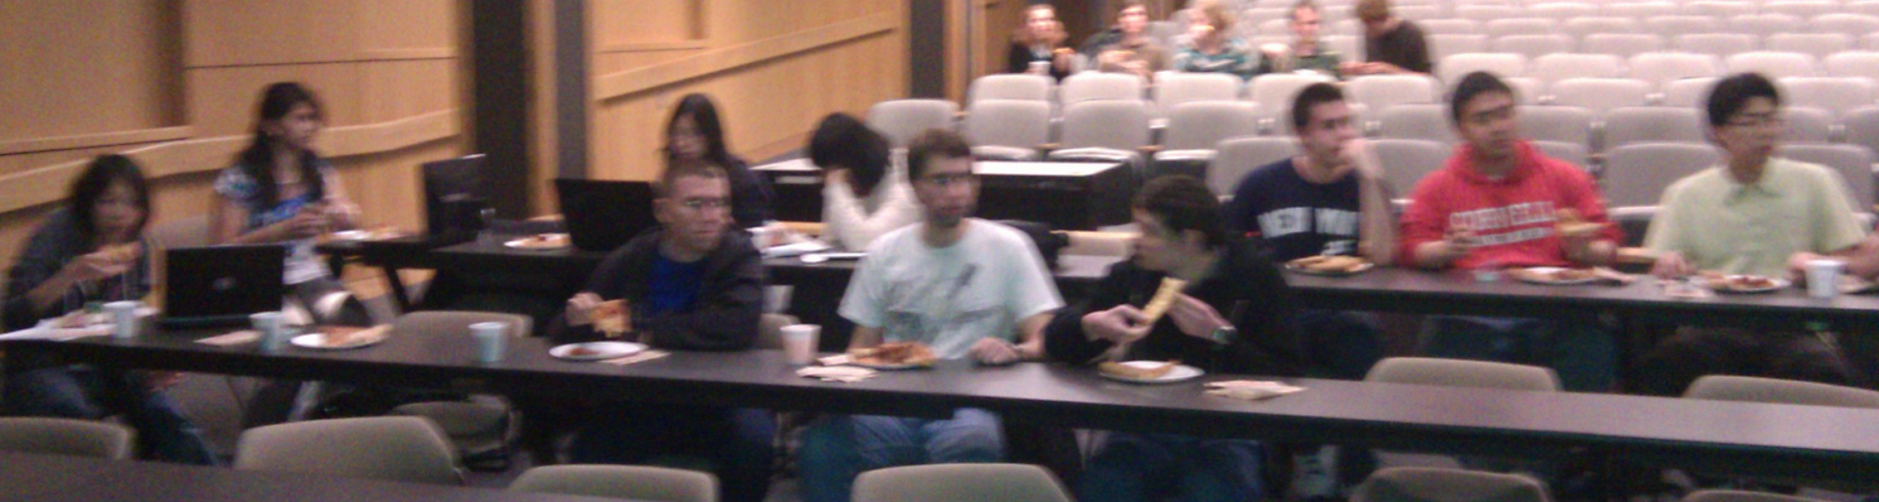
Announcements
FarmVille pizza Party was fun!
  Winner: Team HakimPeterSpoon
  Joseph Mongeluzzi and Jason Zhao

Slide 3
Announcements
HW4 due today, Tuesday, April 26th
  Work alone
Next two weeks
  Prelim2 will in-class this Thursday, April 28th
    90 minutes in class: 1:25pm – 2:55pm
    Topics: Caching, Virtual Memory, Paging, TLBs, I/O, Traps, Exceptions, multicore, and synchronization
  PA4 will be final project (no final exam)
    Available this Friday, April 29th and due Friday, May 13th
    Need to schedule time for presentation May 16, 17, or 18.
    Will not be able to use slip days

Slide 4
Goals for Today
Finish Synchronization
  Threads and processes
  Critical sections, race conditions, and mutexes
Prelim 2 review
  Caching,
  Virtual Memory, Paging, TLBs
  I/O and DMA
  Operating System, Traps, Exceptions,
  Multicore and synchronization

Slide 5
Multi-core is a reality…
… but how do we write multi-core safe code?

Slide 6
Processes and Threads

Slide 7
Processes are heavyweight
Parallel programming with processes:
  They share almost everything
  code, shared mem, open files, filesystem privileges, …
  Pagetables will be almost identical
  Differences: PC, registers, stack
Recall: process = execution context + address space
Notes:
pstree example: Firefox downloader, renderer, toolbar, etc.
Idea: multiple execution contexts sharing a single address space!

Slide 8
Processes and Threads
Process
OS abstraction of a running computation
  The unit of execution
  The unit of scheduling
  Execution state
  + address space
From process perspective
  a virtual CPU
  some virtual memory
  a virtual keyboard, screen, …
Thread
OS abstraction of a single thread of control
  The unit of scheduling
  Lives in one single process
From thread perspective
  one virtual CPU core on a virtual multi-core machine
Notes:
d/Unit of scheduling/
s/execution state/one or more threads/
s/virtual CPU/virtual multi-core machine/

Slide 9

Multithreaded Processes

Slide 10
Threads
#include <pthread.h>
int counter = 0;
void PrintHello(int arg) {
printf(“I’m thread %d, counter is %d\n”, arg, counter++);
... do some work ...
pthread_exit(NULL);
}
int main () {
for (t = 0; t < 4; t++) {
printf(“in main: creating thread %d\n", t);
pthread_create(NULL, NULL, PrintHello, t);
}
pthread_exit(NULL);
}

Slide 11
Threads versus Fork
in main: creating thread 0
I’m thread 0, counter is 0
in main: creating thread 1
I’m thread 1, counter is 1
in main: creating thread 2
in main: creating thread 3
I’m thread 3, counter is 2
I’m thread 2, counter is 3
If processes?

Slide 12
Example Multi-Threaded Program
Example: Apache web server
void main() {
setup();
while (c = accept_connection()) {
req = read_request(c);
hits[req]++;
send_response(c, req);
}
cleanup();
}
Notes:
Use fork
Use threads

Slide 13
Race Conditions
Example: Apache web server
Each client request handled by a separate thread (in parallel)
  Some shared state: hit counter, ...
(look familiar?)
Timing-dependent failure ⇒ race condition
  hard to reproduce ⇒ hard to debug
Thread 52
read hits
addi
write hits
Thread 205
read hits
addi
write hits
Thread 52
...
hits = hits + 1;
...
Thread 205
...
hits = hits + 1;
...
Notes:
What happens when two threads execute concurrently?
sequential with threads
between threads is unsynchronized

Slide 14
Programming with threads
Within a thread: execution is sequential
Between threads?
  No ordering or timing guarantees
  Might even run on different cores at the same time
Problem: hard to program, hard to reason about
  Behavior can depend on subtle timing differences
  Bugs may be impossible to reproduce
Cache coherency isn’t sufficient…
Need explicit synchronization to
make sense of concurrency!

Slide 15
Managing Concurrency
Races, Critical Sections, and Mutexes

Slide 16
Goals
Concurrency Goals
Liveness
  Make forward progress
Efficiency
  Make good use of resources
Fairness
  Fair allocation of resources between threads
Correctness
  Threads are isolated (except when they aren’t)

Slide 17
Race conditions
Race Condition
Timing-dependent error when
accessing shared state
  Depends on scheduling happenstance
  … e.g. who wins “race” to the store instruction?
Concurrent Program Correctness =
all possible schedules are safe
  Must consider every possible permutation
  In other words…
… the scheduler is your adversary

Slide 18
Critical sections
What if we can designate parts of the execution as critical sections
  Rule: only one thread can be “inside”
Thread 52
read hits
addi
write hits
Thread 205
read hits
addi
write hits
Notes:
Show picture

Slide 19
Interrupt Disable
Q: How to implement critical section in code?
A: Lots of approaches….
Disable interrupts?
CSEnter() = disable interrupts (including clock)
CSExit() = re-enable interrupts
Works for some kernel data-structures
Very bad idea for user code
read hits
addi
write hits
Notes:
but only within a single core: why?
(important events are delayed… forever?)

Slide 20
Preemption Disable
Q: How to implement critical section in code?
A: Lots of approaches….
Modify OS scheduler?
CSEnter() = syscall to disable context switches
CSExit() = syscall to re-enable context switches
Doesn’t work if interrupts are part of the problem
Usually a bad idea anyway
read hits
addi
write hits
Notes:
(e.g. won’t work for many kernel datastructures)
(caller forgets to CSExit? Or waits a long time?)

Slide 21
Mutexes
Q: How to implement critical section in code?
A: Lots of approaches….
Mutual Exclusion Lock (mutex)
acquire(m): wait till it becomes free, then lock it
release(m): unlock it
apache_got_hit() {
pthread_mutex_lock(m);
hits = hits + 1;
pthread_mutex_unlock(m)
}

Slide 22
Q: How to implement mutexes?
Notes:
A: next time…

Slide 23
Prelim 2 Review

Slide 24
Caches

Slide 25
Cache Design 101
Memory pyramid
Reg
100s bytes
1 cycle access (early in pipeline)
L1 Cache
(several KB)
1-3 cycle access
L3 becoming more common
(sometimes VERY
LARGE)
L2 Cache (½-32MB)
5-15 cycle access
Memory (128MB – few GB)
50-300 cycle access
Disk (Many GB)
Millions cycle access!
These are rough numbers: mileage may vary for latest/greatest
Caches USUALLY made of SRAM

Slide 26
Cache Misses
Three types of misses
  Cold
    The line is being referenced for the first time
  Capacity
    The line was evicted because the cache was not large enough
  Conflict
    The line was evicted because of another access whose index conflicted

Slide 27
Direct Mapped Cache
Simplest
Block can only be in one line in the cache
How to determine this location?
  Use modulo arithmetic
  (Block address) modulo (# cache blocks)
  For power of 2, use log (cache size in blocks)

Slide 28
Fully Associative Cache
V
Tag
Block
=
line
select
word/byte
select
Tag Offset
=
hit encode

Slide 29
2-Way Set-Associative Cache
V
Tag
Block
V
Tag
Block
Tag Index Offset
=
=

Slide 30
Eviction
Which cache line should be evicted from the cache to make room for a new line?
  Direct-mapped
    no choice, must evict line selected by index
  Associative caches
    random: select one of the lines at random
    round-robin: similar to random
    FIFO: replace oldest line
    LRU: replace line that has not been used in the longest time

Slide 31
Cache Writes
Memory
DRAM
CPU
addr
Cache
SRAM
data
No-Write
  writes invalidate the cache and go to memory
Write-Through
  writes go to cache and to main memory
Write-Back
  write cache, write main memory only when block is evicted

Slide 32
Tags and Offsets
Tag: matching
Offset: within block
Valid bit: is the data valid?
31 Memory Address 0
31 Tag 10
9 Index 5
4 Offset 0
Block

Slide 33
Cache Performance
Consider hit (H) and miss ratio (M)
H x AT_{cache} + M x AT_{memory}
Hit rate = 1 – Miss rate
Access Time is given in cycles
Ratio of Access times, 1:50
90% : .90 + .1 x 50 = 5.9
95% : .95 + .05 x 50 = .95+2.5=3.45
99% : .99 + .01 x 50 = 1.49
99.9%: .999 + .001 x 50 = 0.999 + 0.05 = 1.049

Slide 34
Cache Hit/Miss Rate
Consider processor that is 2x times faster
  But memory is same speed
Since AT is access time in terms of cycle time: it doubles 2x
H x AT_{cache} + M x AT_{memory}
Ratio of Access times, 1:100
99% : .99 + .01 x 100 = 1.99

Slide 35
Cache Hit/Miss Rate
Original is 1GHz, 1ns is cycle time
CPI (cycles per instruction): 1.49
Therefore, 1.49 ns for each instruction
New is 2GHz, 0.5 ns is cycle time.
CPI: 1.99, 0.5ns. 0.995 ns for each instruction.
So it doesn’t go to 0.745 ns for each instruction.
Speedup is 1.5x (not 2x)

Slide 36
Cache Conscious Programming
1 | 11
2 | 12
3 | 13
4 | 14
5 | 15
6
7
8
9
10
int a[NCOL][NROW];
int sum = 0;
for(j = 0; j < NCOL; ++j)
for(i = 0; i < NROW; ++i)
sum += a[j][i];
Every access is a cache miss!

Slide 37
Cache Conscious Programming
1 | 2 | 3 | 4 | 5 | 6 | 7 | 8 | 9 | 10
11 | 12 | 13 | 14 | 15
int a[NCOL][NROW];
int sum = 0;
for(i = 0; i < NROW; ++i)
for(j = 0; j < NCOL; ++j)
sum += a[j][i];
Same program, trivial transformation, 3 out of four accesses hit in the cache

Slide 38
Can answer the question…..
A: for i = 0 to 99
  for j = 0 to 999
    A[i][j] = complexComputation ()
B: for j = 0 to 999
  for i = 0 to 99
    A[i][j] = complexComputation ()
Why is B 15 times slower than A?

Slide 39
MMU, Virtual Memory, Paging, and TLB’s

Slide 40
Processor & Memory
Currently, the processor’s address lines are directly routed via the system bus to the memory banks
  Simple, fast
What happens when the program issues a load or store to an invalid location?
  e.g. 0x000000000 ?
  uninitialized pointer
0x7fffffff
Stack
Processor
Heap
Data
Text
0x1000
Memory

Slide 41
Physical Addressing Problems
What happens when another program is executed concurrently on another processor?
  The addresses will conflict
We could try to relocate the second program to another location
  Assuming there is one
  Introduces more problems!
Stack
0x7fffffff
Stack
Heap
Data
Text
0x4000
Heap
Processors
Data
Text
0x1000
Memory

Slide 42
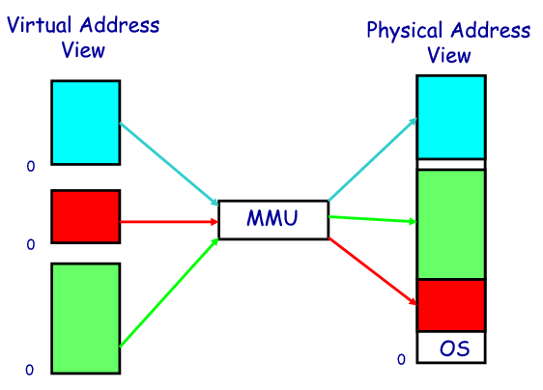
Address Space
Memory Management Unit (MMU)
  Combination of hardware and software

Slide 43
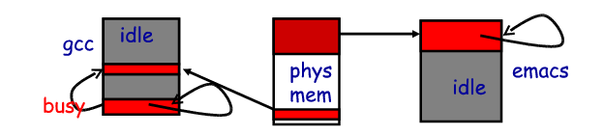
Virtual Memory Advantages
Can relocate program while running
Virtualization
  In CPU: if process is not doing anything, switch
  In memory: when not using it, somebody else can use it

Slide 44
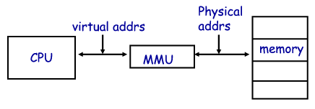
How to make it work?
Challenge: Virtual Memory can be slow!
At run-time: virtual address must be translated to a physical address
MMU (combination of hardware and software)

Slide 45
Two Programs Sharing Physical Memory
The starting location of each page (either in main memory or in secondary memory) is contained in the program’s page table
Program 1
virtual address space
main memory
Program 2
virtual address space
swap
space

Slide 46
Page Table for Translation
Virtual page #
Offset
Physical page #
Offset
Physical page
base addr
V
1
1
1
1
1
1
0
1
0
1
0
Main memory
swap
space
Page Table
(in main memory)
Disk storage

Slide 47
Virtual Addressing with a Cache
Thus it takes an extra memory access to translate a VA to a PA
VA
PA
miss
Trans-
lation
Cache
Main
Memory
CPU
hit
data
This makes memory (cache) accesses very expensive (if every access was really two accesses)

Slide 48
A TLB in the Memory Hierarchy
hit
VA
PA
miss
TLB
Lookup
Cache
Main
Memory
CPU
miss
hit
Trans-
lation
data
A TLB miss:
  If the page is not in main memory, then it’s a true page fault
    Takes 1,000,000’s of cycles to service a page fault
TLB misses are much more frequent than true page faults

Slide 49
Virtual vs. Physical Caches
Memory
DRAM
CPU
addr
Cache
SRAM
MMU
data
Cache works on physical addresses
Memory
DRAM
CPU
addr
Cache
SRAM
MMU
data
Cache works on virtual addresses
L1 (on-chip) caches are typically virtual
L2 (off-chip) caches are typically physical

Slide 50
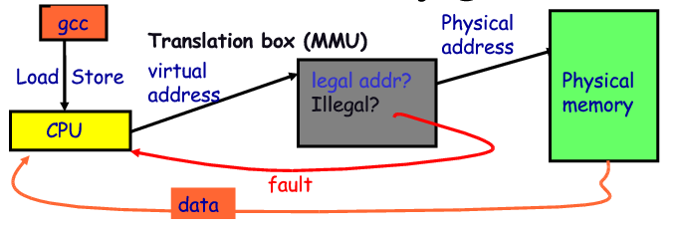
Address Translation
Translation is done through the page table
  A virtual memory miss (i.e., when the page is not in physical memory) is called a page fault
Notes:
The page size is 2¹² = 4KB, the number of physical pages allowed in memory is 2¹⁸, the physical address space is 1GB and the virtual address space is 4GB

Slide 51
Hardware/Software Boundary
Virtual to physical address translation is assisted by hardware?
  Translation Lookaside Buffer (TLB) that caches the recent translations
    TLB access time is part of the cache hit time
    May allot an extra stage in the pipeline for TLB access
  TLB miss
    Can be in software (kernel handler) or hardware

Slide 52
Hardware/Software Boundary
Virtual to physical address translation is assisted by hardware?
  Page table storage, fault detection and updating
    Page faults result in interrupts (precise) that are then handled by the OS
    Hardware must support (i.e., update appropriately) Dirty and Reference bits (e.g., ~LRU) in the Page Tables

Slide 53
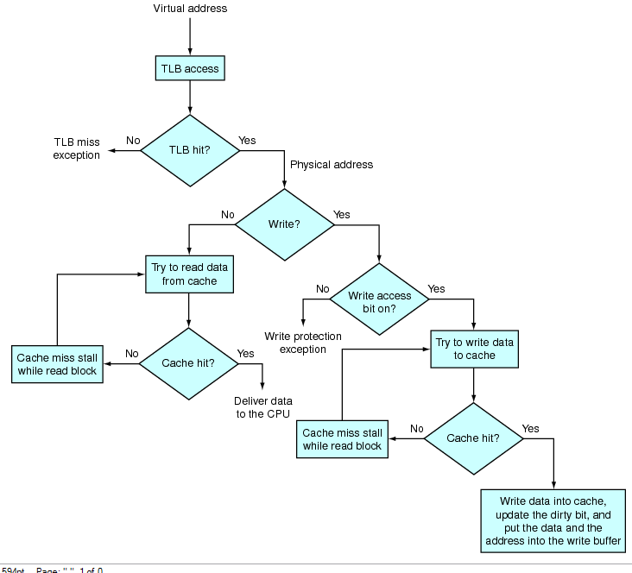

Slide 54
Paging

Slide 55
Traps, exceptions, and operating system

Slide 56
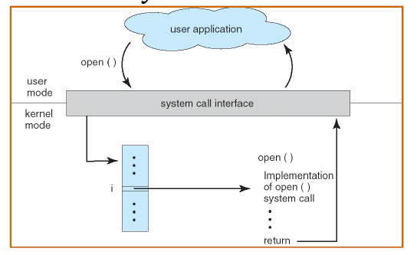

Slide 57
Exceptions
System calls are control transfers to the OS, performed under the control of the user program
Sometimes, need to transfer control to the OS at a time when the user program least expects it
  Division by zero,
  Alert from power supply that electricity is going out,
  Alert from network device that a packet just arrived,
  Clock notifying the processor that clock just ticked
Some of these causes for interruption of execution have nothing to do with the user application
Need a (slightly) different mechanism, that allows resuming the user application

Slide 58
Terminology
Trap
  Any kind of a control transfer to the OS
Syscall
  Synchronous, program-initiated control transfer from user to the OS to obtain service from the OS
  e.g. SYSCALL
Exception
  Synchronous, program-initiated control transfer from user to the OS in response to an exceptional event
  e.g. Divide by zero
Interrupt
  Asynchronous, device-initiated control transfer from user to the OS
  e.g. Clock tick, network packet

Slide 59
I/O and DMA

Slide 60
Memory-Mapped I/O
Processor
Address
Space
I/O Device
Memory
and Control
Registers

Slide 61
DMA: Direct Memory Access
Non-DMA transfer: I/O device ←→ CPU ←→ RAM
  for (i = 1 .. n)
    CPU sends transfer request to device
    I/O writes data to bus, CPU reads into registers
    CPU writes data to registers to memory
DMA transfer: I/O device ←→ RAM
  CPU sets up DMA request on device
  for (i = 1 .. n)
    I/O device writes data to bus, RAM reads data
CPU
RAM
DISK
CPU
RAM
DISK

Slide 62
Multicore and Synchronization

Slide 63
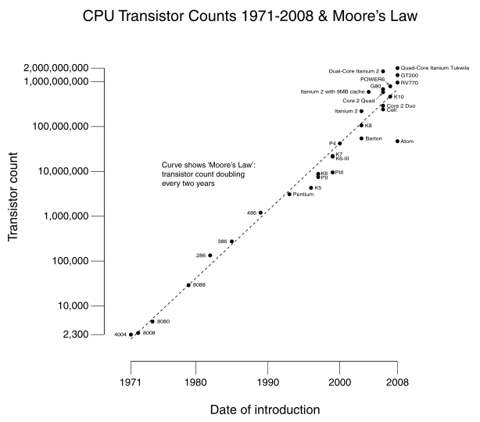
Why Multicore?
Moore’s law
  A law about transistors
    (Not speed)
  Smaller means faster
  transistors
Power consumption growing with transistors

Slide 65
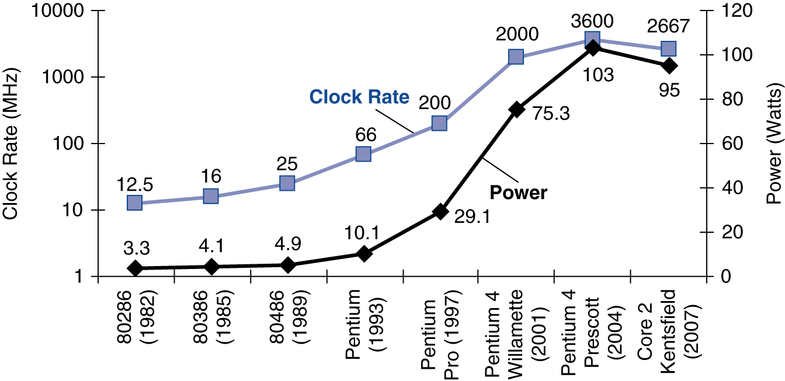
Power Trends
In CMOS IC technology
×30
5V → 1V
×1000

Slide 66
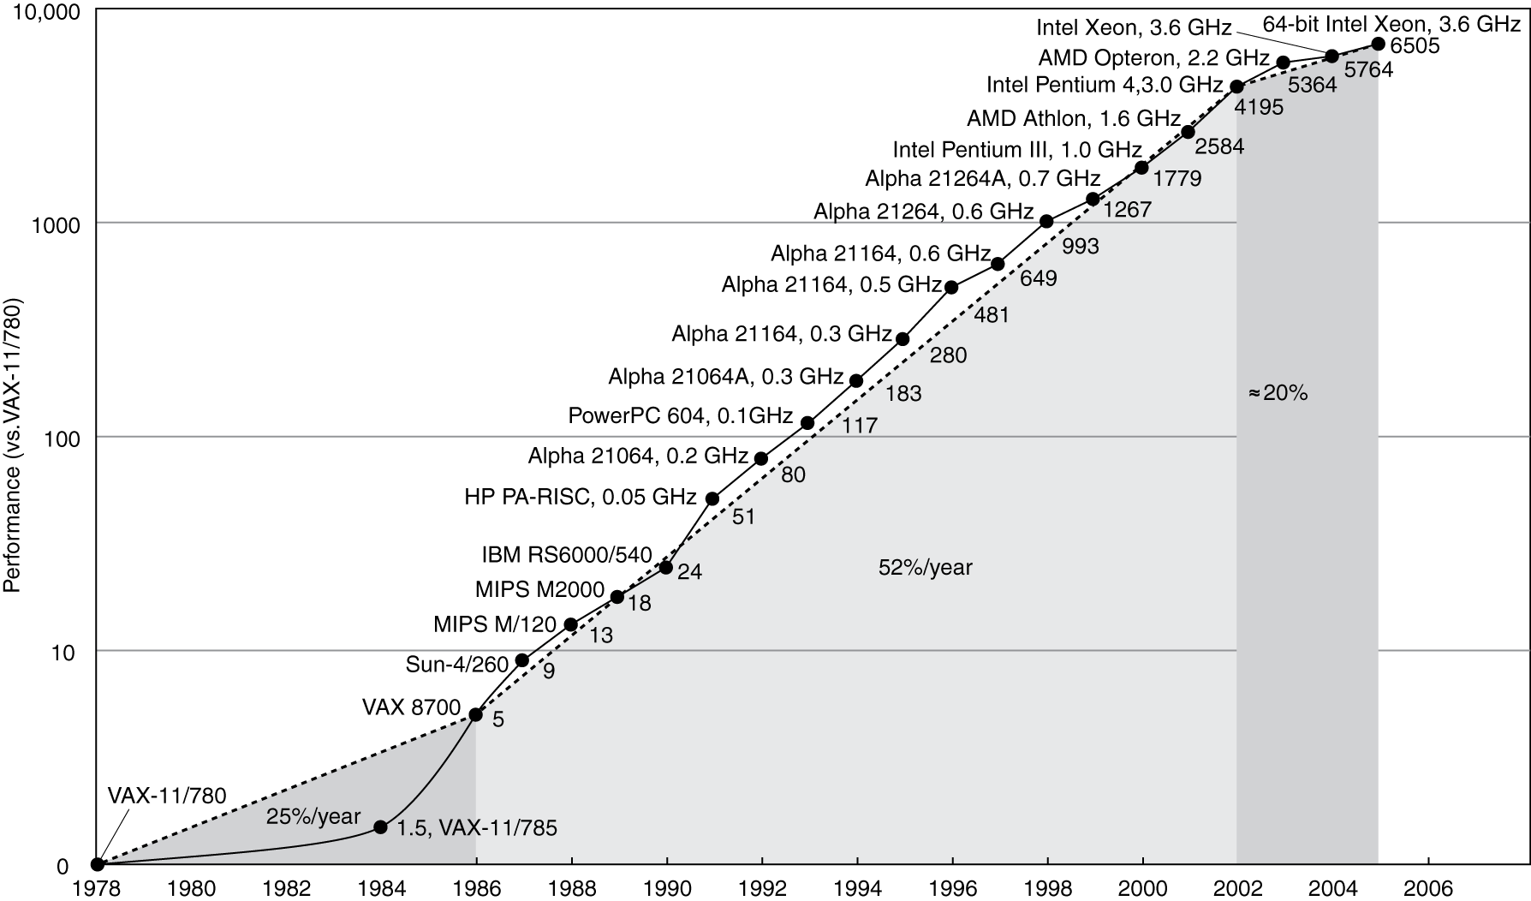
Uniprocessor Performance
Constrained by power, instruction-level parallelism, memory latency

Slide 67
Why Multicore?
Moore’s law
  A law about transistors
  Smaller means faster transistors
Power consumption growing with transistors
The power wall
  We can’t reduce voltage further
  We can’t remove more heat
How else can we improve performance?

Slide 68
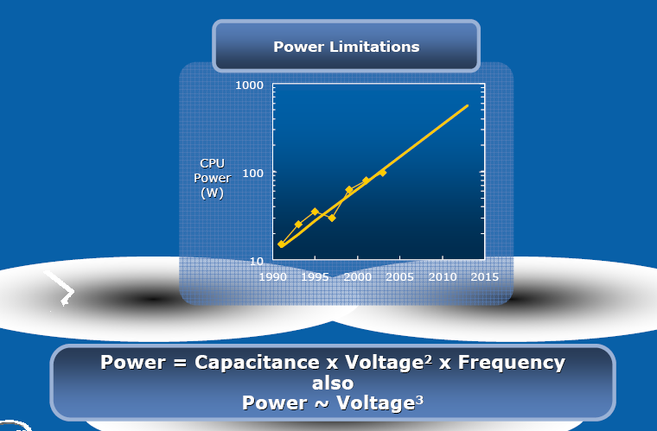
Intel’s argument

Slide 69
1.6x
1.2x

Slide 70
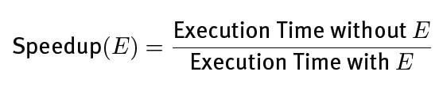
Amdahl’s Law
Task: serial part, parallel part
As number of processors increases,
  time to execute parallel part goes to zero
  time to execute serial part remains the same
Serial part eventually dominates
Must parallelize ALL parts of task

Slide 71
Amdahl’s Law
Consider an improvement E
F of the execution time is affected
S is the speedup
Notes:
F = 0.5, S = 2
1/(0.5 + 0.25) = 1/0.75 = 1.333
F = 0.9, S = 2
1/(0.1 + 0.9/2) = 1/(0.1 + 0.45) = 1/0.55 = 1.8
F = 0.99, S = 2
1/(0.01+0.99/2) = 1/(0.01+0.495) = 1.98
F = 0.5, S = 8
1/(0.5+0.5/8) -> 2

Slide 72
Multithreaded Processes

Slide 73
Shared counters
Usual result: works fine.
Possible result: lost update!
Occasional timing-dependent failure ⇒ Difficult to debug
Called a race condition
hits = 0
T1
T2
time
read hits (0)
read hits (0)
hits = 0 + 1
hits = 0 + 1
hits = 1

Slide 74
Race conditions
Def: a timing dependent error involving shared state
  Whether it happens depends on how threads scheduled: who wins “races” to instructions that update state
  Races are intermittent, may occur rarely
    Timing dependent = small changes can hide bug
  A program is correct only if all possible schedules are safe
    Number of possible schedule permutations is huge
    Need to imagine an adversary who switches contexts at the worst possible time

Slide 75
Critical Sections
Basic way to eliminate races: use critical sections that only one thread can be in
  Contending threads must wait to enter
T1
T2
time
CSEnter();
  Critical section
CSExit();
CSEnter();
  Critical section
CSExit();
T1
T2

Slide 76
Mutexes
Critical sections typically associated with mutual exclusion locks (mutexes)
Only one thread can hold a given mutex at a time
Acquire (lock) mutex on entry to critical section
  Or block if another thread already holds it
Release (unlock) mutex on exit
  Allow one waiting thread (if any) to acquire & proceed
pthread_mutex_init(m);
pthread_mutex_lock(m);
  hits = hits+1;
pthread_mutex_unlock(m);
pthread_mutex_lock(m);
  hits = hits+1;
pthread_mutex_unlock(m);
T1
T2

Slide 77
Protecting an invariant
// invariant: data is in buffer[first..last-1]. Protected by m.
pthread_mutex_t *m;
char buffer[1000];
int first = 0, last = 0;
void put(char c) {
pthread_mutex_lock(m);
buffer[last] = c;
last++;
pthread_mutex_unlock(m);
}
Rule of thumb: all updates that can affect
invariant become critical sections.
char get() {
pthread_mutex_lock(m);
char c = buffer[first];
first++;
pthread_mutex_unlock(m);
}
X what if first==last?

Slide 78
See you on Thursday
Good Luck!

