Slide 1
A Processor
See: P&H Chapter 2.16-20, 4.1-3

Slide 2
Announcements
HW2 available later today
HW2 due in one week and a half
Work alone
Use your resources
FAQ, class notes, book, Sections, office hours, newsgroup, CSUGLab
Make sure you
Registered for class, can access CMS, have a Section, and have a project partner
Check online syllabus/schedule, review slides and lecture notes, Office Hours, early homework and programming assignments

Slide 3
Announcements
Prelims: Evening of Thursday, March 10 and April 28th
Late Policy
1) Each person has a total of four “slip days”
2) For projects, slip days are deducted from all partners
3) 10% deducted per day late after slip days are exhausted
Notes:
Late Policy:
1) Each individual person gets a total of **4 "slip" days**.
Use them whenever you want without penalty. Further, no excuse is necessary. Make sure to email the head TA to enable CMS to accept your assignment when you are ready.
*caution: use slip days wisely, do not use all slip days on HW1, there are more homeworks and programming assignments!
2) For projects/programming assignments, slip days are deducted from all partners. Thus, all partners need a slip day available to use.
3) 10% deducted per day late after slip days are exhausted.

Slide 4
Basic Computer System
Let’s build a MIPS CPU
…but using (modified) Harvard architecture
CPU
Data Memory
Registers
00100000001
00100000010
00010000100
...
Control
data, address,
control
ALU
Program Memory
10100010000
10110000011
00100010101
...
Notes:
The Harvard architecture is a computer architecture with physically separate storage and signal pathways for instructions and data. --- http://en.wikipedia.org/wiki/Harvard_architecture
Under pure von Neumann architecture the CPU can be either reading an instruction or reading/writing data from/to the memory. Both cannot occur at the same time since the instructions and data use the same bus system. In a computer using the Harvard architecture, the CPU can both read an instruction and perform a data memory access at the same time, even without a cache. A Harvard architecture computer can thus be faster for a given circuit complexity because instruction fetches and data access do not contend for a single memory pathway .
Also, a Harvard architecture machine has distinct code and data address spaces: instruction address zero is not the same as data address zero. Instruction address zero might identify a twenty-four bit value, while data address zero might indicate an eight bit byte that isn't part of that twenty-four bit value.
A modified Harvard architecture machine is very much like a Harvard architecture machine, but it relaxes the strict separation between instruction and data while still letting the CPU concurrently access two (or more) memory buses. The most common modification includes separate instruction and data caches backed by a common address space. While the CPU executes from cache, it acts as a pure Harvard machine. When accessing backing memory, it acts like a von Neumann machine (where code can be moved around like data, a powerful technique). This modification is widespread in modern processors such as the ARM architecture and X86 processors. It is sometimes loosely called a Harvard architecture, overlooking the fact that it is actually "modified".

Slide 5
Instructions
High Level Language
C, Java, Python, Ruby, …
Loops, control flow, variables
for (i = 0; i < 10; i++) printf(“go cucs”);
Assembly Language
No symbols (except labels)
One operation per statement
main: addi r2, r0, 10
addi r1, r0, 0
loop: slt r3, r1, r2
...
Machine Langauge
Binary-encoded assembly
Labels become addresses
00100000000000100000000000001010
00100000000000010000000000000000
00000000001000100001100000101010

Slide 6
Instruction Types
Arithmetic
add, subtract, shift left, shift right, multiply, divide
Memory
load value from memory to a register
store value to memory from a register
Control flow
unconditional jumps
conditional jumps (branches)
jump and link (subroutine call)
Many other instructions are possible
vector add/sub/mul/div, string operations
manipulate coprocessor
I/O

Slide 7
Complexity
= Reduced Instruction Set Computer (RlSC)
MIPS
≈ 200 instructions, 32 bits each, 3 formats
mostly orthogonal
all operands in registers
almost all are 32 bits each, can be used interchangeably
≈ 1 addressing mode: Mem[reg + imm]
x86 = Complex Instruction Set Computer (ClSC)
> 1000 instructions, 1 to 15 bytes each
operands in special registers, general purpose registers, memory, on stack, …
can be 1, 2, 4, 8 bytes, signed or unsigned
10s of addressing modes
e.g. Mem[segment + reg + reg*scale + offset]

Slide 8
MIPS Register file
MIPS register file
32 registers, 32-bits each (with r0 wired to zero)
Write port indexed via R_{W}
Writes occur on falling edge but only if WE is high
Read ports indexed via R_{A}, R_{B}
W
r1
r2
…
r31
A
32
32
32
B
clk
5
5
5
WE
R_{W}
R_{A}
R_{B}

Slide 9
MIPS Memory
MIPS Memory
Up to 32-bit address
32-bit data (but byte addressed)
Enable + 2 bit memory control
00: read word (4 byte aligned)
01: write byte
10: write halfword (2 byte aligned)
11: write word (4 byte aligned)
memory
32
32
≤ 32
2
addr
mc
E

Slide 10
Instruction Usage
Basic CPU execution loop
fetch one instruction
increment PC
decode
execute

Slide 11
Instruction Fetch
Instruction Fetch Circuit
Fetch instruction from memory
Calculate address of next instruction
Repeat
Program Memory
inst
32
32
2
00
+4
PC

Slide 12
Arithmetic Instructions
00000001000001100010000000100110
op | rs | rt | rd | - | func
6 bits | 5 bits | 5 bits | 5 bits | 5 bits | 6 bits
R-Type
op | func | mnemonic | description
0x0 | 0x21 | ADDU rd, rs, rt | R[rd] = R[rs] + R[rt]
0x0 | 0x23 | SUBU rd, rs, rt | R[rd] = R[rs] – R[rt]
0x0 | 0x25 | OR rd, rs, rt | R[rd] = R[rs] | R[rt]
0x0 | 0x26 | XOR rd, rs, rt | R[rd] = R[rs] ⊕ R[rt]
0x0 | 0x27 | NOR rd, rs rt | R[rd] = ~ ( R[rs] | R[rt] )

Slide 13
Arithmetic and Logic
Prog.
Mem
Reg. File
inst
ALU
+4
5
5
5
PC
control

Slide 14
Example Programs
ADDU rd, rs, rt
SUBU rd, rs, rt
OR rd, rs, rt
XOR rd, rs, rt
NOR rd, rs rt
r4 = (r1 + r2) | r3
r8 = 4*r3 + r4 – 1
r9 = 9
Notes:
-1: NOR r1, r0, r0
1: SUB r1, r0, r1
2: ADDU r2, r2, r2
4: ADDU r2, r2, r2
8: ADDU r2, r2, r2
9: ADDU r9, r1, r2

Slide 15
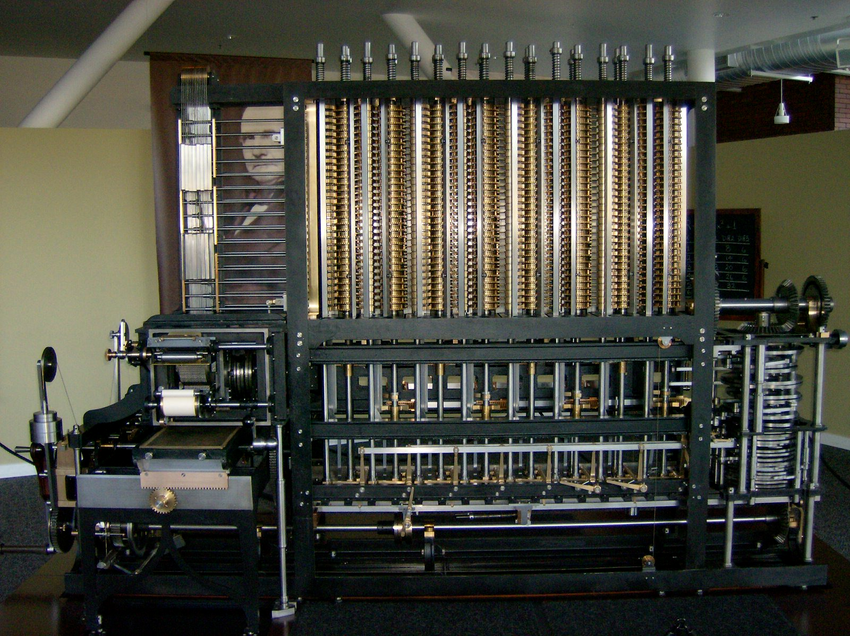
Instruction fetch + decode + ALU
= Babbage’s engine
+ speed
+ reliability
– hand crank
Notes:
A Babbage engine allows the values of the polynomial to be produced without ever having to multiply. A babbage engine only needs to be able to add!
This is why a babbage engine is also called a difference engine
A Babbage Engine (Difference Engine) is an automatic, mechanical calculator designed to tabulate polynomial functions. Both logarithmic and trigonometric functions can be approximated by polynomials, so a difference engine can compute many useful sets of numbers. -- http://en.wikipedia.org/wiki/Difference_engine

Slide 16
Arithmetic Instructions: Shift
00000000000001000100000110000011
op | - | rt | rd | shamt | func
6 bits | 5 bits | 5 bits | 5 bits | 5 bits | 6 bits
R-Type
op | func | mnemonic | description
0x0 | 0x0 | SLL rd, rs, shamt | R[rd] = R[rt] << shamt
0x0 | 0x2 | SRL rd, rs, shamt | R[rd] = R[rt] >>> shamt (zero ext.)
0x0 | 0x3 | SRA rd, rs, shamt | R[rd] = R[rs] >> shamt (sign ext.)
ex: r5 = r3 * 8

Slide 17
Shift
Prog.
Mem
Reg. File
inst
ALU
+4
5
5
5
PC
control
shamt

Slide 18
Arithmetic Instructions: Immediates
00100100101001010000000000000101
op | rs | rd | immediate
6 bits | 5 bits | 5 bits | 16 bits
I-Type
op | mnemonic | description
0x9 | ADDIU rd, rs, imm | R[rd] = R[rs] + imm
0xc | ANDI rd, rs, imm | R[rd] = R[rs] & imm
0xd | ORI rd, rs, imm | R[rd] = R[rs] | imm
op | mnemonic | description
0x9 | ADDIU rd, rs, imm | R[rd] = R[rs] + sign_extend(imm)
0xc | ANDI rd, rs, imm | R[rd] = R[rs] & zero_extend(imm)
0xd | ORI rd, rs, imm | R[rd] = R[rs] | zero_extend(imm)
ex: r5 += 5
ex: r9 = -1
ex: r9 = 65535

Slide 19
Immediates
Prog.
Mem
Reg. File
inst
ALU
+4
5
5
5
PC
control
control
imm
extend
shamt

Slide 20
Arithmetic Instructions: Immediates
00111100000001010000000000000101
op | - | rd | immediate
6 bits | 5 bits | 5 bits | 16 bits
I-Type
op | mnemonic | description
0xF | LUI rd, imm | R[rd] = imm << 16
ex: r5 = 0xdeadbeef

Slide 21
Immediates
Prog.
Mem
Reg. File
inst
ALU
+4
5
5
5
PC
control
control
16
imm
extend
shamt
Notes:
or, extra input to alu B mux from before/after extend
(or, extra mux after alu)

Slide 22
MIPS Instruction Types
Arithmetic/Logical
R-type: result and two source registers, shift amount
I-type: 16-bit immediate with sign/zero extension
Memory Access
load/store between registers and memory
word, half-word and byte operations
Control flow
conditional branches: pc-relative addresses
jumps: fixed offsets, register absolute

Slide 23
Memory Instructions
10100100101000010000000000000010
op | rs | rd | offset
6 bits | 5 bits | 5 bits | 16 bits
I-Type
base + offset addressing
op | mnemonic | description
0x20 | LB rd, offset(rs) | R[rd] = sign_ext(Mem[offset+R[rs]])
0x24 | LBU rd, offset(rs) | R[rd] = zero_ext(Mem[offset+R[rs]])
0x21 | LH rd, offset(rs) | R[rd] = sign_ext(Mem[offset+R[rs]])
0x25 | LHU rd, offset(rs) | R[rd] = zero_ext(Mem[offset+R[rs]])
0x23 | LW rd, offset(rs) | R[rd] = Mem[offset+R[rs]]
0x28 | SB rd, offset(rs) | Mem[offset+R[rs]] = R[rd]
0x29 | SH rd, offset(rs) | Mem[offset+R[rs]] = R[rd]
0x2b | SW rd, offset(rs) | Mem[offset+R[rs]] = R[rd]
signed offsets

Slide 24
Memory Operations
Prog.
Mem
Reg. File
inst
ALU
+4
addr
5
5
5
PC
control
Data Mem
imm
ext

Slide 25
Example
int h, A[];
A[12] = h + A[8];
Notes:
lw, t0, 32(s3)
add t0, s2, t0
sw t0, 48(s3)

Slide 26
Memory Layout
Examples:
# r5 contains 0x5 sb r5, 2(r0) lb r6, 2(r0) sw r5, 8(r0) lb r7, 8(r0) lb r8, 11(r0)
 | 0x00000000
 | 0x00000001
 | 0x00000002
 | 0x00000003
 | 0x00000004
 | 0x00000005
 | 0x00000006
 | 0x00000007
 | 0x00000008
 | 0x00000009
 | 0x0000000a
 | 0x0000000b
 | ...
 | 0xffffffff

Slide 27
Endianness
Endianness: Ordering of bytes within a memory word
Little Endian = least significant part first (MIPS, x86)
1000 | 1001 | 1002 | 1003
as 4 bytes
as 2 halfwords
as 1 word
0x12345678
Big Endian = most significant part first (MIPS, networks)
1000 | 1001 | 1002 | 1003
as 4 bytes
as 2 halfwords
as 1 word
0x12345678

Slide 28
Control Flow: Absolute Jump
00001010100001001000011000000011
op | immediate
6 bits | 26 bits
J-Type
op | mnemonic | description
0x2 | J target | PC = target
op | mnemonic | description
0x2 | J target | PC = target || 00
op | mnemonic | description
0x2 | J target | PC = (PC+4)_{32..29} || target || 00
Absolute addressing for jumps
Jump from 0x30000000 to 0x20000000? NO Reverse? NO
But: Jumps from 0x2FFFFFFF to 0x3xxxxxxx are possible, but not reverse
Trade-off: out-of-region jumps vs. 32-bit instruction encoding
MIPS Quirk:
jump targets computed using already incremented PC

Slide 29
Absolute Jump
Prog.
Mem
Reg. File
inst
ALU
+4
addr
5
5
5
PC
control
Data Mem
imm
ext
tgt
||
long jump? computed jump?

Slide 30
Control Flow: Jump Register
00000000011000000000000000001000
op | rs | - | - | - | func
6 bits | 5 bits | 5 bits | 5 bits | 5 bits | 6 bits
R-Type
op | func | mnemonic | description
0x0 | 0x08 | JR rs | PC = R[rs]

Slide 31
Jump Register
Prog.
Mem
Reg. File
inst
ALU
+4
addr
5
5
5
PC
control
Data Mem
imm
ext
tgt
||

Slide 32
Examples (2)
jump to 0xabcd1234

Slide 33
Examples (2)
jump to 0xabcd1234
# assume 0 <= r3 <= 1
if (r3 == 0) jump to 0xdecafe0
else jump to 0xabcd1234

Slide 34
Examples (2)
jump to 0xabcd1234
# assume 0 <= r3 <= 1
if (r3 == 0) jump to 0xdecafe0
else jump to 0xabcd1234

Slide 35
Control Flow: Branches
00010000101000010000000000000011
op | rs | rd | offset
6 bits | 5 bits | 5 bits | 16 bits
I-Type
signed offsets
op | mnemonic | description
0x4 | BEQ rs, rd, offset | if R[rs] == R[rd] then PC = PC+4 + (offset<<2)
0x5 | BNE rs, rd, offset | if R[rs] != R[rd] then PC = PC+4 + (offset<<2)

Slide 36
Examples (3)
s0
s1
if (i == j) { i = i * 4; }
else { j = i - j; }

Slide 37
Absolute Jump
Prog.
Mem
Reg. File
inst
ALU
+4
addr
5
5
5
=?
PC
control
Data Mem
offset
+
imm
ext
tgt
||
Could have used ALU for branch add
Could have used ALU for branch cmp

Slide 38
Absolute Jump
Prog.
Mem
Reg. File
inst
ALU
+4
addr
5
5
5
=?
PC
control
Data Mem
offset
+
imm
ext
tgt
||
Could have used ALU for branch add
Could have used ALU for branch cmp

Slide 39
Control Flow: More Branches
00000100101000010000000000000010
op | rs | subop | offset
6 bits | 5 bits | 5 bits | 16 bits
almost I-Type
signed offsets
op | subop | mnemonic | description
0x1 | 0x0 | BLTZ rs, offset | if R[rs] < 0 then PC = PC+4+ (offset<<2)
0x1 | 0x1 | BGEZ rs, offset | if R[rs] ≥ 0 then PC = PC+4+ (offset<<2)
0x6 | 0x0 | BLEZ rs, offset | if R[rs] ≤ 0 then PC = PC+4+ (offset<<2)
0x7 | 0x0 | BGTZ rs, offset | if R[rs] > 0 then PC = PC+4+ (offset<<2)

Slide 40
Absolute Jump
Prog.
Mem
Reg. File
inst
ALU
+4
addr
5
5
5
=?
PC
control
cmp
Data Mem
offset
+
imm
ext
tgt
||
Could have used ALU for branch cmp

Slide 41
Control Flow: Jump and Link
00001100000001001000011000000010
op | immediate
6 bits | 26 bits
J-Type
op | mnemonic | description
0x3 | JAL target | r31 = PC+8 PC = (PC+4)_{32..29} || target || 00

Slide 42
Absolute Jump
Prog.
Mem
Reg. File
inst
ALU
+4
+4
addr
5
5
5
=?
PC
control
cmp
Data Mem
offset
+
imm
ext
tgt
||
Could have used ALU for link add

Slide 43
Next Time
CPU Performance
Pipelined CPU

