Slide 1
Memory
See: P&H Appendix C.8, C.9

Slide 2
Announcements
HW1 due today
HW2 available later today
HW2 due in one week and a half
Work alone
Use your resources
  FAQ, class notes, book, Sections, office hours, newsgroup, CSUGLab
Make sure you
  Registered for class, can access CMS, have a Section, and have a project partner
  Check online syllabus/schedule, review slides and lecture notes, Office Hours, early homework and programming assignments

Slide 3
Announcements
Prelims: Evening of Thursday, March 10 and April 28th
Late Policy
1) Each person has a total of four “slip days”
2) For projects, slip days are deducted from all partners
3) 10% deducted per day late after slip days are exhausted
Notes:
Late Policy:
1) Each individual person gets a total of **4 "slip" days**.
Use them whenever you want without penalty. Further, no excuse is necessary. Make sure to email the head TA to enable CMS to accept your assignment when you are ready.
*caution: use slip days wisely, do not use all slip days on HW1, there are more homeworks and programming assignments!
2) For projects/programming assignments, slip days are deducted from all partners. Thus, all partners need a slip day available to use.
3) 10% deducted per day late after slip days are exhausted.

Slide 4
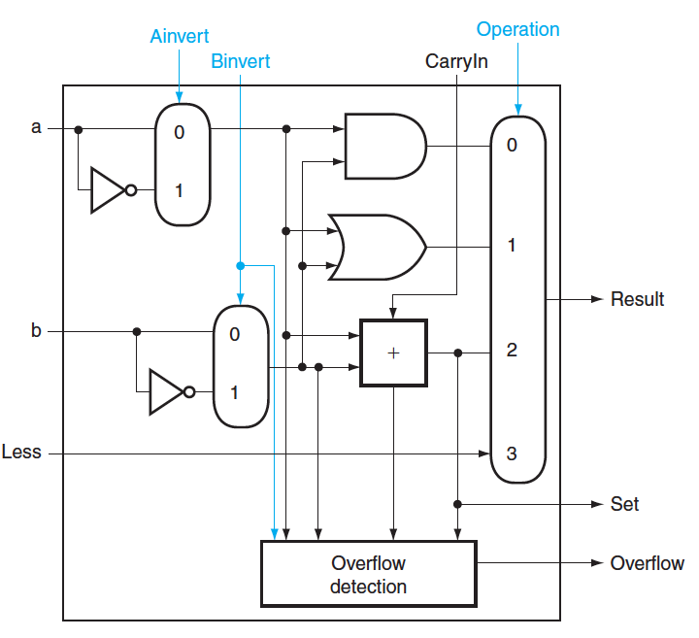
Critical Path
Which operation is the critical path?
A) AND
B) OR
C) ADD/SUB
D) LT

Slide 5
Critical Path
What is the length of the critical path (in gates)?
A) 3
B) 5
C) 8
D) 11

Slide 6
Critical Path
What is the length of the critical path for a 32-bit ALU (in gates)?
A) 11
B) 32
C) 64
D) 70

Slide 7
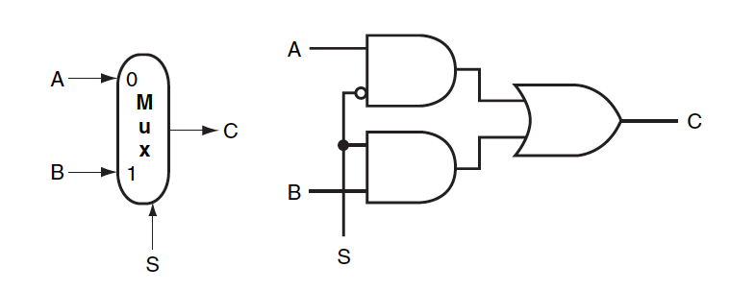
Multiplexor

Slide 8
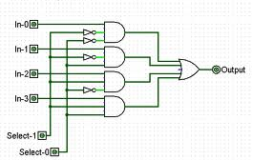
Multiplexor

Slide 9
Goals for today
Review
  SR Latches, D Latches, D Flip Flips, and Registers
Memory
  Register Files
  Tri-state devices
  SRAM (Static RAM—random access memory)
  DRAM (Dynamic RAM)

Slide 10
Bistable Devices
Stable and unstable equilibria?
A
B
A Simple Device
Notes:
How to create state? Feedback.
Show how the signal works

Slide 11
Bistable Devices
Stable and unstable equilibria?
A
B
A Simple Device
In stable state, A = B
How do we change the state?
0
1
1
0
A
B
A
B
Notes:
How to create state? Feedback.
Show how the signal works

Slide 12
SR Latch
Q
R
S
Q
Notes:
Start with 0, 1 => 0, 1
then 0, 0 => 0, 1
then 1, 0 => 1, 0
then 0, 0 => 1, 0, better yet “stay”
1, 1 is forbidden, b/c going to 0, 0 after goes haywire
Asserting S and R simultaneously can lead to incorrect operation: depending on how S and R are deasserted, the latch may oscillate or become metastable (this is described in more detail in Section C.11).

Slide 13
SR Latch
Set-Reset (SR) Latch
Stores a value Q and its complement Q
S | R | Q | Q
0 | 0
0 | 1
1 | 0
1 | 1
Q
S
R
Q
Notes:
Start with 0, 1 => 0, 1
then 0, 0 => 0, 1
then 1, 0 => 1, 0
then 0, 0 => 1, 0, better yet “stay”
1, 1 is forbidden, b/c going to 0, 0 after goes haywire
Asserting S and R simultaneously can lead to incorrect operation: depending on how S and R are deasserted, the latch may oscillate or become metastable (this is described in more detail in Section C.11).

Slide 14
SR Latch
Set-Reset (SR) Latch
Stores a value Q and its complement Q
S
Q
R
Q
S | R | Q | Q
0 | 0 | Q | Q
0 | 1 | 0 | 1
1 | 0 | 1 | 0
1 | 1 | forbidden
Q
S
R
Q
Notes:
Start with 0, 1 => 0, 1
then 0, 0 => 0, 1
then 1, 0 => 1, 0
then 0, 0 => 1, 0, better yet “stay”
1, 1 is forbidden, b/c going to 0, 0 after goes haywire
Asserting S and R simultaneously can lead to incorrect operation: depending on how S and R are deasserted, the latch may oscillate or become metastable (this is described in more detail in Section C.11).

Slide 15
Unclocked D Latch
Data (D) Latch
D
S
Q
D | Q | Q
0
1
R
Q
Notes:
Start in 0, 0, 1
Change to D = 1
After NOT gate, R = 0
After OR+NOT gates, /Q = 0 (R is already ready then), Q goes to 1
Problem: No way to hold state

Slide 16
Unclocked D Latch
Data (D) Latch
D
S
Q
D | Q | Q
0 | 0 | 1
1 | 1 | 0
R
Q
Data Latch
  Easier to use than an SR latch
  No possibility of entering an undefined state
When D changes, Q changes
    … immediately (after a delay of 2 Ors and 2 NOTs)
Need to control when the output changes
Notes:
Start in 0, 0, 1
Change to D = 1
After NOT gate, R = 0
After OR+NOT gates, /Q = 0 (R is already ready then), Q goes to 1
Problem: No way to hold state

Slide 17
D Latch with Clock
D
D | Q | Q
0 | 0 | 1
1 | 1 | 0
S
Q
clk
R
Q
Level Sensitive D Latch
Clock high:
set/reset (according to D)
Clock low:
keep state (ignore D)
Notes:
Any forbidden S=R=1 inputs? No
Need both truth tables

Slide 18
D Latch with Clock
D
D | Q | Q
0 | 0 | 1
1 | 1 | 0
S
Q
clk
R
Q
S | R | Q | Q
0 | 0 | Q | Q
0 | 1 | 0 | 1
1 | 0 | 1 | 0
1 | 1 | forbidden
clk | D | Q | Q
0 | 0 | Q | Q
0 | 1 | Q | Q
1 | 0 | 0 | 1
1 | 1 | 1 | 0
Notes:
Any forbidden S=R=1 inputs? No
Need both truth tables

Slide 19
D Latch with Clock
D
D | Q | Q
0 | 0 | 1
1 | 1 | 0
S
Q
clk
R
Q
clk | D | Q | Q
0 | 0 | Q | Q
0 | 1 | Q | Q
1 | 0 | 0 | 1
1 | 1 | 1 | 0
clk
D
Q
Notes:
Any forbidden S=R=1 inputs? No
Need both truth tables

Slide 20
Edge-Triggered D Flip-Flop
D Flip-Flop
Edge-Triggered
Data is captured when clock is high
Outputs change only on falling edges
D
D
Q
D
Q
Q
F
clk
L
Q
L
Q
Q
c
c
clk
D
F
Q

Slide 21
Registers
D0
Register
D flip-flops in parallel
shared clock
extra clocked inputs:
write_enable, reset, …
D1
D2
D3
4-bit
reg
4
4
clk

Slide 22
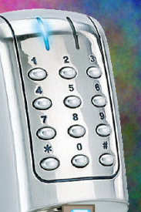

Voting Machine
3
mux
LED dec
mux
+1
32
32
32
reg
reg
reg
...
reg
32
E
E
E
E
decoder (3-to-8)
enc
detect
3

Slide 23
Goals for today
Review
  SR Latches, D Latches, D Flip Flips, and Registers
Memory
  Register Files
  Tri-state devices
  SRAM (Static RAM—random access memory)
  DRAM (Dynamic RAM)

Slide 24
Register File
Register File
  N read/write registers
  Indexed by
  register number
Implementation:
  D flip flops to store bits
  Decoder for each write port
  Mux for each read port
Dual-Read-Port
Single-Write-Port
32 x 32
Register File
Q_{A}
D_{W}
32
32
Q_{B}
32
W
R_{W}
R_{A}
R_{B}
1
5
5
5

Slide 25
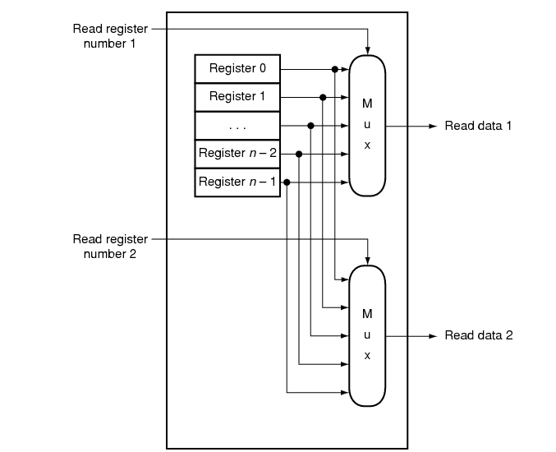
Register File
Register File
  N read/write registers
  Indexed by
  register number
Implementation:
  D flip flops to store bits
  Decoder for each write port
  Mux for each read port
Dual-Read-Port
Single-Write-Port
32 x 32
Register File
Q_{A}
D_{W}
32
32
Q_{B}
32
W
R_{W}
R_{A}
R_{B}
1
5
5
5

Slide 26
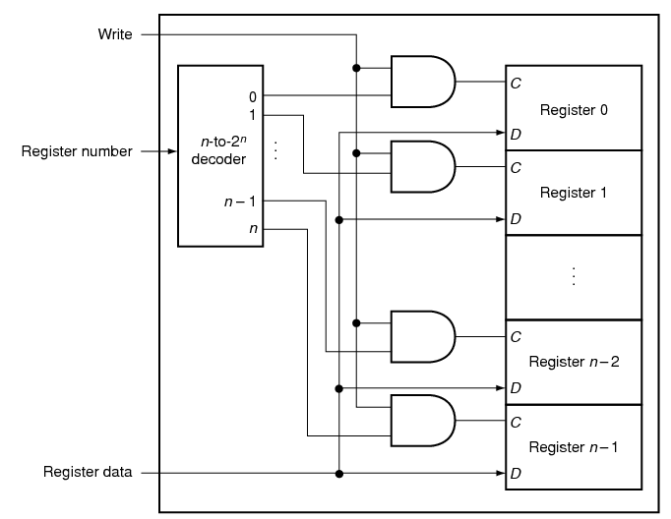
Register File
Register File
  N read/write registers
  Indexed by
  register number
Implementation:
  D flip flops to store bits
  Decoder for each write port
  Mux for each read port
Dual-Read-Port
Single-Write-Port
32 x 32
Register File
Q_{A}
D_{W}
32
32
Q_{B}
32
W
R_{W}
R_{A}
R_{B}
1
5
5
5

Slide 27
Tradeoffs
Register File tradeoffs
  + Very fast (a few gate delays for both read and write)
  + Adding extra ports is straightforward
  – Doesn’t scale

Slide 28
Building Large Memories
Need a shared bus (or shared bit line)
Many FFs/outputs/etc. connected to single wire
Only one output drives the bus at a time

Slide 29
Tri-State Devices
Tri-State Buffers
E
E
Vdd
D
Q
D
D
Q
E | D | Q
0 | 0 | z
0 | 1 | z
1 | 0 | 0
1 | 1 | 1
Gnd
Notes:
z, z 0, 1

Slide 30
Tri-State Devices
Tri-State Buffers
E
E
Vdd
D
Q
D
D
Q
E | D | Q
0 | 0 | z
0 | 1 | z
1 | 0 | 0
1 | 1 | 1
Gnd
Notes:
z, z 0, 1

Slide 31
Shared Bus
D₀
S₀
D₁
S₁
D₂
S₂
D₃
S₃
D₁₀₂₃
S₁₀₂₃
shared line

Slide 32
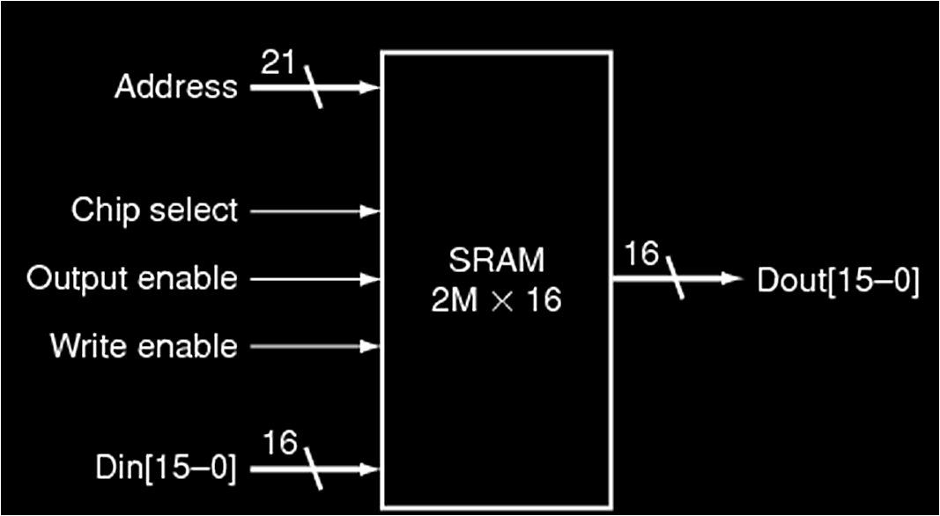
SRAM
Static RAM (SRAM)
  Essentially just SR Latches + tri-states buffers
Notes:
Caption on C.9.1 is incorrect
Output enable is useful for connecting multiple memories to a single-output bus and using Output enable to determine which memory drives the bus.

Slide 33
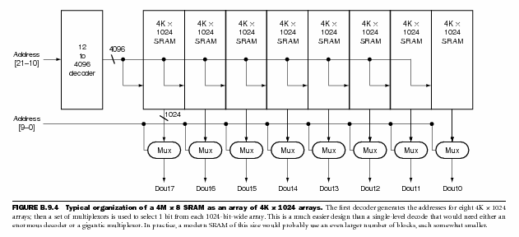
SRAM Chip
Notes:
2 step address decode

Slide 34
SRAM Chip
row decoder
A₂₁₋₁₀
CS
R/W
column selector, sense amp, and I/O circuits
A₉₋₀
Shared Data Bus
Notes:
2 step address decode

Slide 35
SRAM Cell
Typical SRAM Cell
bit line
word line
B
B
Each cell stores one bit, and requires 4 – 8 transistors (6 is typical)
Read:
pre-charge B and B to Vdd/2
pull word line high
cell pulls B or B low, sense amp detects voltage difference
Write:
pull word line high
drive B and B to flip cell
Notes:
Typical
read access times for SRAMs in 2004 varied from about 2–4 ns for the fastest CMOS
parts, which tend to be somewhat smaller and narrower, to 8–20 ns for the typical
largest parts, which in 2004 had more than 32 million bits of data.

Slide 36
SRAM Modules and Arrays
R/W
1M x 4
SRAM
1M x 4
SRAM
1M x 4
SRAM
1M x 4
SRAM
A₂₁₋₀
CS
msb
lsb
CS
Bank 2
CS
Bank 3
CS
Bank 4
Notes:
2, 3, or more step address decode
The first decoder generates the addresses for eight 4M x 4 arrays; then a set of multiplexors is used to select 1 bit from each 4-bit-wide array. This is a much easier design than a single-level decode that would need either an enormous decoder or a gigantic multiplexor. In practice, a modern SRAM of
this size would probably use an even larger number of blocks, each somewhat smaller.

Slide 37
SRAM Summary
SRAM
A few transistors (~6) per cell
Used for working memory (caches)
But for even higher density…

Slide 38
Dynamic RAM: DRAM
bit line
Dynamic-RAM (DRAM)
  Data values require constant refresh
word line
Capacitor
Gnd
Notes:
value kept in a cell is stored as a charge in a capacitor
To refresh the cell, we merely read its contents and write it back.
Because DRAMs store the charge on a capacitor, it cannot be kept indefinitely and must periodically be refreshed. That is why this memory structure is called dynamic, as opposed to the static storage in an SRAM cell.
The pass transistor acts like a switch: when the signal on the word line is asserted, the switch is closed, connecting the capacitor to the bit line. If the operation is a write, then the value to be written is placed on the bit line. If the value is a 1, the capacitor will be charged. If the value is a 0, then the capacitor will be discharged. Reading is slightly more complex, since the DRAM must detect a very small charge stored in the capacitor. Before activating the word line for a read, the bit line is charged to the voltage that is halfway between the low and high voltage. Then, by activating the word line, the charge on the capacitor is read out onto the bit line. This causes the bit line to move slightly toward the high or low direction, and this change is detected with a sense amplifi er, which can detect small changes in voltage.

Slide 39
DRAM vs. SRAM
Single transistor vs. many gates
  Denser, cheaper ($30/1GB vs. $30/2MB)
  But more complicated, and has analog sensing
Also needs refresh
  Read and write back…
  …every few milliseconds
  Organized in 2D grid, so can do rows at a time
  Chip can do refresh internally
Hence… slower and energy inefficient

Slide 40
Memory
Register File tradeoffs
  + Very fast (a few gate delays for both read and write)
  + Adding extra ports is straightforward
  – Expensive, doesn’t scale
  – Volatile
Volatile Memory alternatives: SRAM, DRAM, …
  – Slower
  + Cheaper, and scales well
  – Volatile
  Non-Volatile Memory (NV-RAM): Flash, EEPROM, …
  + Scales well
  – Limited lifetime; degrades after 100000 to 1M writes

Slide 41
Summary
We now have enough building blocks to build machines that can perform non-trivial computational tasks
Register File: Tens of words of working memory
SRAM: Millions of words of working memory
DRAM: Billions of words of working memory
NVRAM: long term storage
(usb fob, solid state disks, BIOS, …)

