Slide 1
Gates and Logic
Hakim Weatherspoon
CS 3410, Spring 2011
Computer Science
Cornell Universty
See: P&H Appendix C.0, C.1, C.2

Slide 2
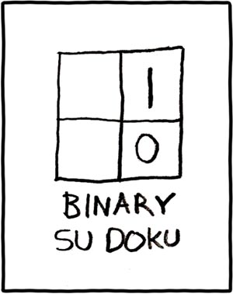
Gates and Logic
See: P&H Appendix C.0, C.1, C.2
http://www.xkcd.com/74/

Slide 3
Announcements
Class newsgroup created
  Posted on web-page
  Use it for partner finding
First assignment is to find partners
Sections start next week
  Use this weeks section to find a partner
Note about class
  No Verilog or VHDL
  Clickers not required, but will use them from time-to-time

Slide 4
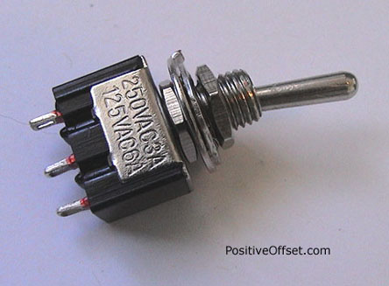
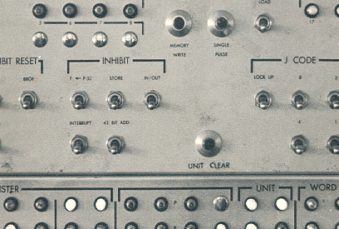

A switch
Acts as a conductor or insulator
Can be used to build amazing things…

Slide 5
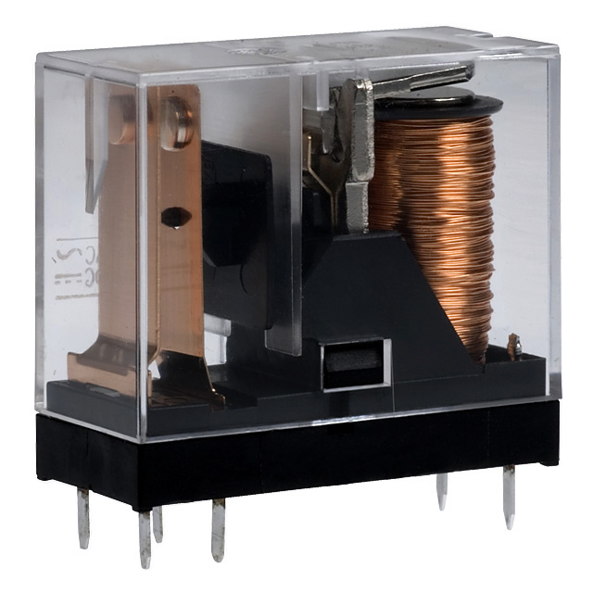
Better Switch
One current controls another (larger) current
Static Power:
  Keeps consuming power when in the ON state
Dynamic Power:
  Jump in power consumption when switching

Slide 6
Atoms
e
e
e
hole
e
e
e
N
e
P
P
N
P
P
P
N
N
N
N
P
P
N
e
e
e
e
e
e
e

Slide 7
Elements
e
e
e
B
e
Si
e
P
e
e
e
e
e
e
e
Boron
Silicon
Phosphorus

Slide 8
Silicon Crystal
Silicon
e
e
e
e
e
e
e
Si
e
Si
e
Si
e
Si
e
Si
e
Si
e
Si
e
e
e
e
e
e
e
e
e
e
e
e
e
e
e
e
e
e
e
e
e
e
Si
e
Si
e
Si
e
Si
e
Si
e
Si
e
Si
e
e
e
e
e
e
e
e
e
e
e
e
e
e
e
e
e
e
e
e
e
e
Si
e
Si
e
Si
e
Si
e
Si
e
Si
e
Si
e
e
e
e
e
e
e
e
e
e
e
e
e
e
e
e
e
e
e
e
e
e
Si
e
Si
e
Si
e
Si
e
Si
e
Si
e
Si
e
e
e
e
e
e
e
e
e
e
e
e
e
e
e
e
e
e
e
e
e
e
Si
e
Si
e
Si
e
Si
e
Si
e
Si
e
Si
e
e
e
e
e
e
e
e
e
e
e
e
e
e
e

Slide 9
Phosphorus Doping
N-Type: Silicon + Phosphorus
e
e
e
e
e
e
e
e
e
e
e
e
e
e
e
e
e
e
e
e
e
e
e
e
e
e
e
e
e
e
e
e
e
e
e
e
e
e
e
P
e
e
e
e
e
e
e
e
e
e
e
e
e
e
e
e
e
e
e
e
e
e
e
e
e
e
e
P
e
e
e
e
e
e
e
e
e
e
e
e
e
e
e
e
e
e
e
e
e
e
e
e
e
e
e
e
e
e
e
e
P
e
e
e
e
e
e
e
e
e
e
e
e
e
e
e
e
e
e
e
e
e
e
e
e
e
e
P
e
e
e
e
e
e
e
e
e
e
e
e
e
e
e
e
e
e
e
e
Notes:
neutral -> conductor
high voltage -> insulator

Slide 10
Boron Doping
P-Type: Silicon + Boron
e
e
e
e
e
e
e
e
e
e
e
e
e
e
e
e
e
e
e
e
e
e
e
e
e
e
e
e
e
e
e
e
e
e
e
e
e
e
e
e
B
e
e
e
e
e
e
e
e
e
e
e
e
e
e
e
e
e
e
e
e
e
e
e
e
B
e
e
e
e
e
e
e
e
e
e
e
e
e
e
e
e
e
e
e
e
e
e
e
e
e
e
e
e
e
B
e
e
e
e
e
e
e
e
e
e
e
e
e
e
e
e
e
e
e
e
e
e
e
e
B
e
e
e
e
e
e
e
e
e
e
e
e
e
e
e
e
e
e
e
Notes:
neutral -> conductor
low voltage -> insulator

Slide 11
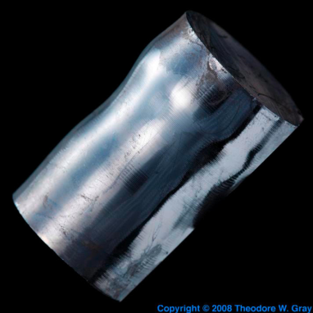
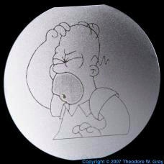


Semiconductors
Insulator
p-type (Si+Boron)
has mobile holes:
n-type (Si+Phosphorus)
has mobile electrons:
low voltage (depleted)
→ insulator
high voltage (mobile holes)
→ conductor
low voltage (mobile electrons)
→ conductor
high voltage (depleted)
→ insulator

Slide 12
Bipolar Junction
P-Type
N-Type
e
e
e
e
e
e
e
e
e
e
e
e
e
e
low v → insulator
high v → conductor
low v → conductor
high v → insulator

Slide 13
Reverse Bias
P-Type
N-Type
e
e
e
e
–
e
e
+
e
e
e
e
e
e
e
e
low v → insulator
high v → conductor
low v → conductor
high v → insulator

Slide 14
Forward Bias
P-Type
N-Type
e
e
e
e
e
e
e
e
e
e
–
+
e
e
e
e
e
e
e
e
e
e
e
e
e
e
e
e
e
e
low v → insulator
high v → conductor
low v → conductor
high v → insulator

Slide 15
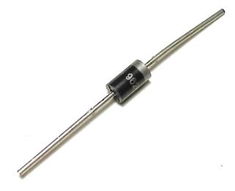
Diodes
PN Junction “Diode”
p-type
n-type
Conventions:
vdd = vcc = +1.2v = +5v = hi
vss = vee = 0v = gnd

Slide 16
PNP Junction
p-type
n-type
p-type

Slide 17
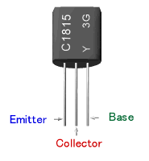
Bipolar Junction Transistors
Solid-state switch: The most amazing invention of the 1900s
Emitter = “input”, Base = “switch”, Collector = “output”
PNP Transistor
NPN Transistor
C
p
n
p
E=vdd
vss=E
n
p
n
C
B
B
vdd
E
C
B
B
C
E
vss

Slide 18
Field Effect Transistors
P-type FET
N-type FET
Drain = vdd
Drain
Gate
Gate
Source
Source = vss
Connect Source to Drain when Gate = lo
Drain must be vdd, or connected to source of another P-type transistor
Connect Source to Drain when Gate = hi
Source must be vss, or connected to drain of another N-type transistor

Slide 19
Multiple Transistors
+5v
Vdd
in
out
0v
t
Vss
Gate delay
transistor switching time
voltage, propagation, fanout, temperature, …
CMOS design
(complementary-symmetry metal–oxide–semiconductor)
  Power consumption =
  dynamic + leakage
In | Out
voltage

Slide 20
Digital Logic
+5v
Vdd
+2v
in
out
+0.5v
0v
Vss
t
In | Out
+5v | 0v
0v | +5v
In | Out
voltage
truth table
Conventions:
vdd = vcc = +1.2v = +5v = hi = true = 1
vss = vee = 0v = gnd = false = 0

Slide 21
NOT Gate (Inverter)
Function: NOT
Symbol:
Vdd
in
out
in
out
Vss
In | Out
0 | 1
1 | 0
Truth table

Slide 22
NAND Gate
Vdd
Vdd
Function: NAND
Symbol:
A
B
out
a
out
b
B
A
A | B | out
0 | 0 | 1
0 | 1 | 1
1 | 0 | 1
1 | 1 | 0
Vss

Slide 23
NOR Gate
Vdd
Function: NOR
Symbol:
A
a
out
B
b
out
A
B
A | B | out
0 | 0 | 1
0 | 1 | 0
1 | 0 | 0
1 | 1 | 0
Vss
Vss

Slide 24
Building Functions
AND:
OR:
NOT:

Slide 25
Universal Gates
NAND is universal (so is NOR)
  Can implement any function with just NAND gates
    De Morgan’s laws are helpful (pushing bubbles)
  useful for manufacturing
E.g.: XOR (A, B) = A or B but not both (“exclusive or”)
Proof: ?

Slide 26
Logic Equations
Some notation:
constants: true = 1, false = 0
variables: a, b, out, …
operators:
  AND(a, b) = a b = a & b = a ∧ b
OR(a, b) = a + b = a | b = a ∨ b
NOT(a) = ā = !a = ¬a

Slide 27
Identities
Identities useful for manipulating logic equations
  For optimization & ease of implementation
  a + 0 =
  a + 1 =
  a + ā =
  a 0 =
  a 1 =
  a ā =
  (a + b) =
  (a b) =
  a + a b =
  a(b+c) =
  a(b+c) =
  a
  1
  1
  0
  a
  0
  a b
  a + b
  a
  ab + ac
  a + bc

Slide 28
Logic Manipulation
functions: gates ↔ truth tables ↔ equations
Example: (a+b)(a+c) = a + bc
a | b | c
0 | 0 | 0
0 | 0 | 1
0 | 1 | 0
0 | 1 | 1
1 | 0 | 0
1 | 0 | 1
1 | 1 | 0
1 | 1 | 1
Notes:
(a+b)(a+c)
= aa + ab + ac + bc
= a + a(b+c) + bc
= a(1 + (b+c)) + bc
= a + bc

Slide 29
Logic Manipulation
functions: gates ↔ truth tables ↔ equations
Example: (a+b)(a+c) = a + bc
a | b | c
0 | 0 | 0
0 | 0 | 1
0 | 1 | 0
0 | 1 | 1
1 | 0 | 0
1 | 0 | 1
1 | 1 | 0
1 | 1 | 1
 |  |  | a+b | a+c | LHS
 |  |  | 0 | 0 | 0
 |  |  | 0 | 1 | 0
 |  |  | 1 | 0 | 0
 |  |  | 1 | 1 | 1
 |  |  | 1 | 1 | 1
 |  |  | 1 | 1 | 1
 |  |  | 1 | 1 | 1
 |  |  | 1 | 1 | 1
 |  |  |  |  |  | bc | RHS
 |  |  |  |  |  | 0 | 0
 |  |  |  |  |  | 0 | 0
 |  |  |  |  |  | 0 | 0
 |  |  |  |  |  | 1 | 1
 |  |  |  |  |  | 0 | 1
 |  |  |  |  |  | 0 | 1
 |  |  |  |  |  | 0 | 1
 |  |  |  |  |  | 1 | 1
Notes:
(a+b)(a+c)
= aa + ab + ac + bc
= a + a(b+c) + bc
= a(1 + (b+c)) + bc
= a + bc

Slide 31
Logic Minimization
A common problem is how to implement a desired function most efficiently
One can derive the equation from the truth table
How does one find the most efficient equation?
  Manipulate algebraically until satisfied
  Use Karnaugh maps (or K maps)
a | b | c | minterm
0 | 0 | 0 | abc
0 | 0 | 1 | abc
0 | 1 | 0 | abc
0 | 1 | 1 | abc
1 | 0 | 0 | abc
1 | 0 | 1 | abc
1 | 1 | 0 | abc
1 | 1 | 1 | abc
for all outputs
that are 1,
take the corresponding
minterm
Obtain the result in
“sum of products” form

Slide 32
Multiplexer
A multiplexer selects between multiple inputs
  out = a, if d = 0
  out = b, if d = 1
Build truth table
Minimize diagram
Derive logic diagram
a
0
b
d

Slide 33
Multiplexer Implementation
a
0
Build a truth table
  = abd + abd + a bd + a b d
  = ad + bd
b
d
a | b | d | out
0 | 0 | 0 | 0
0 | 0 | 1 | 0
0 | 1 | 0 | 0
0 | 1 | 1 | 1
1 | 0 | 0 | 1
1 | 0 | 1 | 0
1 | 1 | 0 | 1
1 | 1 | 1 | 1

Slide 34
Multiplexer Implementation
a
0
Draw the circuit
  out = ad + bd
b
d
a | b | d | out
0 | 0 | 0 | 0
0 | 0 | 1 | 0
0 | 1 | 0 | 0
0 | 1 | 1 | 1
1 | 0 | 0 | 1
1 | 0 | 1 | 0
1 | 1 | 0 | 1
1 | 1 | 1 | 1
a
d
out
b

Slide 35
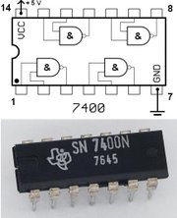
Logic Gates
One can buy gates separately
  ex. 74xxx series of integrated circuits
  cost ~$1 per chip, mostly for packaging and testing
Cumbersome, but possible to build devices using gates put together manually

Slide 36
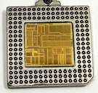
Integrated Circuits
Or one can manufacture a complete design using a custom mask
Intel Nehalem has approximately 731 million transistors

Slide 37
Voting machine
Build something interesting
A voting machine
Assume:
  A vote is recorded on a piece of paper,
  by punching out a hole,
  there are at most 7 choices
  we will not worry about “hanging chads” or “invalids”

Slide 38
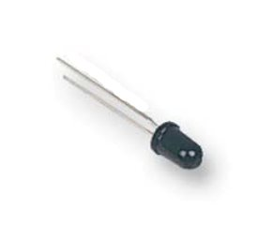
Voting machine
For now, let’s just display the numerical identifier to the ballot supervisor
  we won’t do counting yet, just decoding
  we can use four photo-sensitive transistors to find out which hole is punched out
A photo-sensitive transistor detects the presence of light
Photo-sensitive material triggers the gate

Slide 39
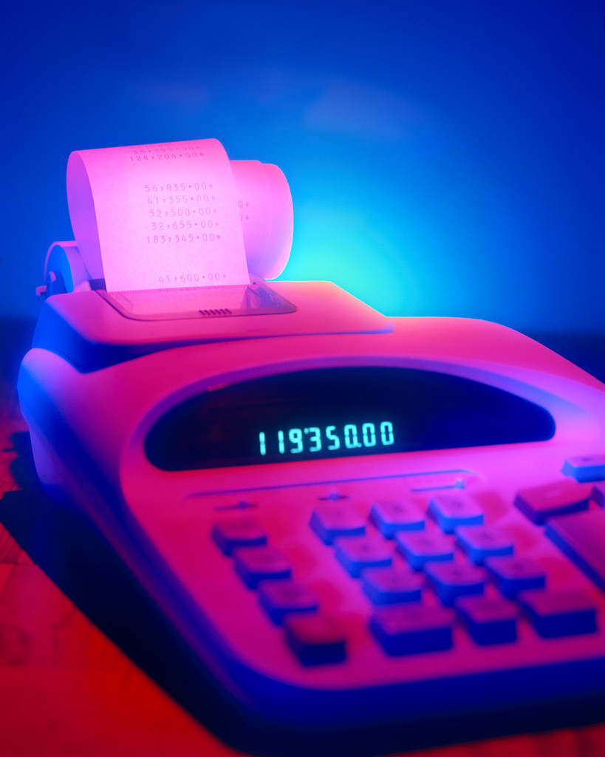
Ballot Reading
  Input: paper with a hole in it
  Out: number the ballot supervisor can record
Ballots
The 3410 vote recording
machine

Slide 40
Encoders
a
1
N sensors in a row
Want to distinguish which of the N sensors has fired
Want to represent the firing sensor number in compact form
  N might be large
  Only one wire is on at any time
  Silly to route N wires everywhere, better to encode in log N wires
b
2
o₀
c
3
d
4
o₁
e
5
o₂
.
.
A 3-bit encoder
(7-to-3)
(5 inputs shown)

Slide 41
Number Representations
37
Decimal numbers are written in base 10
  3 x 10¹ + 7 x 10⁰ = 37
Just as easily use other bases
  Base 2 - “Binary”
  Base 8 - “Octal”
  Base 16 – “Hexadecimal”
10¹ 10⁰

Slide 42
Number Representations
3
7
Base conversion via repetitive division
  Divide by base,
  write remainder,
  move left with quotient
  Sanity check with 37 and base 10
10¹ 10⁰

Slide 43
Binary Representation
Check 37 and base 2
37 = 32 + 4 + 1
0
1
0
0
1
0
1
2⁶
2⁵
2⁴
2³
2²
2¹
2⁰
64
32
16
8
4
2
1
Notes:
1 + 2 x (0 + 2 x 9)
= 1 + 2 x 0 + 4 x (1 + 2 x 4)
= 1 + 2 x 0 + 4 x 1 + 8 x (0 + 2 x 2)
= 1 + 2 x 0 + 4 x 1 + 8 x 0 + 16 x (0 + 2 x 1)
= 1 + 2 x 0 + 4 x 1 + 8 x 0 + 16 x 0 + 32 x 1

Slide 44
Hexadecimal Representation
37 decimal = (25)₁₆
Convention
  Base 16 is written with a leading 0x
  37 = 0x25
Need extra digits!
  0, 1, 2, 3, 4, 5, 6, 7,
  8, 9, A, B, C, D, E, F
Binary to hexadecimal is easy
  Divide into groups of 4, translate groupwise into hex digits
25
16¹ 16⁰

Slide 45
Encoder Truth Table
a | b | c | d |  | o2 | o1 | o0
0 | 0 | 0 | 0 |  | 0 | 0 | 0
1 | 0 | 0 | 0 |  | 0 | 0 | 1
0 | 1 | 0 | 0 |  | 0 | 1 | 0
0 | 0 | 1 | 0 |  | 0 | 1 | 1
0 | 0 | 0 | 1 |  | 1 | 0 | 0
a
1
o₀
b
2
o₁
o₁
c
3
o₂
d
4
o2 = abcd
o1 = abcd + abcd
o0 = abcd + abcd
A 3-bit
encoder
with 4 inputs
for simplicity

Slide 46
Ballot Reading
Ok, we built
first half of the machine
Need to display the result
Ballots
The 3410 voting
machine

Slide 47
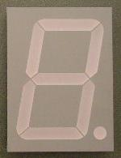
7-Segment LED Decoder
4 inputs encoded in binary
8 outputs, each driving an independent, rectangular LED
Can display numbers
Just a simple logic circuit
Write the truth table

Slide 48
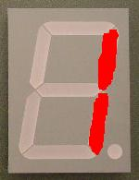
7-Segment LED Decoder
4 inputs encoded in binary
8 outputs, each driving an independent, rectangular LED
Can display numbers
1
0
0
0

Slide 49
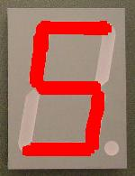
7-Segment LED Decoder
4 inputs encoded in binary
8 outputs, each driving an independent, rectangular LED
Can display numbers
1
0
1
0

Slide 50
7-Segment Decoder Truth Table
i₃ | i₂ | i₁ | i₀ |  | o₀ | o₁ | o₂ | o₃ | o₄ | o₅ | o₆
0 | 0 | 0 | 0 |  | 1 | 1 | 1 | 0 | 1 | 1 | 1
0 | 0 | 0 | 1 |  | 1 | 0 | 0 | 0 | 0 | 0 | 1
0 | 0 | 1 | 0 |  | 1 | 1 | 0 | 1 | 1 | 1 | 0
0 | 0 | 1 | 1 |  | 1 | 1 | 0 | 1 | 0 | 1 | 1
0 | 1 | 0 | 0 |  | 1 | 0 | 1 | 1 | 0 | 0 | 1
0 | 1 | 0 | 1 |  | 0 | 1 | 1 | 1 | 0 | 1 | 1
0 | 1 | 1 | 0 |  | 0 | 0 | 1 | 1 | 1 | 1 | 1
0 | 1 | 1 | 1 |  | 1 | 1 | 0 | 0 | 0 | 0 | 0
1 | 0 | 0 | 0 |  | 1 | 1 | 1 | 1 | 1 | 1 | 1
1 | 0 | 0 | 1 |  | 1 | 1 | 1 | 1 | 0 | 1 | 1
o₁
o₀
o₂
o₃
o₄
o₆
o₅
Exercise: find the error(s) in this truth table

Slide 51
7-Segment Decoder Truth Table
i₃ | i₂ | i₁ | i₀ |  | o₀ | o₁ | o₂ | o₃ | o₄ | o₅ | o₆
0 | 0 | 0 | 0 |  | 1 | 1 | 1 | 0 | 1 | 1 | 1
0 | 0 | 0 | 1 |  | 1 | 0 | 0 | 0 | 0 | 0 | 1
0 | 0 | 1 | 0 |  | 1 | 1 | 0 | 1 | 1 | 1 | 0
0 | 0 | 1 | 1 |  | 1 | 1 | 0 | 1 | 0 | 1 | 1
0 | 1 | 0 | 0 |  | 1 | 0 | 1 | 1 | 0 | 0 | 1
0 | 1 | 0 | 1 |  | 0 | 1 | 1 | 1 | 0 | 1 | 1
0 | 1 | 1 | 0 |  | 0 | 0 | 1 | 1 | 1 | 1 | 1
0 | 1 | 1 | 1 |  | 1 | 1 | 0 | 0 | 0 | 0 | 0
1 | 0 | 0 | 0 |  | 1 | 1 | 1 | 1 | 1 | 1 | 1
1 | 0 | 0 | 1 |  | 1 | 1 | 1 | 1 | 0 | 1 | 1
o₁
o₀
o₂
o₃
o₄
o₆
o₅
Exercise: find the error(s) in this truth table

Slide 52
Ballot Reading
Done!
Ballots
The 3410 voting
machine

Slide 53
Summary
We can now implement any logic circuit
  Can do it efficiently, using Karnaugh maps to find the minimal terms required
  Can use either NAND or NOR gates to implement the logic circuit
  Can use P- and N-transistors to implement NAND or NOR gates

