Slide 1
CS 3410: Computer System Organization and Programming
CS 3410: Systems Programming
Hakim Weatherspoon
Spring 2011
Computer Science
Cornell University

Slide 2
Information
Instructor: Hakim Weatherspoon
(hweather@cs.cornell.edu)
Tu/Th 1:25-2:40
Phillips 101

Slide 3
Course Objective
Bridge the gap between hardware and software
  How a processor works
  How a computer is organized
Establish a foundation for building higher-level applications
  How to understand program performance
  How to understand where the world is going

Slide 4

Who am I?
Prof. Hakim Weatherspoon
  (Hakim means Doctor, wise, or prof. in Arabic)
  Background in Education
    Undergraduate University of Washington
      Played Varsity Football
        Some teammates collectively make $100’s of millions
        I teach!!!
    Graduate University of California, Berkeley
      Some class mates collectively make $100’s of millions
      I teach!!!
  Background in Operating Systems
    Peer-to-Peer Storage
      Antiquity project - Secure wide-area distributed system
      OceanStore project – Store your data for 1000 years
    Network overlays
      Bamboo and Tapestry – Find your data around globe
    Tiny OS
      Early adopter in 1999, but ultimately chose P2P direction

Slide 5
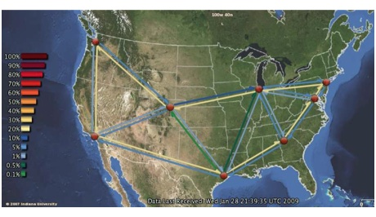

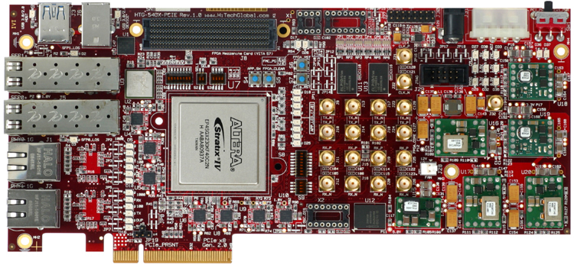
Who am I?
Cloud computing/storage
  Optimizing a global network of data centers
  Cornell Ntional λ-Rail Rings testbed
  Software Defined Network Adapter
  Energy: KyotoFS/SMFS
Antiquity: built a global-scale storage system

Slide 6
Course Staff
cs3410-staff-l@cs.cornell.edu
TAs
  Han Wang (hwang@cs.cornell.edu)
  Bo Peng (bpeng@cs.cornell.edu)
  Jun Erh (je96@cornell.edu)
Undergraduate consultants
  Ansu Abraham (aaa98@cornell.edu)
  Ethan Kao (ek382@cornell.edu)
  Peter Tseng (pht24@cornell.edu)
  Jiaqi Zhai (jz392@cornell.edu)
  Administrative Assistant:
  Angela Downing (angela@cs.cornell.edu)

Slide 7
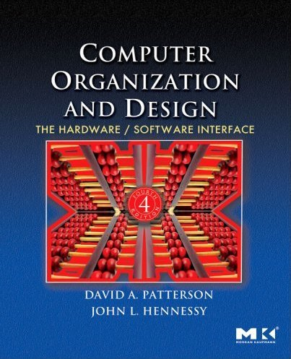
Book
Computer Organization and Design
  The Hardware/Software Interface
David Patterson, John Hennessy
  Get the 4th Edition

Slide 8
Grading
4 Programming Assignments (35-45%)
  Work in groups of two
4-5 Homeworks Assignments (20-25%)
  Work alone
2 prelims (30-40%)
Discretionary (5%)

Slide 9
Grading
Regrade policy
  Submit written request to lead TA,
  and lead TA will pick a different grader
  Submit another written request,
  lead TA will regrade directly
  Submit yet another written request for professor to regrade.

Slide 10
Administrivia
http://www.cs.cornell.edu/courses/cs3410/2011sp
  Office Hours / Consulting Hours
  Lecture slides & schedule
  Logisim
  CSUG lab access (esp. second half of course)
Sections
T 2:55 – 4:10pm Hollister 372
W 3:35 – 4:50pm Upson 215
R 11:40 – 12:55pm Hollister 372
R 2:55 – 4:10pm Hollister 368
F 2:55 – 4:10pm Phillips 213
TBD
  Will cover new material
  Next week: intro to logisim

Slide 11
Communication
Email
  cs3410-staff-l@cs.cornell.edu
  The email alias goes to me and the TAs, not to whole class
Assignments
  CMS: http://cms.csuglab.cornell.edu
Newsgroup
  cornell.class.cs3410
  For students

Slide 12
Sections & Projects
Sections start next week
  But can go this week to find a project partner
Projects will be done in two-person teams
  We will pair you up if you don’t have a preferred partner
  Start early, time management is key
  Manage the team effort

Slide 13
Academic Integrity
All submitted work must be your own
  OK to study together, but do not share soln’s
  Cite your sources
Project groups submit joint work
  Same rules apply to projects at the group level
  Cannot use of someone else’s soln
Closed-book exams, no calculators
  Stressed? Tempted? Lost?
    Come see me before due date!
Plagiarism in any form will not be tolerated

Slide 14
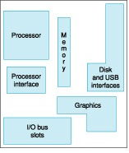
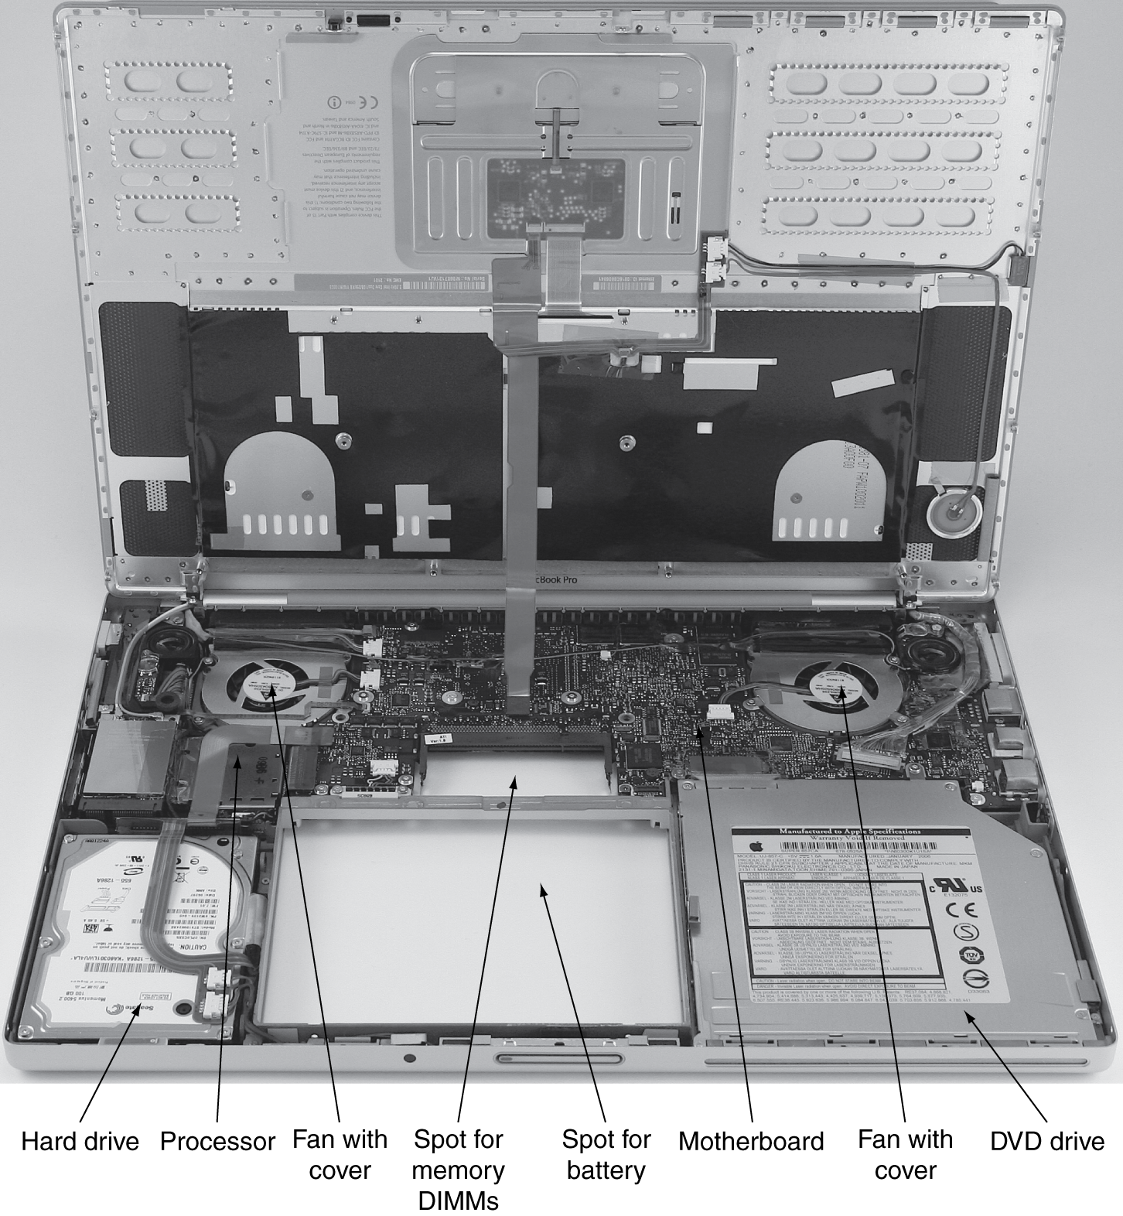
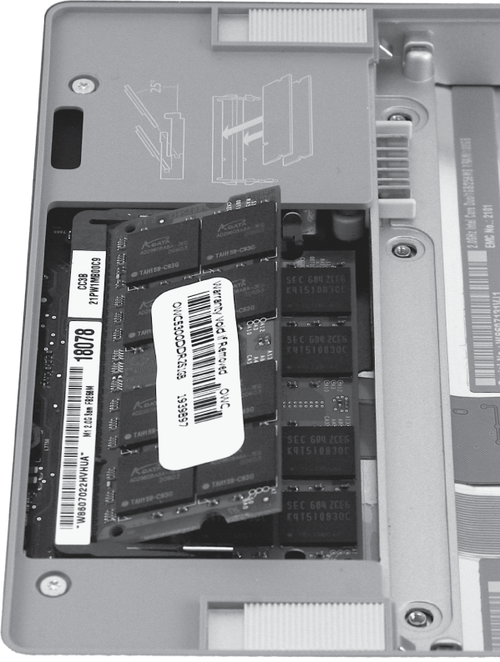
Computer System Organization

Slide 15
Compilers & Assemblers
C
int x = 10;
x = 2 * x + 15;
compiler
MIPS
assembly
language
addi r5, r0, 10
muli r5, r5, 2
addi r5, r5, 15
assembler
MIPS
machine
language
00100000000001010000000000001010
00000000000001010010100001000000
00100000101001010000000000001111
Notes:
32 bits, 4 bytes

Slide 16
Compilers
C
compiler
MIPS
assembly language
int sum3(int v[]) {
return v[0] +
v[1] +
v[2];
}
main() {
...
int v[] = ...;
int a = sum3(v);
v[3] = a;
...
}
sum3:
lw r9, 0(r5)
lw r10, 4(r5)
lw r11, 8(r5)
add r3, r9, r10
add r3, r3, r11
jr r31
main:
...
addi r5, r0, 1000
jal sum3
sw r3, 12(r5)
...

Slide 17
Assemblers
MIPS
assembly language
assembler
MIPS
machine language
sum3:
lw r9, 0(r5)
lw r10, 4(r5)
lw r11, 8(r5)
add r3, r9, r10
add r3, r3, r11
jr r31
main:
...
addi r5, r0, 1000
jal sum3
sw r3, 12(r5)
...
10001100101010010000000000000000
10001100101010100000000000000100
10001100101010110000000000001000
00000001001010100001100000100000
00000000011010110001100000100000
00000011111000000000000000001000
...
...
...
00100000000001010000001111101000
00001100000100000000000000000000
10101100101000110000000000001100
...

Slide 18
Computer System Organization
Computer System =
?
Input +
Output +
Memory +
Datapath +
Control
Keyboard
Mouse
Video
Network
USB
CPU
Registers
bus
bus
Serial
Memory
Disk
Audio

Slide 19
Instruction Set Architecture
ISA
  abstract interface between hardware and the lowest level software
  user portion of the instruction set plus the operating system interfaces used by application programmers

Slide 20
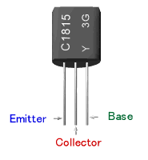
Transistors and Gates
+
in
out
gnd
In | Out
0 | 1
1 | 0
Truth table

Slide 21


Logic and State
a
1
Q
o₀
R
b
2
o₁
o₁
S
c
Q
3
o₂
d
4

Slide 22
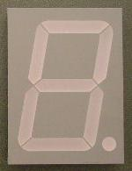
A Calculator
…
8
reg
8
8
adder
led-dec
8
…
reg
mux
8
0
1
mux
add/sub select
doit

Slide 23
Basic Computer System
A processor executes instructions
  Processor has some internal state in storage elements (registers)
A memory holds instructions and data
  von Neumann architecture: combined inst and data
A bus connects the two
01010000
10010100
…
bus
regs
addr, data,
r/w
processor
memory

Slide 24
Simple Processor
inst
alu
memory
register file
32
2
00
5 5 5
pc
new pc
calculation
control
00: addi r5, r0, 10
04: muli r5, r5, 2
08: addi r5, r5, 15

Slide 25
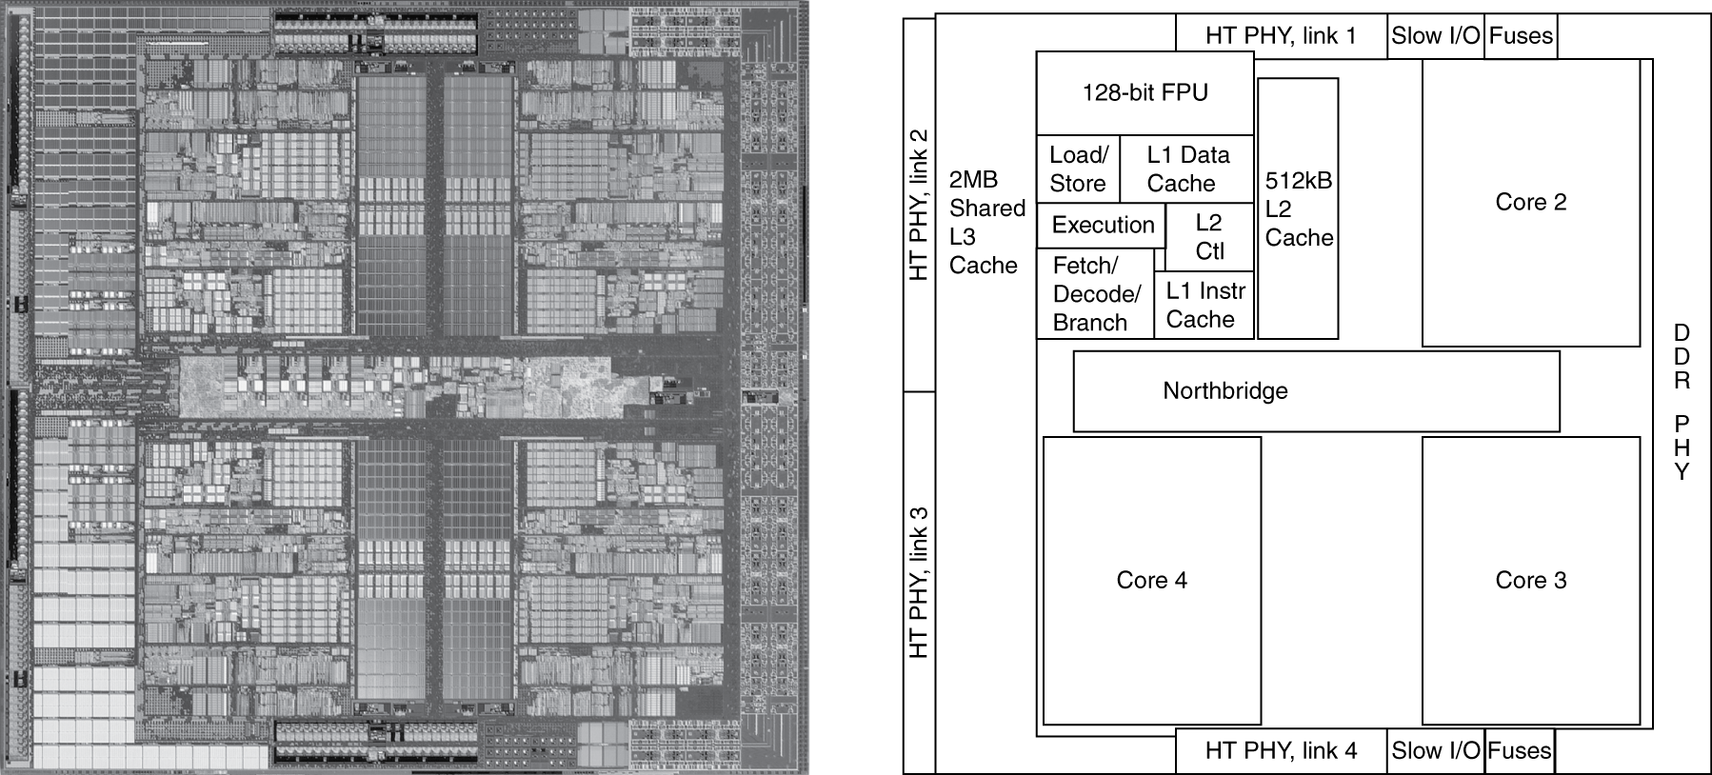
Inside the Processor
AMD Barcelona: 4 processor cores
Figure from Patterson & Hennesssy, Computer Organization and Design, 4th Edition

Slide 26
Overview
Application
Operating
System
Compiler
Firmware
Instruction Set
Architecture
Memory
system
Instr. Set Proc.
I/O system
Datapath & Control
Digital Design
Circuit Design
Notes:
For class handout

Slide 27
MIPS R3000 ISA
Registers
Instruction Categories
  Load/Store
  Computational
  Jump and Branch
  Floating Point
    coprocessor
  Memory Management
R0 - R31
PC
HI
LO
OP
rs
rt
rd
sa
funct
OP
rs
rt
immediate
OP
jump target

Slide 28
Calling Conventions
mult:
addiu sp,sp,-4
sw $31, 0(sp)
beq $4, $0, Lout
...
jal mult
Linside:
…
Lout:
lw $31, 0(sp)
addiu sp,sp,4
jr $31
main:
jal mult
Laftercall1:
add $1,$2,$3
jal mult
Laftercall2:
sub $3,$4,$5

Slide 29
Data Layout
blue() {
pink(0,1,2,3,4,5);
}
pink() {
orange(10,11,12,13,14);
}
saved regs
arguments
return address
local variables
saved regs
arguments
return address
local variables
sp

Slide 30
Buffer Overflows
blue() {
pink(0,1,2,3,4,5);
}
pink() {
orange(10,11,12,13,14);
}
orange() {
char buf[100];
gets(buf); // read string, no check!
}
saved regs
arguments
return address
local variables
saved regs
arguments
return address
local variables
sp

Slide 31
Parallel Processing
Spin Locks
Shared memory, multiple cores
Etc.

Slide 32
Applications
Everything these days!
  Phones, cars, televisions, games, computers,…

Slide 33
Why should you care?
Bridge the gap between hardware and software
  How a processor works
  How a computer is organized
Establish a foundation for building higher-level applications
  How to understand program performance
  How to understand where the world is going

Slide 34
Example: Can answer the question…
A: for i = 0 to 99
  for j = 0 to 999
    A[i][j] = complexComputation ()
B: for j = 0 to 999
  for i = 0 to 99
    A[i][j] = complexComputation ()
Why is B 15 times slower than A?

Slide 35
Example 2: Moore's Law
The number of transistors integrated on a single die will double every 24 months...
– Gordon Moore, Intel co-founder, 1965
Amazingly Visionary
1971 – 2300 transistors – 1MHz – 4004
1990 – 1M transistors – 50MHz – i486
2001 – 42M transistors – 2GHz – Xeon
2004 – 55M transistors – 3GHz – P4
2007 – 290M transistors – 3GHz – Core 2 Duo
2009 – 731M transistors – 2GHz – Nehalem
Notes:
Complexity is *the* issue.

Slide 36
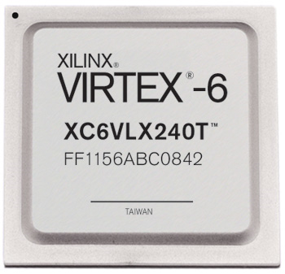
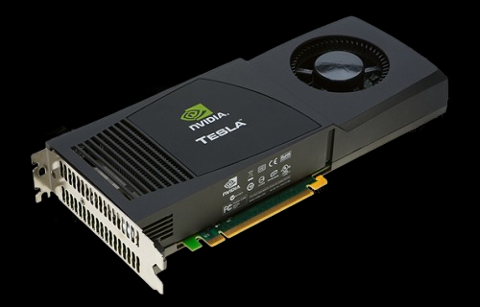

Example 3: New Devices
millions
Xilinx FPGA
Berkeley mote
NVidia GPU

Slide 37
Covered in this course
Application
Operating
System
Compiler
Firmware
Instruction Set
Architecture
Memory
system
Instr. Set Proc.
I/O system
Datapath & Control
Digital Design
Circuit Design
Notes:
For class handout

Slide 38
Nuts and Bolts:
Switches, Transistors, Gates

Slide 39
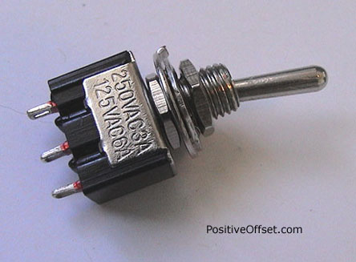
A switch
A switch is a simple device that can act as a conductor or isolator
Can be used for amazing things…

Slide 40
Switches
Either (OR)
Both (AND)
+
-
-
But requires mechanical force

Slide 41
Transistors
Solid-state switch
  The most amazing invention of the 1900s
PNP and NPN
-
P
P
+
collector
N
emitter
base
collector
collector
+
N
N
-
NPN
base
P
base
PNP
emitter
emitter

Slide 42
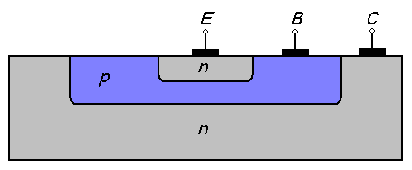
NPN Transistors
Semi-conductor
Connect E to C when
base = 1
E
B
C
collector
+
N
N
-
NPN
P
base
emitter
Notes:
Silicon doped with impurity makes it n-type or p-type (holes)
NPN is most common, since electrons move freely.

Slide 43
P and N Transistors
PNP Transistor
Connect E to C when
base = 0
NPN Transistor
Connect E to C when
base = 1
E
E
B
B
C
C

Slide 44

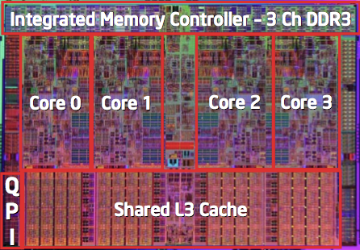
Then and Now
The first transistor
  on a workbench at AT&T Bell Labs in 1947
An Intel Nehalem
  731 million transistors

Slide 45
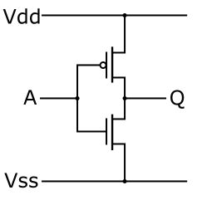
Inverter
Function: NOT
Called an inverter
Symbol:
Useful for taking the inverse of an input
CMOS: complementary-symmetry metal–oxide–semiconductor
in
out
in
out
In | Out
0 | 1
1 | 0
Truth table

Slide 46
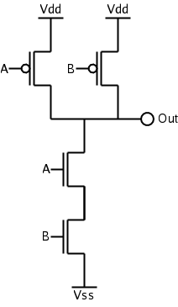
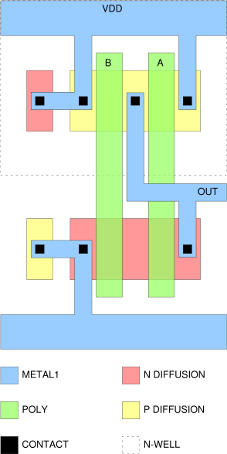
NAND Gate
Function: NAND
Symbol:
a
out
b
A | B | out
0 | 0 | 1
1 | 0 | 1
0 | 1 | 1
1 | 1 | 0

Slide 47
NOR Gate
+Vdd
out
b
Function: NOR
Symbol:
a
Vss
A | B | out
0 | 0 | 1
1 | 0 | 0
0 | 1 | 0
1 | 1 | 0
a
out
b

Slide 48
Building Functions
NOT:
AND:
OR:
NAND and NOR are universal
  Can implement any function with NAND or just NOR gates
  useful for manufacturing

Slide 49
Reflect
Why take this course?
  Basic knowledge needed for all other areas of CS:
    operating systems, compilers, ...
  Levels are not independent
    hardware design ↔ software design ↔ performance
  Crossing boundaries is hard but important
    device drivers
  Good design techniques
    abstraction, layering, pipelining, parallel vs. serial, ...
  Understand where the world is going

