Slide 1

Learning to Diversify using implicit feedback
Karthik Raman, Pannaga Shivaswamy & Thorsten Joachims
Cornell University
Notes:
4 mins motivation
5 mins: Model, learning
3: Online Algo
1.5: Regret bound
6 mins diff experiment
1 min summarize

Slide 2

News Recommendation
U.S. Economy
Soccer
Tech Gadgets

Slide 3

News Recommendation
Relevance-Based?
Becomes too redundant, ignoring some interests of the user.

Slide 4



Diversified News Recommendation
Different interests of a user addressed.
Need to have right balance with relevance.

Slide 5
Intrinsic vs. Extrinsic Diversity
INTRINSIC | EXTRINSIC
Diversity amongst the interests of a single user Avoid redundancy and cover different aspects of a information need. | Diversity among interests/information need of different users. Balancing interests of different users and provide some information to all users.
Less-studied | Well-studied
Radlinski, Bennett, Carterette and Joachims, Redundancy, diversity and interdependent document relevance; SIGIR Forum ‘09
Notes:
Talk in terms of news example

Slide 6
Key Takeaways
Modeling relevance-diversity trade-off using submodular utilities.
Online Learning using implicit feedback.
Robustness of the model
Ability to learn diversity

Slide 7
General Submodular Utility (CIKM’11)
Given ranking θ = (d₁, d₂,…. d_{k}) and concave function g
t₁ | t₂ | t₃
P(t₁) =1/2 | P(t₂) =1/3 | P(t₃) =1/6
4 | 3 | 0
4 | 0 | 0
0 | 3 | 0
0 | 0 | 3
U(d₁|t)
U(d₂|t)
U(d₃|t)
U(d₄|t)
d₁
d₂
d₃
g(x) = √x
d₄
√8 | √6 | √3
= √8 /2 + √6/3 + √3/6
Notes:
Over all intents need to take exprectation

Slide 8
Maximizing Submodular Utility: Greedy Algorithm
Given the utility function, can find ranking that optimizes it using a greedy algorithm:
  At each iteration: Choose Document that Maximizes Marginal Benefit
Algorithm has (1 – 1/e) approximation bound.
d₁ | 2.2
d₂ | 1.7
d₃ | 0.4
d₄ | 1.9
d₁ | 2.2
d₂ | 1.7 | 1.4
d₃ | 0.4 | 0.2
d₄ | 1.9 | 1.7
d₁ | 2.2
d₂ | 1.7 | 1.4
d₃ | 0.4 | 0.2 | 1.3
d₄ | 1.9 | 1.7 | 0.1
d₁
?
Look at Marginal Benefits
?
d₄
?
d₂

Slide 9

Modeling this Utility
What if we do not have the document-intent labels?
Solution: Use TERMS as a substitute for intents.
x: Context i.e., Set of documents to rank.
y: Ranking of those documents
where is the feature map of the ranking y over documents from x.
Notes:
Slightly broader definition of submod utility than presented before

Slide 10

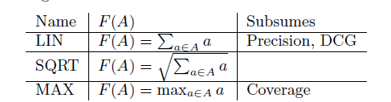
Modeling this Utility – Contd.
Though linear in its’ parameters, the submodularity is captured by the non-linear feature map Φ(x,y).
For with each document d has feature vector Φ(d) = {Φ¹(d), Φ²(d)….} and Φ(x,y) ={Φ¹(x,y), Φ²(x,y)….}, we aggregated features using a submodular fncn F:
Examples:
Notes:
Slightly broader definition of submod utility than presented before

Slide 11
Learn Via Preference Feedback
Getting document-interest labels is not feasible for large-scale problems.
Imperative to be able to use weaker signals/information source.
Our Approach:
  Implicit Feedback from Users (i.e., clicks)

Slide 12
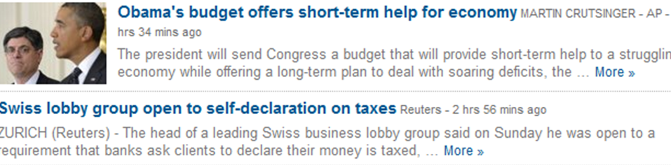
Implicit Feedback From User

Slide 13
Implicit Feedback From User
Present ranking to user: e.g. y = (d1; d2; d3; d4; d5; …)
Observe clicks of user. (e.g. {d3; d5})
Create feedback ranking by:
  Pulling documents clicked on, to the top of the list.
  y' = (d3; d5; d1; d2; d4; ....)

Slide 14
The Algorithm

Slide 15
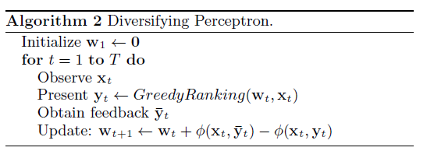
Online Learning method: Diversifying Perceptron
Simple Perceptron Update

Slide 16

Regret
We would like to obtain (user) utility as close to the optimal.
Define regret as :

Slide 17


Alpha-Informative Feedback
FEEDBACK
RANKING
PRESENTED
RANKING
OPTIMAL
RANKING
PRESENTED
RANKING

Slide 18
Alpha-Informative Feedback
Let’s allow for noise:

Slide 19
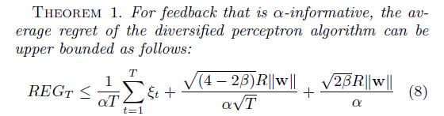
Regret Bound
Independent of Number of Dimensions
Converges to constant as T -> ∞
Noise component
Increases gracefully as alpha decreases.
Notes:
Where beta is the approximation factor

Slide 20
Experiments (Setting)
Large dataset with intrinsic diversity judgments?
Artificially created using the RCV1 news corpus:
  800k documents (1000 per iteration)
  Each document belongs to 1 or more of 100+ topics.
Obtain intrinsically diverse users by merging judgments from 5 random topics.
Performance: Averaged over 50 diverse users.
Notes:
Explain why TREC datasets cannot be used.
Talk about performance measure more in detail.

Slide 21
Can we Learn to Diversify?
Can the algorithm learn to cover different interests (i.e., beyond just relevance)?
Consider purely-diversity seeking user (MAX)
  Would like as many intents covered as possible
Every iteration: Returns feedback set of 5 documents with α = 1
Notes:
Feedback setting : Perfect Feedback.
5 documents returned
Purely diversity seeking users : Minimize redundance.

Slide 22
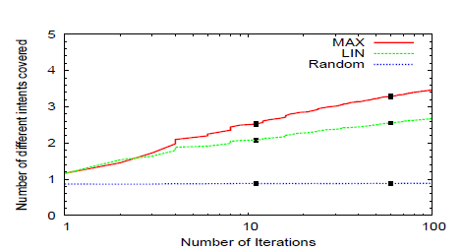
Can we Learn to Diversify?
Submodularity helps cover more intents.
Notes:
- > Say that it means you cover more intents in the set returned (and able to learn it better)
-> However you could do this by learning only say the (easier) 4 of the 5 intents. Next shows that infact you do learn all.
-> Black lines are error bars.

Slide 23
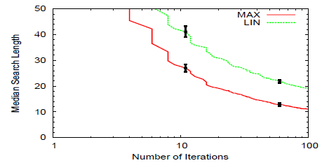
Can we Learn to Diversify?
Able to find all intents faster.
Notes:
Describe what median search length is

Slide 24
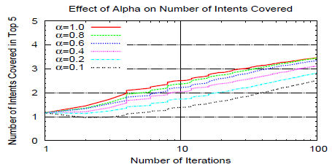
Effect of Feedback Quality (alpha)
Can we still learn with suboptimal feedback?
Notes:
Theoretically we showed that performance scales rather well with alpha.
What do we so empirically?
Able to learn even at very low values of alpha

Slide 25
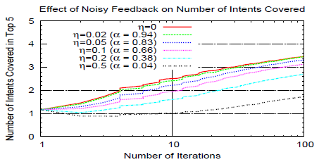
Effect of Noisy Feedback
What if feedback can be worse than presented ranking?
Notes:
Further pushed the limits on feedback: What if users are confused about both diversity and relevance.
Correspond to that expected alpha
IMPLICATION: What this allows is for us to utilize feedback (even from non-experts) in the training of these models.

Slide 26
Learning the Desired Diversity
Users want differing amounts of diversity.
Would like the algorithm to learn this amount on a per-user level.
Consider the DP algorithm using a concatenation of MAX and LIN features (called MAX + LIN)
Experiment with 2 completely different users: purely relevance and purely-diversity seeking.
Notes:
So far we talked about what happens for different users. They have different feature mappings.
Related to work on extrinsic diversity by MacDonald et. al

Slide 27
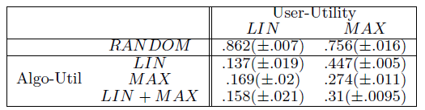
Learning the Desired Diversity
Regret is comparable to case where user’s true utility is known.
Algorithm is able to learn relative importance of the two feature sets.
Notes:
Able to learn as if mapping was known
Due to learning the relative importance can figure out how much diversity is needed

Slide 28

Comparison with Supervised Learning
No suitable online learning baseline.
Instead compare against existing supervised methods.
Supervised and Online Methods trained on first 50 iterations.
Both methods then tested on next 100 iterations and measure average regret:
Notes:
First online learning method for diversification. Hence will compare to existing supervised learning method.
(Includes Yisong and CIKM worl)

Slide 29
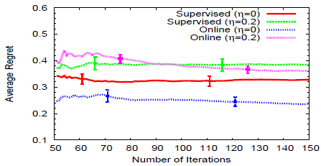
Comparison with Supervised Learning
Significantly outperforms the method despite receiving far less information: complete relevance labels vs. preference feedback.
Orders of magnitude faster for training: 1000 vs. 0.1 sec
Notes:
Our feedback is far worse. Explain how.

Slide 30
Conclusions
Presented an online learning algorithm for learning diverse rankings using implicit feedback.
Relevance-Diversity balance by modeling utility as submodular function.
Theoretically and empirically shown to be robust to noise and weak feedback.

Slide 31
Future Work
Deploy in real-world setting (arXiv).
  Detailed User feedback model study.
Application to extrinsic diversity within unifying framework.
General Framework to learn required diversity.
Related Code to be made available on : www.cs.cornell.edu/~karthik/code.html

