Slide 1
Toward Whole-Session Relevance:
Exploring Intrinsic Diversity in Web Search
Karthik Raman (Cornell University)
Paul N. Bennett (MSR, Redmond)
Kevyn Collins-Thompson (MSR, Redmond)

Slide 2

Whole-Session Relevance
“snow leopards”
Typical search model :
Present results maximizing relevance to current query
NatGeo page on snow leopards
Snowleopard.org new article
News about snow leopards in Cape May
Snow leopard babies at Boise Zoo
BBC video on snow leopards triplets
Notes:
Unlike past work on using past context.
New search paradigm: savings in terms of joint relevance
Reduced search time (Smucker et al last year). Minimize user effort.

Slide 3
Whole-Session Relevance
“snow leopards”
Typical search model :
Present results maximizing relevance to current query
Context can improve search.
Time and user effort matter! [Smucker&Clarke,2012]
Instead :
  Present results maximizing relevance to current and future (in-session) queries
Notes:
Unlike past work on using past context.
New search paradigm: savings in terms of joint relevance
Reduced search time (Smucker et al last year). Minimize user effort.

Slide 4
Whole-Session Relevance
“snow leopards”
Typical search model :
Present results maximizing relevance to current query
Context can improve search.
Time and user effort
matter! [Smucker&Clarke,2012]
Instead :
  Present results maximizing relevance to current and future (in-session) queries
Satisfy users up-front!
Pre-fetch apropos content
NatGeo page on snow leopards
Snow Leopard Habitats
Snow leopards Life Cycle
Snow Leopards in the Wild
Snow Leopards in Zoos.
Snow Leopards Pictures and Videos.
Notes:
Unlike past work on using past context.
New search paradigm: savings in terms of joint relevance
Reduced search time (Smucker et al last year). Minimize user effort.

Slide 5
Intrinsic Diversity
Traditional (extrinsic) diversity:
  Ambiguity in user intent.
Intrinsic Diversity [Radlinski et al ’09]
  User wants diverse results i.e., diversity intrinsic to need.
  Single topical intent but diverse across different aspects.
  Seen in previous example.
Traditional diversification methods not well-suited:
  Need to diversify across aspects of a single intent
  not user intents.
  Observed empirically as well.

Slide 6
Significance of Intrinsic Diversity
Bailey et. al. (2012) studied prevalence of different real world search tasks, some of which can be characterized as ID.
  Require multiple user interactions under paradigm.
For example:
Best Tablet Readers
Kindle Fire vs. Nook
Fire vs Nook specs
Fire vs. Nook apps
Fire vs. Nook screen
Snow Leopard Example
kelly clarkson superbowl performance
How many times has kelly clarkson performed at a game
How many games has kelly clarkson sung the national anthem
How many awards has kelly clarkson won?
remodeling kitchen
installing kitchen cabinets
Installing base cabinets
how to attach countertop to base cabinets?
hanging wall cabinets
Query Type | Avg. # of Queries | Total Search Time (in mins) | Prevalence (of session)
Information Discovery on specific topic | 6.8 | 13.5 | 14%
Comparing Products or Services | 6.8 | 24.8 | 12%
Finding Facts about a person | 6.9 | 4.8 | 3.5%
Learning to perform a task | 13 | 8.5 | 2.5%
Notes:
Snow leopard was example of information discovery

Slide 7
Related Problems
Most work focuses on extrinsic diversity.
Related to previous TREC tracks: Interactive, Novelty, QA and (most recently) Session.
Nothing on ID in context of web search.
neural networks
machine learning
machine learning usage
text classification
support vector machines
red wine
red wine varieties
red wine regions
red wine grape type
red wine ratings
red wine prices
remodeling ideas
cost of typical remodel
hardwood flooring
earthquake retrofit
paint colors
kitchen remodel
Singla et. al. 2010
Yuan & White 2012
Kotov et. al. 2011
White et. al. 2010
Task-Based Retrieval
Exploratory Search
Trail-Finding
Marchionini 2006
White et. al. 2006
White et. al. 2008
ID
Anticipatory search
Faceted Search
Dakka et al 2006
Tunkelag 2009
Zhang & Zhang 2010
Pound et. al. 2011
Liebling et. al. 2012
Notes:
Relation to other query types: exploratory, anticipatory, task tours and trails, faceted.

Slide 8
Example ID session
Initiator Query
facebook
remodeling ideas
cost of typical remodel
hardwood flooring
cnn news
earthquake retrofit
paint colors
kitchen remodel
nfl scores
----
ID Session
Successor Queries

Slide 9
Our Contributions
Mining ID sessions from post-hoc behavioral analysis in search logs.
Learning to predict initiator queries of ID sessions.
Given initiator query, rank results targeting whole-session relevance and also predict which content to pre-fetch.

Slide 10
Our Contributions
Mining ID sessions from post-hoc behavioral analysis in search logs.
Learning to predict initiator queries of ID sessions.
Given initiator query, rank results targeting whole-session relevance and also predict which content to pre-fetch.

Slide 11
Mining ID sessions from logs
Would like authentic ID session instances.
Mine from query logs of a search engine.
Hypothesize ID Sessions to be:
  Longer: User explores multiple aspects.
  Topically Coherent: Aspects should be topically related.
  Diverse in Aspects: Not just simple reformulations.
Proposed algorithm is a series of filters.
Notes:
Motivation
Extraction process (Key Steps)

Slide 12
ID Extraction Algorithm: Key Steps
1. Query Filtering
facebook
remodeling ideas
ideas for remodeling
cost of typical remodel
hardwood flooring
cnn news
earthquake retrofit
paint colors
dublin tourism
kitchen remodel
nfl scores
remodeling ideas
ideas for remodeling
cost of typical remodel
hardwood flooring
earthquake retrofit
paint colors
dublin tourism
kitchen remodel
Remove common queries, auto-generated queries, long queries. Collapse duplicates.

Slide 13
ID Extraction Algorithm: Key Steps
2. Ensure topical coherence
remodeling ideas
ideas for remodeling
cost of typical remodel
hardwood flooring
earthquake retrofit
paint colors
dublin tourism
kitchen remodel
remodeling ideas
ideas for remodeling
cost of typical remodel
hardwood flooring
earthquake retrofit
paint colors
kitchen remodel
No common top-10 results between “dublin tourism” and “remodeling ideas”
Remove successor queries topically unrelated to initiator.
>= 1 common result in top 10 (ensures semantic relatedness w/o requiring ontology).

Slide 14
ID Extraction Algorithm: Key Steps
3. Ensure diversity in aspects
remodeling ideas
ideas for remodeling
cost of typical remodel
hardwood flooring
earthquake retrofit
paint colors
kitchen remodel
remodeling ideas
cost of typical remodel
hardwood flooring
earthquake retrofit
paint colors
kitchen remodel
Trigram-Cosine Similarity with “remodeling ideas”:
“ideas for remodeling” .693 ✗
“cost of typical remodel” .292 ✓
“hardwood flooring” .000 ✓
“earthquake retrofit” .000 ✓
“paint colors” .000 ✓
“kitchen remodel” .371 ✓
….
Restrict syntactic similarity with initiator and among successor queries.
Used character-based trigram cosine similarity.

Slide 15
ID Extraction Algorithm: Key Steps
4. Ensure minimum length
remodeling ideas
cost of typical remodel
hardwood flooring
earthquake retrofit
paint colors
kitchen remodel
✓
>= 2 distinct aspects?
Ensure minimum number of (syntactically) distinct successor queries i.e., aspect threshold.

Slide 16
Evaluating Extraction
Previously unstudied problem.
  Thus quantitatively evaluated by 2 annotators.
Annotated 150 random sessions:
  75 selected by algorithm (as ID) + 75 unselected sessions.
Annotator Agreement | Algorithm Accuracy
79% | 73.7% (Prec:73.9%)
Use this as (noisy) supervision:
  Sessions selected called ID. Others called regular.
Given enough data, learner can overcome label noise (if unbiased) [Bartlett et al ’04].
Notes:
Novel analysis task.

Slide 17
Statistics of Extraction Process
Started with 2 months log data:
  51.2 M sessions (comprising 134M queries)
Running the extraction algorithm leads to 497K sessions (comprising 7M queries)
Accounts for 1% of sessions but 4.3% of time spent searching.
Notes:
Non ID sessions referred to as Regular.

Slide 18
Our Contributions
Mining ID sessions from post-hoc behavioral analysis in search logs.
Learning to predict initiator queries of ID sessions.
Given initiator query, rank results targeting whole-session relevance and also predict which content to pre-fetch.

Slide 19
Predicting ID Initiation
Can alter retrieval for ID sessions:
  Example: Prefetch content/use different ranker ..
  Hence need to identify ID initiation.
Given (initiator) query, binary classification problem: Is the session ID or Regular?
Novel prediction task:
  New type of query and session being analyzed.

Slide 20
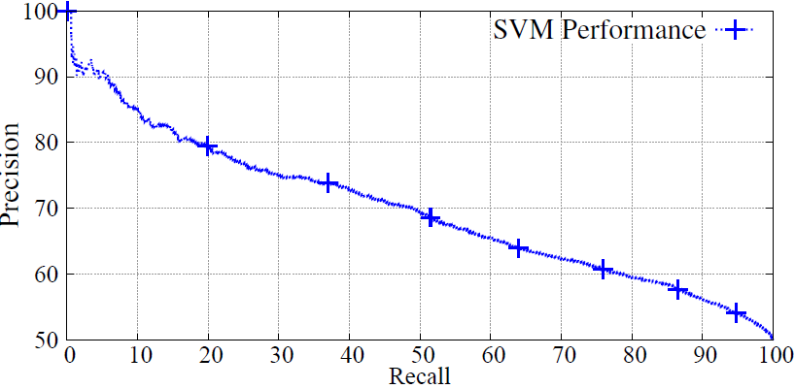
ID Initiation Classification
Labels produced by extraction algorithm.
Balanced dataset: 61K unique queries (50K train)
Used linear SVMs for classification
Can achieve 80% precision@20% recall.

Slide 21
Digging Deeper: ID Initiation Features
5 types of features:
TYPE | Description
Textual | B.O.W. (Unigram) counts
Query-Statistics | e.g. # Words
POS | Part-of-speech tag counts
ODP Categories | 5 Most probable ODP classes
Query-Log Based Statistics | e.g. Avg. session length

Slide 22
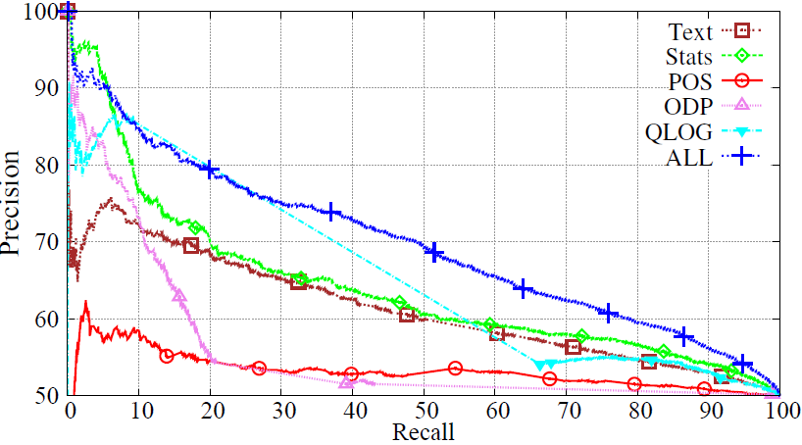
ID Initiation Feature Importance
Text, Stats and Query-Log features most useful.

Slide 23
Linguistic Characterization of ID Queries
Measured Log-Odds-Ratio (LOR) of linguistic features:
  Higher LOR = more pronounced in ID queries.
  List-like nouns appear more commonly.
  Broad information-need terms as well.
  Question words (e.g. who, what, where) and proper nouns (e.g. Kelly Clarkson, Kindle) quite indicative of being ID.
  Plural nouns (e.g. facets, people) favored to singular nouns (e.g. table).
forms | 1.59
facts | 1.45
types | 1.25
ideas | 0.92
information | 1.64
manual | 1.18
Question W | 0.41
Proper N | 0.4
Plural N | 0.13
Singular N | -0.05

Slide 24
Our Contributions
Mining ID sessions from post-hoc behavioral analysis in search logs.
Learning to predict initiator queries of ID sessions.
Given initiator query, rank results targeting whole-session relevance and also predict which content to pre-fetch.

Slide 25
Ranking for ID sessions
Problem: Given initiator query, rerank to maximize whole-session relevance.
First to jointly satisfy current and future queries.
Need to identify content to pre-fetch.
Rank results by associating each with an aspect.
Candidate pool of aspects generated using related queries.

Slide 26

Ranking Algorithm
Given query q:
Produce ranking d₁,d₂.. (with associated aspects q₁,q₂..)
  Documents should be relevant to query q.
  Document d_{i} should be relevant to associated aspect q_{i} .
  Aspects should be relevant to ID task initiated by q.
  Aspects should be diverse.
Objective :

Slide 27
Breaking Down the Objective - 1
Document relevance to query.
Trained Relevance model (with 21 simple features) using Boosted Trees.

Slide 28
Breaking Down the Objective - 2
Document relevance to aspect.
  Represents/Summarizes the aspect.
Can be estimated with same relevance model R

Slide 29

Breaking Down the Objective - 3
Aspect Diversity + Topical Relevance.
MMR-like objective
Submodular Objective:
  Optimize using efficient greedy algorithm.
  Constant-factor approximation.

Slide 30
Performance on Search Log Data
Measured performance as ratio (to baseline ranker)
Baseline is the commercial search engine service.
Relevance-based: ranking with R(d|q).
ID Session SAT clicks used as relevant docs.
Method | PREC |  |  | MAP |  |  | NDCG
 | @1 | @3 | @10 | @1 | @3 | @10 | @1 | @3 | @10
Relevance-Based | 1.00 | 0.94 | 0.97 | 1.00 | 0.97 | 0.98 | 1.00 | 0.97 | 0.99
Proposed Method | 1.10 | 1.09 | 1.09 | 1.10 | 1.10 | 1.10 | 1.09 | 1.10 | 1.11

Slide 31
Other Findings on Search Log Data
Robust: Very few sessions drastically hurt.
Similar performance on using sessions classified as ID (by the SVM)
Even more improvements (30-40%) on using interactivity (based on simple user model).
A good set of aspects can greatly help: 40-50% increase w/o interactivity; 80-120% with it.

Slide 32
Performance on TREC data
Also ran experiments using public dataset:
  TREC 2011 Session data
  63/76 annotated as ID.
  Absolute (not relative) performance values reported.
METHOD | Pr@1 | DCG@1 | DCG@3
Baseline | 0.58 | 0.84 | 2.13
Proposed | 0.71 | 1.39 | 2.41

Slide 33
Contributions Recap
First study of Intrinsic Diversity for Web Search.
Method to mine ID examples from logs.
Characterized and predicted ID initiation.
Presented ranking algorithm for ID sessions maximizing whole-session relevance.

Slide 34
Toward Whole-Session Relevance
Retrieval quality can be directly improved to reduce time spent manually querying aspects.
Presented results can serve as an easy way of summarizing aspects.
Structuring results to enable users to interactively explore aspects is a step towards this goal.

Slide 35
THANK YOU!
QUESTIONS?
Thanks to SIGIR for their generous SIGIR Travel Grant.

Slide 36
THANK YOU!
QUESTIONS?
Thanks to SIGIR for their generous SIGIR Travel Grant.

Slide 37
BACKUP SLIDES

Slide 38
Scope and Applicability
Clearly not feasible for all kinds of sessions!
So what can we handle?
  Breadth-oriented sessions.
  Exploratory sessions.
  Comparative sessions.
Intrinsic Diversity:
  Underlying information need tends to be of one of the above forms.

Slide 39
ID Initiation Classification
Balanced dataset: 61K unique queries (50K train)
Used linear SVMs for classification
5 types of features:
TYPE | Description | # of Feat. | Coverage
Text | B.O.W. (Unigram) counts | 44k | 100%
Stats | e.g. # Words | 10 | 81%
POS | Part-of-speech tag counts | 37 | 100%
ODP | 5 Most probable ODP classes | 219 | 25%
QLOG | e.g. Avg. session length | 55 | 44%

Slide 40
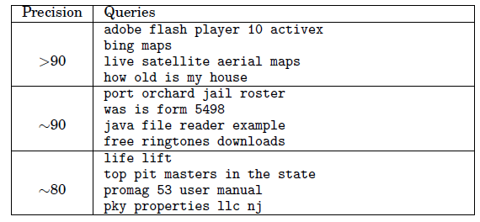
Examples: Misclassified as ID
Precision Level indicates where on the spectrum it lies.

Slide 41
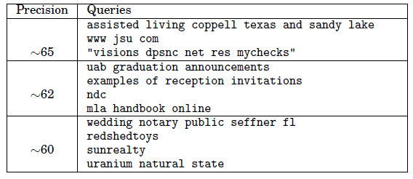
Examples: Misclassified as Regular
Precision Level indicates where on the spectrum it lies.

Slide 42
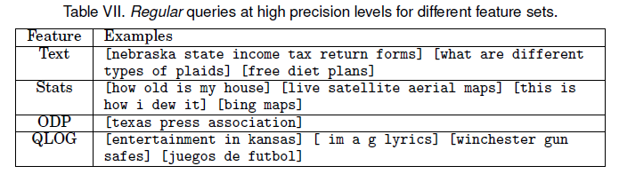
Feature-Wise Errors
Misclassifications for different feature sets.

Slide 43
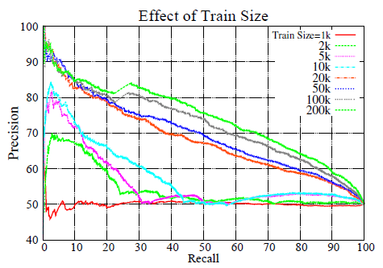
Effect of Training Size
More the data, the better.

Slide 44
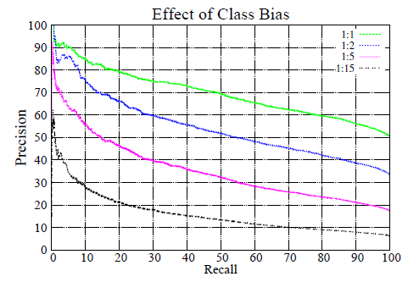
Effect of class bias
No longer balanced dataset.

Slide 45
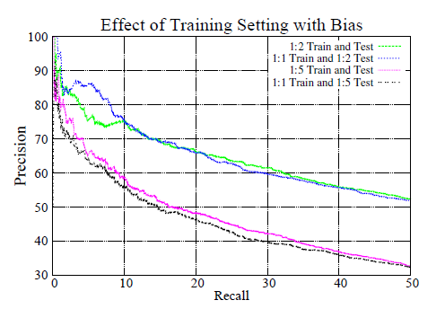
Training effect of class bias
No longer balanced dataset.
Train and Test have different class ratios.

Slide 46
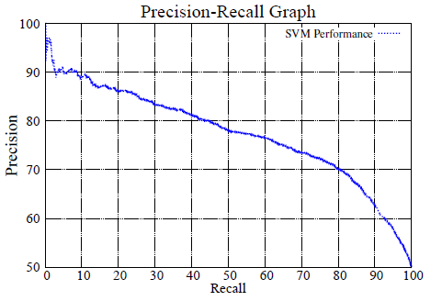
All-Query Classification
Learning to classify if ANY query in a session is part of ID session or not.
Can be used for identifying when ID is over (or off-topic query).

Slide 47
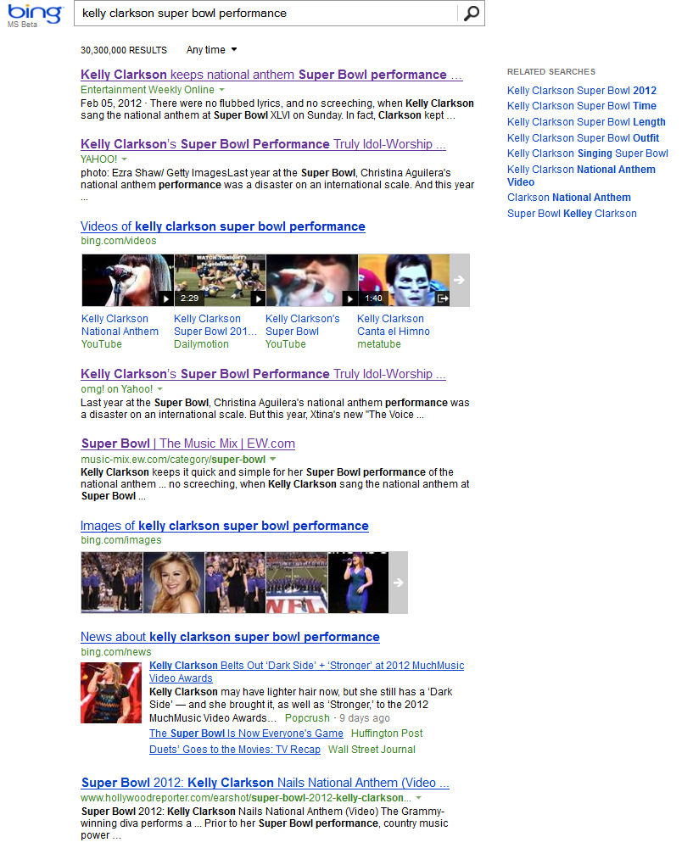
Notes:
Either able to provide relevant information or not.

Slide 48





Notes:
Either able to provide relevant information or not.

Slide 49
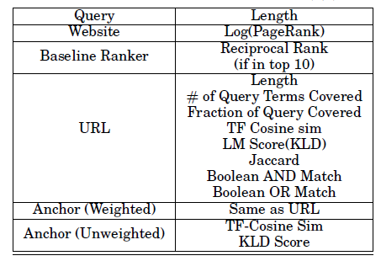
Training Relevance Function
Used 20k queries.
Optimized for NDCG@5.

Slide 50
Reranking Algorithm
Given query q: Produce ranking d₁,d₂,… with associated queries q₁,q₂,… (representing aspects)
  Documents should be relevant to query q.
  Doc. d_{i} should be relevant to associated query q_{i} .
  Aspects should be relevant to ID task initiated by q.
  Aspects should be diverse.
Objective :
Submodular Objective: Optimize using greedy algo.
MMR-Like

Slide 51
Re-ranking for ID sessions
Problem: Given initiator query, re-rank to maximize whole-session relevance.
First to jointly satisfy current and future queries.
Thus also need to identify content to pre-fetch.
Goal: Produce intelligible (and interactive) ranking.
Provide aspect (i.e. related query) with result as an exemplar to facilitate user-driven exploration of aspects.

Slide 52
Related Problems
Most work focuses on extrinsic diversity.
Related to previous TREC tracks: Interactive, Novelty, QA and (most recently) Session.
Nothing on ID in context of web search.
neural networks
machine learning
machine learning usage
text classification
support vector machines
red wine
red wine varieties
red wine regions
red wine grape type
red wine ratings
red wine prices
remodeling ideas
cost of typical remodel
hardwood flooring
earthquake retrofit
paint colors
kitchen remodel
Task-Based Retrieval
Exploratory Search
Trail-Finding
ID
Anticipatory search
Faceted Search
Notes:
Relation to other query types: exploratory, anticipatory, task tours and trails, faceted.

