Slide 1
Methods for Ordinal Peer Grading
Karthik Raman, Thorsten Joachims
Cornell University

Slide 2

Evaluation at Scale is challenging
MOOCs: Promise to revolutionize education with unprecedented access
Need to rethink conventional evaluation logistics:
  Small-scale classes (10-15 students) : Instructors evaluate students themselves
  Medium-scale classes (20-200 students) : TAs take over grading process.
  MOOCs (10000+ students) : ??
MCQs & Other Auto-graded questions are not a good test of understanding and fall short of conventional testing.
  Limits kinds of courses offered.
Image Courtesy: PHDComics

Slide 3


Peer Grading to the Rescue
Students grade each other (anonymously)!
Overcomes limitations of instructor/TA evaluation:
  Number of “graders” scales with number of students!
=
8/10
Cardinal Peer Grading [Piech et. al. 13] require cardinal labels for each assignment.
Each peer grader g provides cardinal score for every assignment d they grade.
  E.g.: Likert Scale, Letter grade

Slide 4
Challenge: Cardinal Feedback is difficult to provide and less reliable
Students are not trained graders:
  Need to make feedback process simple!
Broad evidence showing ordinal feedback is easier to provide and more reliable than cardinal feedback:
  Project X is better than Project Y vs. Project X is a B+.
  Grading scales may be non-linear: Problematic for cardinal grades
?
30000$
45000$
90000$
100000$
?
>
<

Slide 5

Ordinal Peer Grading
Each grader g provides ordering of assignments they grade: σ^{(g)}.
GOAL: Determine true ordering and grader reliabilities
>
…
…
P
Q
>
>
..
..
…
…
R
..
..
P
Q
>
Q
…
R
…

Slide 6
Related Problems
Rank Aggregation/Metasearch Problem:
  Given input rankings, determine overall ranking.
  Performance is usually top-heavy (optimize top k results).
  Estimating grader reliability is not a goal.
  Ties and data sparsity are not an issue.
Social choice/Voting systems:
  Aggregate preferences from individuals.
  Do not model reliabilities and are again top-heavy.
  Also typically assume complete rankings.
Crowdsourcing:
  Estimating worker (grader) reliability is key component.
  Scale of items (assignments) much larger than typical Crowdsourcing task.
  Also tends to be top-heavy.

Slide 7
Mallows Model and Variants
GENERATIVE MODEL:
    is the Kendall-Tau distance between orderings (# of differing pairs).
OPTIMIZATION: NP-hard. Greedy algorithm provides good approximation.
WITH GRADER RELIABILITY:
Variant with score-weighted objective (MALS) also used.
A
P
Q
R
Z
…
………
……..
…
ORDERINGS | PROBABILITY
(P,Q,R) | x
(P,R,Q); (Q,P,R) | x/e
(R,P,Q); (Q,R,P) | x/e²
(R,Q,P) | x/e³
Q
P
R

Slide 8
Bradley-Terry Model & Variants
GENERATIVE MODEL:
  Decomposes as pairwise preferences using logistic distribution of (true) score differences.
OPTIMIZATION: Alternating minimization to compute MLE scores (and grader reliabilities) using SGD subroutine.
GRADER RELIABILITY:
Variants studied include Plackett-Luce model (PL) and Thurstone model (THUR).

Slide 9
Experimental Validation: New Peer Grading Dataset
Data collected in classroom during Fall 2013:
  First real large evaluation of machine-learning based peer-grading techniques.
Used two-stages: Project Posters (PO) and Final-Reports (FR)
  Students provided cardinal grades (10-point scale): 10-Perfect,8-Good,5-Borderline,3-Deficient
Also performed conventional grading: TA and instructor grading.
Statistic | Poster | Report
Number of Assignments | 42 | 44
Number of Peer Reviewers | 148 | 153
Total Peer Reviews | 996 | 586
Number of TA Reviewers | 7 | 9
Total TA Reviews | 78 | 88

Slide 10
How well do OPG methods do w.r.t. Instructor Grades?
Cardinal
Kendall-Tau error measure (lower is better).
As good as cardinal methods (despite using less information).
TAs had error of 22.0 ± 16.0 (Posters) and 22.2 ± 6.8 (Report).

Slide 11
Benefit of grader reliability
Added lazy graders. Can we identify them?
Does significantly better than cardinal methods and simple heuristics.
Better for posters due to more data.
Cardinal

Slide 12
What did Students think about it?

Slide 13
Summary
Benefits of ordinal peer grading for large classes.
Adapted rank aggregation methods for performing ordinal peer grading.
Using data from an actual classroom, peer grading found to be a viable alternate to TA grading.
Students found it helpful and valuable

Slide 14
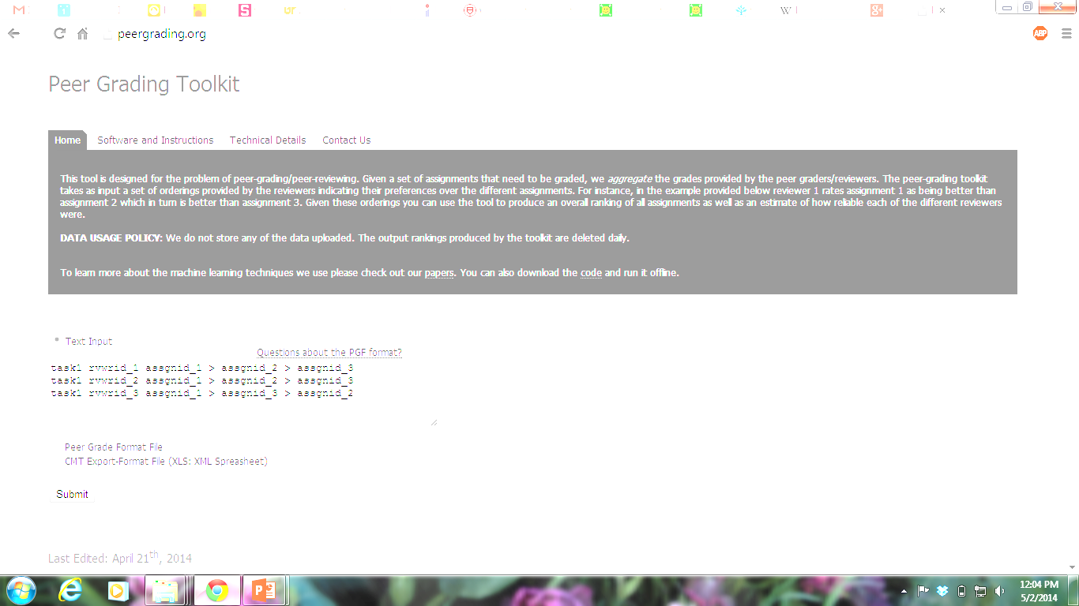
Thank you!
CODE found at peergrading.org where a Peer Evaluation Web SERVICE is available.
DATA is also available

Slide 15

Extra Slides

Slide 16
Statistics of Grades provided

Slide 17
Self-consistency
Self-consistent

Slide 18
Other Results
Consistent results even on sampling graders.
Scales well (performance and time) with number of reviewers and ordering size.

Slide 19
Cardinal Peer Grading [Piech et. al. 2013]
Assume generative model (NCS) for graders:
Grader g’s reliability (precision)
True Score of assignment d
Grader g’s bias
Grader g’s grade for assignment d: Normally distributed
Can use MLE/Gibbs sampling/Variational inference ..

Slide 20
Our Approach to Ordinal Peer Grading
Proposed/Adapted different rank-aggregation methods for the OPG problem:
  Mallows model (MAL).
  Score-weighted Mallows (MALS).
  Bradley-Terry model (BT).
  Thurstone model (THUR).
  Plackett-Luce model (PL).
Ordering-based distributions
Pairwise-Preference based distributions
Extension of BT for orderings.

Slide 21
How well do OPG methods do w.r.t. TA Grades?
Cardinal
Inter-TA Kendall-Tau: 47.5 ± 21.0 (Posters) and 34.0 ± 13.8 (Report).

