Slide 1

Online Learning to Diversify using Implicit Feedback
Karthik Raman, Pannaga Shivaswamy & Thorsten Joachims
Cornell University
Notes:
Upfront Util = relevance
Structured Predictions-Simplify what the regret bounds mean.
- Learning from existing data
Why interesting/sound/relevant?

Slide 2

Intrinsic Diversity
U.S. Economy
Soccer
Tech Gadgets

Slide 3
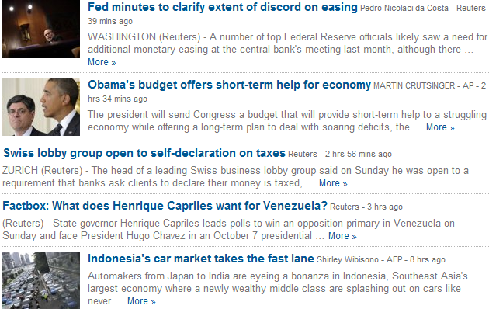
News Recommendation
Relevance-Based?
All about the economy. Nothing about sports or tech.
Becomes too redundant, ignoring some interests of the user.

Slide 4



Diversified News Recommendation
Intrinsic Diversity: Different interests of a user addressed. [Radlinski et. al]
Need to have right balance with relevance.

Slide 5
Previous Work
Methods for learning diversity:
  El-Arini et. al propose method for diversified scientific paper discovery.
    Assume noise-free feedback
  Radlinski et. al propose Bandit Learning method
    Does not generalize across queries
  Yue et. al. propose online learning methods to maximize submodular utilities
    Utilize cardinal utilities.
  Slivkins et. al. learn diverse rankings:
    Hard-coded notion of diversity.

Slide 6
Contributions
Utility function to model relevance-diversity trade-off.
Propose online learning method:
  Simple and easy to implement
  Fast and can learn on the fly.
  Uses implicit feedback to learn
  Solution is robust to noise.
  Learns diverse rankings.
Notes:
Highlight what difference from previous work.

Slide 7
Submodular functions
KEY: For a given query and user intent, the marginal benefit of seeing additional relevant documents diminishes.

Slide 8
General Submodular Utility (CIKM’11)
Given ranking θ = (d₁, d₂,…. d_{k}) and concave function g
t₁ | t₂ | t₃
4 | 3 | 0
4 | 0 | 0
0 | 3 | 0
0 | 0 | 3
P(t₁) =1/2 | P(t₂) =1/3 | P(t₃) =1/6
t₁ | t₂ | t₃
4
4
0
0
t₁ | t₂ | t₃
U(d₁|t)
U(d₂|t)
U(d₃|t)
U(d₄|t)
d₁
d₂
d₃
d₄
*Can replace intents with terms for prediction.
Notes:
Over all intents need to take expectation
Will use utilities and relevance to mean the same at times.
Similarly intents and topics.

Slide 9
Modeling this Utility
where Φ(y) is the :
  aggregation of (text) features
  over documents of ranking y.
  using any submodular function
    Allows to model relevance-diversity tradeoff
Notes:
Mention submodular allows to get the non-linearity to model

Slide 10
Linear Feature Aggregation
 | _{Economy} | _{USA} | _{Soccer} | _{Technology}
d₁ | 5 | ₄ | ₀ | ₀
d₂ | 0 | ₃ | ₄ | ₀
d₃ | 3 | ₂ | ₀ | ₀
d₄ | 0 | ₂ | ₀ | ₄
Φ(y) | ₈ | ₁₁ | ₄ | ₄
 | _{Economy} | _{USA} | _{Soccer} | _{Technology}
d₁ | 5 | ₄ | ₀ | ₀
d₂ | 0 | ₃ | ₄ | ₀
d₃ | 3 | ₂ | ₀ | ₀
Φ(y) | ₈ | ₉ | ₄ | ₀
 | _{Economy} | _{USA} | _{Soccer} | _{Technology}
d₁ | 5 | ₄ | ₀ | ₀
d₂ | 0 | ₃ | ₄ | ₀
Φ(y) | ₅ | ₇ | ₄ | ₀
 | _{Economy} | _{USA} | _{Soccer} | _{Technology}
Φ(y) | ₀ | ₀ | ₀ | ₀
 | _{Economy} | _{USA} | _{Soccer} | _{Technology}
d₁ | 5 | ₄ | ₀ | ₀
Φ(y) | ₅ | ₄ | ₀ | ₀

Slide 11
MAX Feature Aggregation
 | _{Economy} | _{USA} | _{Soccer} | _{Technology}
d₁ | 5 | ₄ | ₀ | ₀
d₂ | 0 | ₃ | ₄ | ₀
d₃ | 3 | ₂ | ₀ | ₀
d₄ | 0 | ₂ | ₀ | ₄
Φ(y) | ₅ | ₄ | ₄ | ₄
 | _{Economy} | _{USA} | _{Soccer} | _{Technology}
d₁ | 5 | ₄ | ₀ | ₀
d₂ | 0 | ₃ | ₄ | ₀
d₃ | 3 | ₂ | ₀ | ₀
Φ(y) | ₅ | ₄ | ₄ | ₀
 | _{Economy} | _{USA} | _{Soccer} | _{Technology}
d₁ | 5 | ₄ | ₀ | ₀
Φ(y) | ₅ | ₄ | ₀ | ₀
 | _{Economy} | _{USA} | _{Soccer} | _{Technology}
Φ(y) | ₀ | ₀ | ₀ | ₀
 | _{Economy} | _{USA} | _{Soccer} | _{Technology}
d₁ | 5 | ₄ | ₀ | ₀
d₂ | 0 | ₃ | ₄ | ₀
Φ(y) | ₅ | ₄ | ₄ | ₀

Slide 12
Maximizing Submodular Utility: Greedy Algorithm
Given the utility function, can find ranking that optimizes it using a greedy algorithm:
  At each iteration: Choose Document that Maximizes Marginal Benefit
Look at Marginal Benefits
d₁ | economy:3, usa:4, finance:2 ..
d₂ | usa:3, soccer:2,world cup:2..
d₃ | usa:2, politics:3, president:5 …
d₄ | gadgets:2, technology:4, usa:2 ..
d₁ | 2.2
d₂ | 1.7 | 1.4 | 1.3
d₃ | 0.4 | 0.2 | 0.1
d₄ | 1.9 | 1.7
d₁ | 2.2
d₂ | 1.7
d₃ | 0.4
d₄ | 1.9
d₁ | 2.2
d₂ | 1.7 | 1.4
d₃ | 0.4 | 0.2
d₄ | 1.9 | 1.7
d₁
?
?
d₄
?
d₂
Notes:
Mention use text to go from intents.

Slide 13
Learn Via Preference Feedback
Hand-labeling document-intent for documents is difficult.
LETOR research has shown large datasets required to perform well.
Imperative to be able to use weaker signals/information source.
Our Approach:
  Implicit Feedback from Users (i.e., clicks)

Slide 14
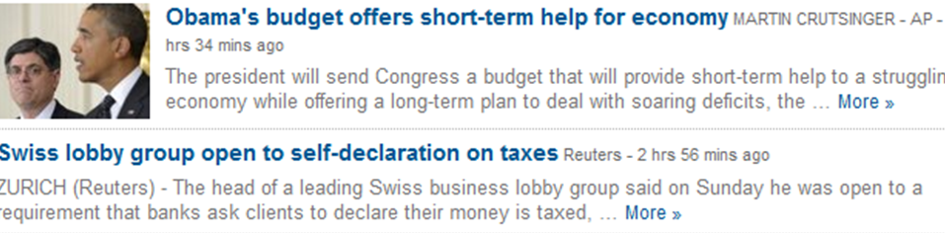
Implicit Feedback From User

Slide 15

Alpha-Informative Feedback
Will assume the feedback is informative:
The “Alpha” quantifies the quality of the feedback and how noisy it is.
FEEDBACK
RANKING
PRESENTED
RANKING
OPTIMAL
RANKING
PRESENTED
RANKING

Slide 16
General Online Learning Algo
Initialize weight vector w.
Get fresh set of documents/articles.
Compute ranking using greedy algorithm (using current w).
Present to user and get feedback.
Update w ...
  E.g: w += Φ( Feedback) - Φ( Presented)
  Gives the Diversifying Perceptron (DP).
Repeat from step 2 for next user interaction.

Slide 17
Regret
Would like to obtain user utility as close to the optimal.
Define regret as the average difference between utility of the optimal and that of the presented.
Despite not knowing the optimal, we can theoretically show the regret for the DP:
  Converges to 0 as T -> ∞, at rate of 1/T
  Is independent of the feature dimensionality.
  Changes gracefully as noise increases

Slide 18
Experimental Setting
No labeled intrinsic diversity dataset.
  Create artificial datasets by simulating users using the RCV1 news corpus.
  Documents relevant to at most 1 topic.
Each intrinsically diverse user has 5 randomly chosen topics as interests.
Results average over 50 different users.
Notes:
Explain why TREC datasets cannot be used.

Slide 19
Can we Learn to Diversify?
Can the algorithm learn to cover different interests (i.e., beyond just relevance)?
Consider purely-diversity seeking user
  Would like as many intents covered as possible
Every iteration: User returns feedback of ≤5 documents (with α = 1)
Notes:
Feedback setting : Perfect Feedback.
5 documents returned
Purely diversity seeking users : Minimize redundance.

Slide 20
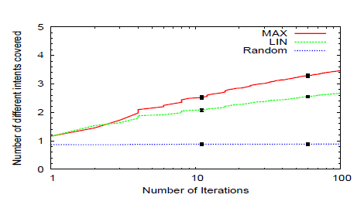
Can we Learn to Diversify?
Submodularity helps cover more intents.
Notes:
- > Say that it means you cover more intents in the set returned (and able to learn it better)
-> However you could do this by learning only say the (easier) 4 of the 5 intents. Next shows that infact you do learn all.
-> Black lines are error bars.

Slide 21
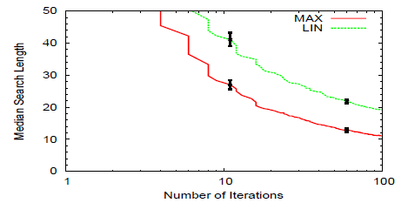
Can we Learn to Diversify?
Able to find all intents in top 10.
  Compared to the 20 required for non-diversified algorithm.
Notes:
Describe what median search length is

Slide 22
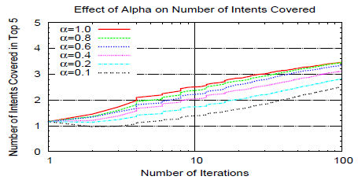
Effect of Feedback Quality
Works well even with noisy feedback.
Notes:
Theoretically we showed that performance scales rather well with alpha.
What do we so empirically?
Able to learn even at very low values of alpha

Slide 23
Other results
Able to outperform supervised learning:
  Despite not being told the true labels and receiving only partial information.
Able to learn the required amount of diversity
  By combining relevance and diversity features
  Works as well almost as knowing true user utility.

Slide 24
Conclusions
Presented an online learning algorithm for learning diverse rankings using implicit feedback.
Relevance-Diversity balance by modeling utility as submodular function.
Theoretically and empirically shown to be robust to noisy feedback.

Slide 25
THANKS.
QUESTIONS?

Slide 26
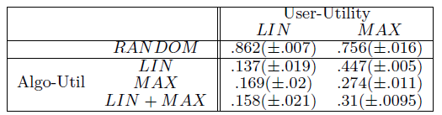
Learning the Desired Diversity
Users want differing amounts of diversity.
Can learn this on per-user level by:
  Combining relevance and diversity features
  Algorithm learns relative weights.
Notes:
So far we talked about what happens for different users. They have different feature mappings.
Related to work on extrinsic diversity by MacDonald et. al

Slide 27
Intrinsic vs. Extrinsic Diversity
INTRINSIC | EXTRINSIC
Diversity among the interests of a single user. Avoid redundancy and cover different aspects of a information need. | Diversity among interests/ information need of different users. Balancing interests of different users and provide some information to all users.
Less-studied | Well-studied
Applicable for personalized search/recommendation | General purpose search/ recommendation.
Radlinski, Bennett, Carterette and Joachims, Redundancy, diversity and interdependent document relevance; SIGIR Forum ‘09
Notes:
Talk in terms of news example
Coarse grained vs. fine grained
Key difference for our purposes is that a single user’s feedback will improve overall utility for intrinsic but can hurt for extrinsic.

Slide 28
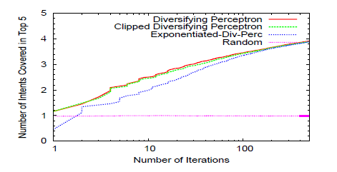
Comparing different methods

Slide 29

Alpha-Informative Feedback
FEEDBACK
RANKING
PRESENTED
RANKING
OPTIMAL
RANKING
PRESENTED
RANKING

Slide 30
Alpha-Informative Feedback
Let’s allow for noise:

Slide 31
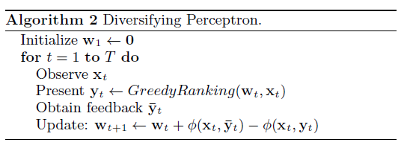
Online Learning method: Clipped Diversifying Perceptron
Previous algorithm can have negative weights which breaks guarantees.
Same regret bound as previous.

Slide 32
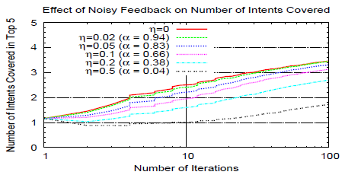
Effect of Noisy Feedback
What if feedback can be worse than presented ranking?
Notes:
Further pushed the limits on feedback: What if users are confused about both diversity and relevance.
Correspond to that expected alpha
IMPLICATION: What this allows is for us to utilize feedback (even from non-experts) in the training of these models.

Slide 33
Learning the Desired Diversity
Regret is comparable to case where user’s true utility is known.
Algorithm is able to learn relative importance of the two feature sets.
Notes:
Able to learn as if mapping was known
Due to learning the relative importance can figure out how much diversity is needed

Slide 34
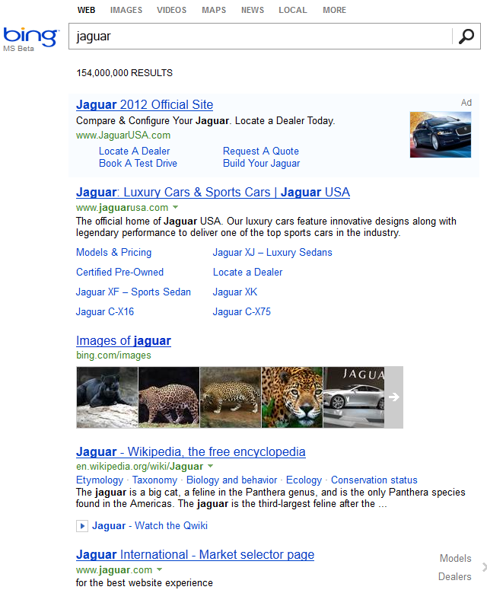
Diversified Retrieval
Different users have different information needs.
Here too balance with relevance is crucial.

Slide 35
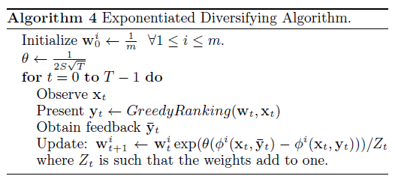
Exponentiated Diversifying Perceptron
This method will favor sparsity (similar to L1 regularized methods)
Similarly can bound regret.
Notes:
Is L1 vs. L2 for others

Slide 36
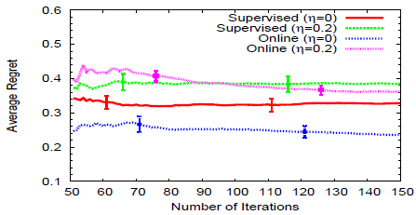
Comparison with Supervised Learning
Significantly outperforms the method despite using far less information: complete relevance labels vs. preference feedback.
Orders of magnitude faster training: 1000 vs. 0.1 sec
Notes:
First online learning method for diversification. Hence will compare to existing supervised learning method.
(Includes Yisong and CIKM work)

