Slide 1

Structured Learning of Two-Level Dynamic Rankings
Karthik Raman, Thorsten Joachims & Pannaga Shivaswamy
Cornell University

Slide 2


Handling Query Ambiguity
Non-Diversified
Diversified

Slide 3
Ranking Metrics: Two Extremes
Non-Div.
t₁ | t₂ | t₃
t₁ | t₂ | t₃
1/2 | 1/3 | 1/6
4 | 3 | 0
4 | 0 | 0
0 | 3 | 0
0 | 0 | 3
Diversified
P(t₁) =1/2 | P(t₂) =1/3 | P(t₃) =1/6
U(d₁|t)
U(d₂|t)
U(d₃|t)
U(d₄|t)
4 | 3 | 0
4 | 0 | 0
0 | 3 | 0
0 | 0 | 3
d₁
d₂
d₃
d₄
8 | 6 | 3
4 | 3 | 3
………………??…….……….
= 8/2 + 6/3 + 3/6
= 4/2 + 3/3 + 3/6
Notes:
Over all intents need to take exprectation

Slide 4
KEY: Diminishing Returns
Non-Diversified
Diversified
Notes:
Original concept from Economics
Resembles a concave function

Slide 5
KEY: Diminishing Returns
For a given query and user intent:
Marginal benefit of seeing additional relevant doc. decreases.
Notes:
Original concept from Economics
Resembles a concave function

Slide 6
General Ranking Metric
Given ranking θ = (d₁, d₂,…. d_{k}) and concave function g
t₁ | t₂ | t₃
1/2 | 1/3 | 1/6
4 | 3 | 0
4 | 0 | 0
0 | 3 | 0
0 | 0 | 3
d₁
d₂
d₃
g(x) = √x
d₄
√8 | √6 | √3
- Can incorporate position discount also
= √8 /2 + √6/3 + √3/6
Notes:
Over all intents need to take exprectation

Slide 7
Computing Optimal Rankings
These utility functions are submodular.
Given the utility function, can find ranking that optimizes it using a greedy algorithm:
  At each iteration: Choose Document that Maximizes Marginal Benefit
Algorithm has (1 – 1/e) approximation bound.
d₁ | 2.2
d₂ | 1.7
d₃ | 0.4
d₄ | 1.9
d₁ | 2.2
d₂ | 1.7 | 1.4
d₃ | 0.4 | 0.2
d₄ | 1.9 | 1.7
d₁ | 2.2
d₂ | 1.7 | 1.4
d₃ | 0.4 | 0.2 | 1.3
d₄ | 1.9 | 1.7 | 0.1
d₁
?
Look at Marginal Benefits
?
d₄
?
d₂

Slide 8
Experimental Settings
Experiments run on TREC and WEB datasets:
  Both datasets have document-intent annotations.
  Avg. Intents per Doc: 20 vs. 4.5
  Prob(Dominant Intent) : 0.28 vs. 0.52
Different Utility functions compared:
  PREC : g(x) =x SQRT : √x LOG : log(1+x)
  SAT-2 : min(x,2) SAT-1 : min(x,1)
Notes:
Mention important differences
This is the function that will be maximized to produce the dynamic ranking.

Slide 9
Turning the knob
No Diversification
?
LOG
SQRT
LOG
SAT-2
SQRT
SAT-2
Maximum Diversity
Notes:
Results

Slide 10
How Do We break this trade-off?
KEY IDEA: Using user interaction as feedback to disambiguate the query on-the-fly, so as to present more results relevant to the user.
(Brandt et. al. WSDM ‘11)

Slide 11
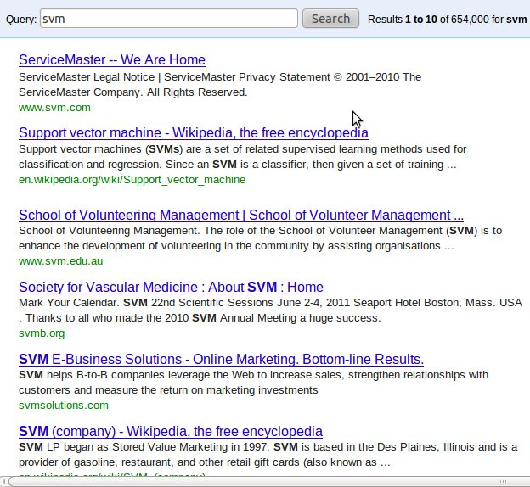
Two-Level Dynamic Ranking: Example
First-Level: Start with a Diverse Ranking
User interested in the ML Method.
Expands to see more such results.

Slide 12
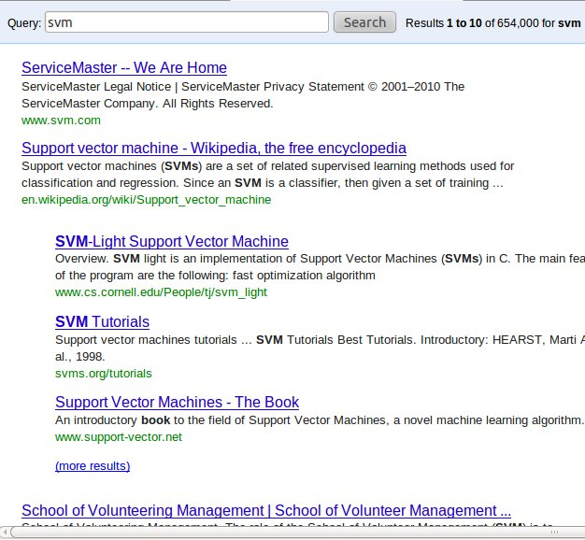
Two-Level Dynamic Ranking: Example
New ranking related to ML Method.
Second-Level Ranking

Slide 13

Two-Level Dynamic Ranking: Example

Slide 14
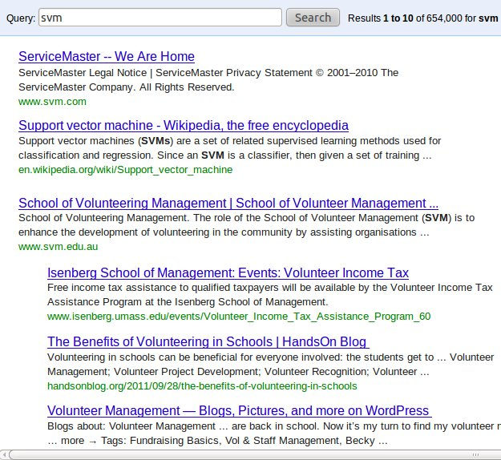
Two-Level Dynamic Ranking: Example

Slide 15
Two-Level Dynamic Ranking : Example
Head
expand
d₁
d_{1,1}
d_{1,2}
d_{1,3}
skip
Tail Documents
expand
d₂
d_{2,1}
d_{2,2}
d_{2,3}
skip
expand
d₃
d_{3,1}
d_{3,2}
d_{3,3}
skip
expand
d₄
d_{4,1}
d_{4,2}
d_{4,3}
Two-Level Ranking (Θ)

Slide 16
Utility of two-level ranking
Can extend definition of Utility for two-level rankings:
  Concave function applied to (weighted) sum over all rows.
  Resulting measure is nested submodular function.
Can similarly extend the greedy algorithm to a nested greedy algorithm for Two-Level Rankings:
  (1): Given a head document, can greedily build a row.
  (2): Each iteration, amongst all rows from (1), choose the one with highest marginal benefit.
Can still prove an approximation bound: ≈ 0.47

Slide 17
Static vs. Two-Level Dynamic Rankings
TREC
WEB

Slide 18


Structural-SVM Based Learning Framework
What if we do not have the document-intent labels?
Solution: Use TERMS as a substitute for intents.
Structural SVMs used to predict complex outputs.
Utility Measure with Words replacing intents
Similarity between head and tail documents.

Slide 19
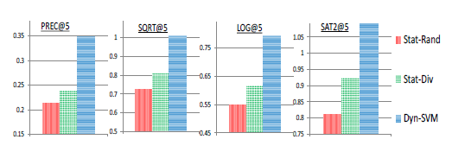
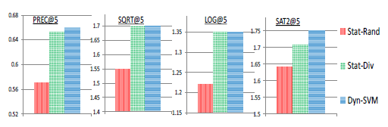
Learning Experiments
Compare with different static-learning baselines:

Slide 20
Main Take-Aways
Using Submodular Performance Measures to smoothly bridge the gap between depth and diversity.
Breaking the Trade-off between depth and diversity via user interaction using Two Level Dynamic Rankings.
Given training data, being able to predict dynamic rankings using the Structural SVM-based Learning Algorithm.
Code up on : http://www.cs.cornell.edu/~karthik/code/svm-dyn.html
Notes:
Give overview of talk and how each relates to the other

Slide 21
Thank You!
--
Questions?

Slide 22
Turning the knob
?
Notes:
Results

Slide 23
Ranking Utility: DCG
Given ranking θ = (d₁, d₂,…. d_{k}) and (position) discount factors γ₁ ≥ γ₂ ≥ .. γ_{k} ≥ 0 :
d₁
U_{dcg}((d₁)|t₁) = (4.γ₁)
4
1
d₂
U_{dcg}((d₁, d₂)|t₁) = (4.γ₁ +1.γ₂)
2
d₃
U_{dcg}((d₁, d₂ , d₃)|t₁) = (4.γ₁ +1.γ₂ +2.γ₃)
2
d₄
U(d|t₁)
Overall utility given by expectation over all intents
Notes:
Over all intents need to take exprectation

Slide 24
Ranking Utility: Diversity
Given ranking θ = (d₁, d₂,…. d_{k}) and (position) discount factors γ₁ ≥ γ₂ ≥ .. γ_{k} ≥ 0 :
4
d₁
U_{diversity}((d₁)|t₁) = max(4.γ₁)
1
d₂
U_{diversity}((d₁, d₂)|t₁) = max(4.γ₁,1.γ₂)
2
d₃
U_{diversity}((d₁, d₂ , d₃)|t₁) = max(4.γ₁,1.γ₂,2.γ₃)
2
d₄
U(d|t₁)
Overall utility given by expectation over all intents
Notes:
Over all intents need to take exprectation

Slide 25
Performance Metric
IR has metrics for:
  Only Depth (Relevance)
  Only Diversity
Need a metric to combine both together.
Model “Diminishing Returns”.
Notes:
Have metrics for extremes. Need to combine them.

Slide 26


General Ranking Utility
Given ranking θ = (d₁, d₂,…. d_{k}), concave function g and (position) discount factors γ₁ ≥ γ₂ ≥ .. γ_{k} ≥ 0 :
4
d₁
1
d₂
2
d₃
U_{sqrt}((d₁)|t₁) = √(4.γ₁)
2
d₄
U(d|t₁)
U_{sqrt}((d₁, d₂)|t₁) = √(4.γ₁ +1.γ₂)
U_{sqrt}((d₁, d₂ , d₃)|t₁) = √(4.γ₁ +1.γ₂ +2.γ₃)
Notes:
Over all intents need to take exprectation

Slide 27
Turning the knob
Notes:
Results

Slide 28
Static vs. Two-Level Dynamic Rankings
Are dynamic rankings really better than static?
Compared three different static rankings with dynamic:
  Stat-Div: Maximizes Diversity (Yue et. al.)
  Stat-Depth: Maximizes Precision
  Stat-Util: Maximizes the corresponding utility function.

Slide 29
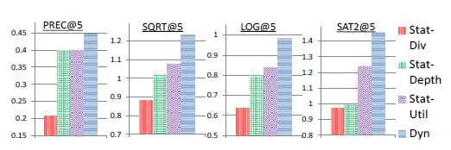
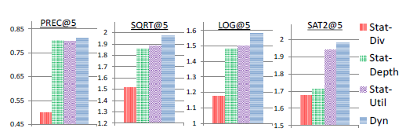
Static vs. Two-Level Dynamic Rankings

Slide 30

Utility of two-level ranking
Given two-level ranking Θ can extend definition of Utility for two-level rankings as :
Inner sum is over tail documents of a given row.
Outer sum is over all rows of the ranking.

Slide 31
Computing Two-Level Dynamic Rankings
Goal: Given a utility function, compute dynamic ranking.
Since submodular, can use (nested) greedy algorithm:
For i = 1 … # Rows:
  Greedily Build Rows for all possible head documents
  Choose Row with highest marginal benefit.
Building Row with Head Document d:
For j = 1 … Row-Width:
  Choose Document with highest marginal benefit.
Notes:
Explain at high-level what these mean
Approximation bound

Slide 32
Example – Outer Loop
(4,1)
(4,0)
(1,3)
(3,0)
d₁
d_{1,1}
d_{1,2}
d_{1,3}
Look at Marginal Benefits for rows
?
Row with head d₂ | 3.4
Row with head d₃ | 5.2
Row with head d₄ | 2.7

Slide 33
Single-Level ranking Utility: Example
(4,1)
d₁
U_{sqrt}((d₁)|t₁) = √(4.γ₁)
d₂
(0,3)
U_{sqrt}((d₁, d₂)|t₁) = √(4.γ₁ +0.γ₂)
(2,2)
d₃
U_{sqrt}((d₁, d₂ , d₃)|t₁) = √(4.γ₁ +0.γ₂ +2.γ₃)
(2,1)
d₄

Slide 34
User Behavior
Expand on a document if relevant.
Skip if not relevant.
After finishing a second-level ranking, users return to the first-level.

Slide 35
User Behavior
d₁
d_{1,1}
d_{1,2}
d_{1,3}
d₂
d_{2,1}
d_{2,2}
d_{2,3}
d₃
d_{3,1}
d_{3,2}
d_{3,3}
d₄
d_{4,1}
d_{4,2}
d_{4,3}

Slide 36
General Ranking Metric
Given query q , ranking θ = (d₁, d₂,…. d_{k}), concave function g and (position) discount factors γ₁ ≥ γ₂ ≥ .. γ_{k} ≥ 0 :
t₁ | t₂ | t₃
1/2 | 1/3 | 1/6
4 | 3 | 0
4 | 0 | 0
0 | 3 | 0
0 | 0 | 3
d₁
d₂
d₃
d₄
√8 | √6 | √3
g(x) = √x
≈ 2.52
Notes:
Over all intents need to take exprectation

