Slide 1
“By the User, For the User, With the Learning System”:
Learning From User Interactions
Karthik Raman
December 12, 2014
Joint work with Thorsten Joachims,
Pannaga Shivaswamy, Tobias Schnabel

Slide 2
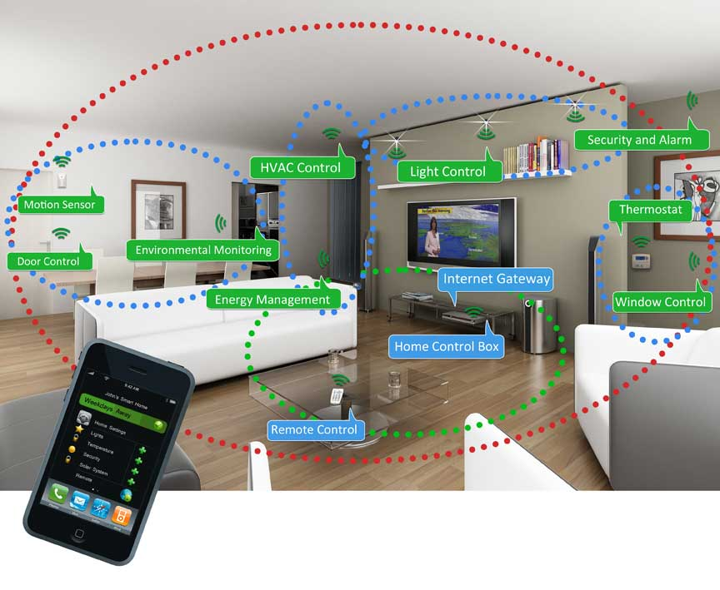

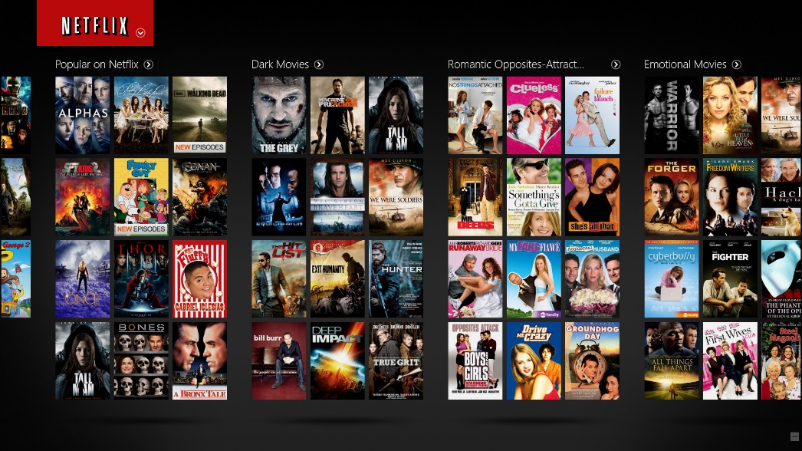
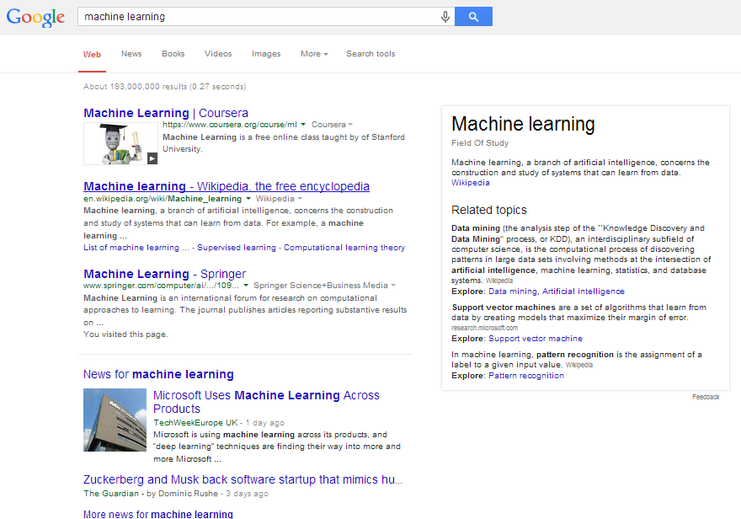
Age Of the WEB & DATA
Learning is important for today’s Information Systems:
  Search Engines
  Recommendation Systems
  Social Networks, News sites
  Smart Homes, Robots ….
Difficult to collect expert-labels for learning:
  Instead: Learn from the user (interactions).
  User feedback is timely, plentiful and easy to get.
  Reflects user’s – not experts’ – preferences

Slide 3
Interactive Learning With Users
Takes Action (e.g., Present ranking)
SYSTEM
(e.g., Search Engine)
USER(s)
Good at computation
Knowledge-Poor
Poor at computation
Knowledge-Rich
Interacts and Provides
Feedback (e.g., User clicks)
Users and system jointly work on the task (same goal).
  System is not a passive observer of user.
  Complement each other
Need to develop learning algorithms in conjunction with plausible models of user behavior.

Slide 4
Agenda For This Talk
Designing algorithms, for interactive learning with users, that are applicable in practice and have theoretical guarantees.
Outline:
  Handling weak, noisy and biased user feedback (Coactive Learning).
  Predicting complex structures: Modeling dependence across items/documents (Diversity).

Slide 5
Agenda For This Talk
Designing algorithms, for interactive learning with users, that are applicable in practice and have theoretical guarantees.
Outline:
  Handling weak, noisy and biased user feedback (Coactive Learning) [RJSS ICML’13].
  Predicting complex structures: Modeling dependence across items/documents (Diversity).

Slide 6
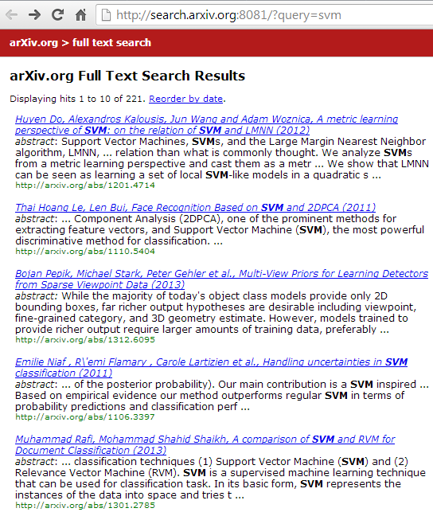
User Feedback?
Building Search Engine For arxiv
POSITION-BIAS: Has been shown to be better than docs above, but cannot say anything about docs below.
Higher the document, the more clicks it gets.
[Joachims et. al. TOIS ’07]
CONTEXT-BIAS: Click on document may just mean poor quality of surrounding documents.
Click!
NOISE: May receive some clicks even if irrelevant.

Slide 7
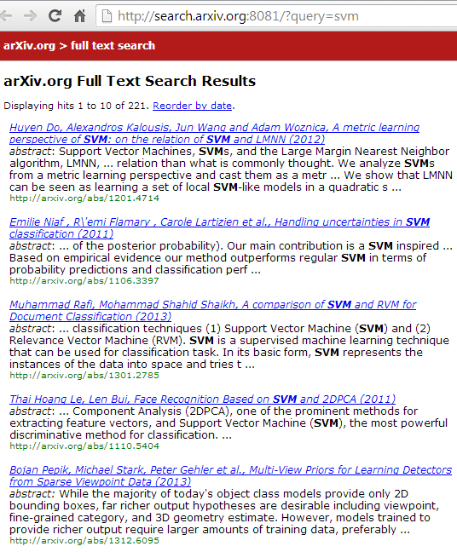
Implicit Feedback From User
Presented Ranking
Improved Ranking
Click!
Click!
Click!

Slide 8
Coactive Learning Model
Present Object y_{t} (e.g., Ranking)
Context x_{t}
e.g., Query
SYSTEM
(e.g., Search Engine)
USER
Receive Improved
Object ̅y_{t}
User has utility U(x_{t}, y_{t}).
COACTIVE: U(x_{t}, ̅y_{t}) ≥_{α} U(x_{t}, y_{t}).
Feedback assumed by other online learning models:
FULL INFORMATION: U(x_{t}, y¹), U(x_{t}, y²) . . .
BANDIT: U(x_{t}, y_{t}).
OPTIMAL : y*_{t} = argmax_{y} U(x_{t},y)

Slide 9
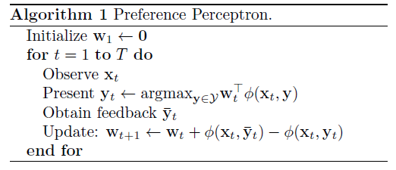
Preference Perceptron
Initialize weight vector w.
Get context x and present best y (as per current w).
Get feedback and construct (move-to-top) feedback.
Perceptron update to w :
  w += Φ( Feedback) - Φ( Presented)

Slide 10
Theoretical Analysis
Analyze the algorithm’s regret i.e., the total sub-optimality
where y*_{t} is the optimal prediction.
Characterize feedback as α-Informative:
Not an assumption: Can characterize all user feedback
  α indicates the quality of feedback, ξ_{t} is the slack variable (i.e. how much lower is received feedback than α quality).

Slide 11
Regret Bound For Preference Perceptron
For any α and w* s.t.:
the algorithm has regret:
Changes gracefully with α.
Independent of Number of Dimensions
Converges as √T
(Same rate as optimal feedback convergence)
Slack component

Slide 12
How Does It Do in Practice?
Performed user study on full-text search on arxiv.org
  Goal: Learning a ranking function
Win Ratio: Interleaved comparison with (non-learning) baseline.
Higher ratio is better
(1 indicates similar perf.)
Preference Perceptron performs poorly and is not stable.
Feedback received has large slack values (for any reasonably large α)

Slide 13
Illustrative Example
T
w
1
1
-1
d₁
Only relevant doc.
d₂
Feature Values
1
0
......
d₁
d_{2…N}
0
1
d_{N}
Say user is imperfect judge of relevance: 20% error rate.

Slide 14
Illustrative Example
T
w
209
-0.1
0.1
10
218
79
17
1
4
2
3
0.2
-0.2
0.4
0.6
1
-0.6
-1
0.2
-0.2
-0.4
d_{N}
d₁
For N=10, Averaged over 1000 runs.
d₂
Method | Avg. Rank of Rel Doc
Preference Perceptron | 9.36
Averaged Preference Perceptron | 9.37
3PR (Our Method) | 2.08
Feature Values
1
0
......
d₁
d_{2…N}
0
1
d₁
d_{N}
Say user is imperfect judge of relevance: 20% error rate.
Algorithm oscillates!!
Averaging or regularization cannot help either.

Slide 15
Key Idea: Perturbation
T
w
Feature Values
6
2
8
1.4
1.8
1.4
1
-1
-1.4
-1.8
-1.4
d₂
d₁
1
0
d₁
d₁
What if we randomly swap adjacent pairs?
  E.g. The first 2 results
Update only when lower doc. of pair clicked.
d₂
0
1
d_{2…N}
......
d_{N}
Algorithm is stable!!
Swapping reinforces correct w at small cost of presenting sub-optimal object.

Slide 16
Perturbed Preference Perceptron for Ranking(3PR)
Initialize weight vector w.
Get context x and find best y (as per current w).
Perturb y and present slightly different solution y’
  Swap adjacent pairs with probability p_{t}.
Observe user feedback.
  Construct pairwise feedback.
Perceptron update to w :
  w += Φ( Feedback) - Φ( Presented)
Can use constant p_{t} = 0.5 or dynamically determine it.

Slide 17
3PR Regret Bound
  Under the α-Informative feedback characterization, we can bound the regret as:
  Better ξ_{t} values (lower slacks) than preference perceptron at cost of a vanishing term.

Slide 18
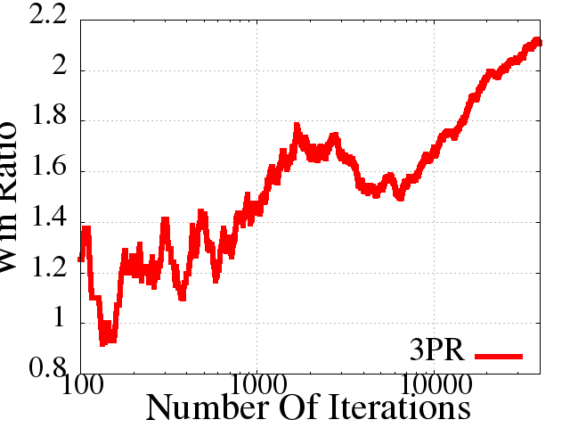
How well does it work?
Repeated arXiv study but now with 3PR
3PR
Cumulative Win Ratio
Baseline
Number of Feedback

Slide 19
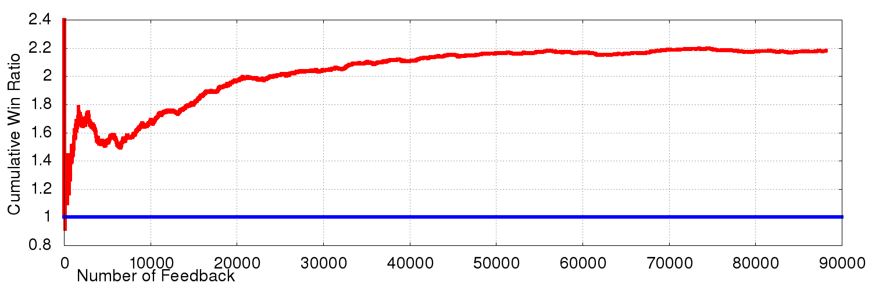
Does This Work?
Running for more than a year
  No manual intervention
[Raman et al., 2013]
3PR
Cumulative Win Ratio
Baseline
Number of Feedback

Slide 20
Agenda For This Talk
Designing algorithms, for interactive learning with users, that are applicable in practice and have theoretical guarantees.
Outline:
  Handling weak, noisy and biased user feedback (Coactive Learning)
  Predicting complex structures: Modeling dependence across items/documents (Diversity) [RSJ KDD’12].

Slide 21

Intrinsically Diverse User
Economy
Sports
Technology

Slide 22
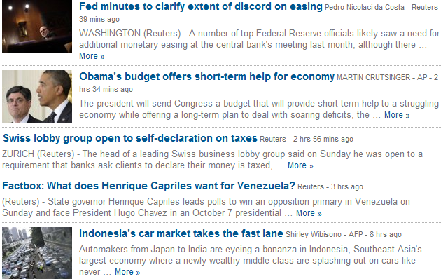
Challenge: Redundancy
Economy
Sports
Tech
Nothing about sports or tech.
Lack of diversity leads to some interests of the user being ignored.

Slide 23
Previous Work
Extrinsic Diversity:
  Non-learning approaches:
    MMR (Carbonell et al SIGIR ‘98), Less is More (Chen et al. SIGIR ‘06)
  Learning approaches: SVM-Div (Yue, Joachims ICML ‘08)
    Require relevance labels for all user-document pairs
  Ranked Bandits (Radlinski et al. ICML’08):
    Use online learning: Array of (decoupled) Multi-Armed bandits.
    Learns very slowly in practice.
  Slivkins et al. JMLR ‘13
    Couples arms together.
    Does not generalize across queries.
    Hard coded-notion of diversity. Cannot be adjusted.
Linear Submodular Bandits (Yue et. al. NIPS’12)
  Generalizes across queries.
  Requires cardinal utilities.

Slide 24
Modeling Dependencies Using Submodular functions
KEY: For a given query and word, the marginal benefit of additional documents diminishes.
E.g.: Coverage Function
Use greedy algorithm:
  At each iteration:
    Choose Document that Maximizes Marginal Benefit
Simple and efficient
Constant Factor approximation
D₄
D₁
D₃
D₂

Slide 25
Predicting Diverse Rankings
Ranking | _{economy} | _{usa} | _{soccer} | _{technology}
d₁ | economy:3, usa:4, finance:2 ..
d₂ | usa:3, soccer:2,world cup:2..
d₃ | usa:4, politics:3, economy:2 …
d₄ | gadgets:2, technology:4, ipod:2..
Word | Weight
economy | 1.5
usa | 1.2
soccer | 1.6
technology | 1.1
Diversity-Seeking User:

Slide 26
Predicting Diverse Rankings: Max(x)
Ranking | _{economy} | _{usa} | _{soccer} | _{technology}
d₁ | economy:3, usa:4, finance:2 ..
d₂ | usa:3, soccer:2,world cup:2..
d₃ | usa:4, politics:3, economy:2 …
d₄ | gadgets:2, technology:4, ipod:2..
Word | Weight
economy | 1.5
usa | 1.2
soccer | 1.6
technology | 1.5
Doc. | _{Marginal Benefit}
d₁ | _{9.3}
d₂ | _{6.8}
d₃ | _{7.8}
d₄ | _{6.0}

Slide 27
Predicting Diverse Rankings
Ranking | _{economy} | _{usa} | _{soccer} | _{technology}
d₁ | ₃ | ₄ | ₀ | ₀
MAX of Column | ₃ | ₄ | ₀ | ₀
d₁ | economy:3, usa:4, finance:2 ..
d₂ | usa:3, soccer:2,world cup:2..
d₃ | usa:4, politics:3, economy:2 …
d₄ | gadgets:2, technology:4, ipod:2..
Word | Weight
economy | 1.5
usa | 1.2
soccer | 1.6
technology | 1.5
Doc. | _{Marginal Benefit}
d₁ | _{9.3}
d₂ | _{6.8}
d₃ | _{7.8}
d₄ | _{6.0}

Slide 28
Predicting Diverse Rankings
Ranking | _{economy} | _{usa} | _{soccer} | _{technology}
d₁ | ₃ | ₄ | ₀ | ₀
MAX of Column | ₃ | ₄ | ₀ | ₀
d₁ | economy:3, usa:4, finance:2 ..
d₂ | usa:3, soccer:2,world cup:2..
d₃ | usa:4, politics:3, economy:2 …
d₄ | gadgets:2, technology:4, ipod:2..
Word | Weight
economy | 1.5
usa | 1.2
soccer | 1.6
technology | 1.5
Doc. | _{Marginal Benefit}
d₁ | _{0.0}
d₂ | _{3.2}
d₃ | _{0.0}
d₄ | _{6.0}

Slide 29
Predicting Diverse Rankings
Ranking | _{economy} | _{usa} | _{soccer} | _{technology}
d₁ | ₃ | ₄ | ₀ | ₀
d₄ | ₀ | ₀ | ₀ | ₄
MAX of Column | ₃ | ₄ | ₀ | ₄
d₁ | economy:3, usa:4, finance:2 ..
d₂ | usa:3, soccer:2,world cup:2..
d₃ | usa:4, politics:3, economy:2 …
d₄ | gadgets:2, technology:4, ipod:2..
Word | Weight
economy | 1.5
usa | 1.2
soccer | 1.6
technology | 1.5
Doc. | _{Marginal Benefit}
d₁ | _{0.0}
d₂ | _{3.2}
d₃ | _{0.0}
d₄ | _{6.0}

Slide 30
Predicting Diverse Rankings
Ranking | _{economy} | _{usa} | _{soccer} | _{technology}
d₁ | ₃ | ₄ | ₀ | ₀
d₄ | ₀ | ₀ | ₀ | ₄
d₂ | ₀ | ₃ | ₂ | ₄
MAX of Column | ₃ | ₄ | ₂ | ₄
d₁ | economy:3, usa:4, finance:2 ..
d₂ | usa:3, soccer:2,world cup:2..
d₃ | usa:4, politics:3, economy:2 …
d₄ | gadgets:2, technology:4, ipod:2..
Word | Weight
economy | 1.5
usa | 1.2
soccer | 1.6
technology | 1.5
Can also use other submodular functions which are less stringent for penalizing redundancy
e.g. log(), sqrt() ..
Doc. | _{Marginal Benefit}
d₁ | _{0.0}
d₂ | _{3.2}
d₃ | _{0.0}
d₄ | _{0.0}

Slide 31



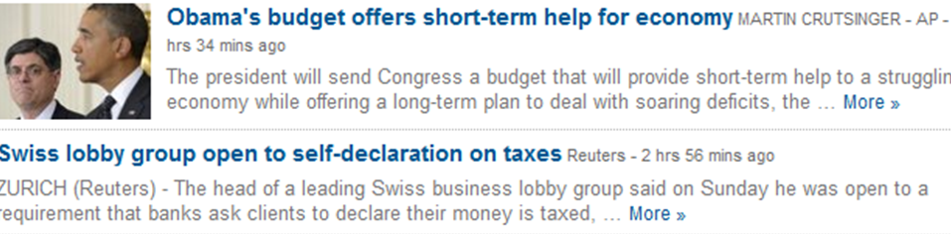
Diversifying Perceptron
Presented Ranking (y)
Improved Ranking (y’)
Click!
Initialize weight vector w.
Get context x and find best y (as per current w):
  Using greedy algorithm to make prediction.
Observe user implicit feedback and construct feedback object.
Perceptron update to w :
  w += Φ( Feedback) - Φ( Presented)
5. Clip weights to ensure non-negativity.
Click!

Slide 32
Diversifying Perceptron
Under same feedback characterization, can bound regret w.r.t. optimal solution:
Term due to greedy approximation

Slide 33
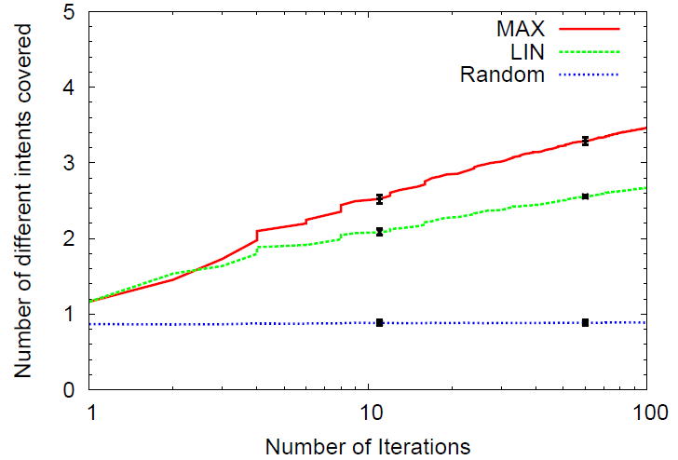
Can we Learn to Diversify?
Submodularity helps cover more intents.

Slide 34
Other results
Robust and efficient:
  Robust to noise and weakly informative feedback.
  Robust to model misspecification.
Achieves the performance of supervised learning:
  Despite not being provided the true labels and receiving only partial feedback.

Slide 35
Other Applications of
Coactive Learning

Slide 36
Extrinsic Diversity: Predicting Socially Beneficial Rankings
Social Perceptron Algorithms.
Improved convergence rates for single query diversification over state-of-the-art.
First algorithm for (extrinsic) diversification across queries using human interaction data.
[RJ ECML ‘14]

Slide 37
Robotics: Trajectory Planning
Learn good trajectories for manipulation tasks on-the-fly.
[Jain et. al. NIPS ‘13]

Slide 38
Future Directions

Slide 39
Personalized Education
Lot of student interactions in MOOCs:
  Lectures and Material
  Forum participation
  Peer Grading [RJ KDD ‘14. LAS ‘15]
  Question-Answering and Practicing Tests
Goal: Maximize student learning of concepts
Challenge:
  Test on concepts students have difficulties with.
  Keeping students engaged (motivated).

Slide 40
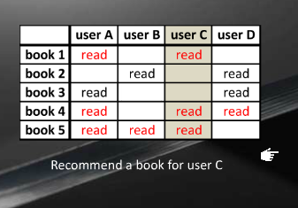
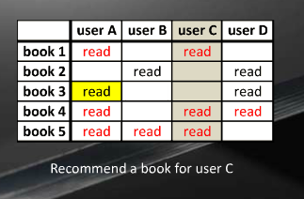
Recommender Systems
Collaborative filtering/matrix factorization.
Challenges:
  Learn from observed user actions: Biased preferences vs. cardinal utilities.
  Bilinear utility models for leveraging feedback to help other users as well.

Slide 41
Short-Term Personalization
This talk: Mostly about Long-Term Personalization.
Can also personalize based on shorter-term context.
Complex search tasks: Require multiple user searches.
Example: Query like remodeling ideas often followed by queries like “cost of typical remodel” “kitchen remodel” “paint colors” etc..
[RBCT SIGIR ‘13]
Challenge: Less signal to learn from.

Slide 42
Summary
Designing algorithms for interactive learning with users that work well in practice and have theoretical guarantees.
Studied how to:
  Work with noisy, biased feedback.
  Modeling item dependencies and learning complex structures
Robustness to noise, biases and model misspecification.
Efficient algorithms that learn fast.
End-to-end live evaluation.
Theoretical analysis of algorithms (helps debugging)!

Slide 43
Thank you!
Questions?

Slide 44
References
A. Slivkins, F. Radlinski, and S. Gollapudi. Ranked bandits in metric spaces: learning optimally diverse rankings over large document collections. JMLR, 2013.
Y. Yue and C. Guestrin. Linear submodular bandits and their application to diversied retrieval. NIPS, 2012.
F. Radlinski, R. Kleinberg, and T. Joachims. Learning diverse rankings with multi-armed bandits. ICML, 2008.
P. Shivaswamy and T. Joachims. Online structured prediction via coactive learning. ICML, 2012.

Slide 45
References (Contd.)
T. Joachims, L. Granka, Bing Pan, H. Hembrooke, F. Radlinski, G. Gay. Evaluating the Accuracy of Implicit Feedback from Clicks and Query Reformulations in Web Search. ACM TOIS, 2007.
Y. Yue and T. Joachims. Predicting Diverse Subsets Using Structural SVMs. ICML, 2008.
J. Carbonell and J. Goldstein. The use of MMR, diversity-based reranking for reordering documents and reproducing summaries. SIGIR, 1998.
H. Chen and D. Karger. Less is more: Probabilistic models for retrieving fewer relevant documents. SIGIR, 2006.

Slide 46
References (Contd.)
Karthik Raman, Pannaga Shivaswamy and Thorsten Joachims. Online Learning to Diversify from Implicit Feedback. KDD 2012
Karthik Raman, Thorsten Joachims, Pannaga Shivaswamy and Tobias Schabel. Stable Coactive Learning via Perturbation. ICML 2013
Karthik Raman, Thorsten Joachims. Learning Socially Optimal Information Systems from Egoistic Users. ECML 2013

Slide 47
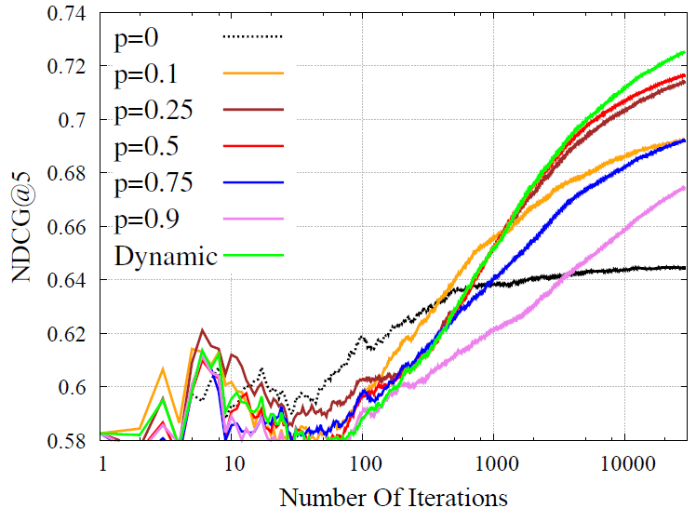
Effect of Swap Probability
Robust to change in swap.
Even some swapping helps.
Dynamic strategy performs best.

Slide 48
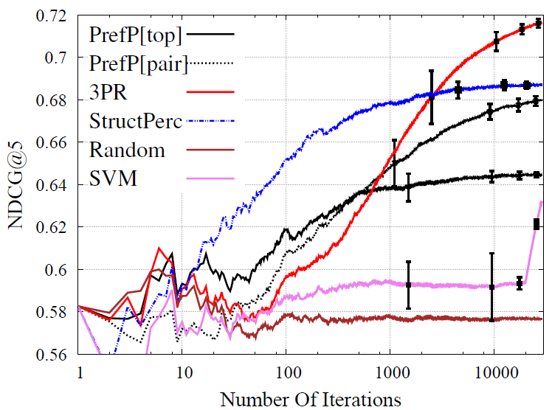
Benchmark Results
On Yahoo! search dataset.
PrefP[pair] is 3PR w/o perturbation
Performs well.

Slide 49
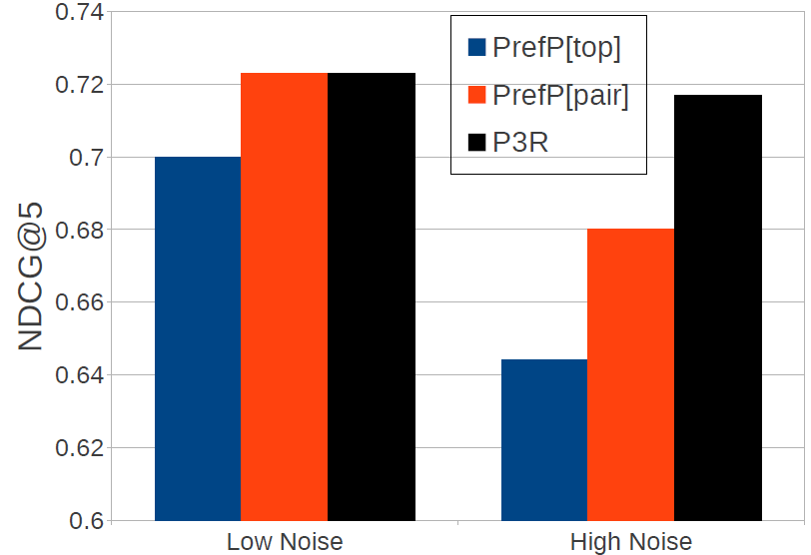
Effect of Noise
Robust to noise:
  Minimal change in performance
Other algorithms: more sensitive.

Slide 50
Effect Of Perturbation
Perturbation only has a small effect even for fixed p (p=0.5)

Slide 51
Stability on ArXiv
Few common results in the top 10 after 100 learning iterations.

Slide 52
General Proof Technique
Bound the 2-norm of the weight vector (w_{T}).
Relate the inner product of w* and w_{T} to regret:
  Use the feedback characterization

Slide 53
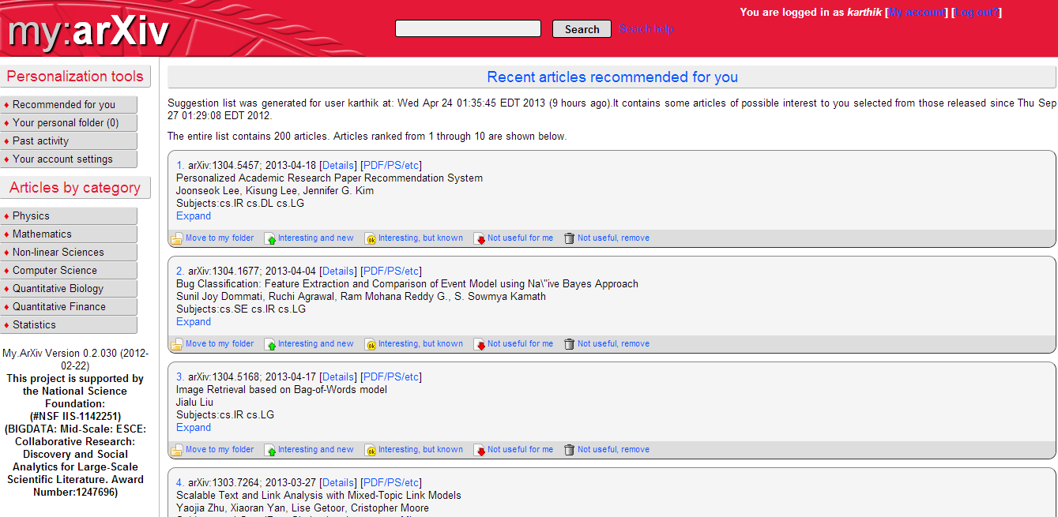
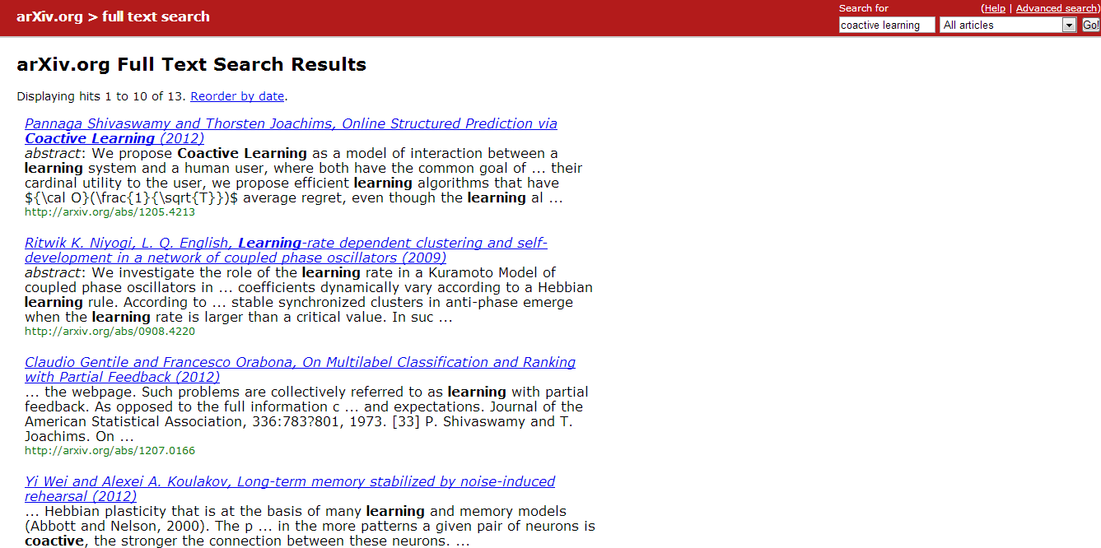
Coactive Learning in real systems

Slide 54
Feature Aggregation
Ranking | _{economy} | _{usa} | _{soccer} | _{technology}
d₁ | ₃ | ₄ | ₀ | ₀
d₄ | ₀ | ₀ | ₀ | ₄
d₂ | ₀ | ₃ | ₂ | ₄
MAX of Column | ₃ | ₄ | ₂ | ₄
SQRT of Col. sum | _{1.73} | _{2.65} | _{1.41} | _{2.82}
Column sum | ₃ | ₇ | ₂ | ₈
d₁ | economy:3, usa:4, finance:2 ..
d₂ | usa:3, soccer:2,world cup:2..
d₃ | usa:4, politics:3, economy:2 …
d₄ | gadgets:2, technology:4, ipod:2..
Word | MAX Weight | SQRT | COLSUM
economy | 1.5 | 3.7 | 0.5
usa | 1.2 | 4.8 | 2.3
soccer | 1.6 | 3.2 | 4.1
technology | 1.5 | 4.9 | 0.4
Can combine different submodular functions.

Slide 55
General Submodular Utility (CIKM’11)
Given ranking θ = (d₁, d₂,…. d_{k}) and concave function g

Slide 56
Use Implicit Feedback
Presented Ranking (y)
Improved Ranking (y’)
Click!
Click!
Click!

Slide 57
Robustness to model mismatch
Works even if modeling function and user function mismatch.

Slide 58
Effect of Feedback Quality

Slide 59
Effect of Feedback Noise

Slide 60
Comparison To Supervised

Slide 61

Bandits For Ranking
Top-K bandits problem:
  Each iteration play K distinct arms.
Probabilistic Feedback:
  MAB assumes that feedback will be received every round.
  If feedback is not assured each round:
    If no feedback, then better to exploit.
Key Ideas:
  Need dynamic “explore-exploit” tradeoff:
    Incorporate uncertainty of receiving feedback.

