Slide 1
General-Purpose Computation on GPU (GPGPU) using CUDA
CS 5520 (Guest Lecture), Fall 2014

Slide 2
Outline
Part I: Background on GPGPU
Part II: CUDA Basics
Part III: More on CUDA

Slide 3
Prerequisites
You need some experience with C/C++ (mostly C)
You do NOT need GPU/3D graphics background

Slide 4
Background on GPGPU
Part I

Slide 5
Moore’s Law is at Risk
Moore’s Law
Prediction made by Gordon Moore in 1965
Computing power doubles approximately every two years
Its Limit
Size of transistors (at atomic level)
Heat (cannot pack too tightly!)

Slide 6
Solution: Multi-Core
Idea
Splitting computation tasks into multiple (even many) cores
Hardware Implementations
Multi-Core CPU
Multiple CPUs
Clusters
GPU

Slide 7
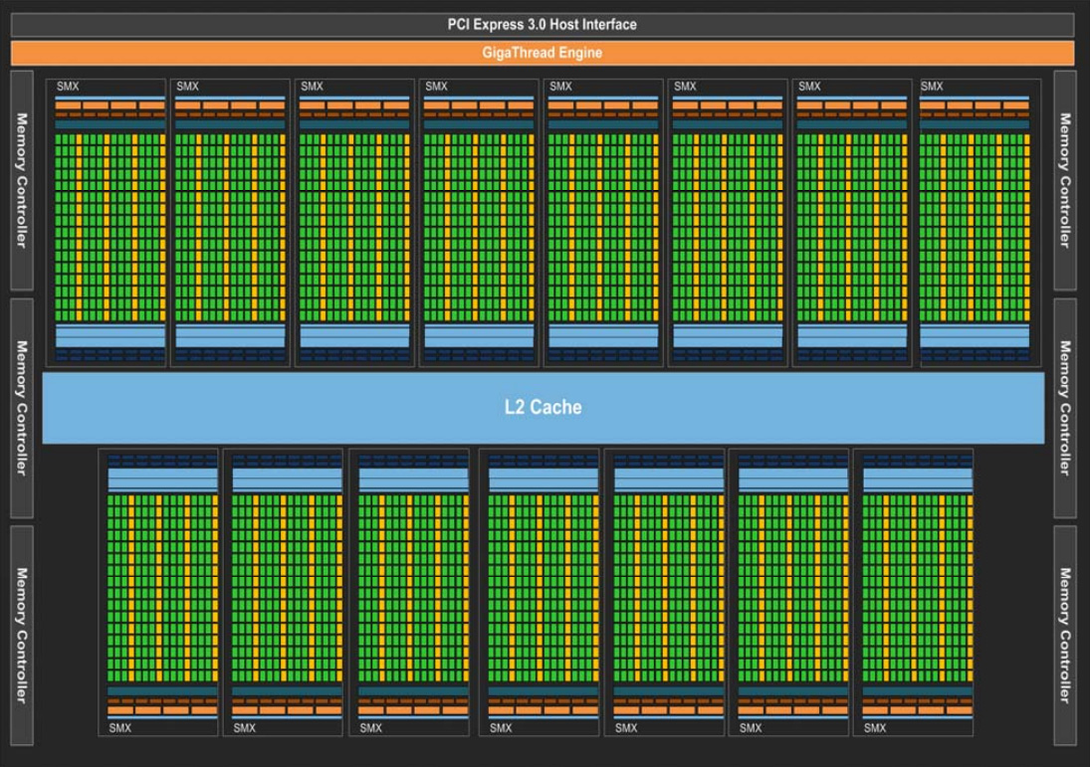
GPU Architecture
nVIDIA Kepler GK110 block diagram

Slide 8

Mythbusters Demo GPU versus CPU (by nVIDIA)

Slide 9
Is GPU really that much faster?
Probably not…
See “On the Limits of GPU Acceleration” by Vuduc et al. https://www.usenix.org/legacy/event/hotpar10/tech/full_papers/Vuduc.pdf
Bottom line:
GPU is still faster (but probably not for 100X)
Well-tuned CPU implementation can have competitive performance

Slide 10
A Brief History on GPU Computing
Graphics Processing Unit
Initially designed for 3D computer graphics
Takes lighting/shading configuration, object geometry/texture
Computes pixel colors
Standard Pipeline
Standardized shading (limited choices on lighting/material settings)
Programmable Pipeline
Customized (procedural) shading using shaders
General-Purpose GPU computing (GPGPU)

Slide 11
GPGPU (Old Model)
Exploit the programmable pipeline
Encode inputs and outputs as textures (RGB images)
Shaders perform the actual computations
Problems
Difficult to implement
Need to include extra logic for packing/unpacking data into/from textures
Painful to debug
printf() is not possible, have to read pixel colors!
Limited per-thread output
At most one 3-vector (RGB values for one pixel)

Slide 12
GPGPU (New Model)
Various versions
CUDA (nVIDIA)
OpenCL (open standard)
Others
DirectCompute (MS), Brook+ (Stanford/AMD), …
Benefits
Much easier to program and debug
General memory access
Presence of third party libraries

Slide 13
CUDA Basics
Part II

Slide 14
What is CUDA?
Compute Unified Device Architecture
Developed by nVIDIA
Initial release in 2007
Now in version 5
CUDA Architecture
Expose GPU computing for general purpose
CUDA C/C++
Based on industrial standard C/C++ (gcc, MSVC, etc)
Small set of extensions to enable heterogeneous computing

Slide 15
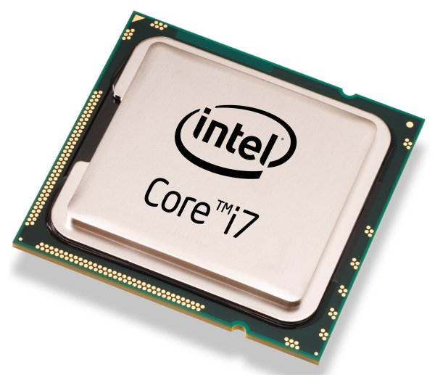
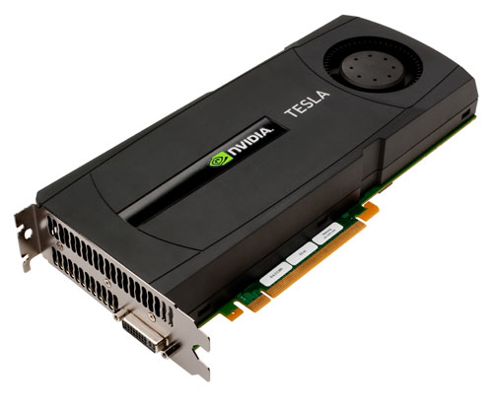
Heterogeneous Computing
Host: the CPU and its memory
Device: the GPU and its memory

Slide 16
CUDA Compiler Driver
Called nvcc
Outputs both CPU (host) and GPU (device) binaries
Device emulation mode
“nvcc -deviceemu”
Run the entire application on CPU
Easy (or easier) debugging

Slide 17
What CUDA code looks like
do_something_on_host();
kernel<<<nBlk, nTid>>>(args);
cudaDeviceSynchronize();
do_something_else_on_host();
…
Highly parallel

Slide 18
Simple Processing Flow
memory_allocation();
copy_input_from_host_to_device();
load_and_execute_gpu_code<<<nBlk, nTid>>>(args);
cudaDeviceSynchronize();
copy_result_from_device_to_host();
memory_cleanup();

Slide 19
Grids, Blocks, and Threads
Kernel function
# Blocks
# Threads (per block)
GPU threads are grouped into equal-sized blocks
Threads in each block can
Communicate via extremely fast on-chip (but small) shared memory
Synchronize with minimal overhead via __syncthreads()
Independent blocks can form grids
load_and_execute_gpu_code<<<nBlk, nTid>>>(args);

Slide 20
CUDA Function Declarations
__global__
Kernel function (must return void)
Invoked from host
Executed in parallel on device
__host__
Called and executed on host
__device__
Called and executed on device
Restrictions: no recursion, no static variables, …

Slide 21
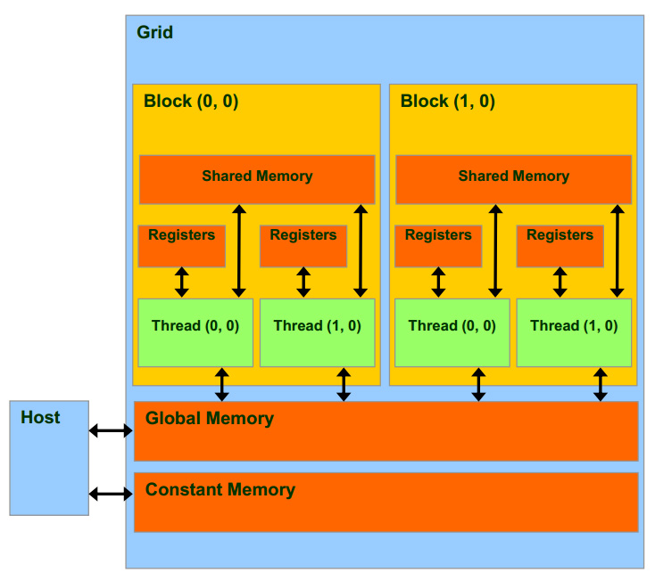
Grids, Blocks, and Threads

Slide 22
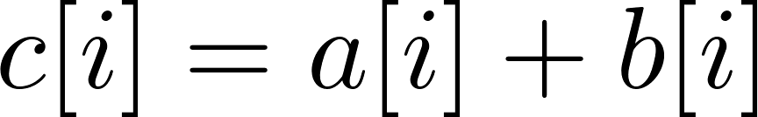
Example 1: Vector Addition
Input: two N-dimensional vectors a, b
Output: the sum c of a and b
0
1
2
N-1
a
……
+
b
……
=
c
……

Slide 23
Vector Addition
#define N 500
__global__
void VecAdd(const float* A, const float* B, float* C, int N) {
int i = blockDim.x * blockIdx.x + threadIdx.x;
if (i < N) C[i] = A[i] + B[i];
}

Slide 24
Vector Addition
void main() {
float *h_A, *h_B, *h_C; // host copies of a, b, c
float *d_A, *d_B, *d_C; // device copies of a, b, c
int size = N * sizeof(float);
// Alloc space for device copies of a, b, c
cudaMalloc((void**)&d_A, size);
cudaMalloc((void**)&d_B, size);
cudaMalloc((void**)&d_C, size);
// Alloc space for host copies of a, b, c and setup input values
h_A = (int*)malloc(size); random_ints(h_A, N);
h_B = (int*)malloc(size); random_ints(h_B, N);
h_C = (int*)malloc(size);

Slide 25
Vector Addition
// Copy inputs to device
cudaMemcpy(d_A, h_A, size, cudaMemcpyHostToDevice);
cudaMemcpy(d_B, h_B, size, cudaMemcpyHostToDevice);
// Launch VecAdd() kernel on GPU
int blocksPerGrid = (N + 255)/256;
VecAdd<<<blocksPerGrid, 256>>>(d_A, d_B, d_C, N);
cudaDeviceSynchronize(); // optional in this case
// Copy result back to host
cudaMemcpy(h_C, d_C, size, cudaMemcpyDeviceToHost);
// Cleanup
free(h_A); free(h_B); free(h_C);
cudaFree(d_A); cudaFree(d_B); cudaFree(d_C);
}

Slide 26
CUDA Memory
Faster, per-block
Fastest, per-thread
Slower, global
Read-only, cached

Slide 27
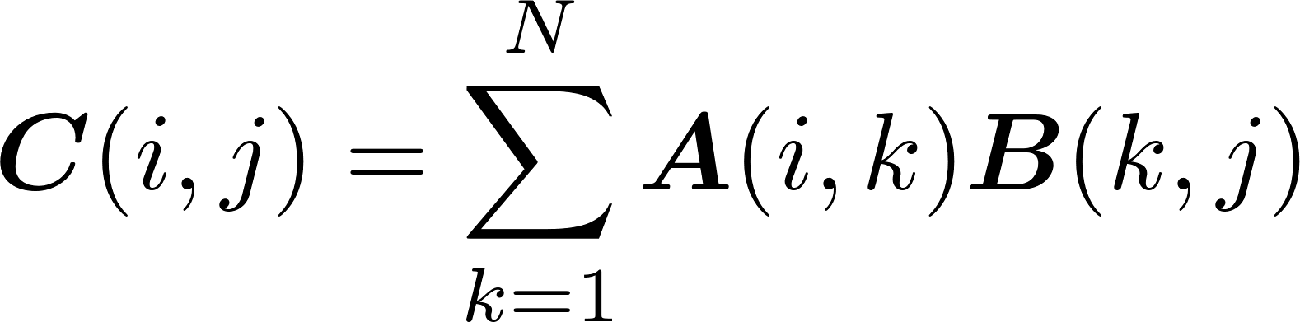
Example 2: Matrix Multiplication
Input: two N-by-N matrices A, B
Output: the product C of A and B

Slide 28
Tiled Matrix Multiplication
Partition matrix C into equal-sized submatrices, or tiles
Each block computes a tile
Each thread computes one element in the tile
TILE_SIZE
C
TILE_SIZE
Blk (1,1)

Slide 29
Tiled Matrix Multiplication: Naïve Version
__global__
void MatrixMult(const float* A, const float* B, float* C, int N) {
int i = blockIdx.y*TILE_WIDTH + threadIdx.y;
int j = blockIdx.x*TILE_WIDTH + threadIdx.x;
if ( i < N && j < N ) {
float Cvalue = 0.0f;
for ( int k = 0; k < N; k++ )
Cvalue += A[i*N + k]*B[k*N + j];
C[i*N + j] = Cvalue;
}
}
Problem: too many global memory access

Slide 30
Tiled Matrix Multiplication
Idea: loading tiles of A, B into shared memory in parallel
B
1
2
3
4
A
C
1
2
3
4
Blk (1,1)

Slide 31
Tiled Matrix Multiplication: Better Version
__global__
void MatrixMult(const float* A, const float* B, float* C, int N) {
__shared__ float As[TILE_WIDTH][TILE_WIDTH];
__shared__ float Bs[TILE_WIDTH][TILE_WIDTH];
int bx = blockIdx.x, by = blockIdx.y;
int tx = threadIdx.x, ty = threadIdx.y;
int i = by*TILE_WIDTH + ty;
int j = bx*TILE_WIDTH + tx;

Slide 32
Tiled Matrix Multiplication: Better Version
if ( i < N && j < N ) {
float Cvalue = 0.0f;
for ( int m = 0; m < N/TILE_WIDTH; m++ ) {
As[ty][tx] = A[i*N + (m*TILE_WIDTH + tx)];
Bs[ty][tx] = B[(m*TILE_WIDTH + ty)*N + j];
__syncthreads();
for ( int k = 0; k < TILE_WIDTH; k++ )
Pvalue += As[ty][k]*Bs[k][tx];
__syncthreads();
}
C[i*N + j] = Cvalue;
}
}

Slide 33
More on CUDA
Part III

Slide 34
Hardware Thread Organization
Threads in a block are partitioned into warps
All threads in a warps execute in a Single Instruction Multiple Data, or SIMD, fashion
All paths of conditional branches will be taken
Warp size varies, many graphics cards have 32
NO guaranteed execution ordering between warps

Slide 35
Branch Divergence
Threads in one warp execute very different branches
Significantly harms the performance!
Solutions:
Reordering the threads so that all threads in each block are more likely to take the same branch
Still an open research topic

Slide 36
Libraries
A handful of third-party CUDA libraries
CUBLAS, CUFFT, CUDA LAPACK, …
CUDA-accelerated libraries

Slide 37
Online Resources
https://developer.nvidia.com/cuda-education-training
http://gpgpu.org/developer

