Slide 1
Making Time-stepped Applications
Tick in the Cloud
Tao Zou, Guozhang Wang, Marcos Vaz Salles*,
David Bindel, Alan Demers,
Johannes Gehrke, Walker White
Cornell University
*University of Copenhagen (DIKU)

Slide 2







Time-Stepped Applications
Executed with parallelism organized into logical ticks.
Implemented using Bulk Synchronous Parallel (BSP) Model
Processors
Tick $i+1$
Tick $i$
$$P_{1}$$
$$P_{2}$$
$$P_{3}$$
……
$$P_{n−1}$$
$$P_{n}$$
……
Local
Computation
Communication
Global Barrier
Notes:
First, let me define what time-stepped applications are.
They are parallel applications organized into logical ticks. These applications are usually implemented in bulk synchronous parallel model.
In this model, within one tick, each processor first runs computation locally. Then processors communicate with other processors.
At the end of one tick, a global barrier is used for synchronization. After this barrier, computation steps into the next tick iteratively.

Slide 3



Running Example: Fish Simulation
Tick $i$
$+1$
Behavioral Simulation
  Traffic simulation
  Simulation of groups of animals
Notes:
Let me give you a concrete example of time-stepped applications.
Behavior simulations simulate lots of individuals that interact with each other in complex systems.
Examples of behavior simulations include large scale traffic simulation and simulation of groups of animals.
In this presentation, I’m going to use fish simulation as the running example.
Imagine the rectangle is a fish school and dots are fish in the school.
In one tick, each fish computes its moving direction and moves accordingly. Then the computation goes into the next tick.
We achieve data parallelism by partitioning the spaces into regions. Each processor runs computation for one region and interacts with other processors.

Slide 4
Other Time-Stepped Applications
Iterative Graph Processing
Matrix Computation
Notes:
Iterative graph processing is another example of time-stepped applications.
The large-scale graph data can be partitioned into sub-graphs
using graph partitioning libraries like METIS to achieve data parallelism.
Certain class of matrix computation also falls into the category of time-stepped applications.

Slide 5
Why Run Scientific Applications in the Cloud?
Elasticity
Cost Saving
Instant Availability
Avoid jobs queuing for days
Notes:
The problem of running these time-stepped scientific applications has been well-studied. But now we want to run them in the cloud, for many reasons:
For example, elasticity and cost saving are classic arguments;
More importantly, in traditional batch style cluster, jobs may queue for several days before being executed.
Since the cloud instances are instantly available. It potentially can greatly reduce the time-to-solution for scientific users.

Slide 6
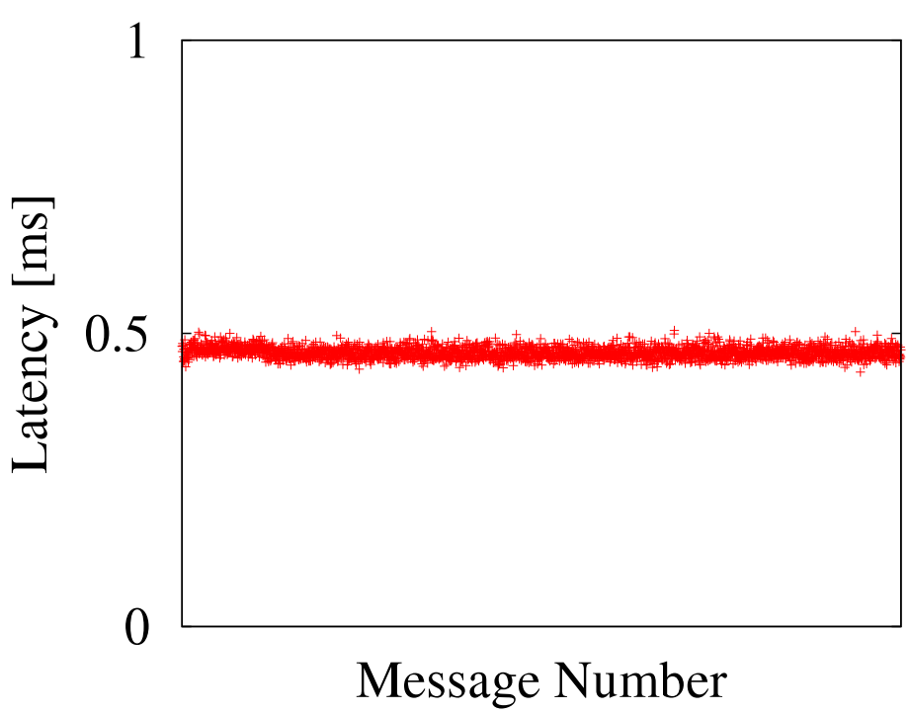
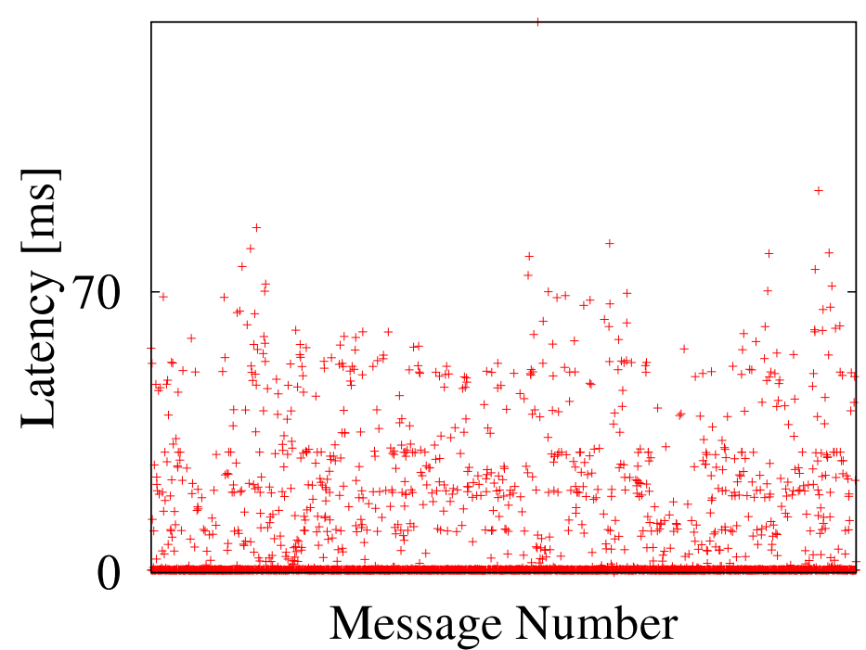
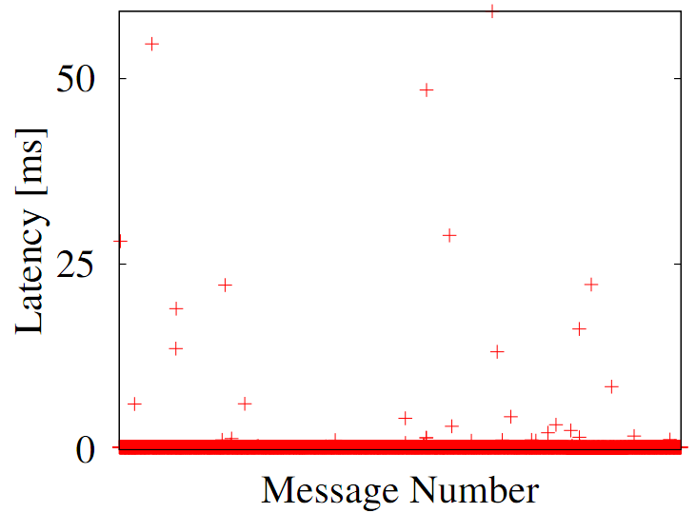
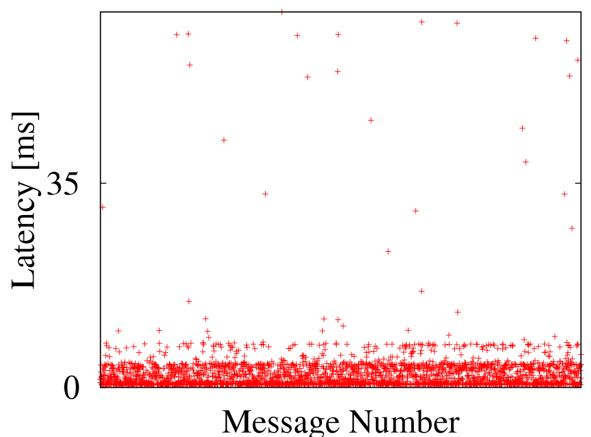
What Does Cloud Infrastructure Imply
→Unstable network latencies
Local Cluster VS
EC2 Large Instance
EC2 Small Instance
EC2 Cluster Instance
Virtualization
Lack of network performance isolation
Notes:
One question to ask here is
can we use cloud in the same way as using local cluster?
Our experience is that they have a key difference in network latencies.
The following figures compare the latencies in local cluster with different types of Amazon EC2 instances.
The x axis is the message number and y axis is the round trip latency between a pair of nodes. Note that the scale of Y axis is not the same for all figures.
The LHS figure shows that the latencies in our local cluster are very stable and have almost no variation.
However, on the right hand side, we observe significant latency jitters in EC2 small instances / as well as large instance/ and even in cluster instances.
There are several reasons for such latency jitter to exist in the cloud.
One possibility is the virtualization layer may delay the message delivery time.
The other reason is the lack of network resource isolation in the public cloud.

Slide 7
Time-Stepped Applications under Latency Jitter
Sensitive to latencies
Remove unnecessary barriers
  Jitter still propagates
Processors
$$P_{1}$$
$$P_{2}$$
$$P_{3}$$
……
$$P_{n−1}$$
$$P_{n}$$
……
Local
Computation
Communication
Barrier
Synchronization
Notes:
Consider running time-stepped applications under such latency jitters.
If the message from processor 1 to processor 2 gets delayed because of latency jitter, the entire synchronization barrier has to be pushed back and therefore this tick takes much longer than expected.
One obvious trick is to replace the global synchronization barrier with local barriers: that is, one processor only needs to wait messages from its communication neighbor to proceed.
However, in this case, processor 2 still finishes this tick later than other processors and this delay will first propagate to neighbors of processor 2 during the next tick, and then its neighbors of neighbors, ultimately the all the processors within the next few ticks.
Therefore, although this trick may help a little bit, it doesn’t fully address the latency jitter problem.

Slide 8
Problem
Time-stepped applications
Unstable latencies
Solution space
  Improve the networking infrastructure
    Recent proposals only tackle bandwidth problems
  Make applications more resistant to unstable latencies

Slide 9
Talk Outline
Motivation
Our Approach
Experimental Results
Conclusions

Slide 10
Why not Ad-Hoc Optimizations?
Disadvantages
  No Generality
    Goal: Applicable to all time-stepped applications
  No Ease of Programming
    Goal: Transparent optimization and communication
  Error-Prone
    Goal: Correctness guarantee
Programming Model + Jitter-tolerant Runtime

Slide 11
Talk Outline
Motivation
Our Approach
  Programming Model
  Jitter-tolerant Runtime
Experimental Results
Conclusions

Slide 12
Data Dependencies: What to Communicate
  Read Dependency
  Example: How far can a fish see?
  Write Dependency
  Example: How far can a fish move?
Key: Modeling Dependencies
Write
Read
Notes:
As we’ve discussed, time-stepped applications are sensitive to latency jitter because processors communicate with other processors frequently.
There are two reasons for them to communicate:
The first reason is the read dependency. In fish simulation, a fish can potentially see some fish in other partition and therefore those processors have to communicate.
The other reason for communication is the write dependency
If a fish moves into another partition, obviously, the two processors have to talk.
Since we want to optimize the communication under latency jitters, the key for the programming model is to model these data dependencies in a general way.

Slide 13
Programming Model
Modeling State
Motivated by thinking of the applications as distributed database system
Application state: Set of tuples
  Fish → tuple
  Fish school → application state
Selection over state: Query
  2D range query over fish school
Notes:
Before modeling data dependencies, we first need to model some more basic concepts.
Motivated by thinking of the application as distributed database system, we first model application state as a set of tuples
For example, in fish simulation, each fish can be represented using a tuple. The fish school which contains a set of fish is its application state.
For parallel computation, we also need to select part of the state. And we use query to represent such selection. In fish simulation, such query could be a 2D range query over fish school. And the result of the query is subset of the entire state.

Slide 14


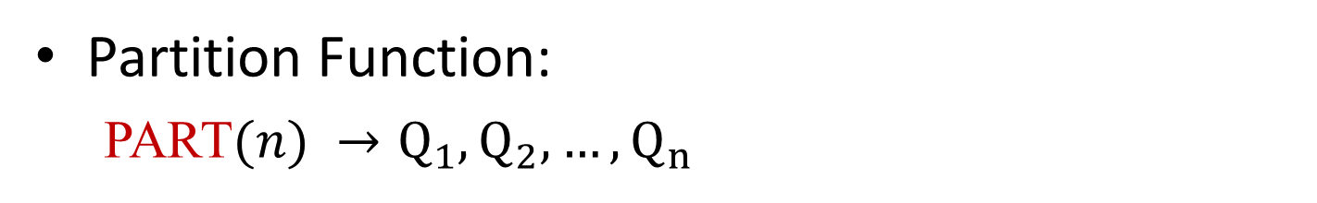







Programming Model
Modeling Data Parallelism
Partition Function:
  PART$(n) →Q_{1}, Q_{2},…,Q_{n}$
$$Q_{1}$$
$$Q_{2}$$
$$Q_{3}$$
$$Q_{4}$$
$$Q_{5}$$
$$Q_{6}$$
$$Q_{7}$$
$$Q_{8}$$
$$Q_{9}$$
Notes:
Next, we need to model data parallelism.
Since we are supporting a wide range of time-stepped applications, the space partitioning cannot be done fully automatically.
We need users’ input to partition the entire space into regions©. Each region can be selected by a query Qi ©and is computed by one processor©.

Slide 15


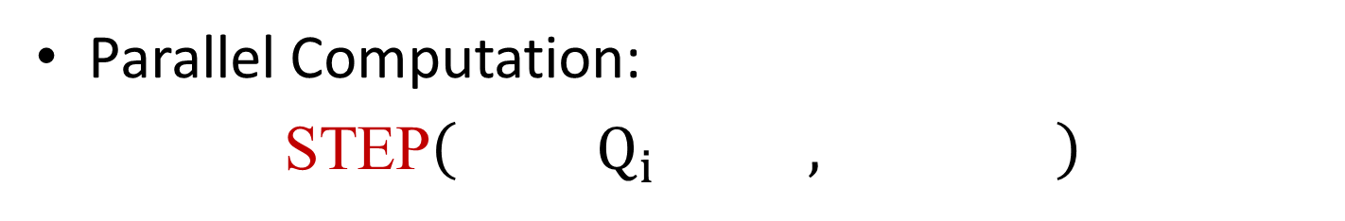









Programming Model
Modeling Computation
Parallel Computation:
STEP$\left({ Q}_{i} , \right)$
$$ToCompute$$
$$Context$$
$$Q_{1}$$
$$Q_{2}$$
$$Q_{3}$$
$$Q_{4}$$
$$Q_{5}$$
$$Q_{6}$$
$$Q_{7}$$
$$Q_{8}$$
$$Q_{9}$$
Context: How large?
Notes:
With the data parallelism, users can define their parallel computation using the following STEP function
This function takes 2 parameters: the first parameter takes a subset of state, which needs to be computed. The second parameter is the context which computation relies on, it is typically larger than the state to be computed.
In the fish case, we need to include every fish falls into the blue region to compute the red region.
One question to ask here is how large the context should be.
It is always safe to use the entire global state as context since we can see everything. However, to minimize the messages being communicated between processors, we expect users to give a reasonable small bound, which they can specify by using read dependency.

Slide 16
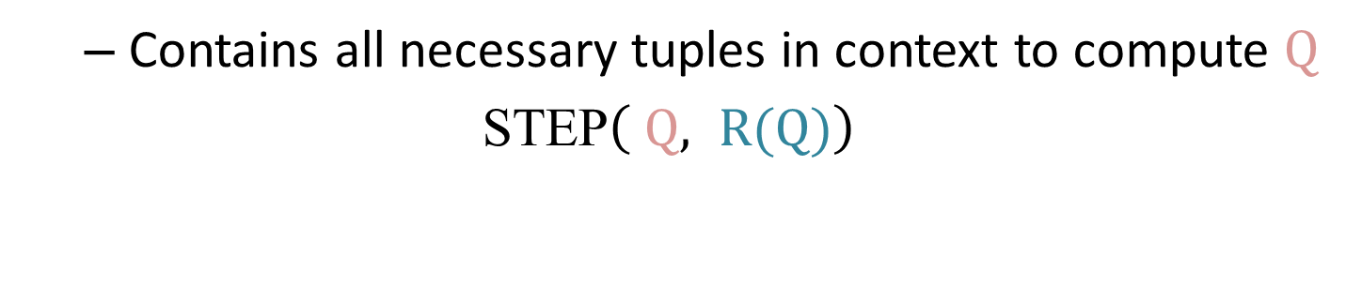



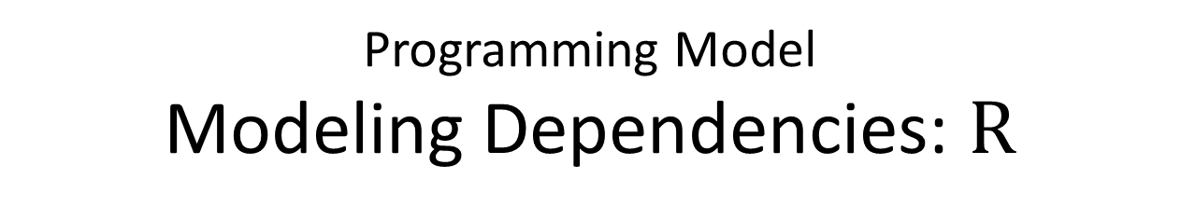
Programming Model
Modeling Dependencies: $R$
Read Dependency: $R(Q)$
$$R(Q)$$
$$Q$$
$$Q$$
  Contains all necessary tuples in context to compute $Q$
  STEP$\left( Q, R(Q)\right)$
Notes:
Read Dependency of the red region Q is a slightly larger blue region.
It contains all necessary tuples in context to compute red region Q.

Slide 17

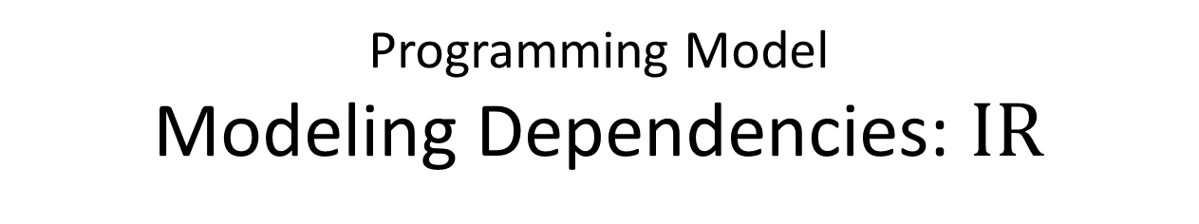



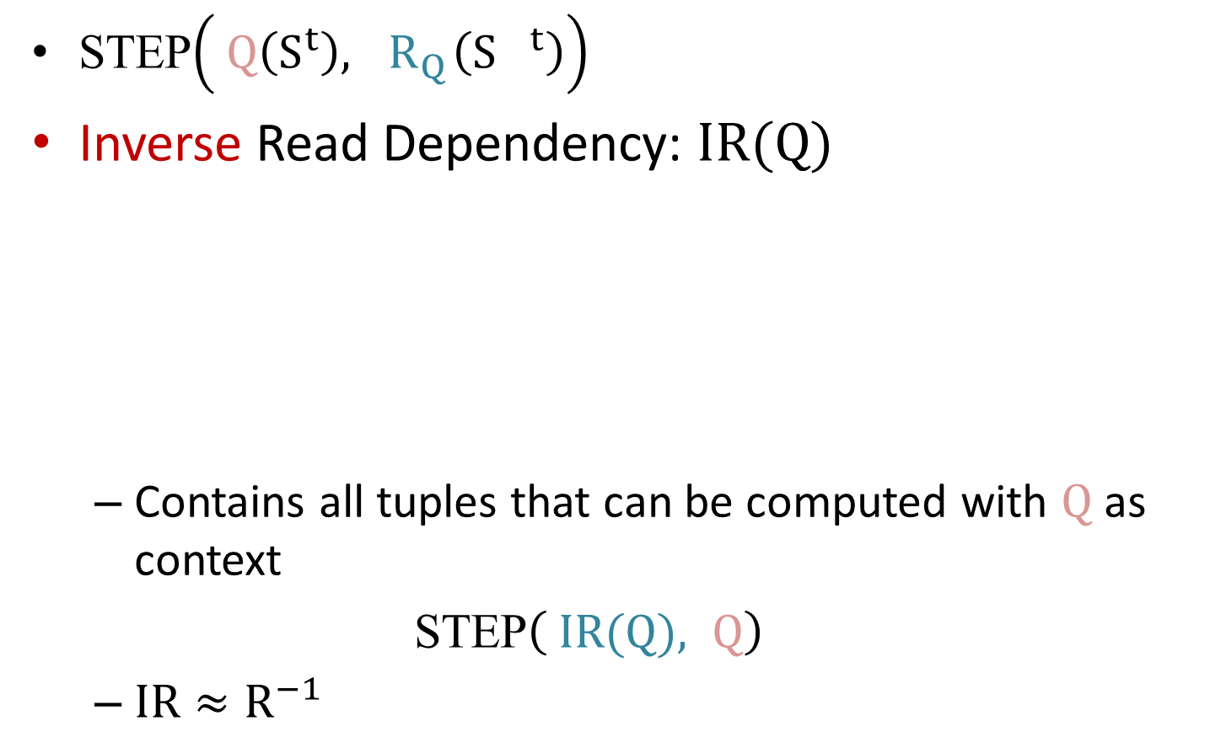
Programming Model
Modeling Dependencies: $IR$
STEP$\left( Q\left(S^{t}\right),{ R}_{Q}\left({S }^{t}\right)\right)$
Inverse Read Dependency: $IR(Q)$
  Contains all tuples that can be computed with $Q$ as context
  STEP$\left( IR(Q), Q\right)$
  $IR≈R^{−1}$
?
$$Q$$
$$R(Q)$$
$$Q$$
$$IR(Q)$$
Notes:
We already know to compute Q, we need its read dependency as context
But if we only have Q as context, what is the largest subset that we can compute.
We define this as inverse read dependency: the smaller blue region contains all tuples can be computed with red region as context.
I’m going to show you in the later part of presentation how such inverse dependency can be used to tolerate latency jitter.

Slide 18
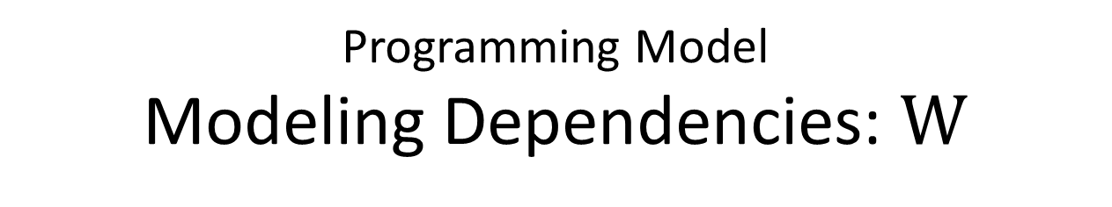




Programming Model
Modeling Dependencies: $W$
Write Dependency: $W(Q)$
  Contains all tuples generated by computing$Q$
$$W(Q)$$
$$Q$$
$$Q$$
Notes:
Next we need to model the write dependency.
The green region, which is the write dependency of Q, contains all the tuples generated by computing Q,
In fish simulation, fish in the red region cannot move further than the green region within one tick.

Slide 19



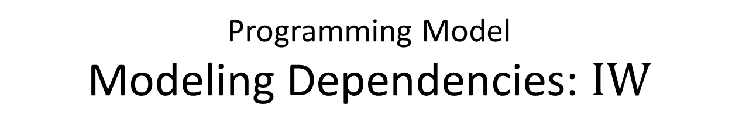
Programming Model
Modeling Dependencies: $IW$
Inverse Write Dependency: $IW(Q)$
  Contains all tuples in the next tick after computing $Q$
  $IW≈W^{−1}$
$$Q$$
$$IW(Q)$$
Notes:
Similar to the inverse read dependency, inverse write dependency is a smaller green region that contains all tuples in the next tick just after computing the red region.

Slide 20
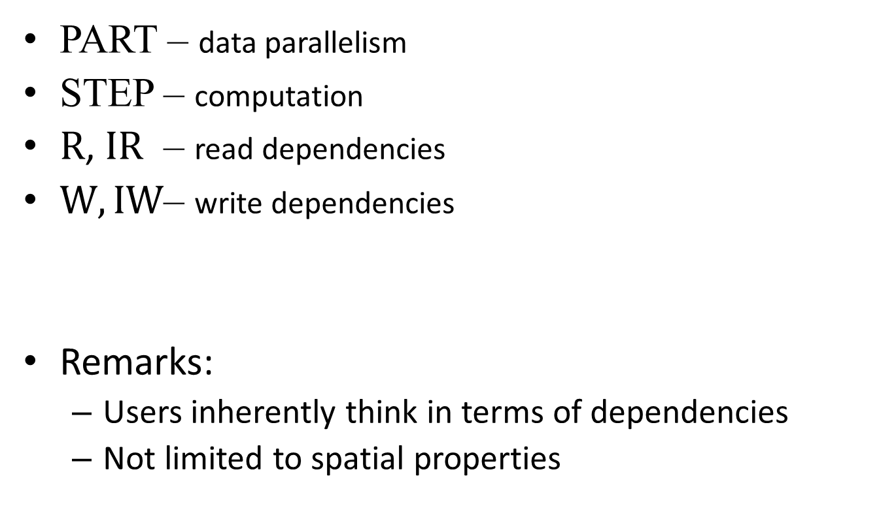

Programming Model: All together
PART – data parallelism
STEP – computation
$R$, $IR$ – read dependencies
$W,IW$– write dependencies
Remarks:
  Users inherently think in terms of dependencies
  Not limited to spatial properties
$$Q$$
$$R(Q)$$
$$IR(Q)$$
PageRank
Notes:
To summarize our programming model, we ask users to implement the following functions,
PART is used to partition the data space
STEP specifies the computation
Read, Inverse Read, Write, Inverse Write, capture the data dependencies.
There are two remarks I want to mention here:
First, we find that users inherently think in terms of dependencies even when they develop their ad-hoc solutions without using our framework. Here what we are really doing is essentially helping users to explicitly formalize these dependencies
Second, such model is not limit to applications’ spatial properties. Iterative Graph Processing is one such example where we are still able to model its dependency, although it’s not spatial.

Slide 21
Talk Outline
Motivation
Our Approach
  Programming Model
  Jitter-tolerant Runtime
Experimental Results
Conclusions

Slide 22
Jitter-tolerant Runtime
Input: Functions defined in programming model
Output: Parallel computation results
Requirement:
Efficiency and Correctness
Notes:
Our jitter-tolerant runtime runs on top of our programming model.
The input are functions defined in programming model
And the output is the parallel computation results.
Our goal is to achieve efficiency by using multiple optimization techniques,
and also ensure correctness by proving the correctness proof of these techniques which I’m not going to show here but is in our paper.

Slide 23

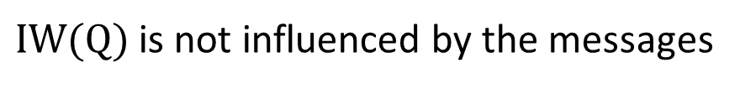












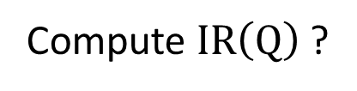

Runtime
Dependency Scheduling
Tick $t$
Compute $Q$
$$Q$$
$$Q$$
Send out updates
$$IW(Q)$$
$$IR(Q)$$
Wait for messages
$$IR∘IW\left(Q\right)$$
All message received
$$IR∘IW\left(Q\right)$$
Tick $t+1$
$${\left(IR∘IW\right)}^{2}$$
$$\left(Q\right)$$
Compute $IR\left(Q\right)$ ?
Compute $IR∘IW\left(Q\right)$
Compute $Q−IR∘IW\left(Q\right)$
Send out updates
……
Tick $t+2$
Compute ${\left(IR∘IW\right)}^{2}\left(Q\right)$
No. Incoming message may contain updates to Q.
……
$IW(Q)$ is not influenced by the messages
Intuition: schedule computation for future ticks when delayed
Notes:
The first optimization technique we use is called dependency scheduling
Let me illustrate this through an example.
During tick t, for a processor gets partition Q, it first runs local computation, sends out updates, and waits for incoming messages.
Suppose one massage from the LHS neighbors gets delayed because of a latency jitter
Now the computation is blocked.
We’ve already specified inverse read dependency, can we compute the blue region for tick t +1, since we’ve already done the computation of the red region and can use it as our context.
Unfortunately this is not correct: because the message from LHS may contain updates to the red region which can further affect the computation result of the blue region.
Remember we also defined Invers Write Dependency. This green region is guaranteed not to be influenced by the message from the LHS. Therefore, we can apply Inver Read Dependency to it to get a smaller subset that is safe to compute now.
We can also apply such idea recursively to calculate the even inner subset which is the dark blue region for tick t +2.
Now when the delayed finally arrives, we just need to compute the remaining red part for tick t+1. Then we are able send out updates faster than starting tick t+1 after receiving all messages.
The intuition of this technique is that we can schedule computation for future ticks during the message delay and the entire computation can catch up more quickly after the delay. Here we see it can be done recursively and it’s provable correct by our dependency model.

Slide 24



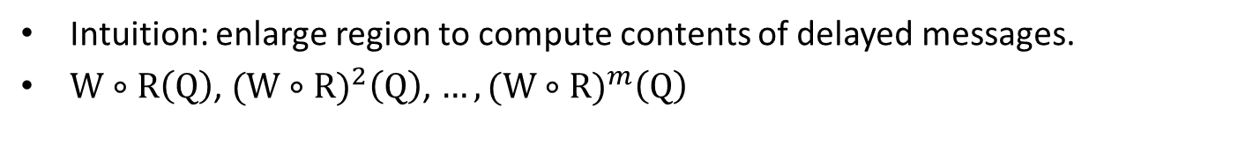



Runtime
Computational Replication
Tick $t$
$$Q$$
Compute $Q$
$$W∘R(Q)$$
Send out updates
$$Q$$
Wait for messages
Compute $W∘R(Q)−Q$
Tick $t+1$
Compute $Q$
……
Intuition: enlarge region to compute contents of delayed messages.
$W∘R\left(Q\right)$, ${(W∘R)}^{2}\left(Q\right)$, $…,{(W∘R)}^{m}\left(Q\right)$
Notes:
The other technique is called computational replication.
Let me also illustrate this through a brief example.
A processor now not only gets its red region Q, but also an enlarged green region.
During tick t, a processor first runs local computation, sends out updates, and waits for incoming messages. Again, one massage from the LHS neighbors gets delayed.
Now instead of blocking waiting, we can use the green ring to compute the incoming message,
And therefore the computation of the tick t+1 can be unblocked. And so on
When the delayed message finally arrives, we simply ignore it.
The intuition of this optimization is also simple: we enlarge the computation region such that when message delayed, we can compute the message.
Similarly, such idea can be applied recursively. And we can even use it to communicate less often, like “ghost cells” from HPC community.

Slide 25
Our Approach: Summary
Programming model captures
  Application state
  Computation logic
  Data dependencies
Jitter-tolerant runtime
  Dependency scheduling
  Computational replication

Slide 26
Talk Outline
Motivation
Our Approach
  Programming Model
  Jitter-tolerant Runtime
Experimental Results
Conclusions

Slide 27
Experimental Setup
A prototype framework
  Jitter-tolerant runtime
    MPI for communication
  Three different applications
    A ﬁsh school behavioral simulation
    A linear solver using the Jacobi method
    A message-passing algorithm computes PageRank
Hardware Setup
  Up to 100 EC2 large instances (m1.large)
    2.26GHz Xeon cores with 6MB cache
    7.5GB main memory
Notes:
We implemented our prototype system and use MPI as the communication primitive.
We also implemented three different applications using our programming model: one fish simulation, one linear solver, and a PageRank computation
Here, we show the experimental results in EC2 using up to 100 large instances.

Slide 28
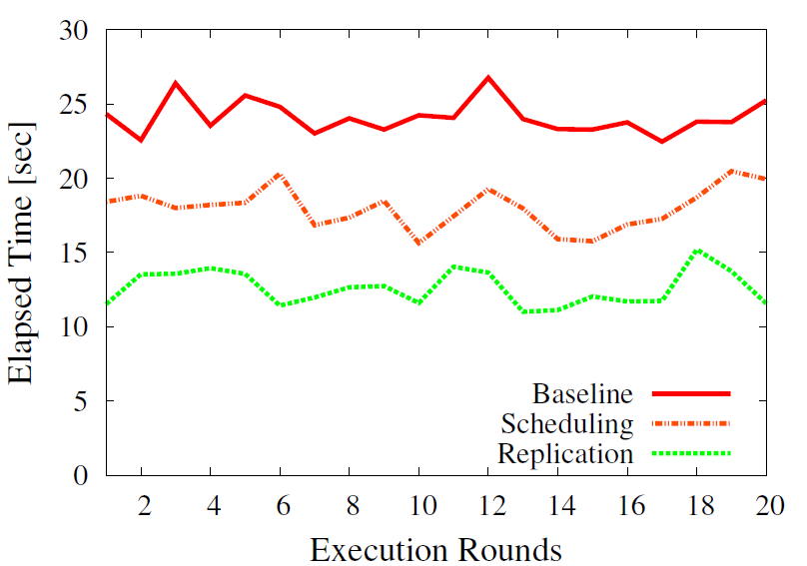
Methodology
Observation: Temporal variation in network performance
Solution
  Execute all settings in rounds of fixed order
  At least 20 consecutive executions of these rounds
Notes:
One other observation we have about Amazon EC2 network is that, even without considering latency jitter, the mean of overall network performance also changes over time.
This figure shows when we run our runtime with different settings in consecutive rounds. The absolute value for each setting has variances, however we can see the relative order is stable.
Therefore, we carefully designed our experiments so that one execution of each settings takes less than one minute. We have observed this is less than the time for network to have large changes in overall performance. At the same time, we are able to make sure each execution contains at least 500 ticks.

Slide 29
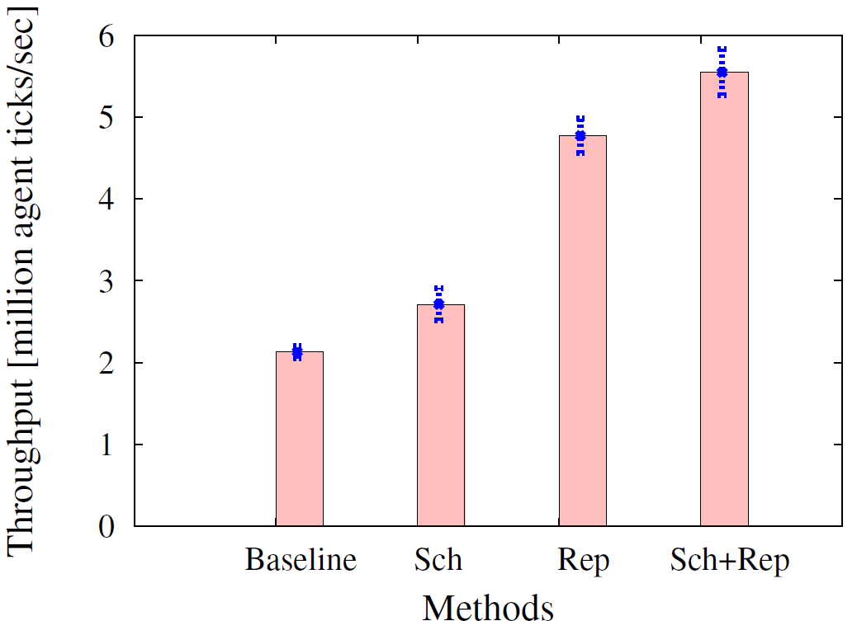
Effect of Optimization: Fish Sim
Baseline: Local Synchronization; Sch: Dependency Scheduling; Rep: Computational Replication

Slide 30
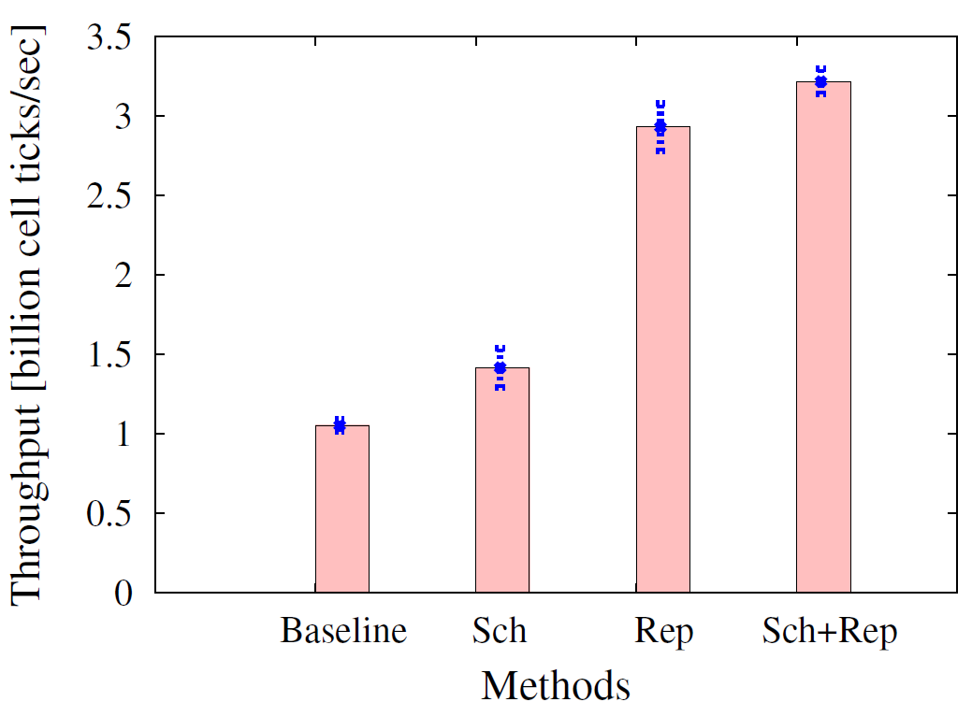
Effect of Optimization: Jacobi
Baseline: Local Synchronization; Sch: Dependency Scheduling; Rep: Computational Replication

Slide 31
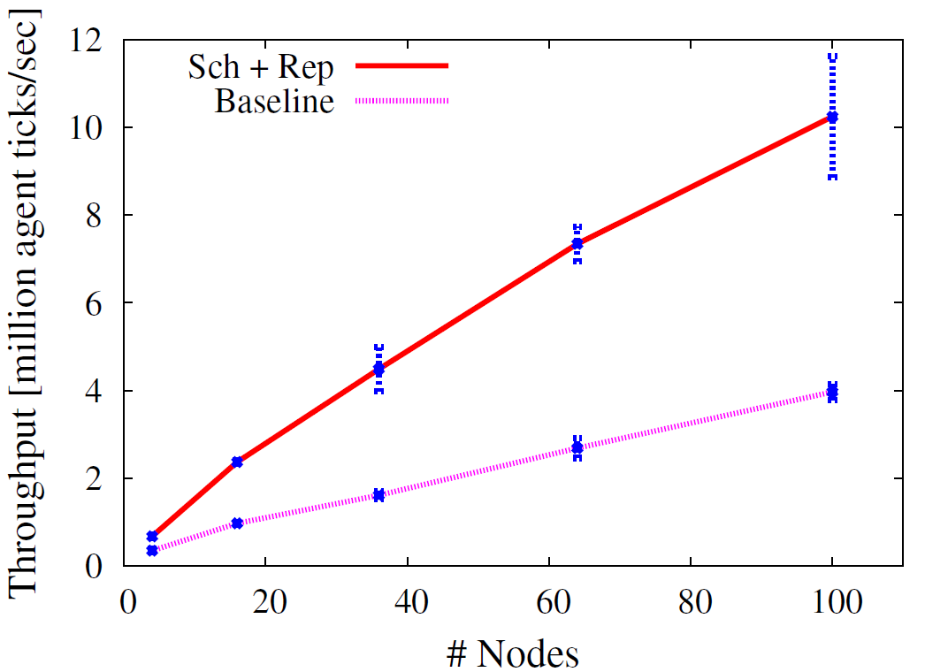
Scalability: Fish Simulation
Baseline: Local Synchronization; Sch: Dependency Scheduling; Rep: Computational Replication
Notes:
We measure the scalability of our runtime by varying the number of instances from 4 to 100 while keeping the average workload of each instance constant.
Our best combination of techniques can achieve much better scalability than the baseline.

Slide 32
Conclusions
Thank you!
Questions?
Latency jitter is a key characteristic of today’s cloud environments.
Programming model + jitter-tolerant runtime
  Good performance under latency jitter
  Ease of programming
  Correctness
We have released our framework as a public Amazon AMI: http://www.cs.cornell.edu/bigreddata/games/.
Our framework will be used this fall in CS 5220 (Applications of Parallel Computers) at Cornell.

