Slide 1

ONION ROUTING
CENSORSHIP RESISTANCE
Vitaly Shmatikov

Slide 2


Privacy on Public Networks
Internet is designed as a public network, routing information is public
  IP packet headers identify source and destination
End-to-end encryption hides payload but does not hide metadata
  Who is talking to whom
  When communication is taking place
  Size of messages
Interception gear
Other major backbone
AT&T network

Slide 3

We kill people based on metadata
Michael Hayden
Former Director,
National Security Agency

Slide 4
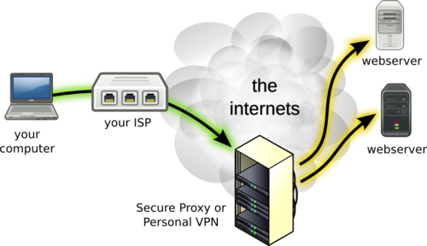
VPN?

Slide 5
VPN Technical Issues
VPNs generally not designed for anonymity
  Typical application: work remotely, connect to corporate network
Even a single leaked DNS request or TCP SYN can identify user
Can’t use the same browser for both anonymous and non-anonymous browsing
  Example: shared cookies
Browser fingerprinting can uniquely identify user

Slide 6

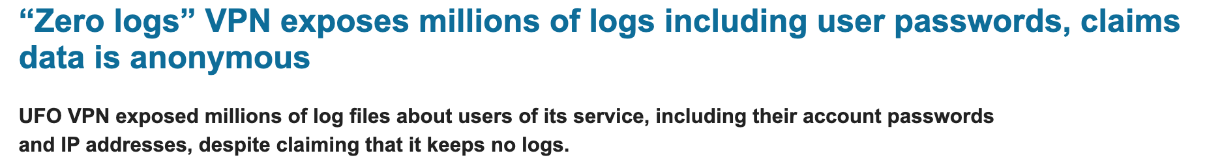


VPN Non-Technical Issues
Must trust the VPN completely
Single point of failure with full visibility into your metadata (and content, unless using E2EE with the destination)

Slide 7
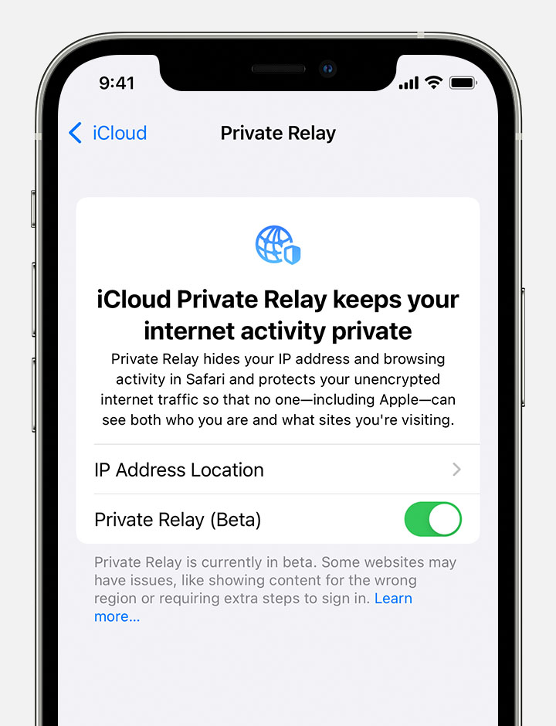
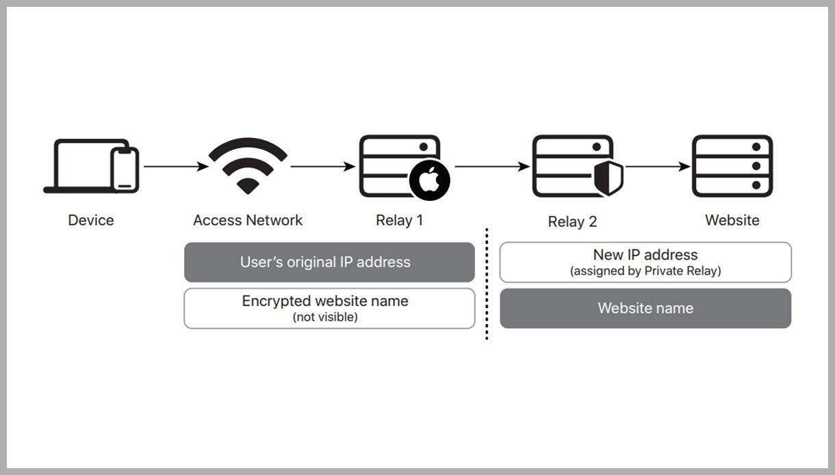
iCloud+ Private Relay
Safari on mobile
Apps (only unencrypted)
run by
Apple
run by a CDN
IP addresses assigned by second relay are rotated over time
DNS lookups use Oblivious DNS over HTTPS
Unlike VPN, cannot change country and time zone

Slide 8
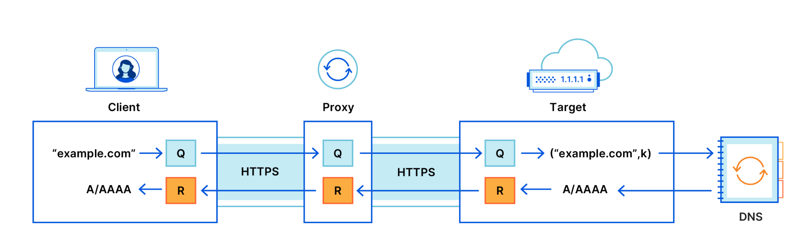
Oblivious DNS over HTTPS
Answers DNS queries but does not see who asked them
Chooses proxy and target
Does not see DNS queries or answers, only forwards them
https://blog.cloudflare.com/oblivious-dns/

Slide 9

Chaum’s Mix
Early proposal for anonymous email
  David Chaum. “Untraceable electronic mail, return addresses, and digital pseudonyms”. Communications of the ACM, February 1981.
Public-key crypto + trusted re-mailer (Mix)
  Untrusted communication medium
  Public keys used as persistent pseudonyms
Modern anonymity systems use Mix as the basic building block

Slide 10
Basic Mix Design
B
{r₁,{r₀,M}_{pk(B)},B}_{pk(mix)}
{r₀,M}_{pk(B)},B
A
{r₅,M’’}_{pk(B)},B
C
E
{r₂,{r₃,M’}_{pk(E)},E}_{pk(mix)}
{r₃,M’}_{pk(E)},E
D
Mix
Adversary knows all senders and
all receivers, but cannot link a sent
message with a received message
{r₄,{r₅,M’’}_{pk(B)},B}_{pk(mix)}

Slide 11
Mix Cascades and Mixnets
Messages are sent through a sequence of mixes
  Can also form an arbitrary network of mixes ("mixnet”)
Some of the mixes may be controlled by attacker, but even a single good mix ensures anonymity
Pad and buffer traffic to foil correlation attacks
Problem:
high latency ☹

Slide 12


Second-generation onion routing network
  http://tor.eff.org
  Specifically designed for low-latency anonymous Internet communications (e.g., Web browsing)
  Running since October 2003
Hundreds of nodes on all continents
Over 2,500,000 users
“Easy-to-use” client + Web browser
Roger Dingledine

Slide 13
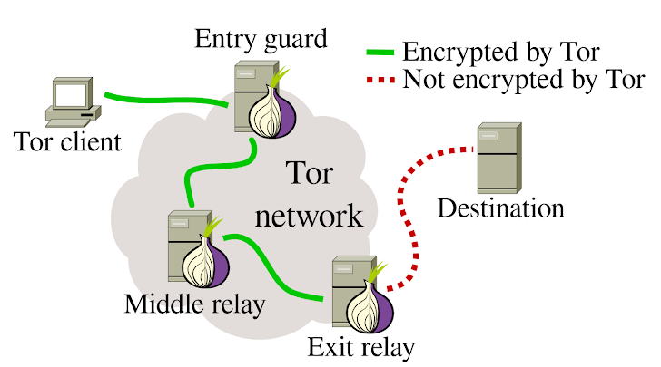
Tor (The Onion Router)
  Main idea: tunnel traffic through multiple relays
  (aka “onion routers”) using public key cryptography
Many TCP connections can be “multiplexed” over one Tor circuit
Key concept: an overlay chain of several Tor routers that can be repeatedly used by the client

Slide 14
Tor Circuit Setup: Overview
Interception gear
Other major backbone
IP:
1.2.3.4
AT&T network
IP:
5.6.7.8
Other major backbone
Tor Node
Tor Node
Tor Node
7.8.9.1
9.1.1.2
8.9.1.1

Slide 15
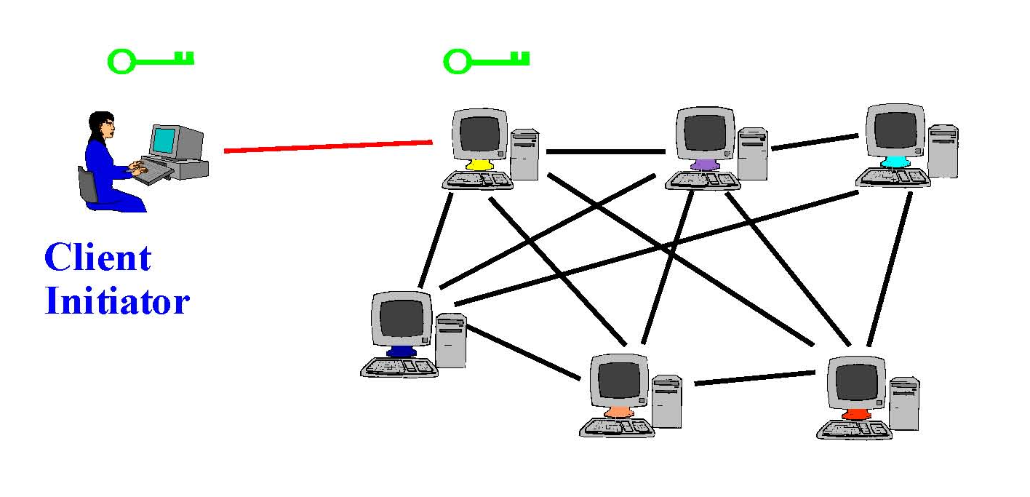
Tor Circuit Setup (1)
Client proxy establishes a symmetric key and circuit with Onion Router #1

Slide 16
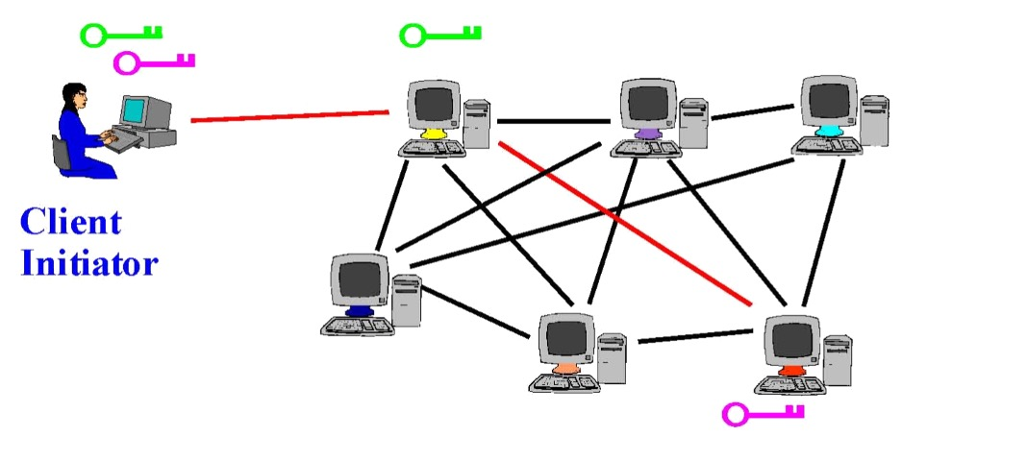
Tor Circuit Setup (2)
Client proxy extends the circuit by tunneling through Onion Router #1 and establishes a symmetric key with Onion Router #2

Slide 17
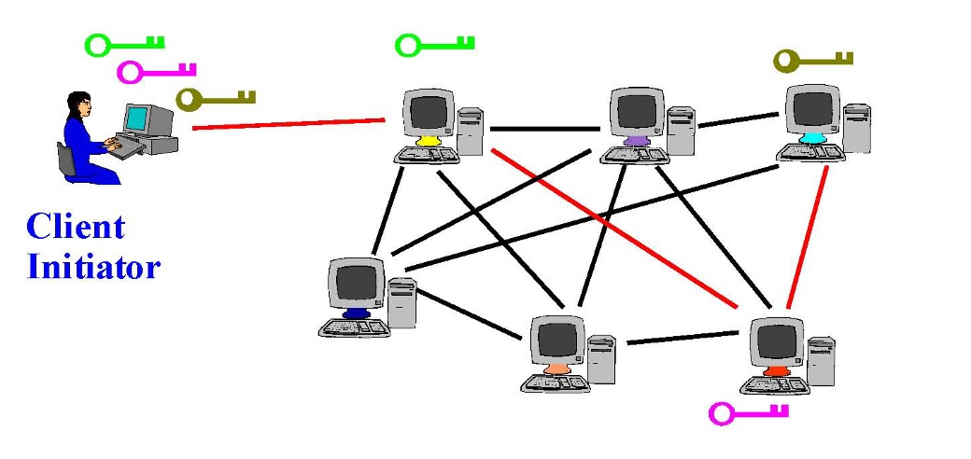
Tor Circuit Setup (3)
Client proxy extends the circuit by tunneling through Onion Routers #1 and #2 and establishes a symmetric key with Onion Router #3

Slide 18
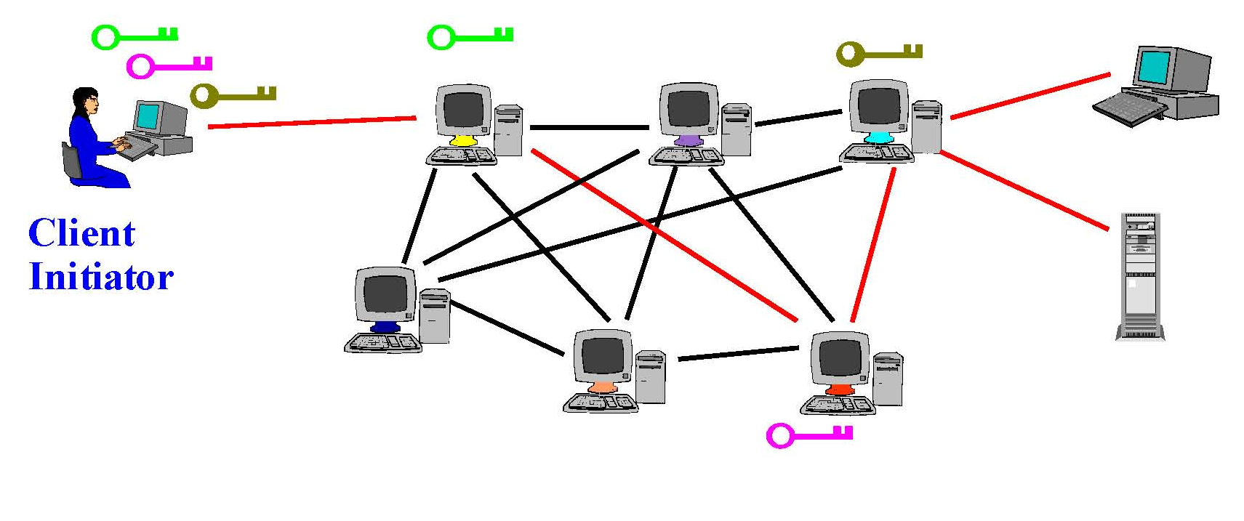
Using a Tor Circuit
Client applications communicate over the established circuit
Datagrams decrypted and re-encrypted at each node of the router chain

Slide 19
Onion Routing: Example
Tor implements a more complex version of this basic idea
IP:
1.2.3.4
7.8.9.1
8.9.1.1
9.1.1.2
IP:
5.6.7.8
Src:
9.1.1.2
Dest:
5.6.7.8
HTTP packet
Src:
8.9.1.1
Dest:
9.1.1.2
Encrypted to 9.1.1.2
Src:
8.9.1.1
Dest:
9.1.1.2
Encrypted to 8.9.1.1
Src:
7.8.9.1
Dest:
8.9.1.1
Encrypted to 7.8.9.1

Slide 20
Who Knows What?
Destination: knows a Tor user is connecting to it via the exit node
Alice
Interception gear
Other major backbone
IP:
1.2.3.4
AT&T network
Destination
IP:
5.6.7.8
Other major backbone
Tor Node
Tor Node
Tor Node
7.8.9.1
9.1.1.2
8.9.1.1
Exit node: knows some Tor user is connecting to destination, but not which user
Entry node: knows Alice is using Tor + identity of middle relay, but not destination

Slide 21
Hiding From the Destination
  • There’s no long-term identifier for a Tor user
  • If a website gets a connection from Tor today, and another one tomorrow, it cannot tell whether those are from the same user or not
  • But two connections in quick succession from the same Tor node are more likely to in fact be from the same user
  Hiding from the destination requires
  application-level protections

Slide 22
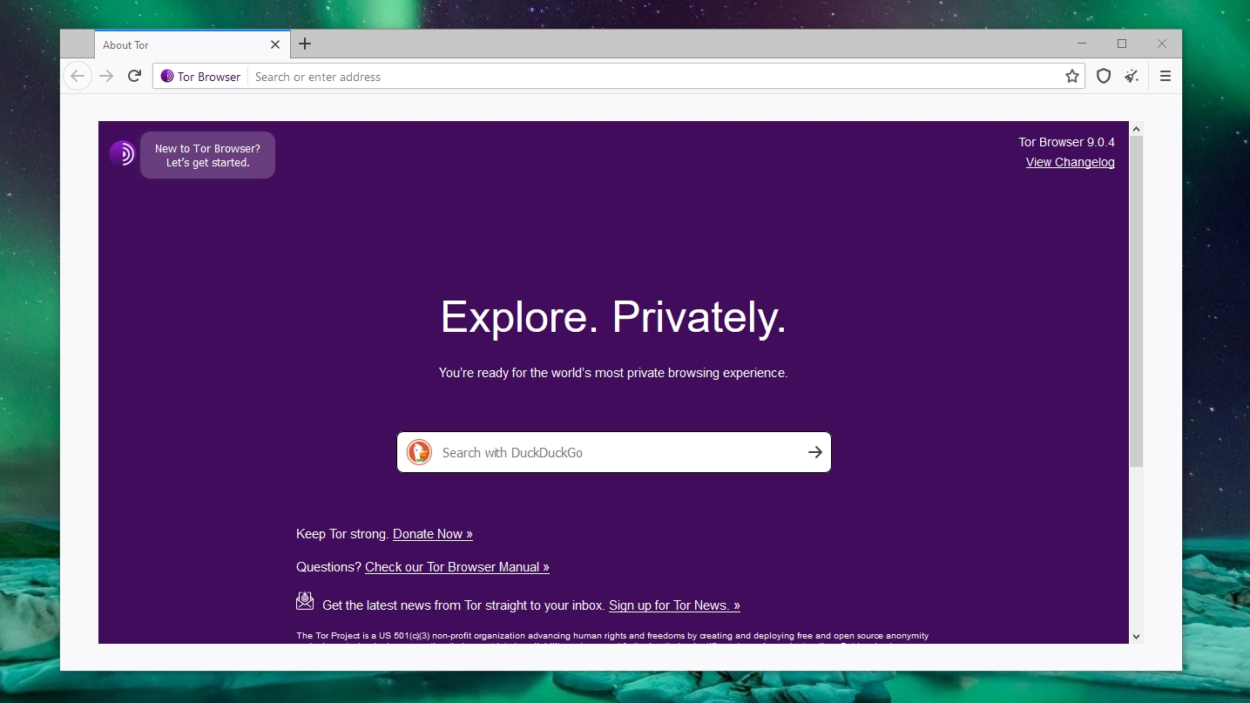
Tor Browser
Protections from browser fingerprinting and other threats

Slide 23
Fingerprinting Tor Browser
https://blog.torproject.org/browser-fingerprinting-introduction-and-challenges-ahead
  Goal: all Tor users should have the same fingerprint
user-agent:
Default fallback fonts
WebGL and Canvas API blocked by default
Access to high-resolution timing blocked
“First Party Isolation”: every source of browser identification keyed to the domain in the URL bar (to prevent cross-site tracking)

Slide 24
Choosing Tor Relays
Tor publishes a directory of of active relays
  Their locations, current public keys, etc.
  Public keys of directory servers ship with Tor code
Must control how relays join
  Attackers try to create many Tor relays, have their relays selected by users
Algorithm for path selection preferences high-capacity, long-lived relays… can also choose manually
Exploited by the CERT / DHS attack on Tor during Operation Onymous

Slide 25
Onion Services (aka Hidden Services)
Goal: deploy a server on the Internet that anyone can connect to without knowing where it is or who runs it
Accessible from anywhere
Resistant to blocking and censorship, denial of service, physical attacks

Slide 26
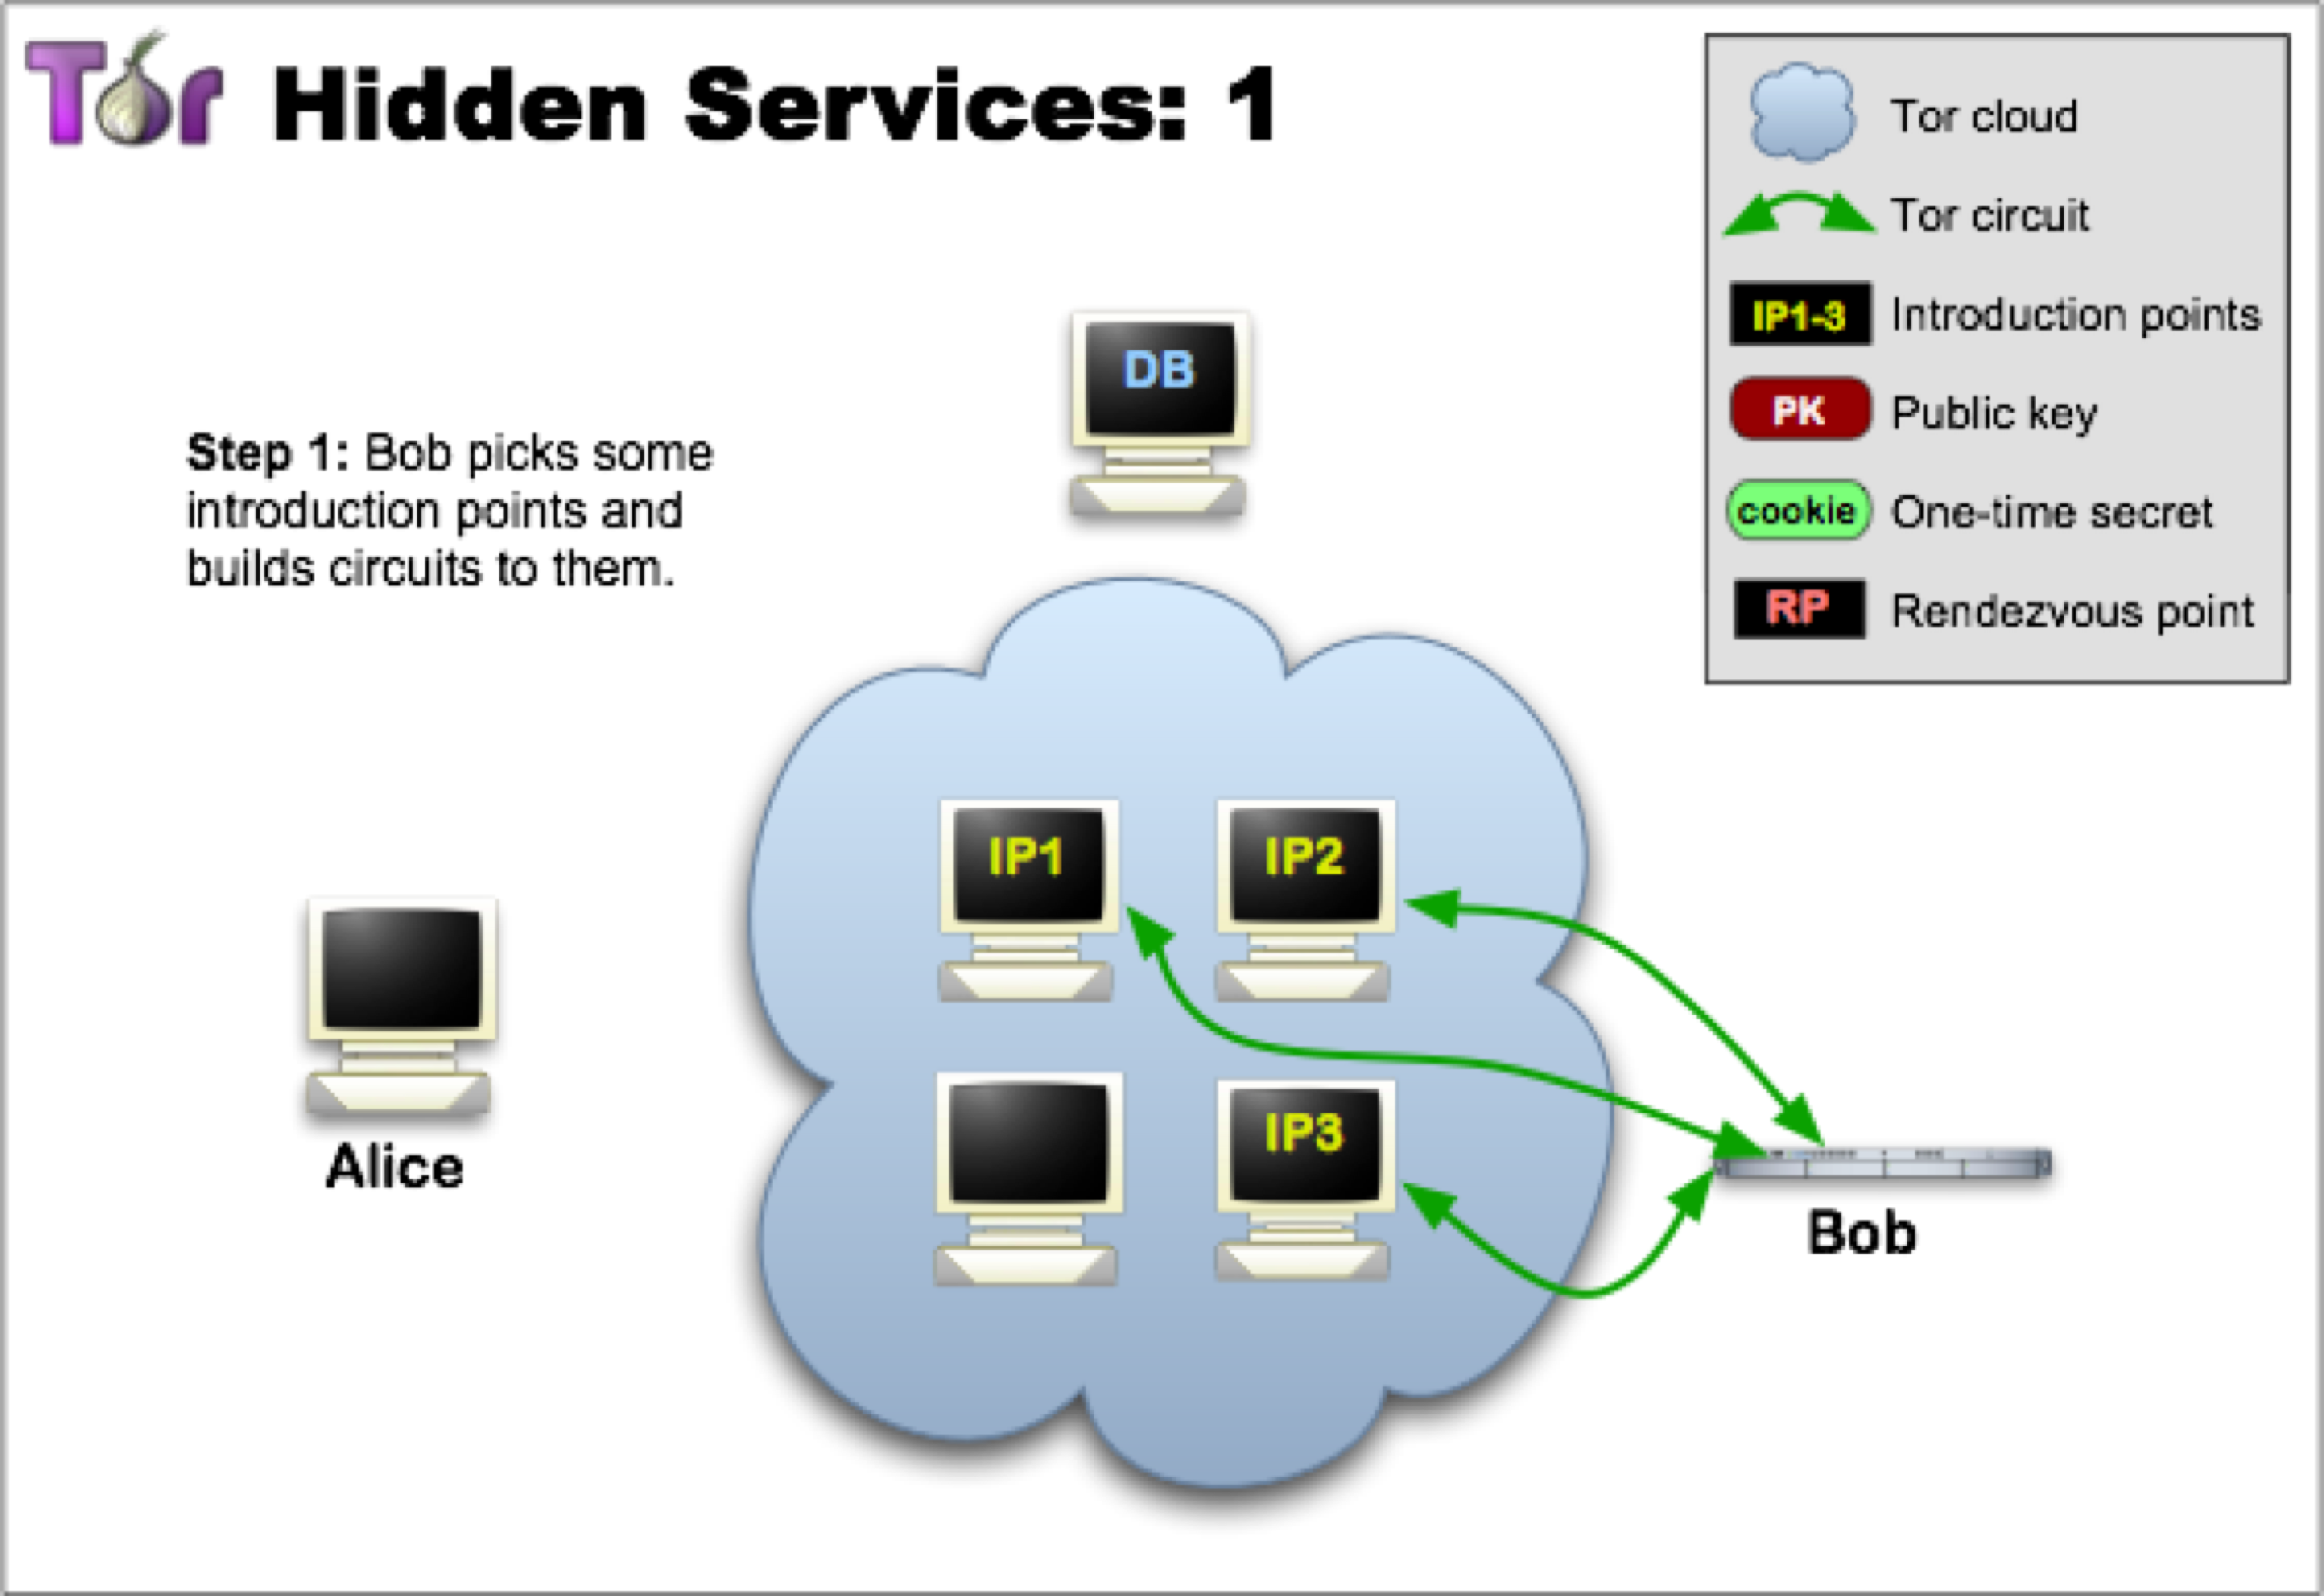

Slide 27
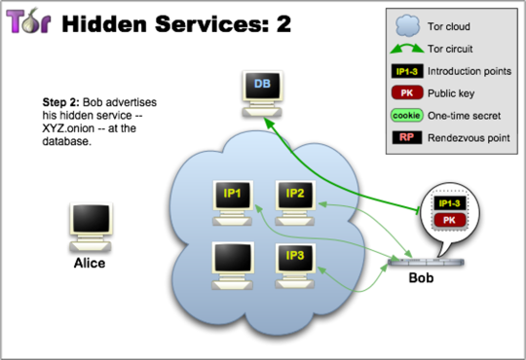

Slide 28
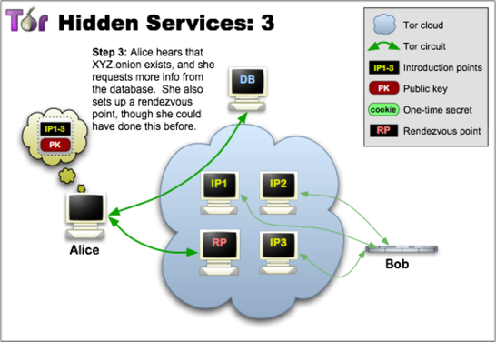

Slide 29
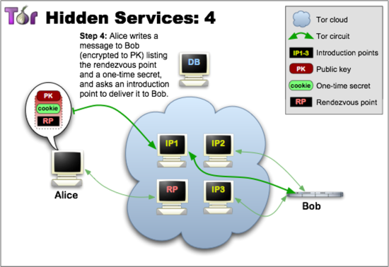

Slide 30
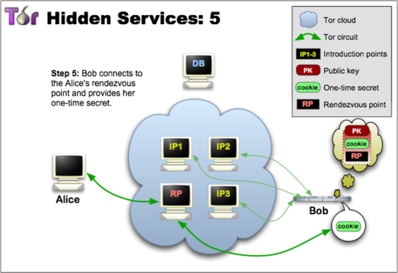

Slide 31
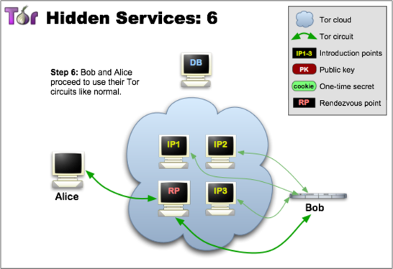

Slide 32
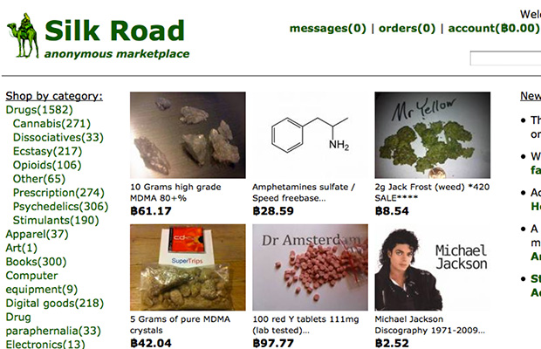

Slide 33
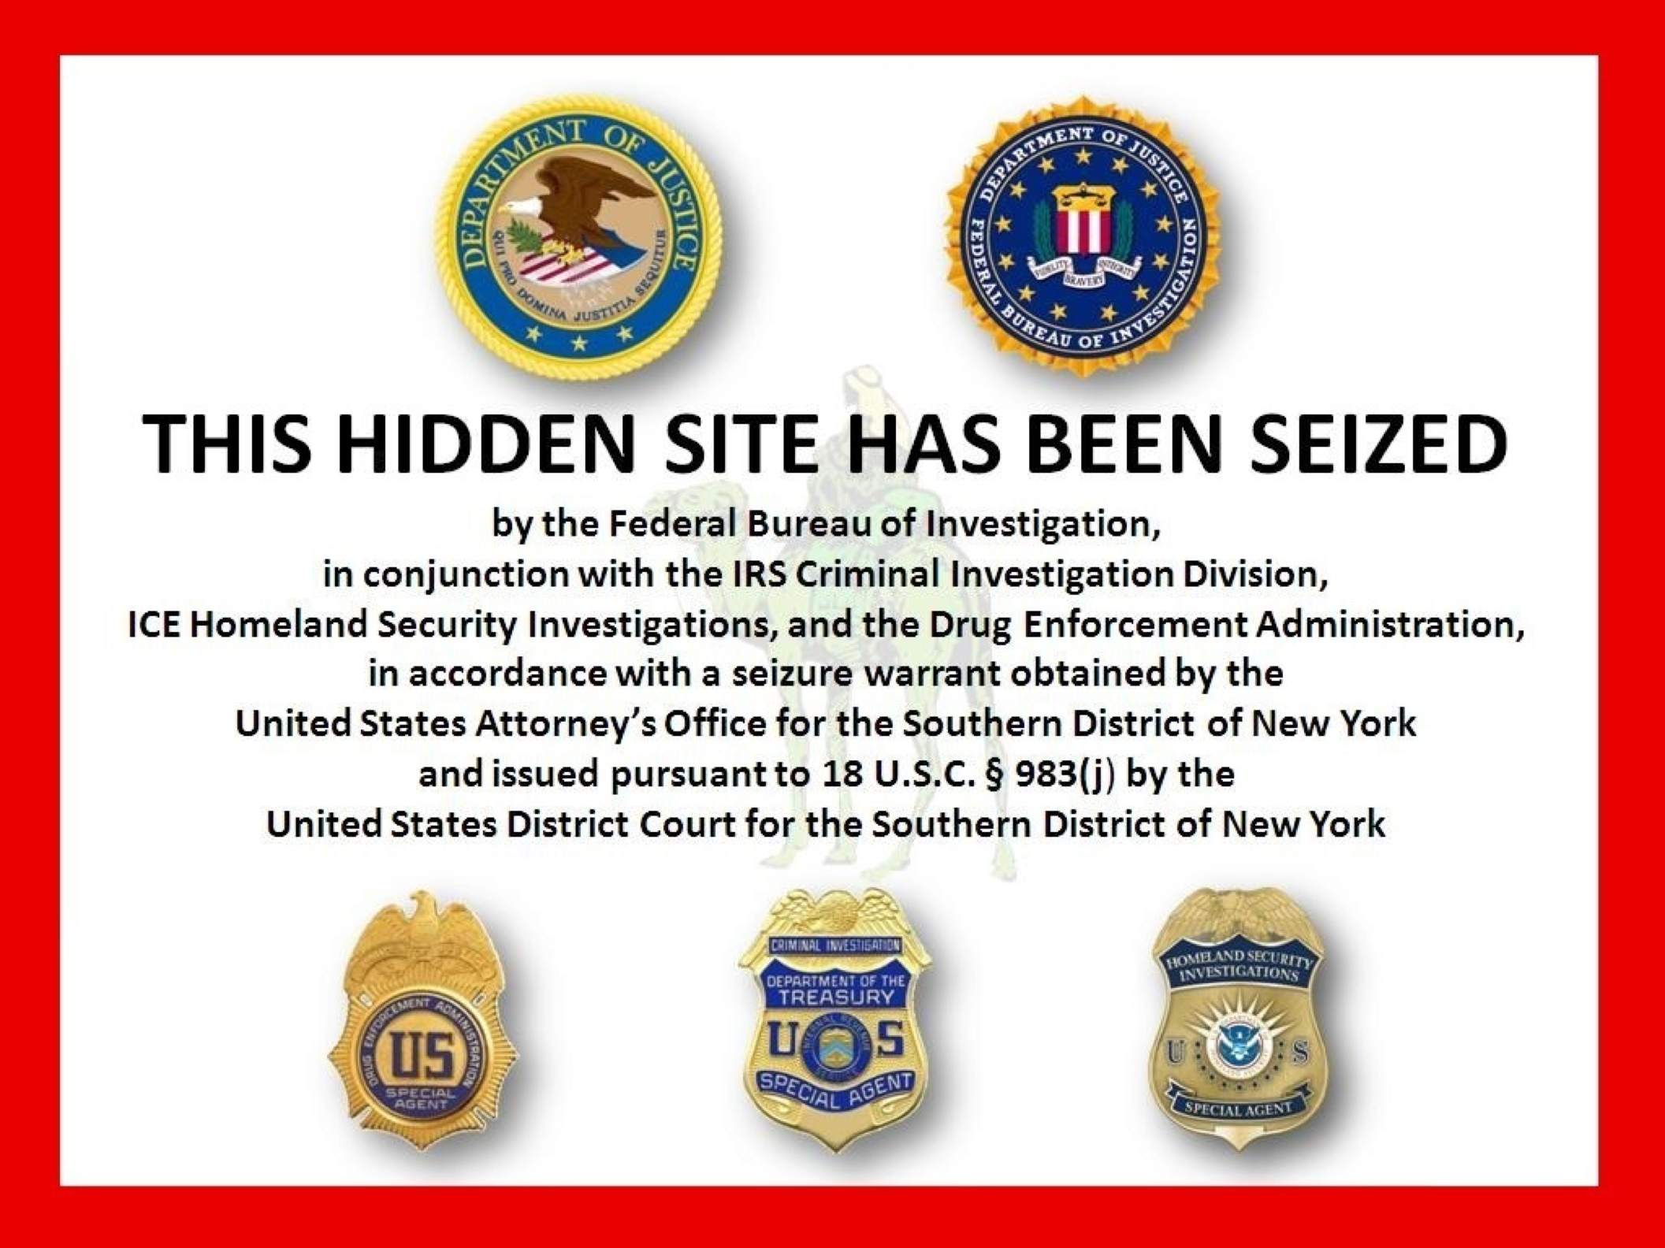

Slide 34
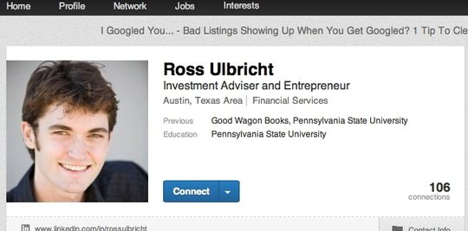

Silk Road Shutdown
How was Ulbricht discovered?
Username “altoid” in an early Silk Road announcement also used by Ulbricht
A Stack Overflow question accidentally posted by Ulbricht under his real name
  “How can I connect to a Tor hidden service using curl in php?”
  … a few seconds later, changed username to “frosty”
  … the encryption key on the Silk Road server ends with the substring "frosty@frosty"
A package of fake IDs from Canada traced to an apartment to San Francisco
A fake murder-for-hire arranged by “Dread Pirate Roberts”, operator of Silk Road
Ross Ulbricht arrested by the FBI on Oct 1, 2013
In 2015, sentenced to double life + 40 years without the possibility of parole

Slide 35
Weaknesses in Tor? Probably Not…
FBI agent Tarbell’s testimony:
  Agents examined the headers of IP packets as they interacted with the Silk Road’s login screen, noticed an IP address not associated with any Tor nodes
  As they typed this address into the browser, Silk Road’s CAPTCHA prompt appeared
  Address led to a rented server in a data center in Iceland
Common problem: misconfigured software does not send all traffic via Tor, leaks IP address
  Is this really what happened with the Silk Road server?

Slide 36
Subsequent Developments
Several DEA and US Secret Service agents convicted of stealing Bitcoin during the Silk Road investigation
Operation Onymous (2014)
  Federal takedown of online drug markets, including Silk Road 2.0
  Facilitated by an attack on the Tor network: multiple relays introduced into the network by a reputable organization (CMU CERT) + a novel exploit of a vulnerability in Tor that enables linkage of entry and exit nodes
Operation DisrupTor (2020)
  Another federal takedown of online drug markets, 179 arrests

Slide 37
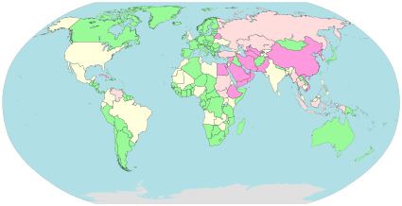
Internet Censorship
Golden Shield Project / Great Firewall of China
Iran, Syria
Pakistan (YouTube hijack),
Turkey (Twitter ban), Russia
Singapore, Australia

Slide 38
Filtering Technologies
National Internet
International Internet
Src:
1.2.3.4
Dest:
5.6.7.8
Filtering equipment
Censorship mechanism | Circumvention mechanism
IP filtering | Proxies
DNS filter/redirection | DNS proxy (1.1.1.1)
URL filtering | Encryption / Tunneling
Packet filtering (keywords in packets) | Encryption / Tunneling
Protocol filtering (e.g., detect Tor) | Protocol obfuscation

Slide 39
Filtering Devices
Blue Coat
NetApp
SmartFilter software from Secure Computing (bought by McAfee)
Reported use in Syria, Iran, Saudi Arabia
  Embargos prevent direct selling by US companies, but resellers still resell

Slide 40

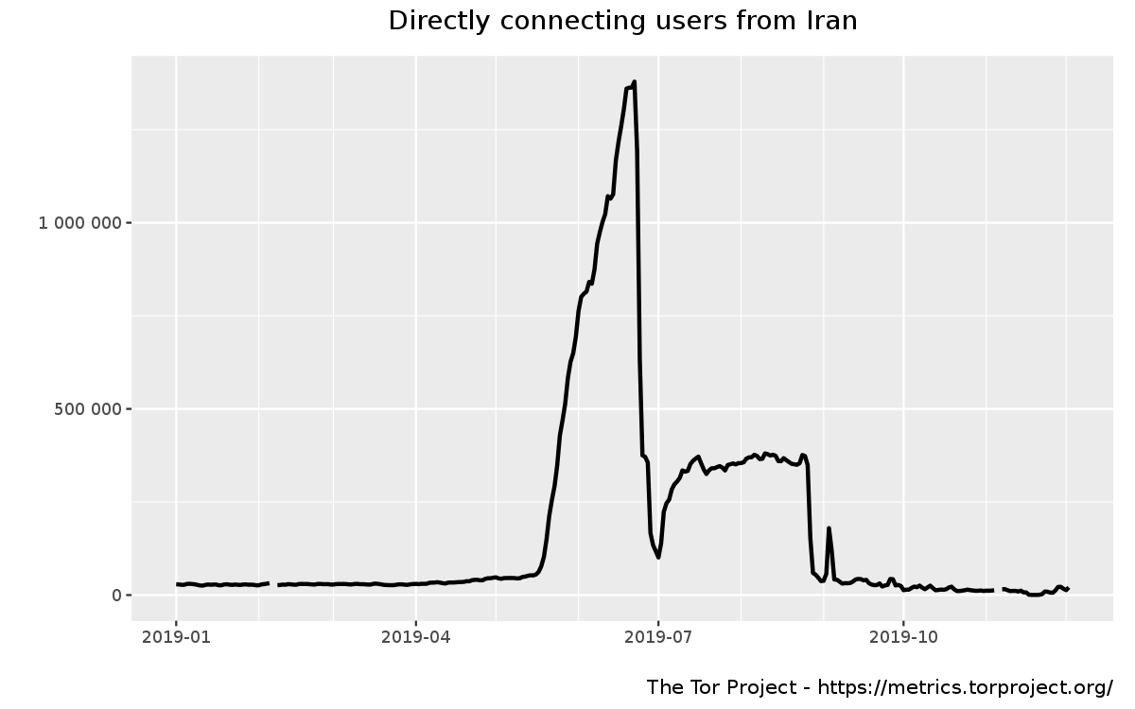
Iran
Every ISP must run “content-control software”
  SmartFilter (up until 2009), Nokia Siemens DPI systems
Filters Facebook, Twitter, YouTube, RapidShare, WordPress, BBC, CNN…
Occasional widespread filtering of Tor, TLS, other encrypted protocols

Slide 41
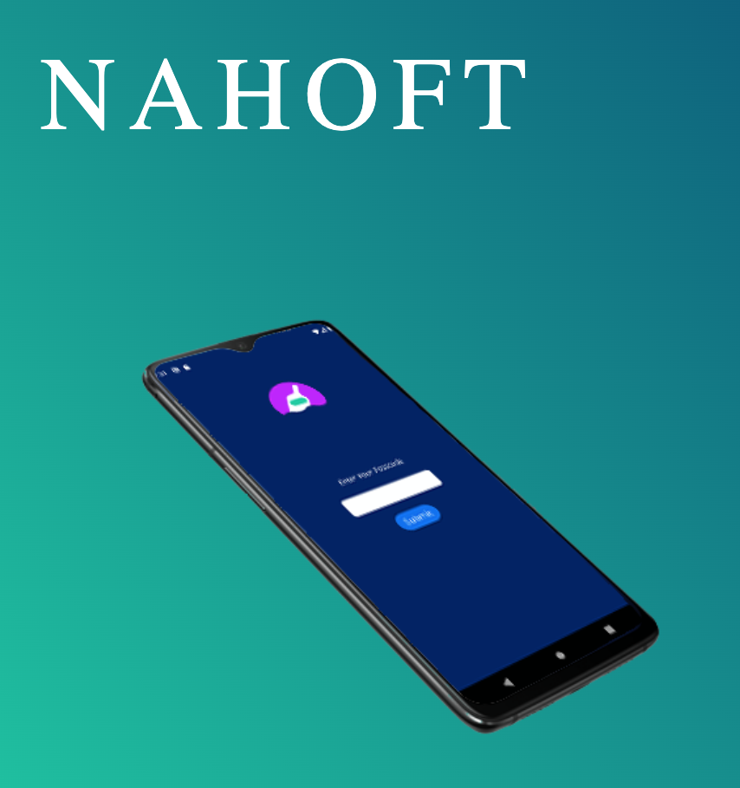
Nahoft is a state-of-the-art encryption app made for Android mobile phones. With Nahoft you can easily encrypt your private message into a string of Persian words or hide your encrypted messages in a photo before sending it safely via any messaging app.
Does not require Internet
Sequence of coded words can be sent by letter, read over the phone, or transmitted over a channel where content is scanned
Recipient uses their app to decode

Slide 42
The Great Firewall of China
IP filtering
DNS filtering / redirection
URL filtering
Packet filtering
  Search for keywords in TCP packets, send TCP FIN both ways
Protocol filtering
  Tor is mostly shut down
Source: Winter, Lindskog (2012)

Slide 43
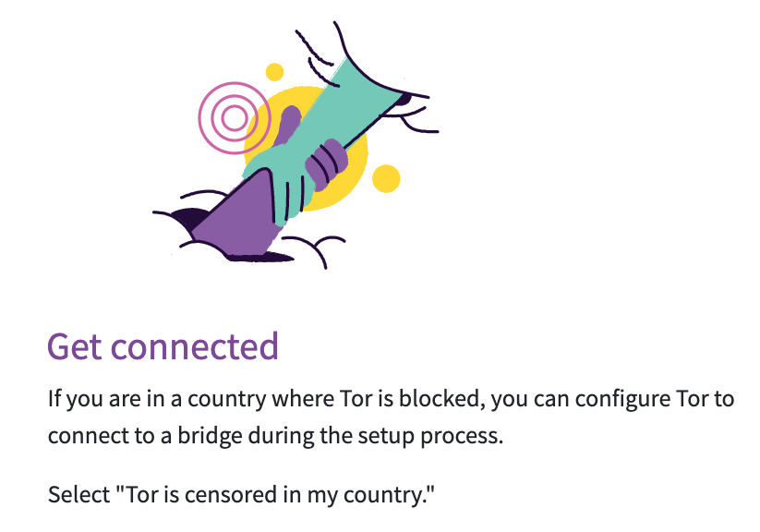


Slide 44
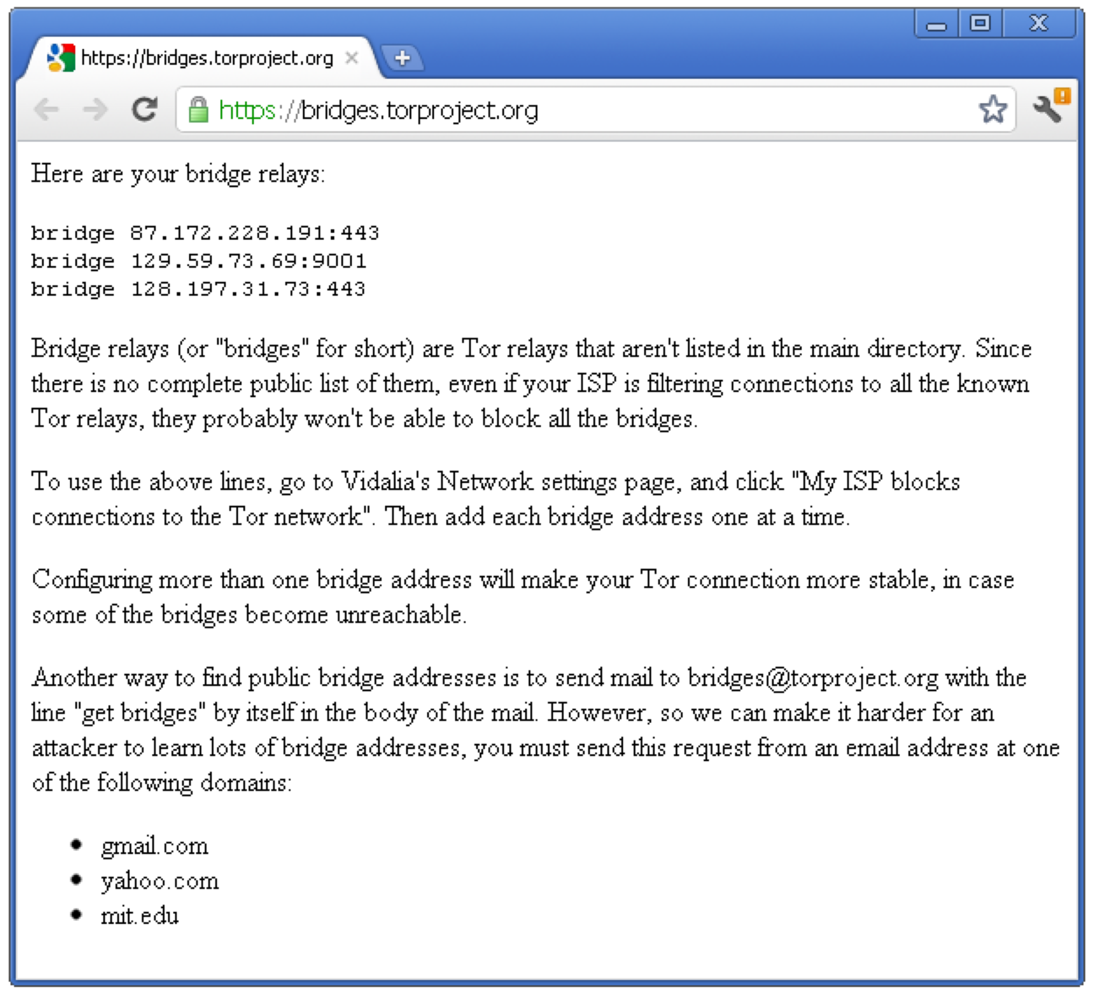
Tor Bridges
Anyone can look up the IP addresses of Tor relays
- Public information in the consensus file
Many countries block traffic to these IPs
Solution: Tor bridges
- Tor proxies that are not publicly known

Slide 45
Obfuscating Tor Traffic
Bridges alone do not get around all types of censorship
- DPI can be used to locate and drop Tor frames
Countries can passively detect and block bridges
- Single-use bridges
Tor adopts a pluggable transport design
- Tor traffic is forwarded to an obfuscation program
- Obfuscator transforms the Tor traffic to look like some other protocol (BitTorrent, Skype, HTTP, streaming audio, …)

Slide 46
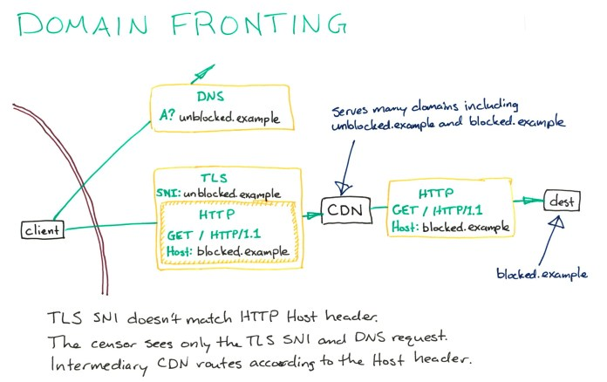
credit: bamsoftware.com

Slide 47
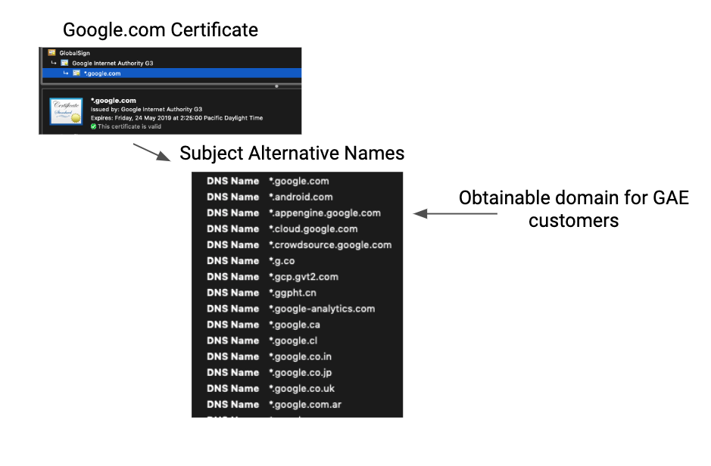
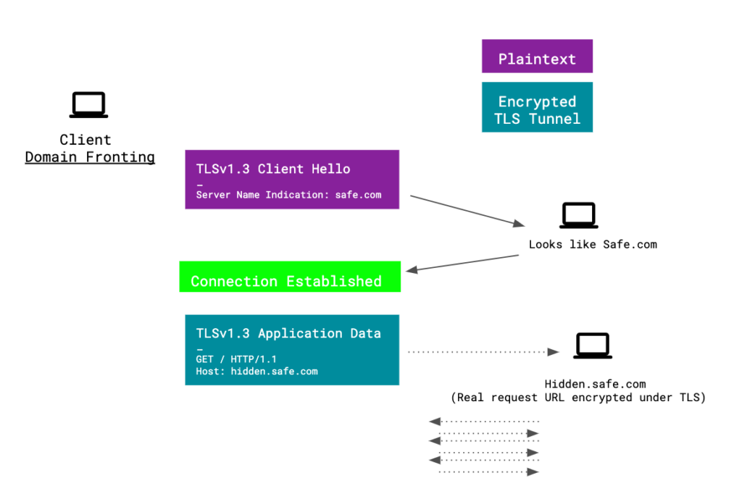
Domain Fronting in Tor
Tor would place bridges in hidden domains behind standard cloud-service domains: Google App Engine, Amazon CloudFront/EC2, Microsoft Azure
… and use domain fronting to access the bridges
https://www.sentinelone.com/blog/privacy-2019-tor-meek-rise-fall-domain-fronting/

Slide 48
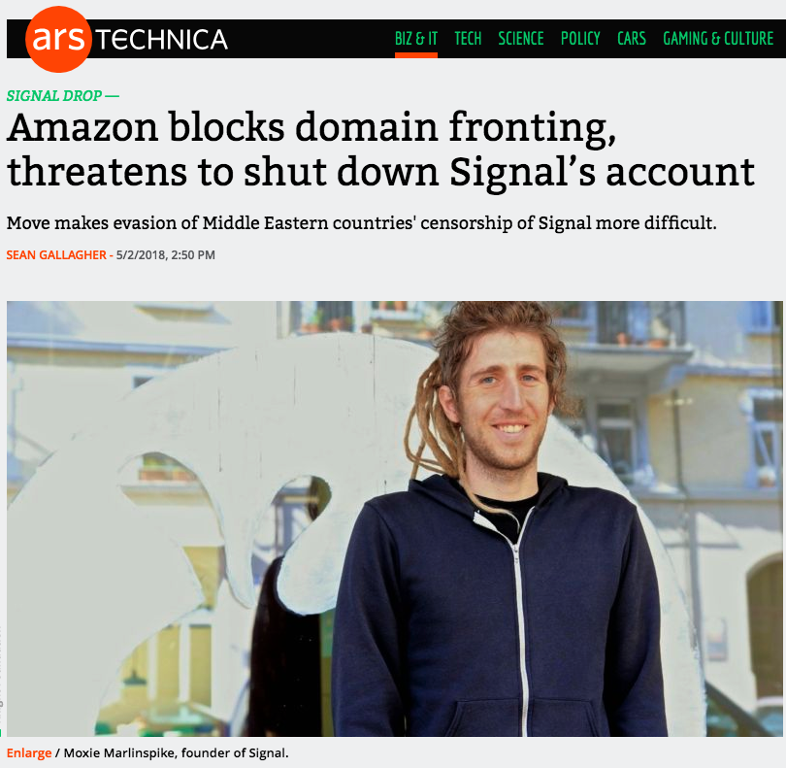
Domain Fronting in Signal
Used by Signal and Telegram to evade
blocking in Egypt, UAE, Qatar, Oman…
But:

Slide 49
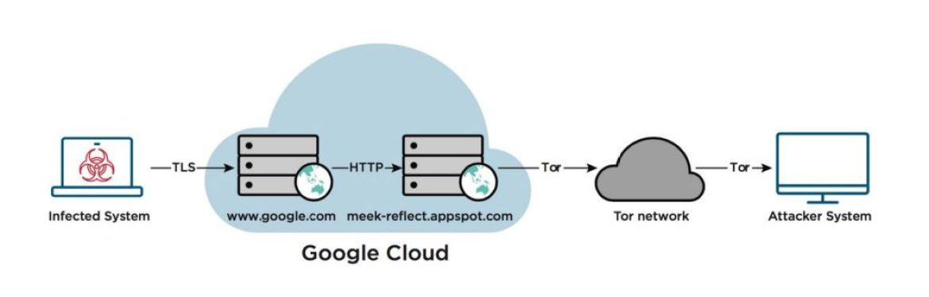
APT29 Domain Fronting with Tor
Russian “Cozy Bear” hacker group used domain fronting to access a Tor hidden service from compromised machines
Responsible for many attacks, including the DNC hack in 2016, attempts to steal vaccine data in July 2020…
https://www.fireeye.com/blog/threat-research/2017/03/apt29_domain_frontin.html

