Slide 1
Mobile Tracking and
Data Collection
Vitaly Shmatikov

Slide 2
1.8 million
apps in Google Play Store
source: AppBrain
41%
include at least one
mobile advertising library
source: AppBrain
Every third
ad-supported app includes
multiple advertising libraries
source: Shekhar et al. (USENIX Security 2012)

Slide 3
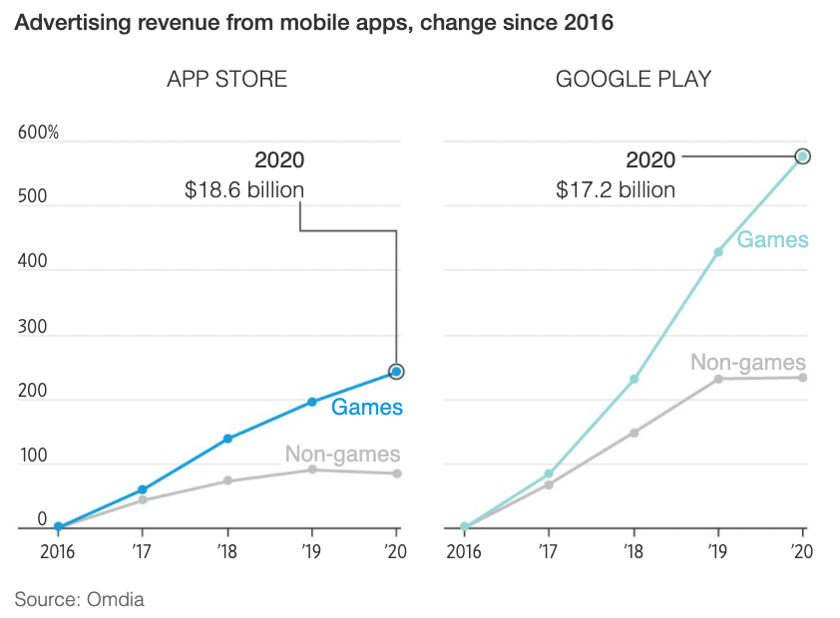
Mobile accounts for 68% of digital ad spending in the US (2020)

Slide 4
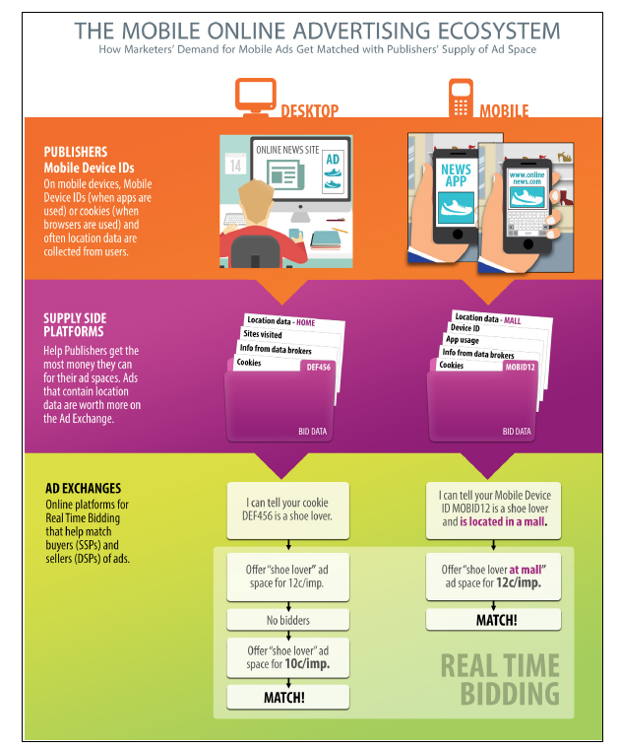
Online Advertising Ecosystem
Location!
Cookies not so useful on mobile (why?)
Mobile device identifiers

Slide 5

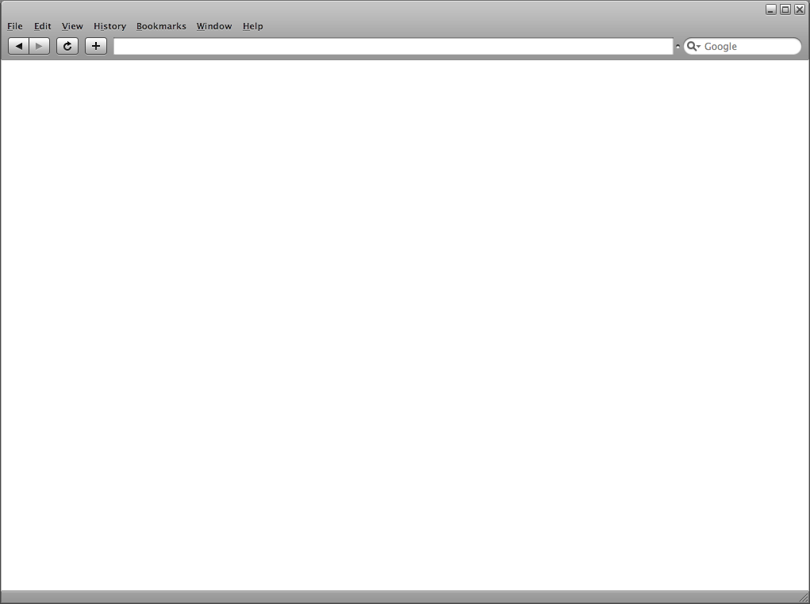
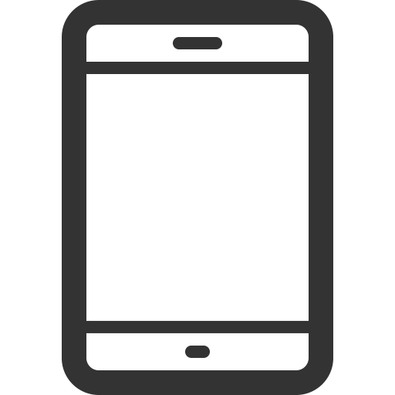




Web
Mobile
Ad library
Web browser
Mobile app

Slide 6
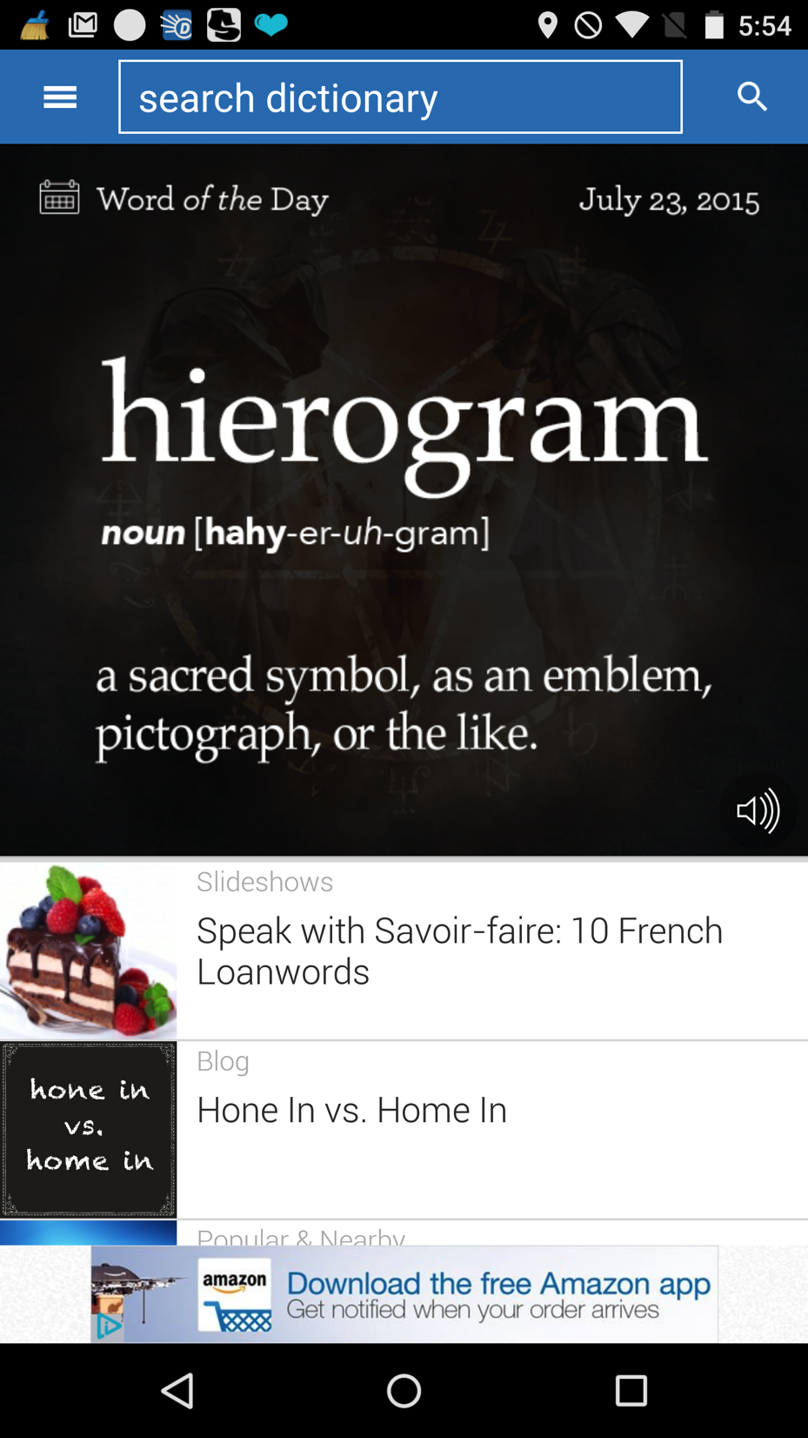
Mobile
Ad library
Mobile app

Slide 7
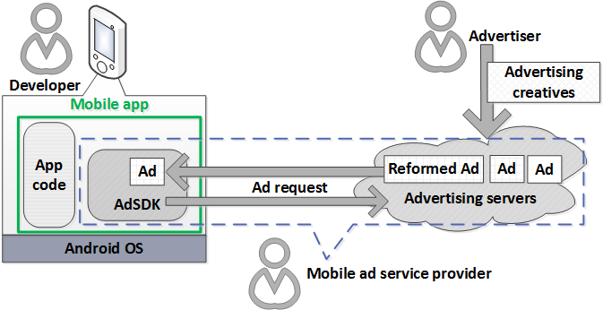

Slide 8
Advertising services
Large businesses
  AdMob (Google),
  Mopub (Applovin),
  AirPush, many others
Provide AdSDK libraries
to 100,000s of developers
Millions of $ in revenue
Reputation at stake
Advertisers
Lots of fly-by-night operators
Ads resold via auctions, brokers, exchanges
No reputation at stake, no accountability
Dynamic filtering and sanitization are hard

Slide 9

Android AdSDK Software Stack
App developers include AdSDKs, add permissions for AdSDKs, repackage apps
App and AdSDK share the same privileges
App
AdSDK
No first party / third party distinction, no separation by origin
Ad
App and Ad should NOT share the same privileges

Slide 10
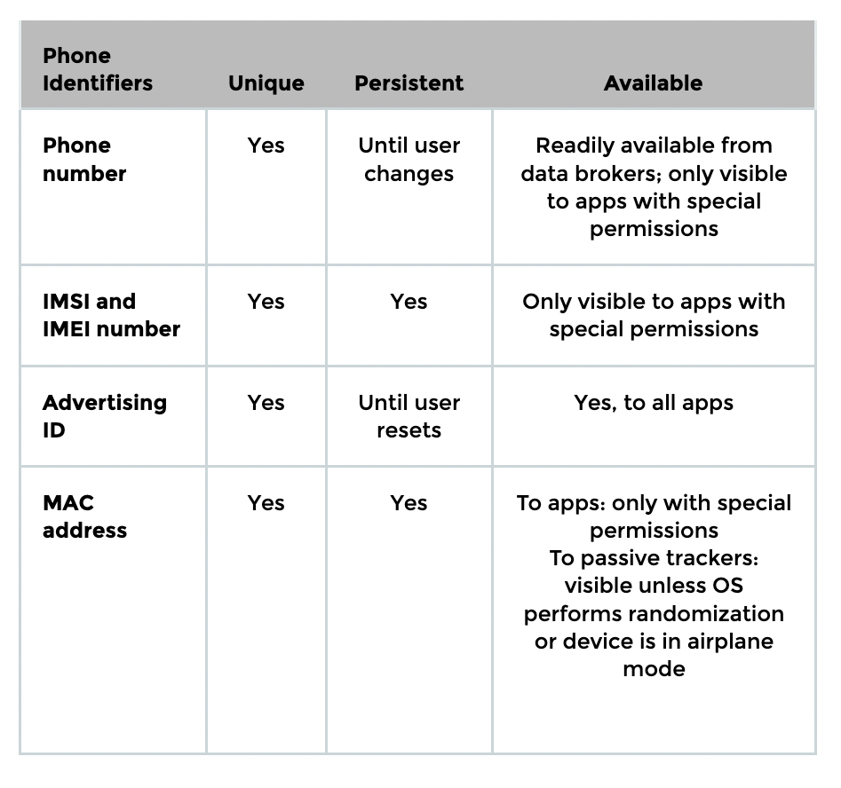
Robust Identifiers
Unique
  Points only to you or your device
Persistent
  Does not change often
Available
  Easy for advertiser to access

Slide 11
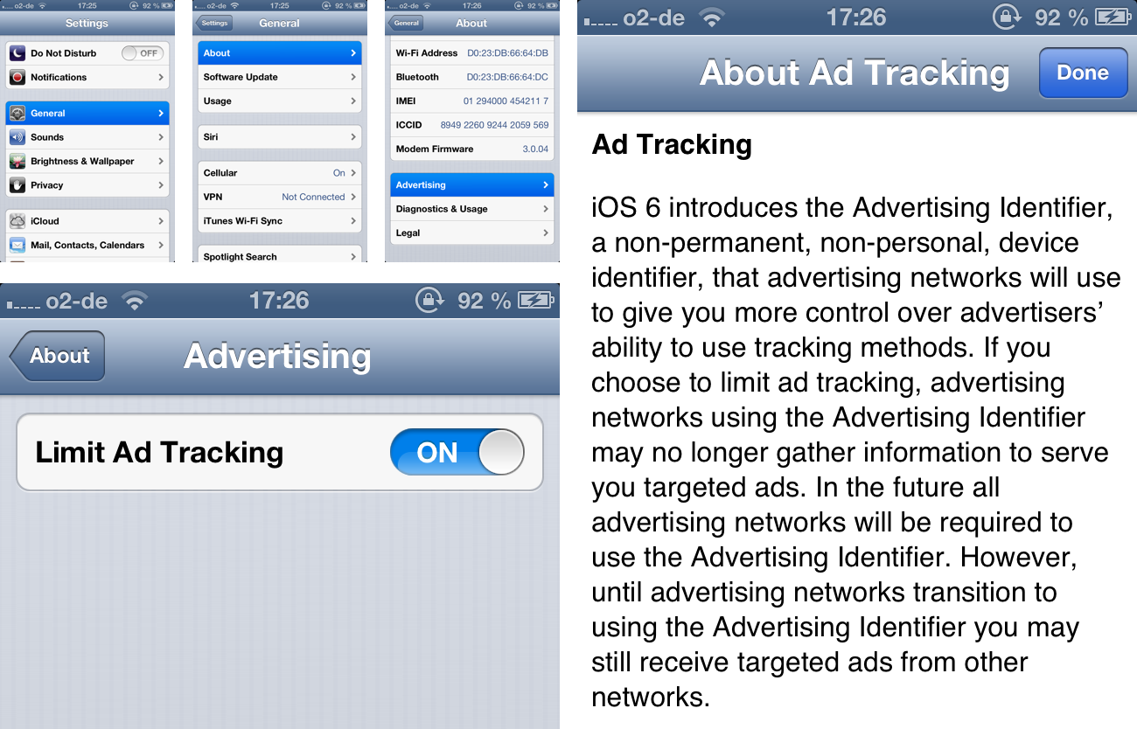
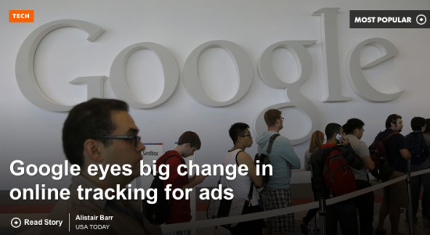
Advertising Identifiers
IDFA
How are these identifiers different from third-party cookies?
Android Advertising ID

Slide 12
Advertising Identifiers
Android and iOS: unique “advertising ID”
Ok to use for advertising and user analytics
Not Ok to connect to PII or device-specific IDs without user consent
Same ID for all apps on the device
  Is this better or worse than cookies?
  No technical enforcement mechanism in SDK

Slide 13
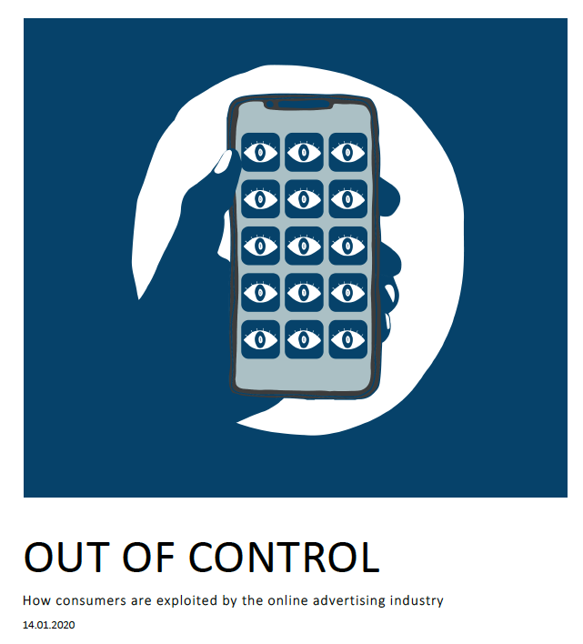
Reading: Forbrukerrådet report

Slide 14
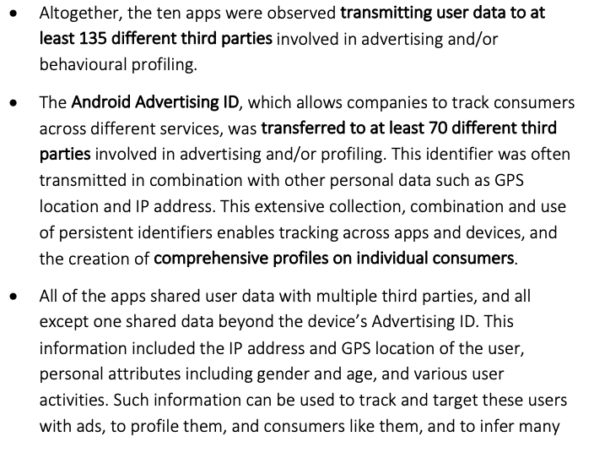
Forbrukerrådet App Study (2020)

Slide 15
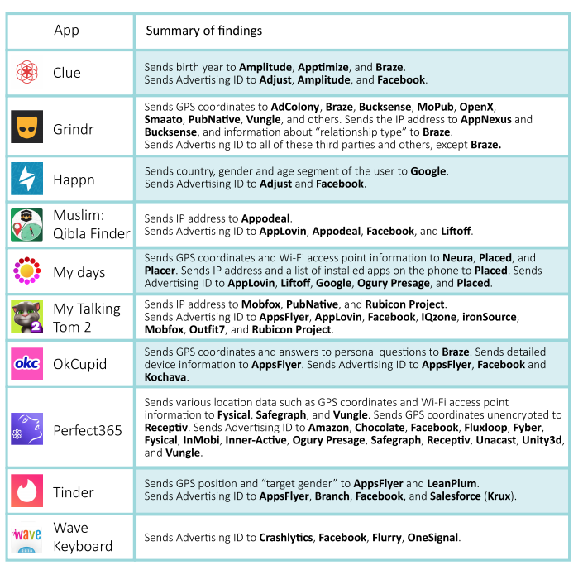
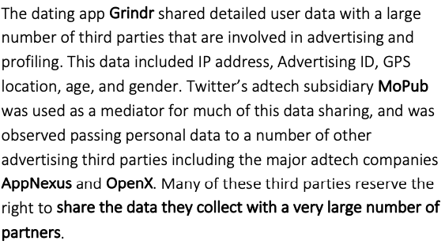

Forbrukerrådet App Study (2020)

Slide 16
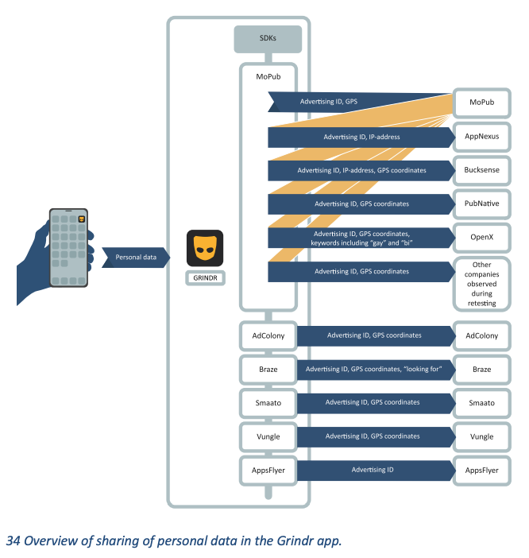
Source: Forbrukerradet app study

Slide 17
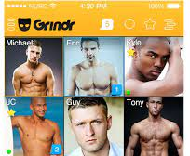
Sent HIV information to third-party analytics companies, together with user’s precise GPS location, phone ID, and email
Also sent precise GPS location, “tribe” (gay subculture), sexuality, relationship status, ethnicity, and phone ID to other third-party advertising companies
Much more about location later…
https://www.buzzfeednews.com/article/azeenghorayshi/grindr-hiv-status-privacy

Slide 18
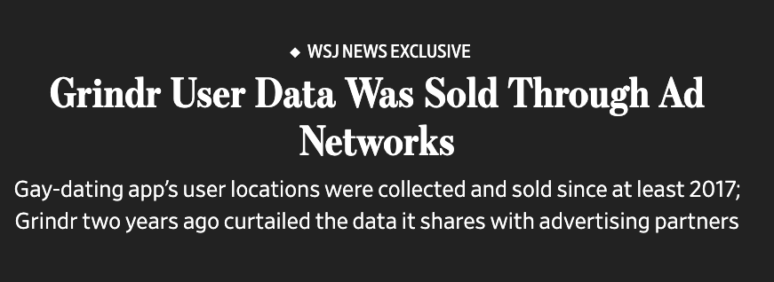

In early 2020, Grindr reduced sharing of information with ad partners
No personal information such as names or phone numbers, but detailed enough to infer romantic encounters between users based on their devices’ proximity to one another + clues to identities based on users’ workplaces and home addresses
Purpose: real-time bidding
Serve targeted ads to users based on their current location
As soon as the user opens the app, information is propagated to “every single entity in the advertising ecosystem”
Company that sold bulk phone-movement data claims that location data stripped of personal information cannot be used to identify specific individuals
https://www.wsj.com/articles/grindr-user-data-has-been-for-sale-for-years-11651492800

Slide 19
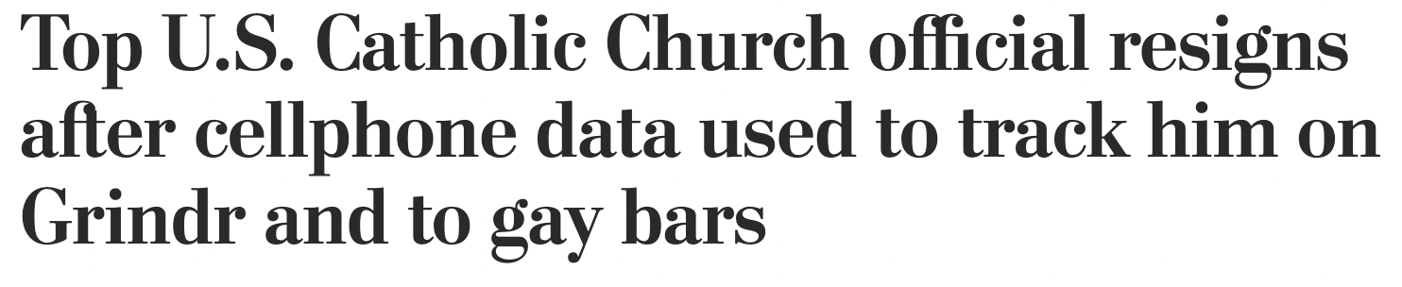


“A mobile device correlated to Burrill emitted app data signals from the location-based hookup app Grindr on a near-daily basis during parts of 2018, 2019, and 2020 — at both his USCCB office and his USCCB-owned residence, as well as during USCCB meetings and events in other cities,” the Pillar reported.
“The data obtained and analyzed by The Pillar conveys mobile app date signals during two 26-week periods, the first in 2018 and the second in 2019 and 2020. The data was obtained from a data vendor and authenticated by an independent data consulting firm contracted by The Pillar,”
https://www.washingtonpost.com/religion/2021/07/20/bishop-misconduct-resign-burrill/

Slide 20
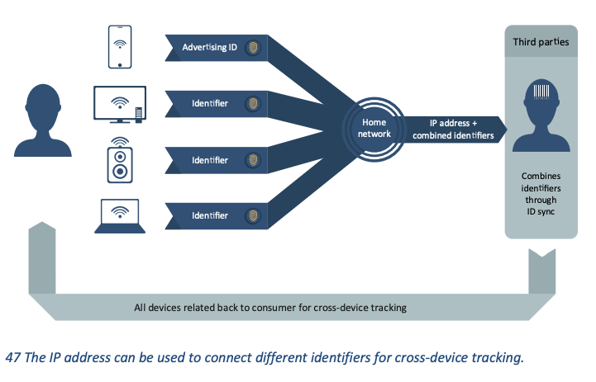
Cross-Device Tracking
Source: Forbrukerradet app study

Slide 21
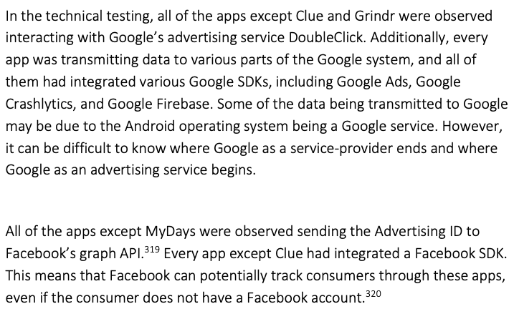
All Roads Lead To …
Source: Forbrukerradet app study

Slide 22
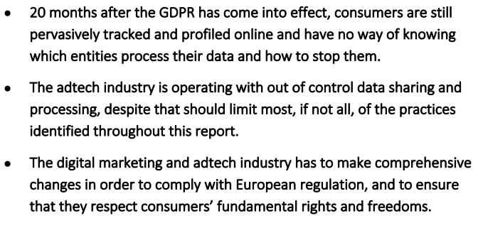
Conclusion of the FR Study

Slide 23

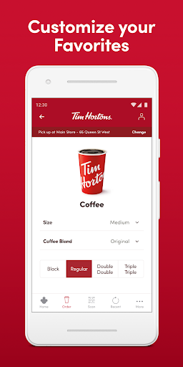
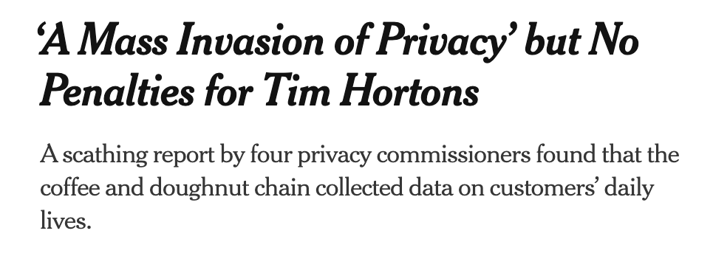

Mobile phone app tracked customers’ locations even when app was closed
… including meta-data: is it a house? Office? Rival coffee shop? Even building names.
Joint report by privacy commissioners of Ontario, Quebec, Alberta, British Columbia
https://www.priv.gc.ca/en/opc-actions-and-decisions/investigations/investigations-into-businesses/2022/pipeda-2022-001/

Slide 24

Gambling Apps
Browsing history
Spending
Demographic data
Behavioral information
Identification numbers of all devices and network information for all deposits to gambling accounts
Most popular gambling app in Britain
140,000 downloads per month
Linked to financial profiles from partners:
Bank accounts
Debts and mortgages
This data is used to lure problem gamblers back… In the data profile that listed Gregg as a customer to “win back” were codes noting he was receptive to gambling promotions that featured Las Vegas. Having made more than 2,500 deposits on Sky Bet, he was listed as a “high value” customer.
https://www.nytimes.com/2021/03/24/technology/gambling-apps-tracking-sky-bet.html

Slide 25
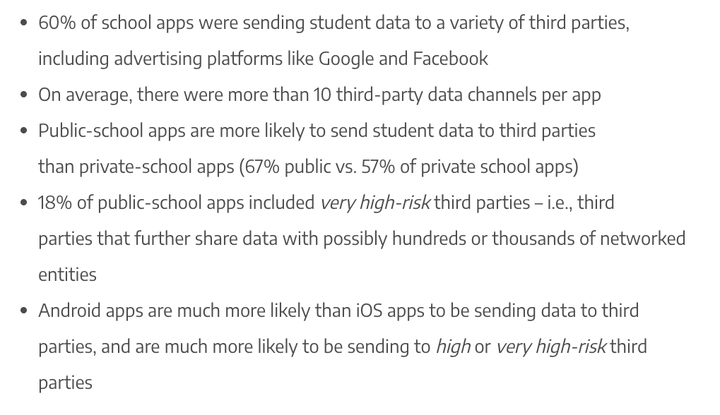
School Apps
Data typically includes mobile advertising identifiers, enabling profile building for students by third-party advertising platforms
https://me2ba.org/school-mobile-apps-student-data-sharing-behavior/

Slide 26
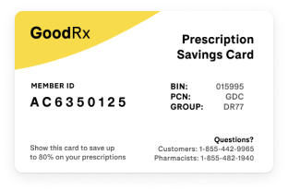
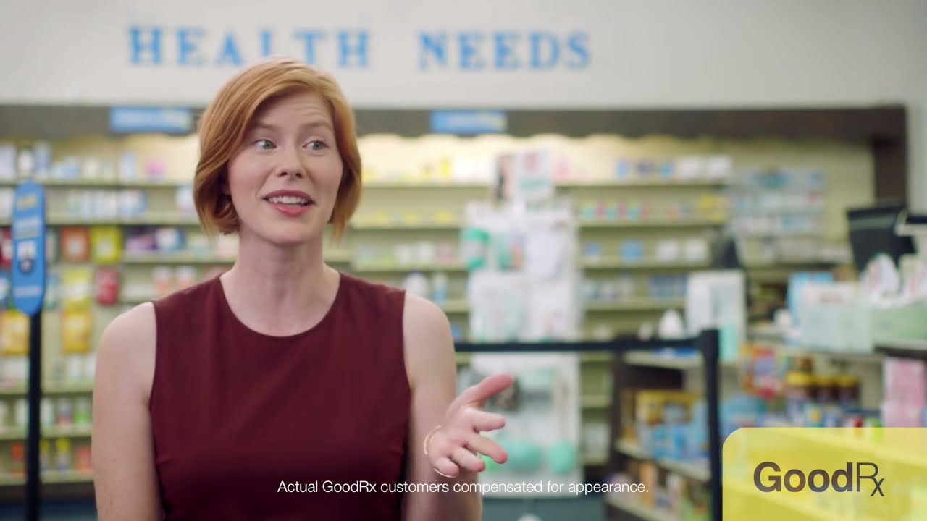
Feb 1, 2023:
First FTC enforcement action under its Health Breach Notification Rule
$1.5 million fine + consent order prohibiting GoodRx from sharing users’ health data for advertising purposes
From 2017 to 2020, GoodRx uploaded the contact information of users who had bought certain medications, like birth control or erectile dysfunction pills, to Facebook… to target users with ads for medications on Facebook and Instagram… GoodRx also targeted users who had looked up information on sexually transmitted diseases on HeyDoctor, the company’s telemedicine service, with ads for HeyDoctor’s S.T.D. testing services
… while promising to never provide advertisers any information that reveals a personal health condition
privacy policy!!
The F.T.C.’s case centers on GoodRx’s use of tracking tools from Facebook, Google and other companies — known as “pixels” and “software development kits” — to track and share data on their users’ activities with third parties
https://www.nytimes.com/2023/02/01/business/goodrx-user-data-facebook-google.html

Slide 27
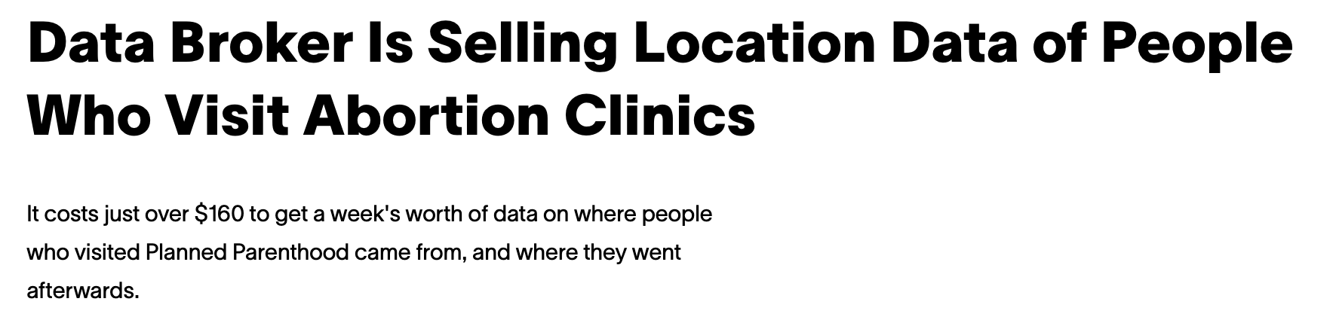
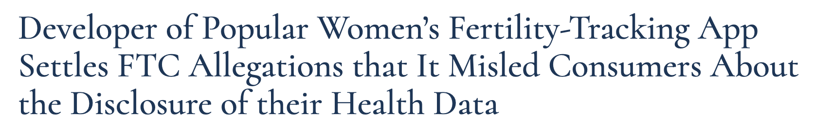
SafeGraph classifies "Planned Parenthood" as a "brand" that can be tracked… “how often people visit, how long they stay, where they came from, where else they go, and more”
https://www.vice.com/en/article/m7vzjb/location-data-abortion-clinics-safegraph-planned-parenthood
https://www.ftc.gov/news-events/news/press-releases/2021/01/developer-popular-womens-fertility-tracking-app-settles-ftc-allegations-it-misled-consumers-about
All of this data is de-identified and anonymous … but linked to the phone’s advertising identifier

Slide 28


Mental-Health Apps
“When I first joined BetterHelp, I started to see targeted ads with words that I had used on the app to describe my personal experiences,” reports one user
BetterHelp says it shares with marketing partners only device identifiers associated with “generic event names”, only for measurement and optimisation, and only if users agree.
Finnish psychotherapy app hacked in 2020
Users blackmailed with details of extramarital affairs, thoughts about paedophilia, other sensitive info from therapist notes
https://www.economist.com/business/2021/12/11/dramatic-growth-in-mental-health-apps-has-created-a-risky-industry

Slide 29
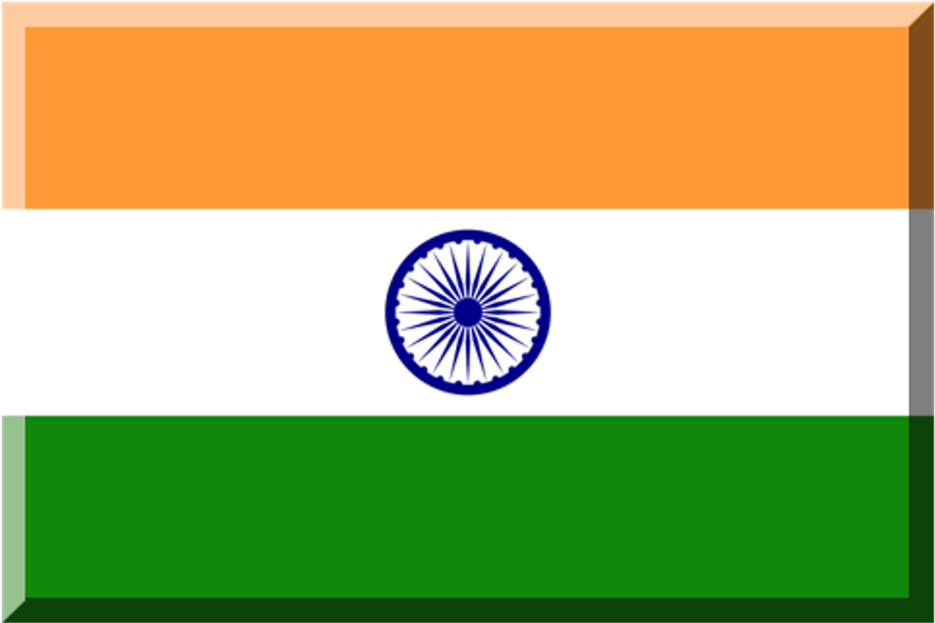
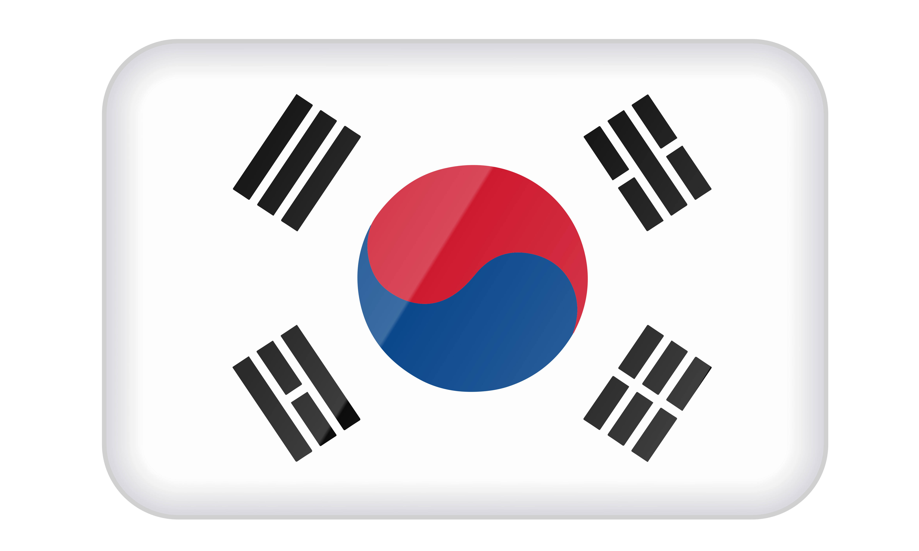
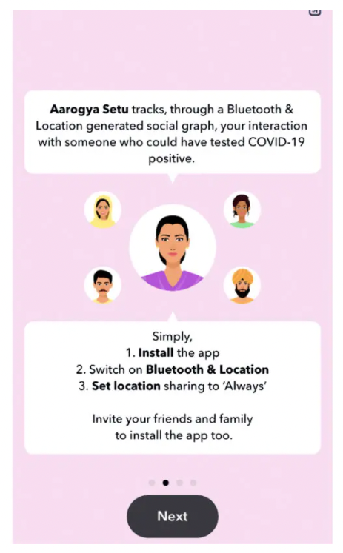
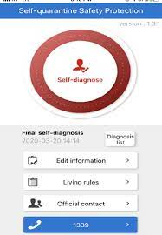
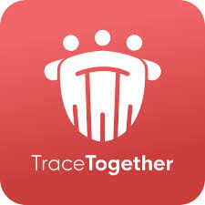

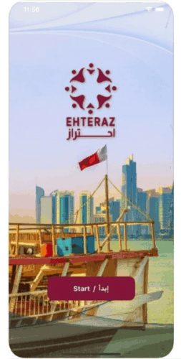
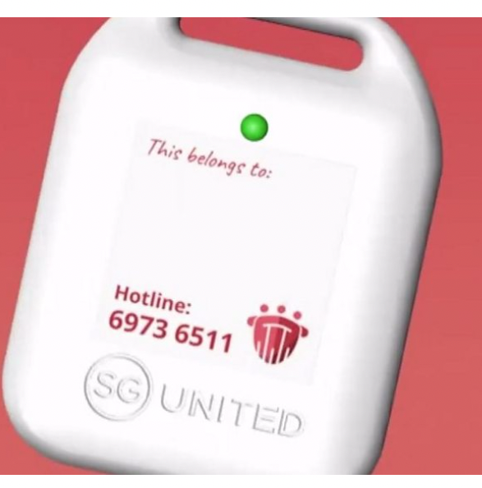

Covid Tracking & Quarantine Apps
Leaked names, addresses, phone numbers, real-time locations of people in quarantine
Traces movements of every Singapore resident
“The data will never be accessed, unless the user tests positive for Covid-19 and is contacted by the contact tracing team.”
Leaked users’ precise locations to a YouTube server (??)
The Singapore Police Force is empowered under the Criminal Procedure Code (CPC) to obtain any data, including TraceTogether data, for criminal investigations
Exposed sensitive personal details of over 1 million users

Slide 30
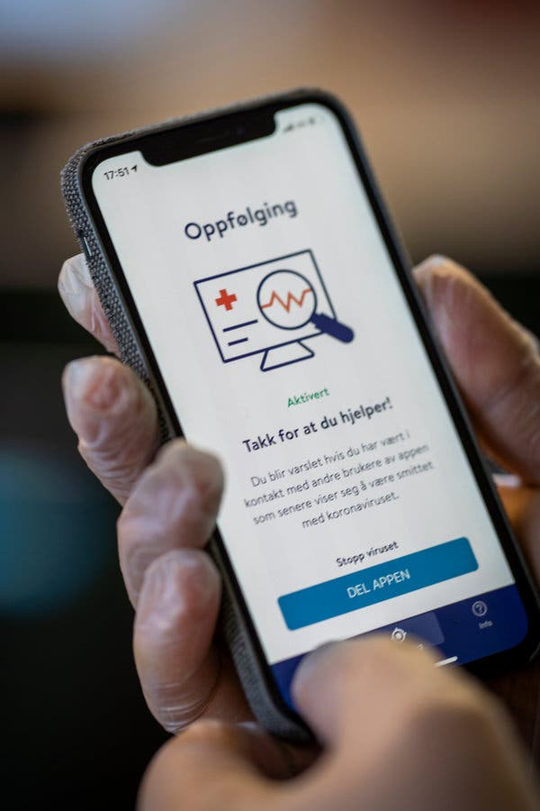

In 2020, Norway’s data protection watchdog temporarily banned a virus-tracing app, saying it collected far more data from users than it needed to function

Slide 31

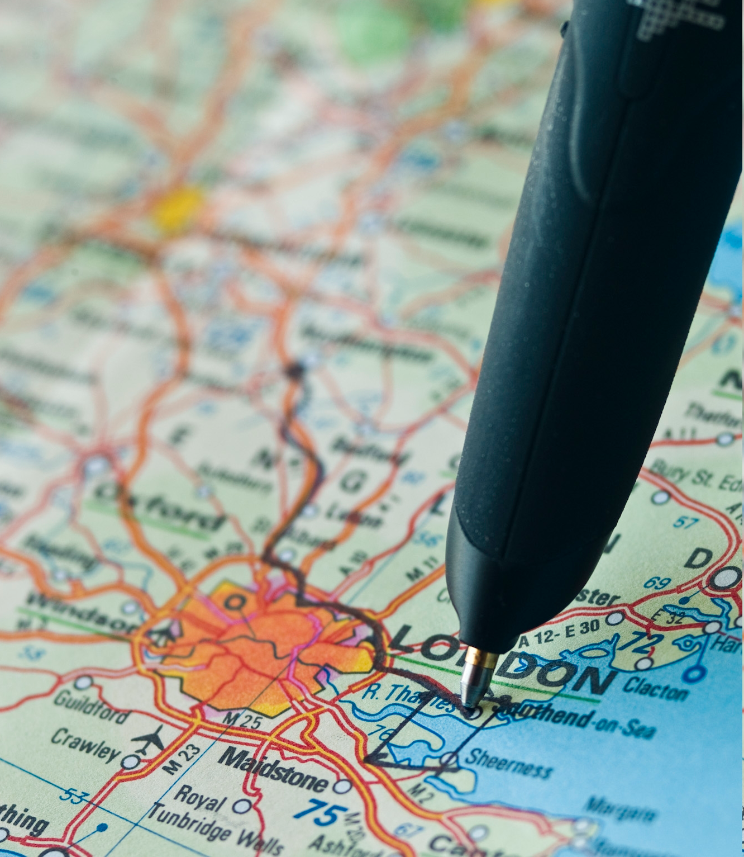

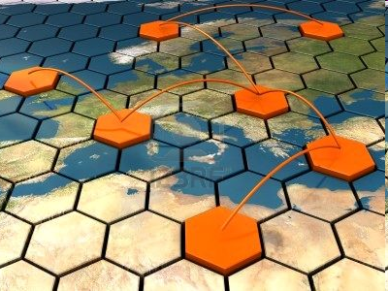

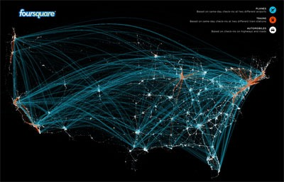

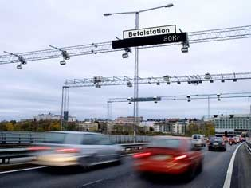
I Beacon Therefore I Am
Cellular Networks
Location-based Services
Social Networks
Internet Service Providers
Wireless Signals
Car GPS
E-Pass Cards
Credit Cards

Slide 32
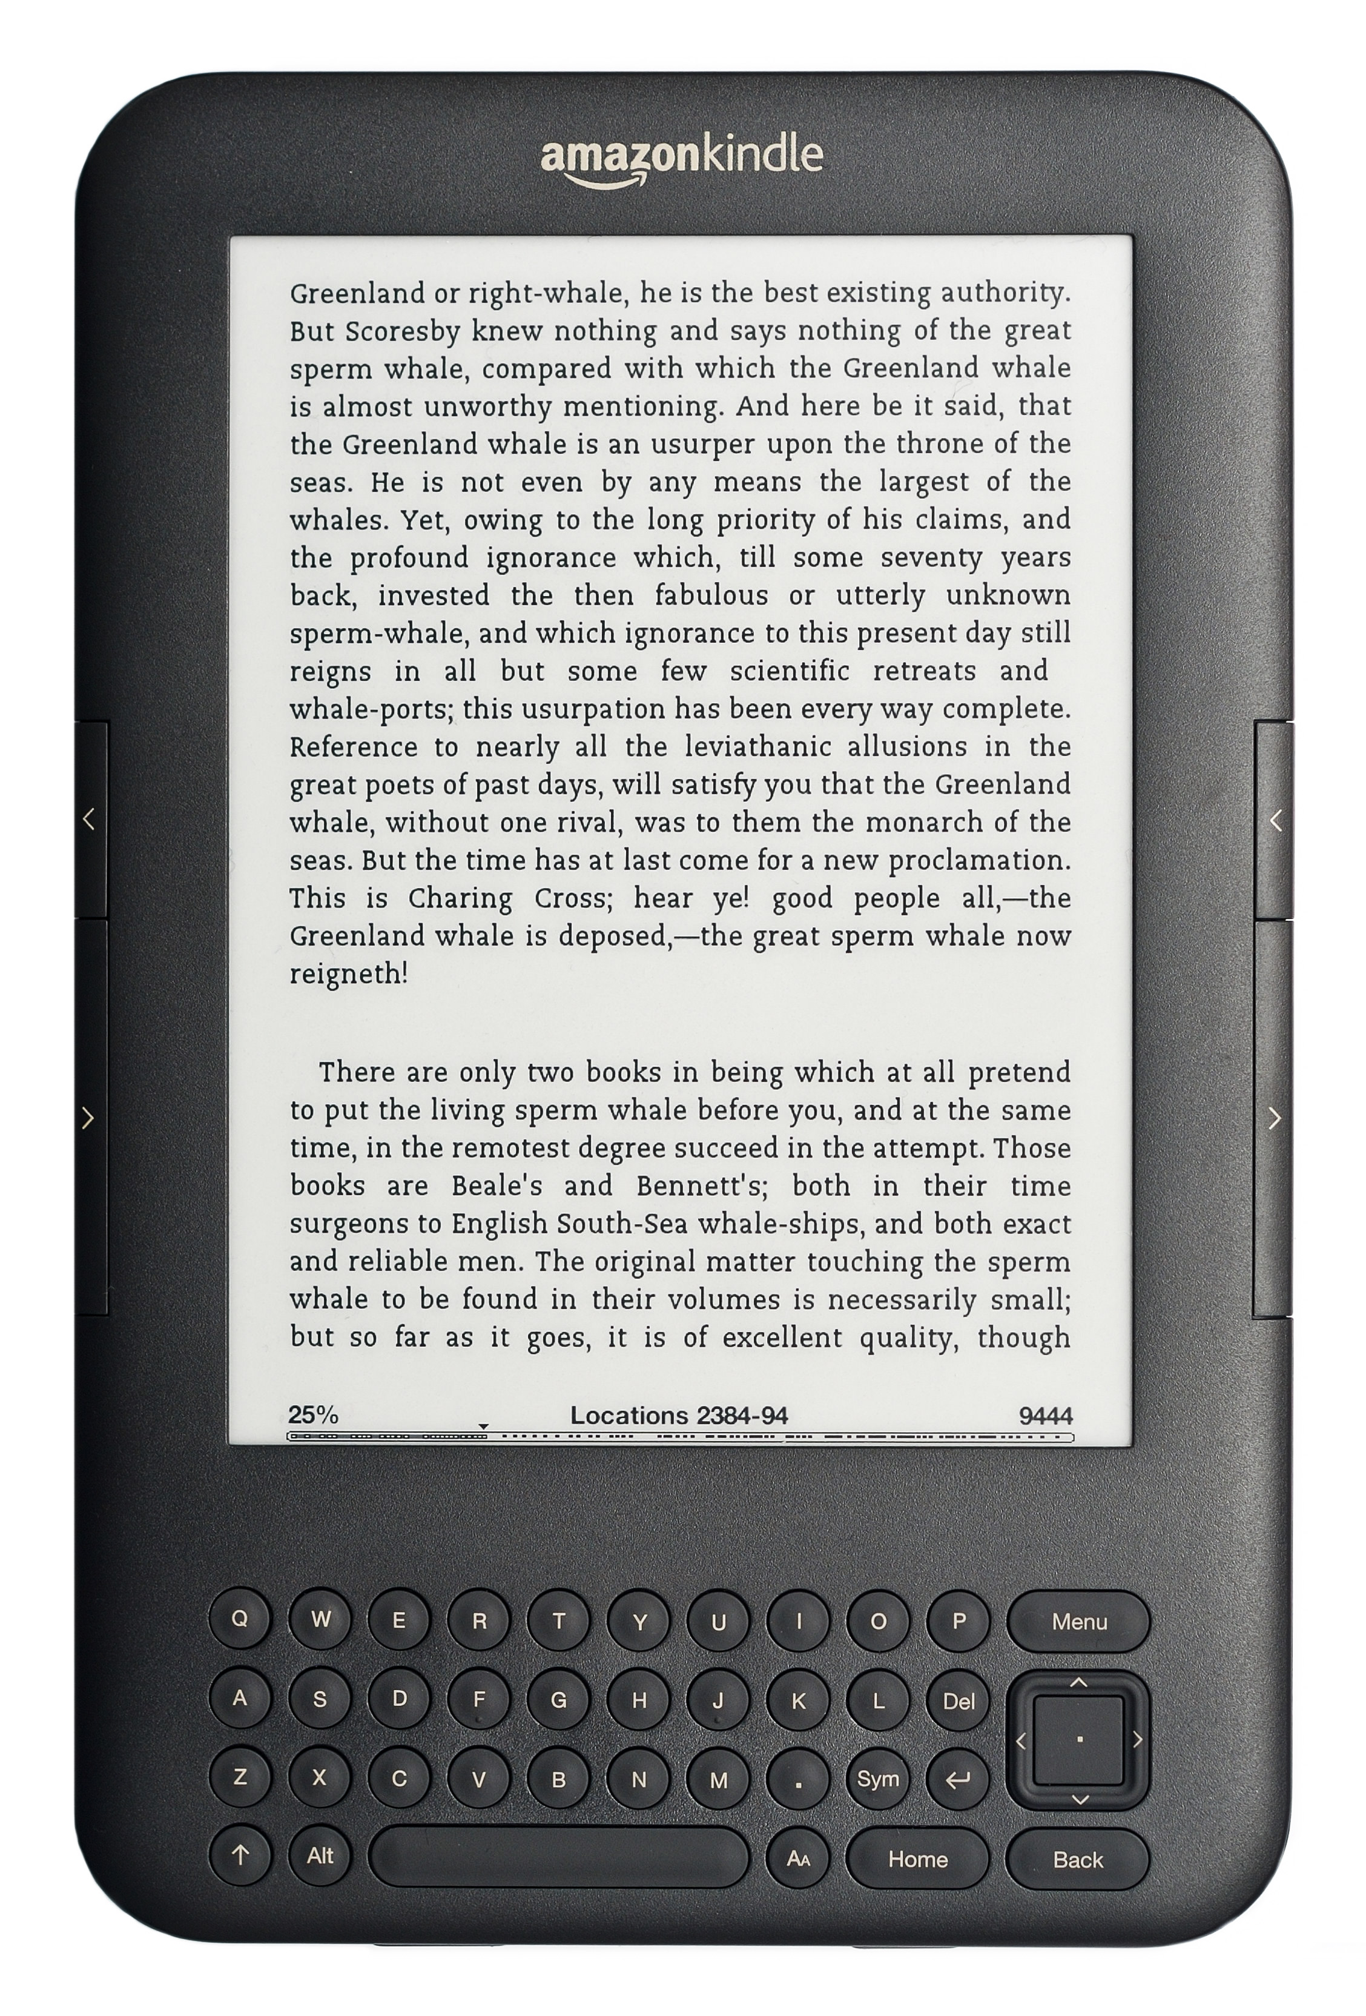
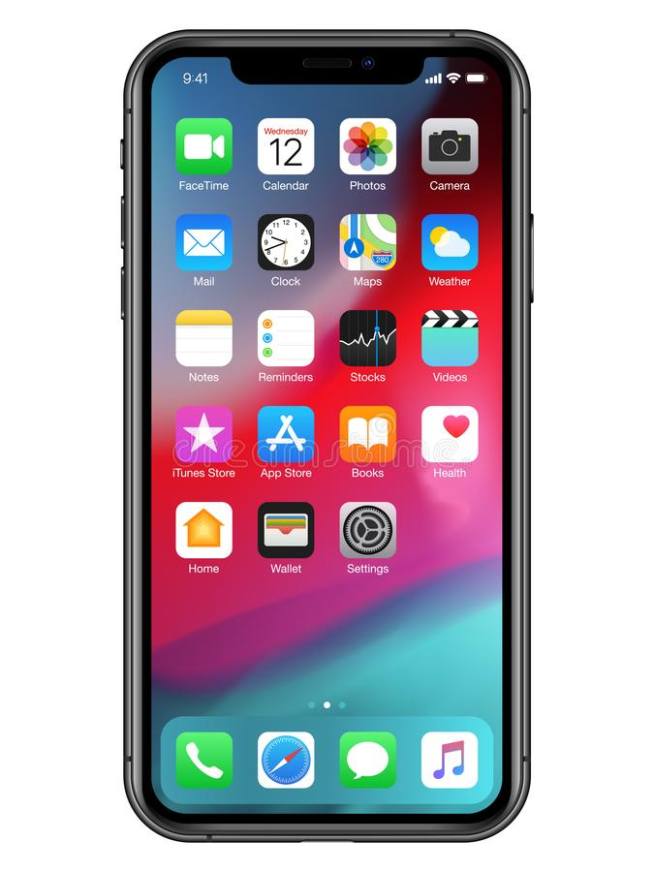

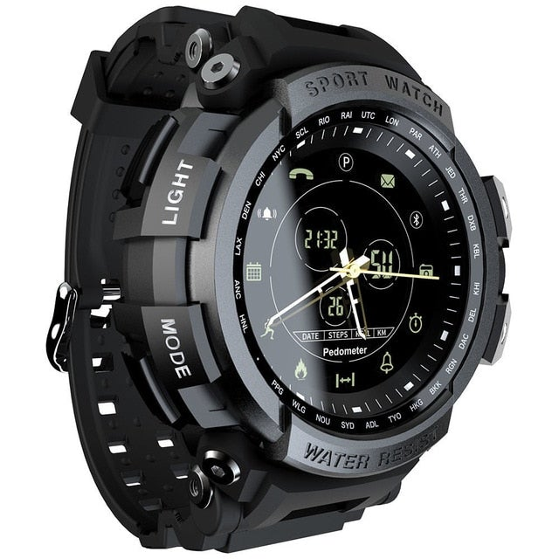
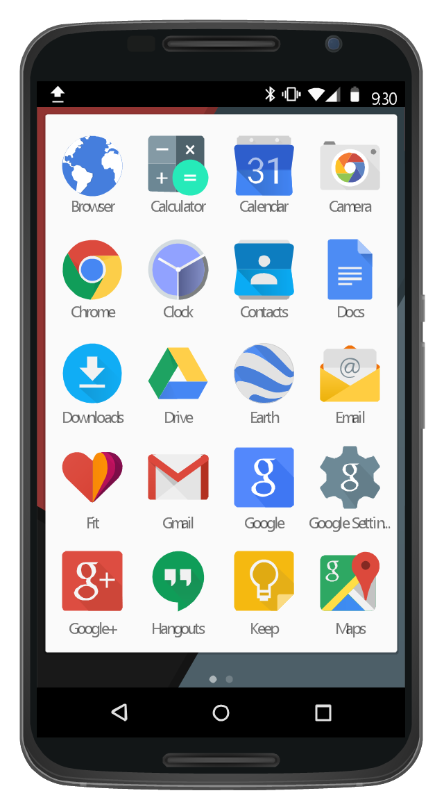

MAC Addresses
MAC addresses randomized
???

Slide 33
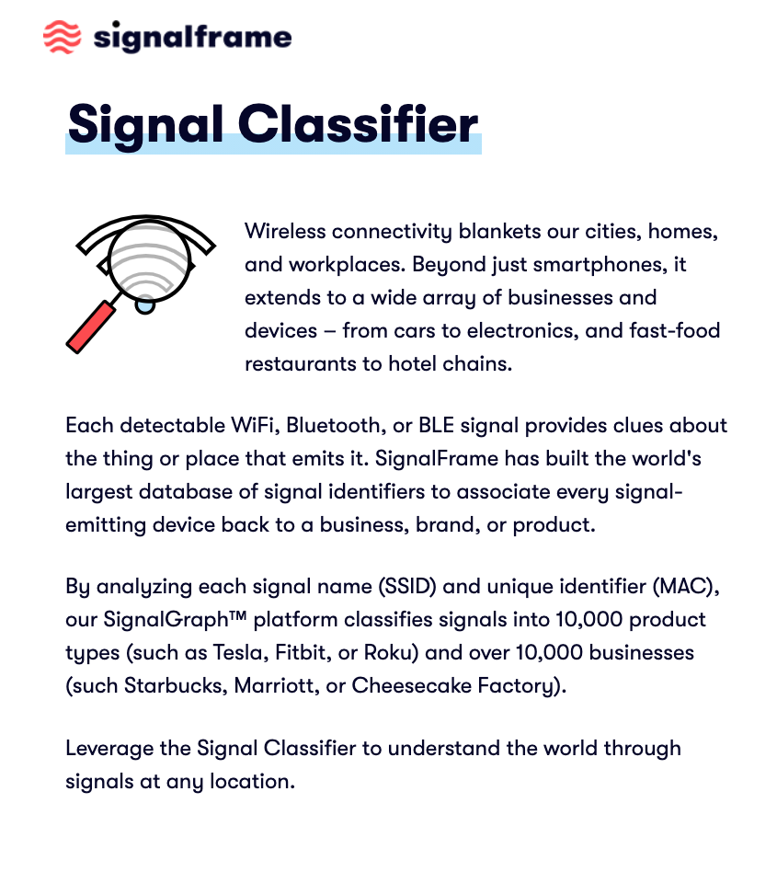
Turns any phone
into a wireless sniffer
Uses data from SDKs embedded in Android apps that are installed on millions of phones
Detailed datasets of locations and “smart things” in every location
Commercial clients +
exploring government
applications
https://www.wsj.com/articles/next-step-in-government-data-tracking-is-the-internet-of-things-11606478401

Slide 34
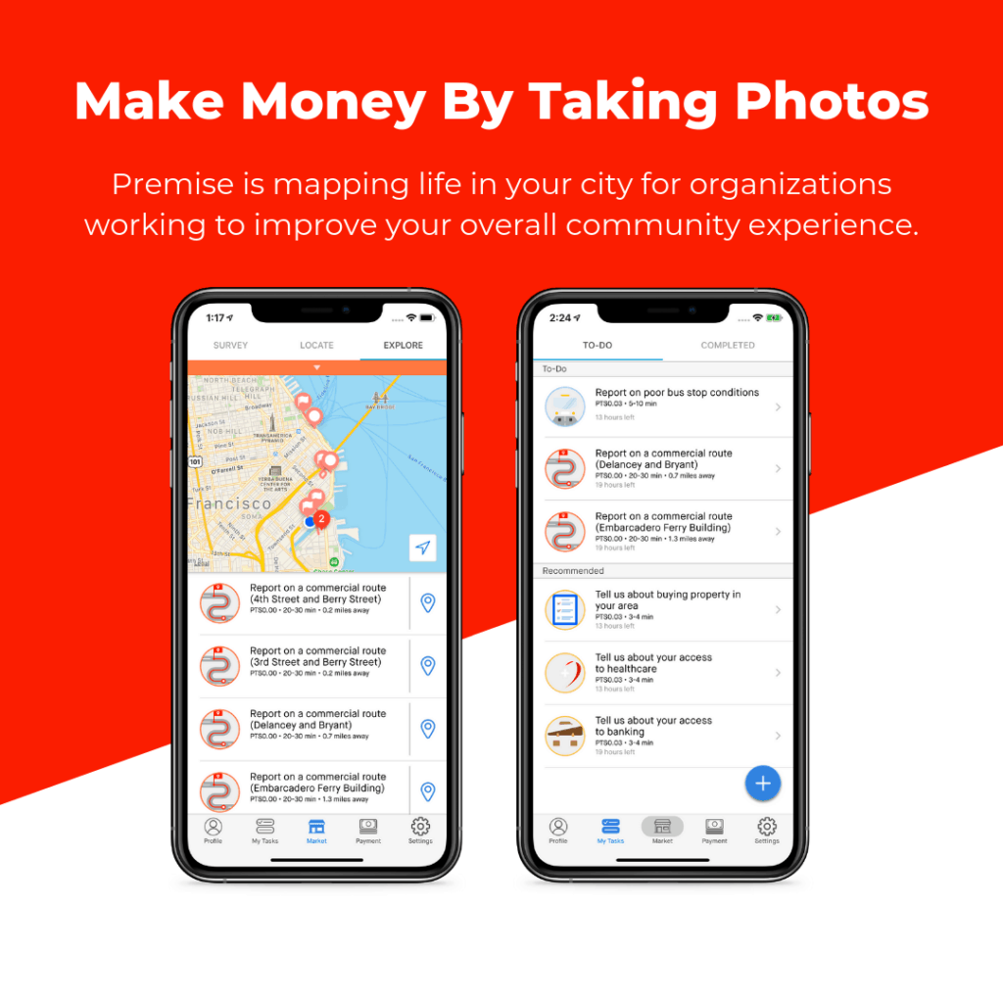
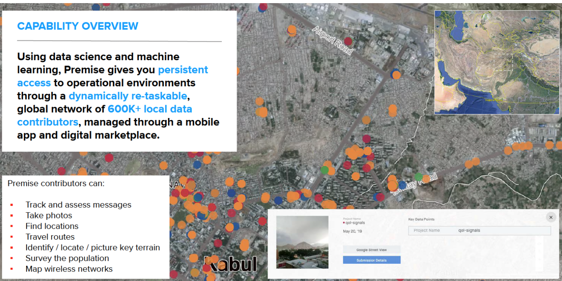
Premise app pays users to complete basic tasks for small payments. Typical assignments involve snapping photos, filling out surveys or doing other basic data collection or observational reporting such as counting ATMs or reporting on the price of consumer goods like food
600,000 contributors in 43 countries
Customers include US military and foreign governments.
Tasks include gauging the effectiveness of US information ops, scouting and mapping out mosques, banks, Internet cafes, covertly monitoring cell-tower and Wi-Fi signals.
https://www.wsj.com/articles/app-taps-unwitting-users-abroad-to-gather-open-source-intelligence-11624544026

Slide 35
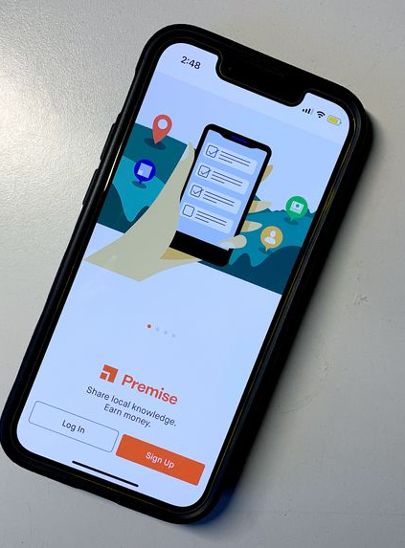


Risks to Users?
“Premise said the number of contributors arrested represents just 0.0007% of its total contributor base”
  Ukraine: user accidentally took a photo of military checkpoint while photographing “fields and farms” to verify accuracy of satellite imagery for a U.S. government contractor
  Arrests in Malawi (suspicion of black magic) and Rwanda
Also: Premise uses sensors on the user’s smartphone to collect data about nearby cellular towers and wireless networks
https://www.wsj.com/articles/gig-app-gathering-data-for-u-s-military-others-prompts-safety-concerns-11646481601

Slide 36
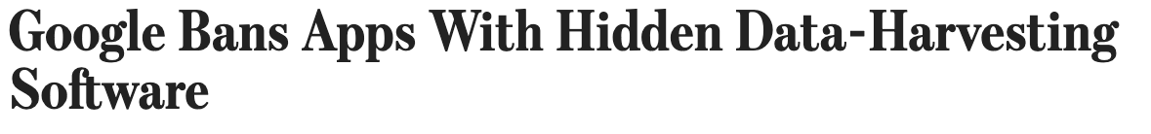
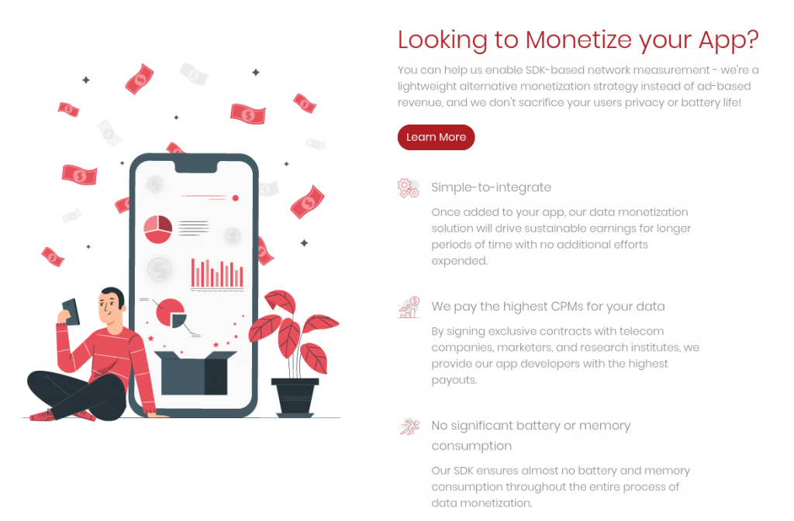
SDK in popular consumer apps on 60 million Android devices
harvested clipboard contents (can include passwords!), precise location, emails and phone numbers, data about nearby devices
Muslim prayer and weather apps, apps to detect highway speed traps
why these?
Developed by a Panamanian company connected to a U.S. defense and national-security contractor
Paid developers up to $10,000 to include SDK in their apps, focus on users in Middle East, Central and Eastern Europe, Asia
this is unusual!
https://blog.appcensus.io/2022/04/06/the-curious-case-of-coulus-coelib/
https://www.wsj.com/articles/apps-with-hidden-data-harvesting-software-are-banned-by-google-11649261181

Slide 37
App Privacy Labels (iOS 14.3)
Data used to track you
Contact info, identifiers …
Data linked to you
Purchase history, browsing history, usage data, financial info, health info …
Data not linked to you
Identifiers of other devices, sensor data …

Slide 38

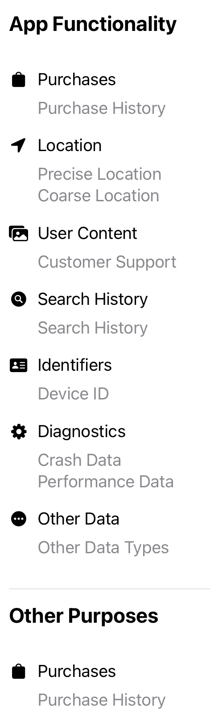





Slide 39



Slide 40

Tracking Permissions (iOS 14.5)
Users must explicitly allow app to track
If user does not grant permission …
No access to IDFA
App not supposed to collect other information, such as email addresses (developer’s responsibility)

Slide 41



Facebook’s Ad Microtargeting
Target ads to FB users with certain characteristics
Target ads to FB users with similar characteristics to existing customers
Very valuable for small businesses with limited advertising budgets!
Image: https://www.kopamarketing.com/blog/lookalike-audiences-facebook-ads-campaign

Slide 42




Cook vs Zuck
In March 2021, French competition regulator rejected the complaint but will investigate if Apple imposes stricter rules on third-party apps than on itself

Slide 43
Privacy vs. Competition?
Apple: “privacy is a fundamental right… A user’s data belongs to them and they should get to decide whether to share their data and with whom.”
Does not apply to Apple's own digital ad business (personalized ads in app store and Apple News)
Apple said its own data collection doesn’t count as tracking because it doesn’t share the data with other companies.
Advertisers: “the use of privacy as a sort of fig leaf for anticompetitive conduct”
https://www.wsj.com/articles/apple-faces-antitrust-complaint-in-france-over-privacy-changes-in-iphones-11603893625

Slide 44





Major Impact on Meta
FB stock performance

Slide 45


Recent Developments (Feb 2023)
Investment in AI to improve ad targeting based on less data
Bargaining with users to get them to agree to tracking in Meta’s own in-app privacy settings. Under the approach being tested, the company promises to show users fewer ads if they agree to provide their data.
New ad formats: lead generation, subscriptions, click-to-book, online promos…
https://www.nytimes.com/2023/02/02/technology/meta-stock.html
https://www.wsj.com/articles/meta-ai-facebook-instagram-reels-ad-targeting-11674829286

Slide 46
New Ad Technologies @ Meta
Advantage custom audience [similar to Lookalike audiences] guided by AI and machine learning to help improve advertiser campaign performance
Click to Messenger ads to reach the people most likely to make a purchase in a direct conversation with a business on WhatsApp, Messenger, or Instagram
Lead generation ads to “funnel” customers to either Messenger, or a form
Did ad result in user action?
Interoperable Private Attribution for privacy-preserving measurement of ad conversion
Private Lift Measurement to “help advertisers understand how their campaigns are performing while limiting what the advertiser and Meta can learn about a person”
Cryptographic techniques based on secure multi-party computation
more later
Did users who received ads buy more vs. those who didn’t?
https://www.facebook.com/business/news/helping-businesses-grow-with-ai-messaging-and-video
https://www.facebook.com/business/news/our-progress-on-developing-and-incorporating-privacy-enhancing-technologies

Slide 47

Apple’s SKAdNetwork
Attribution of ad to specific app takes place on the device
“Privacy-preserving” way to attribute impressions and clicks to app installs
Advertisers receive conversion data without fine-grained, user- or device-level details

Slide 48

Replacement for Advertising ID
https://developer.android.com/design-for-safety/privacy-sandbox

Slide 49







Everything Has a Fingerprint
Note: device fingerprinting banned by Apple, enforced in App Store

Slide 50
What Does an (Android) App See?
Unique device identifier (IMEI)
IP address
Fine- and coarse-grained location
Wi-Fi history
User’s photos, videos, calendar
Microphone, camera, other sensor data
  Note: accelerometer (gyroscope) does not require any permissions
Mobile fingerprint? Harder than on desktops!
Can be inferred from Wi-Fi and Bluetooth usage
Depending on permissions

Slide 51

Uber’s Fraud Problem (c. 2013)
Unscrupulous drivers in China would buy cheap phones, install Uber, register as new clients, order many fake rides from themselves
… erase/reset phones, repeat
Uber’s solution: fingerprint physical phone so that fingerprint survives factory reset
Uber’s app surreptitiously recorded phone’s serial number
  Possible before iOS 10

Slide 52


Uber vs. Apple
Grabbing the serial number is prohibited by Apple, can get an app banned
Uber’s solution: app checks location… if near Apple’s campus in Cupertino, do not grab the phone’s serial number

Slide 53


Also: Uber’s “Greyball”

Slide 54


Exploits a bug in Android that allows apps to access Wi-Fi frames sent by OS (contain networking info, including MAC addresses)
MAC address is a permanent identifier, survives reset of Advertising ID,
phone reset
https://www.wsj.com/articles/tiktok-tracked-user-data-using-tactic-banned-by-google-11597176738

Slide 55

China Advertising ID (CAID)
New device ID intended to bypass Apple’s app tracking transparency
Based on device fingerprinting
  Start-up time, model, time zone, country, language, IP addr
Backed by 2,000 biggest Chinese tech companies
  Goal: identify users who spend big on in-game purchases
None of these are “personal information” per Chinese standards
1.5 billion consumer identifications worldwide.
China is the most sophisticated market, 80% of digital-ad buying through programmatic ads.
No Facebook or Google!
https://www.wsj.com/articles/p-g-worked-with-china-trade-group-on-tech-to-sidestep-apple-privacy-rules-11617902840

Slide 56



What Do Cell Providers See?
T-Mobile tells subscribers it could share their masked browsing, app data and online activity with advertisers unless they opt out
Data “masked” by tagging with an encoded user or device ID to protect customers’ anonymity
ATT and Verizon automatically enroll customers into basic ad program that groups them into pools by interests
Customers can opt into sharing more detailed info for personalized ads
https://www.wsj.com/articles/t-mobile-to-step-up-ad-targeting-of-cellphone-customers-11615285803

Slide 57




What Does the OS See?
Always-on microphone
Fine-grained location tracking
Complete history of user commands, all data from all apps
  Need this to enable natural-language interaction: “show me all emails I ignored last week”
Context awareness
  Understand that “What’s his real name?” refers to the performer of the song being played

