Slide 1
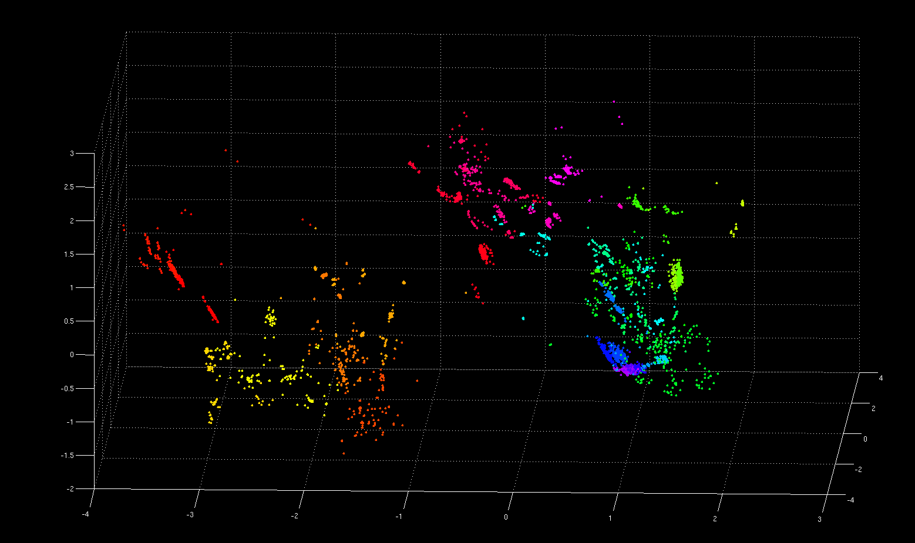
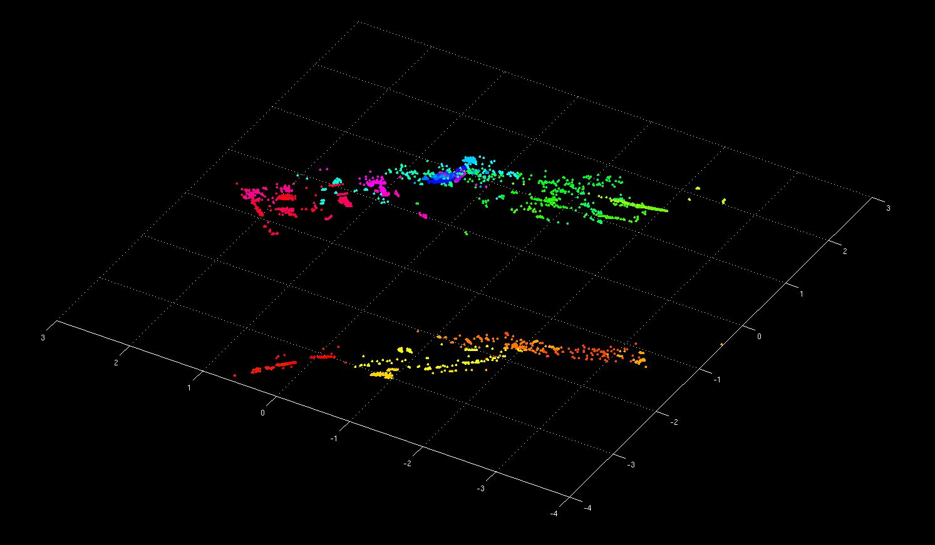
Non-Model-Based Algorithm Portfolios for SAT Yuri Malitsky², Ashish Sabharwal¹, Horst Samulowitz¹, Meinolf Sellmann¹
Algorithm Portfolios for SAT
Motivation
SAT community has produced dozens of excellent solvers!
complementary strengths: no single solver ‘wins’ on all benchmarks ☹
algorithm portfolios: given F, can we predict which solver will work best on F?
Dominant technique: runtime prediction, e.g., highly successful SATzilla variants
limitation: must fit a rather simplistic runtime model to complex solver behavior
Observation: all we need for portfolios is name of best solver, not actual runtime!
Main Findings
A simple k-NN classifier can outperform state-of-the-art portfolio solvers for SAT
E.g., improves upon SATzilla_R, gold medal winner, random category, Competition 2009
Further improvements: distance-weighting, clustering, and solver scheduling [CP-2011]
k-NN Classification for Algorithm Selection: (enhanced version participating in SAT Competition 2011)
SAT Instances in the Feature Space
[ “3D” projection of PCA on the
48-dimensional feature space ]
Working hypothesis:
instances close* in this space are best solved by similar solvers
⇒ ask neighbors rather than, e.g., try to predict runtime
Weight
* distance: Euclidean, L²
Experimental Results (sample)
Base solvers: those used in SATzilla_R (2009 Competition version)
Training instances: random category, SAT Comp. 2002-2007 | Testing: random, SAT Comp. 2009
Training Phase (offline):
repeat for k ∈ {1, 2, …, 200, …}
repeat for 100 random 70-30
base-validation splits of T_{train}
for all F ∈ T_{validation}:
identify k nearest* nbrs T_{nbrs} ⊆ T_{base}
S = solver with best PAR10 on T_{nbrs}
performance = PAR10(S, F)
output overall performance on T_{validation}
68 more instances solved
(closes 55% of gap to VBS)
24 additional solved
(closes 80% of gap)
T_{train} (training set)
compute features** & runtimes of all F ∈ T_{train}
“best” k (for T_{train})
Boosting the Performance of k-NN Portfolios [CP-2011]
(a) distance-based weighting (b) clustering (c) solver scheduling
** features: 48 core SATzilla features
* distance: Euclidean, L²
Challenging benchmark: a mix of 5567 application, crafted, and random instances from SAT Competitions 2002-2009; split 10-ways into 70-30 training-test datasets in a “realistic” / “mean” fashion: complete instance families missing from training!
Solver Selection:
T_{train}: training set (with features and runtimes)
k : “trained” neighborhood size
instance F
compute features of F
identify k nearest nbrs T_{nbrs} ⊆ T_{train}
output solver with best PAR10 on T_{nbrs}
solver S
© 2011 IBM Corporation

