Slide 1
How To Apply?
Sharif Univ. Of Tech.
Comp. Eng. Department
May, 18th 2013

Slide 2
Panel
Saeid Barati Computer Science | Sepehr Assadi Computer Science
Rahmtin Rotabi Computer Science | Negar Rahmati Electrical Engineering

Slide 3
Before we start
Should I Apply?
NOT Discussed Here!

Slide 4
Time Line
July
August
Look Through Universities
September
October
Take TOEFL & GRE
…
Prepare for TOEFL & GRE
Initial Contact with Profs
Write CV/SOP
Ask for Recommendation
Website

Slide 5
Time Line
Early November
Finalize Univeristies
Mid
November
Send Documents
December
Typical Deadlines
Contact Profs
Request Sharif Transcripts
Fill Application Forms

Slide 6
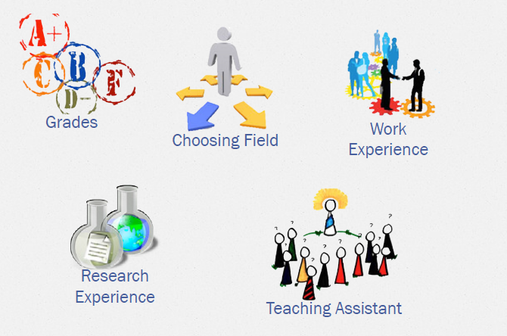
Before the Senior Year

Slide 7
The Summer

Slide 8
The Apply

Slide 9
Follow-up

Slide 10
Useful Resources

Slide 11
Q & A
Any question till now?
We will discuss each one in details later! ☺

Slide 12
GPA & Research
These are not Suggestions! Just experience!
Applying it self is not an academic activity!
There is no such thing as best action in whole apply process!

Slide 13
Research & GPA
Research
Working on a scientific subject
Usually done under supervision of a professor and/or in some lab.
GPA
Passing your courses with good grades.
Highly correlated with Ranks!

Slide 14
Research Experiences
Where to start?
1. Find your interest, then go for it somewhere!
2. Go somewhere to find your interest
A Piece of advice
Make sure about your interests before applying!
Notes
Recommendation Letters
Published Papers
Products

Slide 15
Research Pros & Cons
Pros: Find your interests Find what is your field about Get recommendation letter Prepare you for future It is supposed to be fun! | Cons: Not always straight forward! Not always promising! Bad recommendation letter! Lost in depth before even knowing the area

Slide 16
GPA
Average of the grades you pass in university!
Different Measures:
Total grades
Relevant courses grades
Online courses grades (With certificate)
Requested grades in the application forms.

Slide 17
GPA Pros & Cons
Pros: Completely straight forward! It is side effect of learning sometimes The main factor for some universities ( Especially for internship ) Helps you in university | Cons: Time consuming and requires constant attention! Sometimes, grades are completely independent of knowledge! Just a cut-off factor for many universities. Competitive unlike research

Slide 18
The Summer
Listing Universities
how open is each university in taking Sharif students
O Location
O Trustable Rankings

Slide 19
The Summer - Overview
Searching Universities and Professors
Do they work on fields that you want?
Fame and Popularity of a Prof can lower your chances
Contact their PhD students to get more info
Check other dept.s too, such as Math, ECE,Business, ...
Is the prof looking for a new student?
Have they had Iranian students?
Young Profs are recommended
G-Index, H-Index
Look at their recent publications
Skimming department news

Slide 20
The Summer - English
TOEFL
Summer is a good time
Books: 504, Delta, LONGMAN, Essential Words
You may try private classes especially for writing and speaking
Sample Tests (Cambridge & Barron's)
Good Test Centers: NOET & Amirbahador

Slide 21
The Summer - English
GRE
General
Subject – Computer Science
Recommended for those with low GPA
GRE is so important and effective!
Memorizing the verbal section? Impossible Mission! ☹

Slide 22
The Summer – Resume/CV
You in 2 pages
Important facts
Short explanation(if needed)
You in 2 minutes
Must be Accurate, Correct and Clear
Classify precisely
Bold the important points

Slide 23
The Summer – Resume/CV
Research Interests
Not to broad
Not to specific
Cohesive
GPA
Most updated GPA out of 20
Related course GPA
Publications
Complete information(e.g. Year, Co-authors, …)
Honors and awards
Admissions, Internships, Competitions
Medals, Rank of your entrance exam and …

Slide 24
The Summer – Resume/CV
Research and Academic activities
group or lab you have participated
Your role in the group or lab
Overlapped labs? ? ? ?
Professional experience
Your experience not related to Academia
Working in a company, Projects you have handled
Student divisions (e.g. SSC, Shora, …)
Teaching experience
You know what I mean! ☺
Test Scores
TOEFL, GRE, GRE subject

Slide 25
The Summer – Resume/CV
Skills
Any Programming language
Any software, Any hardware
Optional
Languages
Hobbies
Anything else

Slide 26
The Summer - SOP
SOP = Statement Of Purpose
WRITE IT YOURSELF
MIT wants a SOA(Statement of Objective)
Different ?
Now they are interested
You have been qualified
Purpose
How? when ? why ? then ?
Objective
Have you gone deep enough ?

Slide 27
The Summer - SOP
Tell more about your self
What happened
What are you planning on
Tell about your role in your academic works
You cant like all of the subjects
FOCUS on one subject
You can’t like ML, Theory, SW, Architecture, Network all together

Slide 28
The Summer - Contact
Contacting Professors
Links are everything.
This is where you can increase your chance
When and how many times?
Do not use template emails, try to personalize each email.
Mention highlights of resume +relevant research exp.
How much can you trust their responses?

Slide 29
The Summer - Contact
What can you understand from it?
Find someone in those unis to show your resume to the prof
Do not contact more than one prof at the same time in one uni
Do not contact more than 3 profs in the whole process in one uni

Slide 30
The Apply
Shortlisting Universities
Apply for MS or PhD( or MS-PhD)?
Use previous years results to get an idea about the range of universities you should apply to
Discuss with other people at your field and try to divide universities
How many schools should I apply?
Financial Limitations
Recommendation Limitation

Slide 31
The Apply
Extracting Important Dates
Different Process, Read the instruction page of each university carefully.
Record all data in an excel
Extract documents that should be sent
Some Unis need your recoms be submitted before a deadline
Some Unis send request to your referees after you submitted your application

Slide 32
The Apply
Ask for Recommendations/ Writing Recommendation Letters
Try to avoid recommendation conflicts
Who to ask for recommendations?
Should know you and your works
Are known to give good recommendations
Not good to write your recommendation letters
yourself
Good is Weak, A recom should be VERY STRONG.
Do Research With Your Referee

Slide 33
The Apply
Sending Documents
Easy process, using Sharif TNT
Send them at least 10 days prior to the
deadline
Send in groups to minimize cost, Get the
tracking#
Include your publications and resume if they don’t let you upload them
You may want to include your Resume anyway
Sending TOEFL & GRE scores via ETS

Slide 34
The Apply
Applying
Fill the forms as much as possible during the searching process
Uploading CV/SoP/Transcript/Test Grades
(These uploads should match the ones you mailed them.)
Pay and Submit

Slide 35
Follow-up
Keep in touch with Profs
Tracking Status
The Interviews
Prepare Answers
Choosing the School
Visa
US: Scan of I-20 For Emergency Time

Slide 36
Other Matters
After Getting an Admission
Withdraw the school you will not attend ASAP
Always appreciate their responses (Even if they have rejected you)
How to Pay?
Online Payment
Various Companies Issue Visa/MasterCard gift cards.
Sanctions
Use Proxy For Payment.

Slide 37
Useful Resources
CE-Apply Group
ApplyAbroad
TheGradCafe
USNews Graduate Schools Ranking
Microsoft Academic Search
Google Scholar
Persian Associations of Universities
List of Profs from previous year appliers

Slide 38
Questions & Discussion

