Slide 1
Game Optimization through Large-Scale Experimentation Erik Andersen Ph.D. student Center for Game Science University of Washington Computer Science Dept.
Notes:
Hi everyone! Thanks for coming to my talk. My name is Erik Andersen and I am a Ph.D. student in the Center for Game Science at the University of Washington. Our research group mostly tries to make video games to solve hard social problems such as protein folding and education. We’re also interested in using analytics, telemetry, and experimentation to improve the game design process.

Slide 2



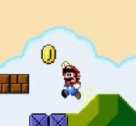
Music
Art
Sound effects
Gameplay
Notes:
One of the biggest problems facing game designers is how to invest money and resources to maximize revenue. If I’m a game designer and I have some budget, I need to decide how much time and money I want to invest in things like music, sound effects, art, and gameplay elements. Unfortunately, there isn’t a lot of data on how to do this efficiently, and what game design decisions will turn out to be the most effective, so we are forced to rely on our own intuition.

Slide 3


?
engagement
retention
revenue
Notes:
The reason that we as game designers invest in things like music is because they hope that the investment will pay off later. Hopefully players will like the game better, leading to increased engagement, retention and revenue. However, I want to show you the results from three experiments that we conducted on 110,000 players of three games showing that this isn’t necessarily the case. I want to make a case that the way that players respond to game design decisions can be quite counterintuitive and so it’s particularly important to test new ideas.

Slide 4


A/B Testing
Notes:
A convenient way to do this kind of testing is called A/B testing. The idea of A/B testing is that you make a change and then two different versions of your game.

Slide 5
A/B Testing
A
B
Notes:
Then you deploy your game to many people and you measure what happens.

Slide 6
Metrics
Levels completed
Time played
Return rate
Notes:
We can analyze engagement through a variety of metrics. One is the number of levels completed. Another is how long people spend playing the game. Also we can look at the return rate.
Jesse Hull and the guys from GSN games said earlier in the Online and Social Games summit that they used this kind of testing to improve revenue by 65% for one of their games. Zynga says that they use A/B testing but we don’t really know what they have discovered. They have said publicly that pink fonts are good for getting people to click on things. Unfortunately a lot of the A/B testing currently going on in the industry just evaluates small questions like what color should a button be. Also, there isn’t a lot of publicly available data. Instead, we want to push A/B testing as far as it can possibly go in order to answer the biggest questions of game design, and we want to gather lots of data so that we all can learn from it.

Slide 7



Secondary Objectives
Aesthetics
Tutorials
Notes:
In this talk, we will present the results of three different experiments that involved over 110,000 players. In the first experiment, we evaluated the importance of aesthetic elements like music, sound effects, and animations. In the second, we examined optional challenges and secondary objectives. In the third, we evaluated six different tutorial designs to find which was the most effective. In all three of our experiments, our hypotheses turned out to be completely wrong.

Slide 8
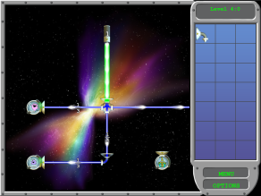
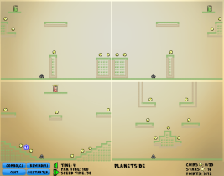
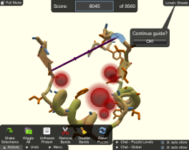
Refraction
Hello Worlds
Foldit
Notes:
We used these three games to conduct our experiments. The first game is Refraction, a puzzle game. The second is Hello Worlds, a puzzle-platformer game. The final game is Foldit, a protein folding game, which is hard to classify.

Slide 9
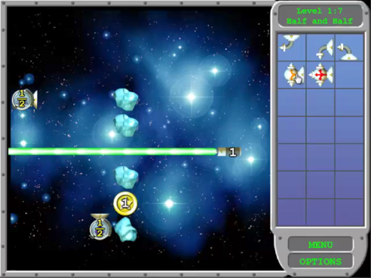
Refraction
Notes:
In Refraction, the player has to use pieces to split lasers to produce the correct fraction of laser. It was originally intended to teach fractions to kids but has also been successful among adults.

Slide 10
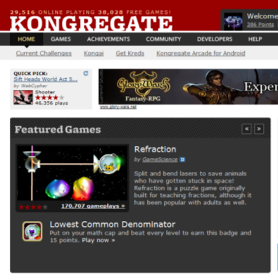
Rating: 3.8 / 5
400,000 plays
Notes:
We released Refraction on Kongregate and it’s rated 3.8 out of 5 and has been played 400,000 times. 3.8 is pretty good for a game on Kongregate, as Anthony Pecorella said at an earlier session in the Online and Social Games summit

Slide 11
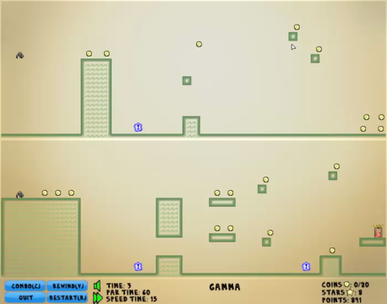
Hello Worlds!
Notes:
Hello Worlds is a puzzle platformer game created by a group of undergraduate students in a game design class at the UW. It’s like a normal platformer except that the player exists in multiple worlds at the same time. If the character hits a wall in one world, he hits a wall in all of the worlds.

Slide 12

Rating: 4.2 / 5
1,385,000 plays
Notes:
Hello Worlds was already released on Kongregate and did quite well. It’s rated 4.2 out of 5 which is high for Kongregate and for a while it was on the top page of the highest rated puzzle games. It has been played over 1,300,000 times.

Slide 13
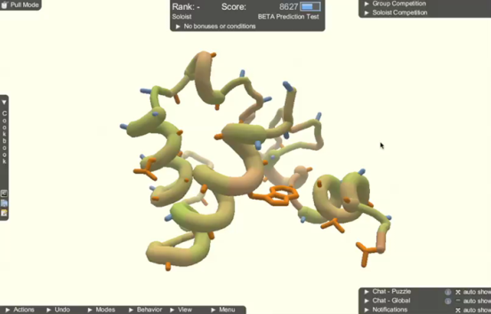
Foldit
Notes:
I hope some of you have heard of Foldit. Foldit is a game in which players fold proteins. Since the 3-D structure of a protein determines its function, we need to know that structure to know what it will do in the body. Finding these structures can lead to new drugs, biofuels, etc. Last year Foldit got a lot of press because a bunch of game players solved a protein structure related to AIDS in monkeys. Although scientists had been working on this problem for over 15 years, the game players solved it in three weeks.

Slide 14
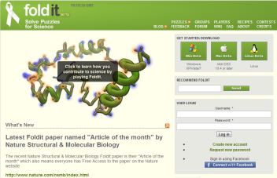
240,000 players
Notes:
Foldit is a downloadable executable hosted on our own website and has been played by over 240,000 people.

Slide 15
Player Tracking
Flash cache / login name
New players only
Notes:
Since players come back to play more than once, we want to track players across multiple play sessions in order to aggregate everything that they ever do in the game. For the Flash games, we tracked players using the Flash cache, which is the standard way that Flash games save play data. For Foldit, we tracked players using login names.
In both cases, we ignored players who had played the game sometime before the experiment because we assumed that they were already corrupted.

Slide 16
Statistical significance
95% confidence level (p<0.05)
Notes:
Whenever you are analyzing two distributions, and you see a difference between those two distributions, it’s important to check whether that effect is due to some real difference or just random noise. To do this we used statistical significance tests and only reported results at the 95% confidence level. For those of you who understand statistics this means that the p value was less than 0.05.

Slide 17
Experiment #1: Audio
Music
Sound Effects
Notes:
The first A/B test that we tried evaluated the importance of audio in Refraction and Hello Worlds. Both games have audio that came from free music websites and websites where you can get music under the Creative Commons license. We first tried removing music for half of the players, and then we tried removing sound effects for half of the players. There were about 2000 players in each experimental condition for each game. We expected that removing music and sound effects would cause players to play less, but we weren’t sure how much less.

Slide 18
Result:
Music and sound effects did not matter
Notes:
Surprisingly, nothing happened. We don’t really know why this happened. It may be because audio isn’t integrated into the gameplay at all. Some games, like rhythm games such as Guitar Hero, or first person shooters, have audio that is really important for gameplay. For us it’s just there for aesthetics, so maybe it doesn’t matter as much. It may also be because we just picked bad music. However, the result shows that the investment didn’t pay off which really surprised us because we used a pretty standard way of obtaining music. We know from our data that a lot of our players are playing during working hours. Therefore we think that a lot of people are playing from work and had the sound muted. This is important, because for free online flash games, if many people have the sound off anyway, then it may not be worth hiring an orchestra.

Slide 19
Experiment #2: Animations
Notes:
The next experiment we tried was to remove animations entirely from both games. Basically this made both games just a series of static images. This time, there were about 4000 players in each condition for each game.

Slide 20
Result:
Animations improved engagement
Notes:
This did affect player behavior. It improved engagement in both games.

Slide 21
Refraction
No Animations
Notes:
For Refraction, 22% more levels completed

Slide 22
Refraction
No Animations
Notes:
19% more time played

Slide 23
Refraction
No Animations
Notes:
2% more players returned.

Slide 24
Hello Worlds
No Animations
Notes:
For Hello Worlds, 18% more time played

Slide 25
Hello Worlds
No Animations
Notes:
2% more players returned.
We think animations mattered more than sound in our games because the animations provide visual cues that help the player know what to do, like how the pieces work in Refraction.

Slide 26
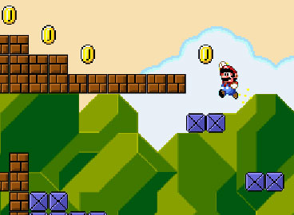
Experiment #3: Secondary Objectives
(Super Mario Bros., Nintendo 1985)
Notes:
We next examined the importance of secondary objectives. This experiment involved 27,000 players of Refraction and Hello Worlds. Modern games are filled with secondary objectives, and they appear as side quests, coins, collectibles, achievements, badges, and many other forms. Recently achievements in particular have become really popular. What distinguishes secondary objectives from primary objectives is that they are optional and the player can choose to go after them or just ignore them. As game designers, we add them for many reasons: to provide ways for expert players to distinguish themselves, to add more content to a game and increase replayability, and to provide flexbility to the player.

Slide 27
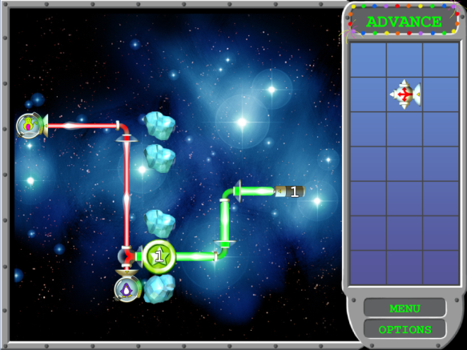
Notes:
In Refraction, these take the form of coins, which force the player to find a more difficult solution to each puzzle.

Slide 28
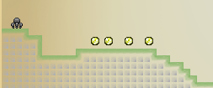
Notes:
Hello Worlds has coins that are very similar to Mario. You just have to touch them to pick them up.

Slide 29
100
% of
players
0
Levels
Notes:
In order to explain the effects the secondary objectives had on our games, we need to visualize progress in the following way. I’m going to show a series of graphs that look like this. The x-axis here is the number of levels completed. The y-axis is the number of players who played for at least that amount of levels. So 100% complete level 1, 90% complete through level 5, etc. Basically all games have a decay curve that looks something like this.

Slide 30
Hypothesis
100
With Coins
% of
players
0
Levels
Notes:
We hypothesized that if we added additional objectives, this would give players something to come back to do, so overall it would increase player progress.

Slide 31
Reality
100
With Coins
% of
players
0
Levels
Notes:
But actually it just distracted them in both games.

Slide 32
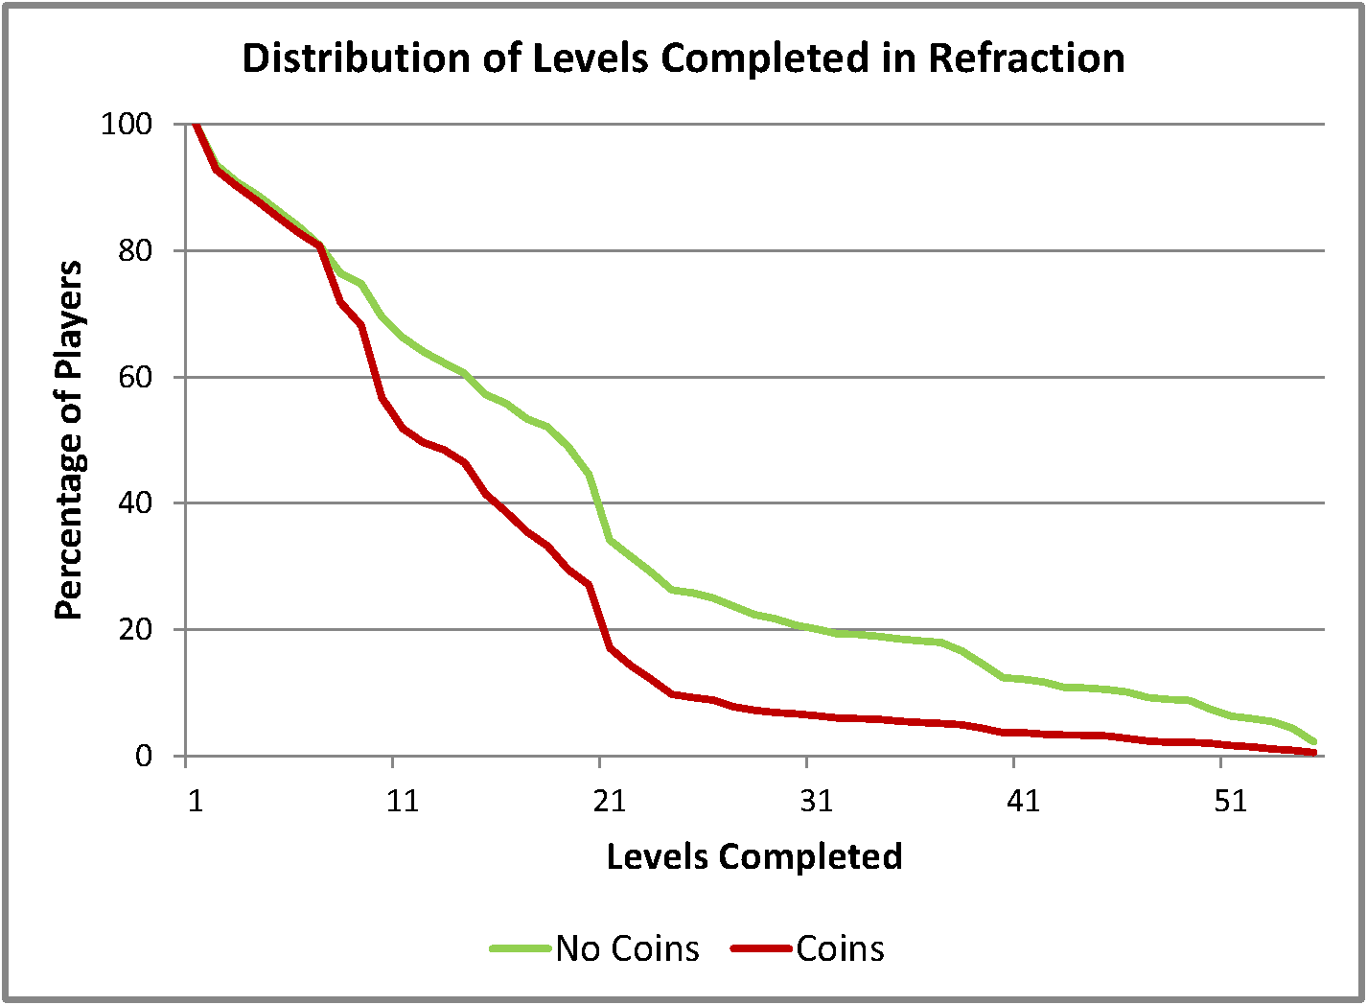
Notes:
The red line is the version with the coins and the green line is the version without coins. Note how the red line is way below.

Slide 33
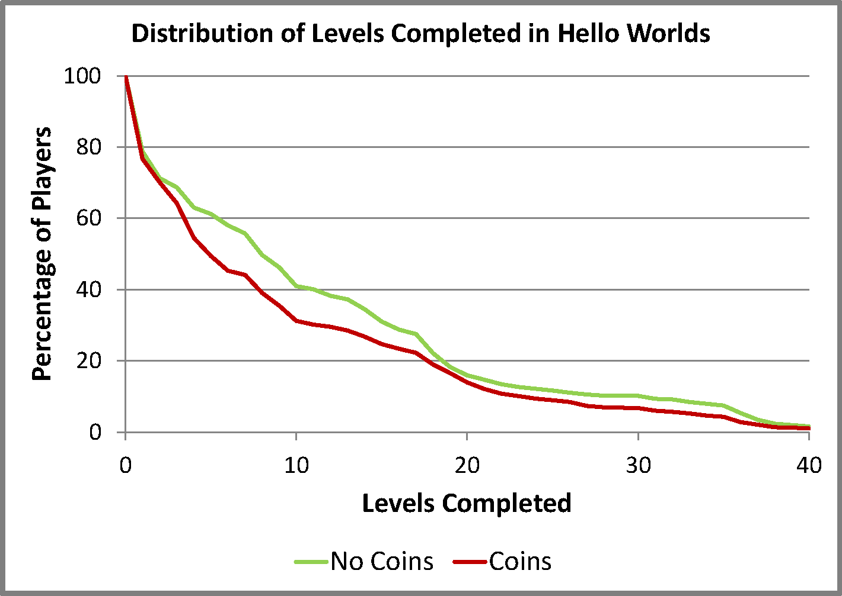
Notes:
Hello Worlds had the same effect although smaller.
Therefore, the coins were distracting players from completing the primary goals of the game. Whether or not this is a problem is up to the designer. A designer might think, well, as long as people are playing the game for the same amount of time, I don’t care what they are doing. If they are completing the secondary objectives or the primary objectives it doesn’t really matter. However, in our case, we do care if people complete the primary objectives because we spent a lot of time developing the end of the game.

Slide 34
What about time played?
100
% of
players
0
Time
Notes:
So a more important question, perhaps, is how do secondary objectives affect the length of time that players play the game? It’s possible that even though players aren’t getting as far, they are spending more time playing the game in order to get the secondary objectives. So let’s look at time played.

Slide 35
Hypothesis
100
With Coins
% of
players
0
Time
Notes:
Again, we hypothesize that if we add coins, players will play longer.

Slide 36
Hypothesis
100
With Coins
% of
players
0
Time
Notes:
But we admit that it might be a bit naïve to assume that we would get a positive effect for all players. But we might at least expect to see a boost for long-term players because they have more to do.

Slide 37
Reality: Many Players Quit Sooner
100
With Coins
% of
players
0
Time
Notes:
What we actually saw was this. The long-term players DO play more, but at the expense of the intermediate-length players! What this means is that the coins incentivize some players to play more, but others to play less. We saw the exact same effect in both games.

Slide 38
100
% of
players
0
Time
Notes:
What was particularly surprising was how big this group of players was. For Refraction, which I will show you in the next slide, this group of players was four times as big as the group of players who played longer.

Slide 39
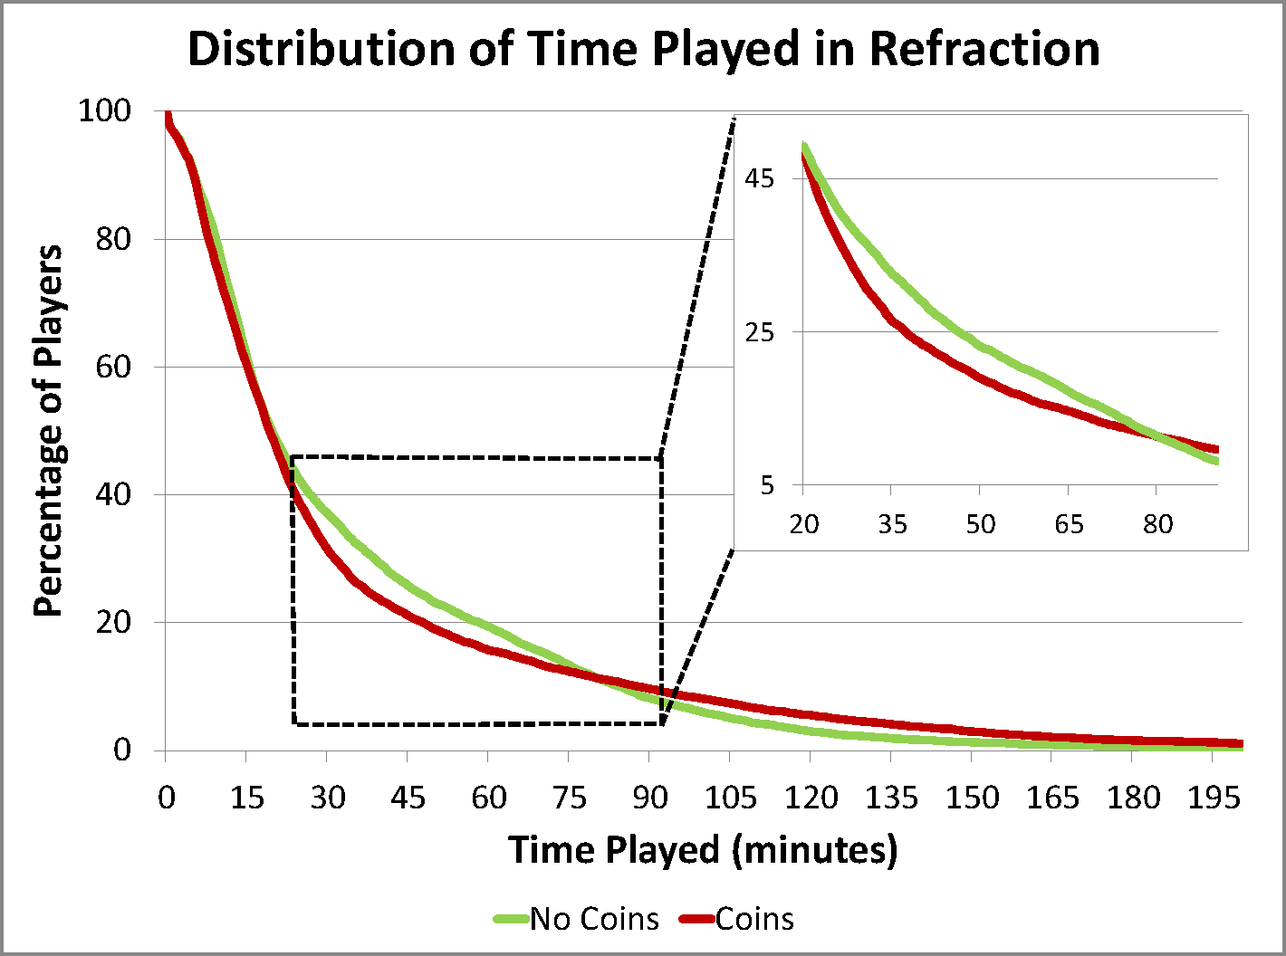
Notes:
There are 8000 players in each condition. In the long-term, the coins do cause players to play longer. However, for players who play between 15 minutes and 80 minutes, the coins cause some players to quit as much as 10 minutes earlier (if you measure the horizontal distance between the curves at about 23% of players remaining). Actually, the average playtime is exactly the same between the two conditions, meaning that the total amount of time that players spend going after the coins is completely canceled out by the players who weren’t there because they quit earlier.

Slide 40
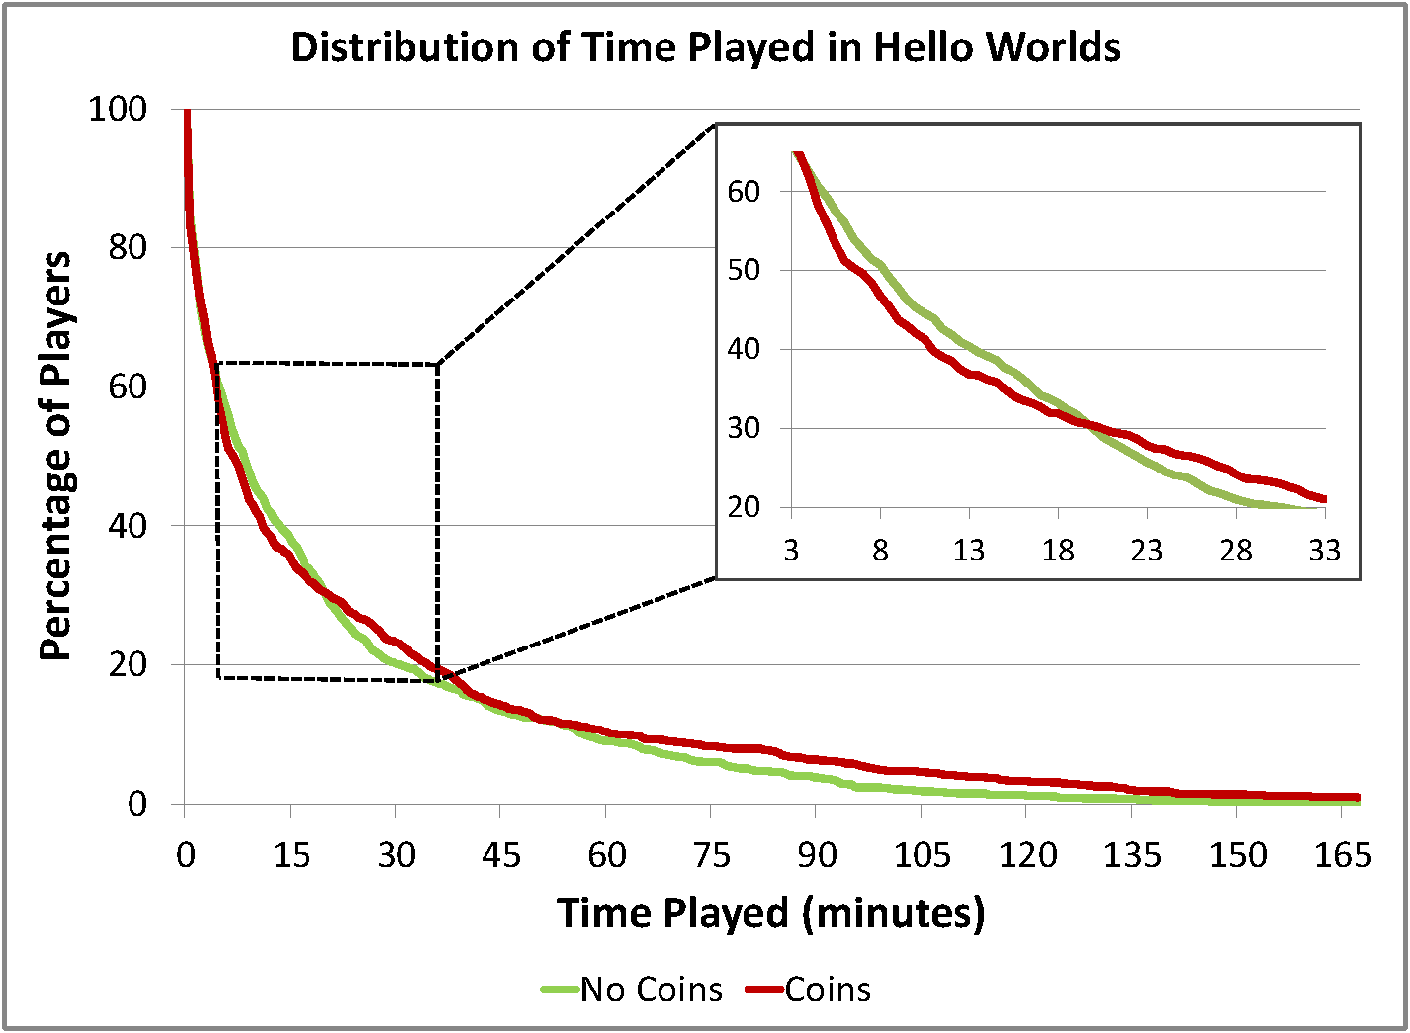
Notes:
There are 1000 players in each condition. We see the same effect. The proportions are a little different here; in this case, about 30% of the players play more with coins, and 30% play less.

Slide 41
Result:
secondary objectives harmed engagement
Notes:
As a result, we can see that for some players secondary objectives actually harmed their engagement! What this shows is that players can easily become fixated on things. Just because the designer thinks something is optional doesn’t mean that the players will think that it is optional. In some cases, adding a difficult secondary objective may dramatically alter the perceived difficulty curve for some players.

Slide 42
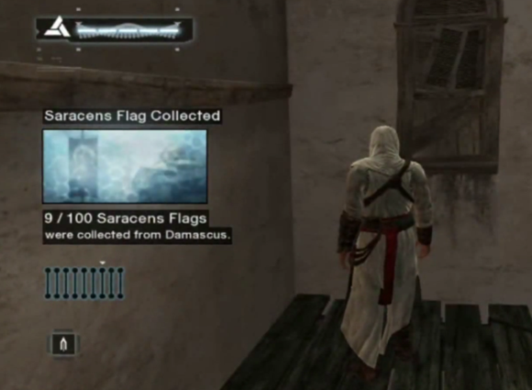
(Assassin’s Creed, Ubisoft 2007)
Notes:
Are there any industry examples of this? One example that comes to mind is Assassin’s Creed. This game was groundbreaking in many ways, but it also received a lot of criticism for having large numbers of boring collectible items. For example I just collected the 9th of 100 flags in this one city. Since the game was criticized so much for this, Ubisoft removed a lot of the secondary objectives in Assassin’s Creed 2 and Assassin’s Creed Brotherhood.

Slide 43
Maybe easier is better?
(Super Mario Bros., Nintendo 1985)
Notes:
However, thinking more, we remembered that many games have secondary objectives and they do fine. One thing we noticed is that in games like Mario, they are all very easy – you never have to go very far out of your way to get them. So we wondered if we were having problems because our secondary objectives are too hard and don’t support the primary objectives at all.

Slide 44

Notes:
So we took all the hard coins in Refraction,

Slide 45
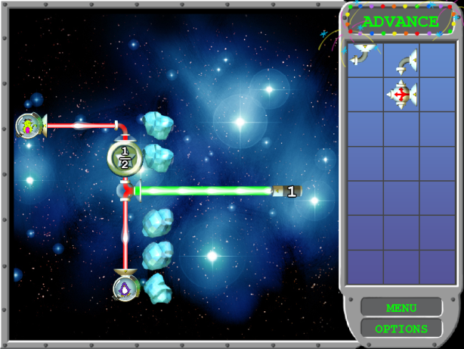
Notes:
And moved them so that they were easy and actually helped the player find the most natural solution to each level.

Slide 46
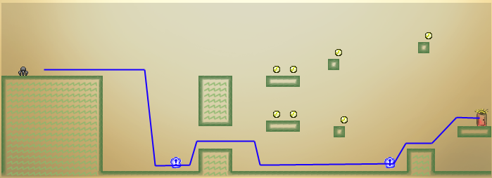
Notes:
In Hello Worlds we did the same thing – we moved coins that were off of the path

Slide 47
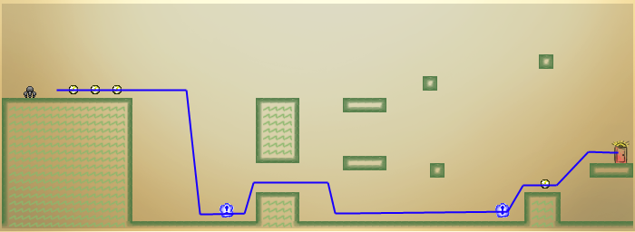
Notes:
And stuck them all on the main path through each level.

Slide 48
100
Off-path Coins
% of
players
0
Time
Notes:
Recall before that we saw a gain of some players and a loss of others when we added the hard coins, which we are calling “off-path”

Slide 49
100
On-path Coins
% of
players
0
Time
Notes:
When we examine the on-path, or easier coins, this dominated everything. We don’t get the sharp reduction of players in the intermediate region, but we still get a boost for long-term players.

Slide 50
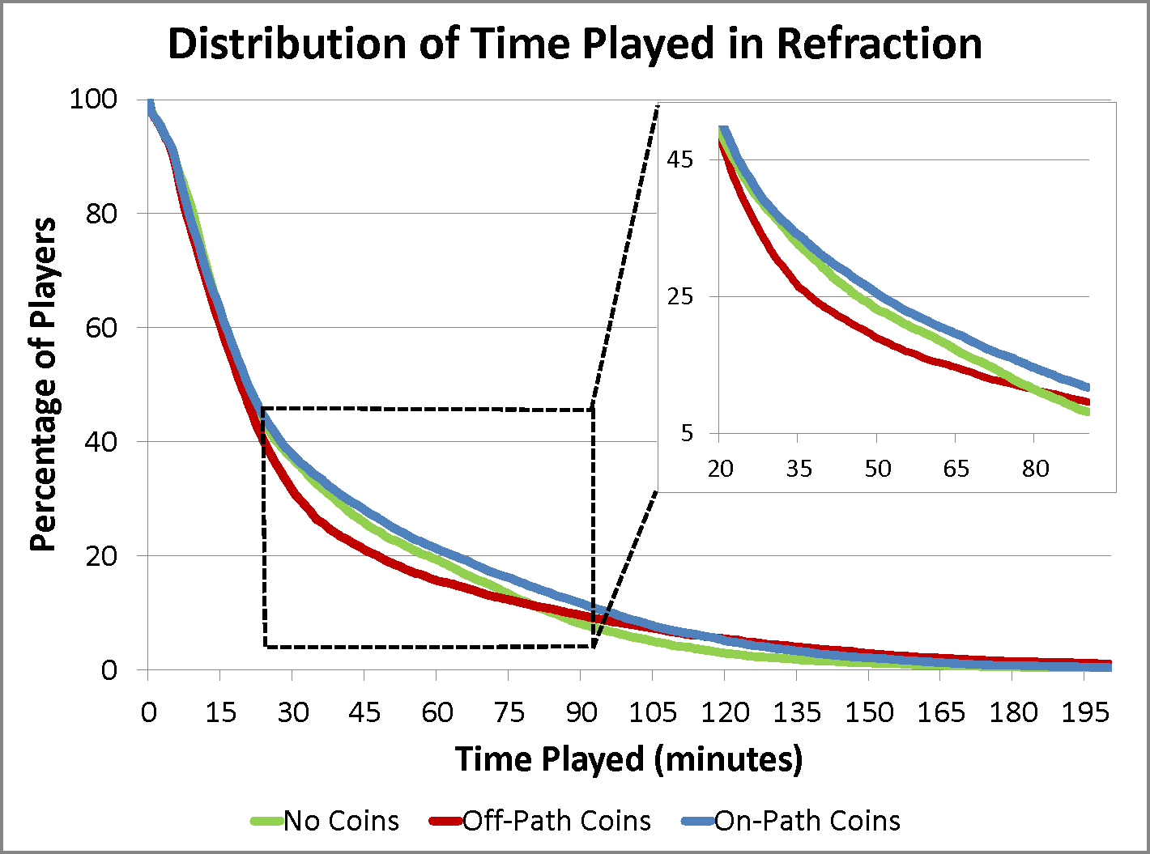
Notes:
The blue line is the on-path coins in Refraction.

Slide 51
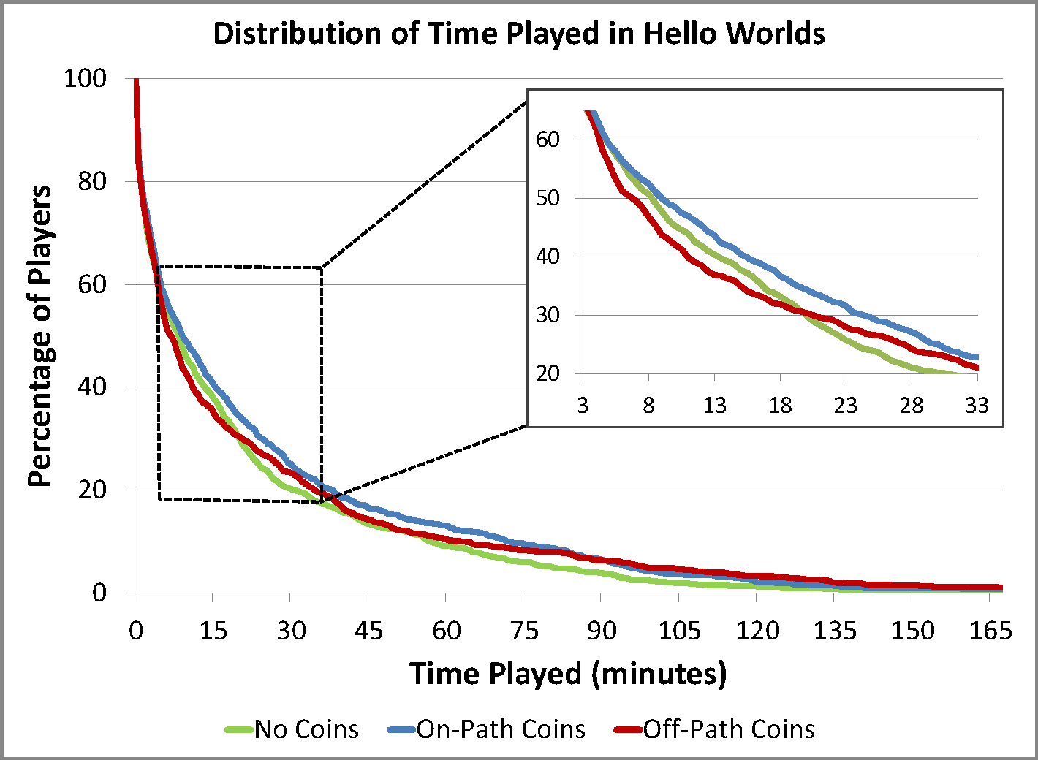
Notes:
We see the same effect for Hello Worlds.

Slide 52
Result:
secondary objectives were good if they supported the primary objectives
Notes:
Therefore, we can update our original statement a bit but saying that secondary objectives were good, but only if they supported the primary objectives of the game.

Slide 53
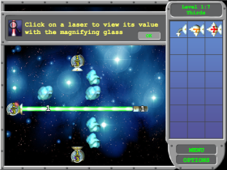
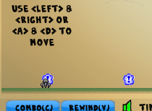
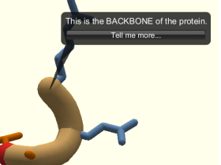
Experiment #4: Tutorials
Notes:
Our final experiment examined tutorials, and examined all three games: Refraction, Hello Worlds, and Foldit. This experiment involved 45,000 people. Tutorials are crucial for games because this is the primary way that players learn how to play. But there is a lot of disagreement within the game design community about how to do these effectively. Minecraft, for example, had no tutorials at all. You don’t want your players to be confused, but you also don’t want to harass them with lots of instructions. The first thing we tried was implementing what we considered to be standard tutorials – little text bubbles that would come up to tell you about new things you needed to do.

Slide 54
Foldit
No Animations
Notes:
In Foldit, this did help. Players had 75% more levels completed

Slide 55
Foldit
No Animations
Notes:
And 29% more time played.

Slide 56
Refraction and Hello Worlds:
no effect
Notes:
But in the other two games nothing happened. I think this is profound because for these two games it didn’t actually matter if we told the players anything about how to play the game. It was just as good to tell them nothing at all. We thought that a lot of players would ignore our tutorials, but we were really surprised that we couldn’t see any benefit at all. This means that this particular audience really seems to learn through exploration. Therefore it seems more important to design games so that players can discover game mechanics through exploration, and text tutorials really may not be that effect for these games.

Slide 57
Result:
text tutorials helped only in
the most complex game
Notes:
Therefore, the text tutorials only helped in the most complicated game.

Slide 58
Number of concepts
11
13
24
Notes:
Foldit is a lot more complicated than the other two, for two reasons. First, there are many more concepts needed to play the game as you can see from this chart. Second, it completely different from other games and so the game cannot rely on player intuition to teach concepts. As a result, the game has to explain more things in detail, and in many cases this is really hard to do without text.

Slide 59

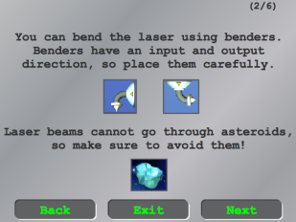
Context-sensitivity
Context-sensitive
Context-insensitive
Notes:
We also examined the importance of providing help “in context”. Many modern games have context-sensitive help, as shown on the right. This kind of help provides information to the player as close as possible to when they first need it. However, as shown on the right, many older games have what we call “context-insensitive” help. Basically this is a manual that the player reads before they play the game. We compared these two kinds of tutorials to each other and also to providing no help at all. We expected to find that the context sensitive help would do better than the context-insensitive, and that this was better than providing no help at all.

Slide 60
Result:
context-sensitive help was better
(if tutorials helped at all)
Notes:
We found that this did matter if the tutorials mattered. Therefore, if tutorials are effective at all, then it’s better to provide them in context.

Slide 61
Foldit
No Animations
Notes:
For foldit we saw 40% more levels completed

Slide 62
Foldit
No Animations
Notes:
And 16% more time played
But not in the other two games.

Slide 63
Let’s gather more data
Let us A/B test your games!
Notes:
I am completely willing to admit that the experiments that I just talked about are limited in scope. It’s just three games with a limited audience. But since many of the effects we observed did carry across multiple games, and we had thousands of players in each experiment, we hope game designers won’t ignore these results either.
So do you have a soundtrack that you think is really effective? Are you sure? We would really like to help you test it for free. Even if it’s just 1% of your player base. We want to test our theories on bigger titles with more players to see if we’re actually discovering something meaningful.

Slide 64
Coauthors
Yun-En Liu
Richard Snider
Roy Szeto
Seth Cooper
Eleanor O’Rourke
Jeff Lowdermilk
David Truong
Zoran Popović
Notes:
Thank you.

Slide 65
Acknowledgements
Kongregate: August Brown and Anthony Pecorella
Logging: Kefan Xu
Refraction Team: Erik Andersen, Yun-En Liu, Marianne Lee, Eric Butler, Brian Britigan, Stephen Sievers, Roy Szeto, Mai Dang, Christian Lee, Ethan Apter, Emma Lynch, Happy Dong, Zorah Lea Fung, Justin Irwen, Seth Cooper, François Boucher-Genesse, Zoran Popović
Hello Worlds Team: Rich Snider, Michael Eng, Marianne Lee, Blake Thompson, Jeff Flatten
Foldit Team: Seth Cooper, Adrien Treuille, Firas Khatib, Janos Barbaros, Joshua Snyder, Alex Cho Snyder, Jeff Flatten, Jeff Lowdermilk, Dun-Yu Hsiao, Jeehyung Lee, David Salesin, David Baker, Zoran Popović

Slide 66
eland@cs.washington.edu

