Slide 1
Density of States for Graph Analysis
David S. Bindel
Cornell University
ABSTRACT
KERNEL POLYNOMIAL ESTIMATES
Most spectral graph theory: extremal eigenvalues and associated eigenvectors.
Spectral geometry, material science: also eigenvalue distributions, a.k.a. density of states
What about the density of states of a graph?
Idea: Compute Chebyshev moments of local/global densities, estimate density as (smoothed) series in dual basis
Get moments via stochastic estimator: if z has independent random entries with mean 0 and variance 1,
GRAPHS AND MATRICES
Building blocks: adjacency matrix A, degree vector d = A1, degree matrix D = diag(d)
Graph Laplacian L = D-A and signless Laplacian Q=D+A
Normalized adjacency D^{-1/2} A D^{-1/2}, transition matrix D⁻¹ A (or A D⁻¹), normalized Laplacian D^{-1/2} L D^{-1/2}
Modularity matrix A-dd^{T}/2m
GLOBAL AND LOCAL DENSITIES
FEATURES OF DOS FOR NORMALIZED ADJACENCY
H = symmetric matrix associated with a network (Laplacian, normalized Laplacian, adjacency, etc)
Spectral mapping theorem:
The global density of states (DoS) is a generalized function associated with taking traces
The local density of states (LDoS) at node k is associated with diagonal elements (sum of LDoS = DoS)
LDoS can be used to compute many node centrality measures – but there is more information there!
Spectrum on [-1,1]
At -1: Bipartite structure
At -0.5: Single-attachment triangles
At 0: Nodes with multiple leaves
At 1: Connected components
More from symmetries: if PH=HP then any maximal invariant subspace of P is an invariant subspace of H.
Also: Have multiple eigenvalues if isomorphism group is non-abelian or if P has complex eigenvalues and H symmetric.

Slide 2
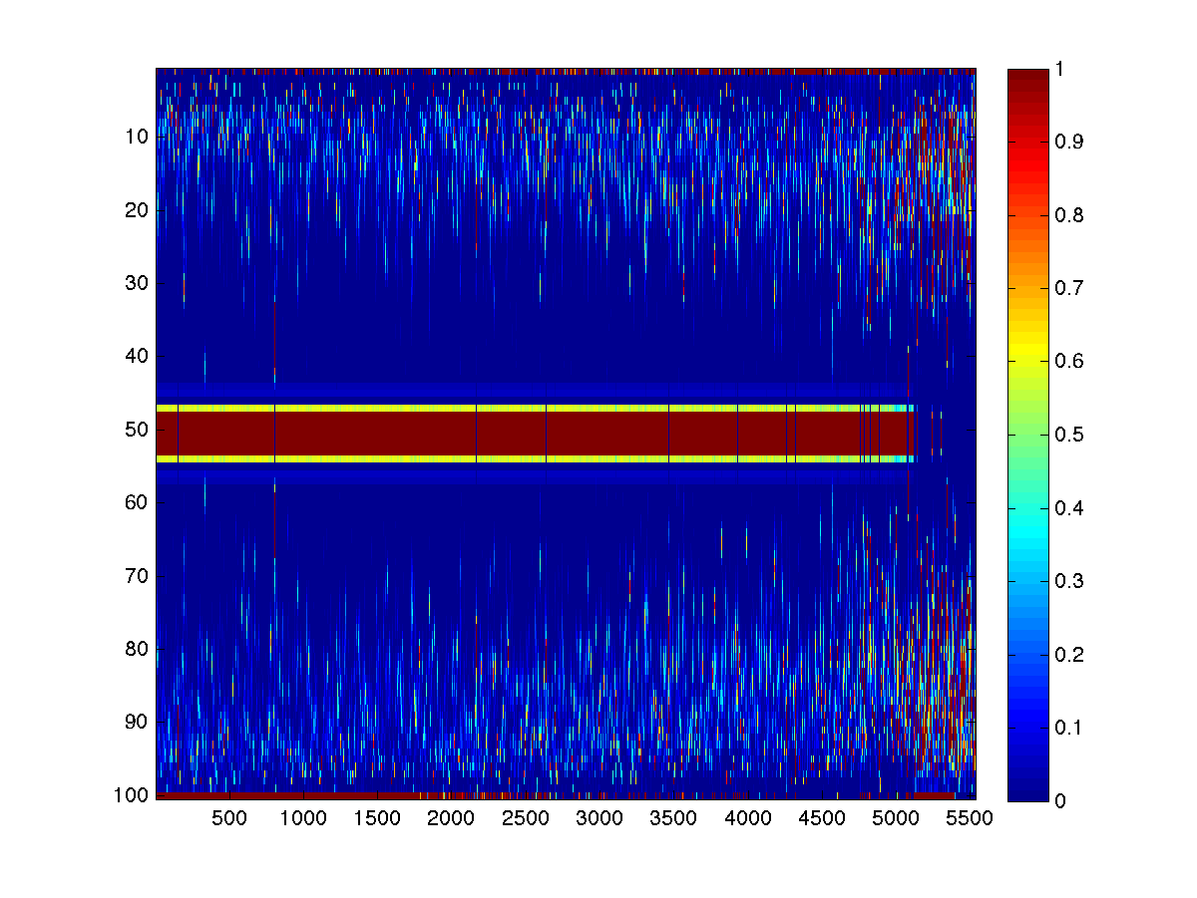
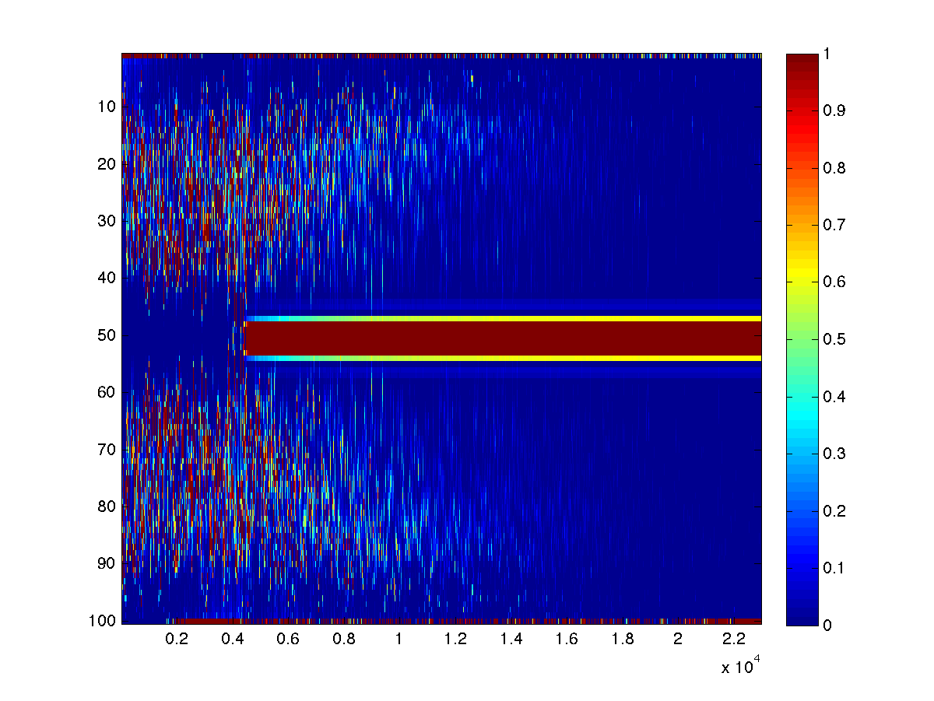
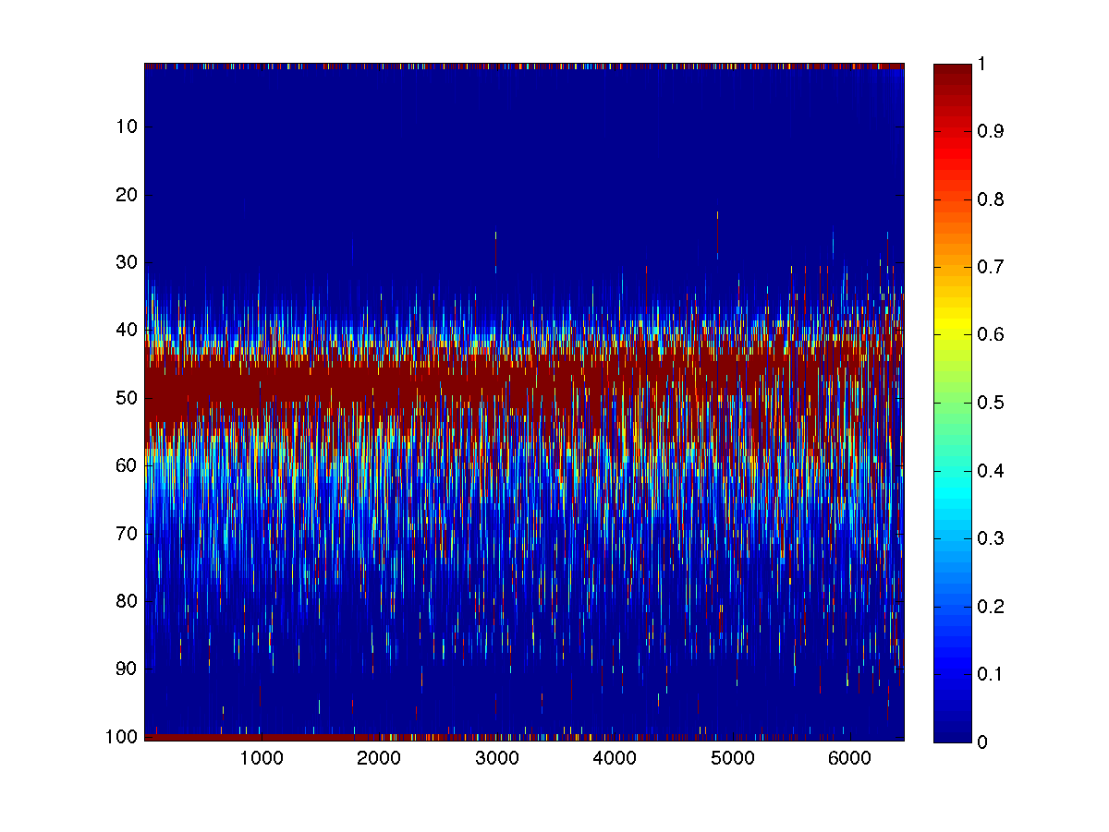
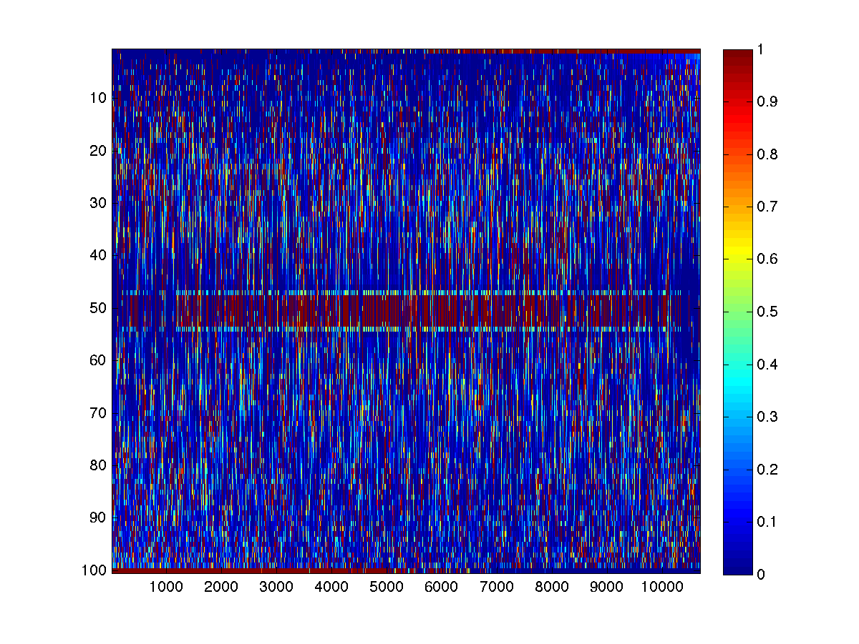
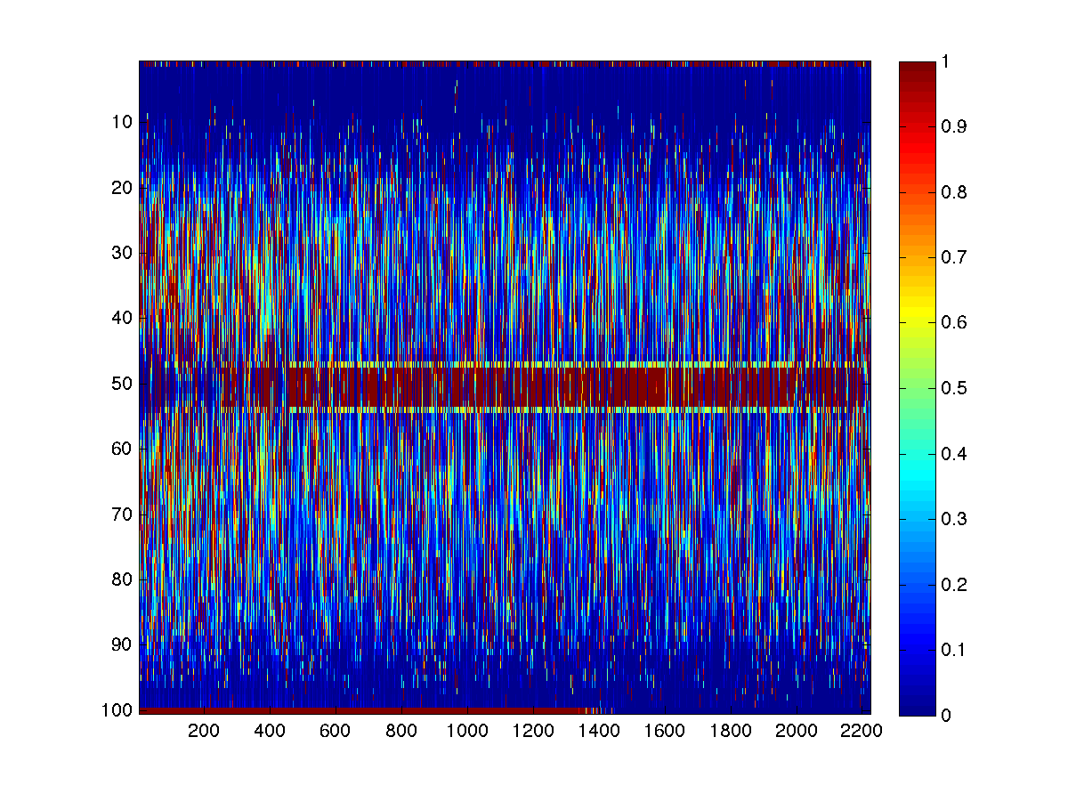
Density of States for Graph Analysis
David S. Bindel
Cornell University
Erdos
AS-CAIDA 2006
Marvel
PGP Keys
Yeast Proteome
Global DOS
(zero eig “trimmed”)
Local DOS
(one node/col)

Slide 3
Density of States for Graph Analysis
David Bindel
Cornell University
WHAT WE KNOW
Stability: DOS is stable under addition/deletion of a few edges (by interlace theorem)
Extreme eigs: Extremal eigenvalues correspond to components / bipartite structure
Exact asymmetry: When random walks on the graph are ergodic, there is an eigenvalue at 1, but not -1
Multiplicity: Highly-symmetric motifs cause “spikes” (particularly at zero)
Localization: Symmetries affecting only a few nodes lead to exactly localized eigenvectors
Semicircles and triangles: Standard random network models produce semicircular distributions (Chung) or sometimes more “triangular” networks for small world networks (Farkas)
Enron Emails
Reuters 9-11 Articles
US Power Grid
WHAT WE DON’T KNOW
Stability: How stable is LDoS under edge addition/deletion?
Approximate symmetry: Why does the DoS look so symmetric for some graphs – and not others?
Multiplicity: Exactly what symmetry patterns cause high-multiplicity “spikes” for some networks?
Localization: How should we interpret localized eigenvectors? What about approximate localization?
Random graph connections: Spectra of real-world networks do not look like those shown in papers based on random graph models; is this a harmless peculiarity, or a shortcoming in the models?
How do we turn pictures of spectra into intuition about graph structure?
REFERENCES
C. Bekas, E. Kokiopoulou, and Y. Saad, “An estimator for the diagonal of a matrix.” Applied Numerical Mathematics, 2007. doi:10.1016/j.apnum.2007.01.003
A. Weisse, G. Wellein, A. Alvermann, and H. Fehske, “The kernel polynomial method.” Review of Modern Physics, 2006. doi:10.1103/RevModPhys.78.275
F. Chung, L. Lu, and V. Vu. “Spectra of random graphs with expected degrees.” PNAS, 2003. doi:10.1073/pnas.0937490100
I. Farkas. “Spectra of ‘real-world’ graphs: beyond the semicircle law.” Phys Rev E, 2001. doi:10.1103/PhysRevE.64.026704
DBLP 2010
Hollywood 2009
https://github.com/dbindel/graph-dos

