Slide 1
Grouping

Slide 2
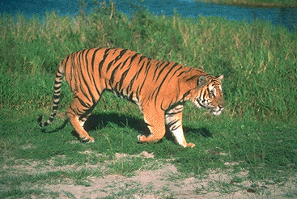
What is grouping?

Slide 3
Regions Boundaries

Slide 4
Why grouping?
Pixels property of sensor, not world
Reasoning at object level (might) make things easy:
  objects at consistent depth
  objects can be recognized
  objects move as one

Slide 5
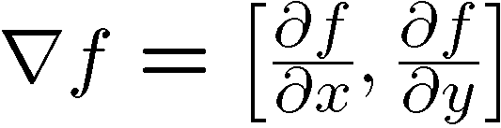
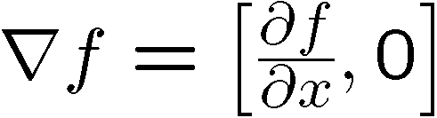
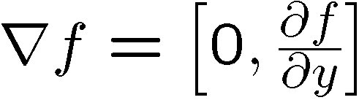
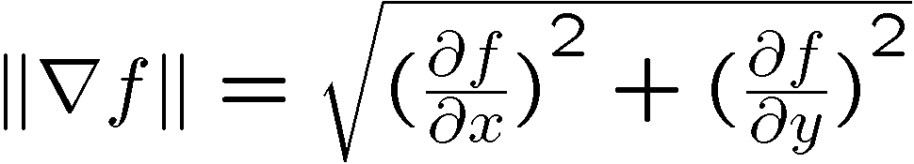
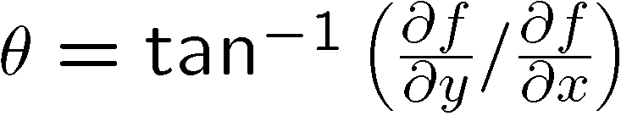
Image gradient
The gradient of an image:
The gradient points in the direction of most rapid increase in intensity
The edge strength is given by the gradient magnitude:
The gradient direction is given by:
  how does this relate to the direction of the edge?
Source: Steve Seitz
Notes:
give definition of partial derivative: lim h->0 [f(x+h,y) – f(x,y)]/h
Gradient direction perpendicular to edge direction

Slide 6
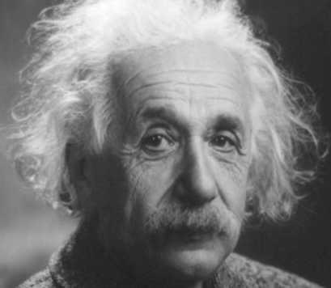
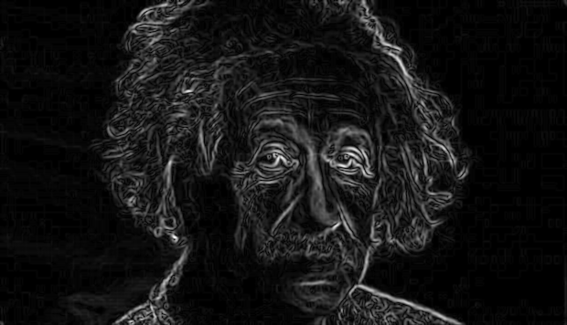
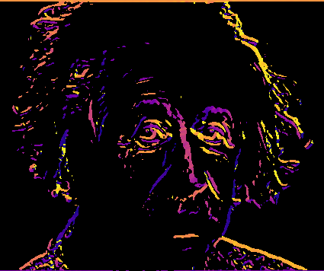
Gradient magnitude and orientation
Orientation is undefined at pixels with 0 gradient
Image
Magnitude
Orientation
theta = numpy.arctan2(gy, gx)

Slide 7


Non-maximum suppression for each orientation
At q, we have a maximum if the value is larger than those at both p and at r. Interpolate to get these values.
Source: D. Forsyth

Slide 8
Before Non-max Suppression

Slide 9
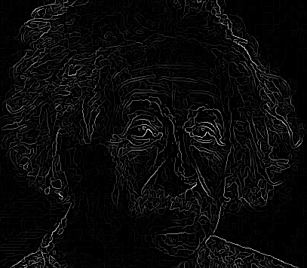
After Non-max Suppression

Slide 10
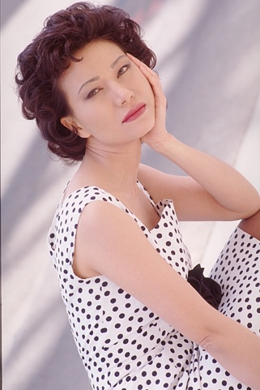

Image gradients are not enough
Hard-to-detect low contrast boundaries
Strong internal image graadients

Slide 11
Image gradients are not enough
Plain
“Texture”
Polka dots

Slide 12
What is texture?
Same thing repeated over and over

Slide 13
What is texture?

Slide 14
Julesz’s texton theory
What is texture?
Distributions of some elements
  Elongated blobs of specific orientations, widths, lengths
  Terminators (ends of line segments)
  Crossings of line segments
Textons

Slide 15
Bringing textons to computer vision
Define a “vocabulary” of textons
Describe texture by a distribution of different textons

Slide 16
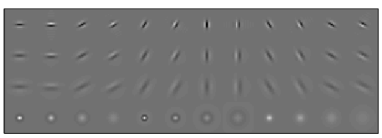
Bringing textons to computer vision
Define a “vocabulary” of textons
Describe texture by a distribution of different textons
Filter responses
Convolve with filter bank

Slide 17
Bringing textons to computer vision
Define a “vocabulary” of textons
Describe texture by a distribution of different textons
Filter responses
Convolve with filter bank
Collection of pixel feature vectors
…
Filter responses
Convolve with filter bank

Slide 18
Bringing textons to computer vision
Define a “vocabulary” of textons
Describe texture by a distribution of different textons
Collection of pixel feature vectors
k-means
Textons

Slide 19
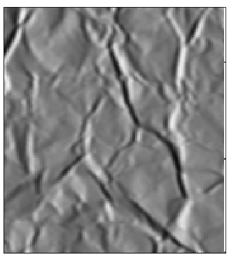
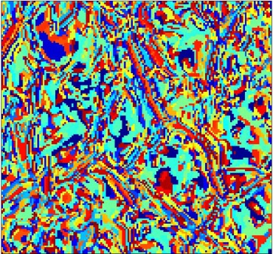
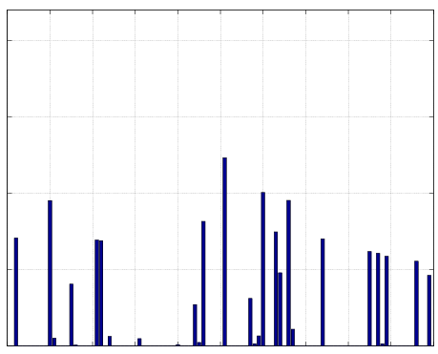
Bringing textons to computer vision
Define a “vocabulary” of textons
Describe texture by a distribution of different textons
Textons
Histogram
Leung, Thomas, and Jitendra Malik. "Representing and recognizing the visual appearance of materials using three-dimensional textons." International journal of computer vision 43.1 (2001): 29-44.

Slide 20
Textons in computer vision
Convolve with filter bank
Assign to k-means centers
Compute histogram
Image
Convolution
Point-wise non-linearity
Avg pooling
Image

Slide 21
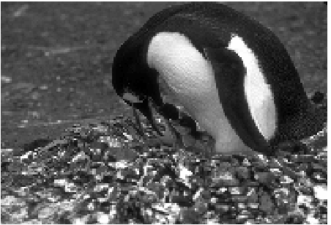
Detecting texture boundaries
Problem: gradient captures change from pixel to pixel
But texture property of region
Take region around pixel and
divide into two halves based
on hypothetical orientation
Martin, David R., Charless C. Fowlkes, and Jitendra Malik. "Learning to detect natural image boundaries using local brightness, color, and texture cues." TPAMI (2004).

Slide 22

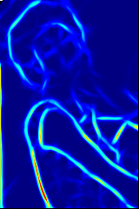
Cue combination
P_{b}
Image
Boundary Cues
Brightness
Color
Average
Texture
Martin, David R., Charless C. Fowlkes, and Jitendra Malik. "Learning to detect natural image boundaries using local brightness, color, and texture cues." TPAMI (2004).

Slide 23
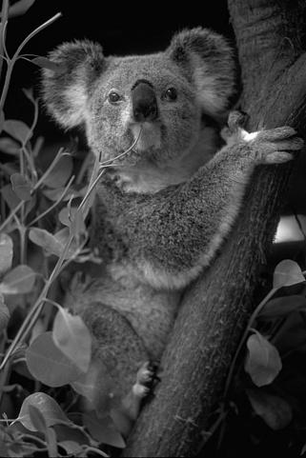
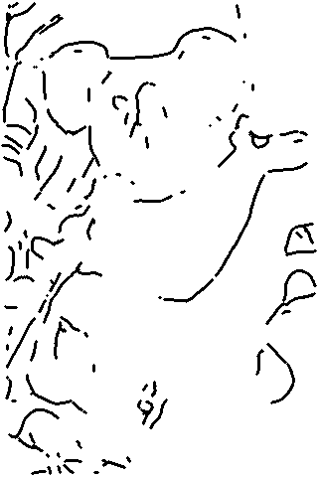
Local computation not enough

Slide 24
Local computation is not enough
Key constraints:
  Boundaries are continuous
  They enclose a region
How do we go from local, patchy contours to boundaries?

Slide 25
Grouping by clustering
Idea: embed pixels into high-dimensional space (e.g. 3-dimensions)
Each pixel is a point
Group together points

Slide 26
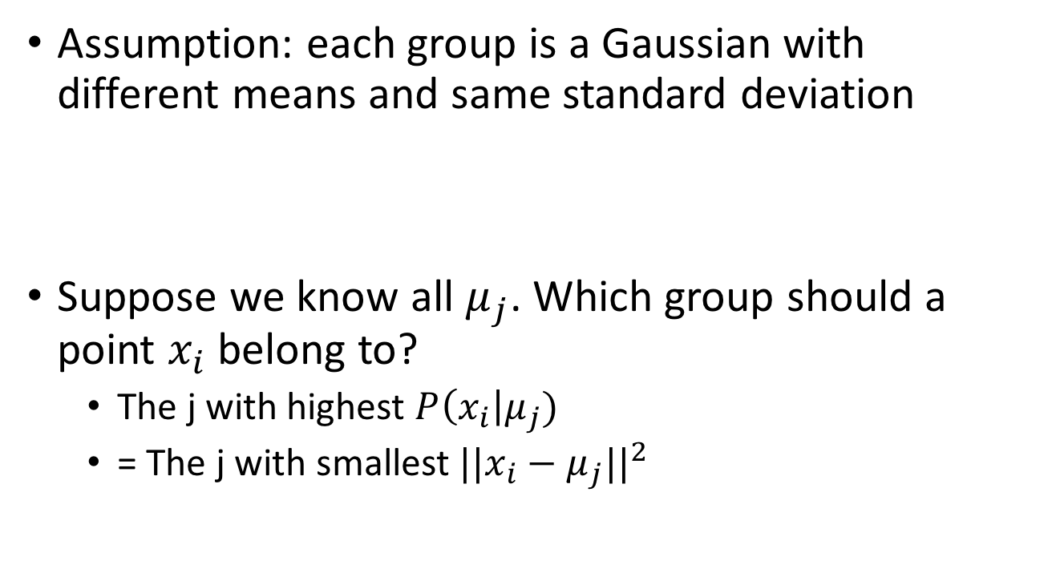
K-means
Assumption: each group is a Gaussian with different means and same standard deviation
Suppose we know all $μ_{j}$. Which group should a point $x_{i}$ belong to?
  The j with highest $P\left(x_{i}\right|μ_{j})$
  = The j with smallest $||x_{i}−μ_{j}||^{2}$

Slide 27
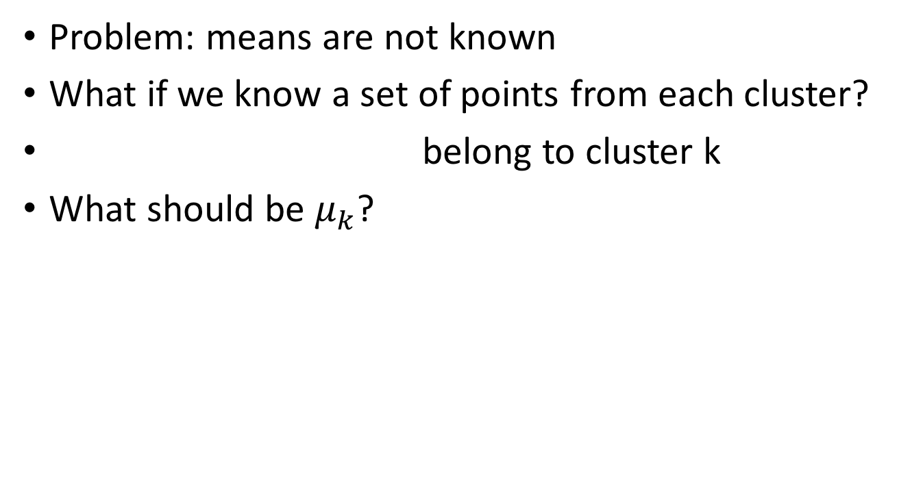
K-means
Problem: means are not known
What if we know a set of points from each cluster?
belong to cluster k
What should be $μ_{k}$?

Slide 28
K-means
Given means, can assign points to clusters
Given assignments, can compute means
Idea: iterate!

Slide 29
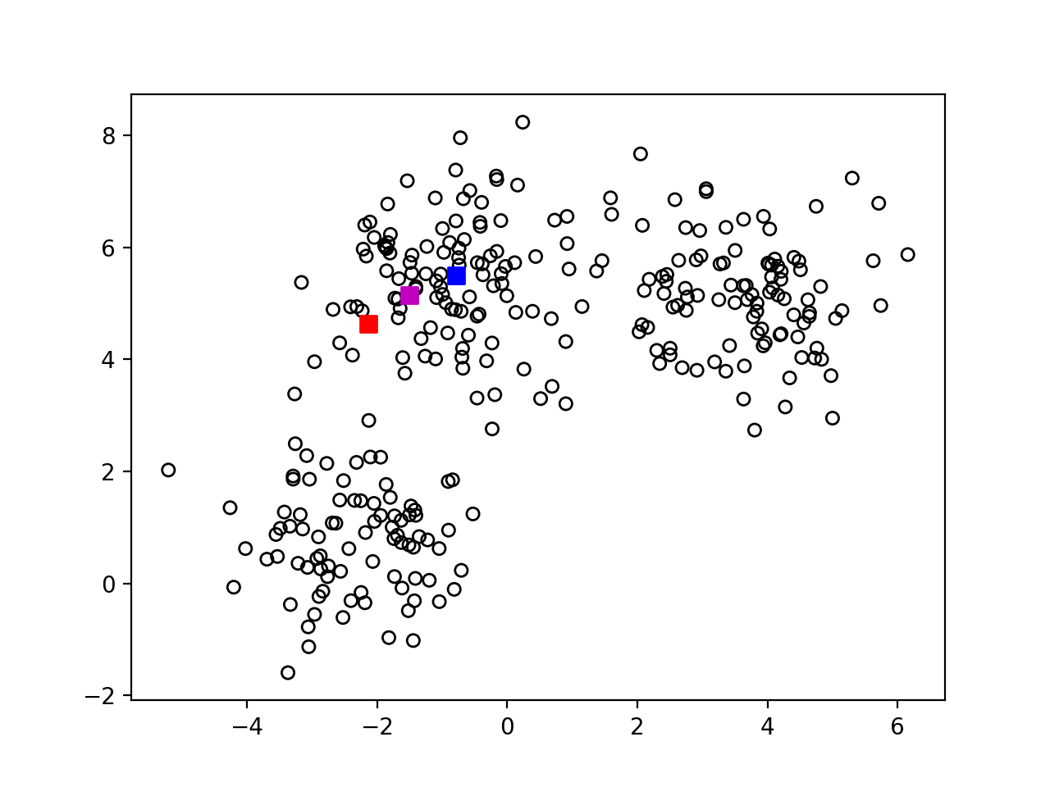
K-means
Step-1 : randomly pick k centers

Slide 30
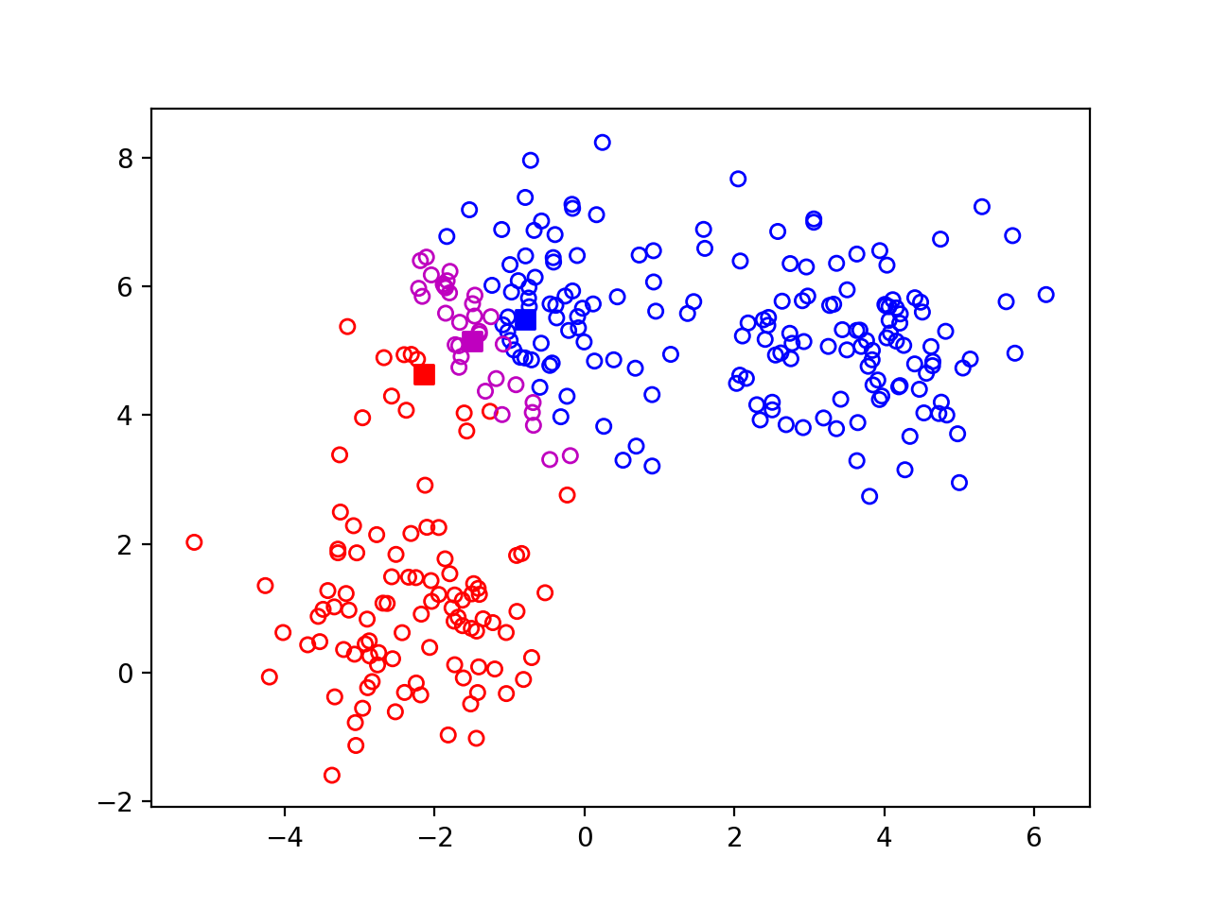
K-means
Step 2: Assign each point to nearest center

Slide 31

K-means
Step 3: re-estimate centers

Slide 32

K-means
Step 4: Repeat

Slide 33
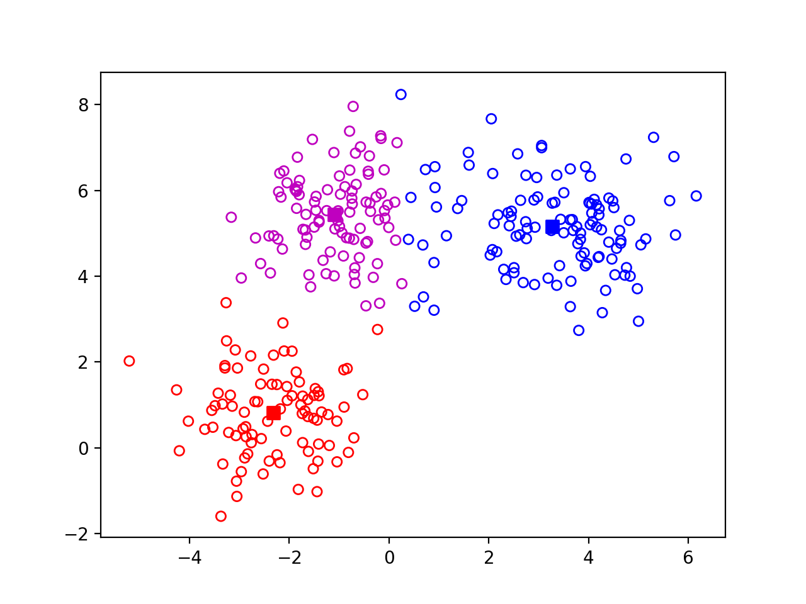
K-means
Step 4: Repeat

Slide 34
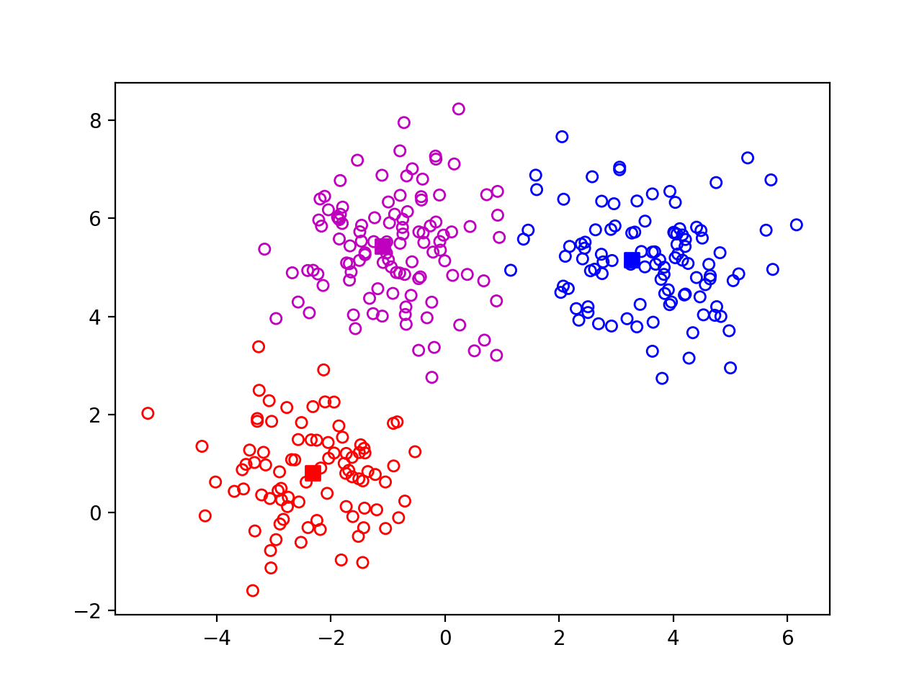
K-means
Step 4: Repeat

Slide 35

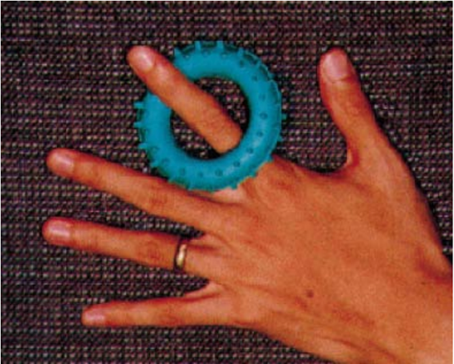
K-means on image pixels

Slide 36
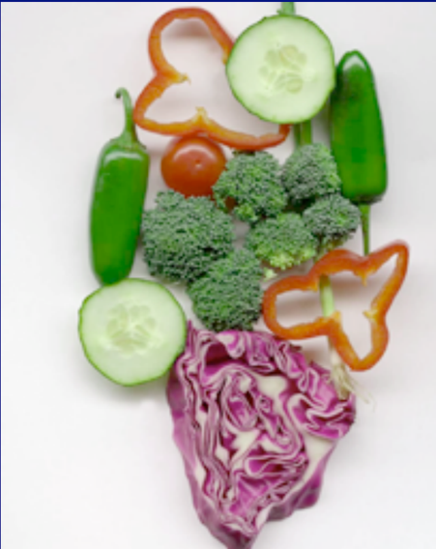
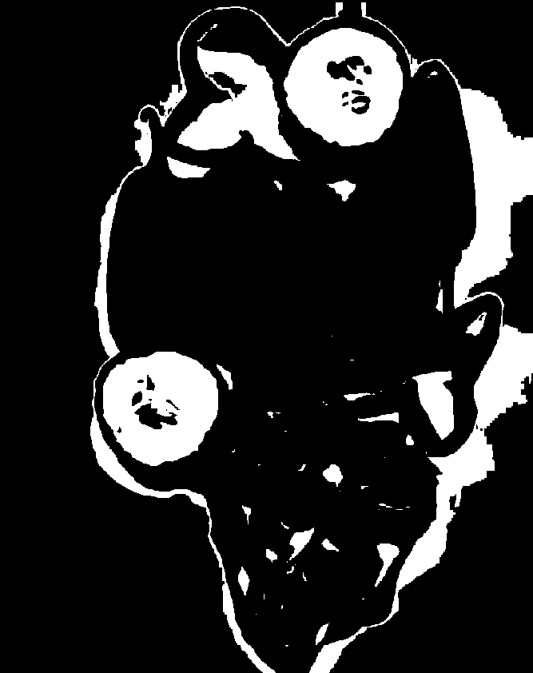
K-means on image pixels
Picture courtesy David Forsyth
One of the clusters from k-means

Slide 37

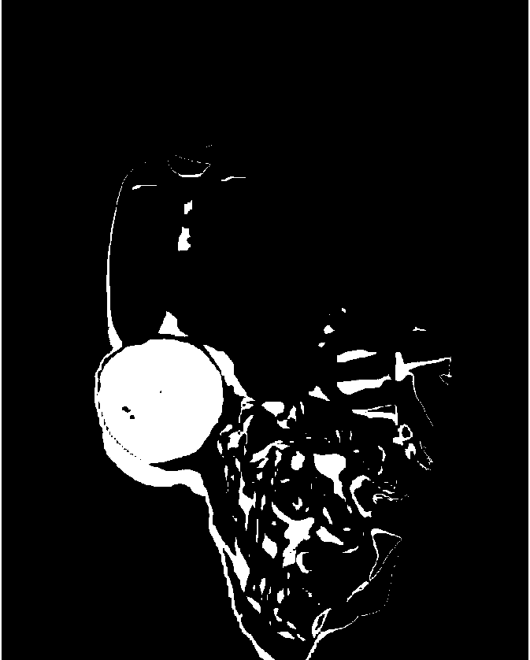
K-means on image pixels+position
Groups pixels together, but does not produce compact regions

Slide 38
Segmentation is graph partitioning

Slide 39
Segmentation is graph partitioning
Every partition “cuts” some edges
Idea: minimize total weight of edges cut!

Slide 40
Criterion: Min-cut?
Min-cut carves out small isolated parts of the graph
In image segmentation: individual pixels

Slide 41
Normalized cuts
“Cut” = total weight of cut edges
Small cut means the groups don’t “like” each other
But need to normalize w.r.t how much they like themselves
“Volume” of a subgraph = total weight of edges within the subgraph

Slide 42
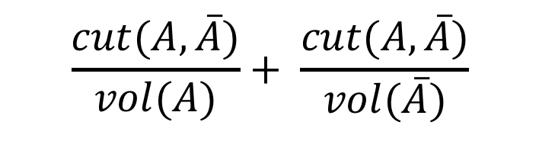
Normalized cut
$$\frac{cut(A, \overline{A})}{vol(A)}+ \frac{cut(A,\overline{A})}{vol(\overline{A})}$$

Slide 43
Min-cut vs normalized cut
Both rely on interpreting images as graphs
By itself, min-cut gives small isolated pixels
  But can work if we add other constraints
min-cut can be solved in polynomial time
  Dual of max-flow
N-cut is NP-hard
  But approximations exist!

Slide 44
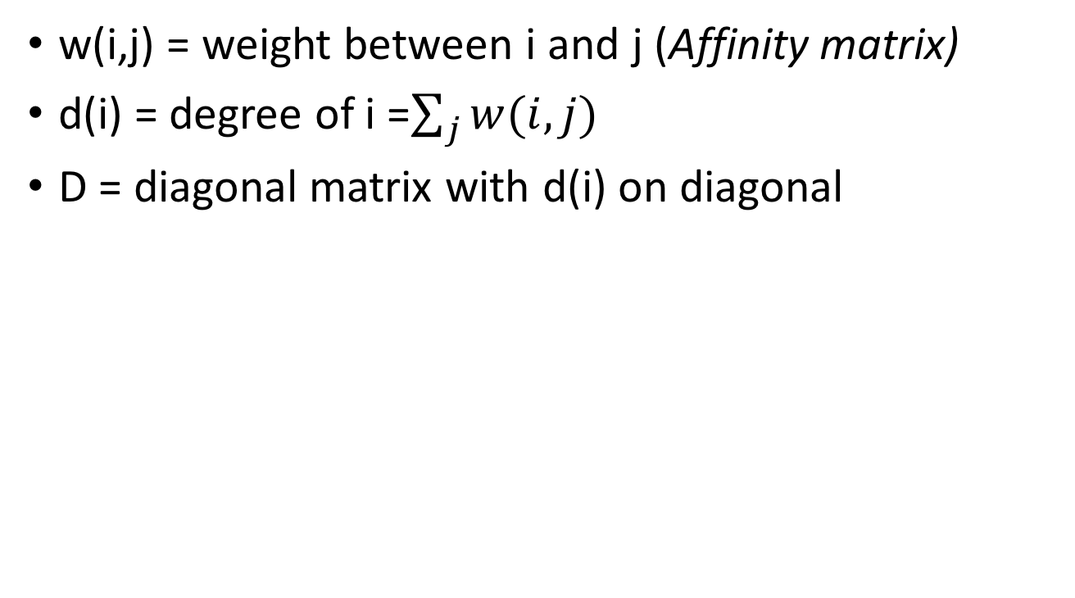
Graphs and matrices
w(i,j) = weight between i and j (Affinity matrix)
d(i) = degree of i =$\sum_{j}{w(i,j)}$
D = diagonal matrix with d(i) on diagonal
W
N
D
N
N
N

Slide 45
Graphs and matrices
1
6
2
7
3
4
8
9
5
0
W

Slide 46
Graphs and matrices
1
6
2
7
3
4
8
9
5
W
0
E = D⁻¹W

Slide 47
Graphs and matrices
How do we represent a clustering?
A label for N nodes
  1 if part of cluster A, 0 otherwise
An N-dimensional vector!
v₁
0:
1:
2:
3:
4:
5:
6:
7:
8:
9:
1
1
1
1
1
0
0
0
0
0
1
6
2
7
3
4
8
9
5
0

Slide 48
Graphs and matrices
How do we represent a clustering?
A label for N nodes
  1 if part of cluster A, 0 otherwise
An N-dimensional vector!
v₁
v₂
0:
1:
2:
3:
4:
5:
6:
7:
8:
9:
1
1
1
1
1
0
0
0
0
0
0
0
0
0
0
1
1
1
1
1
1
6
2
7
3
4
8
9
5
0

Slide 49
Graphs and matrices
How do we represent a clustering?
A label for N nodes
  1 if part of cluster A, 0 otherwise
An N-dimensional vector!
v₁
v₂
v₃
0:
1:
2:
3:
4:
5:
6:
7:
8:
9:
1
1
1
1
1
0
0
0
0
0
0
0
1
1
1
1
1
0
0
0
0
0
1
1
1
1
1
0
0
0
1
6
2
7
3
4
8
9
5
0

Slide 50
Graphs and matrices
v₁
1
6
0:
1:
2:
3:
4:
5:
6:
7:
8:
9:
1
1
1
1
1
0
0
0
0
0
2
7
3
4
8
9
5
0
E = D⁻¹W

Slide 51
Graphs and matrices
v₁
Ev₁
0:
1:
2:
3:
4:
5:
6:
7:
8:
9:
1
1
1
1
1
0
0
0
0
0
1
1
1
1
1
0
0
0
0
0
E = D⁻¹W

Slide 52
Graphs and matrices
v₂
Ev₂
0:
1:
2:
3:
4:
5:
6:
7:
8:
9:
0
0
0
0
0
1
1
1
1
1
0
0
0
0
0
1
1
1
1
1
E = D⁻¹W

Slide 53
Graphs and matrices
v₃
Ev₃
0:
1:
2:
3:
4:
5:
6:
7:
8:
9:
0
0
1
1
1
1
1
0
0
0
0.7
0.8
0.6
0.5
0.6
0.3
0.2
0.5
0.5
0.7
E = D⁻¹W

Slide 54
Graphs and matrices
1
6
2
7
3
4
8
9
5
0
E = D⁻¹W

Slide 55
Graphs and matrices
v₁
Ev₁
0:
1:
2:
3:
4:
5:
6:
7:
8:
9:
1
1
1
1
1
0
0
0
0
0
1
1
1
1
1
0
0
0.2
0
0
E = D⁻¹W

Slide 56
Graphs and matrices
Define z so that

Slide 57
Graphs and matrices
is called the Normalized Graph Laplacian

Slide 58
Graphs and matrices
We want
Trivial solution: all nodes of graph in one cluster, nothing in the other
To avoid trivial solution, look for the eigenvector with the second smallest eigenvalue
Find z s.t.

Slide 59
Normalized cuts
Approximate solution to normalized cuts
Construct matrix W and D
Construct normalized graph laplacian
Look for the second smallest eigenvector
Compute
Threshold y to get clusters
  Ideally, sweep threshold to get lowest N-cut value

Slide 60
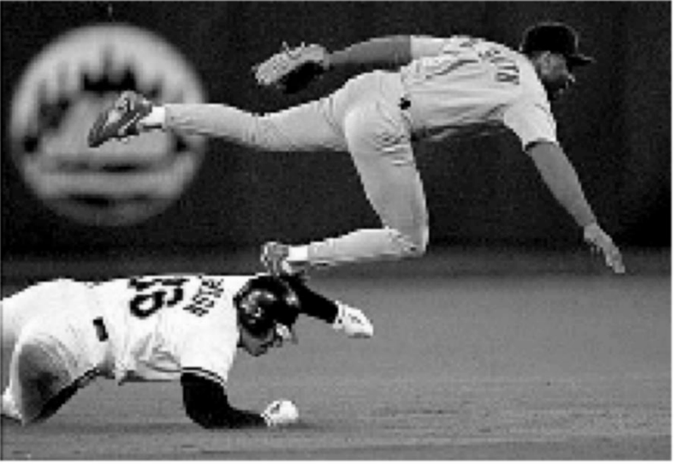
Eigenvectors of images
The eigenvector has as many components as pixels in the image

Slide 61
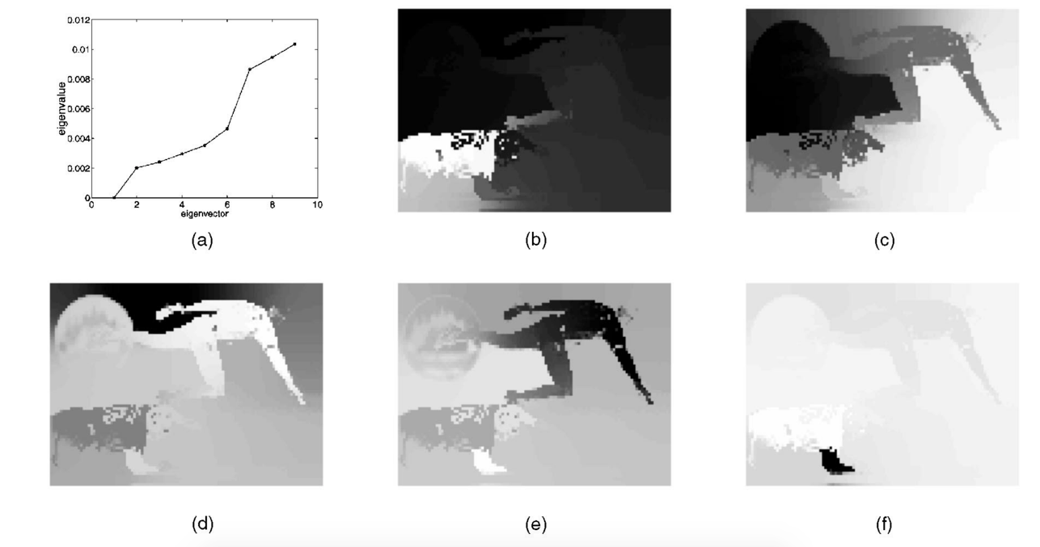
Eigenvectors of images
The eigenvector has as many components as pixels in the image

Slide 62




Another example
2nd eigenvector
3rd eigenvector
4th eigenvector

Slide 63
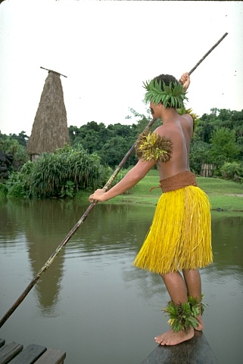
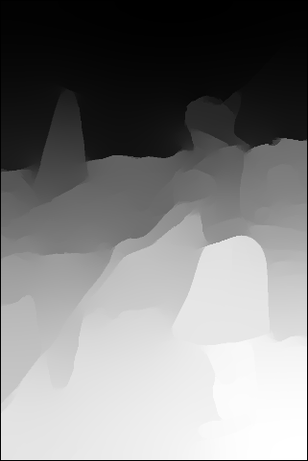
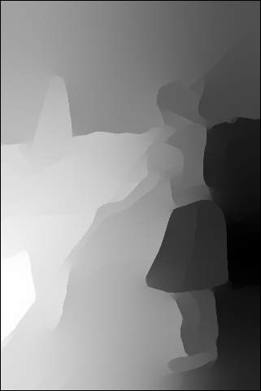
Eigenvectors of images

Slide 64
How do we group things?
Gestalt principles
Principle of proximity
https://courses.lumenlearning.com/wsu-sandbox/chapter/gestalt-principles-of-perception/

Slide 65
How do we group things?
Gestalt principles
Principle of similarity
https://courses.lumenlearning.com/wsu-sandbox/chapter/gestalt-principles-of-perception/

Slide 66
How do we group things?
Gestalt principles
Principle of continuity and closure
https://courses.lumenlearning.com/wsu-sandbox/chapter/gestalt-principles-of-perception/

Slide 67

How do we group things?
Gestalt principles
Principle of common fate

Slide 68
Gestalt principles in the context of images
Principle of proximity: nearby pixels are part of the same object
Principle of similarity: similar pixels are part of the same object
  Look for differences in color, intensity, or texture across the boundary
Principle of closure and continuity: contours are likely to continue
High-level knowledge?

