Slide 1
Object detection

Slide 2
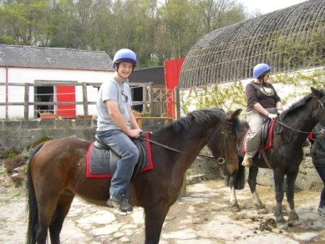
The Task
person 1
person 2
horse 1
horse 2

Slide 3
Step 1: Object proposals
Use segmentation to produce ~5K candidates
Selective Search for Object Recognition
J. R. R. Uijlings, K. E. A. van de Sande, T. Gevers, A. W. M. Smeulders
In International Journal of Computer Vision 2013.

Slide 4
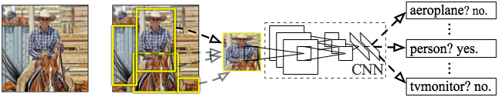
R-CNN: Regions with CNN features
Input
image
Extract region
proposals (~2k / image)
Compute CNN
features
Classify regions
(linear SVM)
Rich Feature Hierarchies for Accurate Object Detection and Semantic Segmentation
R. Girshick, J. Donahue, T. Darrell, J. Malik
IEEE Conference on Computer Vision and Pattern Recognition (CVPR), 2014
Slide credit : Ross Girshick
Notes:
Here’s a schematic of the system that we came up with.
Compared to previous state-of-the-art methods, R-CNN is relatively simple and does not rely on an ensemble of classifiers.
Let’s see how it works at test time.

Slide 5
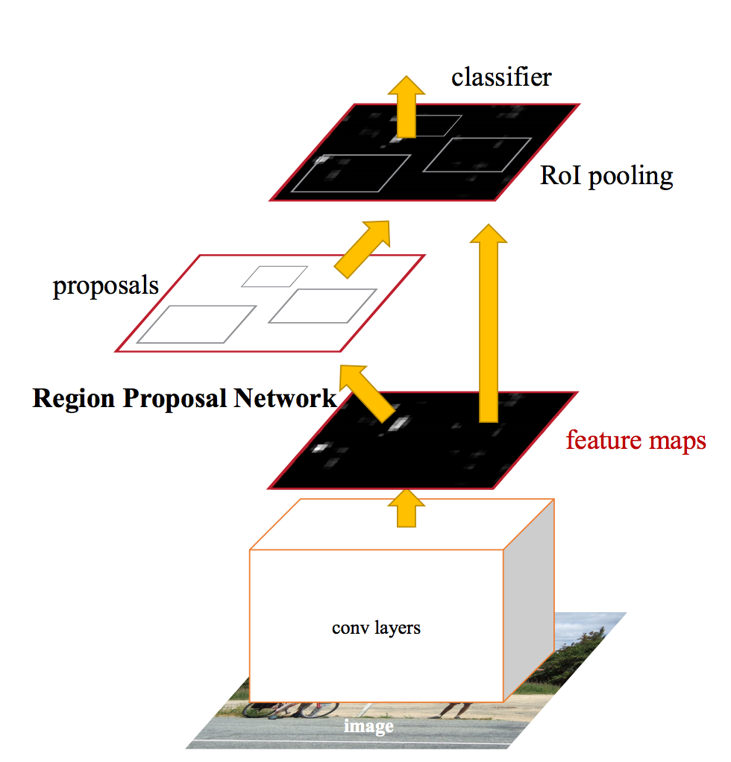
Faster R-CNN

Slide 6
Faster R-CNN
At each location, consider boxes of many different sizes and aspect ratios

Slide 7
Faster R-CNN
At each location, consider boxes of many different sizes and aspect ratios

Slide 8
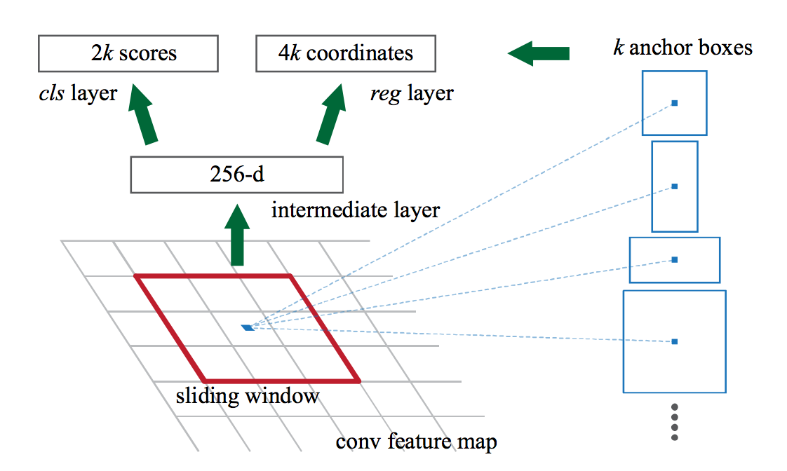
Faster R-CNN
At each location, consider boxes of many different sizes and aspect ratios

Slide 9
Faster R-CNN
s scales * a aspect ratios = sa anchor boxes
Use convolutional layer on top of filter map to produce sa scores
Pick top few boxes as proposals

Slide 10
Faster R-CNN
Method | mean AP (PASCAL VOC)
Fast R-CNN | 65.7
Faster R-CNN | 67.0

Slide 11
Impact of Feature Extractors
ConvNet | mean AP (PASCAL VOC)
VGG | 70.4
ResNet 101 | 73.8

Slide 12
Impact of Additional Data
Method | Training data | mean AP (PASCAL VOC 2012 Test)
Fast R-CNN | VOC 12 Train (10K) | 65.7
Fast R-CNN | VOC07 Trainval + VOC 12 Train | 68.4
Faster R-CNN | VOC 12 Train (10K) | 67.0
Faster R-CNN | VOC07 Trainval + VOC 12 Train | 70.4

Slide 13
The R-CNN family of detectors

Slide 14
SSD (Single Shot Detector)
Why go through separate proposals?
Directly produce class-specific scores at each location for every scale and aspect ratio
  s scales * a aspects * c classes = sac scores per location
SSD: Single Shot MultiBox Detector. Wei Liu , Dragomir Anguelov , Dumitru Erhan , Christian Szegedy , Scott Reed , Cheng-Yang Fu , Alexander C. Berg. In ECCV, 2016

Slide 15
SSD
Method | mean AP (PASCAL VOC)
Faster R-CNN | 70.4
SSD | 74.9

Slide 16
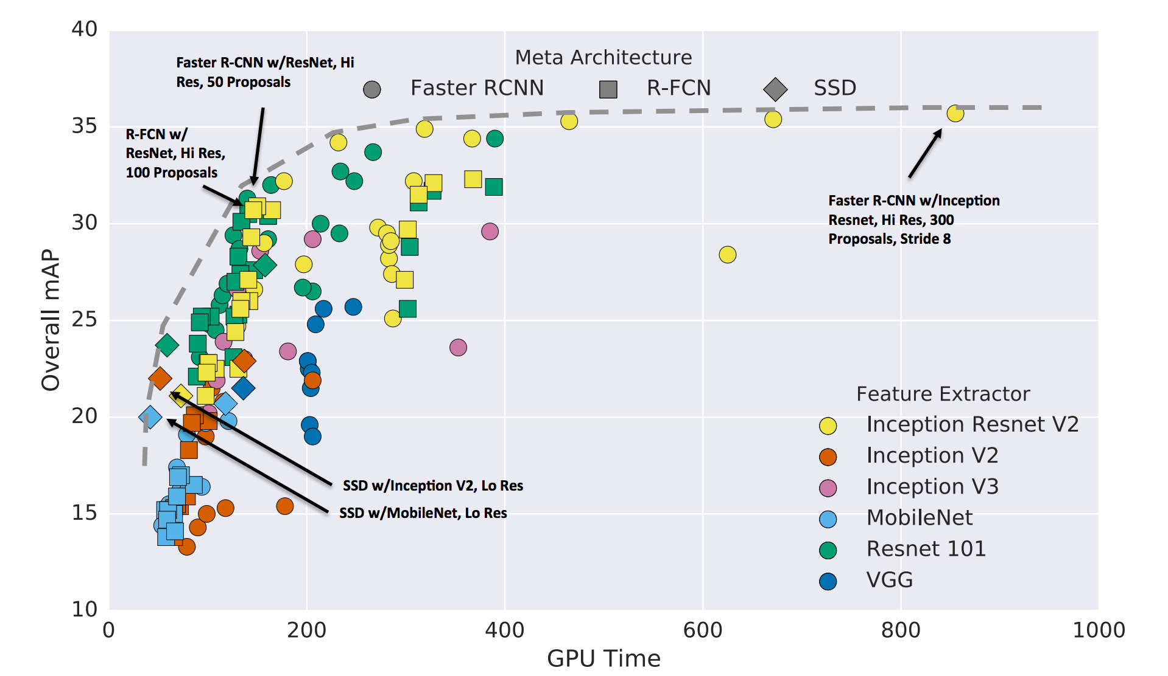
A comprehensive evaluation
Speed and accuracy trade-offs for modern convolutional object detectors
Alireza Fathi, Anoop Korattikara, Chen Sun, Ian Fischer, Jonathan Huang, Kevin Murphy, Menglong Zhu, Sergio Guadarrama, Vivek Rathod, Yang Song, Zbigniew Wojna
CVPR 2017

Slide 17
Detecting small objects
Small objects get low resolution features

Slide 18
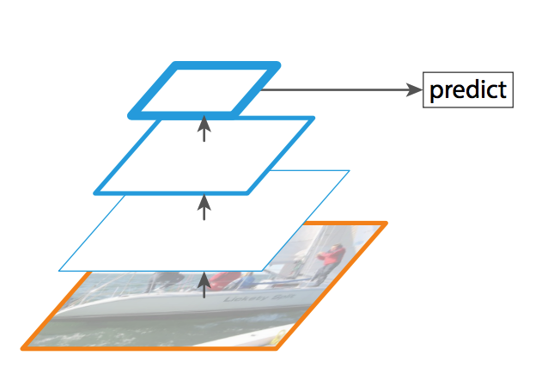
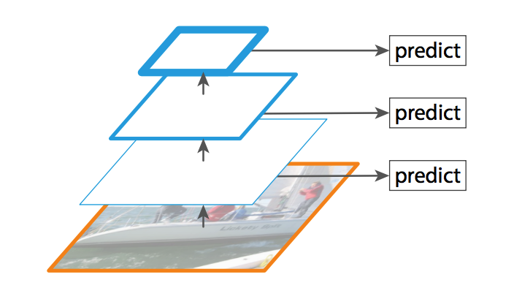
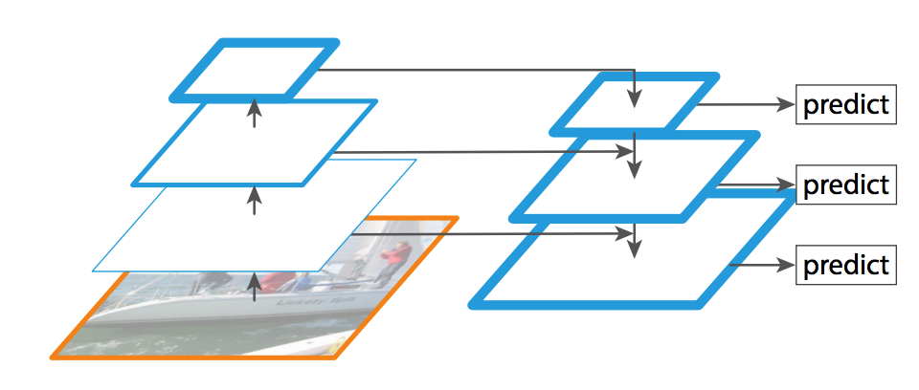
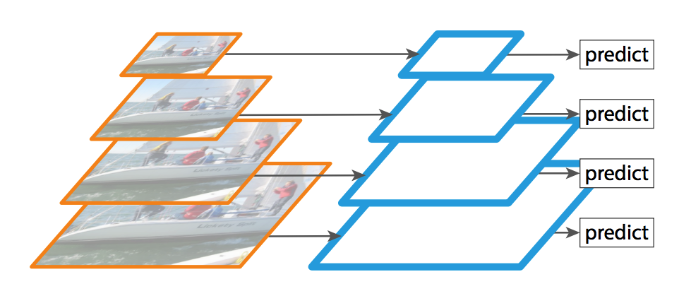
Feature pyramid networks
Standard detection
Detection using multiple layers
Detection on image pyramid
Detection using feature pyramid layers
Lin, Tsung-Yi, et al. "Feature Pyramid Networks for Object Detection." CVPR. Vol. 1. No. 2. 2017.

Slide 19
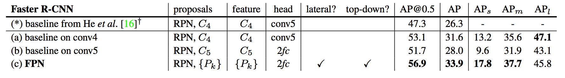
Feature pyramid networks
Lin, Tsung-Yi, et al. "Feature Pyramid Networks for Object Detection." CVPR. Vol. 1. No. 2. 2017.

Slide 20
Other details - Non-max suppression
0.9
0.8

Slide 21
Other details - Non-max suppression
Go down the list of detections starting from highest scoring
Eliminate any detection that overlaps highly with a higher scoring detection
Separate, heuristic step

Slide 22
A comprehensive evaluation
Speed and accuracy trade-offs for modern convolutional object detectors
Alireza Fathi, Anoop Korattikara, Chen Sun, Ian Fischer, Jonathan Huang, Kevin Murphy, Menglong Zhu, Sergio Guadarrama, Vivek Rathod, Yang Song, Zbigniew Wojna
CVPR 2017

Slide 23
Challenges with RoI pooling
Still scales with the number of bounding boxes
O(# bboxes)

Slide 24
RoI pooling (Faster R-CNN) vs convolution (SSD)
Why does Faster R-CNN tend to be more accurate?
RoI pooling takes information from the precise box
Convolution takes information from just the kernel window

Slide 25
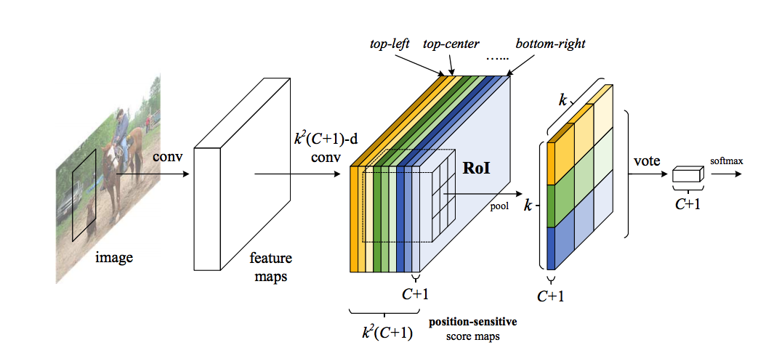
R-FCN
Can we get benefits of RoI pooling in linear time?
Dai, Jifeng, et al. "R-fcn: Object detection via region-based fully convolutional networks." Advances in neural information processing systems. 2016.

Slide 26
Other details - ROI Align
Snapping box to grid introduces quantization artifacts
Instead, use bilinear interpolation
Mask R-CNN. K. He, G. Gkioxari, P. Dollar, R. Girshick. In ICCV 2017.

Slide 27
Instance segmentation

Slide 28
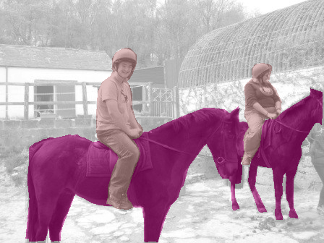
Till now
person 1
person 2
horse 1
horse, person
horse 2
Object Detection
horse
person
Image Classification
Semantic Segmentation
Notes:
Traditionally, “recognition” has been subdivided into a few different buckets. The first bucket is obviously image classification, where you want to assign labels to each image.
But we’ve also seen work on object detection. Given an image, an object detection system will detect each instance of a particular kind of object, and roughly localize it with a bounding box.
A bounding box is a very coarse output if you want to interact with a world. If you are trying to grasp an object you will need the precise boundaries of the object.
Alternatively a semantic segmentation system assigns category labels to pixels. This gives precise boundaries, but fails to resolve individual instances. This is again problematic because usually you want to interact with individual object instances, and a mass of “horseness” doesn’t help.

Slide 29
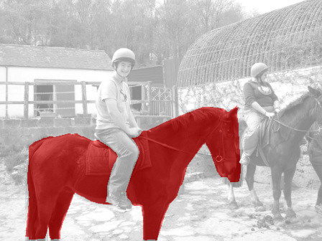
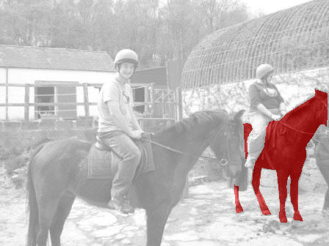
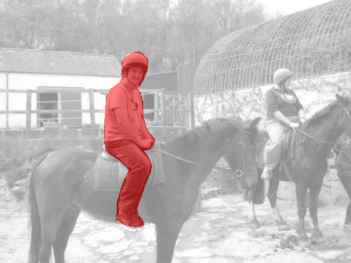
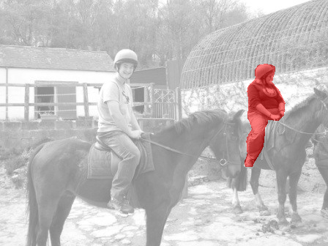
Fine-grained Localization
horse 1
horse 2
person 1
person 2
Instance Segmentation
Notes:
This motivation led us to propose the task of instance segmentation. An instance segmentation system detects every instance of a given object category and also segments them out. For instance, it will tell you that these are the boundaries of horse 1, these are the boundaries of horse 2, and so on.

Slide 30
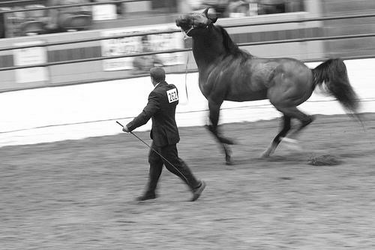

Evaluation Protocol
Sort predicted instances by confidence
Match prediction to closest annotation based on segment overlap
  If segment overlap > threshold, correct
segment = overlap
U
Notes:
We will also assume that we have a held out test set annotated by humans with individual segmented instances and corresponding category labels. We will take each instance predicted by the model, and match it to the closest human annotation of that category based on the overlap of the two segments. The formula for this overlap is given here. If the overlap is greater than a threshold, we will consider the prediction a correct one, with the caveat that if a higher scoring prediction has already been matched to this annotation, we will consider the prediction a duplicate and thus incorrect.

Slide 31
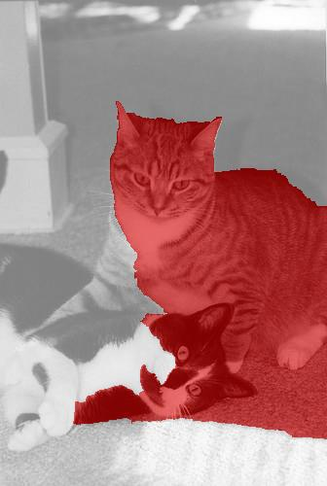
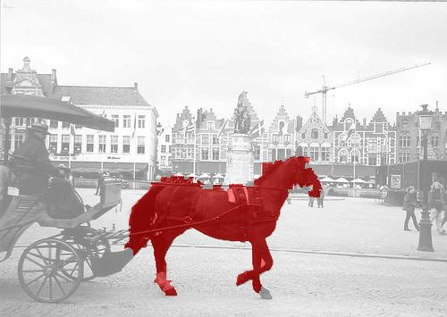
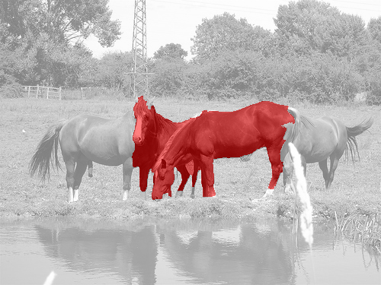
Evaluation Protocol
Labels = [ …. ]
Scores = [ 0.90 0.87 0.82 0.78 0.70 0.69 0.60 …. ]
Notes:
We therefore get a label for each prediction of the model.

Slide 32
Evaluation protocol
Average Precision (AP)

Slide 33
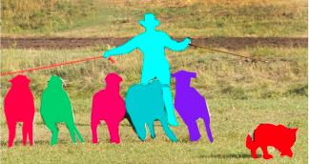
The COCO Challenge
mscoco.org
T. Y. Lin et al. Microsoft COCO: Common Objects in Context. In ECCV, 2014
Notes:
The task of instance segmentation gained a lot of traction in the community, and many people agreed that we need systems that can do this task. The COCO benchmark, which is not the definitive benchmark for all things object recognition, made this task front and center, and used our proposed evaluation protocol as part of their benchmark.
Instance segmentation is now an active area of research.

Slide 34
Two strategies
Segment then classify
  Use bottom-up techniques to come up with segment proposals
  Classify segment proposals with convnets
  Segmentation is category agnostic
  Modification: use convnets to produce segmentation proposals
Detect then segment
  Use standard object detection to produce boxes
  Segment boxes
  Segmentation is category specific

Slide 35
Box proposals
Use segmentation to produce ~5K candidates
Selective Search for Object Recognition
J. R. R. Uijlings, K. E. A. van de Sande, T. Gevers, A. W. M. Smeulders
In International Journal of Computer Vision 2013.

Slide 36
Segment proposals
Multi-scale combinatorial grouping. Pablo Arbelaez, Jordi Pont-Tuset, Jonathan Barron, Ferran Marques, Jitendra Malik. In CVPR, 2014.

Slide 37
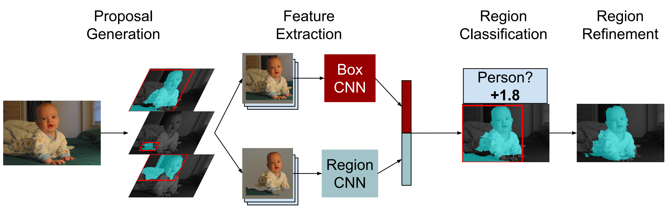
R-CNN for instance segmentation
Simultaneous Detection and Segmentation Bharath Hariharan , Pablo Arbelaez , Ross Girshick, Jitendra Malik. In ECCV 2014

Slide 38
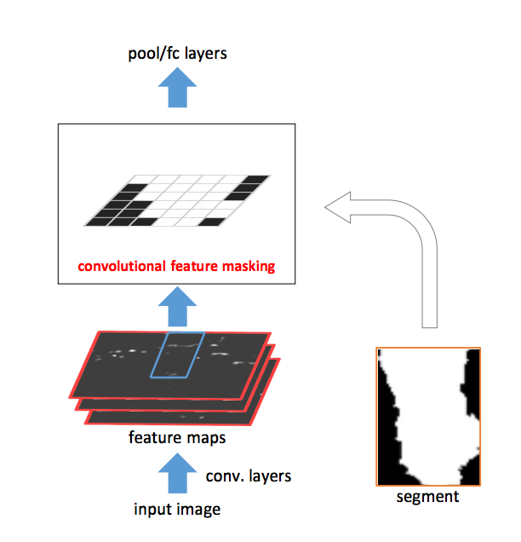
Fast R-CNN for instance segmentation
Convolutional Feature Masking for Joint Object and Stuff Segmentation. Jifeng Dai, Kaiming He, Jian Sun. In CVPR 2015

Slide 39
Fast R-CNN for instance segmentation
CFM
ROI Pool
Convolutional Feature Masking for Joint Object and Stuff Segmentation. Jifeng Dai, Kaiming He, Jian Sun. In CVPR 2015

Slide 40
Two strategies
Segment then classify
  Use bottom-up techniques to come up with segment proposals
  Classify segment proposals with convnets
  Segmentation is category agnostic
  Modification: use convnets to produce segmentation proposals
Detect then segment
  Use standard object detection to produce boxes
  Segment boxes
  Segmentation is category specific

Slide 41
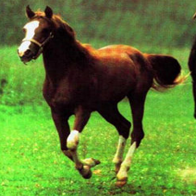
Predicting segmentation for bounding boxes
Given a detection, predict segmentation

Slide 42
Predicting segmentation for bounding boxes
x`

Slide 43
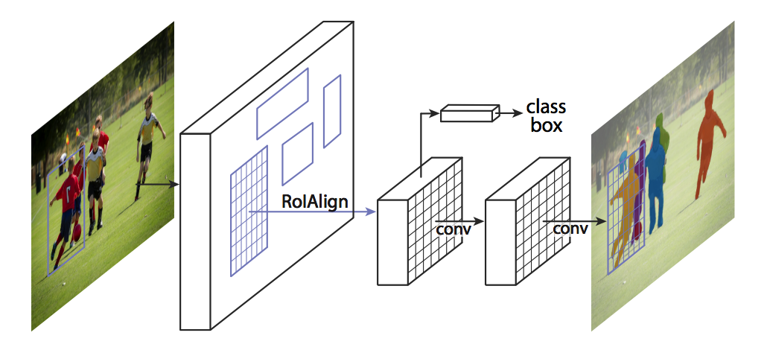
Mask R-CNN
He, Kaiming, et al. "Mask r-cnn." Computer Vision (ICCV), 2017 IEEE International Conference on. IEEE, 2017.

Slide 44
The resolution issue: Skip connections

Slide 45
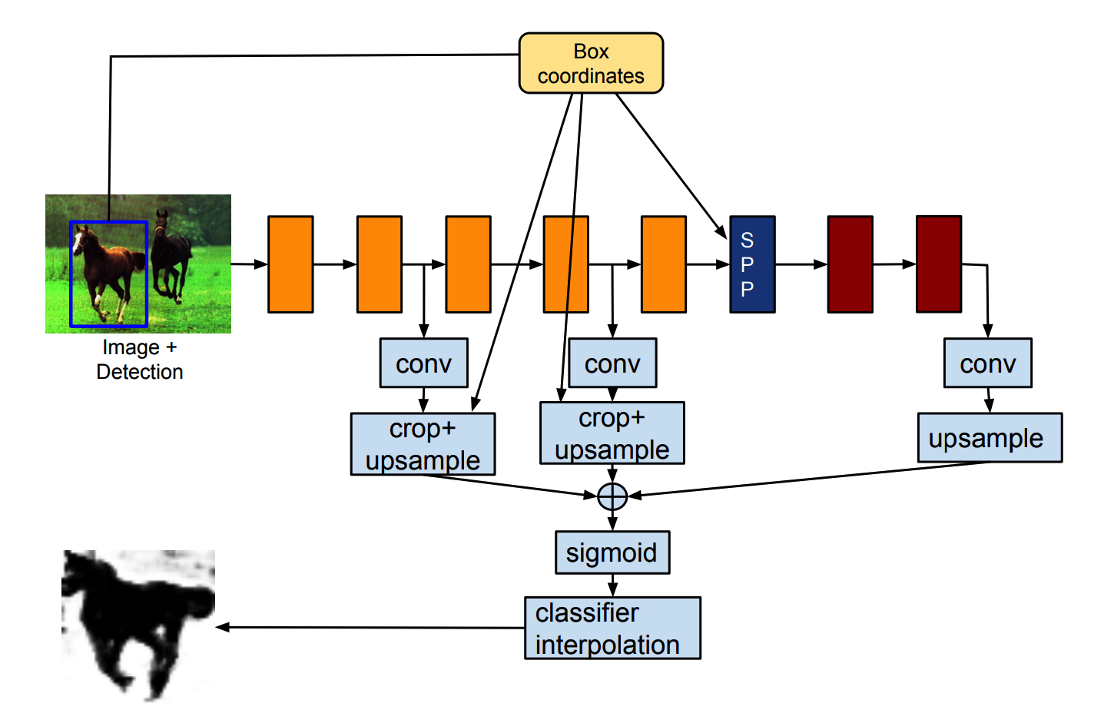
Skip connections with RoI pooling
RoI Pool
Hariharan, Bharath, et al. "Object instance segmentation and fine-grained localization using hypercolumns." IEEE Transactions on Pattern Analysis & Machine Intelligence 4 (2017): 627-639.

Slide 46
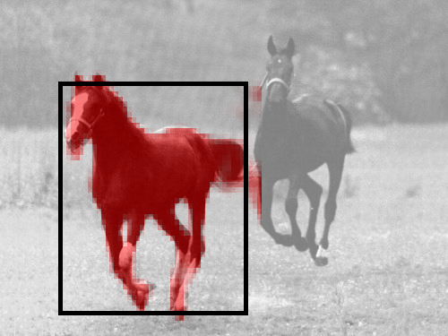
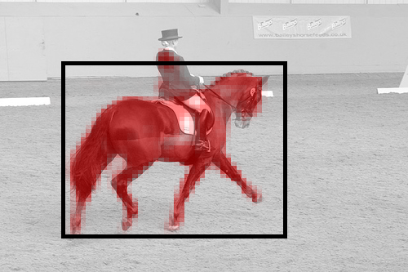
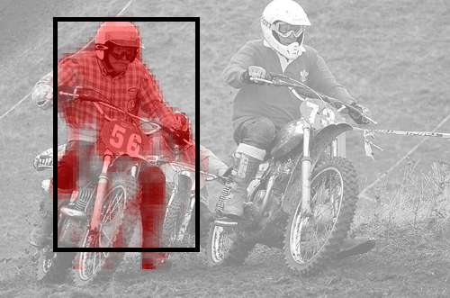
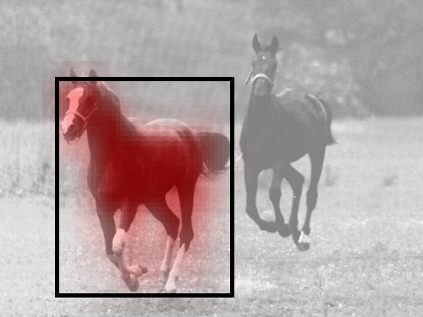
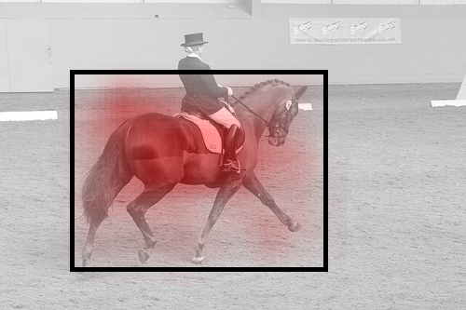
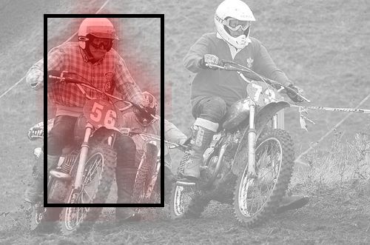
The resolution issue: Skip connections
Hypercolumns for Object Segmentation and Fine-grained Localization. Bharath Hariharan, Pablo Arbeláez, Ross Girshick, Jitendra Malik. CVPR, 2015

Slide 47
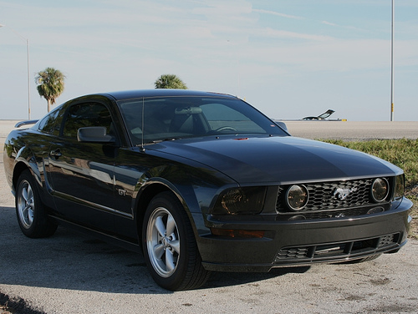
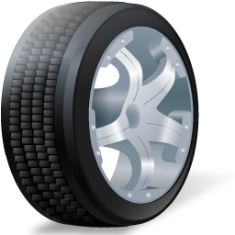
Fully convolutional or not?
Convolution is location invariant
Semantic segmentation is location invariant
Figure-ground segmentation of a detected bounding box is not location invariant

Slide 48
Fully convolutional or not?
Convolution is cheaper
Local connections without parameter sharing?
  Too many parameters?
  Predicting 50x50 segmentation: 2500 times more parameters
Predict lower resolution, then upsample
Fully convolutional:
Mask R-CNN. Kaiming He, Georgia Gkioxari, Piotr Dollar, Ross Girshick. In ICCV, 2017.
Non-fully convolutional:
Learning to Segment Object Candidates. Pedro O. Pinheiro, Ronan Collobert, Piotr Dollar. In ICCV, 2015.

Slide 49
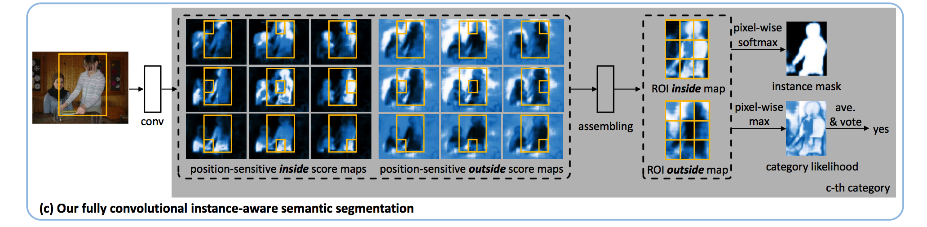
Instance fully-convolutional networks
Li, Yi, et al. "Fully convolutional instance-aware semantic segmentation." arXiv preprint arXiv:1611.07709 (2016).

Slide 50
Final results - what works?
First detect, then segment
Big problem for instance segmentation is object detection
Mask R-CNN (Faster R-CNN + convolution on RoI Pooled feature to get masks) is good starting point

Slide 51
Human pose estimation

Slide 52
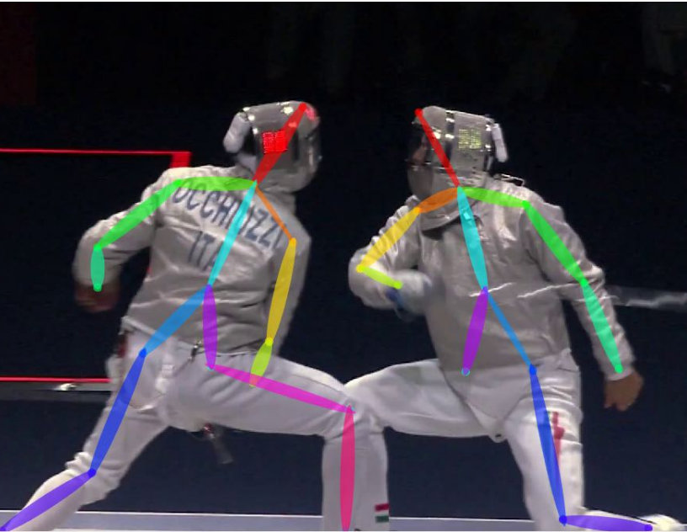
The task
Mark joint locations for person
Nose
Right/left shoulder
Right/left elbow
Right/left hip
…

Slide 53
Two versions of task
Assume people have been detected
Rough bounding box given
Key info available:
  scale
  only 1 location per joint
Pros: disentangles detection and pose estimation
Cons: unrealistic
Tabula rasa without detections
Challenge: no idea of scale or number
Possible opportunity: use keypoint estimates to improve detections
Pros: realistic
Cons: conflates detection and pose estimation

Slide 54
Pose estimation given detection

Slide 55
Evaluation metric - given detection
Evaluate every keypoint separately
For each person, check if keypoint is correct
Compure fraction of people for which keypoint is correct: PCK (Probability of Correct Keypoint)

Slide 56
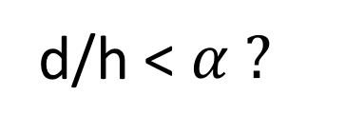
Evaluation metric - given detection
d
d/h < $α ?$
h

Slide 57
R-CNN: Regions with CNN features
Input
image
Extract region
proposals (~2k / image)
Compute CNN
features
Classify regions
(linear SVM)
Rich Feature Hierarchies for Accurate Object Detection and Semantic Segmentation
R. Girshick, J. Donahue, T. Darrell, J. Malik
IEEE Conference on Computer Vision and Pattern Recognition (CVPR), 2014
Slide credit : Ross Girshick
Notes:
Here’s a schematic of the system that we came up with.
Compared to previous state-of-the-art methods, R-CNN is relatively simple and does not rely on an ensemble of classifiers.
Let’s see how it works at test time.

Slide 58
Bounding-box regression
w
Δw × w + w
(x, y)
h
(Δx × w + x,
Δy × h + h)
Δh × h + h
original
predicted
Slide credit : Ross Girshick

Slide 59
Strategy 1: Regression
Regression targets relative to bounding box
Right elbow x: 0.45
Right elbow y: 0.12
Left elbow x: 0.98
…
DeepPose: Human Pose Estimation via Deep Neural Networks. Alexander Toshev and Christian Szegedy. In CVPR, 2014.

Slide 60
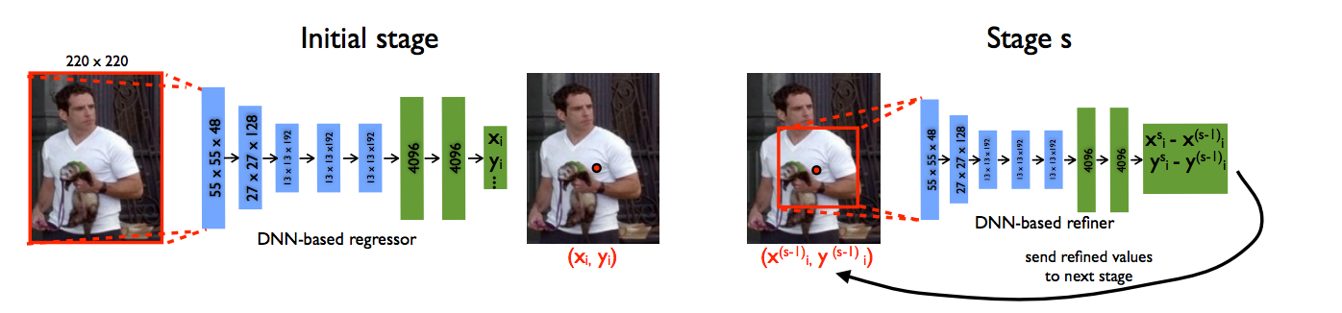
Strategy 1: Regression
Assumes global object features has enough information for accurate localization
  Localization info missing due to subsampling?
Solution: Refinement!
DeepPose: Human Pose Estimation via Deep Neural Networks. Alexander Toshev and Christian Szegedy. In CVPR, 2014.

Slide 61
Strategy 1: Regression
Minimizer of
Multimodal distributions?
p(x)
x

Slide 62
Strategy 2: Heatmaps

Slide 63
Strategy 2: Heatmaps
Still have the resolution issue
Same solutions
  Dilation?
  Multiple layers?
  Multiple image scales?

Slide 64
abc

