Slide 1
Correspondence

Slide 2


Matching feature points
We know how to detect good points
Next question: How to match them?
Two interrelated questions:
How do we describe each feature point?
How do we match descriptions?
?

Slide 3
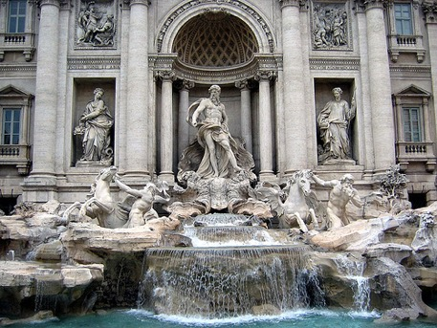
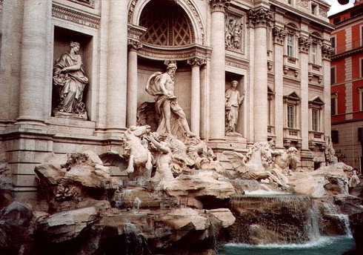




Feature descriptor
$$x_{1}$$
$$x_{2}$$
$$y_{1}$$
$$y_{2}$$

Slide 4
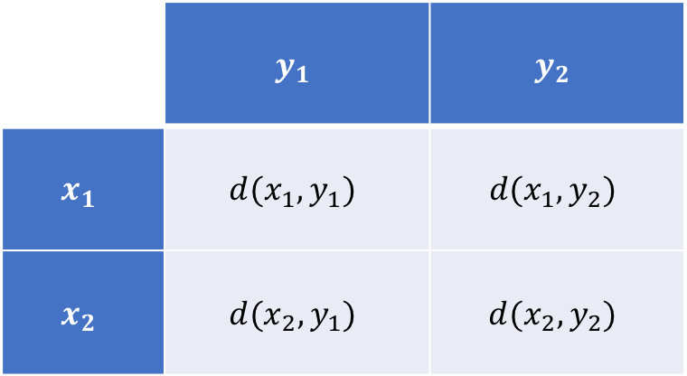
Feature matching
Measure the distance between (or similarity between) every pair of descriptors
 | $$y_{1}$$ | $$y_{2}$$
$$x_{1}$$ | $$d(x_{1},y_{1})$$ | $$d(x_{1},y_{2})$$
$$x_{2}$$ | $$d(x_{2},y_{1})$$ | $$d(x_{2},y_{2})$$

Slide 5
Better representation than color: Edges
Normal discontinuity
Depth Discontinuity
Albedo Edge
Shadow

Slide 6
Towards a better feature descriptor
Match pattern of edges
  Edge orientation – clue to shape
Be resilient to small deformations
  Deformations might move pixels around, but slightly
  Deformations might change edge orientations, but slightly

Slide 7
Invariance to deformation by quantization
37
42
Between 30 and 45

Slide 8
Invariance to deformation by quantization

Slide 9
Spatial invariance by histograms
2 blue balls, one red box
2
1
balls
boxes

Slide 10
Rotation Invariance by Orientation Normalization
[Lowe, SIFT, 1999]
Compute orientation histogram
Select dominant orientation
Normalize: rotate to fixed orientation
0
2
π

Slide 11
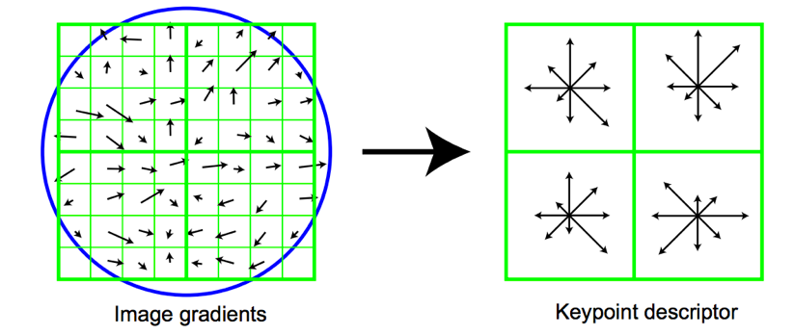
The SIFT descriptor
Compute edge magnitudes + orientations
Quantize orientations (invariance to def)
Divide into spatial cells
Compute orientation histogram in each cell (spatial invariance)
Distinctive Image Features from Scale-Invariant Keypoints. Lowe. In IJCV 2004

Slide 12
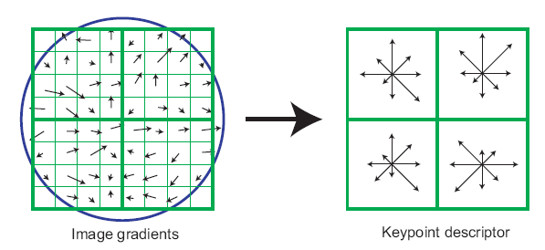
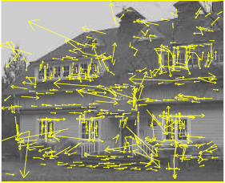
The SIFT descriptor
SIFT – Lowe IJCV 2004
Notes:
Do scale-space invariant feature detection using DoG.

Slide 13
Feature matching
Given a feature in I₁, how to find the best match in I₂?
  Define distance function that compares two descriptors
  Test all the features in I₂, find the one with min distance

Slide 14
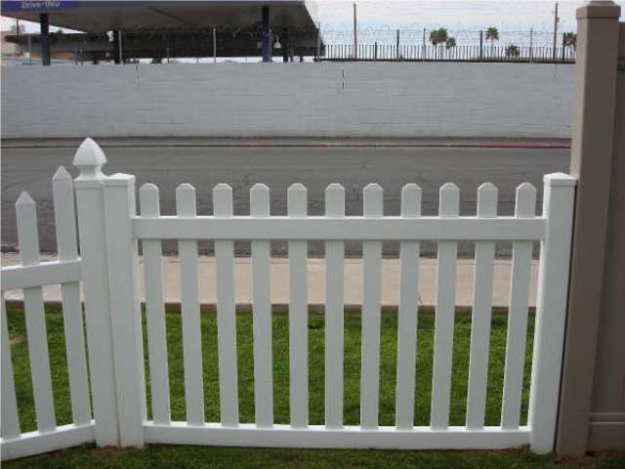
Feature distance
How to define the difference between two features f₁, f₂?
  Simple approach: L₂ distance, ||f₁ - f₂ ||
  can give good scores to ambiguous (incorrect) matches
f₁
f₂
I₁
I₂

Slide 15
Feature distance
How to define the difference between two features f₁, f₂?
  Better approach: ratio distance = ||f₁ - f₂ || / || f₁ - f₂’ ||
    f₂ is best SSD match to f₁ in I₂
    f₂’ is 2nd best SSD match to f₁ in I₂
    gives large values for ambiguous matches
f₁
f₂'
f₂
I₁
I₂

Slide 16
Structure from motion
Given a bunch of images
Get correspondences
  Run interest point detector
  Get SIFT descriptors
  Match to get correspondences
Use correspondences for
  Estimating F/E, R, t
  Estimating 3D structure of the world

Slide 17
Dense correspondence
What if we need depth for every pixel?
Setup: assume rectified images
  Correspondence only along scan-lines
  Can be represented using disparity

Slide 18
Dense correspondence

Slide 19
Dense correspondence
Goal: Assign disparity value to each pixel
Problem: most pixels will be ambiguous
Solution: propagate from unambiguous to ambiguous pixels
Basic idea: nearby pixels likely to have same disparity (smoothness)

Slide 20
Dense correspondence
Goal:
  Assign disparity value to each pixel
Basic idea:
  Disparity image should be smooth
Energy minimization
  min E(d), where d is disparity image
  E(d) = E_{data}(d) + E_{smoothness}(d)
E_{data}(d) : scores based on NCC (for example)
E_{smoothness}(d) =

Slide 21
Markov Random Fields
Probabilistic model
Undirected graphical model
Undirected graph with nodes and edges
Unary potential on nodes = data term
Binary potential on edges = smoothness term

Slide 22
Optimizing MRFs
NP-Hard
Approximate solutions
  Message passing
  Graph cut-based solutions

Slide 23
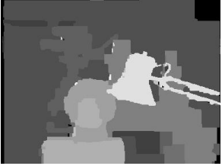
Dense correspondence with MRFs

Slide 24
Dense correspondence
Goal: Assign disparity value to each pixel
Problem: most pixels will be ambiguous
Solution: propagate from unambiguous to ambiguous pixels
Basic idea: nearby pixels likely to have same disparity (smoothness)

Slide 25
Dense correspondence
Obtain disparity through optimization
Based on e.g NCC distance
(d(i,j) – d(k,l))²

Slide 26
Detour: Graphical models
Probabilistic models with graphs
Nodes are variables
Edges determine dependency structure
independent of given all
It is 8 am
Alarm rings
I wake up
Naughty roommate
Roommate sets up prank

Slide 27
Markov Random Fields (MRFs)
Probabilistic model
Represented by graph
Each node is random variable
Edges represent dependence structure
  independent of given all

Slide 28
Markov Random Fields (MRFs)
Hammersley-clifford theorem
Unary potential
Binary potential

Slide 29
Dense correspondence as MRFs
Obtain disparity through optimization
Random variable: disparity
Find most likely disparity
Based on e.g NCC distance
(d(i,j) – d(k,l))²

Slide 30
Aligning depth boundaries to image boundaries
Some pairs more likely to have same disparity
w(i,j) (d(i,j) – d(k,l))²
w(i,j) = 0 for edges
Conditional Random Field (CRF)

Slide 31
Other applications of MRFs / CRFs
Semantic Image Segmentation with Deep Convolutional Nets and Fully Connected CRFs.
Liang-Chieh Chen*, George Papandreou*, Iasonas Kokkinos, Kevin Murphy, and Alan L. Yuille. In ICLR, 2015

Slide 32
Optimizing MRFs
NP-Hard
Approximate solutions
  Message passing
  Mean field-based inference
  Graph cut-based solutions
A comparative study of energy minimization methods for markov random fields with smoothness-based priors. Szeliski, R., Zabih, R., Scharstein, D., Veksler, O., Kolmogorov, V., Agarwala, A., Tappen, M. and Rother, C. In TPAMI, 2008.

Slide 33
Dense correspondence with MRFs

Slide 34
Optical flow

Slide 35
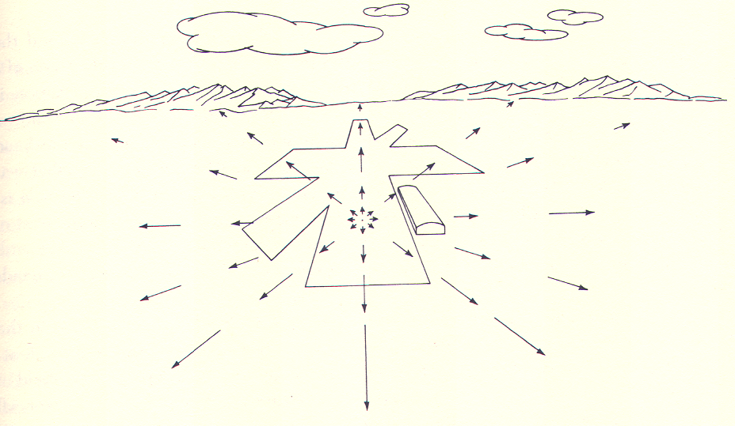
Focus of expansion
J. J. Gibson

Slide 36
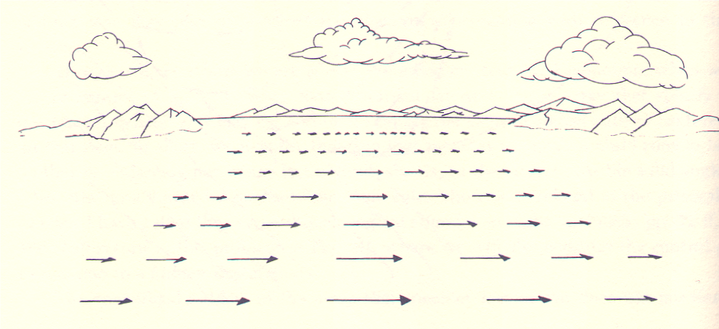

Slide 37
Optical flow due to camera motion
Consider camera translating and rotating

Slide 38
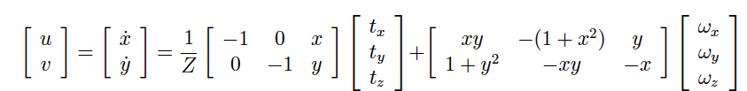
Optical flow due to camera motion

Slide 39
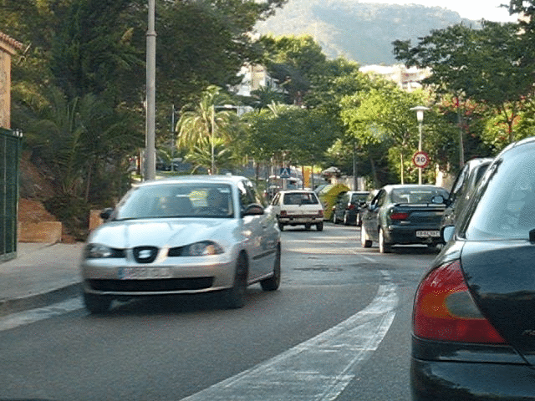
Optical flow for moving scenes

Slide 40
Optical flow for moving scenes

Slide 41
Optical flow for moving scenes
Optical flow helps grouping
Gestalt principle of common fate
  Things that move together belong together

Slide 42
Motion segmentation in humans
Elizabeth Spielke. Principles of Object Perception. In Cognitive Science, 1990.
Notes:
There is evidence from human psychology that this is a really important cue. For example, if you show really young infants this static display on the left, then they cannot distinguish between the two options on the right. In other words, they are unable to decide if the two halves of the rod form a single unified object, or whether they are indeed two rods.

Slide 43
Motion segmentation in humans
Elizabeth Spielke. Principles of Object Perception. In Cognitive Science, 1990.
Notes:
However, if you show infants this moving display

Slide 44
Motion segmentation in humans
Elizabeth Spielke. Principles of Object Perception. In Cognitive Science, 1990.
Notes:
Then they do perceive the rod as connected. This suggests that very young infants are unable to perceive any sort of depth ordering in the static image, but when objects move, they actually use the fact that things that move together form part of a single object.

Slide 45
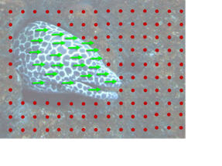
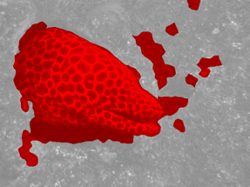
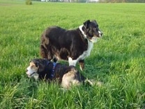
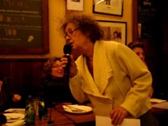
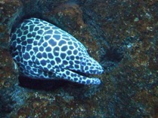
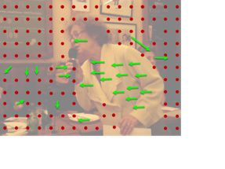
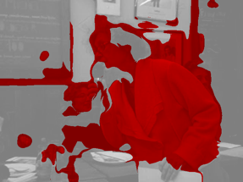
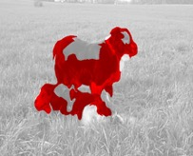
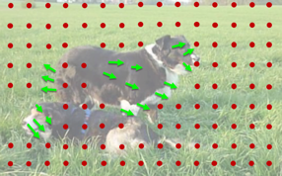
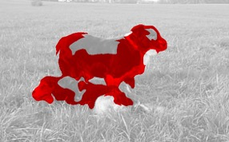


1. Collect videos
2. Segment using motion
3. Train ConvNet
Learning Features by Watching Objects Move. D. Pathak, R. Girshick, P. Dollar, T. Darrell, B. Hariharan. CVPR, 2017.
Notes:
This led to a fairly straightforward approach to learning representations in an unsupervised manner: we collected a large number of uncurated videos, we used motion grouping to segment out the foreground in each frame, and then we trained a ConvNet to predict this foreground segmentation

Slide 46
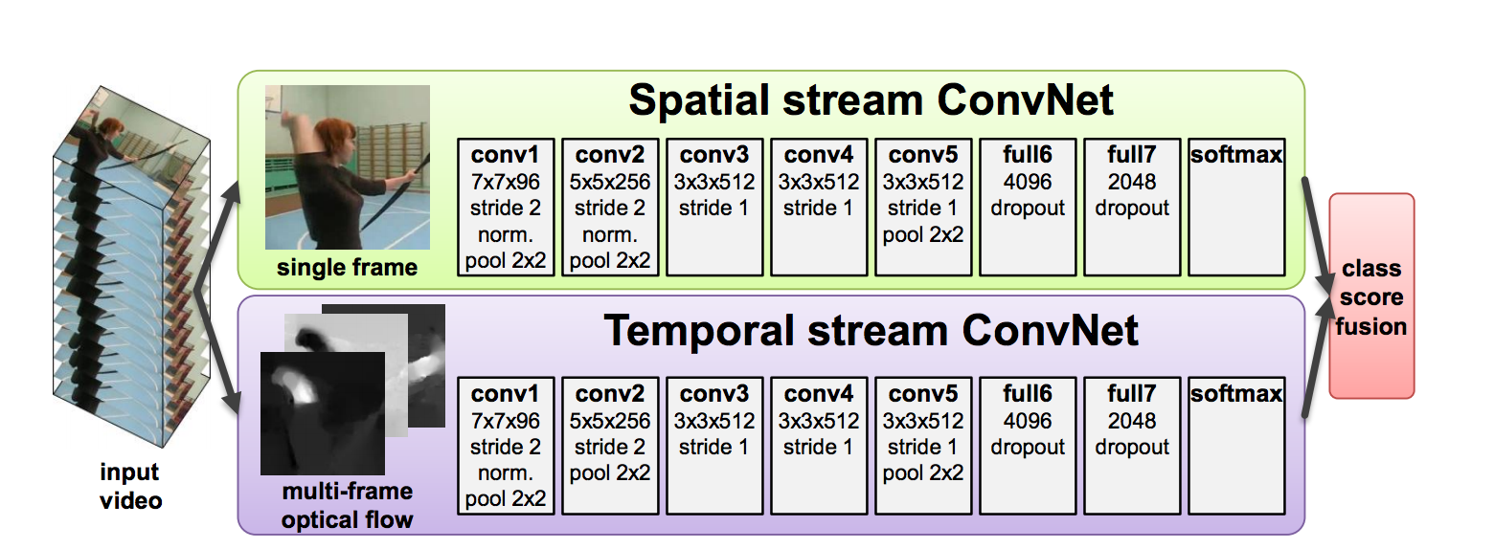
Optical flow for moving scenes
Motion is cue for recognition
  Gestures, actions, …
Two-Stream Convolutional Networks for Action Recognition in Videos. Simonyan and Zisserman. In NIPS 2014.

Slide 47
Optical flow for moving scenes
Motion is cue for recognition
  Gestures, actions, …
Model | Accuracy
Without optical flow | 73.0%
With optical flow | 88.0%
Two-Stream Convolutional Networks for Action Recognition in Videos. Simonyan and Zisserman. In NIPS 2014.

Slide 48
Estimating optical flow
Yet another correspondence problem!
But:
  Bad: scene can move
  Good: changes are usually small (classic optical flow problem: <1 pixel)

Slide 49
Optical flow constraint equation
Image intensity continuous function of x, y, t
In time dt, pixel (x,y,t) moves to (x + u dt, y + v dt, t + dt)
Optical flow constraint equation: One equation, two variables

Slide 50
Lucas-Kanade
Assume all pixels in patch have the same flow
When will this produce a unique solution?

Slide 51
Aperture problem

Slide 52
Aperture problem

Slide 53
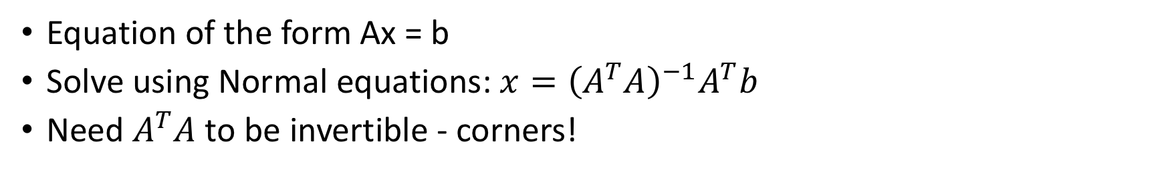
Lucas-Kanade
Equation of the form Ax = b
Solve using Normal equations: $x={\left(A^{T}A\right)}^{−1}A^{T}b$
Need $A^{T}A$ to be invertible - corners!

Slide 54
Lucas-Kanade
What if we consider the whole image as one patch?
  Constant optical flow for the entire image?
Better: what if we consider flow as a parametric function of pixel location?
  e.g. affine
  More generally:
  “Motion models”

Slide 55

Lucas-Kanade
Solve by iterating on $θ$
Newton iteration
Can we remove the parametric assumption?
Baker, Simon, and Iain Matthews. "Lucas-kanade 20 years on: A unifying framework." International journal of computer vision 56.3 (2004): 221-255.

Slide 56
Horn-Schunk
Data
Smoothness

Slide 57
Horn-Schunk
Data
Smoothness

Slide 58
Variational minimization
u and v are functions
Euler-lagrange equations
  Similar to “gradient=0”

Slide 59
Variational minimization

Slide 60
MPI-Sintel
Open-source animated movie “Sintel”
“Naturalistic” video
Ground truth optical flow
Large motions
Complex scenes

Slide 61

MPI-Sintel results

Slide 62
Optical flow with large displacements
Optical flow constraint equation assumes differential optical flow
“Large displacement”?
Key idea: reducing resolution reduces displacement
Reduce resolution, then upsample?
  will lose fine details
3
6
13
24
27

Slide 63
Optical flow with large displacements
Key idea 2: Use upsampled flow as initialization
Changes to initialization will be infinitesimal
compute flow
use as init
compute flow
…
Brox, Thomas, et al. "High accuracy optical flow estimation based on a theory for warping." Computer Vision-ECCV 2004 (2004)

Slide 64
Optical flow for large displacements
Horn-schunk variants match using color - Bad!
Use descriptor matching (e.g. SIFT) on sparse points
Use smoothness to propagate
Brox, Thomas, Christoph Bregler, and Jitendra Malik. "Large displacement optical flow." CVPR, 2009.

Slide 65
Large displacement optical flow (LDOF)

Slide 66
Coarse-to-fine processing
A specific instance of a general idea
Coarse scales:
  Global / large structures
  Long-range relationships
  But: imprecise localization
Fine scales:
  Precise localization
  But: aperture problem
Idea: start from coarse scales, add fine scale detail

Slide 67
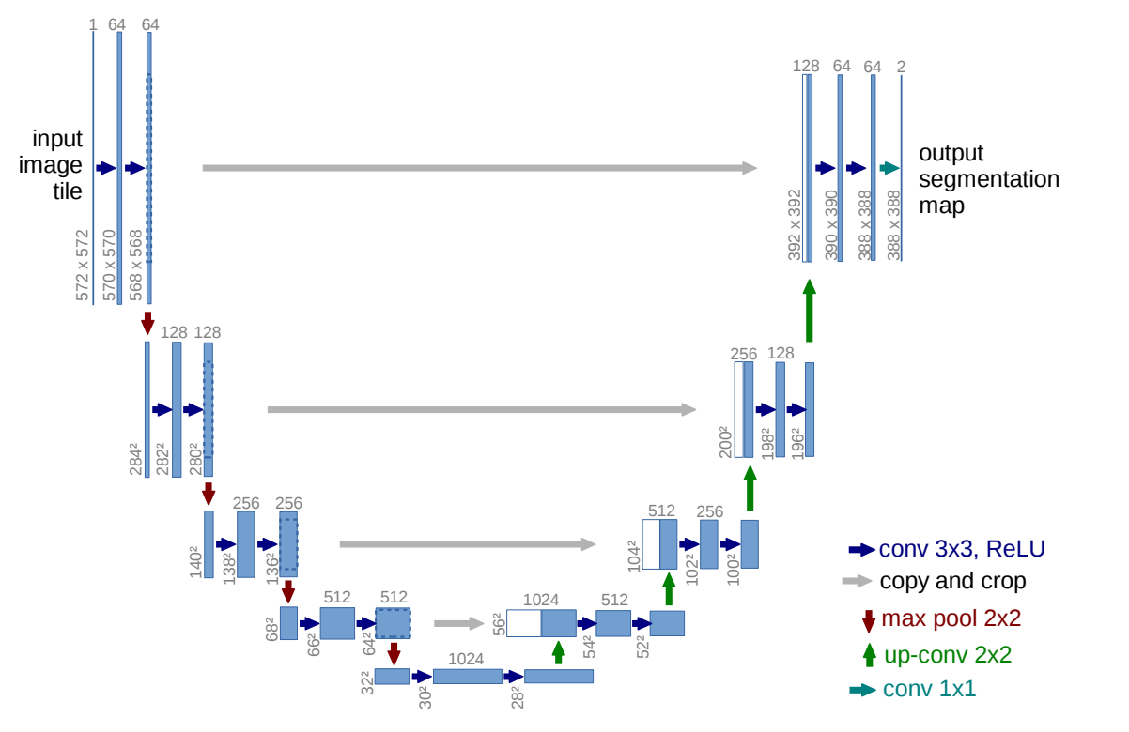
Coarse-to-fine processing
U-Net: Convolutional Networks for Biomedical Image Segmentation. Olaf Ronneberger, Philipp Fischer, and Thomas Brox. In MICCAI, 2015.

