Slide 1
Recognition

Slide 2
Image classification
Given an image, produce a label
Label can be:
  0/1 or yes/no: Binary classification
  one-of-k: Multiclass classification
  0/1 for each of k concepts: Multilabel classification

Slide 3
Image classification
Is this a dog? Yes

Slide 4
Image classification
Which of these is it: dog, cat or zebra?
Dog

Slide 5
Image classification
Is this a dog? Yes
Is this furry? Yes
Is this sitting down? Yes

Slide 6
MNIST
2D
10 classes
6000 examples per class
1990’s

Slide 7
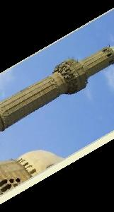
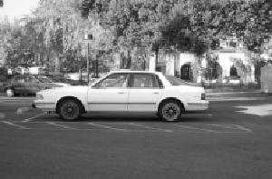
Caltech 101
101 classes
10 classes
30 examples per class
Strong category-specific biases
Clean images
MNIST
1990’s
2004

Slide 8
PASCAL VOC
20 classes
~500 examples per class
Clutter, occlusion, natural scenes
MNIST
Caltech 101
1990’s
2004
2007-2012

Slide 9
ImageNet
1000 classes
~1000 examples per class
Mix of cluttered and clean images
MNIST
Caltech 101
PASCAL VOC
1990’s
2004
2007-2013
2013-2017

Slide 10
Why is recognition hard?
Pose variation

Slide 11
Why is recognition hard?
Lighting variation

Slide 12
Why is recognition hard?
Scale variation

Slide 13
Why is recognition hard?
Clutter and occlusion

Slide 14
Why is recognition hard?
Intrinsic intra-class variation

Slide 15
Why is recognition hard?
Inter-class similarity

Slide 16
Learning
Key idea: teach computer visual concepts by providing examples
Training Set

Slide 17
Example
Binary classifier “Dog” or ”not Dog”
Labels: {0, 1}
Training set
{(
, 1),
(
, 1),
(
, 0) , … }

Slide 18
Choosing a model class
Will try and find P(y = 1 | x)
P(y=0 | x) = 1 - P(y=1 | x)
Need to find
But: enormous number of possible mappings

Slide 19
Choosing a model class
Assume h is a linear classifier in feature space
Feature space?
Linear classifier?

Slide 20
Feature space: representing images as vectors
Find a way to project images onto

Slide 21

Feature space: representing images as vectors
Find a way to project images onto

Slide 22
Feature space: representing images as vectors
Find a way to project images onto
(
) =

Slide 23
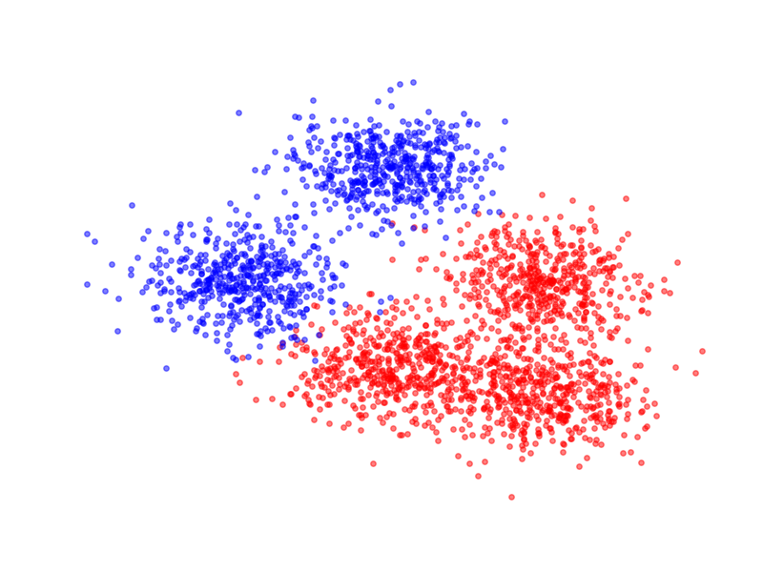
Linear classifiers

Slide 24
Linear classifiers

Slide 25
Linear classifiers in feature space

Slide 26
Linear classifiers in feature space
Family of functions
Each function is called a hypothesis
Family is called a hypothesis class
Hypotheses indexed by w
Need to find the best hypothesis = need to find best w

Slide 27
Training: Choosing the best hypothesis
Use training set to find best-fitting hypothesis
Question: how do we define fit?
Given (x,y), and candidate hypothesis h_{w}
  h_{w}(x) is estimated probability label is 1
  Idea: compute estimated probability for true label y
  Want this probability to be high
  Likelihood

Slide 28
Training: Choosing the best hypothesis

Slide 29
Training: Choosing the best hypothesis
Likelihood of a single data point
Fit = total likelihood of entire training dataset

Slide 30
Training: Choosing the best hypothesis
Use log likelihood
Maximize log likelihood

Slide 31
Training: Choosing the best hypothesis
Maximizing log likelihood = Minimizing negative log likelihood

Slide 32
Training: Choosing the best hypothesis
Negative log likelihood is a loss function

Slide 33
Training = Optimization
Need to minimize an objective
Simple solution: gradient descent

Slide 34
Stochastic gradient descent

Slide 35
Stochastic gradient descent
Randomly sample small subset of examples
Compute gradient on small subset
  Unbiased estimate of true gradient
Take step along estimated gradient

Slide 36
Logistic Regression!

Slide 37
General recipe
Fix hypothesis class
Define loss function
Minimize total loss on the training set
Why should this work?

Slide 38
Risk
Given:
  Distribution
  A hypothesis
  Loss function L
We are interested in Expected Risk:
Given training set S, and a particular hypothesis h, Empirical Risk:

Slide 39
Risk
By central limit theorem,
Variance proportional to 1/n
For randomly chosen h, empirical risk is an unbiased estimator of expected risk

Slide 40
Risk
Empirical risk unbiased estimate of expected risk
Want to minimize expected risk
Idea: Minimize empirical risk instead
This is the Empirical Risk Minimization Principle

Slide 41
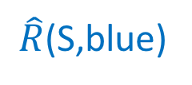
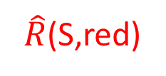
Generalization
$\hat{R}$(S,red)
$\hat{R}$(S,blue)
R(blue)
R(red)

Slide 42
Generalization
Training error
Generalization error

Slide 43
Overfitting
We are minimizing training error
Empirical risk of chosen hypothesis no longer unbiased estimate:
  We chose hypothesis based on S
  Might have chosen h for which S is a special case
Overfitting:
  Minimize training error, but generalization error increases

Slide 44
Controlling generalization error
Variance of empirical risk inversely proportional to size of S
  Choose very large S!
Larger the hypothesis class H, Higher the chance of hitting bad hypotheses with low training error and high generalization error
  Choose small H!
For many models, can bound generalization error using some property of parameters
  Regularize during optimization!
  Eg. L2 regularization

Slide 45
Controlling generalization error
How do we know we are overfitting?
  Use a held-out “validation set”
  To be an unbiased sample, must be completely unseen

Slide 46
Putting it all together
Want model with least expected risk = expected loss
But expected risk hard to evaluate
Empirical Risk Minimization: minimize empirical risk in training set
Might end up picking special case: overfitting
Avoid overfitting by:
  Constructing large training sets
  Reducing size of model class
  Regularization

Slide 47
Putting it all together
Collect training set and validation set
Pick hypothesis class
Pick loss function
Minimize empirical risk (+ regularization)
Measure performance on held-out validation set
Profit!

Slide 48
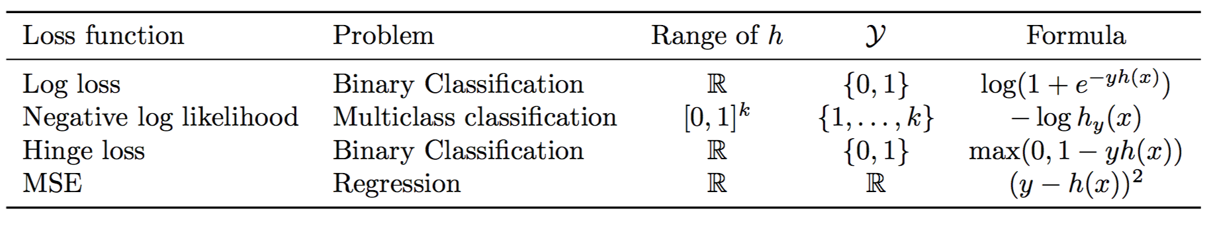
Loss functions and hypothesis classes

Slide 49
Linear classifiers on pixels are bad
Better feature vectors
Non-linear classifiers

Slide 50
Recognition before convnets

Slide 51
Better feature vectors
Need to be invariant to:
  Small deformations
  Small orientation changes
  Color / lightness variation

Slide 52
Rotational invariance by quantization
37
42
Between 30 and 45

Slide 53
Spatial invariance by histogramming
2 blue balls, one red box

Slide 54
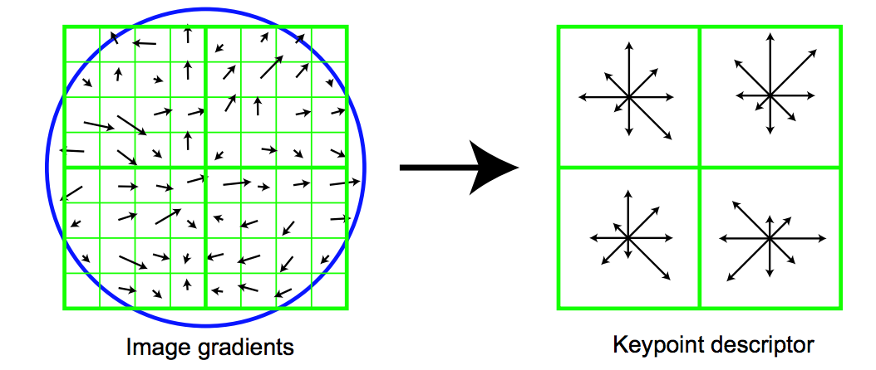
The SIFT descriptor
Compute edge magnitudes + orientations
Quantize orientations (rotational invariance)
Divide into spatial cells
Compute orientation histogram in each cell (spatial invariance)
Distinctive Image Features from Scale-Invariant Keypoints. Lowe. In IJCV 2004

Slide 55
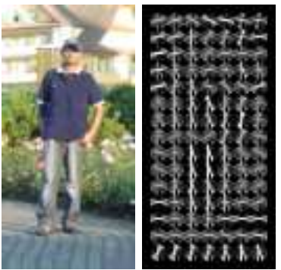
Same but different: HOG
Histogram of oriented gradients

Slide 56
Invariance to large deformations

Slide 57
Invariance to large deformations
Issue: object / object part may occur at any image location
Idea: want to represent the image as a “bag of object parts”

Slide 58
Bags of words
Last night I dreamt I went to Manderley again. It seemed to me I stood by the iron gate leading to the drive, and for a while I could not enter, for the way was barred to me. There was a padlock and a chain upon the gate. I called in my dream to the lodge-keeper, and had no answer, and peering closer through the rusted spokes of the gate I saw that the lodge was uninhabited….
dream
night
drive
locked
gate
lodge
uninhabited

Slide 59
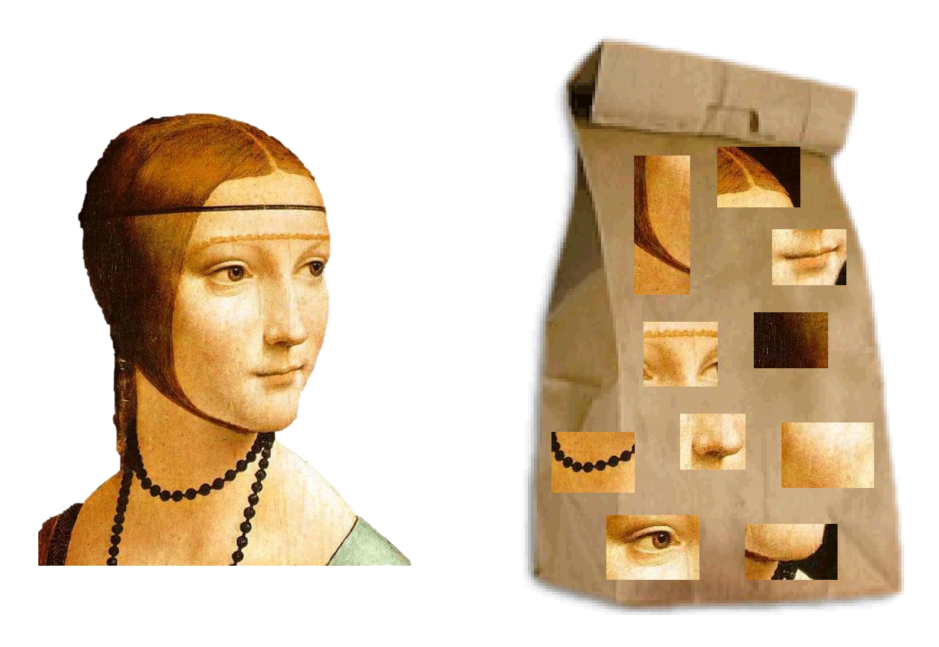
Bags of visual words

Slide 60
What should be visual words?
A visual word is a cluster of image patches that mean the same thing
  Object parts
  Texture patterns
Idea: collect patches from many different images
Cluster using k-means

Slide 61
What should be visual words?
Cluster in what space?
Need invariance to color, small deformations, orientation changes
Cluster in SIFT space!
Each cluster = visual word

Slide 62
Encoding images as bag of words
Densely extract image patches from image
Compute SIFT vector for each patch
Assign each patch to a visual word
Compute histogram of occurrence

Slide 63
Too much invariance?
Object parts appear in somewhat fixed relationships

Slide 64
Idea: Spatial pyramids

Slide 65
Non-linear classifiers: part-based models

Slide 66
Non-linear classifiers: part-based models
sum over
parts
HOG descriptor
of patch at l_{i}
max over locations
Linear
classifier
for part i

Slide 67
Non-linear classifiers: Kernel machines
Representer theorem:
Key idea: replace standard dot product by sophisticated dot product k(x_{i}, x)

Slide 68
Example kernels
RBF kernel
A. Vedaldi

