Slide 1
ZooKeeper
Wait-free coordination for Internet-scale systems
Open source slides shared by purplebleed@gmail.com

Slide 2
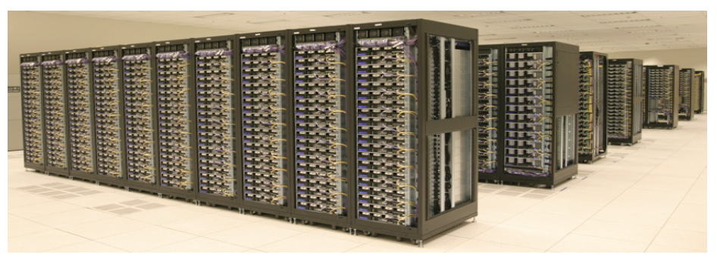
ZooKeeper
Aims to provide a simple and high performance kernel for building more complex client
Wait free
FIFO
No lock
Pipeline architecture

Slide 3
What is coordination?
Group membership
Leader election
Dynamic Configuration
Status monitoring
Queuing
Critical sections

Slide 4
Contributions
Coordination kernel
Wait-free coordination
Coordination recipes
Build higher primitives
Experience with Coordination
Some applications that use ZooKeeper

Slide 5
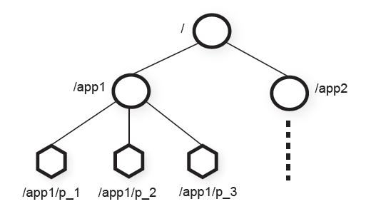
Zookeeper Service
Znode
In-memory data node in the Zookeeper data
Has a hierarchical namespace
UNIX-like notation for path
Types of Znode
Regular
Ephemeral
Znode flags
Sequential flag

Slide 6
Zookeeper Service
Watch Mechanism
Get notification
One time triggers
Other properties of Znode
Znode wasn’t designed for big-data storage, instead it should only store meta-data or configurations
Example: timestamp version
Session
A connection to server from client is a session
Timeout mechanism

Slide 7
Client API
Create(path, data, flags)
Delete(path, version)
Exist(path, watch)
getData(path, watch)
setData(path, data, version)
getChildren(path, watch)
Sync(path)
Two versions: synchronous and asynchronous

Slide 8
Guarantees
Linearizable writes
All requests that update the state of ZooKeeper are serializable and respect precedence
FIFO client order
All requests are in order that they were sent by client.

Slide 9
Examples of primitives
Configuration Management
For dynamic configuration propose
Simplest way is to create a znode c for saving configuration.
Other processes set the watch flag on c
The notification just indicate there is a update without telling how many time updates occurs
If configuration would be too big (8K limit), store it in the blob service and save a URL into c

Slide 10
Examples of primitives
Rendezvous
Configuration of the system may not be sure at the beginning
Create a znode r to solve this problem
When master starts, it creates configuration r
Workers see (1) who the master is, and (2) what configuration the master published. (3) Subsequently, they watch node r
Set to ephemeral node: r is “in memory only”

Slide 11
Examples of primitives
Group Membership
Create a znode g
Each process create a znode under g in ephemeral mode. g will have a list of members!
Just watch g for group information

Slide 12
Examples of primitives
Simple Lock
Create a znode l for locking
If a process is successful in creating l, it holds lock
Other processes fail to create l, switch to watching l
Problems: herd effect: when l is freed they all notice simultaneously!

Slide 13
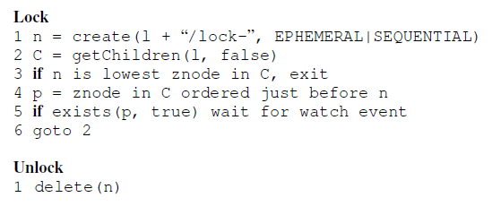
Examples of primitives
Simple Lock without herd effect

Slide 14
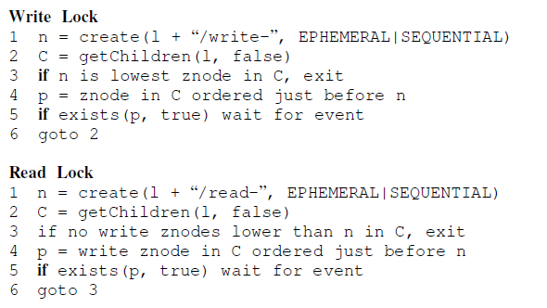
Examples of primitives
Read/Write Lock

Slide 15
Examples of primitives
Double Barrier
To synchronize the beginning and the end of some computation
Create a znode b. Have every process register by adding a znode under b
Set a threshold: when the count reaches this number, we start the process

Slide 16
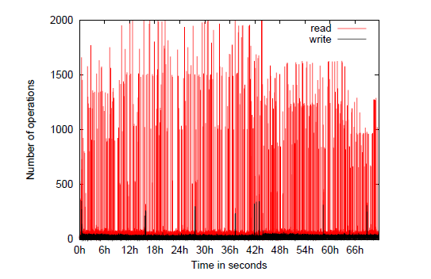
Application
Fetching Service
Using ZooKeeper for recovering from failure of masters
Configuration metadata and leader election

Slide 17
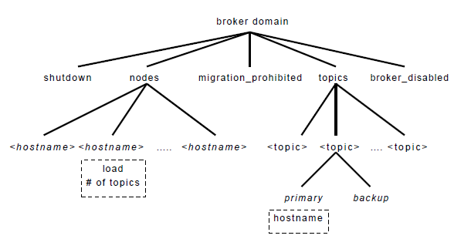
Application
Yahoo Message Broker
A distributed publish-subscribe system

Slide 18
Zookeeper’s “versioning” feature
Versioning is used when several processes compete to update some Zookeeper file.
Suppose that f contains something important, like “the amount of gasoline remaining.”
Processes p and q want to update f – each reads f, computes f-delta_{x} for their respective updates, and each wants to save f back.
Without a lock, they could clash.

Slide 19
Zookeeper’s “versioning” feature
With versioning, when you read a file, you learn the version number. So p and q both read, perhaps, version 18.
When you write a versioned file, you specify which version you are creating. The create will fail if that version already exists!
Effect? If p creates 19, q will fail, can reread the file (now reading version 19), retry update

Slide 20
Details on Zookeeper (this is their slide set and repeats some parts of mine)
Hunt, P., Konar, M., Junqueira, F.P. and Reed, B., 2010, June. ZooKeeper: Wait-free Coordination for Internet-scale Systems. In USENIX Annual Technical Conference (Vol. 8, p. 9).
Several other papers can be found on http://scholar.google.com.

Slide 21
Zookeeper goals
An open-source platform created to behave like a simple file system
Easy to use, fault-tolerant. A bit slow, but not to a point of being an issue.
Unlike standard cloud computing file systems, provides strong guarantees.
Employed in many cloud computing platforms as a quick and standard way to manage configuration data fault-tolerantly.

Slide 22
How is Zookeeper used today?
Naming service − Identifying the nodes in a cluster by name. It is similar to DNS, but for nodes
Configuration management − Latest and up-to-date configuration information of the system for a joining node
Cluster management − Joining / leaving of a node in a cluster and node status at real time
Leader election − Electing a node as leader for coordination purpose
Locking and synchronization service − Locking the data while modifying it. This mechanism helps you in automatic fail recovery while connecting other distributed applications like Apache HBase
Highly reliable data registry − Availability of data even when one or a few nodes are down

Slide 23
Recall the Amazon
μ-Services example
Browser
HTTPS
Web Interface Server
Client SDK
In μ-Services, these need resource management and scheduling
HTTP or TCP/IP
Kafka or SQS
Server SDK
Application Server
Resource Plugins
Billing
Packing
Shipment Planner
Mailing Labels

Slide 24
A Simple μ-service System
Microservice 1
Microservice 1
Microservice 1
UI Server
API Gateway & Router
Microservice 2
N Jobs
Microservice 2
Microservice 2
Some questions that might arise:
Is Replica 2 of microservice 3 up and running?
Do I have at least one service running?
Microservice 3 uses Master-Worker, and the Master just failed. What do I do?
Replica 2 needs to find configuration information. How can it do that?
Microservice 3
Microservice 3
Microservice 3

Slide 25
Apache Zookeeper and μ-services
Zookeeper can manage information in your system
IP addresses, version numbers, and other configuration information of your microservices.
The health of the microservices.
The state of a particular calculation.
Group membership

Slide 26
Apache Zookeeper Is…
A system for solving distributed coordination problems for multiple cooperating clients.
A lot like a distributed file system...
As long as the files are tiny.
You could get notified when the file changes
The full file pathname is meaningful to applications
A way to solve μ-service management problems.

Slide 27
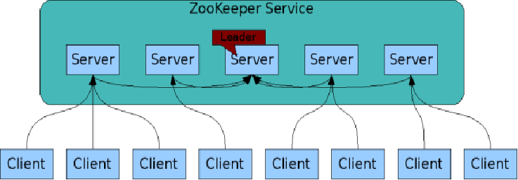
The ZooKeeper Service
Zookeeper is itself an interesting distributed system
These are your microservices
ZooKeeper Service is replicated over a set of machines
All machines store a copy of the data in memory (!). Checkpointed to disk if you wish.
A leader is elected on service startup
Clients only connect to a single ZooKeeper server & maintains a TCP connection.
Client can read from any Zookeeper server.
Writes go through the leader & need majority consensus.
https://cwiki.apache.org/confluence/display/ZOOKEEPER/ProjectDescription

Slide 28
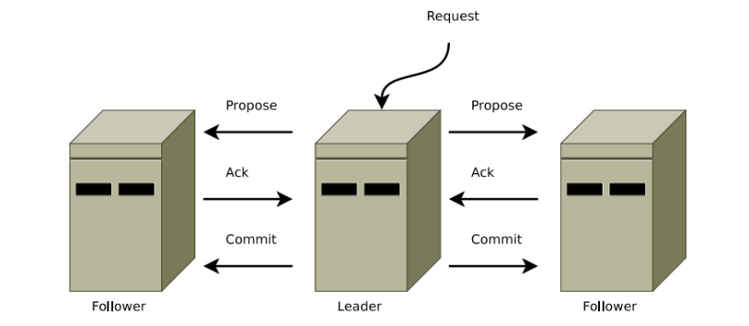
ZAB Protocol
Zookeeper Atomic Broadcast ensures that all see the state change and in the same sequence.
Any update must be acked by a majority of the servers
This is a virtually-synchronous 2-phase commit!

Slide 29
ZAB failure handling
1) Failure causes the 2-PC protocol to pause
2) A Zookeeper election selects a new leader. Then:
2a) The new leader polls servers to learn of 2PCs underway at the time of the crash
2b) It finishes them, updating its own state.
2c) It copies its state to the servers, so all are in the same state when the new epoch begins.
3) Normal execution resumes.

Slide 30
ZAB persistence
When files are ephemeral, performance is good but data can be lost if the service shuts down.
For Zookeeper persistent state, the system does a checkpoint periodically, every 5s
If a crash occurs, the leader resumes from the last checkpoint it can find.

Slide 31
ZAB limitations
Total state limited to 1MB
Individual configuration files limited to 8KB
Could lose an update in the event of

Slide 32
Zookeeper Summary
ZooKeeper provides a simple and high performance kernel for building more complex coordination primitives.
Helps distributed components share information
Clients (your applications) contact Zookeeper services to read and write metadata.
Read from cache but writes are more complicated
Sometimes, just the existence and name of a node are enough

Slide 33
Zookeeper Summary (Cont.)
Tree model for organizing information into nodes.
Node names may be all you need
Lightly structured metadata stored in the nodes.
Wait-free aspects of shared registers with an event-driven mechanism similar to cache invalidations of distributed file systems
Targets simple metadata systems that read more than they write.
Small total storage

Slide 34
Zookeeper, More Briefly
Zookeeper Clients (that is, your applications) can create and discover nodes on Zookeeper trees
Clients can put small pieces of data into the nodes and get small pieces out.
1 MB max for all data per server by default
Individual files limited to 8KB
Each node also has built-in metadata like its version number.
You could build a small DNS with Zookeeper.
Some simple analogies
Lock files and .pid files on Linux systems.

Slide 35
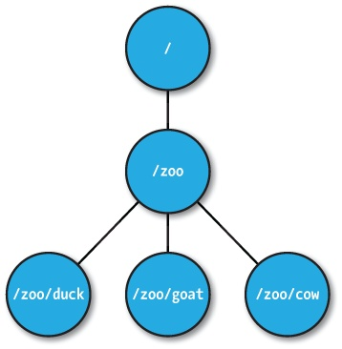
ZNodes
Maintain file meta-data with version numbers for data changes, ACL changes and timestamps.
Version numbers increases with changes
Data is read and written in its entirety

Slide 36
ZNode types
Regular
Clients create and delete explicitly
Ephemeral
Like regular znodes associated with sessions
Deleted when session expires
Sequential
Property of regular and ephemeral znodes
Has a universal, monotonically increasing counter appended to the name

Slide 37
Zookeeper API (1/2)
create(path, data, flags): Creates a znode with path name path, stores data[] in it, and returns the name of the new znode.
flags enables a client to select the type of znode: regular, ephemeral, and set the sequential flag;
delete(path, version): Deletes the znode path if that znode is at the expected version
exists(path, watch): Returns true if the znode with path name path exists, and returns false otherwise.
Note the watch flag

Slide 38
Zookeeper API (2/2)
getData(path, watch): Returns the data and meta-data, such as version information, associated with the znode.
setData(path, data, version): Writes data[] to znode path if the version number is the current version of the znode
getChildren(path, watch): Returns the set of names of the children of a znode
sync(path): Waits for all updates pending at the start of the operation to propagate to the server that the client is connected to.

Slide 39
Configuration Management
All clients get their configuration information from a named znode
/root/config-me
Example: you can build a public key store with Zookeeper
Clients set watches to see if configurations change
Zookeeper doesn’t explicitly decide which clients are allowed to update the configuration.
That would be an implementation choice
Zookeeper uses leader-follower model internally, so you could model your own implementation after this.

Slide 40
The Rendezvous Problem
Classic distributed computing algorithm
Consider master-worker
Specific configurations may not be known until runtime
EX: IP addresses, port numbers
Workers and master may start in any order
Zookeeper implementation:
Create a rendezvous node: /root/rendezvous
Workers read /root/rendezvous and set a watch
If empty, use watch to detect when master posts its configuration information
Master fills in its configuration information (host, port)
Workers are notified of content change and get the configuration information

Slide 41
Locks
Familiar analogy: lock files used by Apache HTTPD and MySQL processes
Zookeeper example: who is the leader with primary copy of data?
Implementation:
Leader creates an ephemeral file: /root/leader/lockfile
Other would-be leaders place watches on the lock file
If the leader client dies or doesn’t renew the lease, clients can attempt to create a replacement lock file
Use SEQUENTIAL to solve the herd effect problem.
Create a sequence of ephemeral child nodes
Clients only watch the node immediately ahead of them in the sequence

Slide 42
Zookeeper is popular in science-computing gateways
Browser
HTTPS
Web Interface Server
Client SDK
In micro-service arch, these also need scheduling
HTTP or TCP/IP
“Super” Scheduling and Resource Management
Server SDK
Application Server
Resource Plugins
Different archs, schedulers, admin domains,
…
Karst: MOAB/Torque
Stampede: SLURM
Comet: SLURM
Jureca:SLURM

Slide 43
With μ-Services we often replicate components.
API Server
Application Manager
Metadata Server
API Server
API Server
API Server
API Server
Application Manager
Metadata Server
Application Manager
Metadata Server
Application Manager
Metadata Server
Application Manager
Metadata Server
Application Manager
Metadata Server
Application Manager
Metadata Server

Slide 44
Why is this form of replication needed?
Fault tolerance
Increased throughput, load balancing
Component versions
Not all components of the same type need to be on the same version
Backward compatibility checking
Component flavors
Application managers can serve different types of resources
Useful to separate them into separate processes if libraries conflict.

Slide 45
Configuration Management
Problem: gateway components in a distributed system need to get the correct configuration file.
Solution: Components contact Zookeeper to get configuration metadata.
Comments: this includes both the component’s own configuration file as well as configurations for other components
Rendezvous problem

Slide 46
Service Discovery
Problem: Component A needs to find instances of Component B
Solution: Use Zookeeper to find available group members instances of Component B
More: get useful metadata about Component B instances like version, domain name, port #, flavor
Comments
Useful for components that need to directly communicate but not for asynchronous communication (message queues)

Slide 47
Group Membership
Problem: a job needs to go to a specific flavor of application manager. How can this be located?
Solution: have application managers join the appropriate Zookeeper managed group when they come up.
Comments: This is useful to support scheduling

Slide 48
System State for Distributed Systems
Which servers are up and running? What versions?
Services that run for long periods could use ZK to indicate if they are busy (or under heavy load) or not.
Note overlap with our Registry
What state does the Registry manage? What state would be more appropriate for ZK?

Slide 49
Leader Election
Problem: metadata servers are replicated for read access but only the master has write privileges. The master crashes.
Solution: Use Zookeeper to elect a new metadata server leader.
Comment: this is not necessarily the best way to do this

Slide 50
Under the Zookeeper Hood
ZAB

Slide 51
Coded in Java
Zab Protocol

Slide 53
Zookeeper Handling of Writes
READ requests are served by any Zookeeper server
Scales linearly, although information can be stale
WRITE requests change state so are handed differently
One Zookeeper server acts as the leader
The leader executes all write requests forwarded by followers
The leader then broadcasts the changes
The update is successful if a majority of Zookeeper servers have correct state at the end of the protocol

Slide 54
Some Zookeeper Implementation Simplifications
Uses TCP for its transport layer.
Message order is maintained by the network
The network is reliable?
Assumes reliable file system
Logging and DB checkpointing

Slide 55
Some Zookeeper Implementation Simplifications
Does write-ahead logging
Requests are first written to the log
The Zookeeper DB is updated from the log
Zookeeper servers can acquire correct state by reading the logs from the file system
Checkpoint reading means you don’t have to reread the entire history
Assumes a single administrator so no deep security

Slide 56
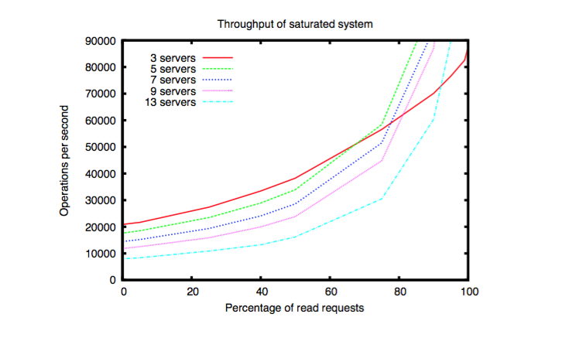
Speed isn’t everything. Having many servers increases reliability but decreases throughput as # of writes increases.

Slide 57
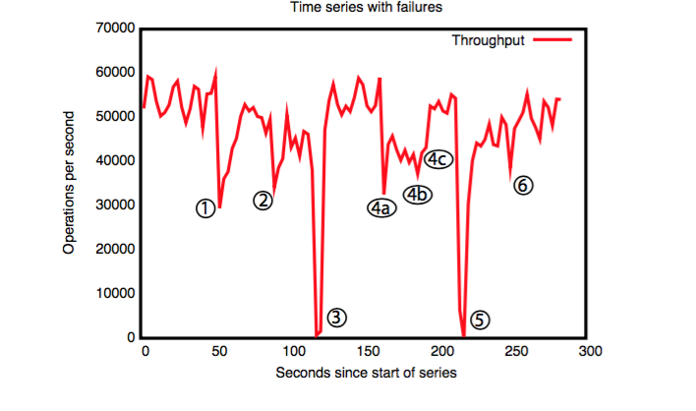
Failure and recovery of follower.
Failure and recovery of follower.
Failure of leader (200 ms to recover).
Failure of two followers (4a and 4b), recovery at 4c.
Failure of leader
Recovery of leader (?)
A cluster of 5 zookeeper instances responds to manually injected failures.

Slide 58
State of the Art today?
Zookeeper is solving a problem that Leslie Lamport formalized as the state machine replication problem. Much work has been done on this.
The “Paxos” protocols solve this problem. Zookeeper’s ZAB is like Paxos for ephemeral state, but not for persistent state.
But checkpointing is not the same as the true durable Paxos. Durable Paxos is like checkpointing on every operation. Zookeeper does so every 5s
Derecho has no bugs of this kind and could replace Zookeeper. Someone would take the Zookeeper API and replace ZAB with calls to Derecho.

