Slide 1
Tensor Flow
Tensors: n-dimensional arrays Vector: 1-D tensor
Matrix: 2-D tensor
Deep learning process are flows of tensors A sequence of tensor operations
Can represent also many machine learning algorithms

Slide 2
A simple ReLU network (ReLU: Rectified Linear Unit)
a1=a0wa,a+b0wb,a+c0wc,a b1=a0wa,b+b0wb,b+c0wc,b c1=a0wa,c+b0wb,c+c0wc,c Apply relu(…) on a1, b1, c1 Slower approach
Per-neuron operation More efficient approach
Matrix operation
a1
b1
c1
w
a0
b0
c0

Slide 3
As matrix operations
wa,a | wa,b | wa,c
wb,a | wb,b | wb,c
wc,a | wc,b | wc,c
a0 | b0 | c0
.
=
a1 | b1 | c1
a1
b1
c1
w
a1
=relu(
a1
)
)
)
a0
b0
c0
b1
=relu(
b1
c1
=relu(
c1

Slide 4
With TensorFlow
import tensorflow as tf x w
wa,a | wa,b | wa,c
wb,a | wb,b | wb,c
wc,a | wc,b | wc,c
a1
b1
c1
a0 | b0 | c0
.
=
a1 | b1 | c1
w
a0
b0
c0
y = tf.matmul(x, w)
a1
=relu( )
=relu( )
=relu( )
a1
b1
b1
c1
c1
out = tf.nn.relu(y)

Slide 5
Define Tensors
xa,a | xa,b | xa,c
xb,a | xb,b | xb,c
xc,a | xc,b | xc,c
Variable(<initial-value>,
name=<optional-name>)
w
import tensorflow as tf
w = tf.Variable(tf.random_normal([3, 3]), name='w') y = tf.matmul(x, w)
relu_out = tf.nn.relu(y)
Variable stores the state of current execution Others are operations

Slide 6
TensorFlow
Code so far defines a data flow graph Each variable corresponds to a
ReLU
node in the graph, not the result Can be confusing at the beginning
Variable
MatMul
x
import tensorflow as tf
w = tf.Variable(tf.random_normal([3, 3]), name='w') y = tf.matmul(x, w)
relu_out = tf.nn.relu(y)

Slide 7
TensorFlow
ReLU
Code so far defines a data flow graph Needs to specify how we
Variable
MatMul
want to execute the graph Session
Manage resource for graph execution
x
import tensorflow as tf sess = tf.Session()
w = tf.Variable(tf.random_normal([3, 3]), name='w') y = tf.matmul(x, w)
relu_out = tf.nn.relu(y) result = sess.run(relu_out)

Slide 8
Fetch
Fetch
Graph
Retrieve content from a node We have assembled the pipes Fetch the data
ReLU
Variable
MatMul
x
import tensorflow as tf sess = tf.Session()
w = tf.Variable(tf.random_normal([3, 3]), name='w') y = tf.matmul(x, w)
relu_out = tf.nn.relu(y)
print sess.run(relu_out)

Slide 9
Initialize Variable
Fetch
Graph
ReLU
Variable is an empty node Fill in the content of a Variable node
Variable
MatMul
x
import tensorflow as tf sess = tf.Session()
w = tf.Variable(tf.random_normal([3, 3]), name='w') y = tf.matmul(x, w)
relu_out = tf.nn.relu(y) sess.run(tf.initialize_all_variables())
print sess.run(relu_out)

Slide 10
Placeholder
Fetch
Graph
ReLU
How about x?
placeholder(<data type>,
shape=<optional-shape>, name=<optional-name>)
Its content will be fed
Variable
MatMul
x
import tensorflow as tf sess = tf.Session()
x = tf.placeholder("float", [1, 3])
w = tf.Variable(tf.random_normal([3, 3]), name='w') y = tf.matmul(x, w)
relu_out = tf.nn.relu(y) sess.run(tf.initialize_all_variables()) print sess.run(relu_out)

Slide 11
Feed
Fetch
Graph
ReLU
Pump data into the pipe
Variable
MatMul
import numpy as np import tensorflow as tf sess = tf.Session()
x
Feed
x = tf.placeholder("float", [1, 3])
w = tf.Variable(tf.random_normal([3, 3]), name='w') y = tf.matmul(x, w)
relu_out = tf.nn.relu(y) sess.run(tf.initialize_all_variables())
print sess.run(relu_out, feed_dict={x:np.array([[1.0, 2.0, 3.0]])})

Slide 12
Session management
Needs to release resource after use
sess.close()
Common usage
with tf.Session() as sess:
…
Interactive
sess = InteractiveSession()

Slide 13
Prediction
Softmax
Make predictions for n targets that sum to 1
import numpy as np import tensorflow as tf
with tf.Session() as sess:
x = tf.placeholder("float", [1, 3])
w = tf.Variable(tf.random_normal([3, 3]), name='w') relu_out = tf.nn.relu(tf.matmul(x, w))
softmax = tf.nn.softmax(relu_out) sess.run(tf.initialize_all_variables())
print sess.run(softmax, feed_dict={x:np.array([[1.0, 2.0, 3.0]])})

Slide 14
Prediction Difference
import numpy as np import tensorflow as tf
with tf.Session() as sess:
x = tf.placeholder("float", [1, 3])
w = tf.Variable(tf.random_normal([3, 3]), name='w') relu_out = tf.nn.relu(tf.matmul(x, w))
softmax = tf.nn.softmax(relu_out) sess.run(tf.initialize_all_variables()) answer = np.array([[0.0, 1.0, 0.0]])
print answer - sess.run(softmax, feed_dict={x:np.array([[1.0, 2.0, 3.0]])})

Slide 15
Learn parameters: Loss
Define loss function
Loss function for softmax softmax_cross_entropy_with_logits(
logits, labels, name=<optional-name>)
labels = tf.placeholder("float", [1, 3])
cross_entropy = tf.nn.softmax_cross_entropy_with_logits( relu_out, labels, name='xentropy')

Slide 16
Learn parameters: Optimization
Gradient descent
class GradientDescentOptimizer GradientDescentOptimizer(learning rate)
learning rate = 0.1
labels = tf.placeholder("float", [1, 3])
cross_entropy = tf.nn.softmax_cross_entropy_with_logits( relu_out, labels, name='xentropy')
optimizer = tf.train.GradientDescentOptimizer(0.1) train_op = optimizer.minimize(cross_entropy) sess.run(train_op,
feed_dict= {x:np.array([[1.0, 2.0, 3.0]]), labels:answer})

Slide 17
Iterative update
Gradient descent usually needs more than one step Run multiple times
labels = tf.placeholder("float", [1, 3])
cross_entropy = tf.nn.softmax_cross_entropy_with_logits( relu_out, labels, name=‘xentropy')
optimizer = tf.train.GradientDescentOptimizer(0.1) train_op = optimizer.minimize(cross_entropy)
for step in range(10): sess.run(train_op,
feed_dict= {x:np.array([[1.0, 2.0, 3.0]]), labels:answer})

Slide 18
Add parameters for Softmax
Do not want to use only non-negative input Softmax layer
…
softmax_w = tf.Variable(tf.random_normal([3, 3])) logit = tf.matmul(relu_out, softmax_w)
softmax = tf.nn.softmax(logit)
…
cross_entropy = tf.nn.softmax_cross_entropy_with_logits( logit, labels, name=‘xentropy')
…

Slide 19
Add biases
Biases initialized to zero
…
w = tf.Variable(tf.random_normal([3, 3])) b = tf.Variable(tf.zeros([1, 3]))
relu_out = tf.nn.relu(tf.matmul(x, w) + b) softmax_w = tf.Variable(tf.random_normal([3, 3])) softmax_b = tf.Variable(tf.zeros([1, 3]))
logit = tf.matmul(relu_out, softmax_w) + softmax_b softmax = tf.nn.softmax(logit)
…

Slide 20
Make it deep
Add layers
…
x = tf.placeholder("float", [1, 3]) relu_out = x
num_layers = 2
for layer in range(num_layers):
w = tf.Variable(tf.random_normal([3, 3])) b = tf.Variable(tf.zeros([1, 3]))
relu_out = tf.nn.relu(tf.matmul(relu_out, w) + b)
…

Slide 21
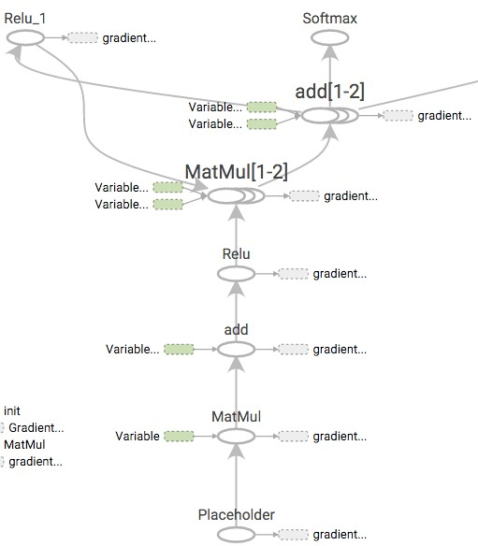
Visualize the graph
TensorBoard
writer = tf.train.SummaryWriter( '/tmp/tf_logs', sess.graph_def)
tensorboard --logdir=/tmp/tf_logs

Slide 22
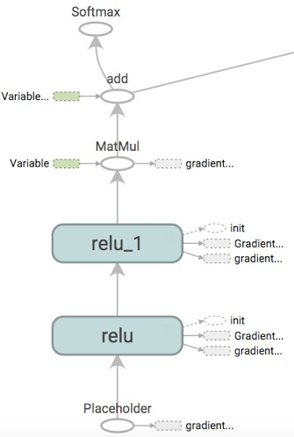
Improve naming, improve visualization
name_scope(name)
Help specify hierarchical names
Will help visualizer to better understand hierarchical relation
…
for layer in range(num_layers): with tf.name_scope('relu'):
w = tf.Variable(tf.random_normal([3, 3])) b = tf.Variable(tf.zeros([1, 3]))
relu_out = tf.nn.relu(tf.matmul(relu_out, w) + b)
…
Move to outside the loop?

Slide 23
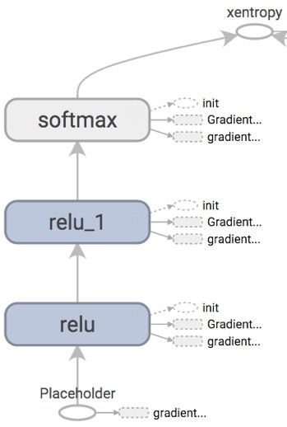
Add name_scope for softmax
Before After

Slide 24
Add regularization to the loss
eg. L2 regularize on the Softmax layer parameters Add it to the loss
Automatic gradient calculation
…
l2reg = tf.reduce_sum(tf.square(softmax_w)) loss = cross_entropy + l2reg
train_op = optimizer.minimize(loss)
…
print sess.run(l2reg)
…

Slide 25
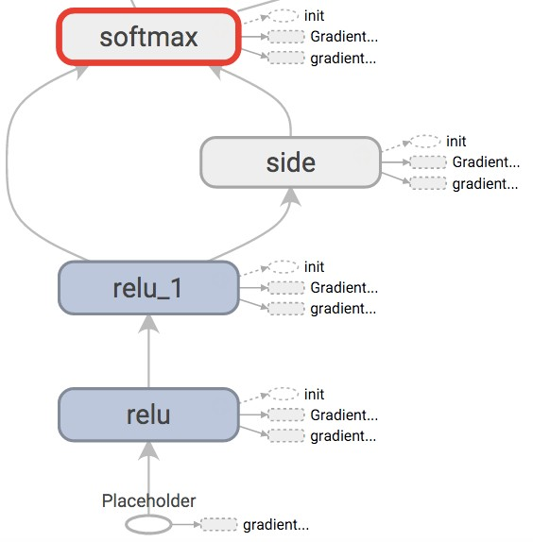
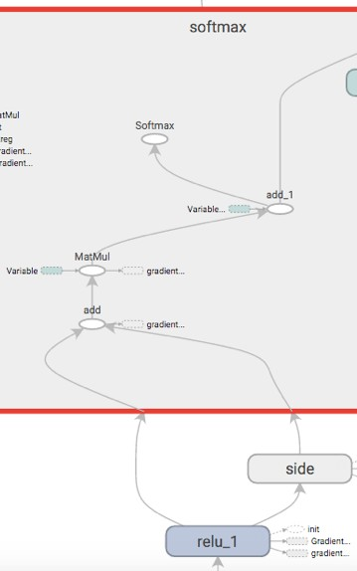
Add a parallel path

Slide 26
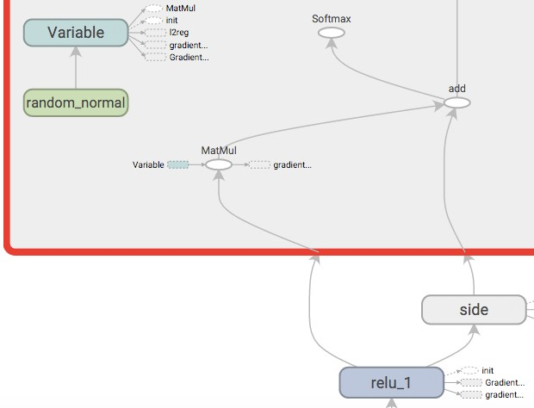
Use activation as bias
Everything is a tensor

Slide 27
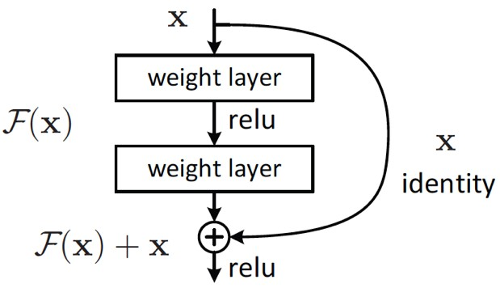
Residual learning
He et al. 2015
ILSVRC 2015 classification task winner

Slide 28
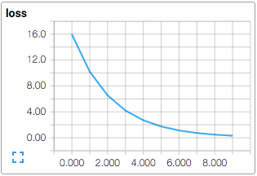
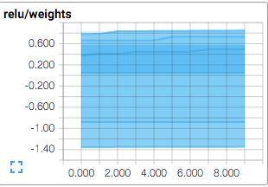
Visualize states
Add summaries scalar_summary
histogram_summary
merged_summaries = tf.merge_all_summaries() results = sess.run([train_op, merged_summaries],
feed_dict=…) writer.add_summary(results[1], step)

Slide 29
Save and load models
tf.train.Saver(…)
Default will associate with all variables all_variables()
save(sess, save_path, …) restore(sess, save_path, …)
Replace initialization
That’s why we need to run initialization separately

Slide 30
Convolution
conv2d(input, filter, strides, padding, use_cudnn_on_gpu=None, name=None)

Slide 31
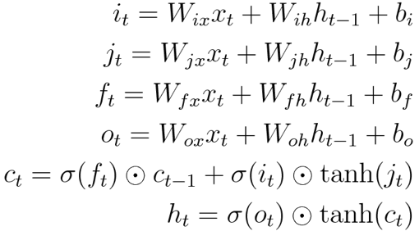
LSTM
BasicLSTMCell
# Parameters of gates are concatenated into one multiply for efficiency. c, h = array_ops.split(1, 2, state)
concat = linear([inputs, h], 4 * self._num_units,True)
# i = input_gate, j = new_input, f = forget_gate, o = output_gate i, j, f, o = array_ops.split(1, 4, concat)
new_c = c * sigmoid(f + self._forget_bias) + sigmoid(i) * tanh(j) new_h = tanh(new_c) * sigmoid(o)

Slide 32
Word2Vec with TensorFlow
# Look up embeddings for inputs. embeddings = tf.Variable(
tf.random_uniform([vocabulary_size, embedding_size], -1.0, 1.0)) embed = tf.nn.embedding_lookup(embeddings, train_inputs)
# Construct the variables for the NCE loss nce_weights = tf.Variable(
tf.truncated_normal([vocabulary_size, embedding_size], stddev=1.0 / math.sqrt(embedding_size)))
nce_biases = tf.Variable(tf.zeros([vocabulary_size]))
# Compute the average NCE loss for the batch.
# tf.nce_loss automatically draws a new sample of the negative labels each
# time we evaluate the loss. loss = tf.reduce_mean(
tf.nn.nce_loss(nce_weights, nce_biases, embed, train_labels, num_sampled, vocabulary_size))

Slide 33
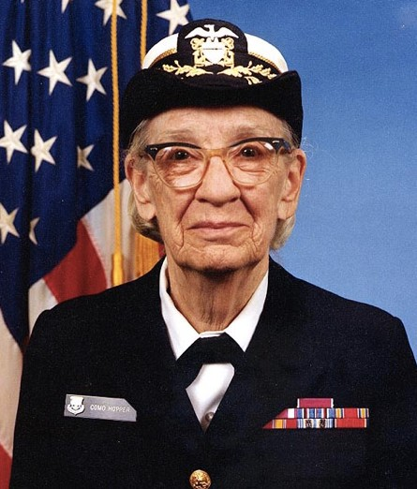
Reuse Pre-trained models
Image recognition Inception-v3
military uniform (866): 0.647296
suit (794): 0.0477196
academic gown (896): 0.0232411
bow tie (817): 0.0157356
bolo tie (940): 0.0145024

Slide 34
Try it on your Android
Tensorflow Android Camera Demo
Uses a Google Inception model to classify camera frames in real-time, displaying the top results in an overlay on the camera image.
github.com/tensorflow/tensorflow/tree/master/tensorflow/ examples/android

Slide 35
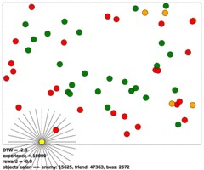
Reinforcement Learning using Tensor Flow
github.com/nivwusquorum/tensorflow-deepq

Slide 36
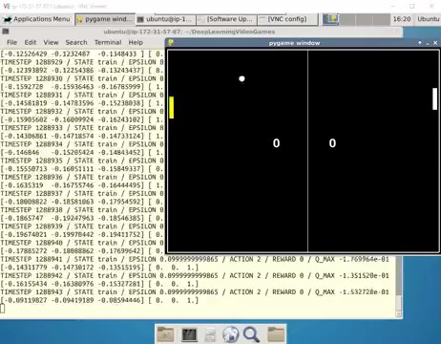
Using Deep Q Networks to Learn Video Game Strategies
github.com/asrivat1/DeepLearningVideoGames

