Slide 1
Emerging Topics: Disaggregated Datacenters
Reuben Rappaport

Slide 2
INTRODUCTION

Slide 3
Traditional Datacenters
Traditional datacenters feature a server-centric design
Each server consists of a set of resources (NIC, Compute, Storage) bundled together
Tasks are scheduled in a fairly course grained manner by allocating machines

Slide 4
Disaggregated Datacenters
Resources are split apart into separate blades each of which contains only one resource type
These blades are networked together by a high bandwidth interconnect
Can be set up at multiple different scales
Rack scale disaggregation
Datacenter scale disaggregation

Slide 5
Advantages to Disaggregation
CPU and memory technologies exhibit significantly different trends
Decoupling the two makes it easier to evolve the technologies separately
Fine grained scheduling for each resource separately
Can exactly match a job’s requirements with no overprovisioning

Slide 6
NETWORK REQUIREMENTS

Slide 7
Introduction
Disaggregating CPU from memory introduces network latency into every single memory access
Due to this, DDC prototypes have mostly relied upon extremely low latency next generation interconnects
Unfortunately these new technologies are both proprietary and expensive
Are these technologies actually necessary for a DDC to function?

Slide 8
Prior Work
Lim et al explore the implications of the different trends for memory capacity and compute
The growing difference between the two is causing a “memory capacity wall” which fundamentally limits colocated CPU and memory setups
Several different authors (FireBox, Theia, R2C2) propose radical network redesigns with new technologies or topologies to support DDC traffic
None of these papers actually evaluate the network requirements for DDC to work

Slide 9
Prior Work
Many recent authors look at reducing network latency by bypassing the kernel stack
RDMA does this in hardware
We read a paper (IX) earlier in the course looking at doing this with a user level network stack inspired by the techniques used for dedicated network devices

Slide 10
Technical Contributions
This paper aims to provide a solid answer to the question “what are the minimum network requirements for a DDC architecture to be feasible”
To do this the authors run a set of simulations on existing applications and analyze the results

Slide 11
DDC Design Assumptions
CPU blades retain some local memory
Cache coherence domain is limited to a single compute blade
All resources are virtualizable
VMs can be provisioned with resources from across the scope of disaggregation
Each rack hosts a mix of resources
CPU blades access remote memory at the page level

Slide 12
Design Knobs
Given the previous assumptions the paper evaluates tweaking two main design knobs
The amount of local memory on each compute blade
The scope of disaggregation

Slide 13
Evaluation Setup
The authors evaluate the performance degradation suffered by existing applications run on a DDC

Slide 14
Evaluation Setup
To simulate DDC behavior the authors partition physical memory into a small “local” section and a “remote” section
They limit the applications to only accessing the “local” section and intercept page faults with a special swap device backed by the “remote” memory
To simulate the network they inject artificial delays into each “remote” access

Slide 15
Results

Slide 16
Results
By varying the latency / bandwidth configurations the authors find two main classes of network requirements

Slide 17
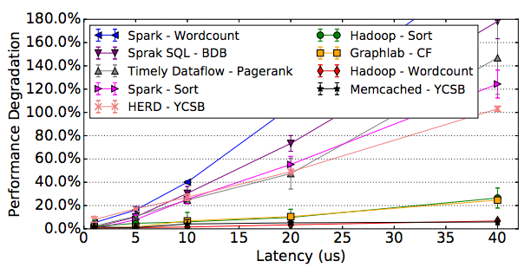
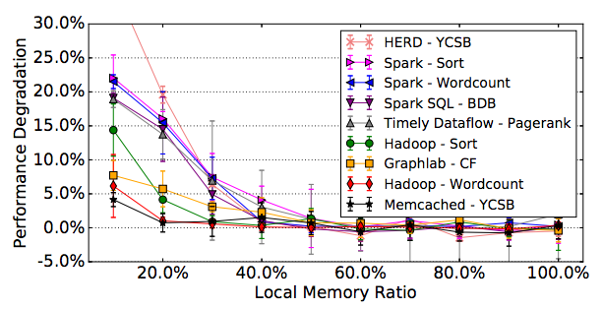
Sensitivity Analysis

Slide 18
Predicting Requirements

Slide 19
Meeting These Requirements
Achieving 100 Gbps bandwidth is reasonable
Hitting $3−5 μs$ latency is much more difficult
Doing it requires RDMA + NIC integration

Slide 20
Getting Congestion Data
The analysis so far completely neglected queuing delays due to congestion
To look at this the authors extend their experimental setup to generate a network log and then evaluate the impact of congestion
Remote Memory Access Trace
Split up Compute and Memory to simulate DDC
Network Flow Model

Slide 21
Congestion Evaluation Setup
The authors evaluate five different protocols on the flow data
TCP
DCTCP
pFabric
pHost
Fastpass

Slide 22
Results
Both pFabric and pHost obtain close to optimal slowdowns
Performance is worst on Wordcount which has very high congestion

Slide 23
Results
Finally the authors redid the original simulation with pFabric congestion factored in

Slide 24
Conclusions
Overall the authors find the following
DDC requires $40−100 Gbps$ bandwidth and $3−5 μs$ latency
The primary factor standing in the way of achieving this latency is software overhead in the kernel stack
Standard transport protocols (TCP) don’t handle DDC congestion well but recent proposals like pFabric do fine

Slide 25
Limitations
The paper evaluates requirements for a fairly large number of applications (10) but it’s not necessarily clear that the results generalize
The paper tries to simulate a system that doesn’t yet exist which is fundamentally an error prone process
This requires making a litany of assumptions about the DDC’s design
The paper only explores two design knobs out of many possible ones

Slide 26
Future Directions
Exploring techniques to reduce the latency of the network stack is key to building a DDC
RDMA is promising but requires specialized hardware
IX might have the right idea with its user level stack
We’ll be able to get a much better idea of network requirements if we actually build a DDC prototype instead of just simulating one

Slide 27
STORAGE DISAGGREGATION

Slide 28
Introduction
Servers today are often equipped with flash cards
Capable of 100Ks of IOPs
To support dynamic load massively overprovisioned
This paper looks at disaggregating these flash resources

Slide 29
Prior Work
Disaggregating disk storage is well known since network latency is tiny compared to disk latency
Petal, Parallax, and Blizzard all present systems for this
Some authors (CORFU, FAWN) propose disaggregating flash as a distributed shared pool instead of as a traditional block device

Slide 30
Traditional Architecture

Slide 31
Disaggregated Architecture

Slide 32
Tuning iSCSI
The iSCSI protocol is far too heavyweight for this application
The authors had to apply significant tuning to get reasonable performance out of it
They ran multiple processes, turned on TSO and LSO offloads, turned on jumbo frames, and manually assigned IRQ affinity to improve the setup

Slide 33
Evaluation
The authors looked at the performance of the rocksdb keystore wrapped in an ssdb interface
They used the mutilate load generator tuned to replicate Facebook workload data

Slide 34
Results
Overall the authors saw about a 20% performance degradation in the remote setup
This was not as bad at the tail

Slide 35
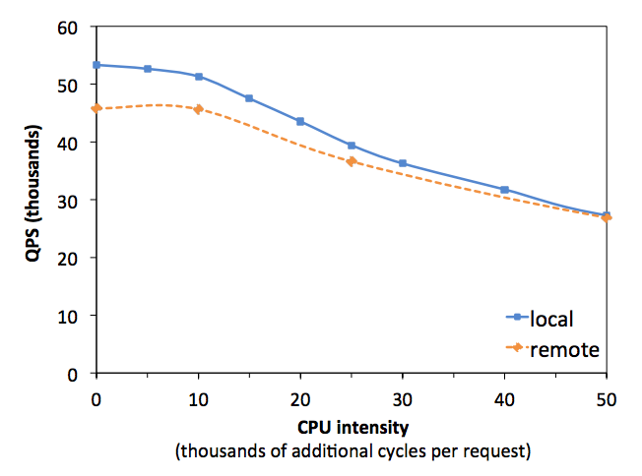
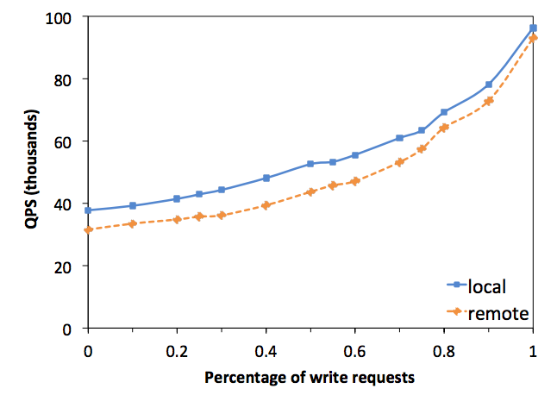
Sensitivity Analysis
Neither CPU intensity nor percentage of write requests saw significant differences between the local and remote cases

Slide 36
Multitenant Scenario
In the multitenant scenario (left 2 tenants, right 3 tenants) average performance degradation is the same but the tail sees much worse degradation

Slide 37
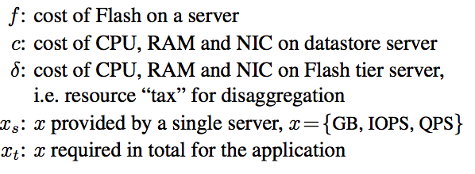
Analysis
The authors finish up the paper by developing a cost model for disaggregated vs local flash storage and plugging in some numbers

Slide 38
Analysis
Disaggregating flash will save costs when compute and storage scale differently
They plot the cost savings by varying these two parameters

Slide 39
Limitations
A major limitation of this work is the need to rely on the iSCSI protocol for the block store interface
Generally when you have to do that much tuning to get reasonable performance it’s a sign that your protocol is not the right choice
20% performance degradation is pretty serious even if you scale up your flash servers to compensate
Can this setup still handle the maximum dynamic load?

Slide 40
Future Directions
Just like with the other paper, exploring techniques to reduce network latency is essential
Is iSCSI really the right choice? Are there any lighter weight protocols we can use?
If we disaggregate flash we’ll need to assign datastore servers to flash servers
Can we apply existing resource allocation work?

