Slide 1
CS 6410: Advanced Systems Prof. Hakim Weatherspoon
Fall 2018
Principled Computer System Design

Slide 2
Systems Research
The study of tradeoffs
Functionality vs performance
E.g. where to place error checking
Are there principles or rules of thumb that can help with large systems design?

Slide 3
What is System Design: Science, Art, Puzzle?
Required Functionality
“Logic”
Expected Workload
“User Load”
Required
Performance
“SLA”
Available
Resources
“Environment”

Slide 4
Something to do with “Abstraction”
IMPLEMENTATION GOES HERE
INTERFACE
(HIDES IMPLEMENTATION)

Slide 5
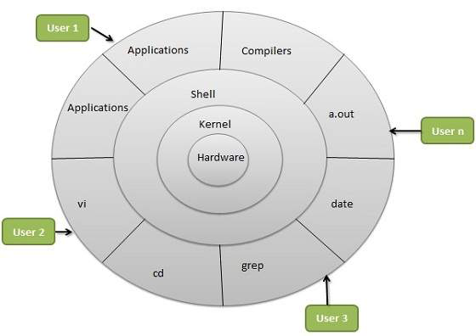
Also, “Layering” (layered modules)
From: http://www.tutorialspoint.com/operating_system/os_linux.htm

Slide 6
Any problem in computer science can be solved with another level of indirection
Attributed to David Wheeler (by Butler Lampson)

Slide 7
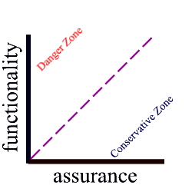
Functionality vs Assurance
Assurance
== Required Performance (Speed, Fault Tolerance)
== Service Level Agreement (SLA)

Slide 8
End-to-End arguments in System Design – Jerry H. Saltzer, David P. Reed, David D. Clark (MIT)
Jerry H. Saltzer
A leader of Multics, key developer of the Internet, and a LAN (local area network) ring topology, project Athena
David P. Reed
Early development of TCP/IP, designer of UDP
David D. Clark
I/O of Multics, Protocol architect of Internet
“We reject: kings, presidents and voting.
We believe in: rough consensus and running code.”
Notes:
Project Athena was a joint project of MIT, Digital Equipment Corporation, and IBM to produce a campus-wide distributed computing environment for educational use

Slide 9
End-to-End argument
Helps guide function placement among modules of a distributed system
Argument
implement the functionality in the lower layer only if
a large number of higher layers / applications use this functionality and implementing it at the lower layer improves the performance of many of them, AND
does not hurt the remaining applications
Notes:
The principle states that, whenever possible, communications protocol operations should be defined to occur at the end-points of a communications system, or as close as possible to the resource being controlled.
According to the end-to-end principle, protocol features are only justified in the lower layers of a system if they are a performance optimization,

Slide 10
Example : File Transfer (A to B)
6. Route packet
A
4. Pass msg/packet down the protocol stack
5. Send the packet over the network
B
Read File Data blocks
App buffers File Data
Pass (copy) data to the
network subsystem

Slide 11
Example : File Transfer (A to B)
A
7. Receive packet and buffer msg.
8. Send data to the application
B
9. Store file data blocks

Slide 12
Possible failures
Reading and writing to disk
Transient errors in the memory chip while buffering and copying
network might drop packets, modify bits, deliver duplicates
OS buffer overflow at the sender or the receiver
Either of the hosts may crash

Slide 13
Solution: make the network reliable?
Packet checksums, sequence numbers, retry, duplicate elimination
Example: TCP
Solves only the network problem
What about the other problems listed?
Not sufficient and not necessary

Slide 14
Solution: end-to-end retransmission?
Introduce file checksums and verify once transfer completes – end-to-end check.
On failure – retransmit file
Works! (modulo rotting bits on disk)

Slide 15
Is network-level reliability useful?
Per-link retransmission leads to faster recovery from dropped packets than end-to-end
Seems particularly useful in wireless networks or very high latency networks
But this may not benefit all applications
Huge unnecessary overhead for, say, Real-Time speech transmission

Slide 16
TCP/IP
Transmission Control Protocol (TCP)
It is a transport protocol providing error detection, retransmission, congestion control, and flow control
TCP is almost-end-to-almost-end
kernel-to-kernel, socket-to-socket, but not app-to-app
Internet Protocol (IP)
IP is a simple ("dumb"), stateless protocol that moves datagrams across the network
The network itself (the routers) needs only to support the simple, lightweight IP; the endpoints run the heavier TCP on top of it when needed.

Slide 17
Other end-to-end examples
End-to-end authentication
TLS, SSL
Duplicate msg suppression

Slide 18
Is argument complete?
E.g. congestion control
TCP leaves it to the ends
Should the network trust the ends?
RED
In a wireless setting
packet loss != congestion
performance problems may appear in end-end systems under heavy load
Performance enhancing Proxies
Notes:
Performance enhancing proxies

Slide 19
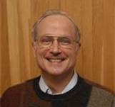
“Hints for Computer System Design” --- Butler Lampson, 1983
Based on author’s experience in systems design
Founding member of Xerox PARC (1970)
Currently Technical Fellow at MSR and adjunct prof. at MIT
Winner of ACM Turing Award (1994). IEEE Von Neumann Medal (2001)
Was involved in the design of many famous systems, including databases and networks

Slide 20
Some Projects & Collaborators
Charles Simonyi - Bravo: WYSIWYG editor (MS Office)
Bob Sproull - Alto operating system, Dover: laser printer, Interpress: page description language (VP Sun/Oracle)
Mel Pirtle - 940 project, Berkeley Computer Corp.
Peter Deutsch - 940 operating system, QSPL: system programming language (founder of Ghostscript)
Chuck Geschke, Jim Mitchell, Ed Satterthwaite - Mesa: system programming language

Slide 21
Some Projects & Collaborators (cont.)
Roy Levin - Wildflower: Star workstation prototype, Vesta: software configuration
Andrew Birrell, Roger Needham, Mike Schroeder - Global name service and authentication
Eric Schmidt - System models: software configuration
(CEO/Chairman of Google/Executive Chairman of Alphabet)
Rod Burstall - Pebble: polymorphic typed language

Slide 22
System Design Hints organized along two axes: Why and Where
Why:
Functionality: does it work?
Speed: is it fast enough?
Fault-tolerance: does it keep working?
Where:
Completeness
Interface
Implementation

Slide 23
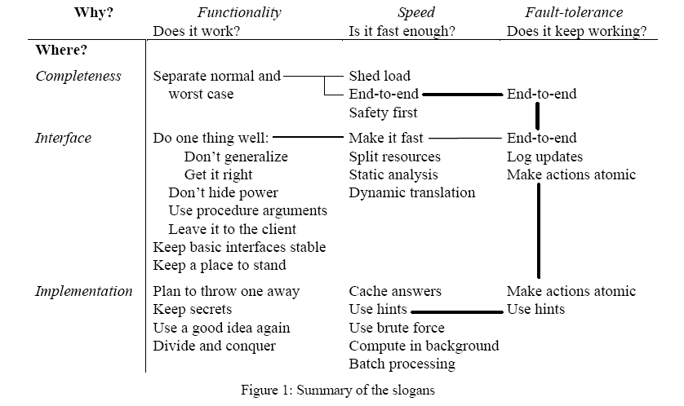
Hints for Computer System Design - Butler Lampson

Slide 24
FUNCTIONALITY
Interface
Between user and implementation of an abstraction
Contract, consisting of a set of assumptions about participants
Assume-Guarantees specification
Same interface may have multiple implementations
Requirements:
Simple but complete
Admit efficient implementation
Examples: Posix File System Interface, Network Sockets, SQL, …
Lampson: “Interface is a small programming language”
Do we agree with this?

Slide 25
Keep it Simple Stupid (KISS Principle)
Attributed to aircraft engineer Kelly Johnson (1910—1990)
Based on observation: systems work best if they are kept simple
Related:
Make everything as simple as possible, but not simpler (Einstein)
It seems that perfection is reached not when there is nothing left to add, but when there is nothing left to take away (Antoine de Saint Exupéry)
If in doubt, leave it out (Anon.)
Complexity is the Enemy: Exterminate Features (Charles Thacker)
The unavoidable price of reliability is simplicity (Tony Hoare)

Slide 26
Do one thing at a time, and do it well Don’t generalize Get it right!
A complex interface is hard to implement correctly, efficiently
Don’t penalize all for wishes by just a few
Basic (fast) operations rather than generic/powerful (slow) ones
Good interface admits implementation that is
Correct
Efficient
Predictable Performance
Simple does not imply good
A simple but badly designed interface makes it hard to build applications that perform well and/or predictably

Slide 27
Make it Fast Leave it to the Client Don’t Hide Power Keep Secrets
Design basic interfaces that admit implementations that are fast
Consider monolithic O.S. vs. microkernels
Clients can implement the rest
Abstraction should hide only undesirable properties
What are examples of undesirable?
Non-portable
Don’t tell clients about implementation details they can exploit
Leads to non-portability, applications breaking when modules are updated, etc.
Bad example: TCP

Slide 28
Use procedure arguments
High-level functions passed as arguments
Requires some kind of interpreter within the abstraction
Hard to secure
Requires safe language or sandboxing

Slide 29
Keep basic interfaces stable Keep a place to stand
Ideally do not change interfaces
Extensions are ok
If you have to change the interface, provide a backward compatibility option
Good example: Microsoft Windows

Slide 30
Plan to throw one away Use a good idea again
Prototyping is often a good strategy in system design
You end up building a series of prototypes
The same good idea may be usable in multiple contexts
Example: Unix developed this way, leading to Linux, Mac OS X, and several others

Slide 31
Divide and Conquer
Several forms:
Recursion
Stepwise Refinement
Modularization
Lampson only talks about recursion
Stepwise refinement is a useful technique to contain complexity of systems
Modules contain complexity
Principle of “Separation of Concerns” (Edsger Dijkstra)

Slide 32
Handle normal and worst case separately
Use a highly optimized code path for normal case
Just try to implement handling the worst case correctly
Sometimes optimizing normal case hurts worst case performance!
And sometimes good worst case performance is more important than optimal normal case performance
Example: normal case in TCP/IP highly optimized

Slide 33
SPEED
Lampson talks mostly about making systems fast
Other, perhaps more subtle considerations include
Predictable performance
Meeting service-level objectives
Cheap to run in terms of resources

Slide 34
Split resources Safety first
Partitioning may result in better performance than sharing
but not always..
for example: a shared cache would result in better overall utilization typically than a partitioned cache
but a partitioned cache may give more predictable performance to any particular user
most low-level resources these days tend to be shared…
Prioritize safety over optimality

Slide 35
Static analysis Dynamic translation
No, this is not a PL course
If you know something about the workload, exploit it!
For example, workload might exhibit locality, periodicity, etc.
Related to “normal case” handling
Prefetching allows I/O and compute to overlap
Examples: paging and scheduling algorithms

Slide 36
Cache answers Use hints
Caching answers to expensive computations trades storage for other resources (CPU, network, etc.)
What does “expensive” mean in this context?
“Hints” are typically caches of potentially wrong information
Example: DNS uses this extensively to provide scalability
Should be easy to check if hint works, and correct for it if not

Slide 37
When in doubt, use brute force
Related idea: don’t optimize blindly
build the system “stupidly”
identify bottlenecks through profiling
eliminate bottlenecks
go back to Step 2 if necessary
If the system is modular, such “adjustments” are typically easy to make
If not, difficult refactoring might be necessary
Related: building series of prototypes

Slide 38
Compute in background Use batch processing Shed load
“Compute in background” essentially means to do I/O and compute in parallel
examples: paging, GC, …
in this day and age, we do everything in parallel…
Batching multiple small jobs into a larger one can significantly improve throughput
although often at the expense of latency
example: TCP
Avoid overload by admission control
example: TCP

Slide 39
Fault Tolerance
We expect 24x7x365.25 reliability these days
In spite of what Lampson says, it’s pretty hard…

Slide 40
Log updates Make actions atomic or restartable
Cheap: many storage devices optimal or optimized for append-only
Useful: after a crash, state can be restored by replaying log
helps if updates are “idempotent” or restartable
example: ARIES “WAL” (Write-Ahead Log)
Atomic (trans-)actions simplify reliable system design
group of low-level operations that either complete as a unit or have no effect
Isolation and Durability are also very useful properties!

Slide 41
Concrete conclusions?
Lessons Learned
Pose your problem in a clean way
Next decompose into large-scale components
Think about the common case that will determine performance: the critical path or the bottleneck points
Look for elegant ways to simultaneously offer structural clarity and yet still offer fantastic performance
This can guide you towards very high-impact success

Slide 42
Next Time
Read and write review:
The UNIX time-sharing system, Dennis M. Ritchie and Ken Thompson. Communications of the ACM Volume 17, Issue 7, July 1974, pages 365 – 375
http://dl.acm.org/citation.cfm?id=361011.361061
The structure of the "THE"-multiprogramming system, E.W. Dijkstra. Communications of the ACM Volume 11, Issue 5, May 1968, pages 341—346
http://dl.acm.org/citation.cfm?id=363143
Need to be on campus, or use VPN to access some papers. Or, change ".acm.org/" to ".acm.org.proxy.library.cornell.edu/" in the URL
Check website for updated schedule

Slide 43
Before Next time
Rank-order papers to present
Read first papers below and write review
The UNIX time-sharing system, Dennis M. Ritchie and Ken Thompson. Communications of the ACM Volume 17, Issue 7 (July 1974), pages 365--375.
The structure of the "THE"-multiprogramming system, E.W. Dijkstra. Communications of the ACM Volume 11, Issue 5 (May 1968), pages 341--346.
Miniproject0
Using Amazon’s EC2/S3 infrastructure
Check website for updated schedule

