Slide 1
Virtualization: IBM VM/370 and Xen
Hakim Weatherspoon
CS6410

Slide 2
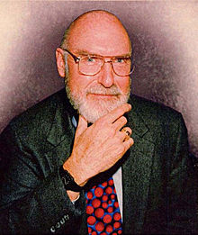
IBM VM/370
Robert Jay Creasy (1939-2005)
  Project leader of the first full virtualization hypervisor: IBM CP-40, a core component in the VM system
  The first VM system: VM/370

Slide 3
Virtual Machine: Origin
IBM CP/CMS
  CP-40
  CP-67
  VM/370

Slide 4
Why Virtualize
Underutilized machines
Easier to debug and monitor OS
Portability
Isolation
The cloud (e.g. Amazon EC2, Google Compute Engine, Microsoft Azure)

Slide 5
IBM VM/370
Conversational Monitor System (CMS)
Specialized VM subsystem (RSCS, RACF, GCS)
Mainstream OS (MVS, DOS/VSE etc.)
Another copy of VM
Virtual machines
Hypervisor
Control Program (CP)
Hardware
System/370

Slide 6
IBM VM/370
Technology: trap-and-emulate
Application
Problem
Kernel
Privileged
Trap
Emulate
CP

Slide 7
Classic Virtual Machine Monitor (VMM)

Slide 8
Virtualization: rejuvenation
1960’s: first track of virtualization
  Time and resource sharing on expensive mainframes
  IBM VM/370
Late 1970’s and early 1980’s: became unpopular
  Cheap hardware and multiprocessing OS
Late 1990’s: became popular again
  Wide variety of OS and hardware configurations
  VMWare
Since 2000: hot and important
  Cloud computing
  Docker containers

Slide 9
Full Virtualization
Complete simulation of underlying hardware
Unmodified guest OS
Trap and simulate privileged instruction
Was not supported by x86 (Not true anymore, Intel VT-x)
Guest OS can’t see real resources

Slide 10
Paravirtualization
Similar but not identical to hardware
Modifications to guest OS
Hypercall
Guest OS registers handlers
Improved performance

Slide 11
VMware ESX Server
Full virtualization
Dynamically rewrite privileged instructions
Ballooning
Content-based page sharing

Slide 12
Denali
Paravirtualization
1000s of VMs
Security & performance isolation
Did not support mainstream OSes
VM uses single-user single address space

Slide 13
Xen and the Art of Virtualization

Slide 14
Xen
University of Cambridge, MS Research Cambridge
XenSource, Inc.
Released in 2003 and published in SOSP 2003
Acquired by Critix Systems in 2007 for $500M
Now in RHEL5, Solaris, SUSE Linux Enterprise 10, EC2

Slide 15
Xen and the art of virtualization
SOSP’03
Very high impact (data collected in 2013)

Slide 16
Xen
No changes to ABI (application binary interface)
Full multi-application OS
Paravirtualization
Real and virtual resources
Up to 100 VMs

Slide 17
Virtualization on x86 architecture
Challenges: Virtualization on x86 architecture
  Correctness: not all privileged instructions produce traps!
    Example: popf
  Performance:
    System calls: traps in both enter and exit (10X)
    I/O performance: high CPU overhead
    Virtual memory: no software-controlled TLB

Slide 18
Xen
Xen 3.0 and up supports full virtualization with hardware support
See backup slides

Slide 19
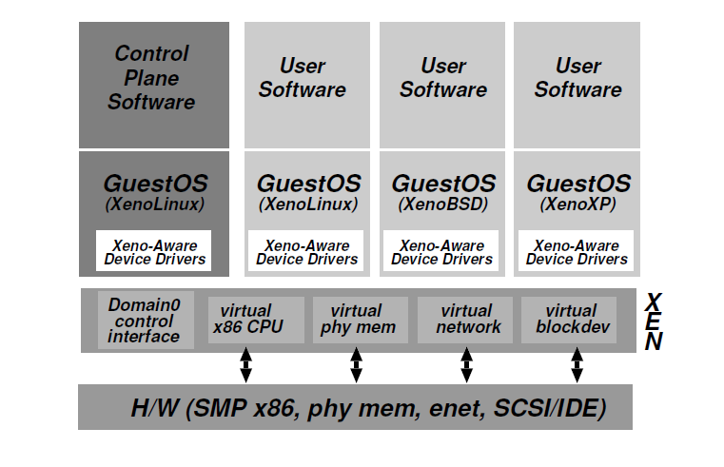
Xen architecture

Slide 20
Domain 0
Management interface
Created at boot time
Policy from mechanism
Privileged

Slide 21
Control Transfer
Hypercalls
Lightweight events

Slide 22
Interface: Memory Management
Guest OSes manage their own page tables
Register pages with Xen
No direct write access
Updates through Xen
Hypervisor @ top 64MB of every address space
  2018: security issues with Meltdown/Spectre

Slide 23
Interface: CPU
Xen in ring 0, OS in ring 1, everything else in ring 3
“Fast” exception handler
Xen handles page fault exceptions
Double faulting

Slide 24
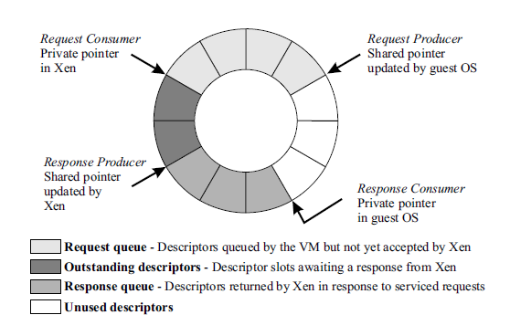
Interface: Device I/O
Shared-memory, asynchronous buffer descriptor I/O rings

Slide 25
Subsystem Virtualization
CPU Scheduling : Borrowed Virtual Time
Real, virtual, and wall clock times
Virtual address translation : updates through hyper call
Physical memory : balloon driver, translation array
Network : VFR, VIF
Disk : VBD

Slide 26
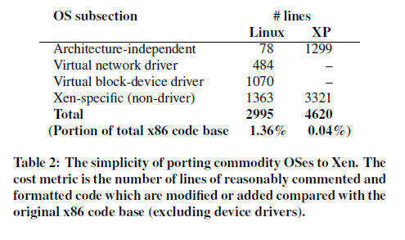
Porting effort

Slide 27
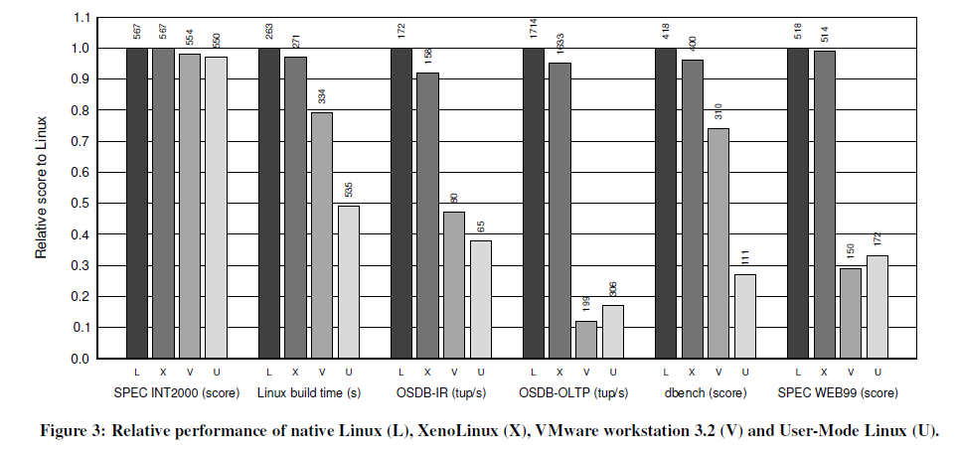
Evaluation: Relative Performance

Slide 28
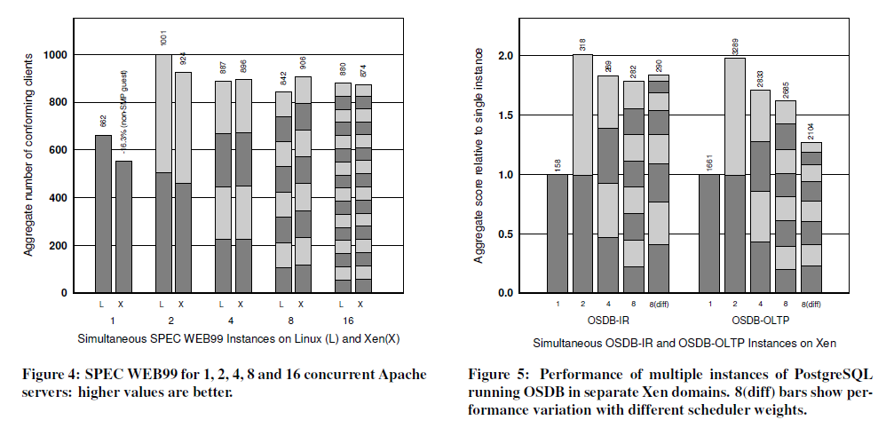
Evaluation: Concurrent Virtual Machines

Slide 29
Conclusion
x86 architecture makes virtualization challenging
Full virtualization
  unmodified guest OS; good isolation
  Performance issue (especially I/O)
Para virtualization:
  Better performance (potentially)
  Need to update guest kernel
Full and para virtualization will keep evolving together

Slide 30
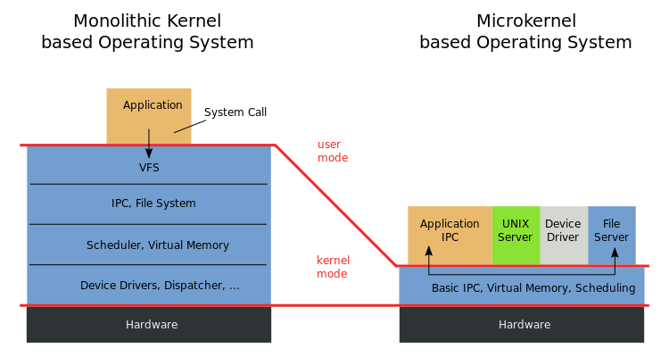
Microkernel vs. VMM(Xen)
Virtual Machine Monitor (VMM): “… software which transforms the single machine interface into the illusion of many. Each of these interfaces (virtual machines) is an efficient replica of the original computer system, complete with all of the processor instructions …“
-- Robert P. Goldberg. Survey of virtual machine research. 1974
Microkernel: "... to minimize the kernel and to implement whatever possible outside of the kernel…“
-- Jochen Liedtke. Towards real microkernels. 1996

Slide 31
Are Virtual Machine Monitors Microkernels Done Right?
Steven Hand, Andrew Wareld, Keir Fraser
HotOS’05
VMMs (especially Xen) are microkernels done right
  Avoid liability inversion:
    Microkernels depend on some user level components
  Make IPC performance irrelevant:
    IPC performance is the key in microkernels
  Treat the OS as a component
    Hard for microkernels to support legacy applications

Slide 32
Are Virtual Machine Monitors Microkernels Done Right?
Gernot Heiser, Volkmar Uhlig, Joshua LeVasseur
ACM SIGOPS’06
VMMs (especially Xen) are microkernels done right.
  Avoid liability inversion:
    Microkernels depend on some user level components
  Make IPC performance irrelevant:
    IPC performance is the key in microkernels
  Treat the OS as a component
    Hard for microkernels to support legacy applications
Xen also relies on Dom0!
Really??
Xen performs the same number of IPC!
Look at L4Linux!

Slide 33
Discussion
What is the difference between VMMs and microkernels?
Why do VMMs seem to be more successful than microkernels?

Slide 34
Perspective
Virtualization: creating a illusion of something
Virtualization is a principle approach in system design
  OS is virtualizing CPU, memory, I/O …
  VMM is virtualizing the whole architecture
  What else? What next?

Slide 35
Next Time
Project: next step is the Survey Paper due next Friday
MP1 Milestone #1 due Today
MP1 Milestone #2 due in two weeks
Read and write a review:
  Required: Disco: Running Commodity Operating Systems on Scalable Multiprocessors, Edouard Bugnion, Scott Devine, and Mendel Rosenblum. 16th ACM symposium on Operating systems principles (SOSP), October 1997, pages 143--156..
  Optional: The Multikernel: A new OS architecture for scalable multicore systems. Andrew Baumann, Paul Barham, Pierre-Evariste Dagand, Tim Harrisy, Rebecca Isaacs, Simon Peter , Tim Roscoe, Adrian Sch�pbach, and Akhilesh Singhania . Proceedings of the Twenty-Second ACM Symposium on Operating Systems Principles (Austin, Texas, United States), ACM, 2009.

Slide 37
Backup

Slide 38
IBM VM/370
Technology: trap-and-emulate
Application
Problem
Kernel
Privileged
Trap
Emulate
CP

Slide 39
Virtualization on x86 architecture
Challenges
  Correctness: not all privileged instructions produce traps!
    Example: popf
  Performance:
    System calls: traps in both enter and exit (10X)
    I/O performance: high CPU overhead
    Virtual memory: no software-controlled TLB

Slide 40
Virtualization on x86 architecture
Solutions:
  Dynamic binary translation & shadow page table
  Hardware extension
  Para-virtualization (Xen)

Slide 41
Dynamic binary translation
Idea: intercept privileged instructions by changing the binary
Cannot patch the guest kernel directly (would be visible to guests)
Solution: make a copy, change it, and execute it from there
  Use a cache to improve the performance

Slide 42
Dynamic binary translation
Pros:
  Make x86 virtualizable
  Can reduce traps
Cons:
  Overhead
  Hard to improve system calls, I/O operations
  Hard to handle complex code

Slide 43
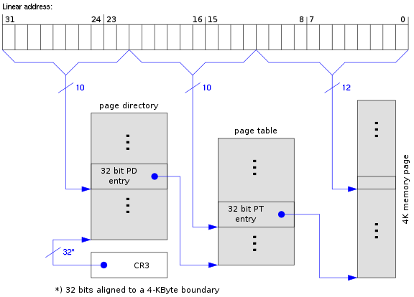
Shadow page table

Slide 44
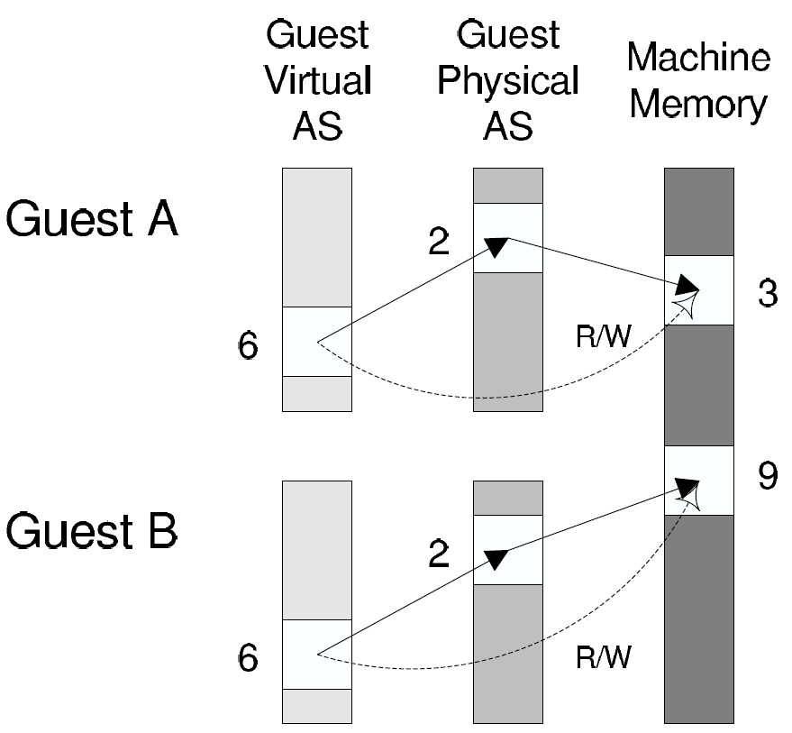
Shadow page table
Guest page table
Shadow page table

Slide 45
Shadow page table
Pros:
  Transparent to guest VMs
  Good performance when working set is stable
Cons:
  Big overhead of keeping two page tables consistent
  Introducing more issues: hidden fault, double paging …

Slide 46
Hardware support
First generation - processor
Second generation - memory
Third generation – I/O device

Slide 47
First generation: Intel VT-x & AMD SVM
Eliminating the need of binary translation
Host mode
Guest mode
Ring3
Ring3
VMRUN
Ring2
Ring2
Ring1
VMEXIT
Ring1
Ring0
Ring0

Slide 48
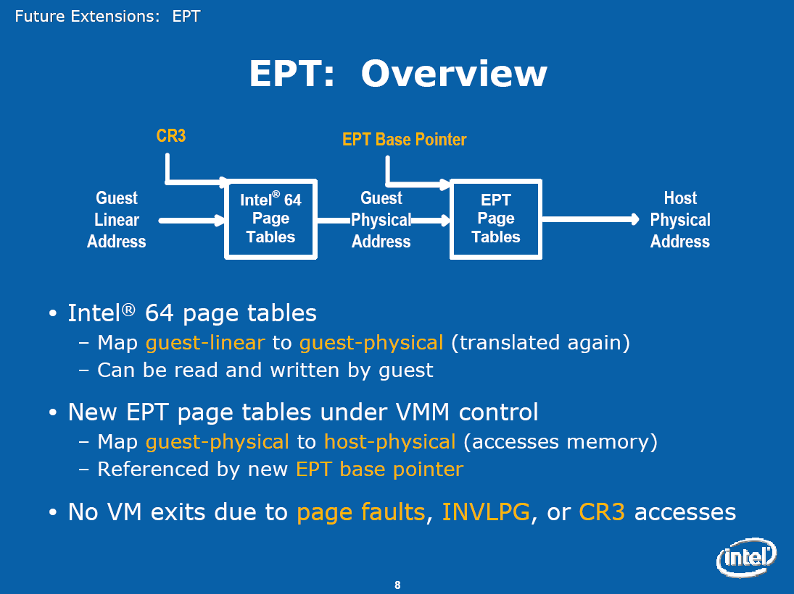
Second generation: Intel EPT & AMD NPT
Eliminating the need to shadow page table

Slide 49
Third generation: Intel VT-d & AMD IOMMU
I/O device assignment
  VM owns real device
DMA remapping
  Support address translation for DMA
Interrupt remapping
  Routing device interrupt

Slide 50
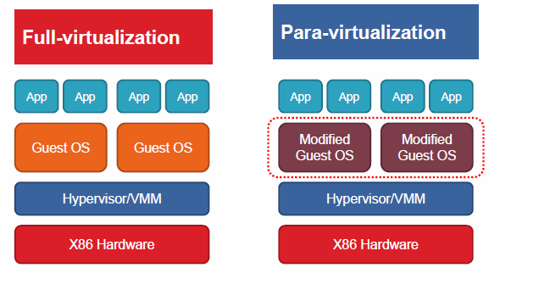
Para-virtualization
Full vs. para virtualization

